Slide 1
Students With Disabilities EOY Reporting and Certification
EOY Overview
Special Education
Behavioral Incidents
Notes:
Welcome to the Students with Disabilities EOY training. This training will focus on SWD reporting for EOY 3 and 4, but also provides general information about the entire EOY data collection.

Slide 2
Target Audience
Those who submit data for Students with disabilities
LEA Special Education System (SEDS) and SELPA Data Coordinators
Notes:
This training is intended for provide LEA data coordinators who submit data to CALPADS. Both Student Information System (SIS) and Special Education System (SES) may benefit from todays training.

Slide 3
Training Sequence
CALPADS Intro
Data Coordinator Orientation
CALPADS
CALPADS Basics
Fall-1 Data Population (Student Profile)
Fall-2 Data Population
EOY 1-4 Data Population
Data Privacy
LEA Admin Data Privacy
SELPA Data Privacy
Data Collections
Fall 1
Reporting and Certification
Advanced
Fall 2
Reporting and Certification
Advanced
EOY
EOY 2&3 Reporting and Certification
EOY 1&4 Reporting and Certification
EOY 1-4 Advanced
Advanced
Guide to CALPADS Documentation
Guide to Troubleshooting CALPADS Errors
Students With Disabilities EOY Reporting and Certification
Notes:
This slide shows the CALPADS course catalog. These courses are mostly available in self-paced recording in Bridge and the CSIS YouTube Channel. The remaining sessions for EOY will become available over the coming days.

Slide 4
Notes:
This world cloud depicts the most common reasons why SPED coordinators are attending the training.

Slide 5
Objective
Identify
Prepare
Coordinate
Certify
the submission requirements, personnel, roles and responsibilities for the EOY submissions
for system changes and local readiness & establish submission strategy
with other staff to ensure everyone is aware of new changes and certification process
EOY 4 and 3 on time or before the final submission deadline
Notes:
At the end of this session, with the information provided, LEAs should be able to:
Identify the changes for EOY submission
Learn about the system changes and establish a submission strategy that works best for your LEA
Coordinate with other staff to ensure everyone is aware of new changes
Lastly, approve EOY 4 and EOY 3 reports on or before the final submission deadline

Slide 6
Agenda
EOY 4 and EOY 3 Overview
Special Education (EOY 4)
Behavioral Incidents (EOY 3)
Wrap-Up
Notes:
Here is the agenda for this training. We will discuss the following:
An overview of the submission
Discuss the details of this year’s EOY changes
Review the certification process
Cover some common problems and wrap up

Slide 7
EOY Data Collections
EOY 3
July 1–June 30
Student Incident/
Spec Ed
Course completion
EOY 1
July 1–June 30
Grades 7-12
EOY 2
July 1–June 30
Program
Participation
CTE participants, concentrators, completers (Perkins Report)
Student Absence Summary
Cumulative Enrollment
EOY 4
July 1–June 30
Students with Disabilities
SWD Services
PSTS for SPED
Homeless Program
Carnegie Units
College Credit
Notes:
These are the current CALPADS EOY Data Collections and a high level view of the data collected in each.
Unlike Fall 1 and Fall 2, EOY reports on the entire year from 7/1/2019 to 6/30/2020, which means any new students or students who have left during this timeline will be reported.
Participant reads slide on their own
Notes:
Student Enrollment (SENR) and Student Information (SINF) must be up-to-date in CALPADS before uploading EOY files.
For EOY-1, do not submit staff assignment or SASS. It is not used in EOY reporting. It may cause a problem with Fall 2 staff assignment data if replaced.

Slide 8
EOY Data Source
EOY 3
July 1–June 30
Student Incident/
Spec Ed
Student Absence Summary
Cumulative Enrollment
EOY 4
July 1–June 30
Students with Disabilities
SWD Services
PSTS for SPED
Homeless Program
School
Information
System
Special Education
System
Through API

Slide 9
Key Dates
Snapshot
started
May 11th
Approval deadline
July 31st
Amendment window ends August 28th
EOY has no census day, snapshot records are reflective of the entire academic year
The End of Year reporting period is July 1, 2019 – June 30, 2020
Notes:
The Key Dates in the EOY 4 submission are:
Snapshot start date, May 11 2020
Approval Deadline July 31, 2020
Amendment Window Deadline August 28, 2020
The End of Year reporting period is July 1, 2019 – June 30, 2020.
CALPADS Calendar: http://www.cde.ca.gov/ds/sp/cl/rptcalendar.asp

Slide 10
EOY Submission Order
EOY 2 - Program Participation
EOY 4 - Special Education
EOY 3 - Cumulative Enrollment, Student Incident, Student Absence Summary
EOY 3 - Cumulative Enrollment, Student Incident, Student Absence Summary
The CDE suggests that LEAs certify the EOY submissions orderof 2, 4. 3 then 1 for the following reasons:
EOY 2 is a straightforward and most of the data certified should have already been updated in CALPADS
EOY 4 should be submitted and certified next because as LEAs submit special education records they identify enrollment updates they need to make before certifying cumulative enrollment counts in EOY 3
Next EOY 3, LEAs need to ensure that all enrollment/exit updates have been made, incident and absence summary data can be submitted with the end of the school year
Lastly EOY 1, anticipating that grades and credits earned may require policy and process changes, it may make sense to complete the EOY 1 submission last.
Notes:
Suggestions for EOY Submission Order
The CDE suggests that LEAs certify submissions in the following order:
EOY 2 - Program Participation
EOY 4 - Special Education
EOY 3 - Cumulative Enrollment, Student Incident, Student Absence Summary
EOY 1 - Course Completion, Career Technical Education (CTE)
This submission order is not required, but is suggested for the following reasons:
EOY 2 is a straightforward submission and most of the data certified as part of this submission should have already been updated in CALPADS. The only change to EOY 2 is the removal of the homeless count, which is now in EOY 3.
EOY 4 should be submitted and certified next because as LEAs submit special education records they identify enrollment updates they need to make before certifying cumulative enrollment counts in EOY 3.
Much of the data for EOY 3 can be submitted now, such as the student absence summary data, and student incident data, since LEAs are no longer taking attendance, and it is unlikely that student incidents will occur. However, LEAs need to ensure that all enrollment updates have been made, and certifying EOY 4 will identify any updates that need to be made. In addition, the CDE encourages LEAs to continue updating the program records that identify students as Free and Reduced-Price Meal (FRPM) eligible (Migrant [135], Free Meal [181], Reduced-Price Meal [182], and Homeless [191]) through the end of June because FRPM eligibility can provide benefits to students whose families apply under the Pandemic-EBT program administered by the California Department of Social Services.
Anticipating that grades and credits earned may require policy and process changes, it may make sense to complete the EOY 1 submission last.

Slide 11
EOY 4 and EOY 3 Overview
Special Education
Student Services
SWD Postsecondary Status
Behavioral Incidents
Notes:
Let's start with the overview of the EOY 4

Slide 12
Data Collected for EOY 4
Special Education(SPED)
Data Submitted Via
Student Services (SSRV)
Post Secondary Status (PSTS)
SPED and SSRV records for all Students w/Disabilities who have been referred and have parental consent any time between July 1 and June 30th
Postsecondary Status
PSTS records for all SWD who exited secondary education in the prior year. For example, in EOY 2020, LEAs will report postsecondary outcomes for SWD who exited secondary education in 2018-2019.
Final Phase of CASEMIS to CALPADS Transition
All SWD Services
Site Staff
Staff Involved with Submission
Special Ed staff
Site Administrators
Student System Support Staff
SELPA Directors
🖌 NOTE: EOY-4 Requires Both LEA and SELPA Approvals
Notes:
EOY 4 is a Brand New Submission as the final phase of rolling CASEMIS into CALPADS.
EOY 4 dates are the same as EOY 1-3.
Include:
SPED and SSRV records for all Students w/Disabilities who have been referred and have parental consent any time between July 1 and June 30th.
PSTS records are required for all SWD who exited secondary education in the prior year. For example, in EOY 2020, LEAs will report postsecondary outcomes for SWD who exited secondary education in 2018-2019.
Like Fall 1, EOY 4 will first need to be approved by the LEA and then approved by the SELPA.
If your Fall 1 had hiccups on the handoffs between approvals, now would be a good time to hold a submission debrief meeting between the two groups. What went well? What could be improved? Are roles and responsibilities clearly defined?

Slide 13
Data Collected for EOY 3
Student Incident (SINC)
Data Submitted Via
Student Incident Results (SIRS)
Student Offense (SOFF)
Student Absenteeism (STAS)
Cumulative Enrollment (SENR)
Homeless Program (SPRG)
FEDERAL & STATE
Incidents
Use of Physical Restraint
Mechanical Restraint
Statutory Offenses committed
Incident Result (one or more)
Student Offense
All Suspensions & Expulsions
Student Absenteeism
Cumulative Enrollment
All Incident resulting in:
Program 191 - Homeless
Seclusion
Site Administrators
Staff Involved with Submission
District Administrators
SIS Support Staff
Special Ed staff
Attendance Clerks
Attendance Supervisor
Notes:
Discipline file restructured into three files referred to as “Incident” submission, in order to collect the use of:
Behavioral Restraint, which includes
Mechanical Restraint – Use of a device or equipment to restrict a pupil’s freedom of movement (with exceptions)
Physical Restraint – A personal restriction that immobilizes or reduces the ability of a pupil to move his or her torso, arms, legs, or head freely (with exceptions)
Seclusion, which means the involuntary confinement of a pupil alone in a room or area from which the pupil is physically prevented from leaving
Homeless Report 5.4 and 5.5, and certification errors and warnings will be moved from EOY 2 to EOY 3.
The homeless subgroup is part of many DataQuest and Dashboard accountability metrics that are sourced from EOY 3 (e.g., suspension and chronic absenteeism rates that both depend on the EOY 3 cumulative enrollment).
Currently, the EOY2 homeless counts can differ from the EOY3 homeless counts because they are certified separately. Moving these reports from EOY2 to EOY3 will help ensure consistency in annual homeless counts in the homeless reports and the counts used for subgroup reporting in other areas related to EOY3.
The CDE suspects that Homeless students are under-reported. There was a significant decrease in the Fall 1census counts.
Reminders:
All students who committed an offense (defined in Ed Code 48900 or 48915) are reported regardless of outcome or duration
All students who committed firearm offenses (codes 100, 101, 103, 104 & 105) reported regardless of outcome
Deciding the most severe offense is a local decision. Refer to the guidelines found in section 2.1.4 of the data guide.

Slide 14
Data Collected for EOY 1
Staff Demographics (SDEM)
Data Submitted Via
Course Completion (CRSC)
Student Crs. Completion (SCSC)
Student CTE (SCTE)
a-g Requirements
Credits
Grades
CTE
Pathways
Teachers Demographics
Completers and Concentrators
State course codes
Student Course Completion
Postsecondary Articulated Course Indicator
Course Completion
Course Attributes
Carnegie Units
College Credit
Site Staff
Staff Involved with Submission
Registrars
Program staff
CTE
Site Administrators
Student System Support Staff
🖌 NOTE: Courses completed are not compared to course enrollment reported during Fall 2
Notes:
Review items on the slide.
Beginning 2019-20 LEAs will be required to submit the Student Course Section (SCSC) file with the number of Carnegie Units a student earned for a course. For more information on this data element, you may refer to the CALPADS File Specification or CFS document.
Reminders:
Course completion for End of Year 1 is not compared to Course enrollment from Fall 2
Course completion is only required for departmentalized classes in grades 7-12
CTE Non-Concentrators are reported in the CRSC file only while CTE Concentrators and Completers are determined using the SCTE file
SEIDs submitted in Course Section Completion (CRSC) records are checked to make sure a corresponding Staff Demographic (SDEM) record exists in CALPADS (unless SEID is 9999999999)
Do not submit the SASS file. Staff Assignment data is not required for EOY and submitting a file may wipe out previously submitted data

Slide 15
Data Collected for EOY 2
108 - Opportunity Program
113 - California Partnership Academy
162 - Pregnant or Parenting Programs
185 - Transitional Kindergarten (TK)
122 - NCLB Title I Part A Basic Targeted
FEDERAL
174 - NCLB Title I Part A Neglected
192 - Armed Forces Family Member
STATE
101 - 504 Accommodation Plan
Data Submitted Via
STUDENT PROGRAM (SPRG)
Site Staff
Program staff
Site Administrators
Student System Support Staff
Staff Involved with Submission
🖌 NOTE: Programs should be reported at each school a student attends except for summer schools
Notes:
Reminders:
EOY 2 counts all students reported for the 8 programs and identifies students from 7/1/19 to 6/30/20.
Check Title I status for your schools.
Program code 162 is also used in Perkins reporting as the “Single Parent” count for CTE reporting

Slide 16
CALPADS Survival Kit
User Roles
Documentation
EOY 3 Reports
Data Collection Certifier
SINC
SPED
PSTS
EOY 4 Reports
User Manual
CALPADS Code Sets
File Specifications Form
Error List
Data Guide
Valid Code Combinations
Flash Communications
Both View and Edit roles for each file type must be assigned
If you have SDIS previously, SDIS roles are automatically converted to SINC role
Notes:
Reference Links:
System Documentation: https://documentation.calpads.org/Support/References/
Flash Communications: https://www.cde.ca.gov/ds/sp/cl/communications.asp

Slide 17
EOY 4 – Special Education
Students with Disabilities
SWD Services
Postsecondary Status
Notes:
Now we are going to review the EOY 4 - Students with Disabilities and Postsecondary Status submission that is required for all LEAs.

Slide 18
Why EOY 4?
The End of Year (EOY) 4 data collection provides information required for students with disabilities for the federal Individuals with Disabilities Education Act (IDEA).
Notes:
The End of Year (EOY) 4 – Special Education Program/Services/Postsecondary data collection provides information required for students with disabilities for federal Individuals with Disabilities Education Act (IDEA) reporting.

Slide 19
What are the data used for?
Special Education (SPED)
Student counts and program exits for IDEA
Special Education Monitoring
District of Special Education Accountability – Dashboard accountability
Special Education Services (SSRV)
Special Education Monitoring
Postsecondary Status (PSTS)
Post-school outcomes for IDEA; outcomes of SWD who exited secondary education in 2018-19

Slide 20
Data Collected
Provide a count of students with disabilities by Education Plan Type and Primary Disability Category of the academic year.
Provide a count of students with disabilities within each Primary Disability Category by Federal Setting during the prior academic year.
Provide a count of students regarding employment and educational status after completely secondary education in the prior academic year for students with disabilities.
Notes:
The EOY Data collection
provides a count of students with disabilities by Education Plan Type and Primary Disability Category of the academic year.
Provide a count of students with disabilities within each Primary Disability Category by Federal Setting during the prior academic year.
Provide a count of students regarding employment and educational status after completely secondary education in the prior academic year for students with disabilities.

Slide 21
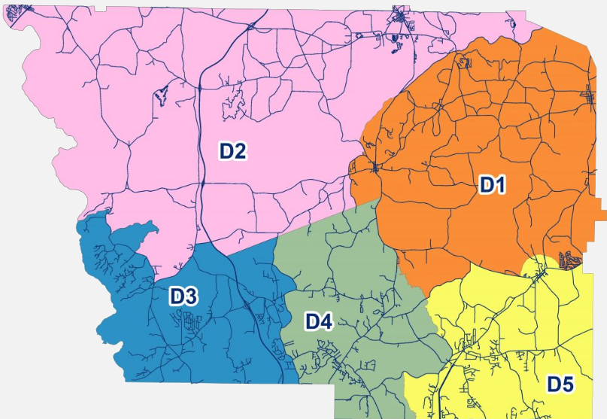
Data Collected
Special education program staff must complete data population in SEDS for submission to CALPADS
Primary Disability
Federal Setting/ LRE
District of Accountability
Education Plan
Postsecondary Status
Meeting & Amendments
Service Provider
Services
Notes:
The SWD data submission is used to collect information about students, SPED programs and services. LEAs and SELPAs will provide counts of students by primary disability and special education plan type (IFSP, IEP, ISP), and the special education services offered by primary disability. Also required will be data related to SWD’s postsecondary status. To facilitate monitoring, LEAs report for SWD the type of plan they have (IFSP, IEP, ISP), the type of meeting held (initial evaluation, annual, pending, triennial), the date the meeting was held, and any amendments to the plan that occur during the year

Slide 22
What is different here than Fall1?
EOY 4 reporting window is July 1, 2019 through June 30, 2020
The submission of the Services (SSRV) file is required for EOY 4
The Postsecondary status (PSTS) file will be required for EOY 4 submission and certification
EOY 4 for is exclusively related to data for special Education students
Notes:
So, what’s the difference between EOY 4 and Fall 1?
The EOY 4 reporting window is July 1, 2019 through June 30, 2020, all records reported in that time are relevant. Fall 1 data is only reflective of census day.
The submission of the Services File is required for EOY 4. Remember that for fall 1, the services file was not required.
The Postsecondary status (PSTS) file will be required for EOY 4 submission and certification. This is an additional file type that was not part of Fall 1. The PSTS submitted for Fall 2 was not for students with disabilities and the students submitted in the PSTS will not have any other record submitted in EOY 4.
EOY 4 for is exclusively related to data for special Education students. Again thinking about Fall 1, the Data was reflective of all students enrolled on census day including special education and general education students.

Slide 23
Students Included
EOY 4 includes:
Students with disabilities ages 0-22
Have received special education or related services
Have been referred for services
Have had a meeting to determine eligibility for services,
but have been determined to be ineligible
but have been determined to be eligible but who are not receiving services
Have had an annual meeting or triennial evaluation
EOY 4 also includes student employment and educational status after completing secondary education in the prior academic year for students with disabilities.
Note: Do not submit SSRV for Plan type 300, 700, 800, 900.
Notes:
EOY 4 includes students with disabilities ages 0-22 who, from July 1 – June 30 of the reporting year who:
Have received special education or related services according to their IFSP, IEP, or ISP; or
Have been referred for services but have not yet had a meeting to determine eligibility for services; or
Have had a meeting to determine eligibility for services, but have been determined to be ineligible;
Have had a meeting to determine eligibility for services, but have been determined to be eligible but who are not receiving services (e.g. parent refusal of free and appropriate public education (FAPE);
Have had an annual meeting or triennial evaluation
EOY 4 also includes student employment and educational status after completing secondary education in the prior academic year for students with disabilities.

Slide 24
Postsecondary Status for EOY 4
LEAs should only submit Postsecondary Status (PSTS) records for students with disabilities with Education Plan Type 100 (IEP) who exited secondary education in the prior year, with the exception of a few circumstances. Do not report those students who:
returned to regular education
transferred to another program, or
are deceased
for end-of-year cycle reporting only
Notes:
LEAs should only submit Postsecondary Status (PSTS) records for students with disabilities with Education Plan Type 100 (IEP) who exited secondary education in the prior year, with the exception of a few circumstances. Do not report those students who:
returned to regular education
transferred to another program, or
are deceased

Slide 25
EOY 4 Record Types
Special Education
Postsecondary Status
Student Services
EOY 4 (July 1
–June 30)
Notes:
The data submitted for EOY 4 encompasses the entire academic year, July 1 – June 30. Two files that were submitted throughout the year and one submitted during this collection window will be the source of data required for the EOY 4 data collection. The SPED and SSRV should have been submitted throughout the year as needed and the PSTS is expected during the collection window. PSTS records will be submitted for students with disabilities who exited secondary education in the prior year (e.g., in EOY 4 2020, LEAs will report postsecondary outcomes for SWD exiting secondary education in 2018-2019).

Slide 26
EOY 4 Submission Data
SPED, SSRV, PSTS

Slide 27
District of Special Education Accountability
The District of Special Education Accountability is the district or charter LEA that is responsible for ensuring that special education services are provided for a student participating in special education
Notes:
The District Of Special Education Accountability is the district or charter school that is responsible for ensuring that special education services are provided for a student participating in special education as the CDS code for the district or charter school that is responsible for ensuring that SPED services are provided. Often it is also the District of Residence.
For accountability purposes, generally the Reporting LEA and the District of Special Education Accountability (DSEA) are the same, and generally the DSEA and the District of Geographic Residence are the same. However, these generalizations do not always hold true. The Reporting LEA may not be the DSEA, which is the LEA ultimately responsible for the student and is held accountable for the student on the California School Dashboard (Dashboard).
The following definition can be found at https://www.cde.ca.gov/ds/sp/cl/swdreporting.asp:
District of Special Education Accountability
The District of Special Education Accountability (DSEA) for a student with an Individualized Education Program (IEP) is defined to be either of the following:
The district of GEOGRAPHIC residence, if any of the following conditions apply:
The student’s parents or guardians reside in the same district in which the student is receiving special education instruction.
The student is placed outside of his/her district of geographic residence through the IEP process.
or:
A district OTHER THAN the district of geographic residence, if any of the following conditions apply:
The student has a formal inter-district transfer agreement under Education Code 63600. In this case, the DSEA is the county/district code of the district to which the student has transferred.
The student attends a charter school. In this case, the DSEA is the county/district code of the charter authorizer, or the school code of the charter school if the charter is acting as an LEA for special education purposes.
The student is a ward of the court and housed in a juvenile court, or attends a county community school. In this case, the DSEA is the county/district code of the COE serving the student while the student is incarcerated.
The student is a ward of the court and housed in a licensed children’s institution (LCI). In this case, the DSEA is the county/district code of the district where the LCI is located.
The student is housed in an adult county jail. In this case, the DSEA is the county/district code of the district where the student's parents reside.
The student attends a private school that is not geographically located in the boundaries of the school district where the student lives and is on an individualized service plan (ISP). In this case, the DSEA is the county/district code of the district where the private school is located. Note: The student's parents may also request that the student be evaluated for services by the district in which they geographically reside.

Slide 28
Special Education Meeting Type
The Special Education Meeting Type Code represents the type of SPED meeting. These decision-making meetings on special education eligibility, assessment or educational placement documents decisions for students to receive free appropriate public education (FAPE) and that LEAs meet the “Child Find” requirement by IDEA
Notes:
The Special Education Meeting Type is required for every SPED record. The meeting type indicates the reason for evaluation.
The Special Education Meeting Type Code represents the type of SPED meeting. These decision-making meetings about the special education eligibility, assessment or educational placement are records that all students receive free appropriate public education (FAPE). Additionally meeting records show an effort to identify students who are in need of special education as “Child Find” is required by IDEA. In California, LEAs must “actively and systematically” seek out all individuals with exceptional needs. The SPED Meeting Type is validated against the Education Plan Type Code, Meeting Delay Code and student age.
10 – Part B Initial Evaluation (evaluation to determine eligibility for services for IEP or ISP, part B)
15 – Part C Evaluation (Review the initial evaluation and determine eligibility for IFSP services in Part C)
20 – Annual Education or Service Plan Meeting
30 – Pending Evaluation (A referral for services and the parent provided consent for the initial evaluation, which is pending)
40 – Triennial Evaluation ( IEP or ISP evaluation must occur at least once every three years after the Part B initial evaluation)
The Special Education Amendment date is required for IEPs, IFSPs and ISPs when the Special Education Meeting Type Code and Special Education Meeting Date match a SPED record for the same SS

Slide 29
Meeting Delay Codes
Meeting delay codes are available for meetings that are delayed. They represent the reason the meeting date exceeds the required timeline but should be considered timely.
However, the code should be put on the record once the delayed meeting is held.
If you have a meeting that is delayed and you have not been able to hold the meeting, please do nothing. When you have a meeting add the code to that record.
DO NOT make fake meetings to input a delay code.
Effects of COVID-19 delays will be considered in the monitoring of timelines next year.
Notes:
The Meeting Delay Code explains the reason a meeting did not occur during the expect timeline:
10 Parent Refused To Consent
20 Parent Did Not Make Child Available
30 Parent Contacted - Did Not Attend
40 School Break
50 Transfer
60 School Emergency
70 Student Emergency
75 Temporary School Closure
80 Due Process / Settlement Agreement
85 Did not pass hearing and/or vision screening
90 Late Without Cause
ID, Reporting LEA, and SELPA Code in the ODS but changes have been made to other SPED fields.

Slide 30
If LEAs are unable to complete timely assessments and IEPs while school sites are closed or when school is not in session, how should LEAs report those late assessments and IEPs to CDE?
In the event that initial evaluations, annual reviews, or triennial reviews cannot be held on time, the following delay reason codes may be used:
Part B Initial Evaluations
The delay was due to the parent not making student available for testing despite the LEA being open for distance learning: Use meeting delay code “20”
The delay was due to LEA closure due to COVID-19 quarantine requirements: Use code “60”
Part C initial Evaluations
The delay was due to the parent not making child available for testing: Use meeting delay code “20”
The delay was due to LEA closure due to COVID-19 quarantine requirements: Use code “60” or “75”
Annual review or Individual Family Service Plan meeting
Meeting delay code “20” is not valid with annual meeting type.
The delay was due to the LEA closure due to COVID-19 quarantine requirements: Use code “60” or “75”
Notes:
Do not create fake transactions to submit a delay code. The delay code explains why a meeting WAS late, NOT why it has yet to occur. First hold the meeting, then add the delay code after.
In the event that initial evaluations, annual reviews, or triennial reviews cannot be held on time, the following delay reason codes may be used:
Part B Initial Evaluations
The delay was due to the parent not making student available for testing despite the LEA being open for distance learning: Use meeting delay code “20”
The delay was due to LEA closure due to COVID-19 quarantine requirements: Use code “60”
Part C initial Evaluations
The delay was due to the parent not making child available for testing: Use meeting delay code “20”
The delay was due to LEA closure due to COVID-19 quarantine requirements: Use code “60” or “75”
Annual review or Individual Family Service Plan meeting
Meeting delay code “20” is not valid with annual meeting type.
The delay was due to the LEA closure due to COVID-19 quarantine requirements: Use code “60” or “75”

Slide 31
Education Plan Amendment Date
The Education Plan Amendment Date reflect the date in which services change as defined in the Education Plan.
Every IEP meeting and subsequent amendment is uploaded to CALPADS for the specific fields in the CALPADS file specification.
If the LEA uploads a record that has the same IEP date, but something has changed then it must include an amendment date (Error SPED 441).
If the LEA uploads an amendment and attempts to change a field that would only be held in an IEP meeting, then it will error (Error SPED 438).
If the LEA uploads a record and determines that there is an error and it needs to be changed, they should delete the erroneous record and add the correct record. The revise function is not currently acting properly.
Notes:
The Education Plan Amendment Date reflect the date in which services change as defined in the Education Plan. Parental consent is not required for an amendment. Parents must be included in review of the IFSP/IEP/ISP
Every IEP meeting and subsequent amendment is uploaded to CALPADS for the specific fields in the CALPADS file specification.
If the LEA uploads a record that has the same IEP date, but something has changed then it must include an amendment date (Error SPED 441).
If the LEA uploads an amendment and attempts to change a field that would only be held in an IEP meeting, then it will error (Error SPED 438).
If the LEA uploads a record and determines that there is an error and it needs to be changed, they should delete the erroneous record and add the correct record. The revise function is not currently acting properly.

Slide 32
Education Plan Type
The Education Plan Type represents the program providing SPED services (IFSP, IEP, ISP), or other codes related to reasons for no services.
IFSP – for infants/toddlers, birth to age 3 receiving services
IEP – for preschool students ages 3 to 5 years or students attending a public school, ages 6 through 21
ISP – for students attending a private school receiving services from a COE or district
Notes:
Education plans relate to programs of service for children eligible under IDEA. Part C of IDEA deals with early intervention services (birth through 36 months of age), while Part B applies to services for school-aged children (3 through 21 years of age). The Education Plan Type Code represents the type of plan providing SPED services (IFSP, IEP, ISP), or other codes related to reasons for no services. The Education plan Type is used to indicate pending services and students that do not qualify for services. Plans include:
100 - Individualized Education Program (IEP)
150 - Individual Family Service Plan (IFSP)
200 - Individual Service Plan (ISP)
700 - Eligible - No Education Plan (Parent Declined FAPE - Private Placement)
800 - Eligible - No Education Plan (Other Reasons)
300 – Pending
900 – Not Eligible

Slide 33
Disability Category
The Disability Codes represent the disability qualifying the student for services under one of the 13 IDEA eligibility categories. Disability 1 Code cannot be 200 (None)
Intellectual Disability (210)
Hard of hearing (220)
Deafness (DEAF)/Hearing impairment (230)
Speech or language impairment (240)
Visual impairment (250)
Emotional disturbance (260)
Orthopedic impairment (270)
Other health impairment (280)
Established medical disability (281)
Specific learning disability (290)
Deaf-blindness (300)
Multiple disabilities (310)
Autism (320)
Traumatic brain injury (330)
Notes:
A Disability Category Code is required for all students with an Education Plan Type Code 100 (IEP), 150( IFSP), or 200 (ISP). The Disability Codes represent the disability qualifying the student for services under one of the 13 IDEA eligibility categories. A child’s school performance must be “adversely affected” by a disability in one of the 13 federal categories to be eligible for Special education program services. Students can have multiple disabilities reported however, Disability 1 Code cannot be 200 (None). The Disability category codes are:
Intellectual Disability (210)
Hard of hearing (220)
Deafness (DEAF)/Hearing impairment (230)
Speech or language impairment (240)
Visual impairment (250)
Emotional disturbance (260)
Orthopedic impairment (270)
Other health impairment (280)
Established medical disability (281)
Specific learning disability (290)
Deaf-blindness (300)
Multiple disabilities (310)
Autism (320)
Traumatic brain injury (330)

Slide 34
Special Education Program Setting
A Special Education Program Setting Code represents the SPED program setting in which the student is receiving or has received the majority of special education and related services. Required for IEP, ISP and IFSP Education Plan Types
Notes:
The Individuals with Disabilities Act (IDEA) mandates regulation for students with disabilities to protect their rights as students and the rights of their parents. The IDEA requires that all students receive a Free and Appropriate Public Education (FAPE) and that these students should be educated in the least restrictive environment (LRE). The Special Education Program Setting code maps to the federal setting or least restrictive environment.
Special Education Program Setting Code relates to the setting in which the student is receiving or has received the majority of special education and related services. The different settings are:
103 - Community Based Setting
104 - Other Setting
200 - Home
201 - Regular Early Childhood Program or Kindergarten
203 - Separate Class
204 - Service Provider Location
300 - Separate School
301 - Residential Facility
400 - Regular Classroom/Public Day School
401 - Homebound/Hospital
402 - Correctional Facility
403 - Parentally Placed in Private School
500 - Regular Independent Study or Virtual Charter
The Preschool Program Setting Service Location Code identifies that a preschool student is either at the:
1 - Same Location
2 - Different Location
As their early childhood education program.

Slide 35
Work-Based Learning Indicators for SWD
Transition Work-Based Experience
An indication of whether or not a student successfully completed a minimum of 100 hours of work-based learning since entering 9th grade of a program for students with disabilities on an individualized education program (IEP) that offers students work-based learning experiences that develop knowledge and job skills, in compliance with the Fair Labor Standards Act (FLSA) requirements.
Transition Classroom-Based Work Exploration
An indication of whether or not a student successfully completed the equivalent of four courses of college and career exploration/preparation designed to prepare a student with an IEP for employment and independent living since entering 9th grade.
Notes:
Programs that offer students with an Individualized Education Program (IEP) the opportunity to complete their secondary education while also obtaining marketable job skills are an essential component of transition services. The statewide WorkAbility I program (WAI) goverend by California Education Code (EC) sections 56470–56474 is funded and administered by the CDE. Work based learning indicators identify High School students who have been provided curriculum integration of work readiness skills, a career/vocational assessment, and a minimum of one Connecting Activity and one Work-Based Learning Service. For accountability purposes the SPED record has two indicators that count towards the CA School Dashboards CCI:
Transition Work-Based Experience
Current year hours may be added to hours in previous school years to determine whether this indicator was met or not. A “Y” indicates the student has completed employment experience (one or more of these activities total a minimum of 100 hours). An “N” indicates the student has not completed 100 hours of employment experience since entering 9th grade.
Transition Classroom-Based Work Exploration
The courses may have been completed during any grades 9 through 12. Current year courses may be added to courses completed in previous school years to determine whether this indicator was met or not. A “Y” indicates the student has completed the equivalent of 4 courses since 9th grade. An “N” indicates the student has not completed 4 courses since 9th grade.
These two indicators are captured in the special education data systems (SEDS)
SEIS, SIRAS, Faucette Systems, Edupoint, Welligent, SEAS, SPED-4.
LEAs should check with Special Education Program Staff to ensure these fields are populated correctly
Download the Special Education (SPED) Extract for:
Completion of Transition Classroom Based Work
Completion of Transition Work Experience

Slide 36
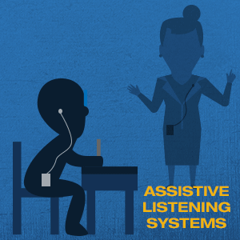
Special Education Service
The Special Education Service Code represents a special education service or related service received by the student
Notes:
The Special Education Service Code represents a special education service or related service received by the student. There is no limit on how many services the student or infant can receive, but each service should have either different Special Education Servicer Codes or Special Education Service Provider Codes.

Slide 37
Special Education Service Provider & Location
The Special Education Service Provider code represents the entity providing of the service reported
The Special Education Service Location Code represents the location where the student receives services
Notes:
The Special Education Service Provider Code and the Special Education Service Location Code are strictly required for all SSRV records.

Slide 38
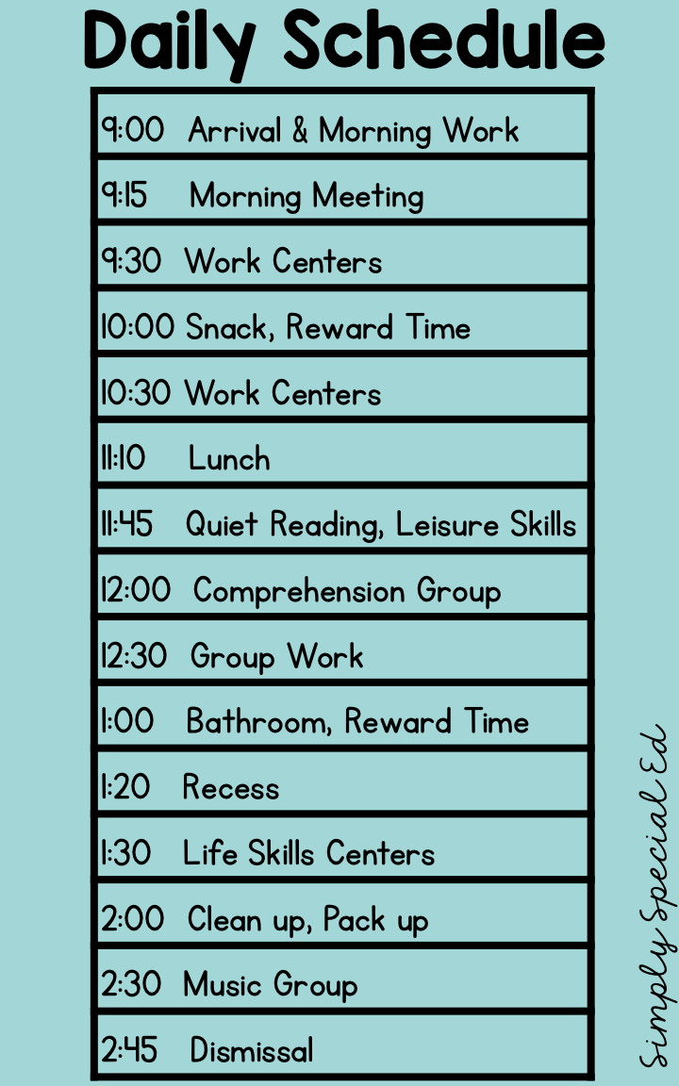
Service Frequency & Duration
The Service Frequency Code represents the frequency of the service. How often the service is provided
The Service Duration is the number of minutes per session (day/week/month/year) that the service is provided
Notes:
The Service Frequency Code describes how often services are provided:
10 Daily (one or more times a day)
20 Weekly (one or more times a week)
30 Monthly (one or more times a month)
40 Yearly one or more times a year)
90 Any other frequency or as needed
The Service Duration is the number of minutes per session relevant to the Service Frequency Code.

Slide 39
Postsecondary Status
The Postsecondary Status Code represents the student's postsecondary status after exiting secondary education.
200 - Enrolled in a Four-year college/university
210 - Enrolled in a community college
220 - Enrolled in a vocational or technical school (two year degree program)
300 - Enrolled in a High School Equivalency Test Preparation Program
310 - Enrolled in a vocational or technical school (certificate program)
320 - Enrolled in a Regional Occupational Program (ROP)
330 - Enrolled in a Work Force Innovation and Opportunity Act (WIOA) Supported Program
340 - Enrolled in a Non-Workability Employment Program
350 - Enrolled in an Adult Training Program
400 - Military Enlistment
900 - Incarcerated
910 - Competitively Employed
920 - Not Competitively Employed
930 - Other employment
940 - Other
950 - Not able to contact
960 - Refused to answer
Notes:
The Postsecondary Status Code represents the student's postsecondary status after exiting secondary education.
200 - Enrolled in a Four-year college/university
210 - Enrolled in a community college
220 - Enrolled in a vocational or technical school (two year degree program)
300 - Enrolled in a High School Equivalency Test Preparation Program
310 - Enrolled in a vocational or technical school (certificate program)
320 - Enrolled in a Regional Occupational Program (ROP)
330 - Enrolled in a Work Force Innovation and Opportunity Act (WIOA) Supported Program
340 - Enrolled in a Non-Workability Employment Program
350 - Enrolled in an Adult Training Program
400 - Military Enlistment
900 - Incarcerated
910 - Competitively Employed
920 - Not Competitively Employed
930 - Other employment
940 - Other
950 - Not able to contact
960 - Refused to answer

Slide 40
EOY 4 Approval Process
LEA and SELPA Approval
Notes:
Although the data submitted for EOY 4 exclusively comes from student information systems, it requires SELPA approval in addition to an LEA Approval. The data is representative of all student with no exceptions and is used to meet federal reporting and monitoring requirements under the Individual with Disabilities Education Act (IDEA),

Slide 41
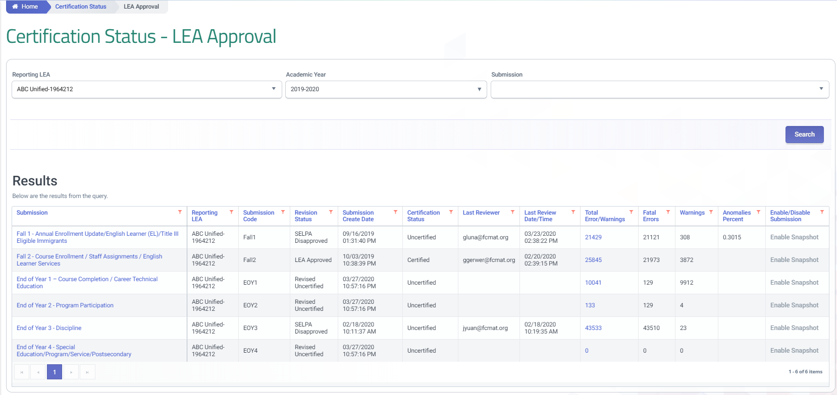
Certification Status
Notes:
The certification status can be reviewed by:
Using the left navigation, select Certification Status
Decide which Submission you want to work with
3. From the certification Status screen scroll down to the Results table
This will display the current Revision status. Each Revision includes the Fatal Error counts, and snapshot reports.
Warnings should be reviewed as they can impact the data on your 8 aggregate reports
41

Slide 42
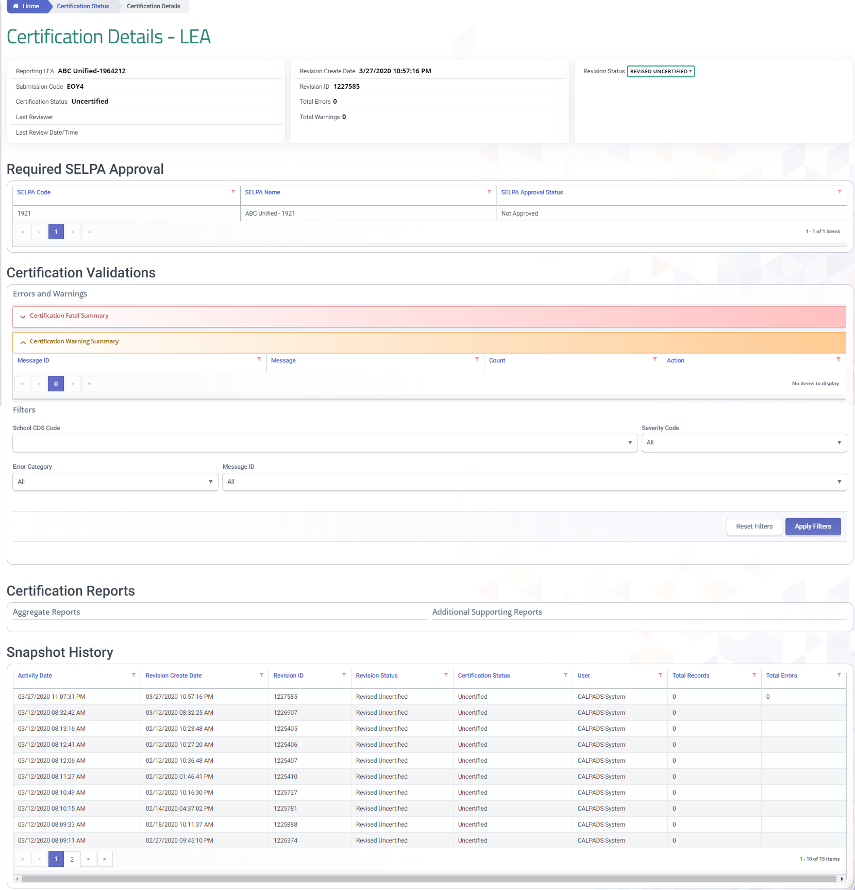
Certification Details
Select revision
Indication of SELPA approval
Certification Errors and warnings
Snapshot processing history
Scroll down to see new SWD reports
Notes:
The certification Details Screens shows relevant data to the snapshot at the top of the screen and allows the user to sort by revision status. Prominent in the middle of the screen is an indication of SELPA approval status for snapshots that require a SELPA approval. In the middle of the screen are a list of errors and the reports related to the snapshot. At the botto.m of the screen is the Snapshot History

Slide 43
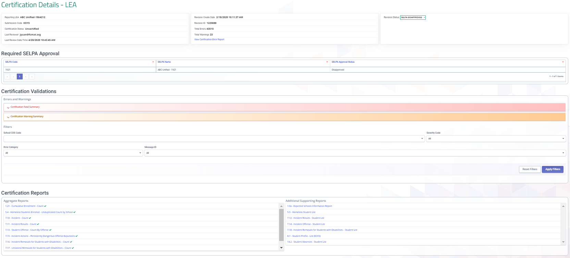
LEA Approval
Approval Requirements
Resolve Fatal errors
Review Certification reports
Notes:
The LEA must resolve all fata errors and review the certification reports to enable an approval button. The certification details screen features supporting reports, warnings, snapshot history and a revision status filter in addition to the fatal errors and certification reports. Every feature on the certification details screen has been added to assist LEAs in ensuring the accurate reporting of data.

Slide 44
EOY 4 Errors
Error # | Error Name
CERT004 | Ethnicity / Race Data Missing
CERT132 | Missing SPED Record for Enrolled Student at Reporting LEA
CERT133 | Invalid Student Special Education Exit Reason and Student Enrollment Exit Reason combination
CERT134 | Missing Student Exit Reason Code for Student with Disabilities who left program after Completing HS
CERT135 | Part B Initial Evaluation for a student with an IFSP occurred late (after child's 3rd Birthday)
CERT136 | Special Education Meeting Should Occur within 60 Days from Parental Consent
CERT137 | Late Triennial Meeting
CERT138 | Missing Student Enrollment Exit Reason for Student With Disabilities Dropping from Program
CERT139 | Late Annual Meeting
CERT140 | Missing SPED record for a student with a SSRV record
CERT141 | Missing Student Enrollment Exit Reason for Student with Disabilities leaving program due to Max Age Reached
CERT142 | Missing Special Education Service for Education Plan Type Code 100, 150, or 200
CERT143 | Missing SENR Record for a student with SPED Record
CERT144 | SPED Record Missing for student Enrolled at NPS school
CERT145 | SPED record missing for student enrolled in Private School
CERT147 | Invalid Postsecondary/Transition Status Indicator
CERT160 | Invalid Education Plan Type Code for student enrolled in Private School (0000002)
CERT161 | Special Education Program Exit Date Or Special Education Exit Reason Code Mismatch
Reenabled for EOY 4
Newly updated severity to fatal
Warning
Notes:
Here is a List or the CVRs that trigger during EOY 4. The Highlighted errors were reenabled and can potentially trigger on existing data requiring clean up. CERT 140 and 142 have increased severity and now will prevent snapshot approval. Below are a description of the reenabled EOY 4 CVRs:
CERT133 – Triggers when a student who died and was exited from the Special Education Program with code (77) must also have a Student Enrollment Record with an Exit Reason equal to E130 – Died
CERT134 – Triggers when a student exits the Special Education Program because they are a High School Completer (71), but does not have the corresponding Exit reason code/completion status combination. The student must have an SENR record showing they left Public HS because of a completion reason
E125 (Prior Completer Special Education)
E230/100 (Graduate)
E230/120 (Student with disabilities certificate of completion)
E230/250 (Adult Ed High School Diploma)
E230/320 (Received a High School Equivalency Certificate (and no standard HS diploma))
E230/330 (Passed CHSPE (and no standard HS diploma)
E230/360) (Completed grade 12 without completing graduation requirements, not grad)
CERT138 – Triggers when a student exits the Special Education Program because have dropped out (74), the student must have an SENR record showing they left Public HS because of a completion reason
E230/360 (Completed Gd 12 without all requirements) ,
E140 (Noknownenrolltruant),
E300 (Expell no known enroll),
E400 (other or unknown),
T380 (Trans to Institution where no HS diploma)
CERT140 - Triggers when a student has an SSRV record and no corresponding SPED program record. Students must have an associated SPED record at the same LEA in the same academic year with the same Student Special Education Meeting or Amendment Identifier where the meeting type is 10 (Part B Initial), 15 (Part C Initial Evaluation), or 20 (Annual Education or Service Plan Meeting).
Note: Do not submit SSRV for Plan type 300, 700, 800, 900.
CERT143 - When a student has a SPED record, but no corresponding enrollment. Students must have an associated SENR record at the same LEA in the same academic year.

Slide 45
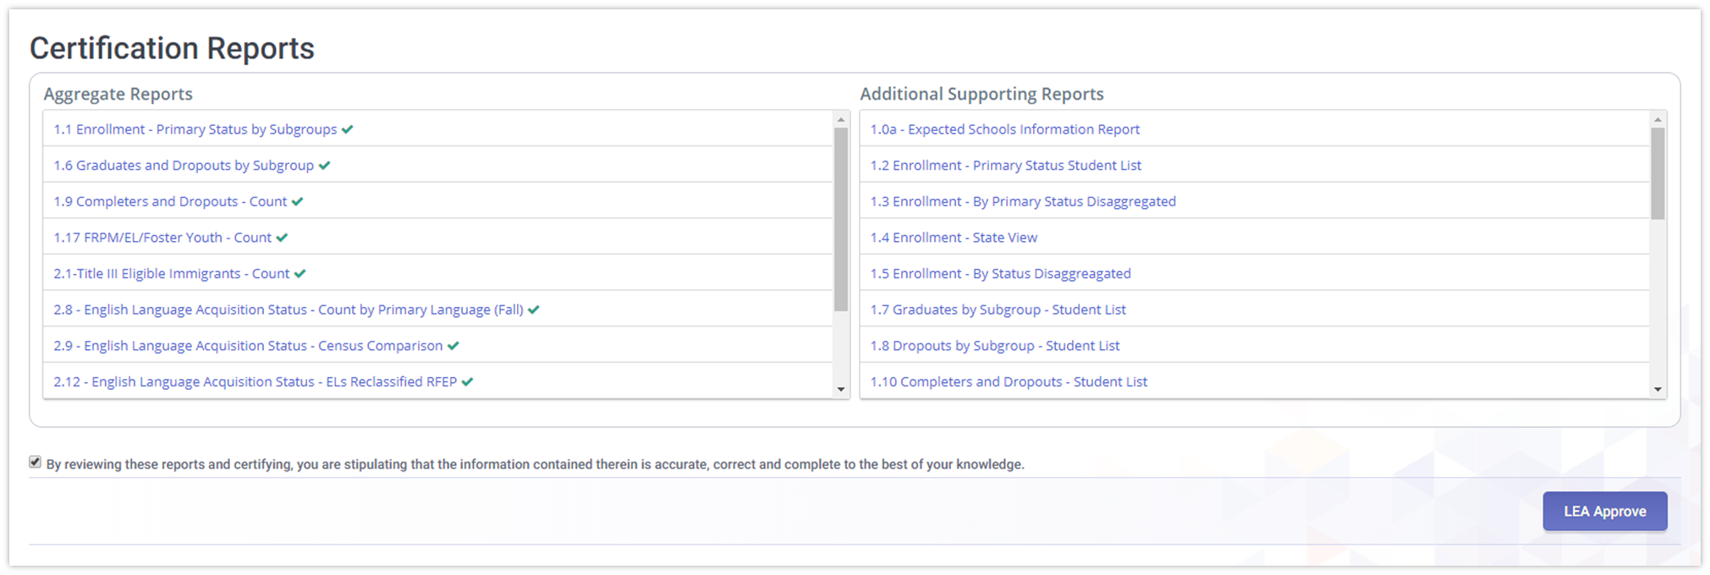
Certification Status
Once all fatal errors are cleared, all Snapshot Reports have been reviewed, and the agree box checked, the Approval appear below the Certification Report Section.
Notes:
Once all Fatal errors are corrected the reports have been reviewed, the Certify and Decertify button will appear above the Snapshot History.

Slide 46
SELPA Approval

Slide 47
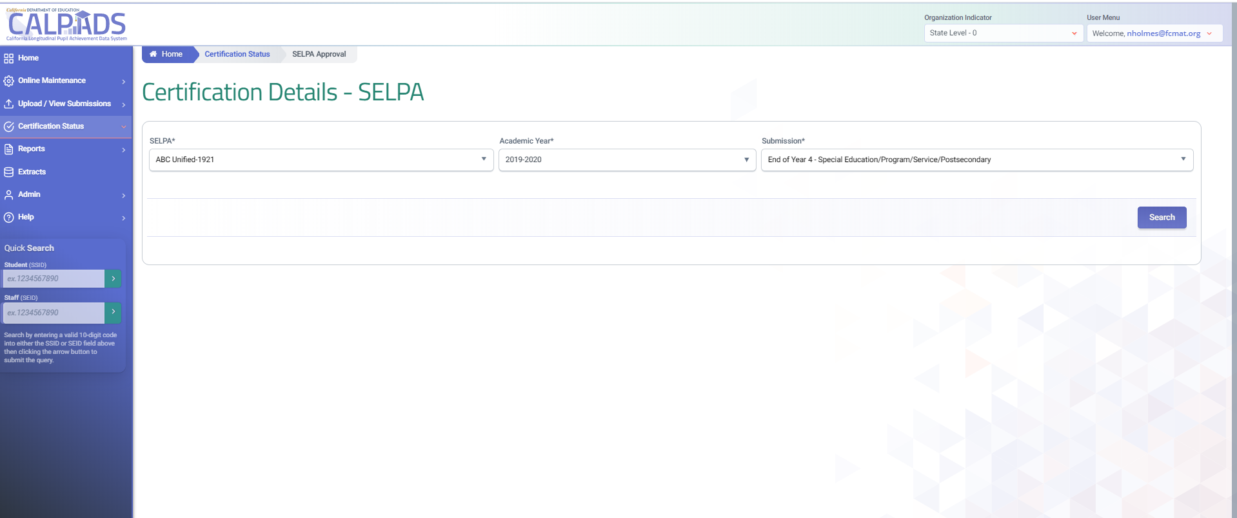
Certification Details UI for SELPA
1
2
3
Select the
1. Academic Year filter or
2. Submission filter as EOY 4
3. Search criteria to access the certification details for a specific submission
Notes:
Nate

Slide 48
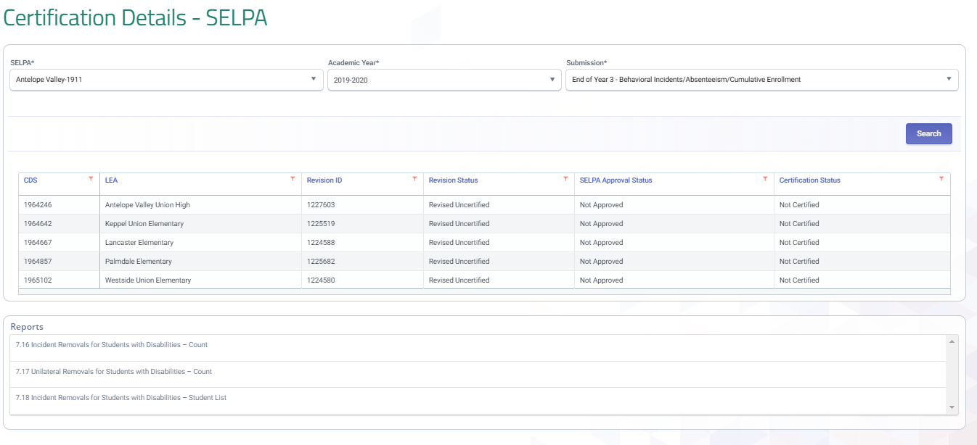
SELPA Approval
All LEAs and status are listed for the SELPA
Approval button becomes functional after LEA status changes to approved
Notes:
After an LEAs has approved a revision SELPAs can then approve the LEAs revision. While the approval functionality is only permitted after an LEA approves their revision, SELPAs can access reports prior to an LEA approval. A final review of reports should be made by SELPAs prior to approving any LEA revision. SELPAs multiple LEAs will have each LEA listed along with their status. SELPAs can approve LEA revisions one by one or in mass.

Slide 49
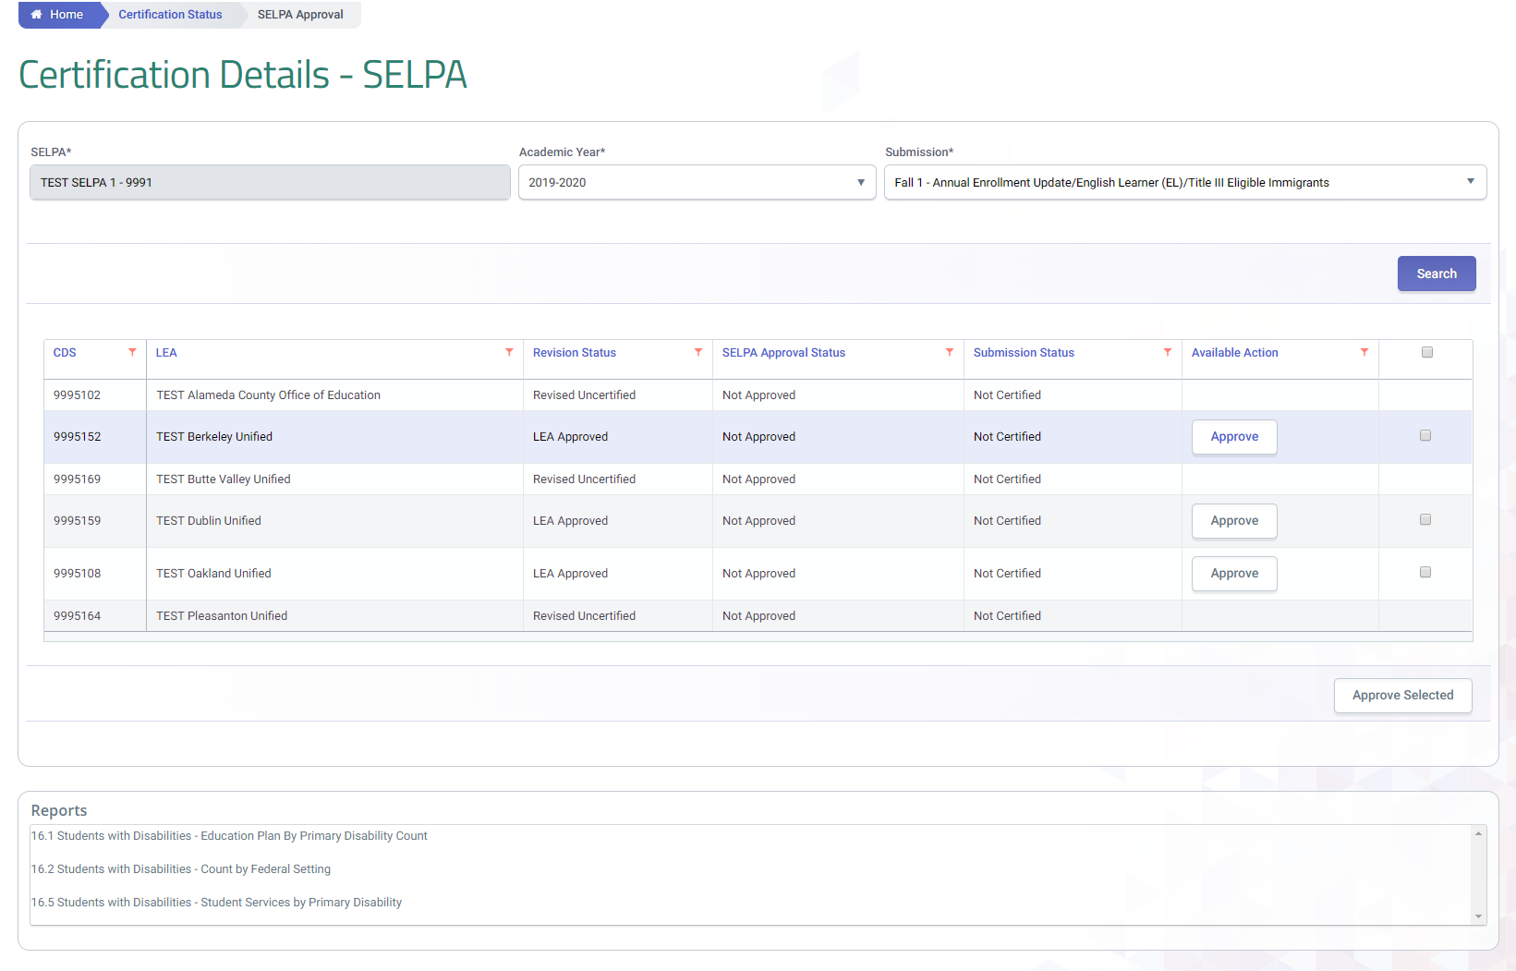
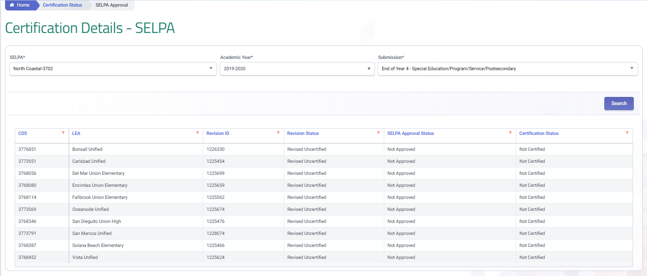
Approval - SELPA
SELPA approval button for individual LEAs
Multi approval select
SELPA approval for selections
SELPA reports
Notes:
Once the SELPA has reviewed the reports, SELPA users have the ability to approve revisions individually or several at a time.

Slide 50
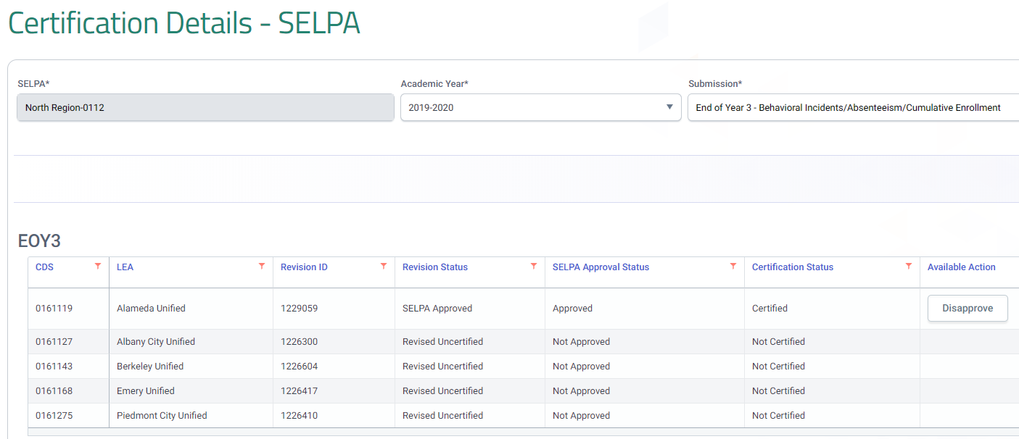
Hierarchy of Revision
Scenario 1 | Scenario 2 | Scenario 3 | Scenario 4 | Scenario 5 | Scenario 6 | Scenario 7
1. Revised Uncertified | 1. In Review Uncertified | 1. LEA Approved | 1. SELPA Approved | 1. LEA Disapproved | 1. SELPA Disapproved | 1. LEA Approved
 | 2. Revised Uncertified | 2. In Review Uncertified | 2. In Review Uncertified | 2. In Review Uncertified | 2. In Review Uncertified | 2. SELPA Disapproved
 |  | 3. Revised Uncertified | 3. Revised Uncertified | 3. Revised Uncertified | 3. Revised Uncertified | 3. In Review Uncertified
 |  |  |  |  |  | 4. Revised Uncertified
Regardless of the multiple revision status available, SELPAs will see only one LEA status based on the hierarchy table.
Notes:
LEAs are presented one or more revision statuses depending on the prior actions of the data certifier. Since the revision status is limited to showing one status, a hierarchy of available revisions is employed by CALPADS to determine what the default revision is reflected. This impacts both the certification status in the main Certification Status - LEA Approval page as well as the revision status inside the Certification Detail - LEA page

Slide 51
EOY 4 Reports

Slide 52
Certification Reports
All Reports will be available to both LEA and SELPA Users
Report 16.3
Students with Disabilities - Count by Federal Setting (EOY4)
Report 16.1
Students with Disabilities - Education Plan By Primary Disability Count (EOY4)
Report 17.3
Postsecondary Survey Outcome for SWDs - Count
Report 17.4
Postsecondary Survey Outcome for SWDs - Student List
Legend
Aggregate Report
Supporting Report
Report 16.2
Students with Disabilities - Count by Federal Setting (EOY4)
Report 16.5
Students with Disabilities - Student Services by Primary Disability (EOY4)
Report 16.6
16.6 - Students with Disabilities - Student Services Student List (EOY4)

Slide 53
Report 16.1 – Students with Disabilities – Education Plan by Primary Disability Count (EOY 4)
Description: Reports unduplicated counts of Students with Disabilities by Education Plan Type and Primary Disability Category
Notes:
Reports unduplicated counts of Students with Disabilities by Education Plan Type and Primary Disability Category

Slide 54
Report Filters (Report 16.1 )
SELPA
LEA
Notes:
When reviewing the reports remember to set the filter criteria prior to rendering the report. SELPA need to be aware of the status type. Revised uncertified will always have the most up to date information, but when an LEA is ready for certification, they will have a LEA approved revision waiting for the SELPA.
Both reports have default criteria for age and Education plan type that may need to be changed prior to running the reports.

Slide 55
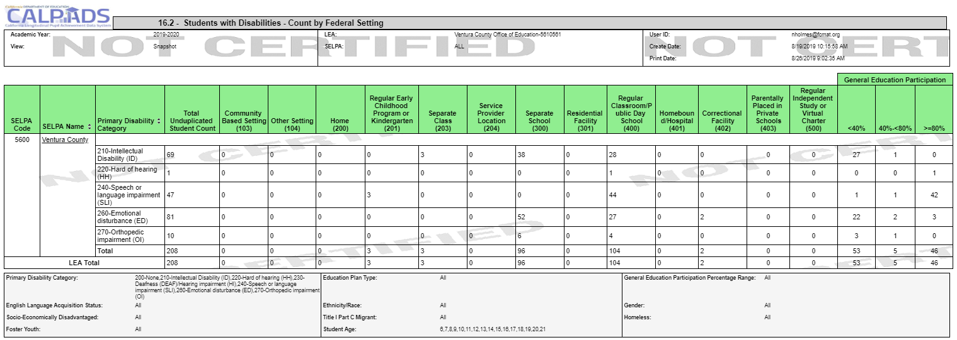
Report 16.2 Student with Disabilities – Count by Federal Setting (EOY 4)
Description: Reports unduplicated counts of Students with Disabilities within each Primary Disability Category by Federal Setting
Notes:
Reports unduplicated count of students with disabilities within each Primary Disability Category by Federal Setting.

Slide 56
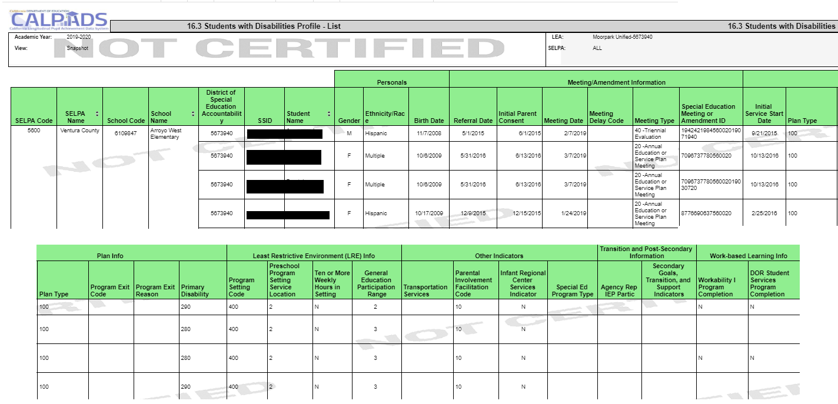
Report 16.3 Students with Disabilities – List (EOY 4)
Description: Reports a list of students with disabilities and associated meeting, plan, and other SPED-related information.
Notes:
Reports a list of students with disabilities and associated meeting, plan, and other SPED-related information.

Slide 57
Report 16.5 Students with Disabilities – Student Services (EOY 4)
Description: Reports the counts of students with disabilities by services received and primary disability category
Notes:
Nate

Slide 58
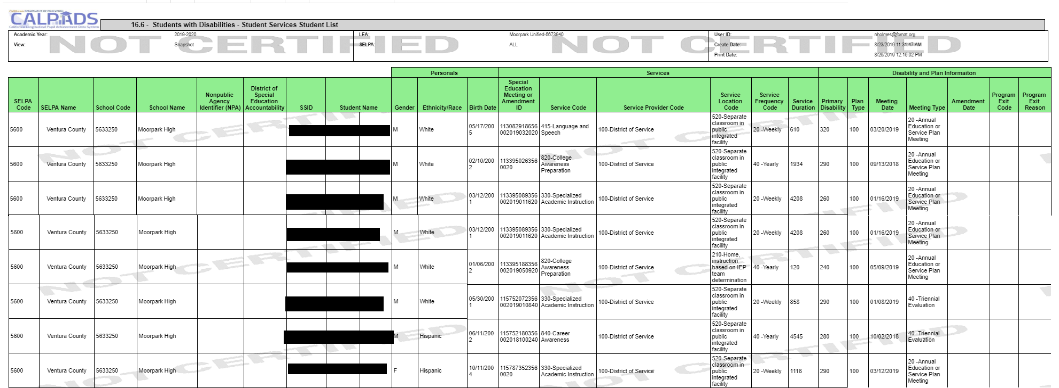
Report 16.6 Students with Disabilities – Student Services Student List (EOY 4)
Description: Reports a list of students with disabilities receiving services and associated meeting and plan information
Notes:
Nate

Slide 59
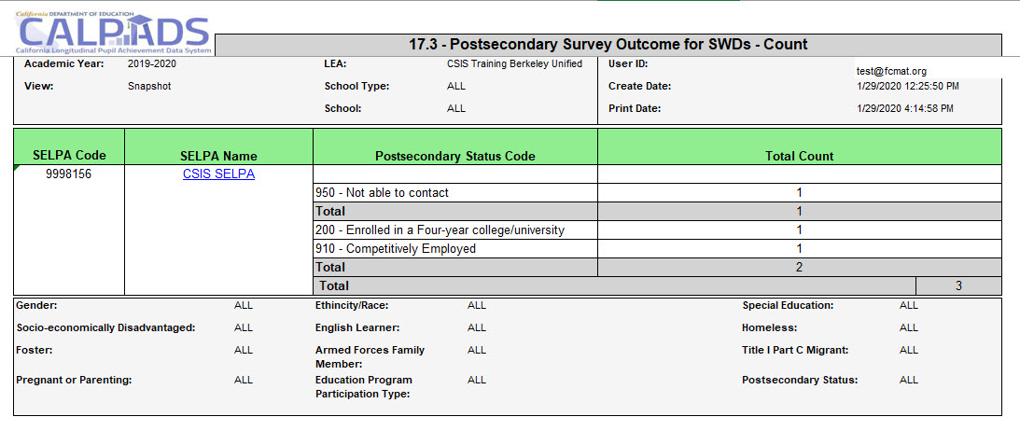
Report 17.3 - Postsecondary Survey Outcome for SWDs - Count
Notes:
Reports the total number of students with disabilities identified in the Postsecondary (PSTS) survey outcome.

Slide 60
Report 17.4 Postsecondary Status-Student List
Notes:
Reports the details for students with disabilities identified in the Postsecondary (PSTS) survey outcome

Slide 61
Data used for compliance monitoring or other purposes?
LEAs should submit any of the following transactions on at least a monthly basis:
Initial Evaluations for Part C
Initial Evaluations for Part B
Annual IEP meetings
Additional IEP meetings (e.g. exit meetings)
Triennial meetings
Meetings to amend an IEP
These data will be used to monitor LEAs selected for compliance monitoring on an as-needed basis
Special education data needs to be updated regularly so student test accommodations and designated supports can be provided from CALPADS to the Test Operations Management System (TOMS) so that students have access to the appropriate testing supports

Slide 62
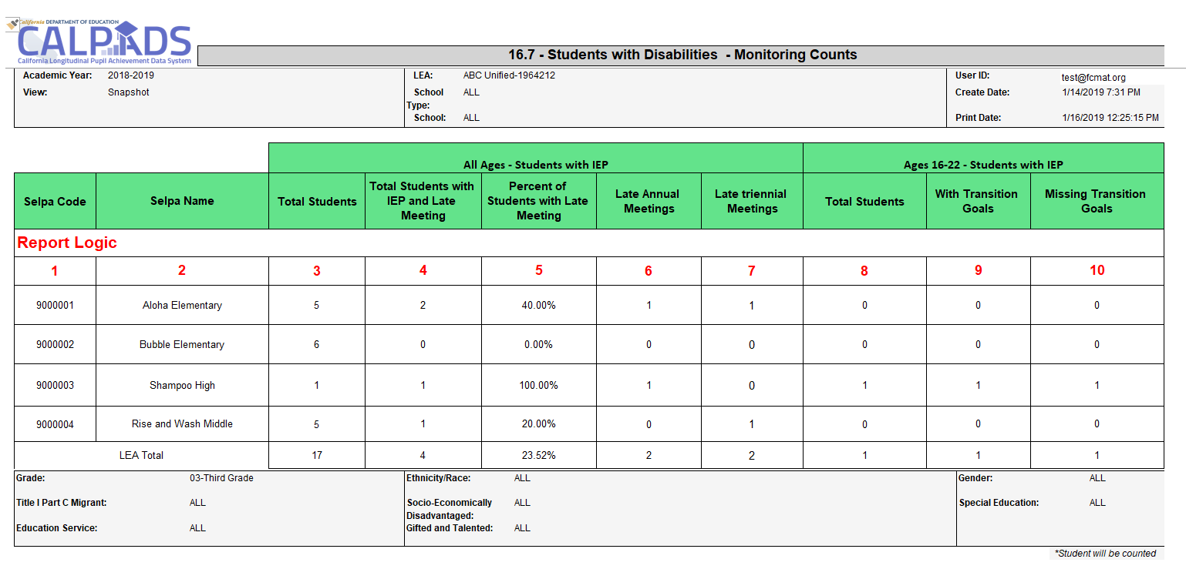
Monitoring Reports (ODS)
The 16.7 report counts the number of SWD with an Active IEP by the number of Late Annual Meetings, Late Triennial Meetings, and those with and without Transition Goals.

Slide 63
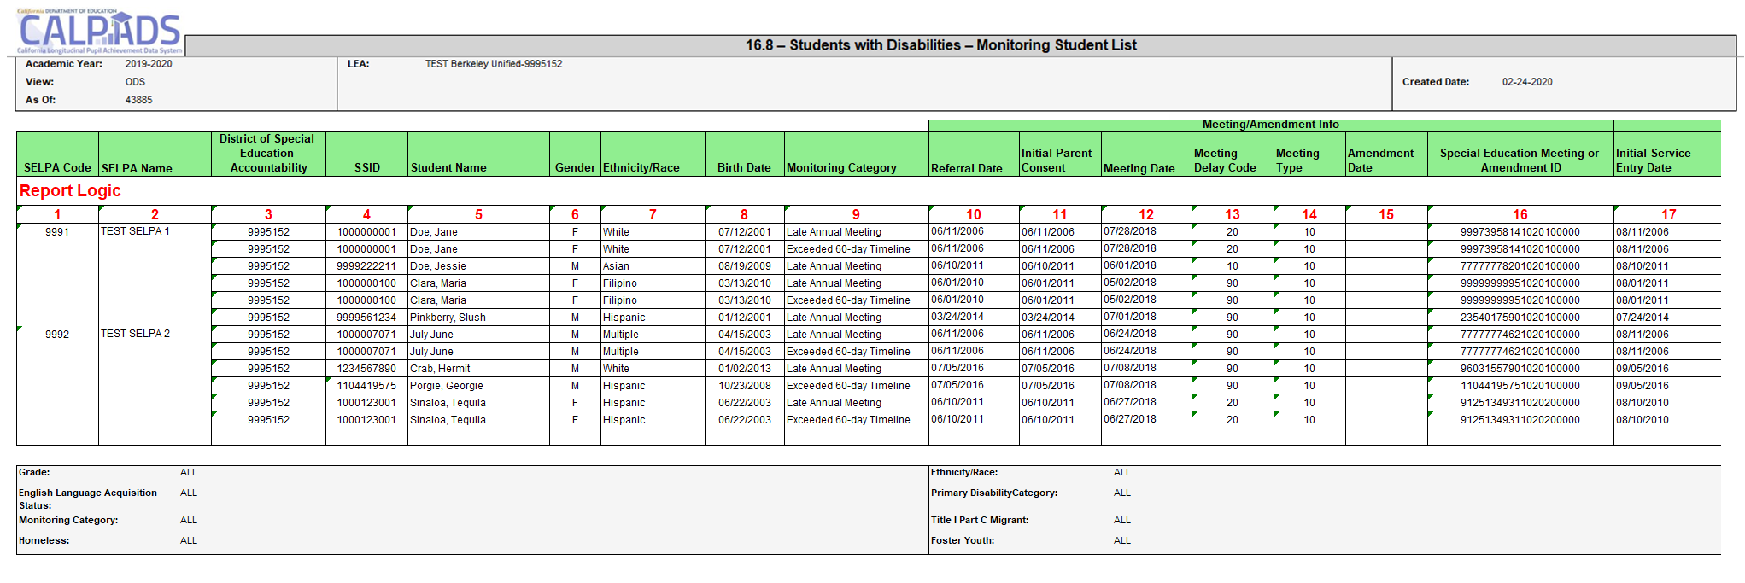
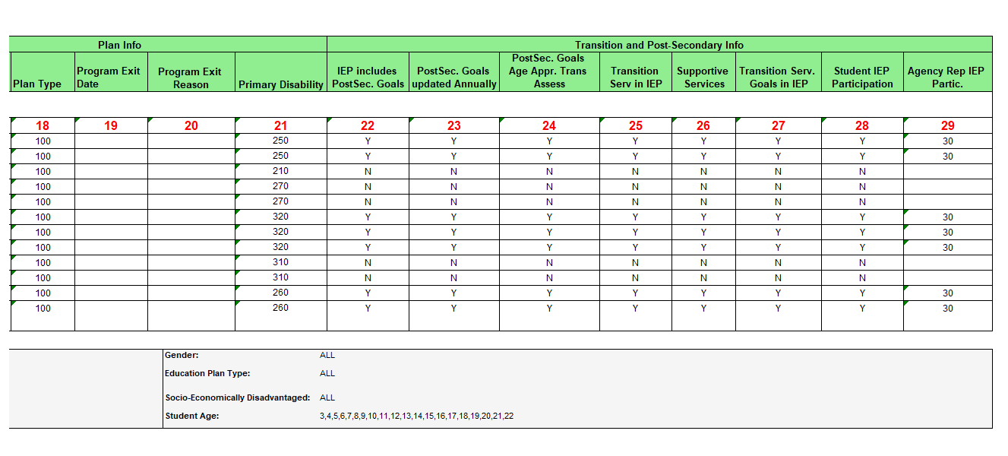
Monitoring Reports (ODS)
The 16.8 report shows the student details of SWD with an Active IEP who had at least one late annual or Triennial Meeting and those students with Part C Initial and Part C Initial Evaluations where 60 days passed from parental consent before they were evaluated.
Note that 16.7 may not match 16.8 as 16.7 does not include students who where 60 days passed from parental consent before they were evaluated.

Slide 64
District of Special Education Accountability Extract
The DSEA extract will help LEA’s determine a student’s District of Special Education Accountability.
The extract contains enrollment and Special Education program data for students who may be:
sent to another district or
received by the requesting LEA for purposes of Special Education Accountability.
The Accountability Attribution status, a calculated field in the extract, will indicate the which direction the student’s accountability information is being attributed.
Sending- Enrolled in the LEA requesting the extract and has a different LEA for the student’s District of Special Education Accountability, or
Receiving - Enrolled in a different LEA than the LEA requesting the extract and the student’s District of Special Education Accountability is the LEA requesting the extract
.
This extract is not available for Charter Schools as students with disabilities do not have accountability attributed to other LEAs.
Notes:
For additional information: https://documentation.calpads.org/Extracts/DSEAExtract/
Used to determine which Local educational agency (LEA) is responsible for reporting students with disabilities (SWD) data, and which LEA will be held accountable on the Dashboard.

Slide 65
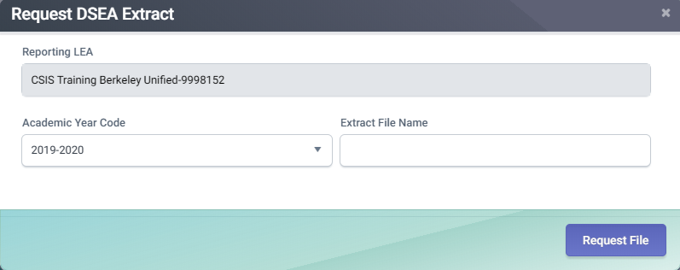
DSEA Extract Request Process
1
2
3
4
5
6
Notes:
1) Click on Extracts link from the Left Navigation menu.
2) Click on DSEA button.
3) Select Academic year from the dropdown selection.
4) Label with desired Extract File Name (optional)
5) Click on Request File button to finalize request.
6) Requested file will be available under Submitter Extracts. Click on Download button next to extract.

Slide 66
DSEA Extract Layout Example
Notes:
Send a copy to someone in the field…

Slide 67
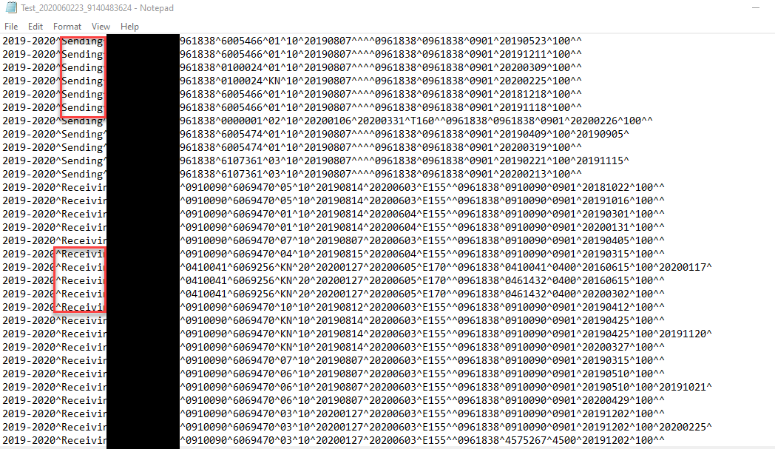
DSEA Extract

Slide 68
Planning
Things to consider prior to submitting and certifying EOY:
Personal considerations
Ease of submission, workload, summer break/vacation
Local factors
Availability of school site staff and district personnel, internal deadlines
Potential reporting milestones
Meeting dates
Last day of school
CALPADS deadlines
Benefits and consequences of meeting the initial
EOY deadline and amendment window deadline

Slide 69
Behavioral Incidents
Discuss background of behavioral incidents submission
Notes:
Let’s look at the Behavioral incident submission.

Slide 70
Purpose
Provide student expulsion and suspension information to satisfy Every Student Succeeds Act (ESSA) requirements related to "persistently dangerous" schools and the Uniform Management Information Reporting System (UMIRS)
To determine persistently dangerous schools
Provide student suspension and expulsion counts and related information for students with disabilities for federal Individuals with Disabilities Education Act (IDEA) reporting.
Provide information regarding the use of restraint and seclusion for students receiving either general education or special education to the fulfill statutory requirements of AB 2657
Notes:
The behavioral incident submission
Provides student expulsion and suspension information to satisfy Every Student Succeeds Act (ESSA) requirements related to "persistently dangerous" schools and the Uniform Management Information Reporting System (UMIRS)
To determine persistently dangerous schools
Provides student suspension and expulsion counts and related information for students with disabilities for federal Individuals with Disabilities Education Act (IDEA) reporting.
Provides information regarding the use of restraint and seclusion for students receiving either general education or special education to the fulfill statutory requirements of AB 2657

Slide 71
SELPA Staff will need to review several reports from EOY 3 because they feature the:
Count of students with disabilities (SWD) removed to an interim alternative educational setting.
Count of SWD unilaterally removed by school personnel (not IEP team) from their current educational placement to an interim alternative educational setting due to offenses related to drug, weapon, or serious bodily injury.
Count of SWD suspended or expelled, and the duration of the disciplinary action
Unduplicated count of SWD subject to any kind of disciplinary removal
Total number of times SWD were subject to any kind of disciplinary removal
Incident Information for IDEA
Notes:
SELPAs must review incident reports of LEA data that have relevant information about students with disabilities because they feature the:
Count of students with disabilities (SWD) removed to an interim alternative educational setting.
Count of SWD unilaterally removed by school personnel (not IEP team) from their current educational placement to an interim alternative educational setting due to offenses related to drug, weapon, or serious bodily injury.
Count of SWD suspended or expelled, and the duration of the disciplinary action
Unduplicated count of SWD subject to any kind of disciplinary removal
Total number of times SWD were subject to any kind of disciplinary removal

Slide 72
Incidents resulting in the use of behavioral restraints and seclusion even if they were not a result of a violation of Education Code Sections 48900 and 48915
California Education Code Section 49005.1 for specific definitions of restraint and seclusion
Refer to FLASH #159 for a summary of the discipline file restructuring
Incidents involving violations of Education Code Sections 48900 and 48915 even if they did not result in suspension or expulsion and;
LEAs should refer to:
Required Data
Notes:
Student discipline incidents that are outlined in Ed code sections 48900 an 48915 are required. Additionally, behavioral incidents outlined in section 49005.1 must be reported.

Slide 73
Change in Defiance Law
Current law prohibits* (through July 1, 2020):
Suspending students in K-3 for committing “defiance” (Education Code section 48900(k))
Expelling students in K-12 for committing defiance
Beginning July 1, 2020, the law prohibits*:
Suspending students in grades K-5 for committing defiance
Suspending students in grades 6-8 for committing defiance,
This clause will become inoperative on July 1, 2025
Charter schools from suspending and expelling students for defiance
The same law is applied to charter schools
Except as provided in the authority provided to teachers in EC Section 48910
Notes:
California Education Code (EC) Section 48900(k)(2) prohibits students enrolled in kindergarten or any grades one through three (K–3) from being suspended for “willful defiance” (student offense code 511 – disruption, defiance), except suspensions made under the authority provided by EC Section 48910(a), and prohibits students enrolled in kindergarten or any grades one through twelve (K–12) from being recommended for expulsion for willful defiance.
NOTE: Beginning July 1, 2020, EC Section 48900(k)(3)(4) and EC Section 48901.1 prohibit students, including students in charter schools, enrolled in K–5 from being suspended for “willful defiance,” and prohibit students enrolled in K–12 from being recommended for expulsion for willful defiance. These EC sections further prohibit students enrolled in 6–8 from being suspended for willful defiance until July 1, 2025.

Slide 74
Teacher Suspension
Defined in EC section 48910, a teacher may suspend any pupil from class, for any of the acts in section 48900, for the day of the suspension and the day following. The
teacher shall immediately report the suspension
to the principal for appropriate action.
Notes:
California Education code section 48910 states:
(a) A teacher may suspend any pupil from class, for any of the acts enumerated in Section 48900, for the day of the suspension and the day following. The teacher shall immediately report the suspension to the principal of the school and send the pupil to the principal or the designee of the principal for appropriate action. If that action requires the continued presence of the pupil at the school site, the pupil shall be under appropriate supervision, as defined in policies and related regulations adopted by the governing board of the school district. As soon as possible, the teacher shall ask the parent or guardian of the pupil to attend a parent-teacher conference regarding the suspension. If practicable, a school counselor or a school psychologist may attend the conference. A school administrator shall attend the conference if the teacher or the parent or guardian so requests. The pupil shall not be returned to the class from which he or she was suspended, during the period of the suspension, without the concurrence of the teacher of the class and the principal.
(b) A pupil suspended from a class shall not be placed in another regular class during the period of suspension. However, if the pupil is assigned to more than one class per day this subdivision shall apply only to other regular classes scheduled at the same time as the class from which the pupil was suspended.
(c) A teacher may also refer a pupil, for any of the acts enumerated in Section 48900, to the principal or the designee of the principal for consideration of a suspension from the school.

Slide 75
Incident Data for Nonpublic schools
Same rules and requirements as the LEA
Ensure all incidents resulting from violations of Education Code Sections 48900 and 48915 have been reported for all students attending NPS schools regardless of the outcome and duration of a removal
Report all instances of restraint or seclusion for general education and students with disabilities even if it was not the result of a violation of 48900 or 48915 for students attending NPS schools
LEA need to work with the NPS to collect and report the data that reflects the time the student attended the NPS during the school year
Notes:
Please review the following training video to learn more about this topic:
https://www.youtube.com/channel/UCA9oRTiyVECCCzOxpmJheZw/search?query=NPS

Slide 76
NPS Expectations
LEAs and NPS schools must have policies and procedures in place to identify, document, and report incidents involving restraint and seclusion for students with disabilities
LEAs and NPS schools should ensure that all staff are appropriately trained
CALPADS Administrators should not have to determine what discipline records are reportable incidents
Notes:
Are LEAs required to submit data for students at Nonpublic schools?
YES – LEAs are required to submit incident data that occurred at Nonpublic schools
LEA need to work with the NPS to collect and report the data that reflects the time the student attended the NPS during the school year

Slide 77
Terminology
Incident - An event resulting in the use of physical restraint, mechanical restraint, or seclusion or a statutory offense is committed. Each incident may have multiple students involved, and each student may commit multiple offenses during a single incident
Incident Result - Outcome or result of an incident for a specific student
Statutory Offense – Student violations outlined in Education Code Sections 48900 and 48915
Seclusion - the involuntary confinement of a pupil alone in a room or area from which the pupil is physically prevented from leaving
Behavioral Restraint
Mechanical Restraint – Use of a device or equipment to restrict a pupil’s freedom of movement
Physical Restraint – A personal restriction that immobilizes or reduces the ability of a pupil to move his or her torso, arms, legs, or head freely

Slide 78
Discipline File Restructuring
The Student Discipline (SDIS) file has been retired.
LEA will submit:
Student Incident (SINC) File
Student Incident Results (SIRS) File
Student Offense (SOFF) File
Notes:
Discipline file restructured into three files referred to as “Incident” submission, to accommodate the additional data collection of behavioral incidents along with student discipline. The current Student Discipline (SDIS) file is retired. LEAs will submit:
Student Incident (SINC) File
Student Incident Results (SIRS) File
Student Offense (SOFF) File

Slide 79
Incident File Types
Student Incident (SINC) File, LEAs will report all incidents:
In which a statutory offense is committed
Resulting in the use of physical restraint, or seclusion even without a statutory offense
Student Incident Results (SIRS) File, LEAs will report all results for each incident
Each incident should have at least one corresponding SIRS record for each student who was restrained or secluded, or who committed an offense
Student Offense (SOFF) File, LEAs will report the statutory offense committed
LEAs are required to report all statutory offenses committed regardless of the result type, e.g. regardless of whether the student was suspended or expelled

Slide 80
Student Incident Reporting
Report all results for each incident for each student
Report the duration of all:
Suspensions (in and out of school)
Expulsion
Duration is not required for any other incident results
Report all statutory offenses committed
Report Weapon category if weapon was used
Report Removal to an interim Alternative Setting
Report Instructional support
SWD End of Year R&C v2.0 June 2020
Notes:
Let’s look at what is required for incident reporting.
Report all results for each incident for each student
Report the duration of all:
Suspensions (in and out of school)
Expulsion
Duration is not required for any other incident results
Report all statutory offenses committed
Report Weapon category if weapon was used
Report Removal to an interim Alternative Setting
Report Instructional support

Slide 81
How can LEAs submit the incident data for EOY 3, including suspensions and expulsions, and new data regarding restraint and seclusion when schools are closed or have moved to distance learning?
At this time, there is no change in the statutorily required collection of restraint and seclusion data
Therefore, LEAs should submit in EOY 3, all incidents that occurred during the school year (through June 30, 2020), including any incidents and outcomes that occur subsequent to the LEA transitioning to distance learning.
Submitting 19-20 Incident Data
SWD End of Year R&C v2.0 June 2020
Notes:
Any behavioral incidents or student discipline that would be reported in a traditional environment should still be reported if your LEA adopted a distancing learning medium to finish the year.

Slide 82
Student Incident - OM
Incident Data
Student Profile
Notes:
We will now do a high level demonstration of the student discipline functionality in Online Maintenance.

Slide 83
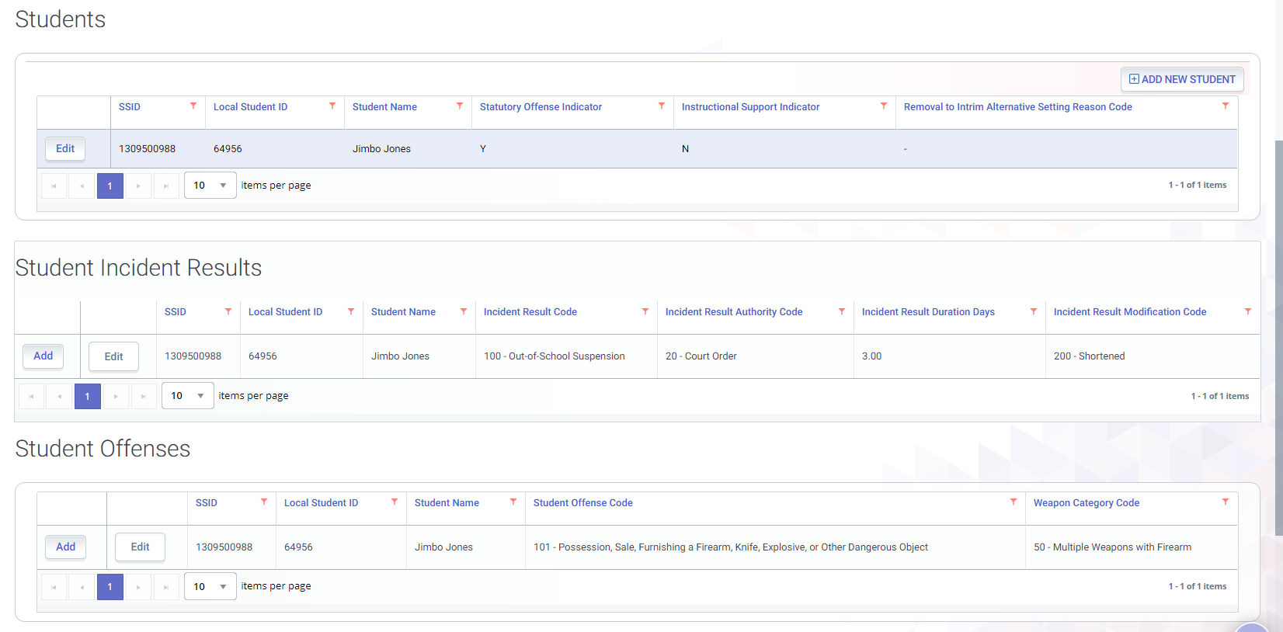
Incident Data
Incidents can only added or modified from the Incident Data section
SINC
SIRS
SOFF
Notes:
Incidents are edited in different modules for each record type on the incident data screen.

Slide 84
Student Profile - Incident Data
The student Incident & Offense Data are also available in “View Only” mode in the Student Profile.
1
2
Notes:
The SINC and the SIRS are represented in the Student Incident Result container on the student details screen. Student Offenses are represented in a separate container. No Incident details can be submitted or edit from the student details screen. Opening an individual record will display the record in its entirety.

Slide 85
Student Incident Module
For students with disabilities:
An indication of instructional support services is required
It indicates that all services on the student's IEP are provided through the duration of suspension
The Interim Alternative Setting is required
It Describes the reason a student was removed to an interim alternative setting for 45 days or less.
Notes:
For students with disabilities, instructional support services include providing all services on the student's IEP during the duration of his/her suspension regardless of the number of days. The services may be provided in the home; however, providing homework does not meet the definition of instructional support for students with disabilities.

Slide 86
EOY 3 Certification Errors & Reports

Slide 87
Incident CERT Errors
Error # | Error Name
CERT147 | Invalid Postsecondary/Transition Status Indicator
CERT148 | No Student Incident Data Submitted for a School
CERT149 | Missing Expulsion or Suspension Incident Result Record
CERT150 | Missing Expulsion Incident Result Record
CERT151 | Invalid Student Offense and Incident Result Code Combination
CERT152 | Invalid Incident Result Code and Grade Level Combination for Student Offense Code 511 (disruption, defiance)
CERT153 | Missing Student Incident Result (SIRS) Record for Student
CERT154 | Missing Student Incident (SINC) Record for Student
CERT155 | Missing Student Offense (SOFF) Record for Student
CERT156 | Missing Suspension Data for a student who was reported as absent due to either out-of-school suspension or in-school suspension
CERT157 | Invalid Incident Result Code and Removal to Alternative Setting Reason Code combination
CERT158 | Missing Removal to Interim Alternative Setting Reason Code
CERT159 | Removal to Interim Alt Setting Populated for Non-Special Education Student

Slide 88
Certification Reports
Legend
Report 1.21
Cumulative Enrollment - Count
Report 8.1 (EOY 3)
Cumulative Enrollment – Student
Report 14.1
Student Absenteeism - Count
Report 14.2
Student Absenteeism - Details
Report 5.4
Homeless Students Enrolled - Unduplicated Count by School
Report 5.5
Homeless Student List
Aggregate Report
Supporting Report
Report 7.12
Incident Results - Student List
Report 7.10
Incident Count
Report 7.14
Incident Offense - Student List
Report 7.13
Student Offense - Count by Offense
Report 7.15
Incident Results- Persistently Dangerous Offense Expulsions
Report 7.16
Incident Removals for Students with Disabilities – Count
Report 7.18
Incident Removals for Students with Disabilities – Student List
Report 7.11
Incident Result – Count
Report 7.17
Unilateral Removals for Students with Disabilities - Count
Notes:
1.21-Reports the cumulative enrollment for the academic year. The total primary, secondary, and short-term enrollment counts are grouped and certified census day enrollment count is provided for comparison.
The EOY 3 has 8 aggregate reports and 5 supporting reports.
Please note that:
7.1 Is an aggregate report and 7.2 provides the detail data in reconciling CALPADS data to a local system
7.3. & 7.4 are aggregate reports and 7.5 provides the detail data in reconciling CALPADS data to a local system
7.6 is another aggregate report providing persistently dangerous offense expulsions count and it does not have a supporting report.
7.7 and 7.8 are new aggregate reports for this year with a supporting report 7.9 providing details of Discipline removals for students with Disabilities.
14.1- Reports the number of students who were enrolled over the course of the academic year and absenteeism counts as a percentage of the total cumulative enrollment by school for the LEA.
14.2- Reports a student list of positive attendance and student absenteeism by days of expected attendance, days attended and days absent. Absences are totaled by days excused, days unexcused, and days missed due to out-of-school suspensions.

Slide 89
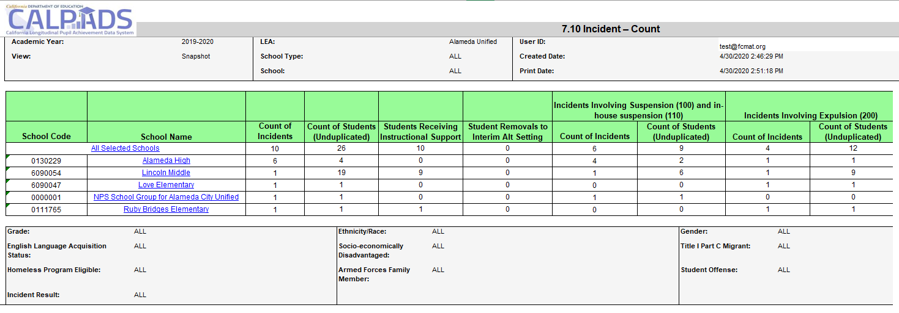
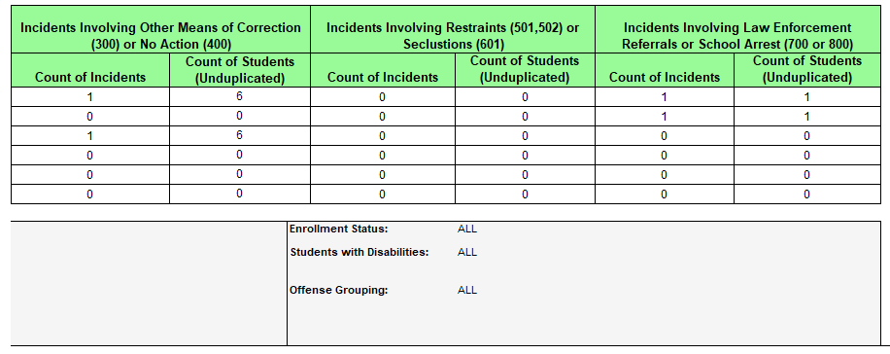
Report 7.10 Incident - Count
Notes:
Reports the counts of incidents occurring at the LEA by each school of attendance, the number of students involved an incident, the number of students receiving instructional support, and the number of students removed to interim alternative setting. Counts of incidents and students involved in incidents are displayed by Incident Result categories.

Slide 90
Report 7.11 Incident Result - Count
Notes:
Reports an unduplicated count of students and Students with Disabilities by Incident Result type, total of count of each incident result, and the number of incident results that were modified all by School of Attendance.

Slide 91
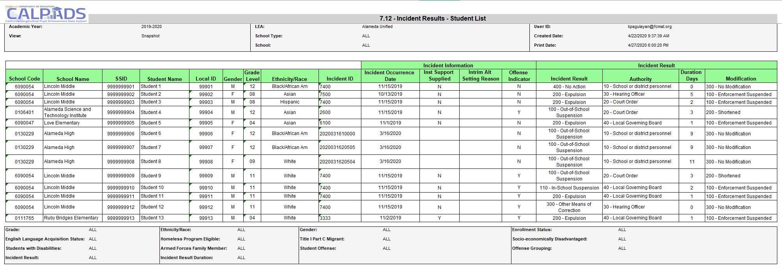
Report 7.12 Incident Results –Student List
Notes:
Reports students regardless of enrollment status, who were involved in an incident. Also reports information about each incident, including the incident result, duration days, and cumulative duration days.

Slide 92
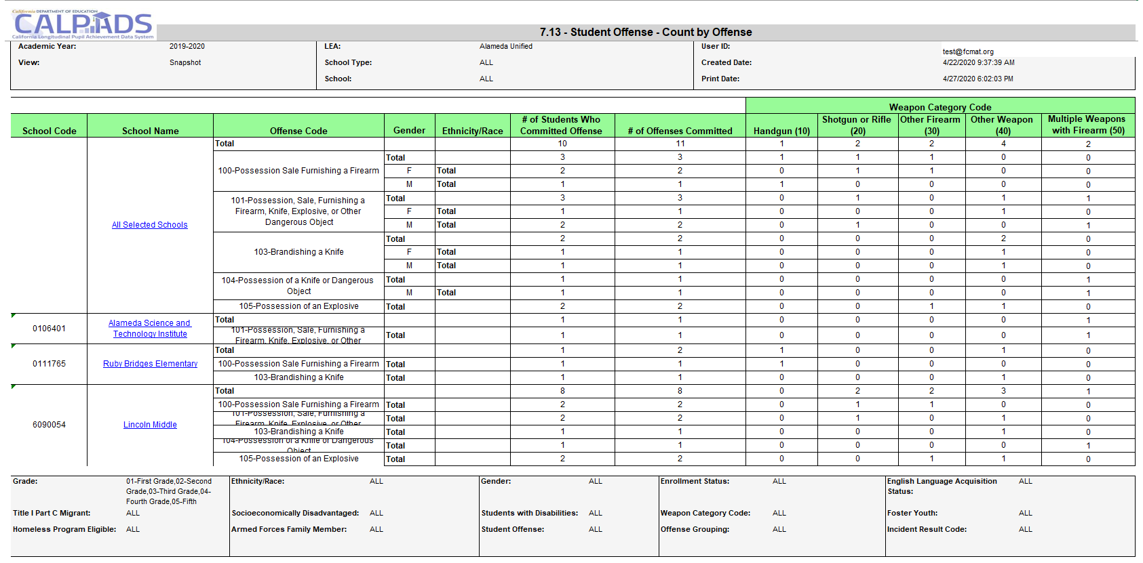
Report 7.13 Student Offense – Count by Offense
Notes:
Reports an unduplicated count of students who committed offenses, total count of offenses committed by each offense code, and a breakdown of offenses involving a weapon by gender and ethnicity/race

Slide 93
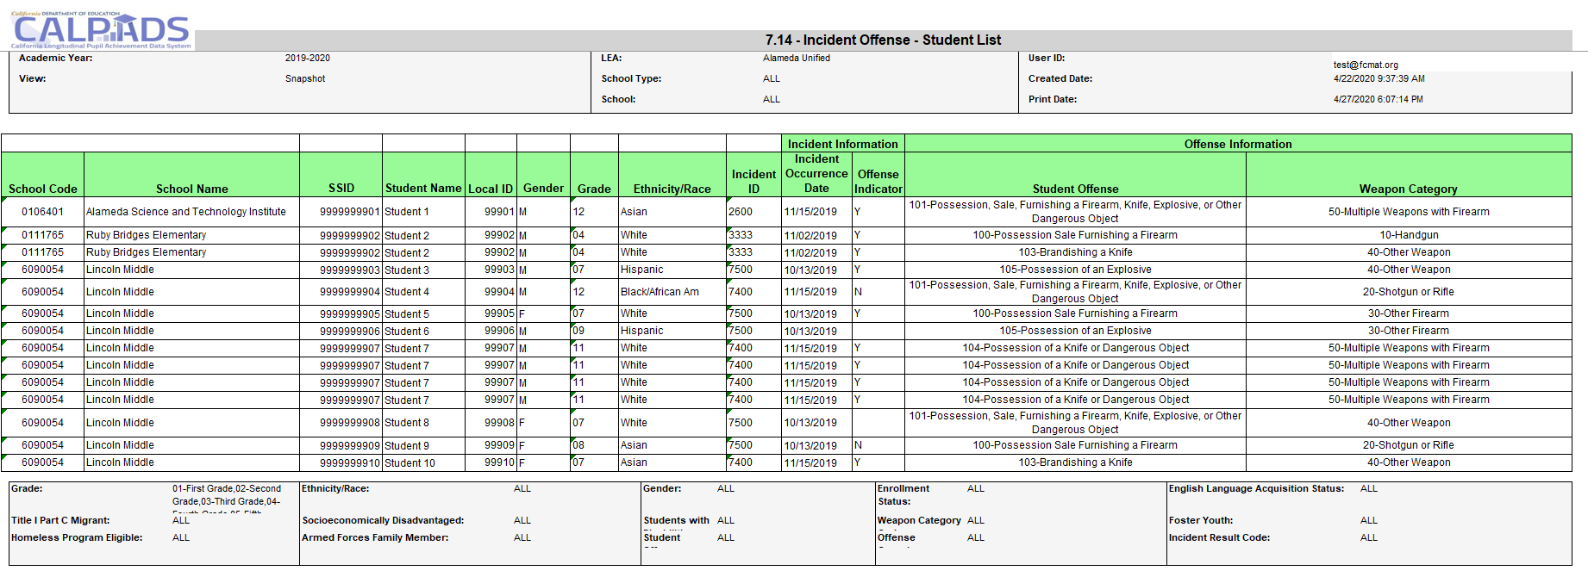
Report 7.14 Incident Offense – Student List
Notes:
Reports students in grades KN, 01-12, who were involved in discipline incidents including the disciplinary action taken. (Drill down from report 7.13)

Slide 94
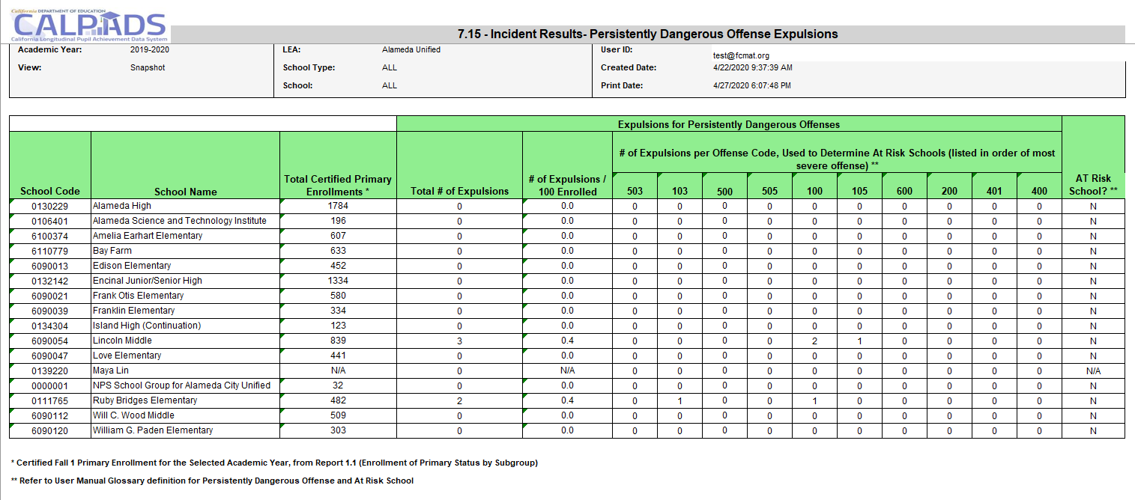
Report 7.15 Incident Results Persistently Dangerous Expulsions
Notes:
Reports the counts of K-12 expulsions for the applicable Persistently Dangerous Schools California Education Code violations. Reports the counts of expulsions for the Persistently Dangerous Schools California Education Code violations. By school, it includes the total number of expulsions, the # of expulsions per 100 enrolled students (based on the selected year’s certified Fall 1 enrollment), and the # of expulsions per offense codes that are applicable in determining At-Risk Schools. It also indicates whether a school is an At-Risk School.

Slide 95
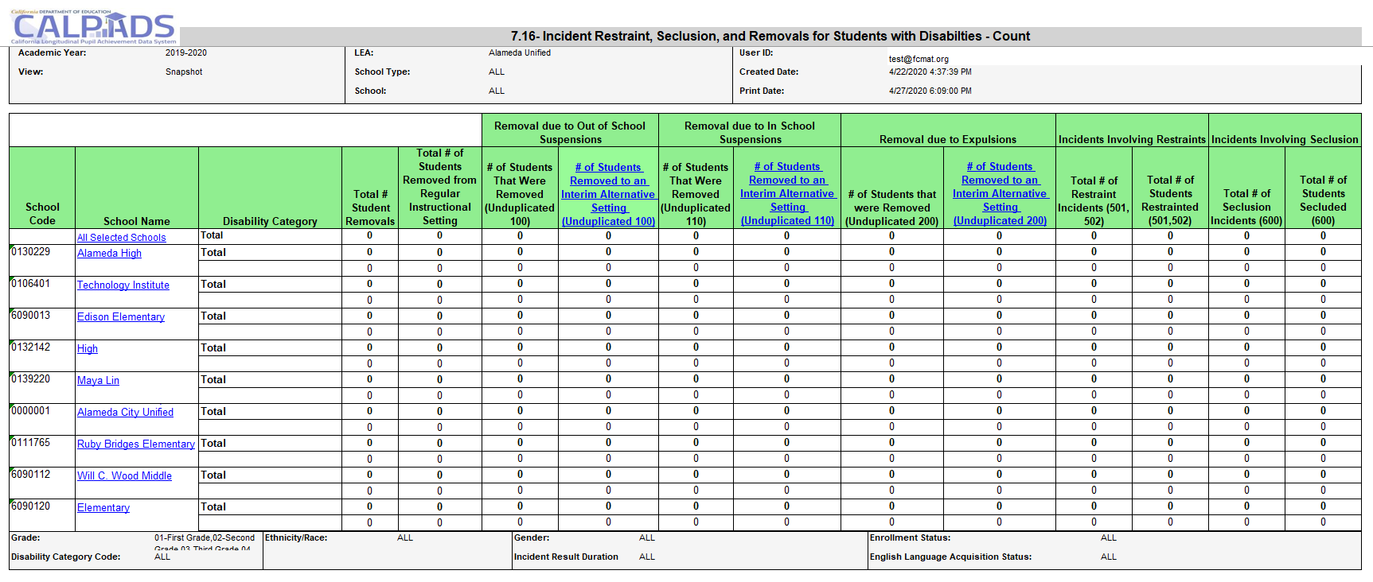
Report 7.16 Incident Restraints, Seclusion, and Removals for Student with Disabilities - Count
Notes:
SELPA Report
Reports the number of students with disabilities who were removed from their regular instructional setting for disciplinary reasons, regardless of enrollment status. It also reports the total number of removals and the number of students with disabilities who commit offenses that resulted in no suspension or expulsion, by disability category.

Slide 96
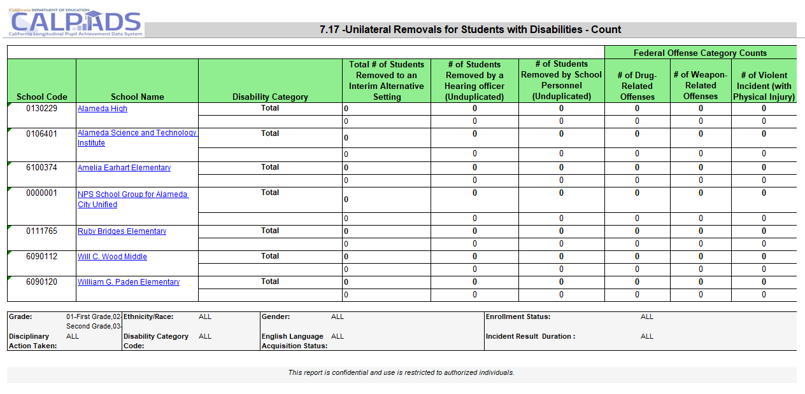
Report 7.17 Unilateral Removals for Students with Disabilities - Count
Notes:
SELPA Report
Reports the number of students with disabilities (by Primary Disability Category) who were removed from their regular instructional setting to an interim alternative setting for disciplinary reasons, regardless of enrollment status. It also reports the counts of removals to interim alternative setting by federal offense category.

Slide 97
Report 7.18 Incident Removals for Students with Disabilities – Student List
Notes:
SELPA Report
Reports students with disabilities who were removed from their regular instructional setting for disciplinary reasons, regardless of enrollment status. It also reports characteristics about each student and each incident including the Incident Results and Incident Result modifications.

Slide 98
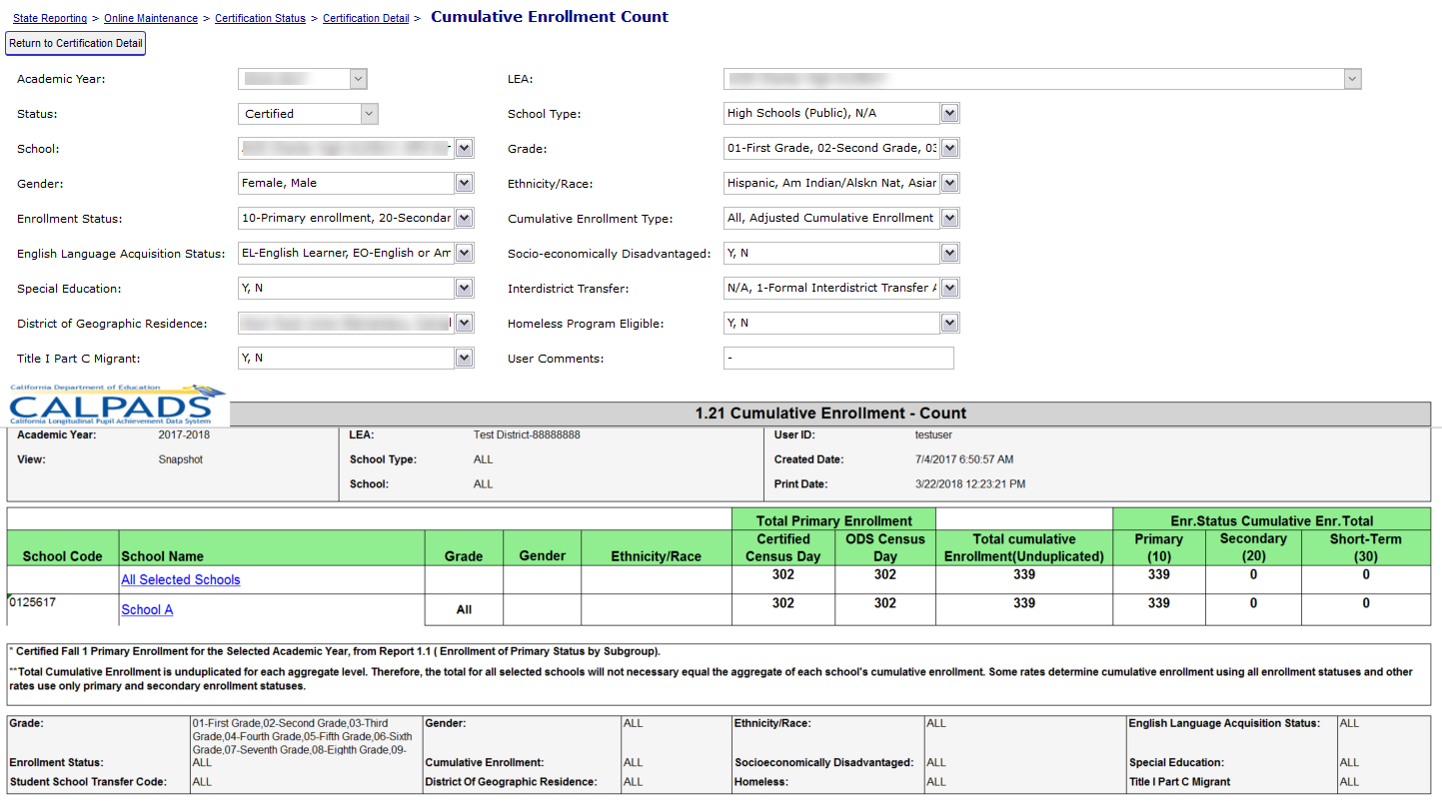
Report 1.21 Cumulative Enrollment - Count
A new filter on the Cumulative enrollment report in EOY 3 will be provided to view one-year graduate counts
Notes:
Report 1.21, Cumulative Enrollment counts the number of students with an enrollment record in the academic year. The total primary, secondary and short term enrollment counts are grouped. All students with enrollment at any time during the Report Period for the Academic Year are included. Primary, Secondary, Short-term cumulative count is used to calculate suspension/expulsion rates. Just primary and short-term cumulative count is used to calculate attendance rates.
The certified census day enrollment count column is listed for comparison. The cumulative enrollment should be greater than or equal to certified primary enrollment.
A new filter on the Cumulative enrollment report in EOY 3 will be provided to view one-year graduate counts

Slide 99
Report 8.1 Student Profile – List (EOY 3)
Notes:
Report 8.1 Student profile reports a lists individual student data in support of the Cumulative Enrollment report. Students listed on this report have had an open or closed enrollment record within the LEA at any time during the Academic Year.

Slide 100
Wrap Up
Key Points, Resources and Support

Slide 101
EOY SWD Submission Summary
The data in EOY is reflective of entire academic year.
EOY 4 submission will involve SPED, SSRV and PSTS reporting from SEDS.
Previously disabled IVRs and CVRs from Fall 1 will be reactivated for EOY 4
The Discipline File is now broken into 3 file types: SINC, SIRS, SOFF
Discipline Reports are now in the 7.10 to 7.18
SELPA reports are 7.16, 7.17 and 7.18
New IVRs and CVRs will be activated for EOY 3
Nonpublic, Nonsectarian Schools (NPS) are required to report incidents: https://www.youtube.com/watch?v=q8IEYoqlwCE
Communicate, Collaborate and Coordinate!!
Some key points to remember

Slide 102
Certification Process Reminder
EOY 3 and 4 have TWO levels of approval
LEA Approved
SELPA Approved
The SELPA and data collection certifier are emailed if either party disapproves a revision
Notes:
If either of two approving parties disapproves the certified revision it becomes decertified. A decertification requires the review and approval from both the LEA data coordinator and the SELPA. Automatic notifications are sent when a revision is disapproved.

Slide 103
EOY 4 Checklist
Ensure all students who received parental consent for evaluation who were enrolled in your LEA from July 1 – June 30 are represented in the child counts
Ensure services have been submitted for every student on an IEP, IFSP, and ISP
Ensure that special education program exits are populated for all students who are not or no longer eligible for services
Ensure all students with disabilities who have exited secondary education in 2018-19 have been surveyed for their postsecondary outcomes and responses have been recorded in the special education data system
Review DSEA extract
Notes:
Procedures for ensure a complete EOY 4 submission.
Ensure all students who received parental consent for evaluation who were enrolled in your LEA from July 1 – June 30 are represented in the child counts
Ensure services have been submitted for every student on an IEP, IFSP, and ISP
Ensure that special education program exits are populated for all students who are not or no longer eligible for services
Ensure all students with disabilities who have exited secondary education in 2018-19 have been surveyed for their postsecondary outcomes and responses have been recorded in the special education data system
Review DSEA extract

Slide 104
EOY 3 Checklist
Ensure all incidents resulting from violations of Education Code Sections 48900 and 48915 have been reported for all students (including students attending NPS schools) regardless of the outcome and duration of a removal
Report all instances of restraint or seclusion for general education and students with disabilities even if it was not the result of a violation of 48900 or 48915 (including students attending NPS schools)
LEAs required to report incidents that occurred at Nonpublic, Nonsectarian Schools: https://www.youtube.com/watch?v=q8IEYoqlwCE
Duration Days should reflect ALL days a student was removed from instruction for each result
Notes:
If STAS file is not required this year, validations will the be relaxed

Slide 105
Suggested Milestones
EOY 1-4 Timeline
Now – 5/30
Complete EOY 1-4 data population in local SIS
Now – 6/15
Submit and post files. Review validation errors and reconcile as needed
6/15 – 6/30
Resolve certification errors, anomalies. Review snapshot reports and update records as needed
EOY 1-4
2019 - 2020
7/1 – 7/19
Send reports to local data stewards, site leaders and administrators for approval
7/20 – 7/31
8/1 – 8/28
Certify by Initial Deadline
Amendment and Final Deadline
(EOY 3 & 4 require SELPA Approval)
Congratulations!
Notes:
Sometimes it is difficult to determine how to pace yourself through the CALPADS work because the deadlines start off so far in advance. Here we’ve provided a sequence of suggested milestones that you can use to break up the work and use as a checklist. Note that you should adjust the dates based on staff availability and other factors.
LEAs can upload data now and review the ODS reports for a high-level review of their EOY data

Slide 106
Learning Opportunities
What were the challenges of Fall 1
Do you have access to CALPADS/ SEDS
Do you maintain SPED data in your SIS
How do you import Sped data from your SEDS to SIS
Coordination with SEDS data
Coordinator and SELPA
Certification and Report Review Process
Internal milestones and timelines
SWD End of Year R&C v2.0 June 2020

Slide 107
Considerations
What is my role in the EOY 3/4 submission
What is my role during EOY 3/4 with approval and report review process (certification)
How can I assist in error resolution
What is my responsibility if EOY 3/4 is not certified
Can I leverage my experience from Fall 1 to overcome the challenges with EOY
How is the communication with SIS or SEDS data coordinators and SELPA contact
Which factors to consider when setting internal milestones and timelines
107
Notes:
Since the EOY 4 submission only requires SWD data to be submitted by the SEDS system, consider what are your roles and responsibilities

Slide 108
Resources
Here are some important resources related to SELA reporting.
https://learn.fcmat.org/
https://www.youtube.com/channel/UCA9oRTiyVECCCzOxpmJheZw
https://documentation.calpads.org/Support/References
https://www.cde.ca.gov/ds/sp/cl/index.asp
SWD End of Year R&C v2.0 June 2020

Slide 109
Support
http://www2.cde.ca.gov/calpadshelp/default.aspx
Web
calpads-support@cde.ca.gov
Email
916-325-9210
Phone
https://csis.fcmat.org/ListServ
You can get help through these channels.
Listserv

Slide 110
Feedback
I have a question…
“
”
Please complete survey…
https://bit.ly/2MXsECg
“
”
SWD End of Year R&C v2.0 June 2020

Slide 111
Thank You
Presenter Name
916-325-9200
csistraining@fcmat.org
https://csis.fcmat.org/

