Slide 1
San Diego COE EOY 1 2019 - 2020
Overview
Data Submission
Certification Errors
Reports Review
Notes:
Welcome to the End of Year 1 Reporting and Certification Training.

Slide 2
Target Audience
Data Coordinators
New to CALPADS
Notes:
This training is intended for data coordinators, those doing the routine maintenance and submission of CALPADS records. This training would also be beneficial for those of you who are new to CALPADS reporting. End of Year 2 submission involves all school types with eligible/participating students.

Slide 3
Training Sequence
CALPADS Intro
Data Coordinator Orientation
CALPADS
CALPADS Basics
Fall-1 Data Population (Student Profile)
Fall-2 Data Population
EOY 1-4 Data Population
Data Privacy
LEA Admin Data Privacy
SELPA Data Privacy
Data Collections
Fall 1
Reporting and Certification
Advanced
Fall 2
Data Population
Reporting and Certification
Advanced
EOY
EOY 1-4 Reporting and Certification
EOY Advanced
Advanced
Guide to CALPADS Documentation
Guide to Troubleshooting CALPADS Errors
EOY 1 R&C
EOY 2 R&C
EOY 3 R&C
EOY 4 R&C
Notes:
This EOY 1 training will prepare you for the End of Year Course completion and CTE data collection.

Slide 4
Objective
Identify
Prepare
Submit
Certify
the changes and requirements for EOY 1 submissions
Local system for submission by populating data
Files from your SIS to CALPADS for EOY 1 reporting
EOY 1 on time or before the final submission deadline
Notes:
At the end of this session, with the information provided, LEAs should be able to:
Identify the changes and requirements so that you can establish a submission strategy that works best for your LEA
Populate data in your Local SIS for the EOY 1 submission
Submit required data
Lastly, certify EOY 1 reports on or before the final submission deadline

Slide 5
Agenda
EOY 1 Overview
Course Completion
Career Technical Education
Certification Errors
Reports Review
Wrap-Up
Notes:
Here is the agenda for this training. We will discuss the following:
An overview of the submission
Discuss the Course completion and CTE submissions
Look at the most common certification errors
Review the EOY 1 Reports
Lastly, wrap up The session with reminders and resources

Slide 6
Overview
The End of Year (EOY) 1 – Course Completion / Career Technical Education Data Submission provides:
LEA course section completer counts by State Course Code for courses completed at any time during the current academic year
counts of CTE non-concentrator participants, concentrators, and completers for Perkins reporting
Notes:
The of Year (EOY) 1 – Course Completion / Career Technical Education Data Submission provides:
LEA course section completer counts by State Course Code for courses completed at any time during the current academic year
counts of CTE non-concentrator participants, concentrators, and completers for Perkins reporting

Slide 7
Why?
EOY 1 provides LEA course section completer counts for courses completed and CTE non-concentrator participants, concentrators, and completers. Course completion and student career technical education are used as state accountability measures and to meet federal reporting requirements
Notes:
Under Perkins V, all LEAs providing CTE programs are required to report CTE data regardless of whether they are receiving federal Perkins funding. Perkins V requirements are aligned with reporting under the federal Every Student Succeeds Act (ESSA). In addition to federal Perkins funding, California provides funds to support CTE education through the Career Technical Education Incentive Grant (CTEIG) and Strong Workforce Program (SWP) programs. CTE and Course completion data is used for the Cohort graduation rate and on the California School Dashboard.

Slide 8
What’s required?
SDEM – Teachers during the entire school year
CRSC – Courses during the entire school year
SCSC – Credits and grades for official grading periods
SCTE – concentrators and completers at any time during the school year
Data Collected:
CTE Pathway Completion
CTE Participants
CTE Concentrators
CTE Completers
AP Course Completion
IB Course Completion
College Credit Course (formerly called Dual Enrollment)
UC/CSU A–G Completion
Notes:
The file types required for EOY 1 all use replacement processing where any record in the CALPADS ODS with the same operational keys are replaced on upload. The only exception is the Staff Demographic file, which uses the more flexible effective date processing method.
The SDEM file is used to submit demographic data about staff members who actively employed at any time during the current academic year. An update of the SDEM file is typically submitted to include those teachers of record who were not active during the fall 2 reporting period.
The CRSC file is used to submit course completion data for all course sections students completed during the academic year.
The SCSC file format is used to submit student course section data. Student course completion data must be submitted for all course sections students completed during the academic year and received a grade.
The SCTE file format is used to submit career technical education (CTE) information about a student. Specifically, those students who should be identified as CTE concentrators or students who completed a CTE pathway within the academic year.
For EOY 1, the SDEM is primarily submitted to provide SEIDS for the CRSC, however the combination of the CRSC and SCSC provides the following information:
Course Offering - Content, CTE Tech Prep, UC/CSU Approval, etc.
Course Section Delivery - Non-standard instructional level, instructional strategy, etc.
Course Completers - Number of students who completed the course

Slide 9
Record Relationships
Staff Demographics
Submission Order
SDEM
Teachers of courses completed
CRSC
Departmentalized courses
SCSC
Student completion results
SCTE
Pathways, Concentrators, completers
SEID
Course Section
Completion
Course Section ID
Course Pathway Code
Student Course Section Completion
Student Career Technical Education
Notes:
Although not strictly required, the SDEM may need to be updated so that all teachers instructing students are reported during the academic year. Once the staff demographic submission is complete the CRSC should be submitted and posted. The SEID from the SDEM ties the teacher to the Course section. After the courses have been posted in CALPADS the SCSC file can be submitted to post the completed student course sections. The SCSC records are tied to individual course sections by a shared course section ID. Lastly, The SCTE file is submitted to identify Concentrators and completers of specific pathways. The Course pathway code ties SCTE records to CRSC records to validate that CTS students received the correct pathway curriculum.

Slide 10
Course
LEAs must submit information on courses that students have completed during the year.
Course completion data is required for students in departmentalized classroom settings in grades 7–12 attending traditional schools.
Grades, credits attempted, and credits earned are only required for grade levels 9–12
Only grades are required for 7–8.
Submit student course completion data from all official grading periods for the school year
Notes:
LEAs must submit information on courses that students have completed during the year.
Course completion data is required for students in departmentalized classroom settings in grades 7–12 attending traditional schools.
Grades, credits attempted, and credits earned are only required for grade levels 9–12
Only grades are required for 7–8.
Submit student course completion data from all official grading periods for the school year

Slide 11
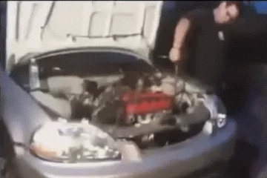
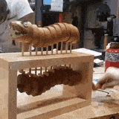
Course
CTE participants
Students enrolled in a pathway that are not Concentrators or completers
Submitted through the CRSC and SCSC records
Must not have a SCTE record
Notes:
By submitting course completion data for students in departmentalized courses in grades 7 – 12, LEAs identify CTE participants. Students who have completed CTE courses that do not have SCTE records are participants. These students are further defined as:
CTE Participant: A CTE participant is a student who has completed the equivalent of a conventional 50-minute class taken five times per week for 180 school days, or approximately 150 hours of instruction in a state-recognized CTE pathway. The CDE counts as a participant, any student who has completed a CTE course.

Slide 12
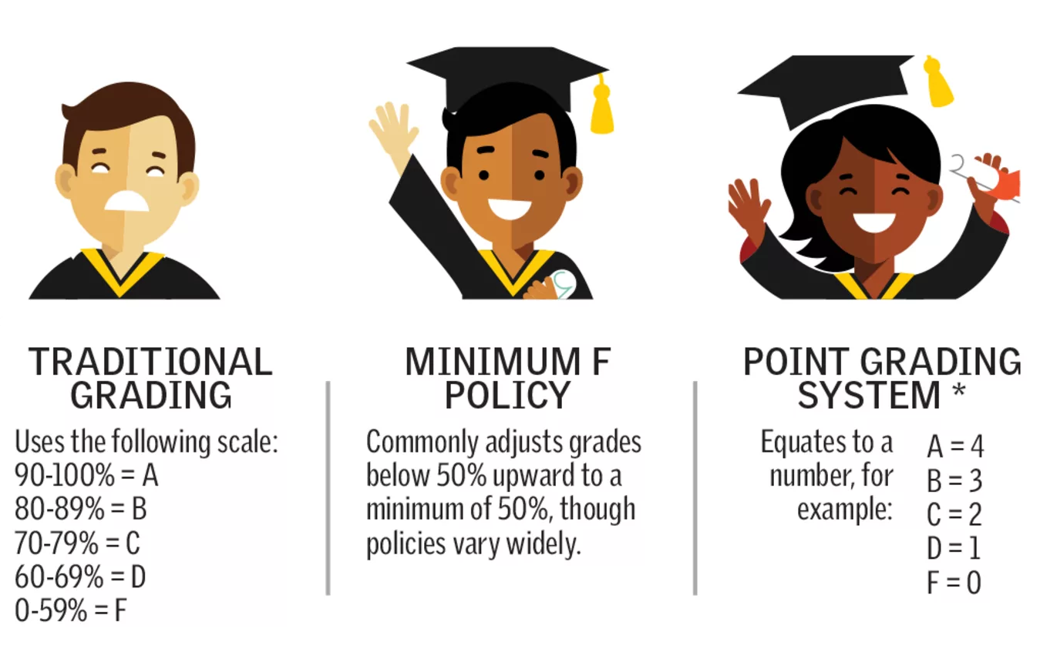
Grades
Standard and nonstandard grades accepted
The final grade a student received after completing a specific Course Section
Can be Alpha numeric or special character
Limited to three characters
Notes:
The final grade a student received after completing a specific Course Section, only required for departmentalized courses for students in grades 7-12.

Slide 13
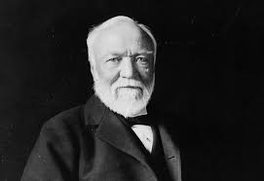
Student Credits - Carnegie units
Added to the SCSC for the 19-20 year
Required for the Migrant Program
The Carnegie Unit is granted to a student completing approximately 120 hours of class in one subject over the course of one year. For example, a total of 120 hours in one subject—meeting 4 or 5 times a week for 40 to 60 minutes, for 36 to 40 weeks each year—earns the student one “Carnegie unit” of high school credit.”
Two semester courses equal one yearlong course. A yearlong course constitutes one Carnegie unit. Semester courses constitute one-half of a Carnegie unit. But most school districts award ten local units for each Carnegie unit and five local units for a semester course.
Notes:
In addition to Credits earned, student progress and achievement will be derived forma the SCSC records through the Carnegie unit. The Carnegie unit:
Was added to the SCSC for the 19-20 year
Is granted to a student completing approximately 120 hours of class in one subject over the course of one year. For example, a total of 120 hours in one subject—meeting 4 or 5 times a week for 40 to 60 minutes, for 36 to 40 weeks each year—earns the student one “Carnegie unit” of high school credit.”
Two semester courses equal one yearlong course. A yearlong course constitutes one Carnegie unit. Semester courses constitute one-half of a Carnegie unit. But most school districts award ten local units for each Carnegie unit and five local units for a semester course.

Slide 14
High Quality CTE Courses
Courses that have been developed with the CTE Pathway Standards (even standalone courses)
Are taught by a CTE-credentialed teacher
Example: CTE-IG funded
Notes:
The Career Technical Education (CTE) curriculum standards are designed to develop high-quality curriculum and instruction that help ensure that students are career and college ready. The standards offer clear guidelines for course content development and expectations for student achievement. The CTE standards are described as career ready practice providing the fundamental knowledge and skills that students need to prepare for transition to postsecondary education, career training, or the workforce. These standards are not exclusive to a career pathway, a CTE program of study, a particular discipline, or level of education.
High quality CTE courses and pathways are developed based on the framework of 12 CTE Model Curriculum Standards and the Common Core State Standards: https://www.cde.ca.gov/ci/ct/sf/documents/ctescrpposter.pdf
For more CTE information visit:
https://www.cde.ca.gov/ci/ct/sf/ctemcstandards.asp
https://www.ctc.ca.gov/docs/default-source/leaflets/cl888.pdf?sfvrsn=88065bf8_18
https://www.ctc.ca.gov/credentials/req-teaching

Slide 15
SCTE Data Collected
Along with key data from the CRSC and SCSC, the following data are collected from the SCTE
CTE Completer Info
CTE Concentrator
CTE Pathway
CTE Completion Year
Small file, a lot of data
Notes:
The SCTE file provides us with CTE Completers and Concentrators. It indicates the pathways of the concentrators and completers as well as provides the completion year. The SCTE is a relatively small file but provides of with key data elements.

Slide 16
Student Career Technical
Concentrator
Completer
A CTE concentrator is identified by the LEA as students who have completed 50 percent of a state approved CTE Pathway sequence (in hours or credits) and is enrolled in the next course in that sequence, or has completed 50 percent of a single state-recognized multi-hour course and is enrolled in the second half of that course.
A CTE completer is identified by the LEA as a student who has completed a minimum of 300 hours in a state-approved CTE pathway and has successfully passed the capstone course in that sequence with a grade of C- or better
Notes:
Students who are CTE pathway concentrators and completers are defined under Perkins IV and the current State Plan as follows:
CTE Concentrator: A CTE concentrator is identified locally and is a student who has completed 50 percent of a planned program sequence (in hours or credits) in a state-approved CTE pathway and is enrolled in the next course in that sequence, or has completed 50 percent of a single state-recognized multi-hour course and is enrolled in the second half of that course. The CDE counts as a concentrator, students the LEA has identified as concentrators by populating Field 11.13 – CTE Pathway Code on the SCTE file with the pathway code that the student is concentrating in. CALPADS validates whether students identified as CTE concentrators on the SCTE file, have completed a course in the identified CTE pathway.
CTE Completer: A CTE completer is identified locally and is a student who has completed a minimum of 300 hours in a state-approved CTE pathway and has successfully passed the capstone course in that sequence with a grade of C- or better. The CDE counts as a completer, students the LEA has identified as a completer by populating the Field 11.14 – CTE Pathway Completion Academic Year ID on the SCTE file with the current academic year. CALPADS validates whether students who are identified as CTE pathway completers on the SCTE file, have completed the capstone course in the pathway.

Slide 17
Course Section Completion (CRSC)

Slide 18
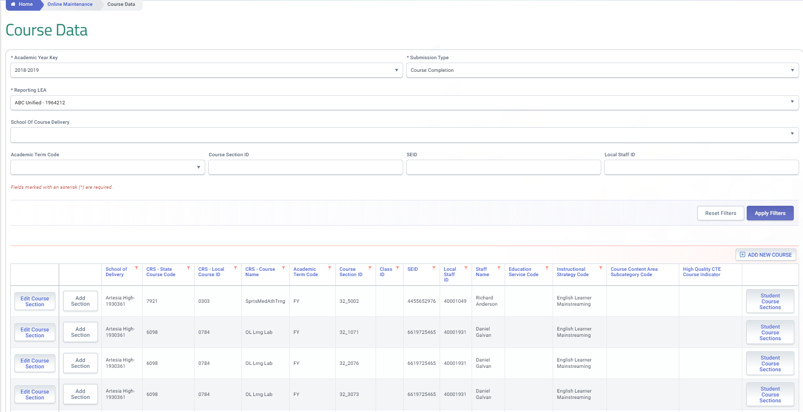
Course Data
Only data for departmentalized courses grade 7-12 should be reported
Notes:
Student Course completion data provide information about individual student completion of departmentalized courses (for students in grades 7–12). The data are submitted through the Course Section completion (CRSC) and the Student Course Section (SCSC) file. To See EOY 1 courses filter for the CRSC submission type in the CALPADS User Interface.

Slide 19
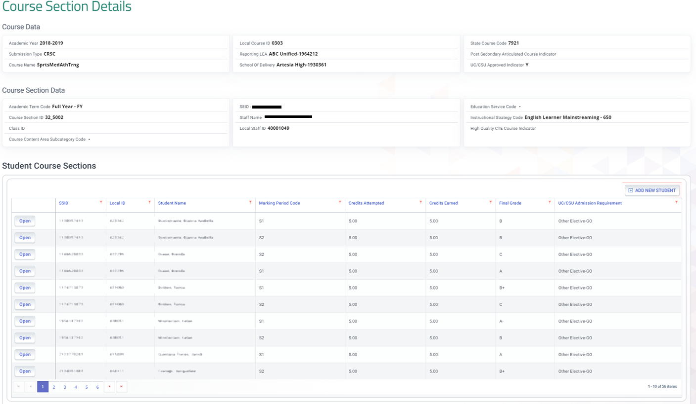
Course Section Details
Course completion should be submitted for official grading periods in which credits are awarded. LEAs should submit all the courses students completed during the school year, the credits they attempted and received, and the grades they earned. Only data for grades 7-12, departmentalized courses will be accepted. For grades 7-8 do not submit credits
Notes:
Course completion should be submitted for official grading periods in which credits are awarded. LEAs should submit all the courses students completed during the school year, the credits they attempted and received, and the grades they earned. Only data for grades 7-12, departmentalized courses will be accepted. For grades 7-8 do not submit credits. Submit data for all courses completed including special education courses, independent study courses, home hospital courses.

Slide 20
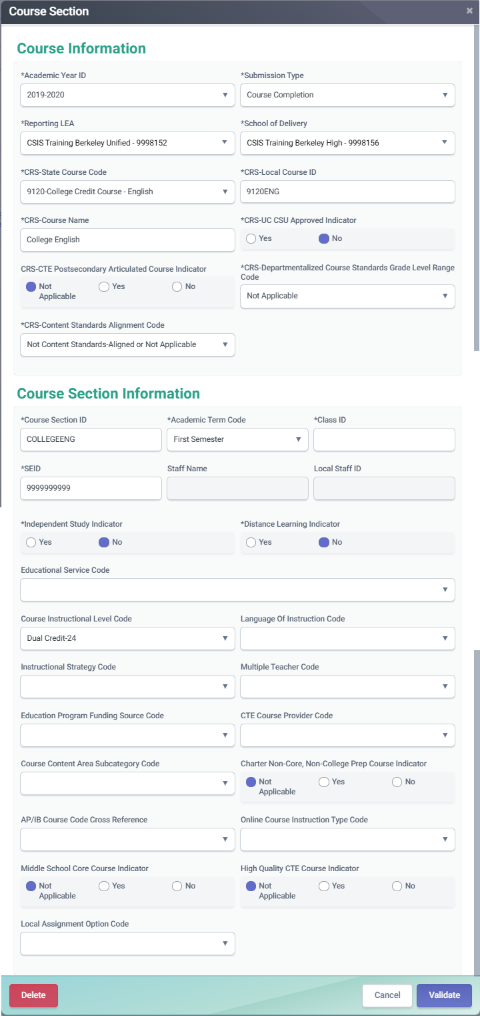
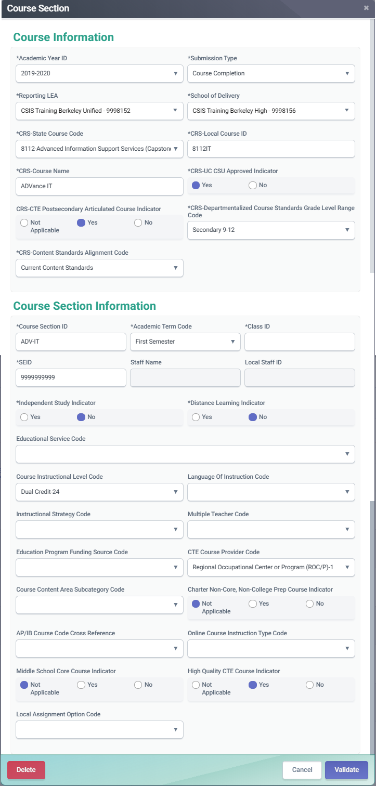
Course Completion (CRSC)
College courses should be reported using the designated state course codes. Those courses can be used as CCI indicators
CTE courses for which a student earns college credit should have the Course Instructional Level code populated with 23 - College Credit or 24 - Dual credit
Notes:
LEAs should report college courses that students complete with a C- or better, or passing, as it is one factor used in determining whether students are prepared for college/career on the CCI. LEAs should indicate in the course section record that courses are college level by using the appropriate CALPADS Course Code.
For a CTE courses use the Course Section Instructional Level Code with either code 23 – College Credit Only, or code 24 – Dual Credit.
LEAs should only report a course as “College Credit Only” if the student earns college credit upon completion. The student may earn high school credit in addition, but the student must also earn college credit in order to be reported as “Dual Credit”. If LEAs do not have SEIDs and staff information for college teachers, LEAs should submit “9999999999” as the SEIDs for the teachers in the Course Section record

Slide 21
Dashboard CCI College Courses
State Course Code | State Course Code Name
9020 | College Credit Course – Visual Arts
9082 | College Credit Course – Dance
9096 | College Credit Course – Theatre
9120 | College Credit Course – English Language Arts
9154 | College Credit Course – World Languages
9200 | College Credit Course – History/Social Science
9227 | College Credit Course – Other
9273 | College Credit Course – Mathematics
9303 | College Credit Course – Music
9358 | College Credit Course – Science
9373 | Leadership/Military Science
7000–8999 | Any CTE course code indicated in Nonstandard Instructional Level as College Credit Only (23) or Dual Credit (24)
Notes:
Data submitted in the CRSC and SCSC files as part of the EOY 1 submission are used to identify whether students in the 4-year Adjusted Cohort Graduate Rate (ACGR) are prepared for college/career as measured by the College/Career Indicator (CCI) on the California School Dashboard.

Slide 22
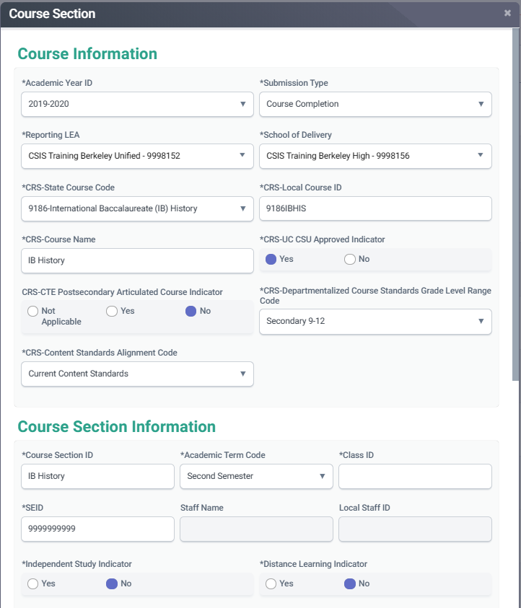
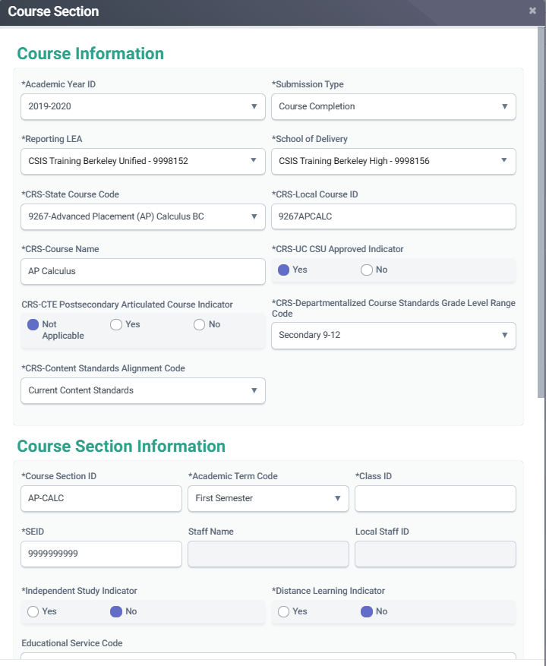
Course Completion (CRSC)
Advanced Placement (AP) courses should have the appropriate state course code to align with a specific content area
International Baccalaureate (IB) courses must be reported with the appropriate state course code, unless they are Middle school IB courses. Us e the course instructional level field to indicate Middle years IB courses.
to the appropriate CTE course
Notes:
LEAs should use designated state course code values for Advanced Placement or International Baccalaureate courses.

Slide 23
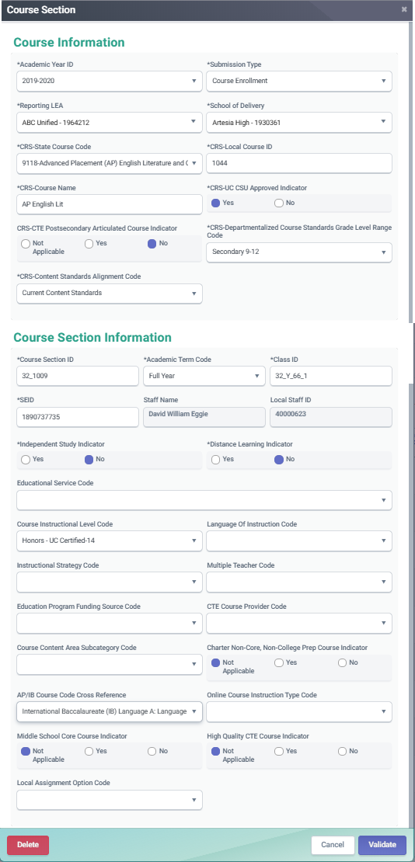
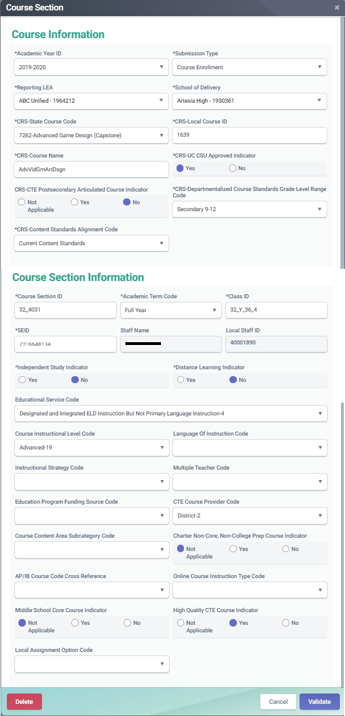
Course Completion (CRSC)
CTE participants, completers and concentrators must have SCSC records that correspond to the appropriate CTE course
CTE courses that are also AP or IB courses can have the AP/IB code cross reference populated so that the course maps to both content areas
Notes:
Course completion data determines the LEAs’ CTE participant counts using the state course codes in the 7000 and 8000 series. All students completing CTE courses will be counted as “CTE participants” for federal Perkins reporting purposes. LEAs do not have to submit any additional data for CTE participant counts. CTE courses require the following fields to be populated:
CRS-State Course Code - State Course Codes in the 7000 and 8000 series are CTE courses
CRS-CTE Postsecondary Articulated Course Indicator - element is used to collect information on whether or not a CTE course has been articulated with a postsecondary institution.
CTE Course Section Provider Code - element indicates whether a given CTE course section is provided by:
A Regional Occupational Center (ROC) or Program.
The District.
High Quality CTE Course Indicator - indicates whether the course section is being taught by a CTE credentialed teacher.
Previously LEAs were forced to choose between either the CTE State Course Code or the AP or IB Course Code. The AP/IB Course Code Cross Reference field allows the LEA to use map to the CTE State Course Code in the State Course Code field, while providing the cross-reference to the actual AP or IB course code. This is a four-digit cross reference to the actual AP or IB State Course Code for AP or IB courses that a local educational agency has mapped to a Career Technical Education (CTE) State Course Code (7000-8999) because that course is part of a CTE pathway. This allows an LEA to identify that the CTE course that a student completed was also an AP or IB course.

Slide 24
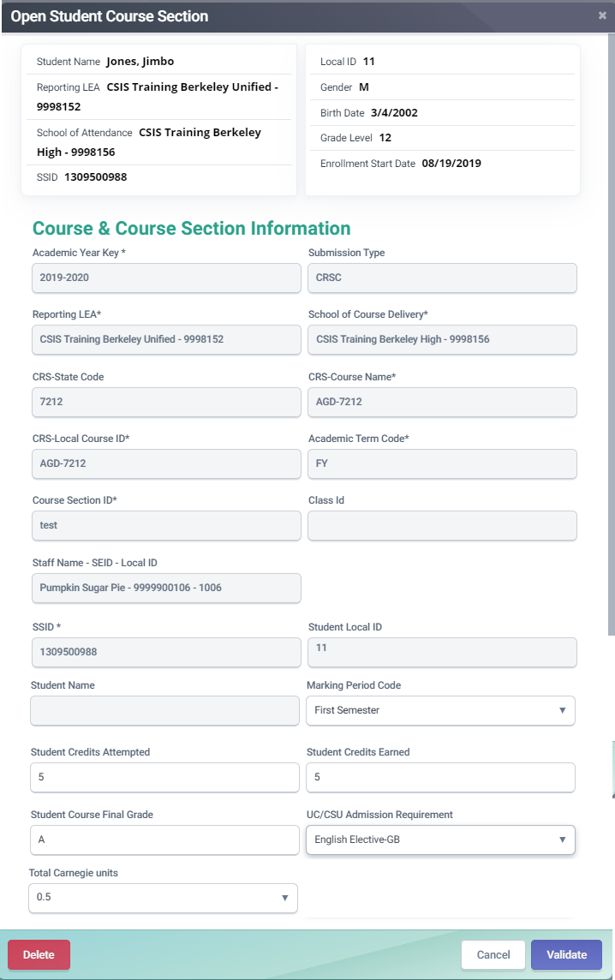
Course Completion (SCSC)
A count of the credits attempted by a student for a specific Course Section is required for grades 9-12
A “Carnegie unit” represents a student completing approximately 120 hours of class in one subject over the course of one year. Typically 10 high school credits equal 1 Carnegie Unit, 5 high school credits are normally equal to 0.5 Carnegie units.
A count of the credits earned by a student for a specific Course Section is required for grades 9-12
Notes:
Include all Student Course Section records for students enrolled at any time during the current academic year that completed a course and received a grade.
This following fields are required in the SCSC:
Academic Term Code - represents an Academic Term. An Academic Term is the period of time into which the education institution divides the academic year for the purpose of instruction.
Student Credits Attempted – are a count of the credits attempted for a specific Course Section in grades 9-12.
Student Credits Earned – are a count of the credits earned after a student completes a specific Course Section in grades 9-12.
Student Course Final Grade – is the final grade a student received after completing a specific Course Section for grades 7-12.
Marking Period Code - represents the name or description of the period within a course session in which a course mark is given to a student for a particular course.
The following field is not required in the SCSC:
UC/CSU Admission Requirement Code – represents the category of University of California or California State University College Admission Course requirement that a high school course has been determined to meet.

Slide 25
Student Career Technical Education

Slide 26
Mapping CTE information
Below is a summary of how different CTE student groups are reported in CALPADS.
CTE Participants
Non-concentrators
Non-completers
CRSC
Report CTE course
State course 7000-8999
SCSC
Submit SCSC
SCTE
Do not submit SCTE
CRSC
Report Concentrator course appropriate to CTE Pathway
State course 7000-8999
SCSC
Submit SCSC associated to the CTE course
SCTE
Submit SCTE
CTE Pathway Completion Academic Year ID must be blank
Report CTE Pathway Code
CTE Concentrators
CRSC
Report Capstone course appropriate to CTE Pathway
SCSC
Submit SCSC associated to the CTE course
SCTE
Submit SCTE
State course 7000-8999
CTE Pathway Completion Academic Year ID must be populated
CTE Pathway Completion Academic Year ID must be current year.
Report CTE Pathway Code
CTE Completers

Slide 27
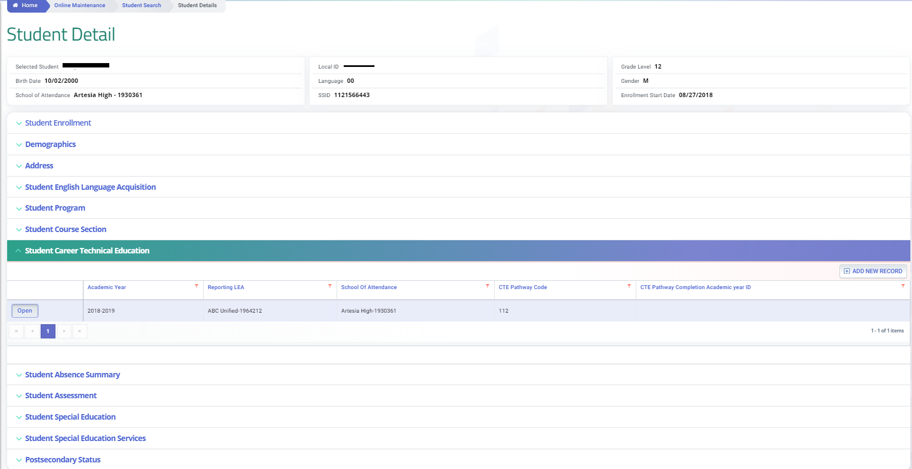
Career Technical Education (SCTE)
SCTE records should be reported in the academic year that the concentrator or capstone course was completed
Notes:
This Student Career Technical Education (SCTE) is used to submit CTE information about a student. This record type is required to be submitted for all students enrolled at any time during the academic year who were CTE concentrators or students who completed a CTE pathway within the academic year. Concentrator and completer records can be seen from the student detail screen once they have been posted.

Slide 28
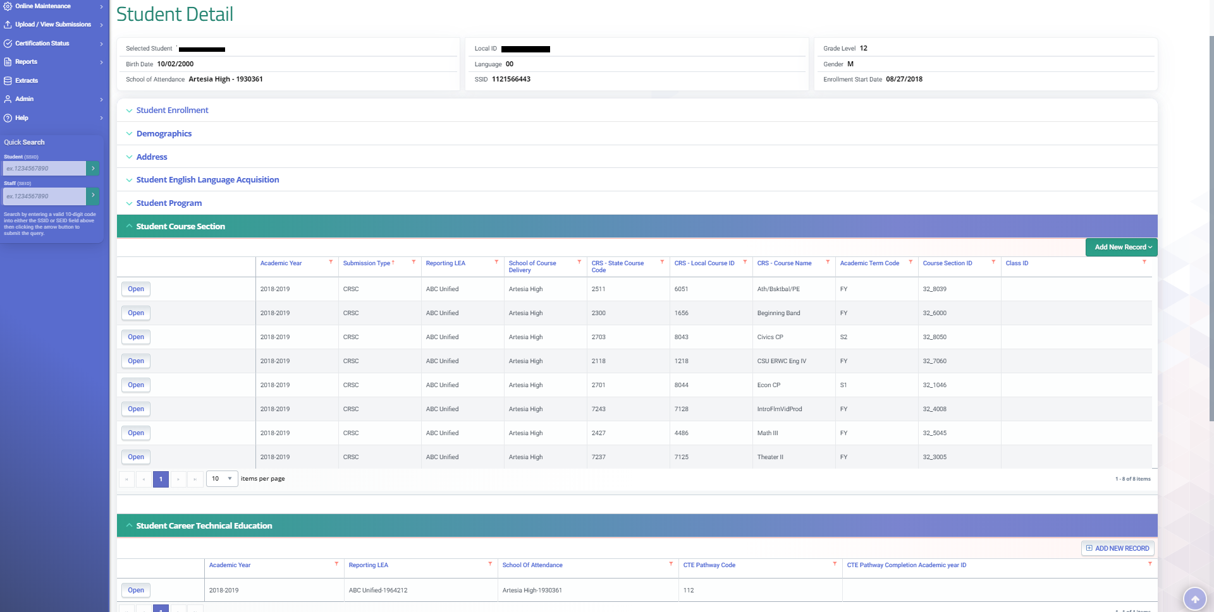
Career Technical Education (SCTE)
All concentrators and completers must have a CTE course in the SCSC record with a corresponding academic year
The CTE Pathway Code must correspond to a CTE course in the SCSC record
Notes:
The system is validates that students with SCTE records also have at least one course submitted in the SCSC file in a CTE Pathway associated with the SCTE record. Use the Valid Code Combinations document at https://www.cde.ca.gov/ds/sp/cl/systemdocs.asp, to ensure CTE pathway codes are mapped correctly to the State Course Codes in the 7000-8999 series.

Slide 29
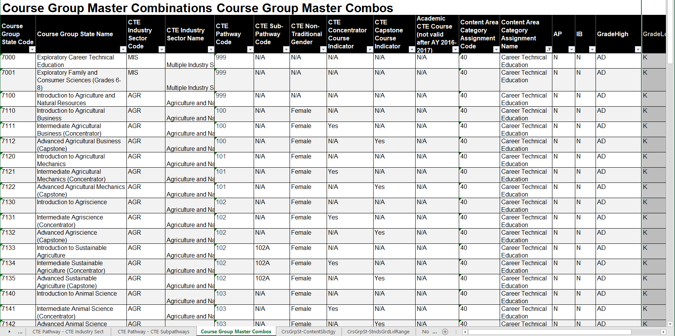
Course Group master Combos (VCC)
Each CTE state course code aligns with a specific pathway code
Notes:
The Course Group master Combos tab in the CALPADS Valid Code Combinations document shows what pathway each state course code corresponds to.

Slide 30
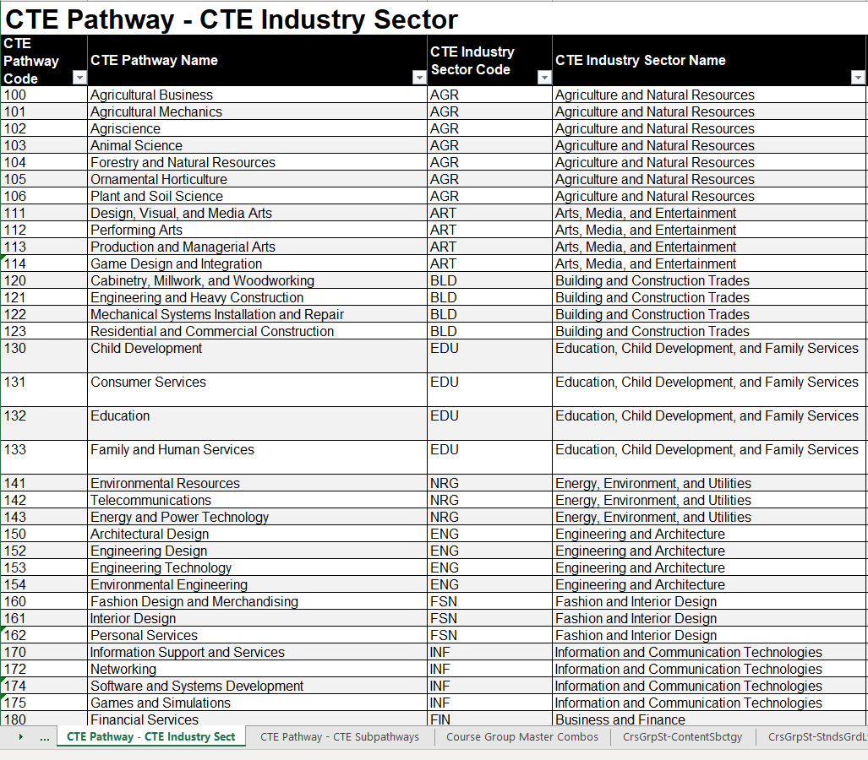
CTE Pathway – Industry Sect (VCC)
CTE Pathways and CTE state course codes should be mapped so that they align with the content of the curriculum
Notes:
There are multiple pathways in CTE industry sectors, a common problem in EOY 1 reporting is that CTE state courses codes are mapped to the wrong pathway. CTE Pathways and CTE state course codes should be mapped so that they align with the content of the curriculum. Use the CTE Pathway – CTE Industry Sect tab to identify Pathway by Industry Sector.

Slide 31
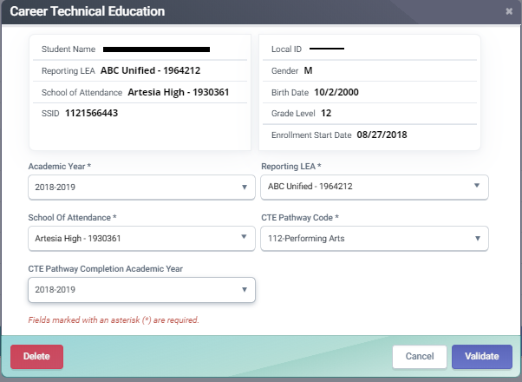
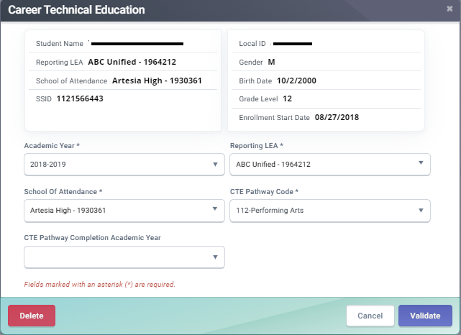
Concentrators and Completers
All completers must have the CTE Pathway Code and Completion Academic year populated
All concentrators must have a SCTE record with the CTE Pathway Code populated
Notes:
LEAs has identify concentrators by populating the CTE Pathway Code on the SCTE file. CALPADS validates whether students identified as CTE concentrators on the SCTE file, have completed a course in the identified CTE pathway. Completers are identified by an LEA by populating the CTE Pathway Code and the CTE Pathway Completion Academic Year ID. Students who have completed a CTE pathway will also be used in the Career/College Indicator (CCI) in the California School Dashboard. LEAs submit CTE pathway completer information on the Student Career Technical Education (CTE) file, however, in order to submit that a student is a CTE completer, the student must have completed a CTE Capstone course with a grade of C- or better.

Slide 32
Update Student Profile
Student profile data
CRSC, SCSC & SCTE data
Notes:
Although Only the CRSC, SCSC and SCTE are required to submit EOY 1 data, it is important to update student profile records throughout the year and specifically prior to EOY reporting as that information is relevant to reports. Student Enrollment Demographics, English Language Acquisition , Programs and Special Education information is pertinent to reports.

Slide 33
CERTIFICATION ERRORS

Slide 34
CERT122
Scenario 1
No SCSC record submitted to reflect a CTE Concentrator Course code for indicated pathway.
SCSC file not uploaded
SCSC file uploaded but not posted
Inadvertently posted a SCTE record.
Missing Concentrator SCSC Record
Scenario 2
A. No SCSC record submitted to reflect a CTE Concentrator Course code for indicated pathway.
SCSC file not uploaded
SCSC file uploaded but not posted
SCSC file posted but linked to a CTE Capstone course.
Inadvertently posted a SCTE record.
Missing Concentrator SCSC Record
Notes:
The CERT122 error triggers when a student with a SCTE record submitted does not have at least one CTE concentrator level course in the associated CTE Pathway in the SCSC record.
Things to check in the submission: Ensure you have submitted at least one SCSC record with a Course Section ID for the student that is mapped to a CRS-State Course Code in a CRSC record that can then be mapped to a State Course Code in the 7000-8999 series.
Suggested Resolution: If the student did not complete a course for the academic year in the CTE Pathway specified in the SCTE file, then remove the student's record from the SCTE file. If the student is a concentrator in a CTE Pathway, ensure you have submitted at least one SCSC record with a Course Section ID for the student that is mapped to the Pathway Code designated in the SCTE file and maps to a State Course Code for that pathway marked CTE Concentrator Course Indicator = Yes in the Valid Code Combos.

Slide 35
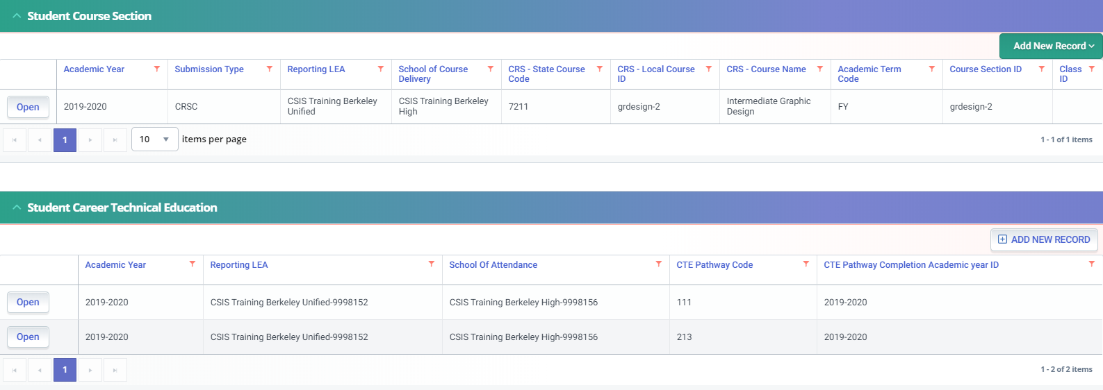
CERT123
Scenario 1
No SCSC record submitted to reflect a CTE Capstone Course code for indicated pathway.
SCSC file not uploaded
SCSC file uploaded but not posted
Inadvertently posted a SCTE record.
Scenario 2
A. No SCSC record submitted to reflect a CTE Capstone Course code for indicated pathway.
SCSC file not uploaded
SCSC file uploaded but not posted
SCSC file posted but linked to a CTE Concentrator course.
Inadvertently posted a SCTE record with Academic year ID
Notes:
The CERT123 error triggers when a student with a SCTE Completer record has not completed at least one capstone course associated with the CTE pathway in the SCTE record, as indicated in the CALPADS Valid Combinations - Course Group Master Combos.
Things to check in the submission: Ensure you have submitted at least one SCSC record with a Course Section ID for the student that is mapped to a CRS-State Course Code in a CRSC record that can then be mapped to the CTE Pathway specified for the student in the SCTE file and the SCSC record must have a Capstone Course Indicator = Yes.
Suggested Resolution: If the student did not complete a course for the academic year in the CTE Pathway specified in the SCTE file, then remove the student's record from the SCTE file. If the student is a completer in that CTE Pathway, ensure you have submitted at least one SCSC record with a Course Section ID for the student that is mapped to a CRS-State Course Code in a CRSC record that can then be mapped to the same CTE Pathway specified for the student in the SCTE file. Verify that the course completed maps to a state course code whose Capstone Course Indicator (in Course Group Master Combos) = Yes.

Slide 36
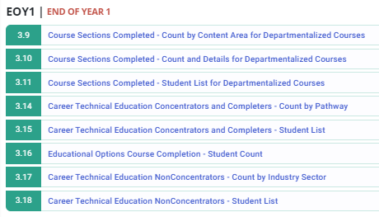
EOY 1 Reports

Slide 37
Report Linking
3.16 – Educational Options Course Completion – Student Count
3.9 – Course Sections Completed – Count by Content Area for Departmentalized Courses
3.10 – Course Sections Completed – Count and Details for Departmentalized Courses
3.11 – Course Sections Completed – Student List for Departmentalized Courses
3.14 – Career Technical Education Concentrators and Completers – Count by Pathway
3.15 – Career Technical Education Concentrators and Completers – Student List
3.17 – Career Technical Education Non-Concentrators – Count by Industry Sector
3.18 – Career Technical Education Non-Concentrators - Student List
Notes:
For End of Year 1 there are aggregate reports, shown in white that are required to be reviewed. There are also multiple supporting reports which provide more specific counts or detailed lists of students who were counted in the aggregate reports.

Slide 38
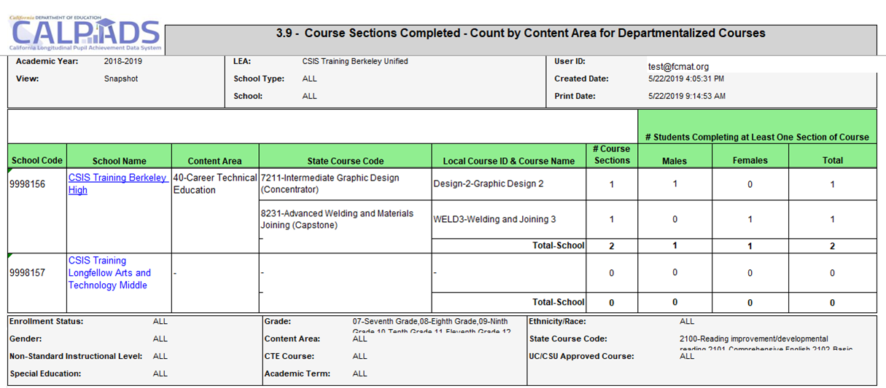
Report 3.9 Course Sections Completed
Count by Content Area for Departmentalized Courses
Notes:
Reports number of departmentalized course sections for each Course within Content Area. The content area is determined by the state course code. For each course, it includes the number of students who completed at least one course section of the course. (Note: a student in multiple course sections related to one local course ID is counted only once. A student with a same course section and term with multiple marking periods is counted only once).

Slide 39
Report 3.10 Course Sections Completed
Count and Details for Departmentalized Courses
Notes:
Reports the details of completed local course sections by State Course Code within Content Area as well as the number of students who completed each course section.

Slide 40
Report 3.11 Course Sections Completed
Student List for Departmentalized Courses
Notes:
Reports list of students in each completed course section by school with final completion information.

Slide 41
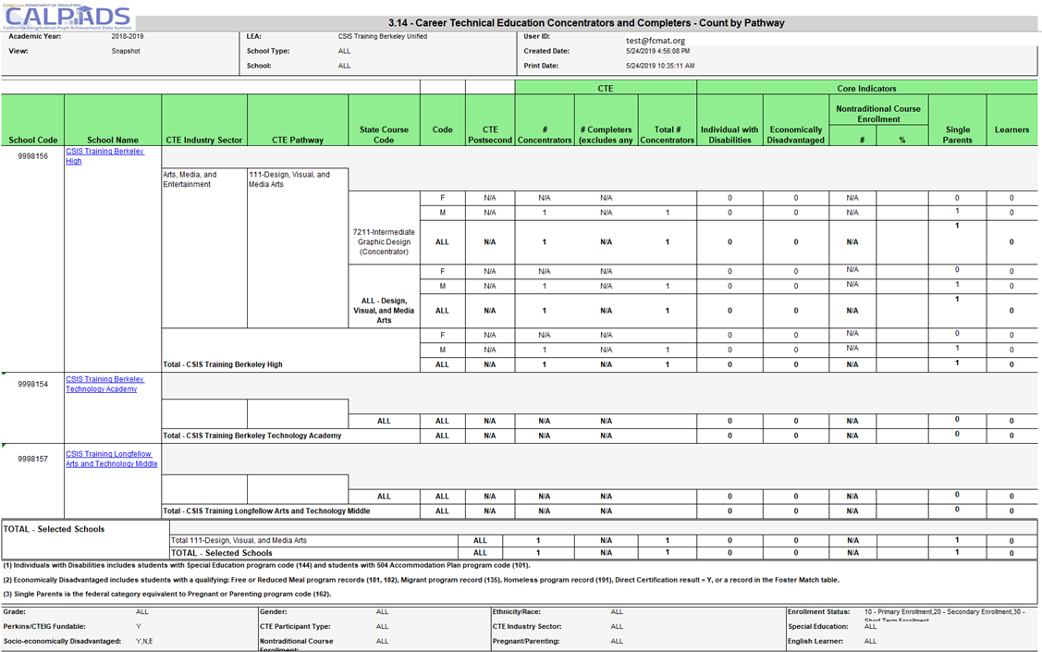
Report 3.14 - Career Technical Education
Concentrators and Completers - Count by Pathway
Notes:
Reports the total number of CTE Concentrators and Completers by Pathway and CTE Course at the school level, by gender. School level data is also aggregated at the LEA level. The number of Concentrators and Completers within each Core Indicator group are also counted. The report defaults to counting Perkins/CTEIG fundable students. These students are in CTE courses flagged with a Course content Code 154 that require the course be part of a CTE Pathway and are taught by a CTE-credentialed teacher.

Slide 42
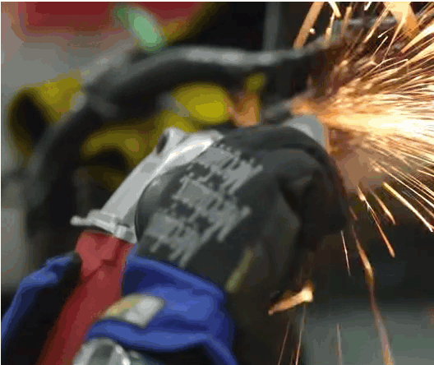
CTE Core Indicators
Individuals with Disabilities
Economically Disadvantaged: includes students with a qualifying: Free or Reduced Meal program record (181, 182), Migrant program record (135), Homeless program record (191), Direct Certification result = Y, or a record in the Foster Match table
Single Parents: is the federal category equivalent to Pregnant or Parenting program code (162)
Non-traditional Gender: gender less commonly associated with a field
Notes:
The core indicators listed on reports 3.14 and 3.15 CTE Education Concentrators and Completers are part of a students profile. Single parents and Individuals with Disabilities come from program records, while the Economically Disadvantage sub-group is a combination of program or student demographic information.

Slide 43
Report 3.15 - Career Technical Education Concentrators and Completers – Student List
Notes:
Lists Career Technical Education (CTE) Concentrators and Completers and the Pathway they are pursuing. Also provides core indicators on these students.

Slide 44
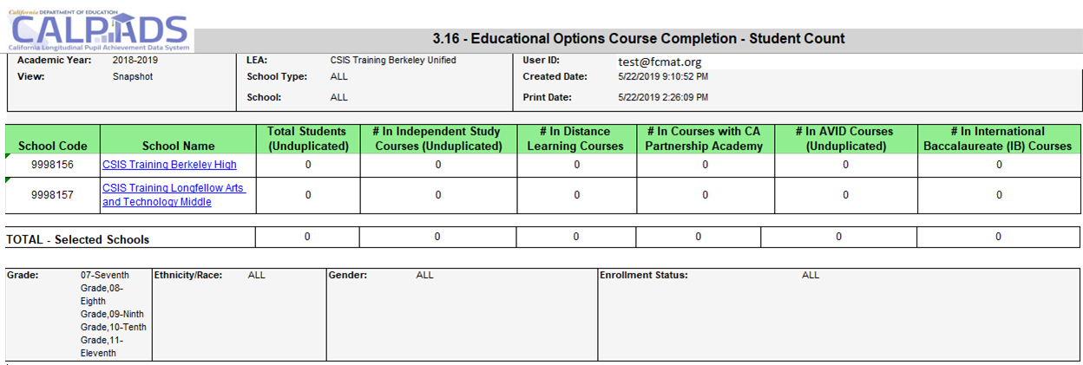
Report 3.16 – Educational Options Course Completion Student Count
Notes:
Reports the number of students who have completed Educational Options courses during the Report Period.

Slide 45
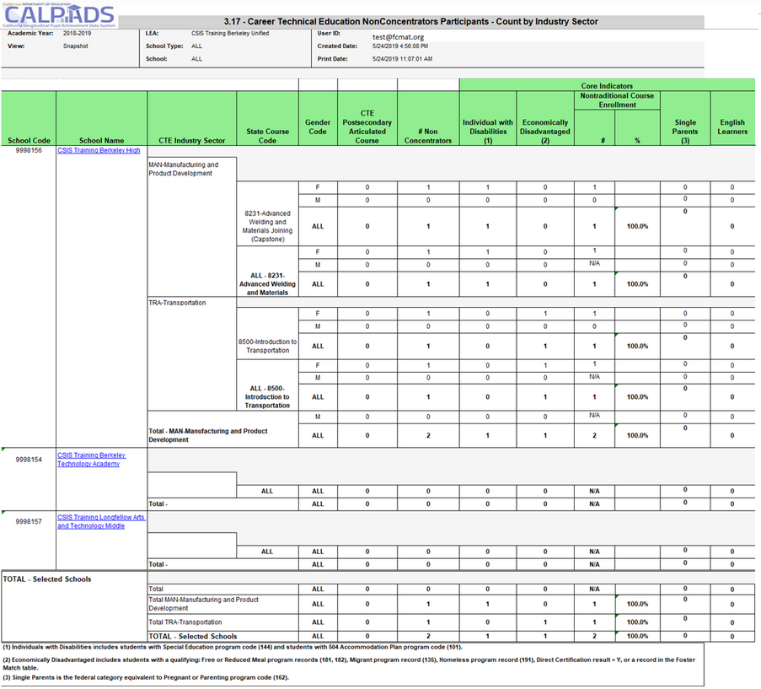
Report 3.17 - CTE NonConcentrators
Count by Industry Sector
Notes:
Reports the total number of CTE Non-Concentrator Participants by Industry Sector at the school level, by gender. School level data is also aggregated at the LEA level. The number of Non-Concentrators within each Core Indicator group are also counted.

Slide 46
Report 3.17 - CTE NonConcentrators
Count by Industry Sector
Notes:
Lists Career Technical Education (CTE) Non-Concentrator Participants and the courses they have completed. Also provides core indicators on these students. The report defaults to counting Perkins/CTEIG fundable students.

Slide 47
Wrap Up
Key Points, Resources and Support

Slide 48
Data Collected for EOY 1
Staff Demographics (SDEM)
Data Submitted Via
Course Completion (CRSC)
Student Crs. Completion (SCSC)
Student CTE (SCTE)
a-g Requirements
Credits
Grades
CTE
Pathways
Teachers Demographics (SEIDs)
Completers and Concentrators
State course codes
Student Course Completion
Postsecondary Articulated Course Indicator
Course Completion
Course Attributes
Site Staff
Staff Involved with Submission
Registrars
Program staff
CTE
Site Administrators
Student System Support Staff
🖌 NOTE: Courses completed are not compared to course enrollment reported during Fall 2
Notes:
Review items on the slide.
Course Content Code 154 is used to designate High Quality CTE courses only. These staff are credentialed to teach career tech ed.
Reminders:
Course completion for End of Year 1 is not compared to Course enrollment from Fall 2
Course completion is only required for departmentalized classes in grades 7-12
CTE Non-Concentrators are reported in the CRSC file only while CTE Concentrators and Completers are determined using the SCTE file
SEIDs submitted in Course Section Completion (CRSC) records are checked to make sure a corresponding Staff Demographic (SDEM) record exists in CALPADS (unless SEID is 9999999999)
Do not submit the SASS file. Staff Assignment data is not required for EOY and submitting a file may wipe out previously submitted data

Slide 49
EOY 1 LEA Approval Process
LEA Submission Process
Resolution of certification errors
Certification report review
LEA approves certification reports
No SELPA Approval needed
Notes:
EOY 1 has a streamlined certification process, the LEA will:
Submit student records and resolve validation errors
After the submission is complete the LEA will resolve certification errors including anomalies
Once all certification errors are resolved the LEA will disseminate reports for review
After the reports have been reviewed the LEA can certify

Slide 50
Notes:
State Accountability: CTE data, specifically, students who are CTE pathway completers in the 4-year Adjusted Cohort Graduation Rate (ACGR) are used as factors in the College/Career Indicator on the California School Dashboard.

Slide 51
SCTE, Perkins Reporting
Data Collection
Finding & Allocation
Local Plan & Application
Filing Claims
Accountability reports
It is anticipated that under Perkins V, all LEAs providing CTE programs are required to report CTE data regardless of whether they are receiving federal Perkins funding
Carl D. Perkins Career and Technical Improvement Act
California requires CTEIG and SWP programs receiving funds to report CTE data
Notes:
Federal Reporting: Previously, LEAs receiving funding under the Carl D. Perkins Career and Technical Education Improvement Act of 2006, referred to as “Perkins IV”, were required to report counts of participants and program performance data. Perkins IV was recently reauthorized as the Strengthening Career and Technical Education for the 21st Century Act, referred to as “Perkins V”. To implement Perkins V, California is developing a new State Plan, which must be approved by the State Board of Education (SBE) and then submitted to the United States Department of Education. The CDE anticipates SBE approval of the new State Plan in the spring of 2020. Under Perkins V, all LEAs providing CTE programs are required to report CTE data regardless of whether they are receiving federal Perkins funding.
State Reporting: In addition to federal Perkins funding, California provides funds to support CTE education through the Career Technical Education Incentive Grant (CTEIG) and Strong Workforce Program (SWP) programs. LEAs receiving funds under these programs are also required to report CTE data. The CDE is in the process of aligning and streamlining all of the reporting requirements for Perkins, CTEIG, and SWP, utilizing CALPADS data to the extent possible.

Slide 52
EOY 1 – Checklist
Ensure CTE Completers have been appropriately identified in your student information system
Ensure all students completing College Credit courses have been reported
Ensure all students completing Leadership/Military Science courses have been reported
Ensure your vendor has translated credits earned into Carnegie Units

Slide 53
Suggested Milestones (based on current deadlines, subject to change)
Now – 5/30
Complete Data Population in local SIS
Now – 6/15
Submit and post files. Review Validation errors and reconcile as needed
6/15 – 6/30
Resolve certification errors. Review snapshot reports and update records as needed
EOY
2019 - 2020
7/1– 7/19
Send reports to local data stewards, site leaders and administrators for approval,
7/20 – 7/31
Certify by Initial Deadline
8/1 – 8/28
Amendment and Final Deadline

Slide 54
Resources
Here are some important resources related to EOY reporting.
https://learn.fcmat.org/
https://www.youtube.com/c/CSISCALPADSTrainingChannel
https://documentation.calpads.org/Support/References
https://www.cde.ca.gov/ds/sp/cl/systemdocs.asp
https://csis.fcmat.org/resources

Slide 55
Support
http://www2.cde.ca.gov/calpadshelp/default.aspx
Web
calpads-support@cde.ca.gov
Email
916-325-9210
Phone
https://csis.fcmat.org/ListServ
https://www.cde.ca.gov/ds/sp/cl/listservs.asp
You can get help through these channels.
Listserv

Slide 56
Feedback
I have a question…
“
”
Please complete survey…
https://bit.ly/2MXsECg
“
”
Notes:
Please take the time to complete our training survey. Your responses assist in improving our trainings.
We review these surveys on a regular basis—in fact due to LEAs’ suggestions we have changed our survey, have included more visual aids, and demonstrations in our trainings.
If you experience any technical difficulty with accessing the survey, please try the alternative long URL:
Long URL: https://forms.office.com/Pages/ResponsePage.aspx?id=k1b3XxqV6E2E3dWxsESwNX2FYi3dRZNNt8LpvkF_wmhUNVRLOVBDVkoySE01UTJSRk42VTlaUUFIQi4u
Short URL: https://bit.ly/2MXsECg
Thank you for providing us the opportunity to evaluate our trainings.

Slide 57
Thank You
CSIS Training Team
916-325-9200
csistraining@fcmat.org
https://csis.fcmat.org/

