Slide 1
What’s Your Data Worth
CETPA 2019
Anaheim, CA

Slide 2
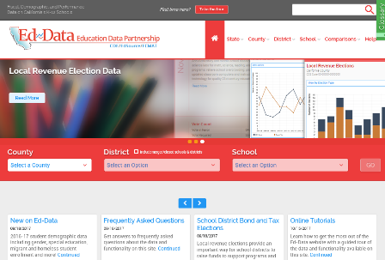
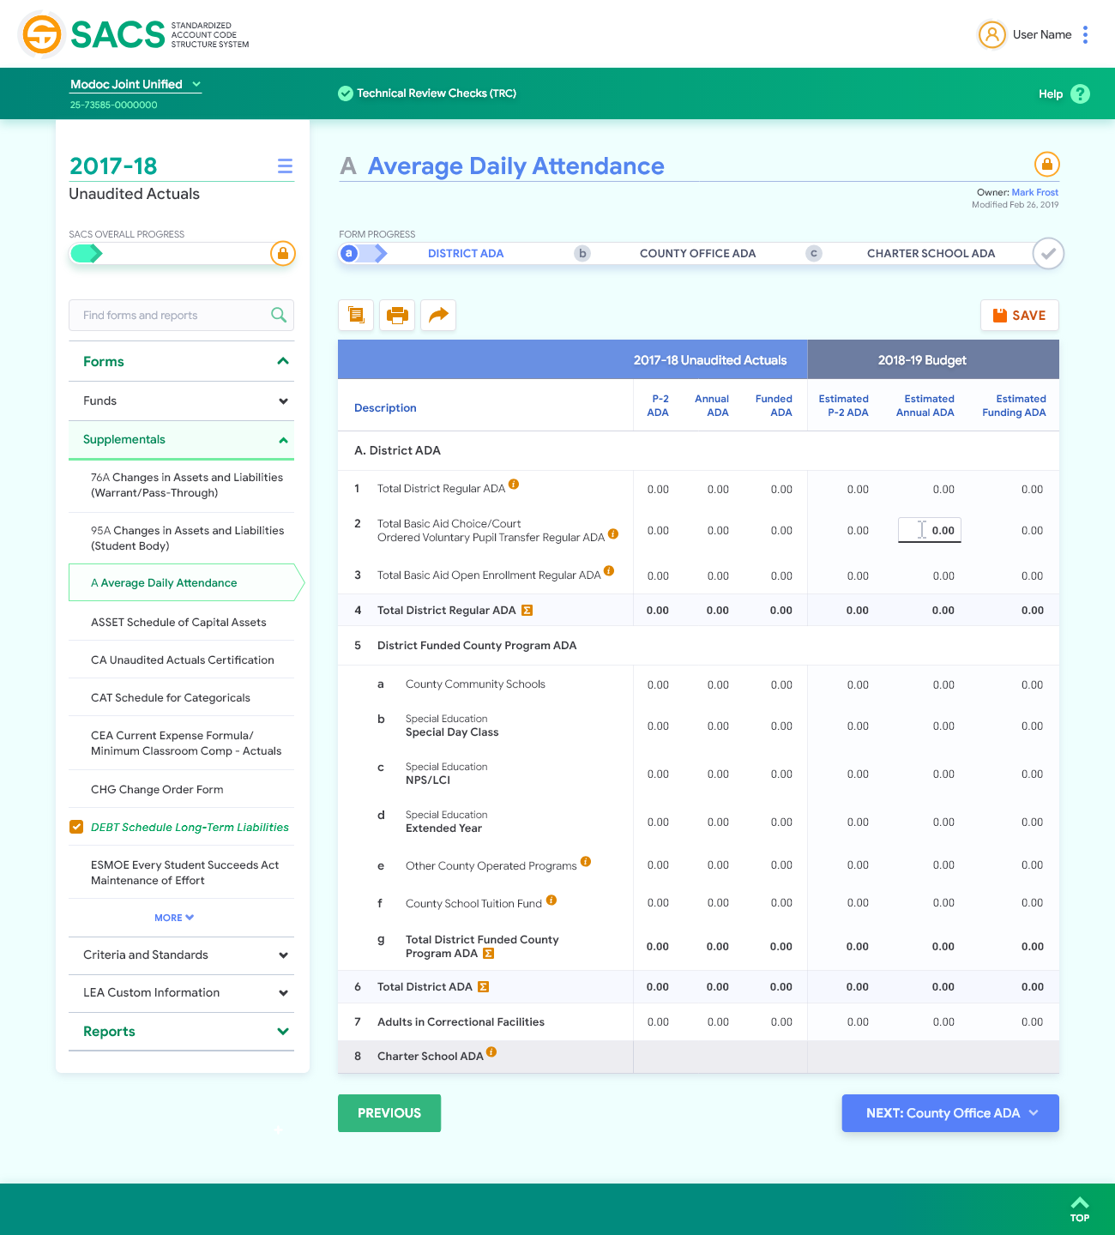
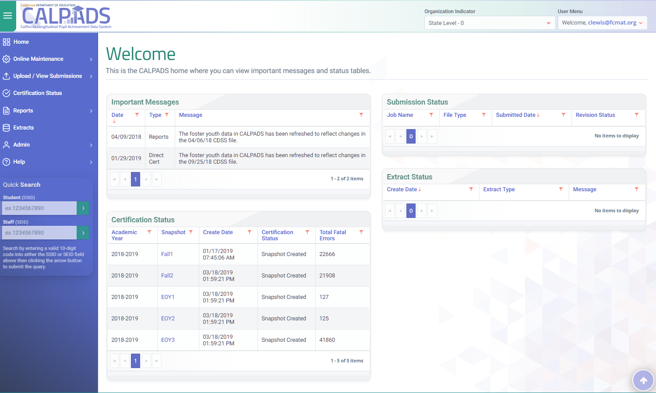
Better data. Better schools.
CALPADS
Ed-Data
Projection-Pro
SACS

Slide 3
Session Purpose
Highlight several of the high stakes ways data are being used and how you can impact the quality and accuracy of those data to maximize funding, insure student and school performance are accurately reflected, and direct the use of limited resources.
Notes:
Continuous improvement
How to invest in resources

Slide 4
CALPADS Data Uses
State Agencies
(Data Matches)
LCFF and Other Funding
Eligibility for State and Federal Grants
Statewide
Assessments
State and Federal
Reporting
Research
DataQuest
School Accountability Report Cards
LCAP Development and Evaluation Rubrics
Notes:
Some of the ways CALPADS data are used

Slide 5
Local Control Funding Formula
Enacted in 2013–14
Replaced the previous K–12 finance system
Established base, supplemental, and concentration grants
Established eight statewide priorities (10 for COEs)
Requires all LEAs to develop Local Control Accountability Plans (LCAP) describing the goals, actions, services, and expenditures to support state and local priorities
Required development of new accountability system based on multiple measures
Notes:
Replacing the myriad of previously existing K–12 funding streams, including revenue limits, general purpose block grants, and most of the 50-plus state categorical programs that existed at the time.
Established separate funding streams for oversight activities and instructional programs

Slide 6
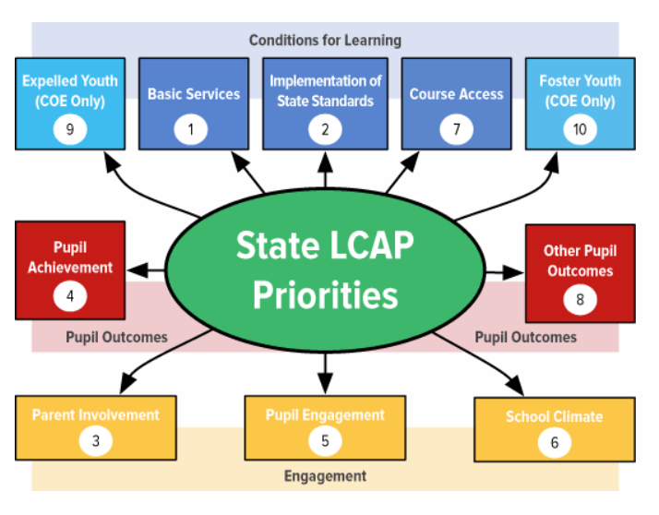
LCFF State Priorities
Source: Fresno County Office of Education

Slide 7
Local Control Accountability Plan
The LCAP is a tool for local educational agencies to set goals, plan actions, and leverage resources to meet those goals to improve student outcomes.
This Photo by Unknown Author is licensed under CC BY-NC

Slide 8
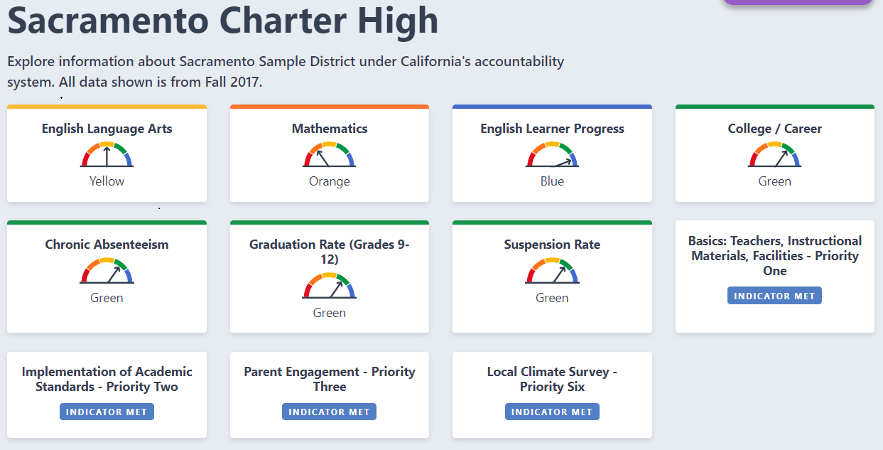
California School Dashboard

Slide 9
Data in the Fall 2019 Dashboard
Indicator | Data Source | Year of Data Source
Chronic Absenteeism | CALPADS EOY 3 Chronic Absenteeism, Cumulative Enrollment | 2017-18 and 2018-19
Suspension Rate | CALPADS EOY 3 Suspension, Cumulative Enrollment | 2017-18 and 2018-19
English Learner Progress Indicator (ELPI) | ELPAC end of year data file | No performance indicator in 2019 Need 3 years of ELPAC to calculate change
Graduation Rate Indicator | CALPADS ODS | Class of 2018-19 (status) Class of 2017-18 (to calculate change)
Academic Indicator | Smarter Balanced Results (3–8) CALPADS Demographics | 2019 Smarter Balanced Assessments 2018 Smarter Balanced Assessments
College/Career Indicator (CCI) | CALPADS EOY 1 (Course, CTE) CALPADS ODS (cohort, a-g indicator, State Seal of Biliteracy) AP, IB Results Smarter Balanced Results (11) | Class of 2019, Graduate Cohort (status) Class of 2018, Graduate Cohort (to calculate change)

Slide 10
CALPADS Data Used in Indicators
Data Used From CALPADS | Suspension Rate | English Learner Progress | Graduation Rate | Academic: Grades 3 8 | College/ Career | Grade 11 Distance from Level 3
Enrollment | Yes | Yes | Yes | Yes | Yes | Yes
Exit Date |  | Yes | Yes | Yes | Yes | Yes
Discipline | Yes
School Completion (Graduated) |  |  | Yes |  | Yes
A-G Completion |  |  |  |  | Yes
Dual Enrollment |  |  |  |  | Yes
Race/Ethnicity | Yes |  | Yes | Yes | Yes | Yes
English Learner | Yes | Yes | Yes | Yes | Yes | Yes
Reclassified Fluent (RFEP) |  | Yes | Yes | Yes | Yes | Yes
English Learner Enrolled in a US School less than one year |  |  |  | Yes |  | Yes
Valid Disability Code | Yes |  | Yes | Yes | Yes | Yes
Direct Certification | Yes |  | Yes | Yes | Yes | Yes
Parent Education Level | Yes |  | Yes | Yes | Yes | Yes
Foster Youth (Fall 2017) | Yes |  | Yes | Yes | Yes | Yes
Homeless (Fall 2017) | Yes |  | Yes | Yes | Yes | Yes
Migrant | Yes |  | Yes | Yes | Yes | Yes
Free and Reduced | Yes |  | Yes | Yes | Yes | Yes
County-District-Residence Code |  |  |  | Yes |  | Yes

Slide 11
Local Control
Funding
Formula
LCFF is calculated using three-year rolling percentage of LEA Unduplicated Pupil Percentage (UPP) and P-2 ADA rates
This Photo by Unknown Author is licensed under CC BY-SA

Slide 12
Funding Calculations
Low Income
English Learners
Foster Youth
Free/Reduced Price Meal Eligible (NSLP/Alternative Application)
Homeless
Migrant Ed
Direct Certification
Incarcerated Youth
Student eligibility is based on the certified “unduplicated” count of students enrolled on Information Day which means each student is counted only once, even if the student qualifies under more than one of the above three categories.

Slide 13
Base Rate per Student at Full Funding
Grade Span | Base Rate
TK-3 | $ 7,702
4-6 | $ 7,818
7-8 | $ 8,050
9-12 | $ 9,329
Per-pupil amounts are increased annually by COLA, if provided (In 2019-20 the statutory cost-of-living adjustment (COLA) is 3.26%; these base amounts are adjusted for COLA each year).

Slide 14
Grade Span Adjustments per ADA
Grade Span | Base Rate | Adjustment | %
TK-3 | $ 7,702 | $ 801 | 10.4%
4-6 | $ 7,818
7-8 | $ 8,050
9-12 | $ 9,329 | $ 243 | 2.6%
Grade Span Adjustments (GSA):
TK-3 to support average class size of 24:1, and
9-12 in recognition of the costs for Career Technical Education (CTE)
The percentage rates above will not change, but the base rate will increase with COLA each year, if provided.

Slide 15
Supplemental Rates at Full Funding
Grade Span | Adj Base Rate | Supplemental
TK-3 | $ 8,503 | $ 1,701
4-6 | $ 7,818 | $ 1,564
7-8 | $ 8,050 | $ 1,610
9-12 | $ 9,572 | $ 1,914
20% of Adjusted Base for each unduplicated student at full funding

Slide 16
Concentration Grant at Full Funding
Grade Span | Adj Base Rate | Concentration
TK-3 | $ 8,503 | $ 4,252
4-6 | $ 7,818 | $ 3,909
7-8 | $ 8,050 | $ 4,025
9-12 | $ 9,572 | $ 4,786
50% of the base that exceeded 55%
of population in 2019-20
100% ADA and 100% UPP at full funding

Slide 17
LCFF Calculations
Supplemental = (Base+Gr Span Adj)*.20*UPP
*Concentration = (Base+Grade Span Adj)*.50*(UPP-.55)
*If UPP > 55%
Total = (Base+Grade Span Adj+Supplemental+Concentration) * ADA

Slide 18
Sample Calculation – 70.78 UPP
 | ADA | Base | Gr Span | Supp | Concent | Grade Span Total | Rate
TK-3 | 2,912.72 | 7,459 | 776 | 1,166 | 650 | $ 29,274,258 | $ 10,050
4-6 | 2,049.69 | 7,571 | - | 1,072 | 597 | $ 18,939,346 | $ 9,240
7-8 | 1,224.72 | 7,796 | - | 1,104 | 615 | $ 11,652,851 | $ 9,515
9-12 | 2,911.47 | 9,034 | 235 | 1,312 | 731 | $ 32,935,841 | $ 11,312
 | 9,098.60 |  |  |  |  | $ 92,802,295
Supplemental = (Base+Gr Span Adj)*.20*UPP
*Concentration = (Base+Grade Span Adj)*.50*(UPP-.55)
*If UPP > 55% then Total = (Base+Grade Span Adj+Supplemental+Concentration) * ADA
Notes:
+ 10 students = $56K+
Supplemental
$ 8,235 $ 1,647
$ 7,571 $ 1,514
$ 7,796 $ 1,559
$ 9,269 $ 1,854
Concentration
$ 8,235 $ 4,118
$ 7,571 $ 3,786
$ 7,796 $ 3,898
$ 9,269 $ 4,635
1500 more attendance days $100K

Slide 19
LCFF Calculator
https://www.fcmat.org/lcff
Notes:
+ 10 students = $56K+
Supplemental
$ 8,235 $ 1,647
$ 7,571 $ 1,514
$ 7,796 $ 1,559
$ 9,269 $ 1,854
Concentration
$ 8,235 $ 4,118
$ 7,571 $ 3,786
$ 7,796 $ 3,898
$ 9,269 $ 4,635
1000 more attendance days $1.5M

Slide 20
Sample Scenarios
Under-identification Over-identification ADA effects
This Photo by Unknown Author is licensed under CC BY-NC-ND

Slide 21
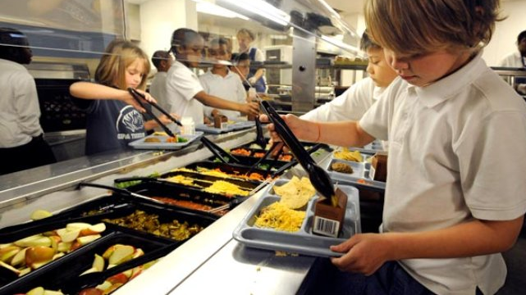
Identifying Eligible FRPM Students
System Synchronization
Direct Certification
Provision 2/3/CEP
Verification
Documentation
This Photo by Unknown Author is licensed under CC BY-NC-ND

Slide 22
Promote Data-Driven Decision-Making
Plan
Formulate a Strategy
Develop Data Governance structures
Inventory current data sets
Build Capacity
Hire staff skilled in data analysis
Build data literacy for existing staff
Leverage partnerships
Seek grants to support data-driven projects
Share
Improve data quality and accessibility
Develop an enterprise data view
Analyze
Use analytics techniques
Provide visualized views of data
Sustain
Demonstrate a culture that prioritizes data

Slide 23
Thank you!
Lisa Hayes, CSIS Implementation Specialist
lhayes@fcmat.org
Martha Friedrich, CSIS Client Services Officer
mfriedrich@fcmat.org
csis.fcmat.org

