Slide 1
Quality Engineering for Software that Works
Paul Wang, Gene Timmerman
pwang@fcmat.org

Slide 2
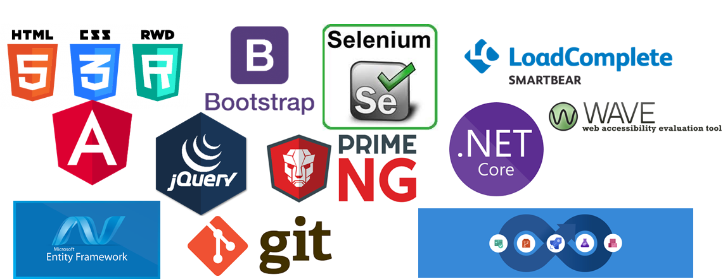
We Are In the Software Business

Slide 3
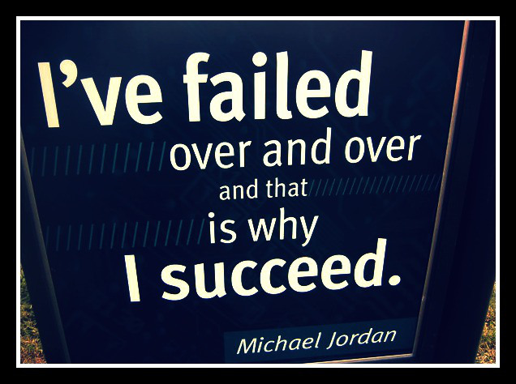
Our Stories
Success stories
Failures we are proud of

Slide 4
What Went Well and What Didn’t Go So Well
The whole team approach
Agile Scrum framework
Agile and Test Automation go hand in hand
Test automation best practices
Accessibility Testing
Performance testing Lessons, the do’s and don’ts

Slide 5
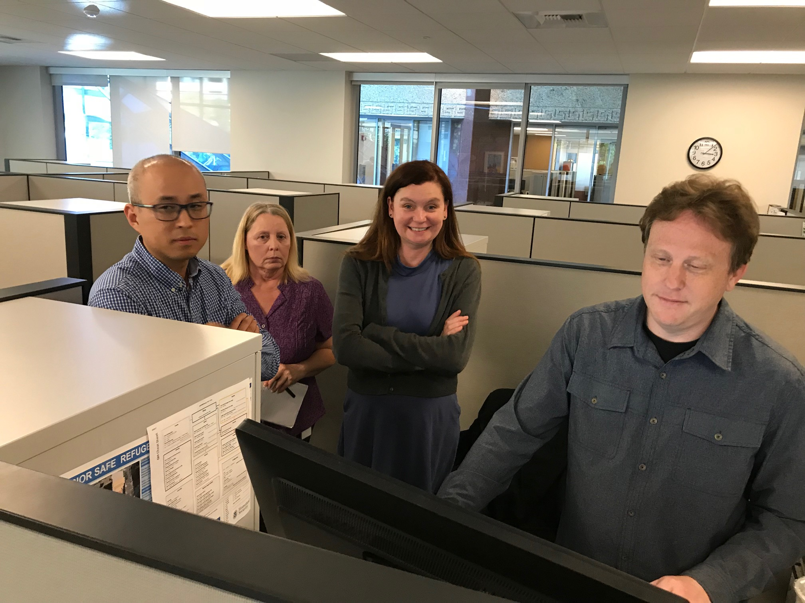
The Whole Team Approach
Quality is everyone’s responsibility
Collaboration across developers, testers, and business analysts (the “Three Amigos”)
Empowered, self-organizing
Quality focused

Slide 6
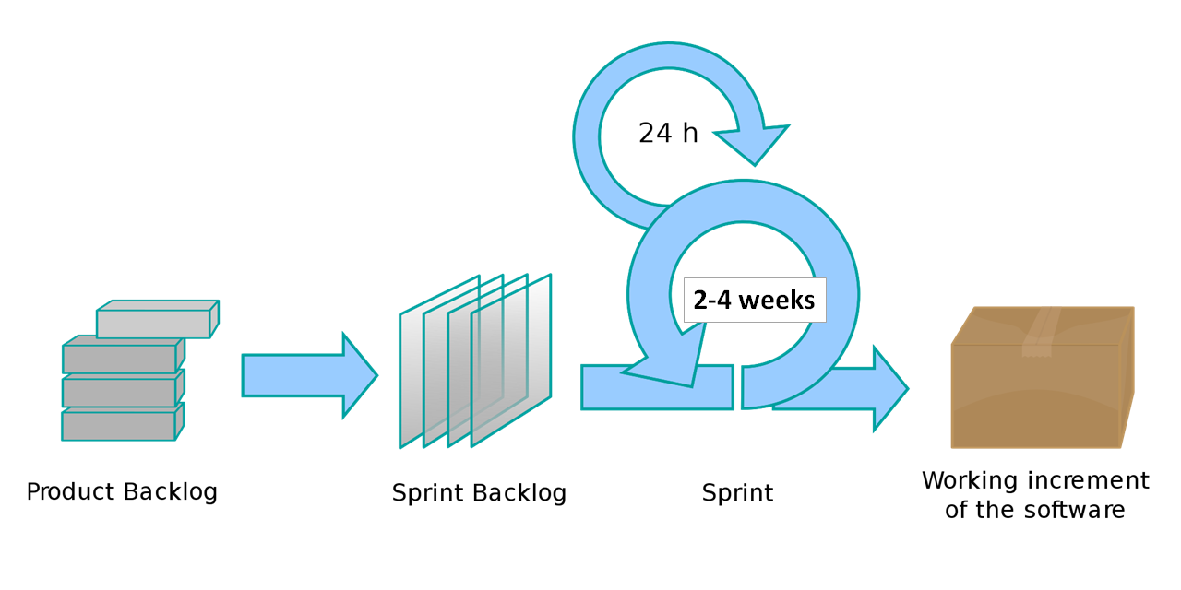
Agile Scrum Transformation

Slide 7
Agile and Test Automation Go Hand in Hand
Dilbert comic strip on October 21, 2018.
https://dilbert.com/strip/2018-10-21

Slide 8
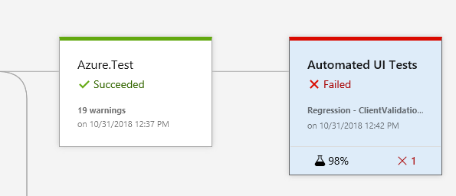
Test Automation Best Practices
Make it a priority, automate from day one
Design application testable
Get the right people on the bus
Automate what matters
Co-locate application and automation
Fail early and frequently
Keep up with the upkeep

Slide 9
Accessibility Testing Standards
International: WCAG 2.1
CDE Web Standards
US: The Rehabilitation Act
Section 508

Slide 10
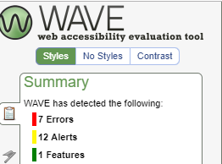
Accessibility in the DNA
Design-Develop-Test
FREE Tools –
WAVE Web Accessibility Tool
aXe Chrome Extension
Chrome Developer Tools (Audits)
NVDA (NonVisual Desktop Access)
Screen Reader (Narrator, VoiceOver, NV)

Slide 11
Performance Testing Do’s and Don'ts
YouTube clip – Ghostbusters Elevator Scene – the unlicensed nuclear accelerator
INT. THE ELEVATOR -- NIGHT The Ghostbusters look nervous as they ride up the elevator. STANTZ I just realized something. We've never had a completely successful test with any of the equipment. SPENGLER I blame myself. VENKMAN So do I. STANTZ No sense worrying about it now. VENKMAN (doubtful) Sure. Each of us is wearing an unlicensed nuclear accelerator on our back. No problem.

Slide 12
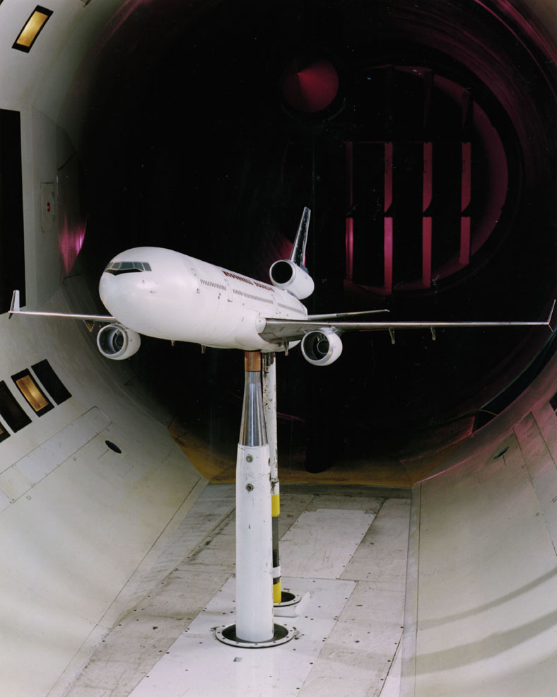
Performance Testing Do’s and Don’ts
Define application performance test objectives
Realistic transaction mix & workload assumptions
Have a strategy – cloud-based or on-premises
(Pay per use, or Build your own wind tunnel)
Integrate performance testing in Sprints
Test Early, Test often!

Slide 13
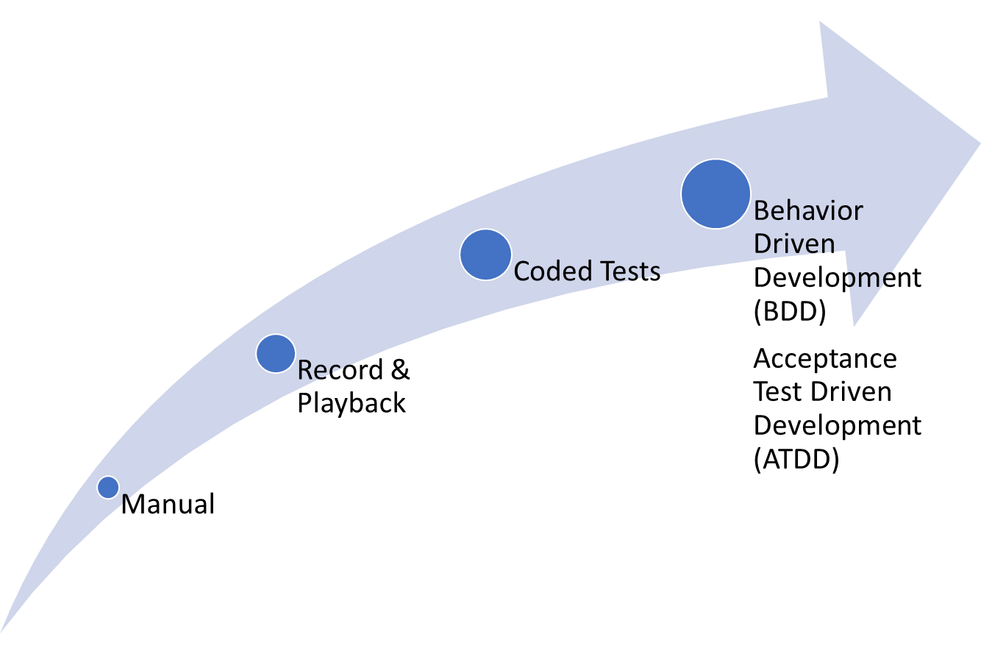
Moving Up the Test Maturity Levels

Slide 14
What If We Could

Slide 15
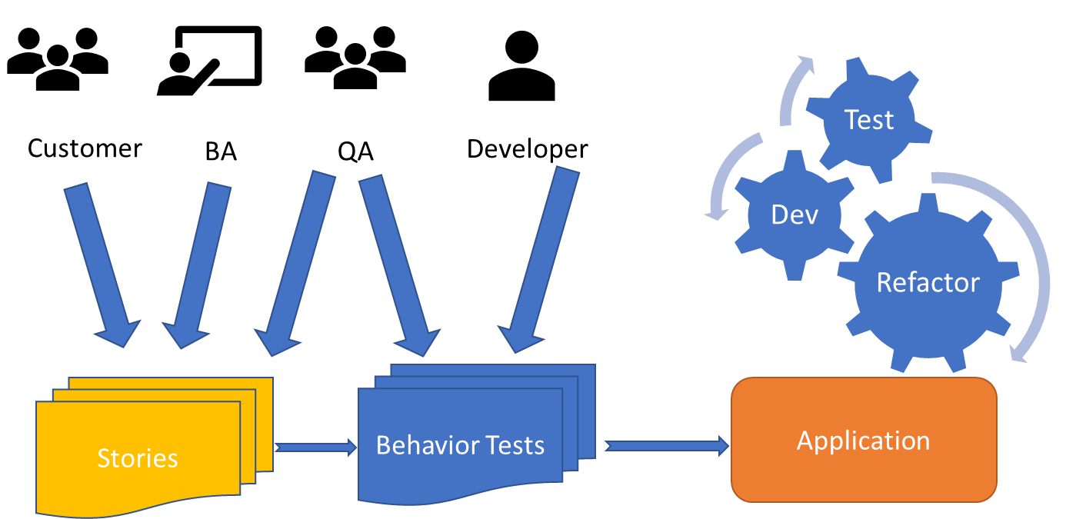
Introducing BDD and ATDD
Specification by examples
The whole team distills user stories into a set of acceptance tests before development begins.

Slide 16
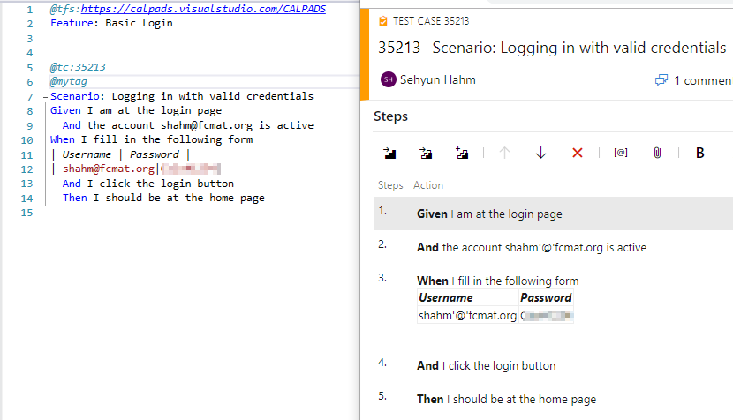
Implementing BDD and ATDD
Behavior driven tests written in Gherkin syntax
Given.When.Then.
And.But
BDD Tools for .NET: SpecFlow, SpecSync, NUnit/MSTest

Slide 17
Share Your Stories
What have you learned from our stories and failures?
Tell us about your stories.
Questions?

Slide 18
Thank You!
Email us: pwang@fcmat.org

