Slide 1
Work-Based Learning (WBLR) Data Population
Background & Intro
Submission Methods
Functionality
Data Details
Summary & Resources
Notes:
Welcome to the Work-Based Learning Data population Training. Today we will introduce you to a new CALPADS file type. We will look at the methods of submission, functionality, data details provide you with some resources of information.

Slide 2
Objective
The objective of this training is to familiarize the CTE coordinators with the data collection and their responsibility. Additionally, we will explain the system requirements so CALPADS data coordinators can implement processes to meet the data population requirements in preparation of the EOY 1 Submission.
Familiarize
Explain
Implement
Prepare
Notes:
The objective of this training is to familiarize the CTE coordinators with the data collection and their responsibility. Additionally, we will explain the system requirements so CALPADS data coordinators can implement processes to meet the data population requirements in preparation of the EOY 1 Submission.

Slide 3
Agenda
Overview
Data Submission
Wrap-Up
Data Details
Notes:
Here is the agenda for this training. We will discuss the following:
An overview of Work based learning and details about the submission.
Discuss the submission process and methods.
Look at the data in detail. Examine the field specifications and valid codes.
Lastly, wrap up the session with a summary along with some reminders and resources.

Slide 4
Overview
Discuss Work-Based Learning background & introduce key concepts
Notes:
Let’s begin with the overview where we will provide some general information about the Work-Based Learning then introduce key concepts and the purpose for this CALPADS data submission. Brandi…

Slide 5
What is Work-based Learning?
Work-based Learning is an education strategy that links classroom instruction to work-related experiences, aims to increase students’ technical skills and knowledge, and helps shape career decision making. Work-based learning is offered on campuses or in community locations and includes explorations, simulations, student-led enterprise, service learning, community classroom or cooperative education, internships, and apprenticeships
5
Notes:
Work-Based Learning is an education strategy that links classroom instruction to work-related experiences, aims to increase students’ technical skills and knowledge, and helps shape career decision making. Work-based learning is offered on campuses or in community locations and includes explorations, job shadowing, simulations, student-led enterprise, service learning, community classroom or cooperative education, internships, and apprenticeships.
https://www.cde.ca.gov/ci/ct/sf/documents/ctestdfrontpages.pdf

Slide 6
Purpose
The purpose of the Work-based Learning data collection is to enhance the career-related components in the Career/College Indicator in the Dashboard
6
Notes:
Beginning now in the 2020­-2021 academic year, local educational agencies (LEAs) are required to submit work-based learning data for students enrolled in grades 9-12. These data will be used to indicate preparedness for the College/Career Indicator (CCI) on the California School Dashboard.
For more information: https://www.cde.ca.gov/sp/se/sr/wrkabltyiaryserv.asp or
https://6abb391c-dbc9-4e2e-9cd4-f10c9c4bb967.filesusr.com/ugd/c055a4_f1b186d9ab24411eb8971d6583e849b5.pdf

Slide 7
Current Career-Related CCI Measures
7
Notes:
There are currently a subset of career-related data and work-based learning programs that will be used to generate the CCI for the Fall 2021 Dashboard.

Slide 8
CTE Pathway Completion
Finish a sequence of courses totaling at least 300 hours
Capstone course must be in the same industry as the pathway
Prepared:
Complete CTE Pathway with a C- or better in the capstone course plus one of the following:
Score Level 3 or higher on either ELA or Math and at least Level 2 on the other assessment
Completes a-g requirements with C- or better
One semester/two quarters/two trimesters of college credit courses with a grade of C- or better
Approaching Prepared:
Complete CTE Pathway with C- or better in the capstone course
Work-Based Learning Data Population v1.1 November 24, 2020
8

Slide 9
Pre-Apprenticeship (Registered)
Prepared:
Completion of a program that is:
Recognized by business and/or industry and registered at the state or national level
Provide students with the entry-level skills necessary to be eligible to enter a registered apprenticeship program
Approaching Prepared:
N/A –No criteria for approaching
Work-Based Learning Data Population v1.1 November 24, 2020
9

Slide 10
Pre-Apprenticeship (Non-Registered)
Completion of a program that:
Is recognized by business and/or industry
Provides students with the entry-level skills necessary to be eligible to enter a registered apprenticeship program
Prepared:
Non-DASS Schools: must also complete CTE Pathway to earn Prepared​
DASS Schools: must also complete either: ​
One CTE Pathway, or​
One semester/two quarters/two trimesters of a CTE course​
Approaching Prepared:
Completion of a non-registered Pre-Apprenticeship only
Work-Based Learning Data Population v1.1 November 24, 2020
10

Slide 11
State or Federal Job Program
Applies to DASS schools only
Completion of one of the following programs:
Workforce Innovation and Opportunity Act (WIOA)
Job Corps
YouthBuild
California Conservation Corps
Regional Occupational Centers/Programs
Prepared:
Complete a State or Federal Job Program and complete at least one semester/two quarters/two trimesters of CTE courses (with C minus or better)​
Approaching Prepared:
Complete a State or Federal Job Program only
Work-Based Learning Data Population v1.1 November 24, 2020
11

Slide 12
Transition Classroom-Based Work Exploration & Work-Based Experience
Applies to students with an Individualized Education Program (IEP) who do not earn a standard high school diploma
Classroom-Based Work Exploration: Completion of four semester courses any time during grades 9 through 12 that offer college and career exploration/preparation that are designed to prepare a student for employment and independent living.
Work-Based Experience: Completion of a minimum of 100 hours of work-based learning since entering grade 9 that offers work-based learning experiences that develop knowledge and job skills.
Prepared:
Complete both classroom-based work exploration and work-based experience
Approaching Prepared:
Complete classroom exploration or work-based experience
Work-Based Learning Data Population v1.1 November 24, 2020
12

Slide 13
New WBL Data Collected for 2020-21
New Work-based Learning Codes will be analyzed for potential inclusion in the Fall 2022 Dashboard.
Internships
Student-led Enterprise
Virtual/Simulated Work-based Learning
13

Slide 14
Data Collection
LEAs are required to submit work-based learning completion information in any grades 9-12. Include all Work-Based Learning updates for students enrolled at any time during the Reporting Year
CALPADS Submission | Primary Data Submitted | Official Submission Window | Certification Deadline | Amendment Window
EOY 1 | Course Completion for Grades 7–12 CTE Participants, Concentrators, Completers Work-Based Learning | May 10, 2021 to July 30, 2021 | July 30, 2021 | July 31, 2021 to August 27, 2021
14
Notes:
Work-Based Learning (WBLR) file that will be submitted and certified as part of the CALPADS End-of-Year (EOY) 1 submission. LEAs are required to submit work-based learning completion information in any grades 9-12. Include all Work-Based Learning updates for students enrolled at any time during the Reporting Year.
https://www.cde.ca.gov/ds/sp/cl/calpadsupdflash184.asp

Slide 15
Preparing for the WBLR Submission
Things to consider
Review current business processes for administering Internships
Standardize the performance evaluation conducted by employers of student interns
Establish processes to collect the WBLR data (Student work hours)
Map courses that include the content for Work-Based Learning to valid CALPADS State course codes
15
Notes:
LEAs should review the data requirements and implement business processes to collect and maintain the data that will be submitted from the SIS to CALPADS. LEAs will need to:
Reviewing current business processes for creating, administering, supervising, and evaluating internships, and adjust as necessary to capture the required data (data related to number of hours, employer performance evaluation, sponsorship, and supervision).
Standardizing the performance evaluation conducted by employers to capture the performance levels included in the Internship Employer Performance Evaluation code set.
Establishing processes to collect the number of hours that students spend outside the school at the internship, working on a student-led enterprise, or engaging in virtual/simulated work-based learning.
Identifying (or creating) courses that include the content required for Student-led Enterprises and Virtual/Simulated Work-Based Learning.

Slide 16
Roles and Responsibilities (1)
CTE Coordinators
Identify current work-based learning programs at a district and school
Work based learning (internships, community classroom, cooperative vocational education, work experience education, etc.)
Ensure local business process includes
Standardized process for employer evaluations
Process for collection of student logs for external hours spent on WBL
Review of CALPADS Certification Reports prior to certification
16

Slide 17
Roles and Responsibilities (2)
CTE Teachers
Identification of courses that include and or contain work-based learning components:
Virtual or Simulated Work-Based Learning
Student-Led Enterprise
ROC/P
Coordinate collection of student logs for Virtual or Simulated Work-Based Learning and Student-Led Enterprise external hours
17

Slide 18
Roles and Responsibilities (3)
Special Education staff
Identification of students with disabilities (SWD) that complete
Transition Work-Based Experience
Transition Classroom-based Work Exploration
Review of CALPADS Certification Reports prior to certification
18

Slide 19
Roles and Responsibilities (4)
CALPADS/SIS Data Coordinators
Train key staff on:
Data entry into SIS
Key reporting deadlines and due dates
Work with program staff to:
Map courses that include the content for Work-Based Learning to valid CALPADS State course codes
Resolve CALPADS Errors
Ensure review and certification of CALPADS Snapshot Reports
19

Slide 20
Data Submission
Review CALPADS submission methods and functionality
Notes:
First, we will start with some general information related to the CALPADS data submission and then introduce key concepts related to the data collected.

Slide 21
Record Relationships
Staff Demographics
Student Enrollment
SEID
Course Section
Completion
SSID
SSID
Work-Based Learning
Course Section ID
Course Pathway Code
Student Course Section Completion
Student Career Technical Education
Notes:
The WBLR file may be submitted independently of other EOY 1 file types. However, an enrollment record for the School of Attendance during the Academic Year reported must exist for the student. There is the potential for a record relationship with the CRSC file as State course codes can be mapped to some WBLR records, but at this time there are no validations that create a relationship between the two files.

Slide 22
Where Does the Data Come from?
There are three new work-based learning types, seven work-based learning types from the SENR and 2 work-based learning types from the SPED that combined make the 12 types in the WBLR file.
Notes:
Where Does the Data Come from?
This information comes from the new work-based learning data as announced in Flash#184 as well as data that was formerly submitted in the Student Enrollment (SENR) and Special Education (SPED) files. LEAs are required to submit work-based learning completion information in any grades 9-12.
To give you a little bit more background, of the 12 work-based learning types, two were collected in the Special Education (SPED) file, and three were collected as indicators on the Student Enrollment (SENR) file. The State and Federal Program indicator from the SENR has now been broken into five separate work-based learning codes. Basically, there are three new work-based learning types, seven work-based learning types from the SENR and two work-based learning types from the SPED that combined make the 12 types in the WBLR file.

Slide 23
Data Submission
The WBLR data can be submitted via batch file or online maintenance. It is expected that the SPED data formerly submitted via the SEDS system will now come from the SIS
Notes:
So, how is the data submitted to CALPADS?
The records can be submitted via batch file or Online Maintenance. The WBLR file format uses the Replacement processing method by Academic Year and School of Attendance and used for batch processing. Submitted files replace existing records in CALPADS when the School of Attendance, Academic Year ID, SSID and Work-Based Learning Type Code match between the existing records and submission. WBLR records can also be maintained using the CALPADS Online Maintenance user interface and are processed using the same rules and validations.

Slide 24
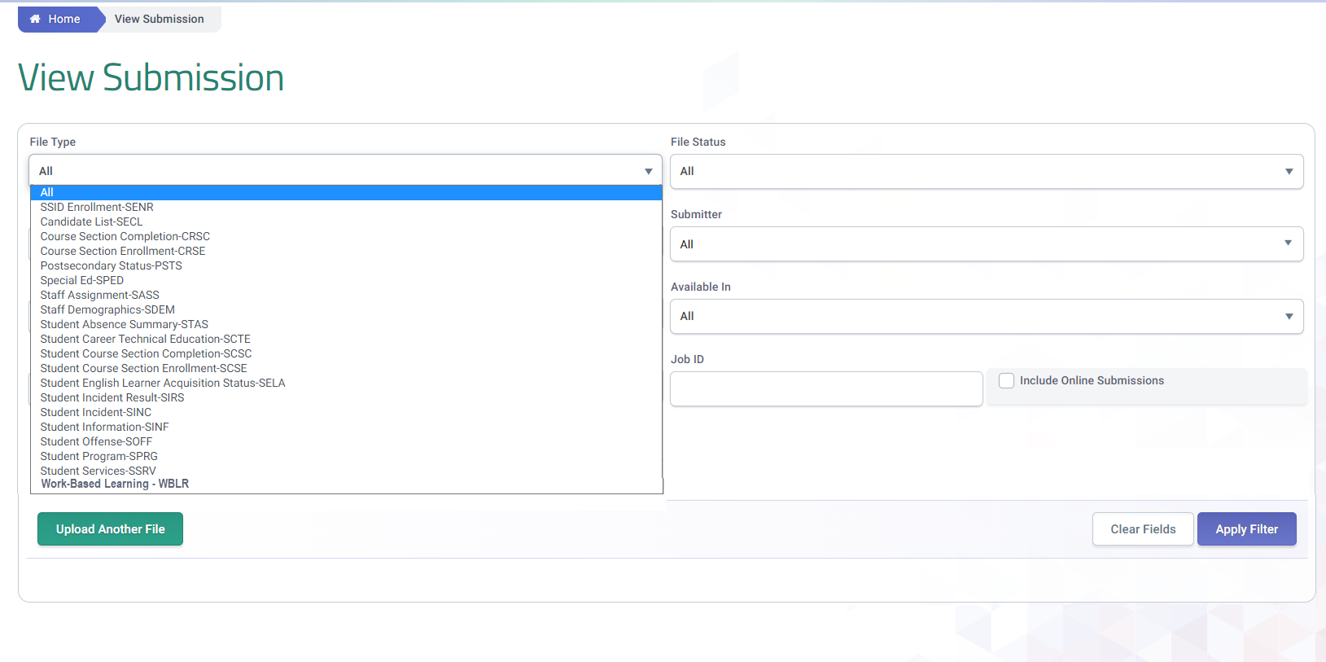
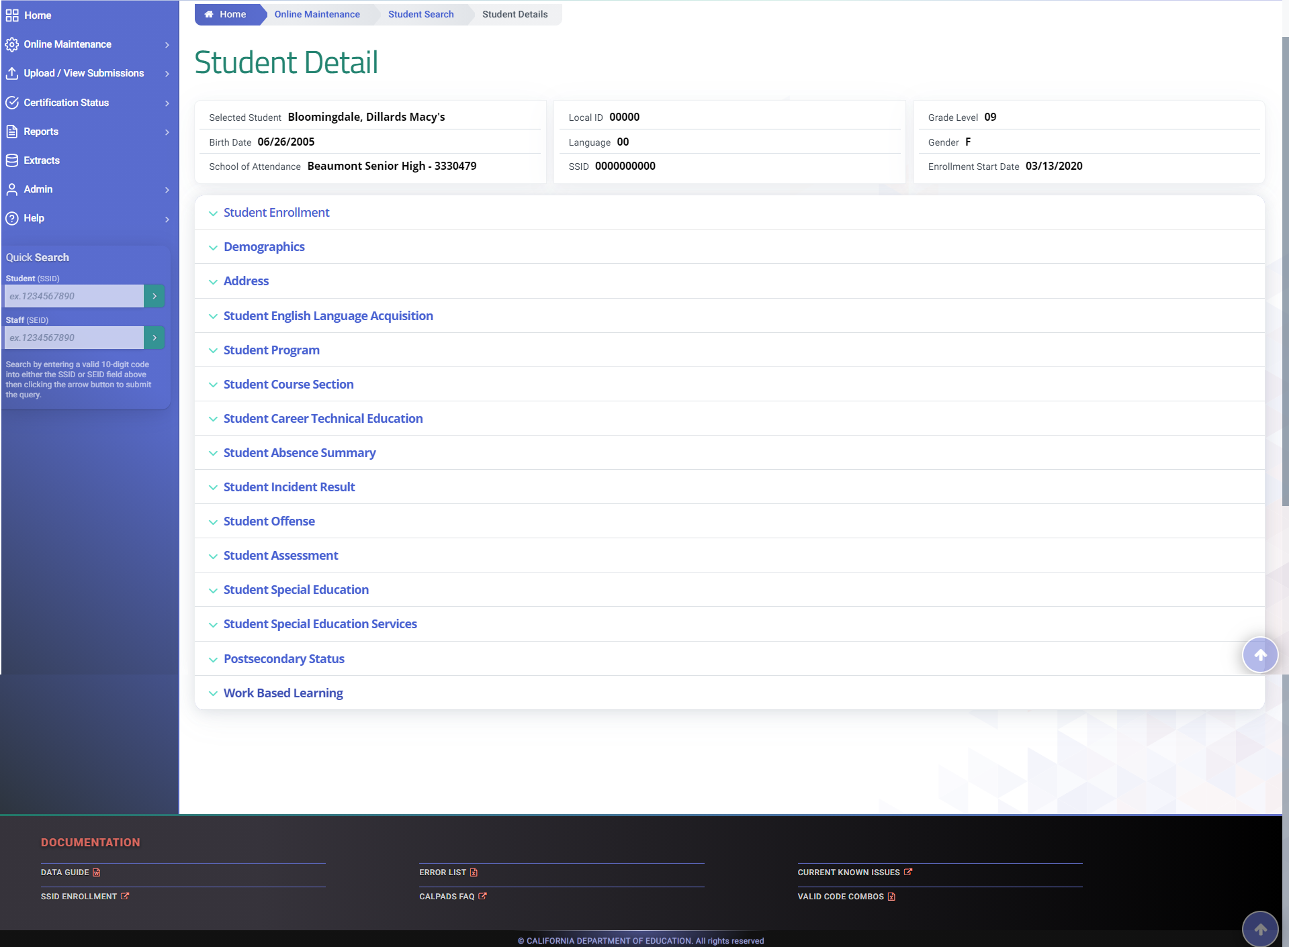
USER Interface Mock-UP
Submission of the WBLR will have the same functionality as the other CALPADS record types.
24
Notes:
These are the CALPADS UI mock ups. The WBLR file will be listed in alphabetical order on the submission screen under the File Type dropdown menu and like all other new functionality, it will most likely be added to the bottom of the container list on the student detail screen.
Please note that these images are mock-up variations and changes should be expected when the file is implemented in CALPADS.

Slide 25
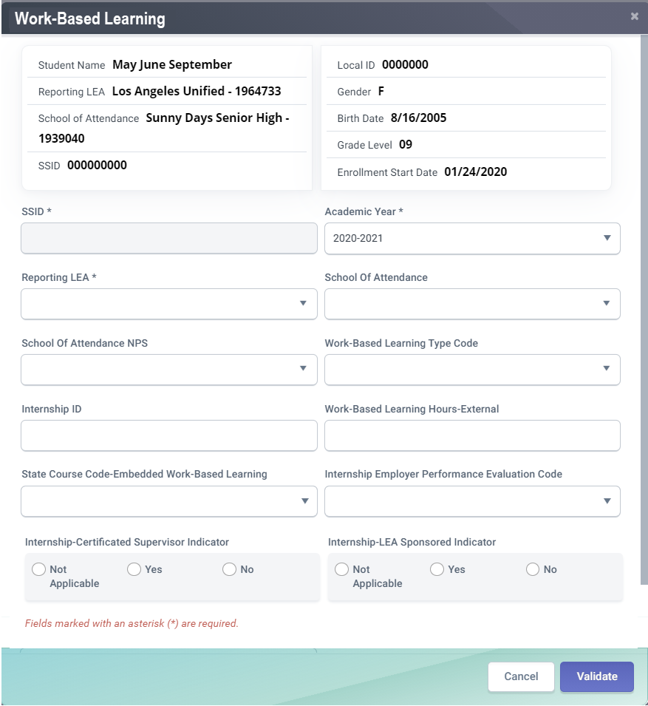
WBLR Data Fields Mock-UP
CFS# | Field Name
21.09 | Work-Based Learning Type Code
21.10 | Internship ID
21.11 | Work-based Learning Hours - External
21.12 | State Course Code -Embedded Work-based Learning
21.13 | Internship -Employer Performance Evaluation Code
21.14 | Internship -LEA Sponsored Indicator
21.15 | Internship –Certificated Supervisor Indicator
21.09
21.10
21.11
21.12
21.13
21.14
21.15
25
25
Notes:
The WBLR file features student demographic and enrollment data for identification and verification, but there are seven fields of data specific to work-based learning.
Work-Based Learning Type Code
Internship ID
Work-based Learning Hours - External
State Course Code - Embedded Work-based Learning
Internship - Employer Performance Evaluation Code
Internship - LEA Sponsored Indicator
Internship - Certificated Supervisor Indicator

Slide 26
Data Details
Examination of Field Specifications and code values
Notes:
In the data details we will provide an examination of field specifications and code values for the seven WBLR data fields.

Slide 27
Work-Based Learning Type Code (21.09)
Code | Name | Previous
10 | Internship | New
15 | Student-led Enterprise | New
20 | Virtual/Simulated Work-Based Learning | New
25 | Registered Pre-Apprenticeship Program | SENR
30 | Non-registered Pre-Apprenticeship Program | SENR
35 | Job Corps | SENR
40 | Workforce Innovation and Opportunity Act (WIOA) | SENR
45 | YouthBuild | SENR
50 | California Conservation Corps | SENR
55 | Regional Occupational Centers/Program | SENR
60 | Transition Work-Based Experience | SPED
65 | Transition Classroom-Based Work Exploration | SPED
The Work-Based Learning Type Code represents the work-based learning that the student completed during the academic year.
Students may have multiple work-based learning codes
Include summer work-based learning
Exclude summer internships that occur after the student has graduated
Definitions for each WBL Type can be found in the CALPADS Code Sets Document > Work-Based Learning Type Code Set
27
Notes:
WBLR field 21.09, Work-Based Learning Type Code is a coded value representing the work-based learning that the student completed during the academic year, in any grades 9 - 12. The codes are defined in the CALPADS Code Sets document.
LEAs should report the work-based learning in the year it was completed.
Students may have more than one work-based learning activity that can be reported for a student for the academic year.
You would want to report summer work-based learning for grades 9-11, however, do not include summer internships that occur after the student has graduated.
Please keep in mind that the Work-Based learning Code will dictate that other fields be populated. We will cover some of those conditional edits a little later in this training.
So, now let’s take a closer look at each of these work-based learning type codes…

Slide 28
WBLR Type: Internship (10)
Internships are county, district, or school-sponsored experiences that expose students to work in partnerships with local business, industries, or other organizations in the community.
Internships can:
be paid or unpaid
occur over the summer or during the school year
occur at any business type, profit or non-profit, in various settings such as community classroom, Co-Op CTE/ Vocational Education
Internships may, but are not required to be connected to a CTE pathway course or any course
Internships are not:
Job shadowing (there must be supervision and specific practice and working alongside an industry expert)
Apprenticeships
Jobs that students secure on their own (e.g., summer job)
28
Notes:
Internship
Internships are county, district, or school-sponsored experiences that expose students to work in partnerships with local business, industries, or other organizations in the community. If a student participates in an internship that spans more than one academic year, LEAs should report what the student completed (for example, number of hours) in each academic year.
Internships can:
be paid or unpaid,
be Community Classroom, see California Education Code Section 52372.1 and Title 5, California Code of Regulations Section 10080
be Co-Op Career Technical Education/Cooperative Vocational Education, see California Education Code Section 52372.1 and Title 5, California Code of Regulations Section 10100
occur over the summer or during the school year
occur at any business type, profit or non-profit
Internships may, but are not required to be connected to a CTE pathway course or any course
Internships are not:
Job shadowing (there must be supervision and specific practice and working alongside an industry expert)
Apprenticeships
Jobs that students secure on their own (e.g., summer job)
Definitions
Internship:
provides students an opportunity to participate in unpaid, work-based learning in an integrated setting for a specified period of time to learn about a particular industry or occupation. In most internship situations, a workplace mentor instructs the student, critiques the performance, challenges, and encourages the student to do well. It is critical to ensure that all aspects of criteria outlined by the FLSA are met to ensure that this experience is a work-based learning experience – not employment, or mock sheltered workshop activities
Community Classroom:
A method of instruction which utilizes unpaid on-the-job training experiences at business, industry, or public agency sites to assist students in acquiring those competencies needed to acquire entry-level, competitive, integrated employment. The intent of the community classroom experience is to augment classroom instruction that can be extended into the community. It is most typically associated with ROCP. It is critical to ensure that all aspects of criteria outlined by the FLSA are met to ensure that this experience is a work-based learning experience – not employment.
Community-Based Vocational Instruction:
the development of learning experiences in the community through WAI and in compliance with all FLSA requirements for a work-based learning experience
https://www.cde.ca.gov/sp/se/sr/wrkabltyiaryserv.asp

Slide 29
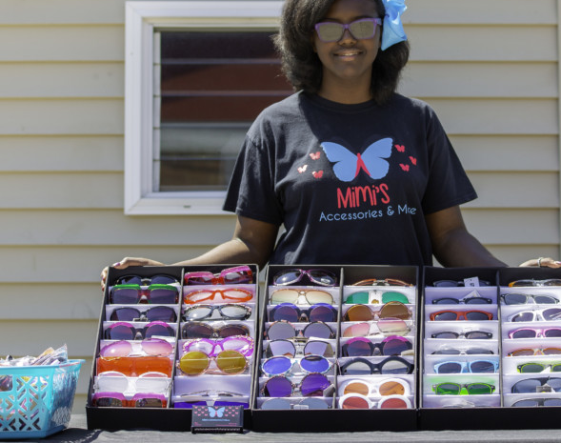
WBLR Type: Student-Led Enterprise (15)
A student-led enterprise involves the development and operation of a revenue-generating business outside the classroom but is associated with a course at the school and evaluated by the course instructor.
A Student-Led Enterprise:
must be operated by the student (student is not just an employee of the enterprise)
must be ongoing and not a one-day event
must be tied to a course in which students develop a business and marketing plan. This may be any course, including CTE courses
must be co-curricular (time spent in and out of the classroom)
must bring in revenue (but does not need to make a profit)
can include a non-profit venture
A student-led enterprise is not:
A student working at the campus bookstore or volunteering at the school bake sale
29
Notes:
Student-Led Enterprises
A student-led enterprise involves the development and operation of a revenue-generating business outside the classroom but is associated with a course at the school and evaluated by the course instructor. Students produce goods or services for sale to or use by people other than their selves. Examples include student-run cafes or video production studios that serve clients and generate revenue. Benefits include the development of entrepreneurial, technical and academic skills in a school-based environment.
A Student-Led Enterprise:
must be operated by the student (student is not just an employee of the enterprise)
must be ongoing and not a one-day event
must be tied to a course in which students develop a business and marketing plan. This may be any course, including CTE courses
must be co-curricular (time spent in and out of the classroom)
must bring in revenue (but does not need to make a profit)
can include a non-profit venture
A student-led enterprise is not:
A student working at the campus bookstore or volunteering at the school bake sale

Slide 30
WBLR Type: Virtual/Simulated Work-Based Learning (20)
A Virtual/Simulated Work-Based Learning is a program where students can gain business experience through a virtual environment that is aligned to the classroom curriculum. The virtual or simulated program must be tied to a course in which students develop their own business plans and websites, but must consist of more than an online course
30
Notes:
A Virtual/Simulated Work-Based Learning is a program where students can gain business experience through a virtual environment that is aligned to the classroom curriculum.
The Virtual/Simulative Work-Based Learning:
Must be tied to a course in which students develop their own business plans and websites
May be tied to any course, including a course that is part of a CTE Pathway (e.g., business, marketing, entrepreneurship, STEAM, hospitality, tourism, information technology, etc.)
Virtual/Simulation Work-Based Learning is not:
An online course/program

Slide 31
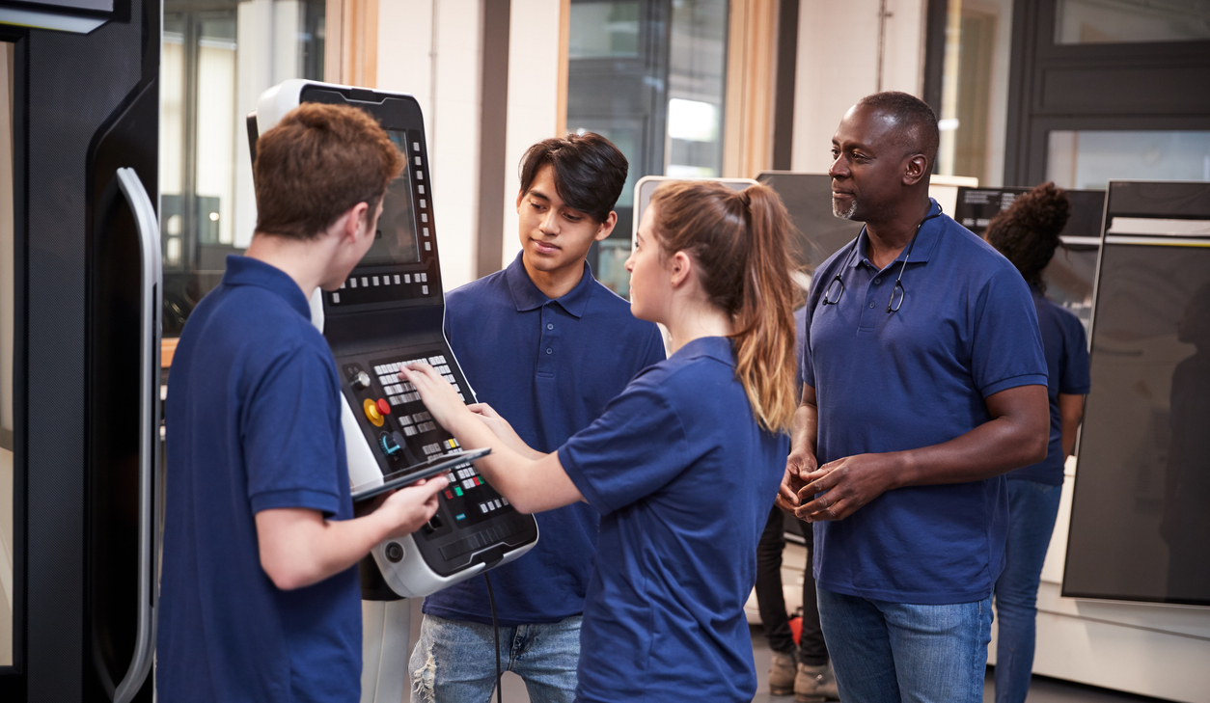
WBLR Type: - Registered Pre-Apprenticeship Program (25) - Non-registered Pre-Apprenticeship Program (30)
Registered and non-registered pre-apprenticeship programs are designed to provide students with the entry-level skills necessary to be eligible to enter a registered apprenticeship program (i.e., an apprenticeship program that is registered at the state or national level). Typically, schools that offer pre-apprenticeship programs have a partnership with a local business.
Notes:
Apprenticeship
Youth apprenticeship programs are formal, multi-year programs that combine school and work-based learning at a competitive wage in a specific occupational area or cluster and are designed to lead directly into either a postsecondary program, entry-level job or registered apprenticeship program. Most apprenticeship programs are developed in collaboration with the State Apprenticeship Standards Board.
Registered pre-apprenticeship program The student
successfully completed, during the academic year, a registered pre-apprenticeship program that is recognized by business and/or industry and registered at the state or national level, and
is awarded a certificate of completion upon successful completion of the pre-apprenticeship program.
A pre-apprenticeship program is designed to provide students with the entry-level skills necessary to be eligible to enter a registered apprenticeship program (i.e., an apprenticeship program that is registered at the state or national level). Typically, schools that offer pre-apprenticeship programs have a partnership with a local business.

Slide 32
WBLR Type: - Job Corps (35) - Workforce Innovation and Opportunity Act (40) - YouthBuild (45)
Work based learning programs administered by the U.S. Department of Labor
Job Corps program, offers General Educational Development test (GED) support and vocational training to youth, ages16 to 24 years old.
A Workforce Innovation and Opportunity Act (WIOA) Youth Program works to overcome barriers between in-school or out-of-school youth and employment by placing them in (minimum wage) jobs.
A YouthBuild program trains youth, ages 16- to 24-year-old, who have dropped out of high school, in construction by building homes for low-income members of their communities.
32
Notes:
These three work-based learning types are Work based learning programs administered by the U.S. Department of Labor.
Job Corps - The student successfully completed, during the academic year, a Job Corps program, administered by the U.S. Department of Education (29 USC Sections 3191-3212), which offers General Educational Development test (GED) support and vocational training to youth, ages16 to 24 years old. Job Corps is described as a free education and training program that helps young people learn a career, earn a high school diploma or GED, and find and keep a good job. For eligible young people at least 16 years of age that qualify as low income, Job Corps provides the all-around skills needed to succeed in a career and in life.
Workforce Innovation and Opportunity Act (WIOA) - The student successfully completed, during the academic year, a Workforce Innovation and Opportunity Act (WIOA) Youth Program, administered by the U.S. Department of Labor (19 USC Ch. 32 (128 Stat. 1425)), which works to overcome barriers between in-school or out-of-school youth and employment by placing them in (minimum wage) jobs.
WIOA brings together, in strategic coordination, the core programs of Federal investment in skill development:
Employment and training services for adults, dislocated workers, and youth and Wagner-Peyser employment services administered by the U.S. Department of Labor (DOL) through formula grants to states; and
Adult education and family literacy programs as well as State Vocational Rehabilitation Services programs that assist eligible individuals with disabilities in obtaining employment; both core programs are administered by the U.S. Department of Education.
WIOA also authorizes programs for specific vulnerable populations, including the Job Corps, YouthBuild, Indian and Native Americans, and Migrant and Seasonal Farmworker programs as well as evaluation and multistate projects administered by DOL. In addition, WIOA authorizes other programs administered by U.S. Department of Education and the U.S. Department of Health and Human Services.
YouthBuild - The student successfully completed, during the academic year, a YouthBuild program, administered by the U.S. Department of Labor (29 USC Section 3226), which trains youth, ages 16 to 24 year old, who have dropped out of high school, in construction by building homes for low-income members of their communities. YouthBuild programs to provide students with vocational training, counseling, leadership development and an education leading to a diploma. YouthBuild programs vary according to local community needs, funding, and partnerships.

Slide 33
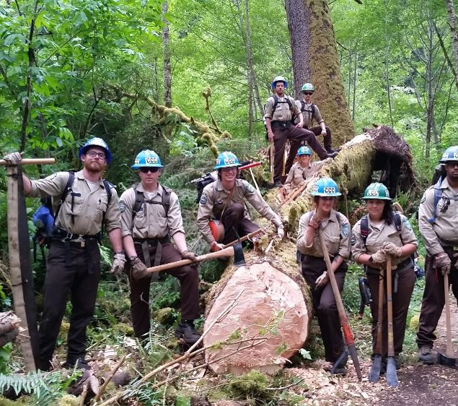
WBLR Type: California Conservation Corps (50)
The student successfully completed, during the academic year, a California Conservation Corps program, which engages students, ages 18 to 25 years old, to perform physical labor for environmental conservation and provides life skills training.
33
Notes:
The student successfully completed, during the academic year, a California Conservation Corps program, administered by the California Resources Agency (CA Public Resources Code Sections14000-14424), which engages students, ages 18 to 25 years old, to perform physical labor for environmental conservation and provides life skills training.
Members of the California Conservation Corps receive on-the-job training from agencies like CAL FIRE, U.S. Forest Service, Caltrans, State Parks, and the National Park Service. Additionally, supervisors at private companies oversee Corps members working on electrical, construction, and specialized CCC projects.

Slide 34
WBLR Type: Regional Occupational Centers/Program (55)
A Regional Occupational Center/Program (ROC/P) program, administered by an ROC/P (CA Education Code Section 52301), which provides career/technical education and services to California high school students.
34
Notes:
A Regional Occupational Center/Program (ROC/P) program, administered by an ROC/P (CA Education Code Section 52301), which provides career/technical education and services to California high school students.
The major goal of Career Technical Work-based learning is to develop and refine occupational competencies necessary to acquire paid employment or non-paid placements, to adapt to the employment environment, and to advance in an occupation. Career Technical Work-based learning extends vocational learning opportunities to students through a combination of related classroom instruction in Work Experience Education and supervised paid employment in the occupation for which their Career Technical course in school prepares them. California’s 49 ROCPs provide high school and adult students with valuable career technical education so students can
enter the workforce with skills and competencies to be successful in life,
pursue advanced training in higher educational institutions, and/or
upgrade existing skills and knowledge.

Slide 35
WBLR Type: Transition Work-Based Experience (60) & Transition Classroom-Based Work Exploration (65)
Transition WBLR experience is a program requiring 100 hours of for students with disabilities on an individualized education program (IEP) that develops knowledge and job skills, in compliance with the Fair Labor Standards Act (FLSA) requirements.
Transition WBLR exploration requires four semesters of college and career exploration/preparation courses designed to prepare a student with an IEP for employment and independent living.
35
Notes:
Work Experience Education combines an on-the-job component with related classroom instruction designed to maximize the value of the on-the-job experience . Transition WBLR experience is a program requiring 100 hours of for students with disabilities on an individualized education program (IEP) that develops knowledge and job skills, in compliance with the Fair Labor Standards Act (FLSA) requirements..
Transition WBLR Exploration requires four semesters of college and career exploration/preparation courses designed to prepare a student with an IEP for employment and independent living.

Slide 36
Internship ID (21.10)
The Internship ID is for an internship work-based learning activity at the school of attendance during the academic year. The ID is only for internships, Work-Based Learning Type Code 10 (Internship). For any other Work-Based Learning Type the field must be left blank.
36
Notes:
An Internship ID is unique identifier for an internship work-based learning activity. The Identifier must be unique for the internship within the School of Attendance and Academic Year. Must be populated when the Work-Based Learning Type Code is 10 (Internship) otherwise it should be left blank.

Slide 37
Work-based Learning Hours – External (21.11)
Work-based Learning Hours are the count of hours that the student spent outside of school in a work-based learning activity in the academic year being reported. Hours must be rounded to the nearest whole number. Only report hours for WBLR types 10 (internship), 15 (Student-Led Enterprise), and 20 (Virtual/Simulated Work-Based Learning).
37
37
Notes:
Work-based Learning Hours are the count of hours that the student spent outside of school in a work-based learning activity in the academic year being reported. Hours must be rounded to the nearest whole number. Only report hours for WBLR types 10 (internship), 15 (Student-Led Enterprise), and 20 (Virtual/Simulated Work-Based Learning).
Code 60 and 65 do not report hours, but locally the hours need to be tracked to determine if student satisfied the requirement.

Slide 38
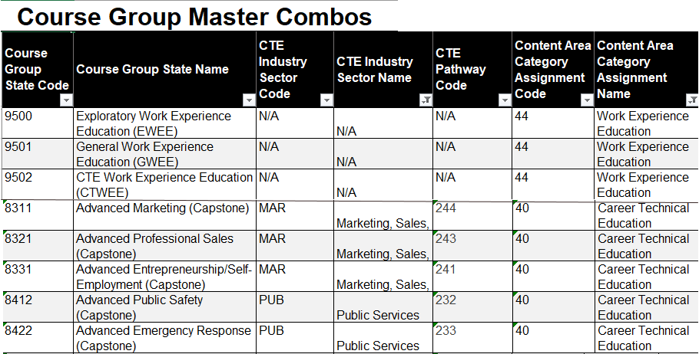
State Course Code-Embedded Work-based Learning (21.12)
Required for Work-based Learning Type Codes 15 (Student-led Enterprise) or 20 (Virtual/Simulated Work-Based Learning), the State Course Code-Embedded Work-based Learning is the State Course Code that the student completed in which the Work-Based Learning was embedded. The course may or may not be a CTE course. An embedded work-based Learning code may be reported for an internship (10) but is not required.
38
Notes:
Required for Work-based Learning Type Codes 15 (Student-led Enterprise) or 20 (Virtual/Simulated Work-Based Learning), the State Course Code-Embedded Work-based Learning is the State Course Code that the student completed in which the Work-Based Learning was embedded. The course may or may not be a CTE course. An embedded work-based Learning code may be reported for an internship (10) but is not required.

Slide 39
Internship -Employer Performance Evaluation Code (21.13)
The Internship-Employment Performance Evaluation is a coded value representing the student’s performance as evaluated by their employment supervisor. Possible code values are:
1 - Unsatisfactory or Unacceptable
2 - Less than Satisfactory
3 - Satisfactory
4 - Exceptional
39
Notes:
The Internship-Employment Performance Evaluation is a coded value representing the student’s performance as evaluated by their employment supervisor and should only be populated when the Work-Based Learning type code I s10 (Internship). Possible code values are:
1 - Unsatisfactory or Unacceptable
Employer evaluated student's overall internship performance as unsatisfactory or unacceptable. The evaluation should include the following four categories: 1) Foundational Skills, 2) Applied Workplace Skills, 3) Self-Management and Personal Responsibility, 4) Knowledge of the Field and Organizational Context. The student received a rating of "Less than Satisfactory" in two or more categories.
2 - Less than Satisfactory
Employer evaluated student's overall internship performance as less than satisfactory. The evaluation should include the following four categories: 1) Foundational Skills, 2) Applied Workplace Skills, 3) Self-Management and Personal Responsibility, 4) Knowledge of the Field and Organizational Context. The student received a rating of "Less than Satisfactory" in one category.
3 - Satisfactory
Employer evaluated student's overall internship performance as less than exceptional but satisfactory. The evaluation should include the following four categories: 1) Foundational Skills, 2) Applied Workplace Skills, 3) Self-Management and Personal Responsibility, 4) Knowledge of the Field and Organizational Context. Minimally, the student must earn a rating of "Satisfactory" in all four categories.
4 - Exceptional
Employer evaluated student's overall internship performance as exceptional. The evaluation should include the following four categories: 1) Foundational Skills, 2) Applied Workplace Skills, 3) Self-Management and Personal Responsibility, 4) Knowledge of the Field and Organizational Context. Minimally, the student must earn a rating of "Exceptional" in three of the four categories, and no rating less than satisfactory.

Slide 40
Internship-Indicators
Internship-Certificated Supervisor Indicator (12.14)
The Internship –Certificated Supervisor Indicator provides an indication of whether the internship was part of a program supervised (regularly visit the work site, elicit feedback from employer on intern’s performance). ) by a certificated staff member of the school, district, or county. This is only reported for Work Based Learning Type code 10 (internship)
Internship-LEA Sponsored Indicator (12.15)
The Internship -LEA Sponsored Indicator describes whether the school, district, or county played a direct role in securing the internship for the student. This is only reported for Work Based Learning Type code 10 (internship)
Work-Based Learning DP v1.0 11.24.2020
40
Work-Based Learning Data Population v1.1 November 24, 2020
Notes:
The Internship indicators should only be populated when the Work-Based Learning type code is 10 (Internship).
The Internship -LEA Sponsored Indicator describes whether the school, district, or county played a direct role in securing the internship for the student. This is only reported for Work Based Learning Type code 10 (internship). A “Y” would indicate that the school, district, or county played a direct role in securing the internship. An “N” would indicate it did not. (Students obtain their own summer jobs the school, district or county has not played a direct role).
The Internship –Certificated Supervisor Indicator provides an indication of whether the internship was part of a program supervised by a certificated staff member of the school, district, or county. A “Y” would indicate that the internship was part of a program supervised by a certificated staff member of the school, district, or county. An “N” would indicate that it was not. Supervised can be described as a certificated staff member closely monitoring the student throughout the internship (i.e., regularly visit the work site, elicit feedback from employer on intern’s performance). This indicator should only be reported for Work based Learning Type Code 10 (Internships).

Slide 41
Submission Validation Edits
Discussion of WBLR conditional validation edits
41

Slide 42
Wrap Up
Key Points, Resources and Support
Notes:
Okay, nearly finished. Let’s recap what we discussed today and point you in the direction of more information. This is the Wrap-up.

Slide 43
Summary
The WBLR file is part of the EOY 1 submission
All Work-Based Learning data will come from the SIS
Work-Based learning data should be submitted for grades 9-12
Students may have multiple WBLR records
The WBLR file has conditional field validations based on the WBLR Type code
WBLR data for SWD must be imported from the SEDS into the SIS for upload into CALPADS
43
Notes:
Here are some key points worth remembering:
The WBLR file is part of the EOY 1 submission
All Work-Based Learning data will come from the SIS
Work-Based learning data should be submitted for grades 9-12
Students may have multiple WBLR records
The WBLR file has conditional field validations based on the WBLR Type code
WBLR data for SWD must be imported from the SEDS into the SIS for upload into CALPADS if it doesn’t exist in SIS

Slide 44
Proposed CTE WBLR CCI Indicator Levels
Work-Based Learning Career Readiness Levels and Indicators
CAREER LEVELS | Career Awareness | Career Exploration | Career Preparation | Career Specific Training
CCI READINESS INDICATOR LEVEL | Not Prepared | Approaching Prepared | Prepared | Well Prepared
WBL INDICATOR
Career Interview | 1 Interview
CALCRN Program Tools | One classroom project per year | Four classroom projects per year
Guest Speakers | 1 guest speaker in a year | 4+ guest speakers in a year
Career Research Visits | 1 Visit | 3+ Visits
Job Shadow | 1 Day | 3+ Days
Career Conference/Camp/ Summer/Weekend Academy Event | 1 Day Career conference/camp | 1 Week Summer Career Camp 1 Week Summer Academy Camp
Exploratory Work Exp. Ed. (WEE) | Complete Exploratory WEE course
General WEE | Complete one-year course | Complete second year course
CTE WEE (aligned with CTE MCS) |  |  | 1 Semester | 2+ Semesters
School Based Enterprise (aligned with CTE MCS) |  | 1 year in SBE course | 2+ Years in SBE course
CTSO Leadership/Skills Attainment |  | 1 Year Participation | 2+ Years Participation
CTSO Leadership/Skills Assessment (Practical and Written) |  |  | Achieved Cut Score on Assessment | Placement at State and/or National Level Competition
Summer Internship |  |  | 40+ Hours | 300+ hours
Community Classroom (CC) (unpaid) |  |  | 1 Semester | 2 Semesters
Cooperative Vocational Education (CVE) (paid) |  |  | 1 Semester | 2+ Semesters
Year Long Internship (Concentrator) |  |  | 150+ Hours
Year Long Internship (Capstone) |  |  | 150+ hours | 350+ Hours
Explorer Program (Fire, Police, Paramedic) |  |  | Certificate of Completion | Acceptance into Academy
ROTC/Military Cadets |  | 1 Year in ROTC | Complete ROTC Program | Enlist into Branch of the Military
Pre-Apprenticeship |  |  | Pre-Apprentice Certificate | Acceptance into Apprenticeship
Industry Certification |  |  |  | Industry Specific Certificate
44
Notes:
This chart was developed by the Career Technical Education Leadership Office. These proposed Work-based Learning College and Career Indicators (CCI) would be applicable to all students not just CTE students. You can expect that this chart will continue to be built out and quantified. As you know, these recommendations have already been incorporated into CALPADS at least in part, as that is the basis of today’s training.
Original presentation https://www.ctecs.org/sites/default/files/files/Cali_McIntosh.pdf

Slide 45
CALPADS Resources
Here are some important resources related to EOY reporting.
https://learn.fcmat.org/
https://www.youtube.com/c/CSISCALPADSTrainingChannel
https://documentation.calpads.org/Support/References
https://www.cde.ca.gov/ds/sp/cl/systemdocs.asp
https://csis.fcmat.org/resources
Notes:
Here are some important resources related to EOY reporting.

Slide 46
Work-Based Learning Resources
CALPADS Update FLASH #184
CALPADS File Specifications v12.1
CALPADS Code Sets v12.1
CA CTE Model Curriculum Standards
Work Experience Education (WEE) Guide
WorkAbility I
Work-Based Learning in California
46
Notes:
The listed resources are specific to Work-Based Learning:
CALPADS Update FLASH #184
CALPADS File Specifications v12.1
CALPADS Code Sets v12.1
CA CTE Model Curriculum Standards
Work Experience Education (WEE) Guide
WorkAbility I
Work-Based Learning in California

Slide 47
Support
http://www2.cde.ca.gov/calpadshelp/default.aspx
Web
calpads-support@cde.ca.gov
Email
916-325-9210
Phone
https://csis.fcmat.org/ListServ
https://www.cde.ca.gov/ds/sp/cl/listservs.asp
You can get help through these channels.
Listserv
Notes:
As always, here are the ways that we can be contacted. Keep in mind that the fastest most direct method is the Webform listed at the top.

Slide 48
Feedback
I have a question…
“
”
Please complete survey…
https://bit.ly/2MXsECg
“
”
Notes:
Please take the time to complete our training survey. Your responses assist in improving our trainings.
We review these surveys on a regular basis—in fact due to LEAs’ suggestions we have changed our survey, have included more visual aids, and demonstrations in our trainings.
If you experience any technical difficulty with accessing the survey, please try the alternative long URL:
Long URL: https://forms.office.com/Pages/ResponsePage.aspx?id=k1b3XxqV6E2E3dWxsESwNX2FYi3dRZNNt8LpvkF_wmhUNVRLOVBDVkoySE01UTJSRk42VTlaUUFIQi4u
Short URL: https://bit.ly/2MXsECg
Thank you for providing us the opportunity to evaluate our trainings.

Slide 49
Thank You
CSIS Training Team
916-325-9200
csistraining@fcmat.org
https://csis.fcmat.org/
Notes:
Thank you for your attendance. Thank you for your participation. Thank you for allowing us to share with you today, but most of all thank you for your tireless hard work and dedication.

