Slide 1
SSID Request & Enrollment (SENR) Data Population
Key concepts
Online maintenance
Batch file upload
Enrollments
Notes:
Welcome to CALPADS SSID Request and Enrollment live training with CSIS supporting CALPADS. In this training, we will provide an explanation of key concepts in the SSID request and enrollment process, and provide a demonstration of the process in both OM and batch file upload.

Slide 2
Target Audience
CALPADS
LEA Coordinator
School site Registrars
Administrators

Slide 3
Objectives
Identify
Conceptualize
Perform
Develop
The field specifications and data requirements related to enrolling student records in CALPADS
(Manage and Maintain Data)
The SSID enrollment process beginning with assigning SSIDs and ending with SIS data population
(Critical Thinking)
The online maintenance or Batch file upload process using the SSID Match tool, select matching SSID records and updating SIS
(Manage and Maintain Data)
The local practices that ensure appropriate SSID assignment of incoming students
(Data Leadership)
Notes:
Identify field specifications and data requirements related to enrolling and exiting student records in CALPADS (Manage & Maintain Data)
Conceptualize the SSID Enrollment process beginning with assigning SSIDs and ending with SIS data population (Critical Thinking) skills are needed to understand or explain the relationship and flow of data between CALPADS and your SIS.
Perform Online maintenance or Batch file uploads using the SSID Matching tool, select matching SSID records and updating SIS (Manage & Maintain Data).
Develop Local practices that ensure appropriate SSID assignment of incoming students. (Data leadership) involves sharing knowledge and expertise to help guide data management policy and practices.

Slide 4
Agenda
Overview
Online Maintenance Demonstration
Batch File Demonstration
Wrap-Up
Notes:
Here is the agenda for this training. We will discuss the following:
An overview of the submission.
Discuss how to enroll students.
Review potential validation error.
Spend some time explaining how to exit student enrollments in CALPADS.
Lastly we will recap and try to hammer home the key points of today’s training.

Slide 5
Overview
Key Concepts and Guidelines

Slide 6
Just a Piece of the Pie
The SENR file is another data set that is part of the Student Profile
SENR
SINF
SPRG
SELA
SWDS
MEET
PLAN
& SERV
File extracted from local school information system and uploaded to CALPADS
Files coming from local SEDS system through API
Files extracted from local school information system and uploaded to CALPADS
These record types are needed for Fall 1, the complete student profile features more record types
Notes:
The SENR file is the first file submitted when creating a student profile, however a complete profile requires the submission of many other files as well. For fall 1 reporting Student information (SINF), Student Program (SPRG), Student English Language Acquisition (SELA) and Student with Disabilities (SWD) records. SWD records are submitted via API transfer in Special Education Program (SPED) and Student Services (SSRV) data sets.

Slide 7
Student Enrollment (SENR)
What are Student Enrollment (SENR) records used for?
The student enrollment data is required to obtain SSIDs, enroll or exit students, update students’ grade levels in CALPADS and inclusion for CAASPP, ELPAC testing
SENR enrollments are used to:
Establish ownership of a students record in CALPADS
Determine cohort inclusion and cumulative enrollment
Designate district of geographic residence, transfer reason and enrollment status

Slide 8
SENR Submission Guidelines
Students must be enrolled at the start of every school year
Student should be enrolled on their first date of expected enrollment and exited with their last date of attendance
At the end of the school year, LEAs must exit all students, including those whom they expect will be continuing at the same school the following school year. At the beginning of the next school year, LEAs must re-enroll all students with the appropriate grade level for that year
The SENR is not used to update a student’s demographic information or any other information that has changed. The appropriate file must be used to update student information

Slide 9
Overview
CALPADS
SSID
STATE
Local SIS maintain student data
LEA extract files and send to CALPADS for matching and reporting
Each student must have one and only one SSID.
Stores student data
Generates new SSIDs upon request
Matches existing SSIDs to student requested an SSID for
Matches student data with state database
Matches CALPADS data with other state department
TOMS for Assessments
CDSS databases for foster youth, direct certification

Slide 10
Statewide Student Identifier (SSID)
All public California K–12 local educational agencies must obtain statewide student identifiers from CALPADS.
The SSID is a unique
10-digit
Random
System-generated
Non-personally-identifiable number
SSIDs are used to track students, determine accurate dropout and graduation rates as well as to link students to assessment scores. It is critical that LEAs take great care when requesting new to preserve the integrity of data reported.
1234567890
SSID Request and Enrollment v1.1 September 5, 2024

Slide 11
Data Submission Methods
Ways to submit student data
One student at a time
Edit data manually in CALPADS portal
Online Maintenance
CALPADS
Online & batch transactions are processed the same way
One or more students
Enter data in SIS or Excel; then upload extract using CALPADS portal
Batch File
SSID Request and Enrollment v1.1 September 5, 2024

Slide 12
SSID Enrollment Process
SENR capabilities:
Batch Upload
SENR Batch
- Submit SSID Enrollment batch File
Verify SSID Match
Run candidate list
Verify matches with school sites
Gain Ownership
Match to existing SSIDs
Request new SSID
Other Record/File Types
Online Maintenance
-Search manually for Student SSID/ Demographics Online
Gain Ownership
Match to existing SSIDs
Request new SSID
Establish Student Profile
Student Information
Student Programs
Student English Language Acquisition
Maintain Student Data
Regularly update student profile and pertinent data
Online Maintenance

Slide 13
Ownership
SENR start and end dates determine the period of ownership of student records in CALPADS. To add, update or delete student information, LEAs must have ownership of the student record
Record Type | Ownership Rules
SINF | Effective start dates must correspond with enrollment start dates
SPRG | If there is no conflicting ownership, eligibility program start dates may precede enrollment start dates. Participation programs must fall within the student’s enrollment period at the school of enrollment
SELA | If there is no conflicting ownership the TBD status can preceded enrollment. The EL and IFEP status date should reflects the date the student’s testing was completed. The start date for EO should align with the first day of the student enrollment. The start date for RFEP should fall with an enrollment period
SWDS, PLAN, MEET, SERV | SWDS, PLAN must fall within enrollment period. SERV must fall within enrollment period except 20 – Secondary enrollments. No MEET ownership validation
SINC, SIRS, SOFF | Incident must fall on a date within the enrollment period (within SENR start and end dates)
STAS | Records must be reported for each school of primary or short-term enrollment each year
SCSE, SCSC | Courses must be submitted at the school of enrollment (on census day for CRSE)

Slide 14
Student Profile
Student profile records are required for each submission, an enrollment record exist in CALPADS prior to any other record types being posted
Fall 1
SENR
SINF
Fall 2
SCSE
SCSC
SPRG
SELA
MEET
PLAN
EOY 1
SCTE
EOY 3
STAS
SDIS
EOY 2
SPRG
SENR
SWDS
SERV
Fall 2 & EOY 1 require staff and/or course records types in addition to student profile data

Slide 15
Online Maintenance Demonstration
Notes:
Now lets put this theory into practice as we demonstrate how to enroll a few students in CALPADS.

Slide 16
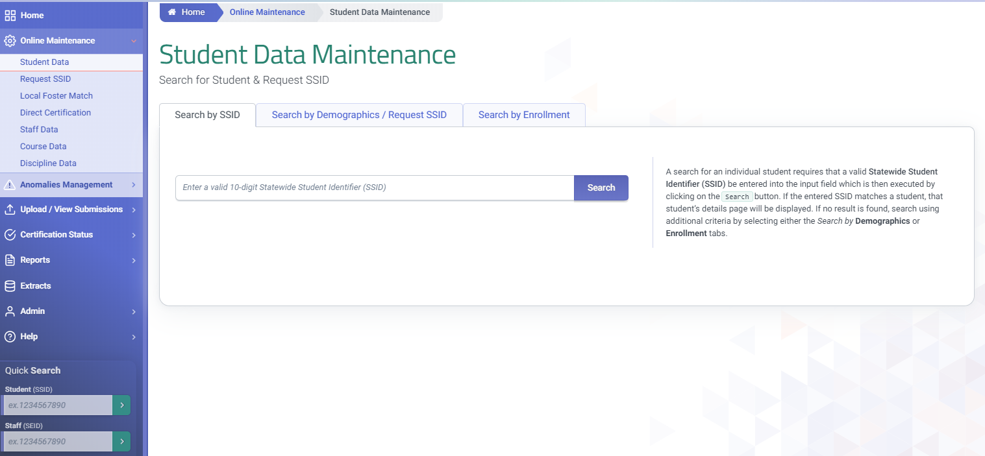
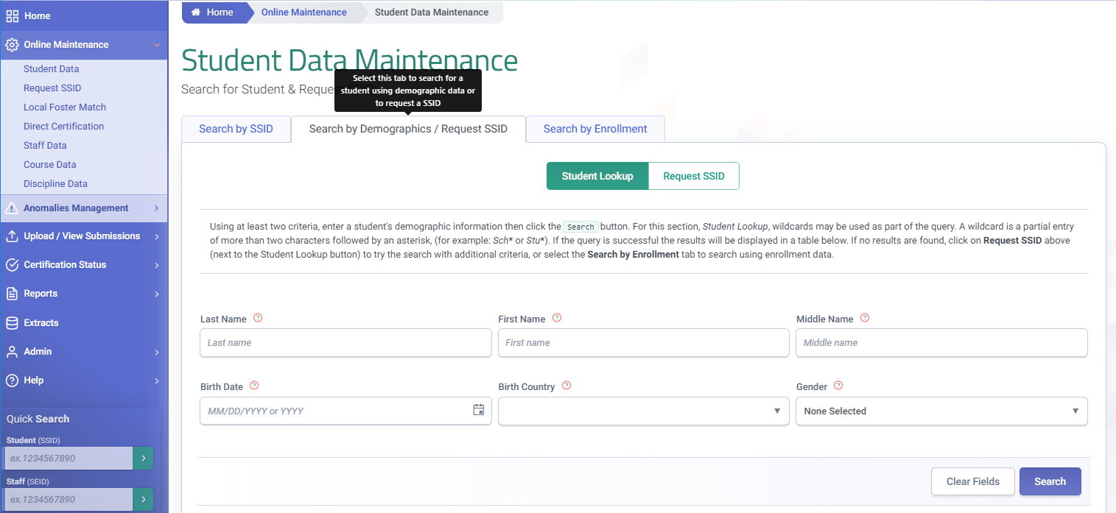
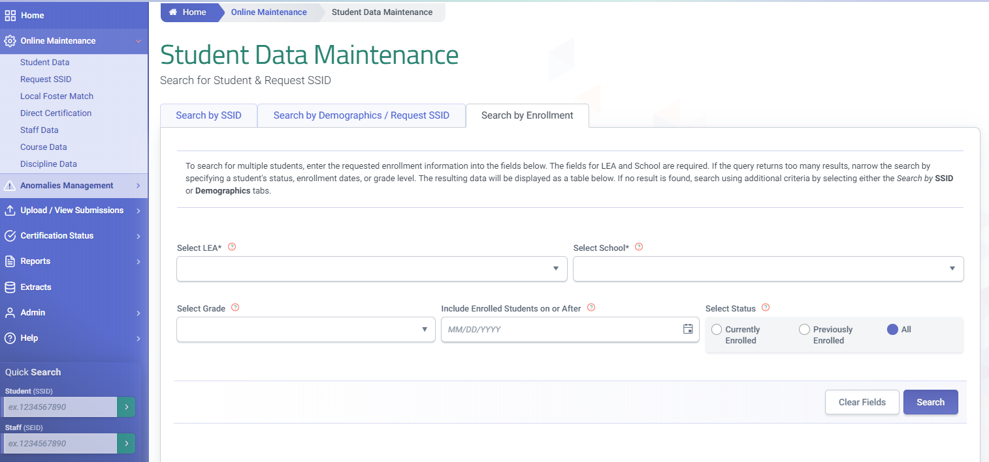
Search for Student
Search by enrolment provides a list of student for the selected criteria
Search by SSID is an exact search using a state identifier
Search by Demographics locates students who have been enrolled in California public schools when the SSID is unavailable
Notes:
In addition to the Quick in the left navigation, the Student data Maintenance screen allows you to search by SSID, demographics and by enrollment. Additionally the demographic search tab can toggle to request SSID to complete a student enrollment online.

Slide 17
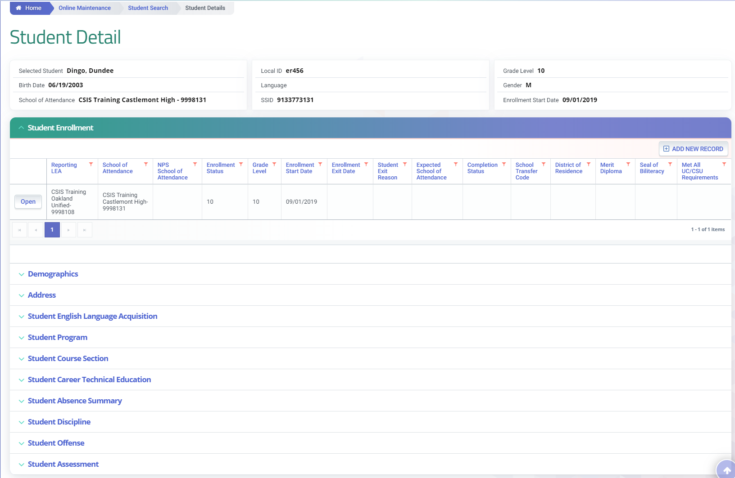
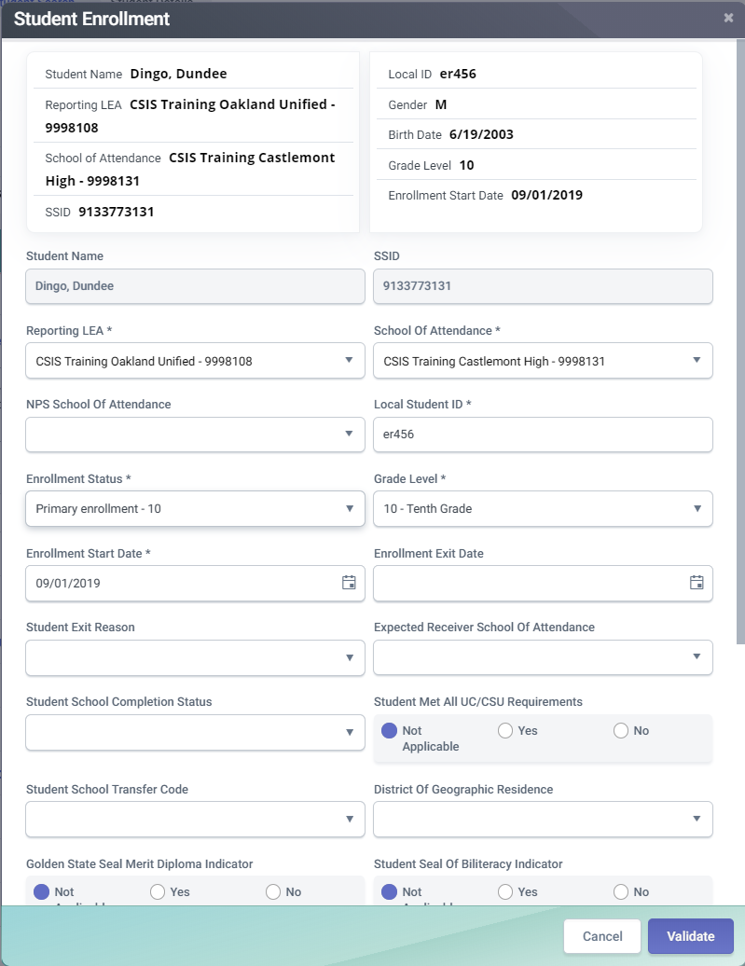
Student Detail
The record can be posted to the CALPADS ODS after validation, by clicking “Validate” after making changes in the modal, validated and post the record to the CALPADS ODS
The record can be updated by opening the modal
Notes:
The student detail screen allows access to the student enrollment details. Inside the enrollment container is a button that open an existing record. These records can be updated and modified online in a modal. Any changes must be first validated prior to posting.

Slide 18
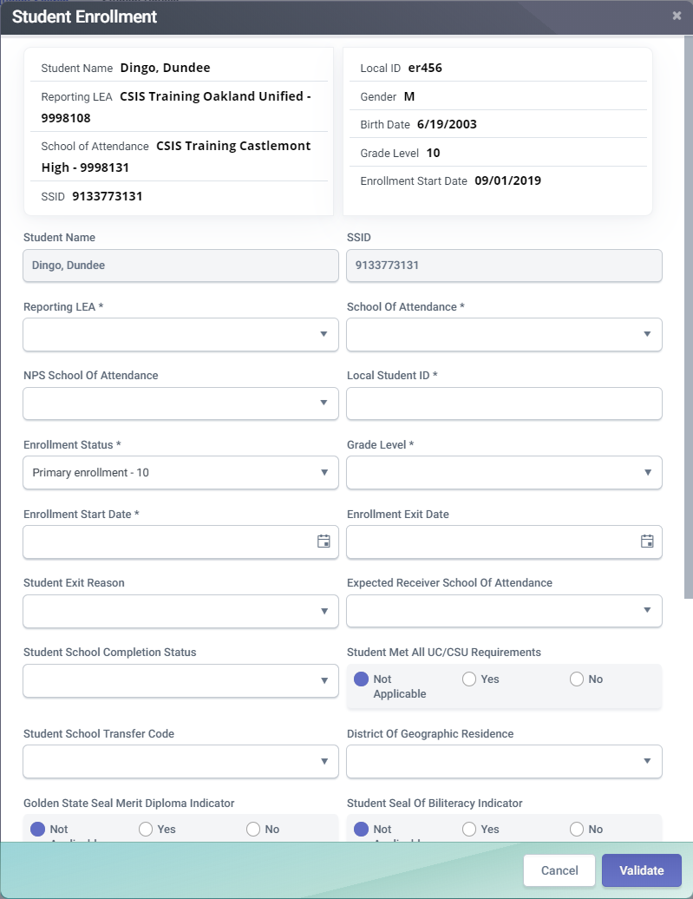
Add New Record
Select Add New Record to add additional enrollment records
Notes:
The Add New Record button allows a user to create a new enrolment record for an existing student in CALPADS. When the modal opens with the student details, the Student name SSID and reporting LEA fields are prepopulated with all the remaining fields left blank.

Slide 19
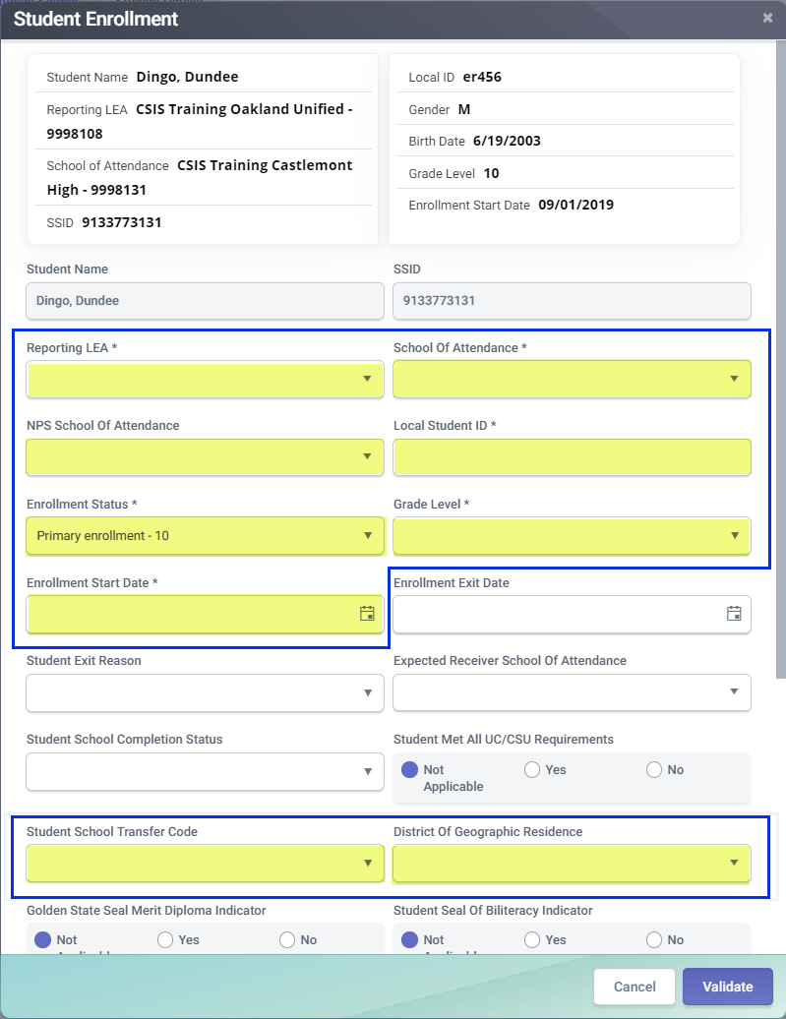
Student Enrollment
The SENR is used to enroll students update enrollment information and exit students. Understanding the data expected in each field allows for the data to be correctly populated
The fields highlighted are typically populated during the submission of an enrollment record
Notes:
The SENR is used to enroll students update enrollment information and exit students. Understanding the data expected in each field allows for the data to be correctly populated. A review of the CALPADs file specification and code sets is advisable for new users.

Slide 20
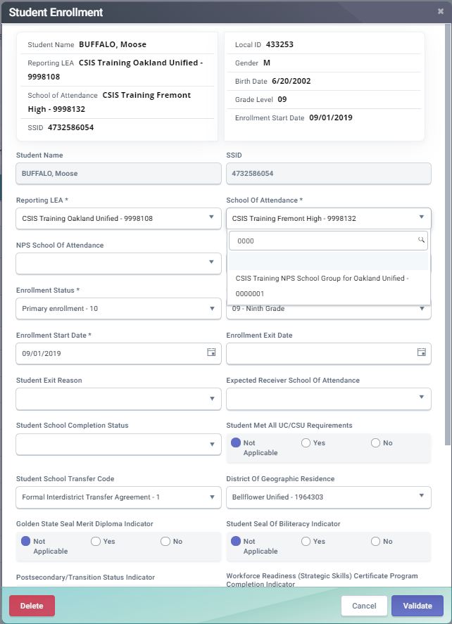
Reporting LEA and School of Attendance
The Reporting LEA is the district, county office or charter school that the user account is associate with during data population
The School of Attendance code indicates the school where the student attends
The independently reporting charter school should have the same Reporting LEA and School of Attendance codes
Notes:
The Reporting LEA is automatically populated with the code associated to your account. The school of attendance is a unique identifier for the school in which the student is enrolled. If the entity is an independently reporting charter school, the School code must be submitted for both the School of Attendance and the Reporting LEA

Slide 21
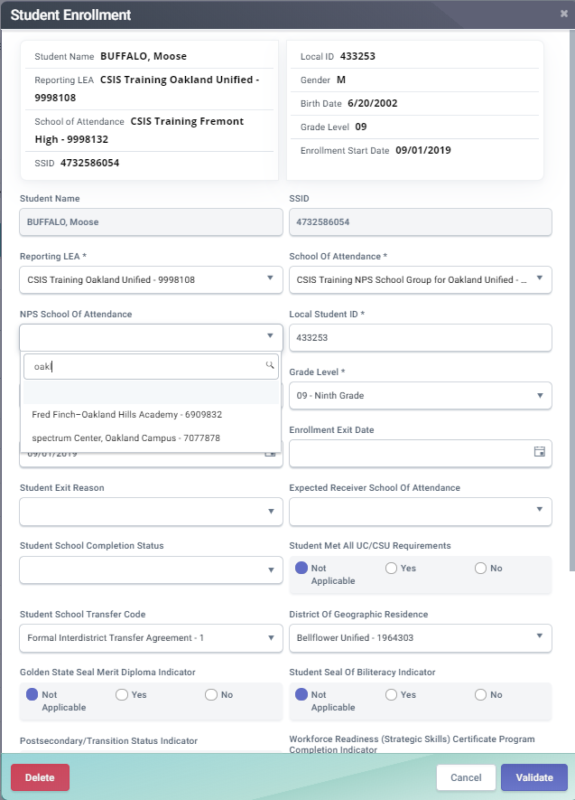
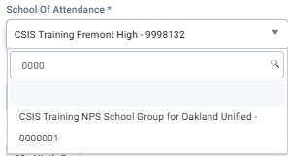
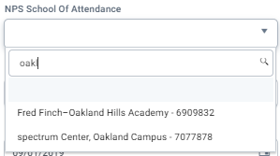
NPS Enrollment
The NPS School of Attendance code should be populated for certified NPS schools. If the NPS school is not certified use the generic code of 9999999
The School of Attendance code of 0000001 is used for All NPS schools
Identifier used to facilitate locating the original record in their local SIS
Notes:
If student attends an NPS school, the School of Attendance is identified as 0000001. The NPS School is identified in the element "School of Attendance NPS“. If a student with disabilities is enrolled at a non-public non-sectarian school that is not certified by the California Department of Education, use "9999999" in this field. This code is generic for "non-certified, non-sectarian non-public school."

Slide 22
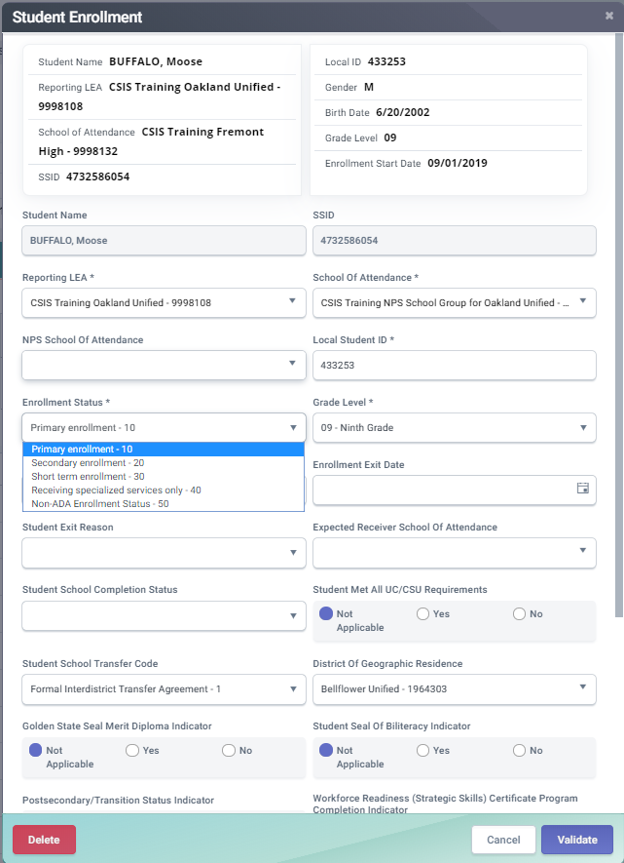
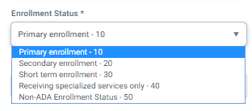
Enrollment Status
Short-Term Enrollment (30) status can only be used by educational options schools
Non-ADA Enrollment (50) Examples:
Students enrolled at private schools receiving services
Students paying tuition to go to a public school
Primary Enrollment (10) status establishes ownership
Secondary Enrollment (20) status may be concurrent with primary enrollments
Notes:
The enrollment status code designates the type of enrollment a student has within a school. Primary enrollments give an LEA ownership of a student record. Primary enrollments typically describe the school that provides the majority of a students instruction. A secondary enrollment status is used to denote a school providing supplemental enrollment instruction. A short term enrolment can only be used by educational option schools. This type of enrollment should be limited to 30 days or less.
New Enrollment Status 50 – Non-ADA Enrollment
Beginning with the 2019–20 Fall 1 submission, LEAs will be able to submit enrollments using a new Enrollment Status Code of 50 - Non-ADA Enrollment. This enrollment status code is specifically for use when reporting enrollments for students who are required to be tracked for state reporting, but for whom the LEA receives no apportionment. Following are examples of the use of this enrollment status:
Students with disabilities enrolled in private schools (not nonpublic nonsectarian certified schools) on Individualized Service Plans (ISPs)
Students who are paying tuition to attend a California public school, e.g., foreign exchange students or students whose primary residence is in Mexico.
This enrollment status should NOT be used for students in Transitional Kindergarten programs who are not yet five years old.

Slide 23
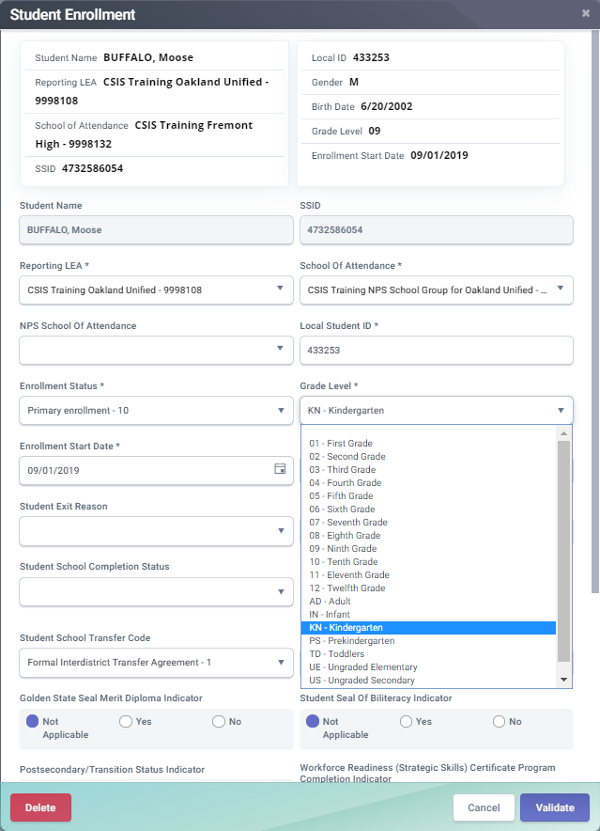
Enrollment Start & Date Grade Level
Ownership of student records begin on the Enrollment Start Date
Primary enrollments with the same school start date cannot exist
Ownership belongs to the LEA with the most recent Enrollment Start Date when there are concurrent enrollments
Notes:
The enrollment start date represents the first date that a student was expected to attend a particular school for a period of enrollment. A returning student would be expected to attend the first day of school. A new student is expected to attend on their first day of school.

Slide 24
Student Transfer Agreements
The Independently Reporting Charter school should have the same Reporting LEA and School of Attendance codes
The Reporting LEA is the district, county office or charter school that the user account is associate with during data population
The School of Attendance code indicates the school where the student attends
Notes:
This indicates the type of transfer that occurred between two districts, districts and county offices of education, or schools within a district.
This is required for all students enrolled in a county office of education in order to determine which students to attribute to which district for purposes of determining LEAs’ disadvantaged student count for the Local Control Funding Formula supplemental and concentration grant.
This field should be populated with a county-district code representing an active, open district that is not a county office of education or charter school.
1) If Reporting LEA = County Office of Education and school is not a charter or juvenile court school
OR
If school is a charter school AND Education Options Type = OPP, COMM, or SPEC;
THEN Y,
Else N
2) OR Student School Transfer Code must be populated if student has an enrollment status of primary or short-term and if Reporting LEA is a District of Choice AND the student's most recent prior enrollment is in a California public school in a different district.

Slide 25
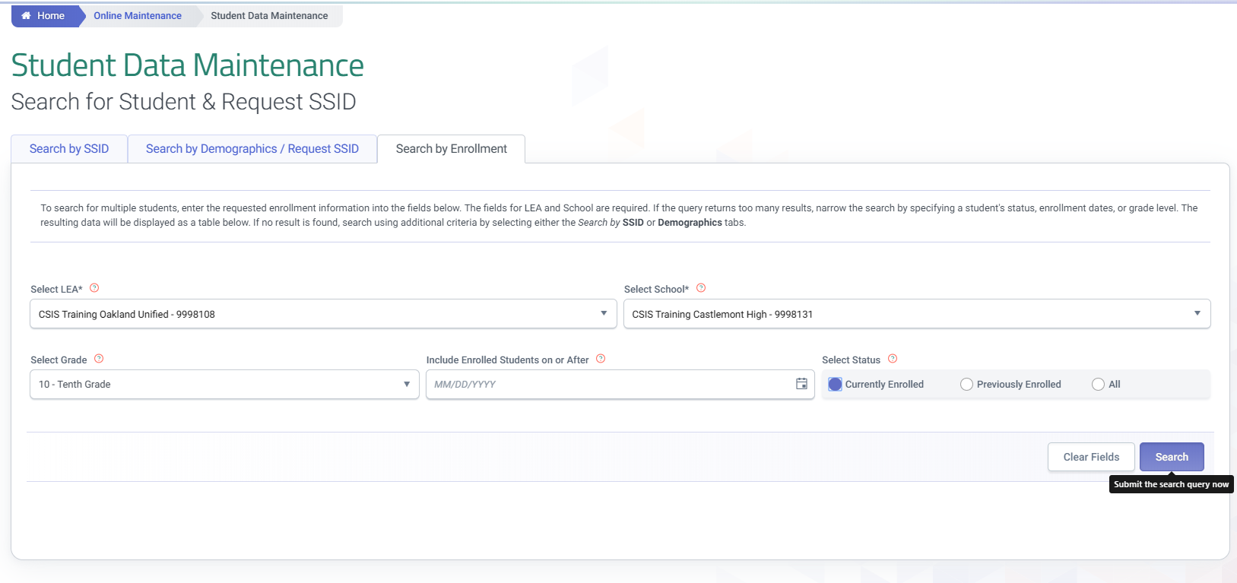
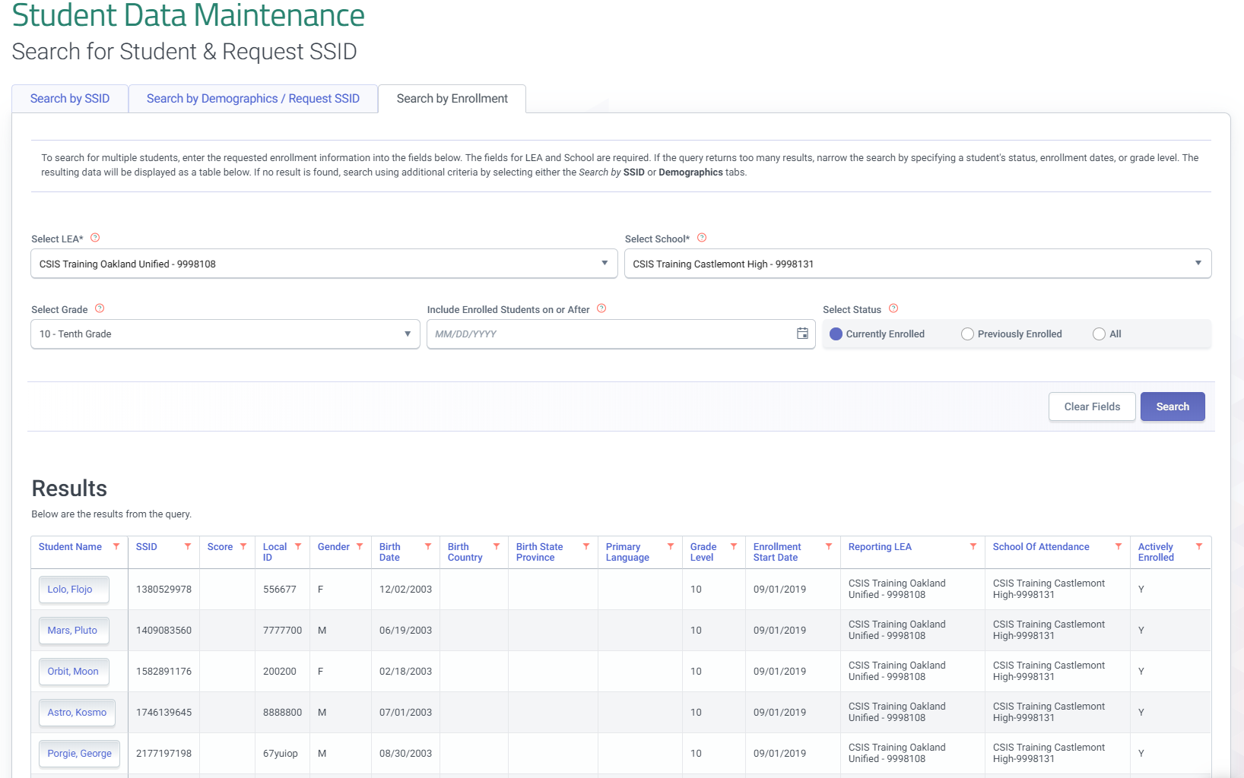
Search by Enrollment
The Search by Enrollment tab allows students to be located by school and grade
Notes:
When searching by enrollment a student list will result from the selection criteria. Student lists can be filtered by school, grade level and enrollment period.

Slide 26
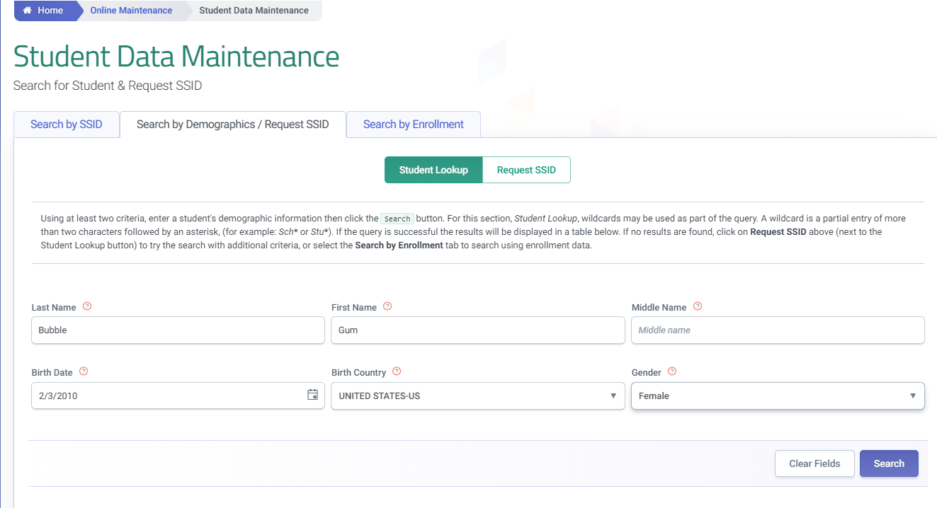
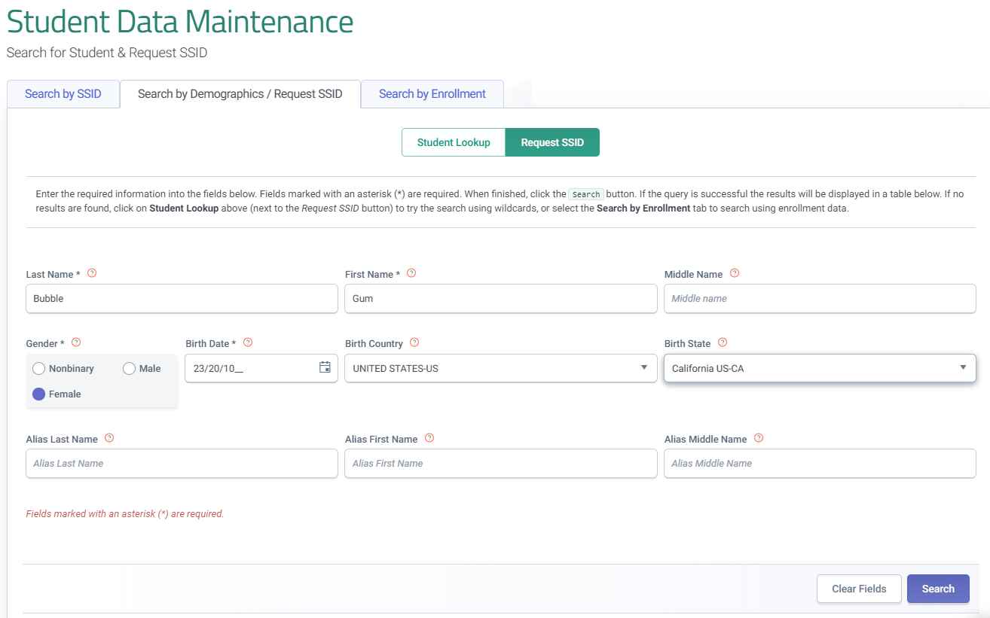
Request SSID
Toggle between Student Lookup and Request SSID to perform a more advanced search. After an advanced search the option to request an SSID will appear
Notes:
To request an SSID for a newly enrolled student, toggle from Student look up to the Request SSID screen within the Search by Demographics/ Request SSID tab on the Student data Maintenance screen. An SSID request requires several fields to be populated:
Last Name
First name
Gender
Birthdate

Slide 27
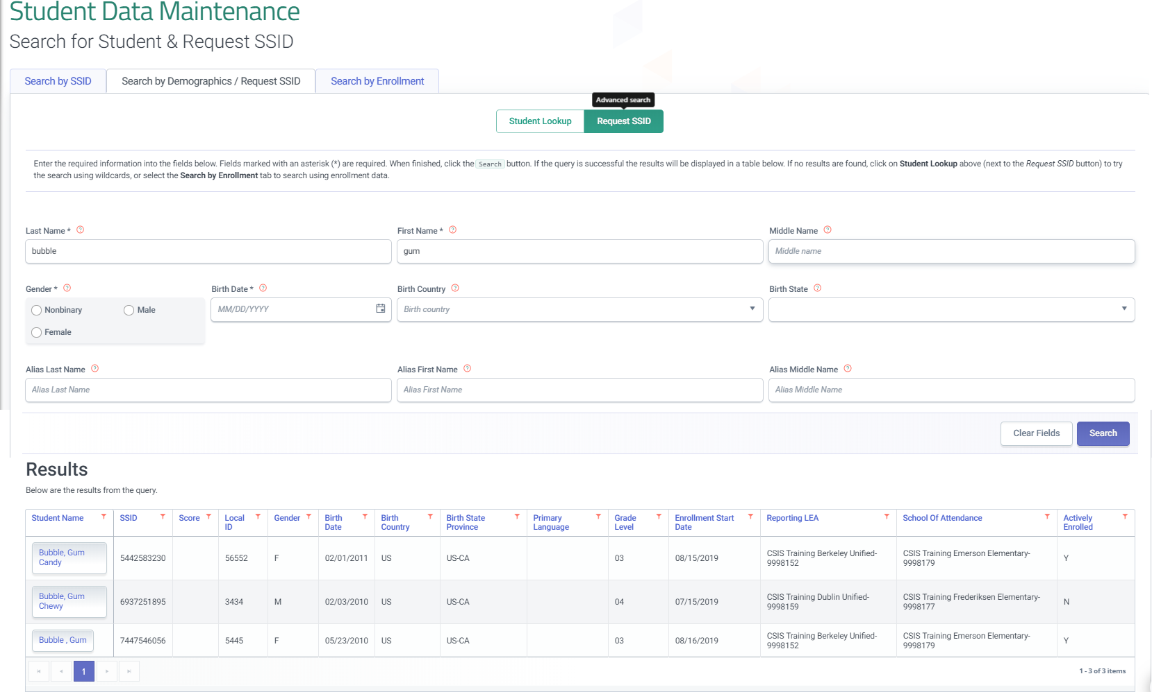
Request SSID Results
Review all of the potential candidates to find the match for your request. Select the name of the student to access the student’s profile
Notes:
When a match or multiple matches are found, carefully review the students record to ensure you do not assign a student more than one SSID. Select the student name to access a matching record.

Slide 28
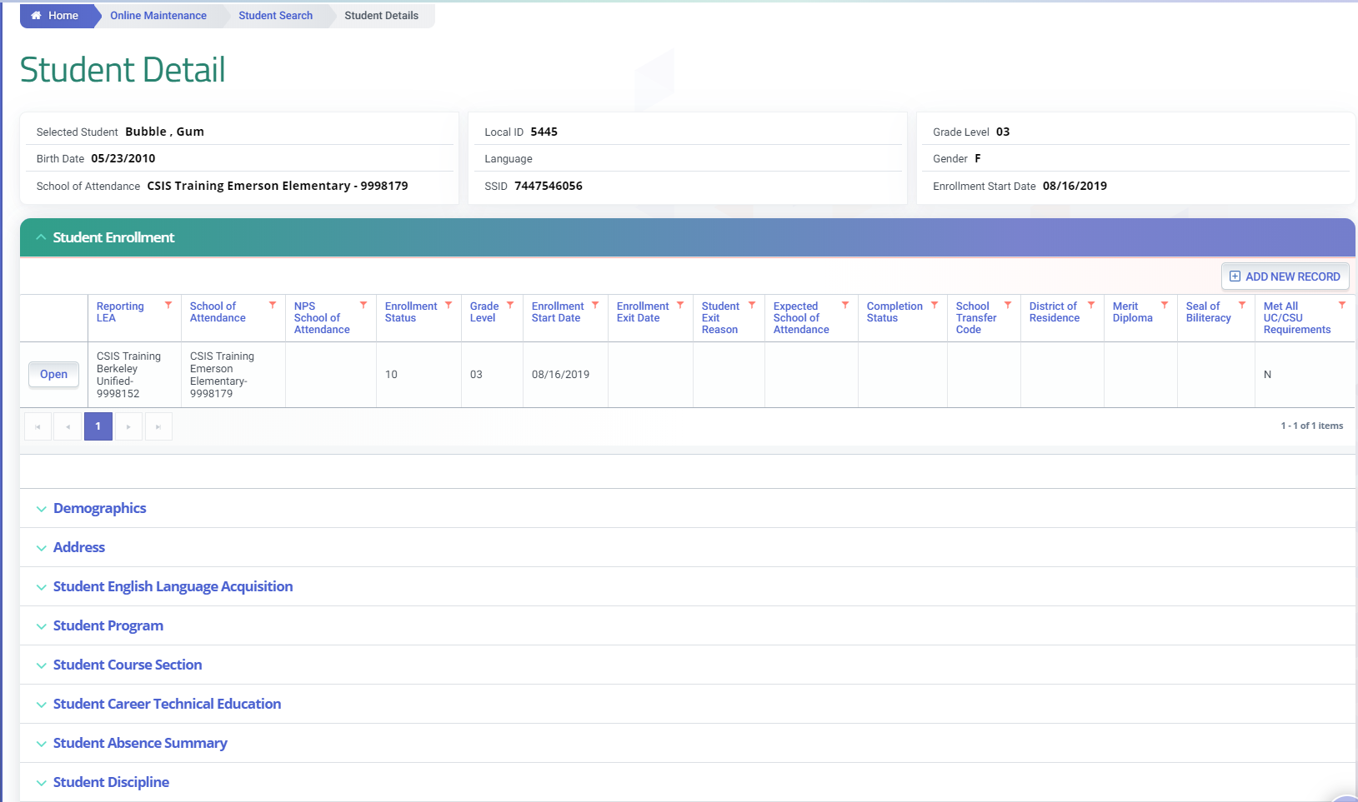
Request SSID
The Student Detail screen provides access to the complete student profile
Notes:
After selecting a student, you will have access to the student profile through the student detail screen.

Slide 29
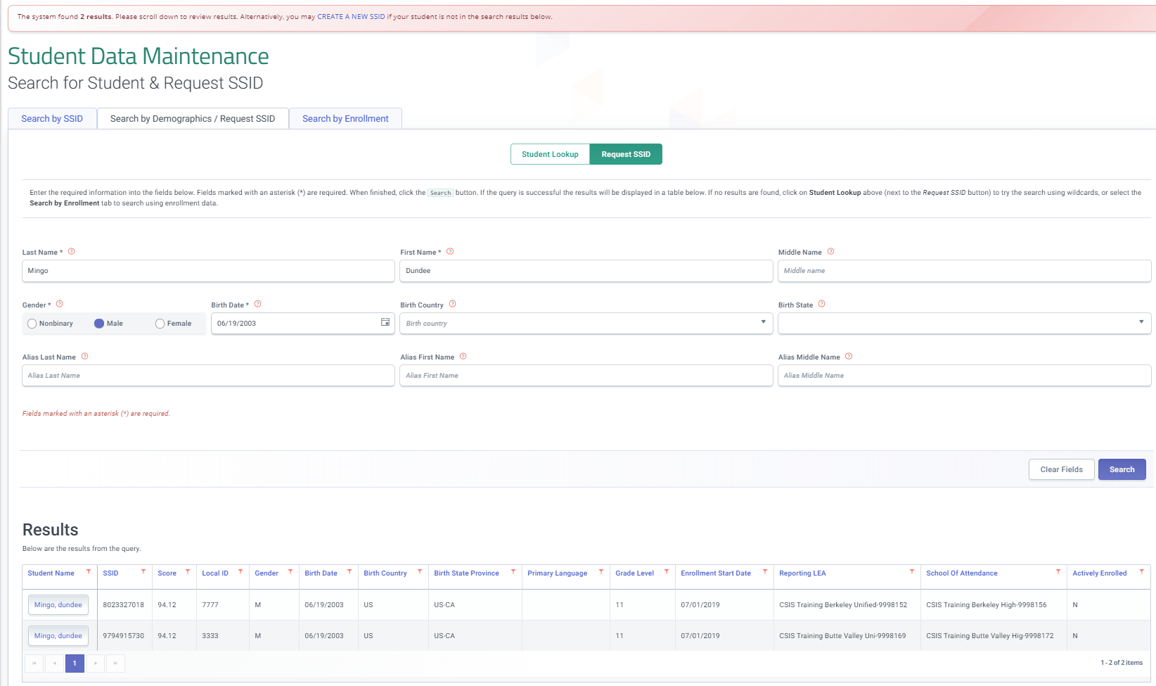
Create New SSID
When no records match your search criteria select Create A New SSID
Notes:
Back on the Request SSID screen. The additional fields required can be used to provide an LEA with advance search options, but when no student matches the criteria the option to select a new SSID will appear.

Slide 30
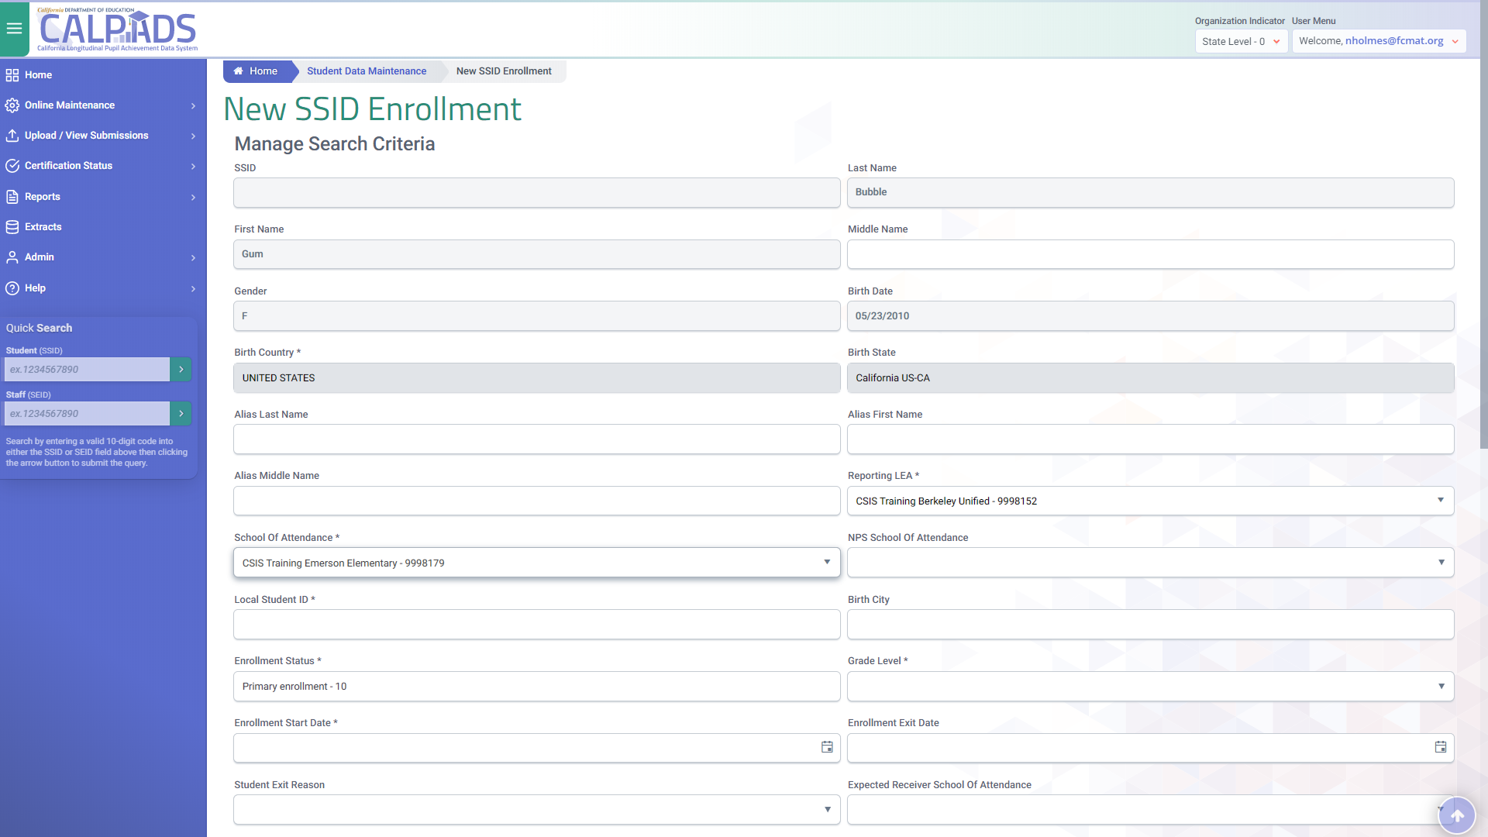
New SSID Enrollment
Students with no previous enrollment in CALPADS should be assigned new SSIDs
Notes:
After selecting Create a New SSID a blank New SSID Enrollment screen is available to begin the enrollment process.

Slide 31
Batch File Demonstration
Notes:
The SENR file is unique from all other files that can be uploaded to CALPADS because it provides the SSID request functionality and the matching of candidates. This demonstration will focus primarily on that functionality. Lease review the Batch file submission course and the CALPADS User Manual for information about the general functionality related to the submission process.

Slide 32
SSID Enrollment Process
SSID Matching Tool
Upload blank SSIDs
Input validation
(File passes)
Download SSID Match results
Review SSIDs for matches to import into the SIS
SIS
Note:
The Benefit of running the SSID match process first is having fewer MIDs
Auto Post to Data Store
Auto Generated
New SSIDs
from records in file
SSID Request or Enrollment Update
Batch File or
Online Maintenance
File Input Validations
(File Passes)
MIDs need to be resolved
SSID Extract
SIS
Note:
The SSID extract should still be used to reconcile SSIDs, Initial US Enrollment, ELA Status…
Upload File & View Submission Screens

Slide 33
Student Enrollment (SENR) File
The SENR file is used for a variety of actions
Search the ODS for an existing SSID
Request a new SSID
Submit a new SSID enrollment
Update an existing enrollment
Exit students

Slide 34
Student Enrollment (SENR) Fields
The SENR file contains ….
Identifiers
Matching Criteria
Other Student Information
Enrollment Fields
Enrollment Update Fields
Record Type, Transaction Code (Blank = Add/Update)
Reporting LEA, School of Attendance, Academic Year
Name, Gender, Birth Date, Birth Country, Primary Language, and SSID if known
Birth City, Birth State Province, Grade for SSID Enrollment
School Start Date, Enrollment Status Code
School Exit Date, Exit Reason Code, School Completion Status, Expected Receiver School of Attendance, Student Met All UC/CSU Requirements Indicator, Transfer code, DOR
Processing codes

Slide 35
SSID Matching Logic
Matching Logic is used as follows ….
When an SSID is included in the SSID Enrollment file
If the SSID is found in the ODS, the logic determines if the demographics submitted in the file match the demographics of the found SSID. If yes, CALPADS accepts the enrollment as an enrollment update – either an enrollment in a subsequent school in the LEA or an update to an existing enrollment

Slide 36
SSID Match Tool Tab
Select the SSID Match Tool tab to access the functionality
From the left navigation bar got to Online Maintenance, Student data and finally SSID Match tool
Notes:
The SSID Match tool is located in the Online Maintenance>Student Data tab in CALPADS. Along with the “Search by SSID,” “Search by Demographics/Request SSID,” and “Search by Enrollment” tabs, there will be a new tab for the SSID Matching Tool.
From the left navigation bar got to Online Maintenance, Student data and finally SSID Match tool
Select the SSID Match Tool tab to access the functionality

Slide 37
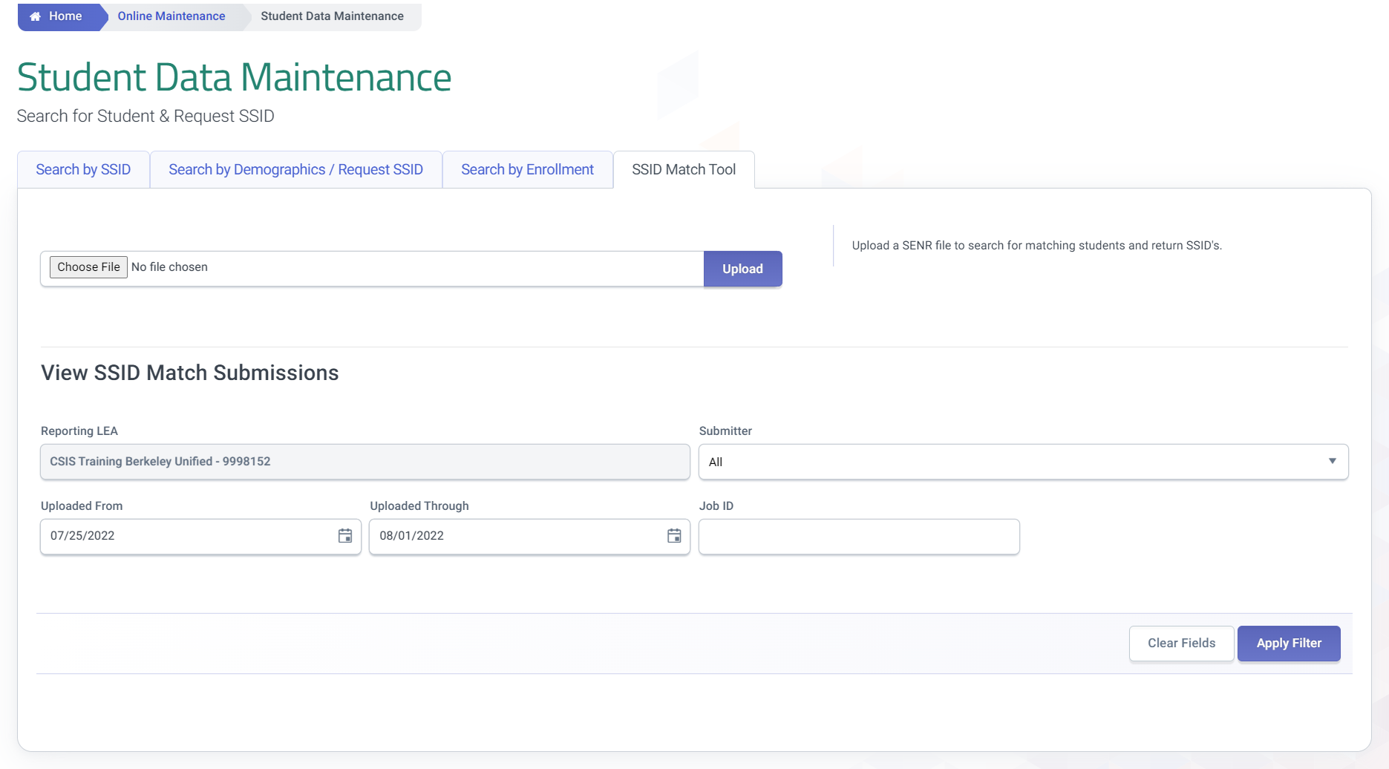
Upload Match File
The file upload mechanics are the same as the file upload screen
Notes:
The SSID Match Tool tab that contains both File Upload and View Submission functions in the same screen. All the functionality needed to upload a file for matching and download the results are contained in this tab. Similar functionality to the file upload screen is used to submit SENR file for matching. The tool accepts the current file formats (.csv, .xlsx and .txt).

Slide 38
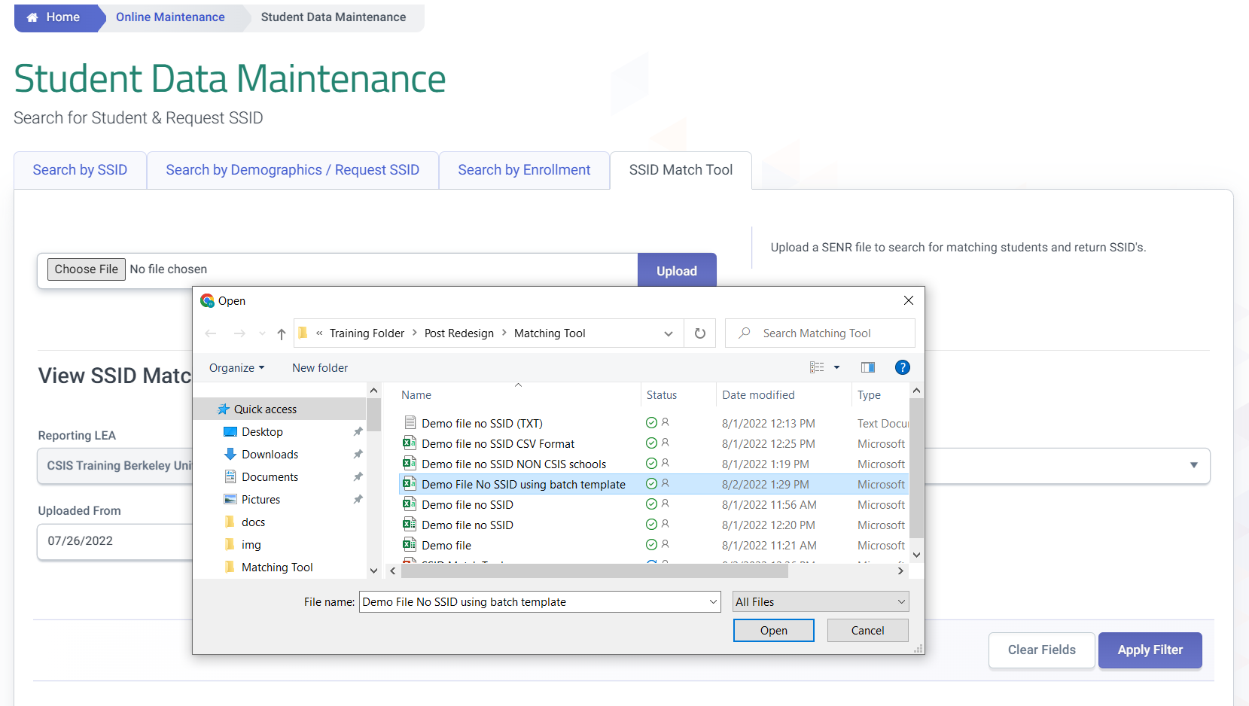
Select Match File
Select file to upload for matching
Only SENR files with blank SSIDs can be submitted

Slide 39
Submit File to Matching Process
After selecting a file click the upload button to submit the file for matching

Slide 40
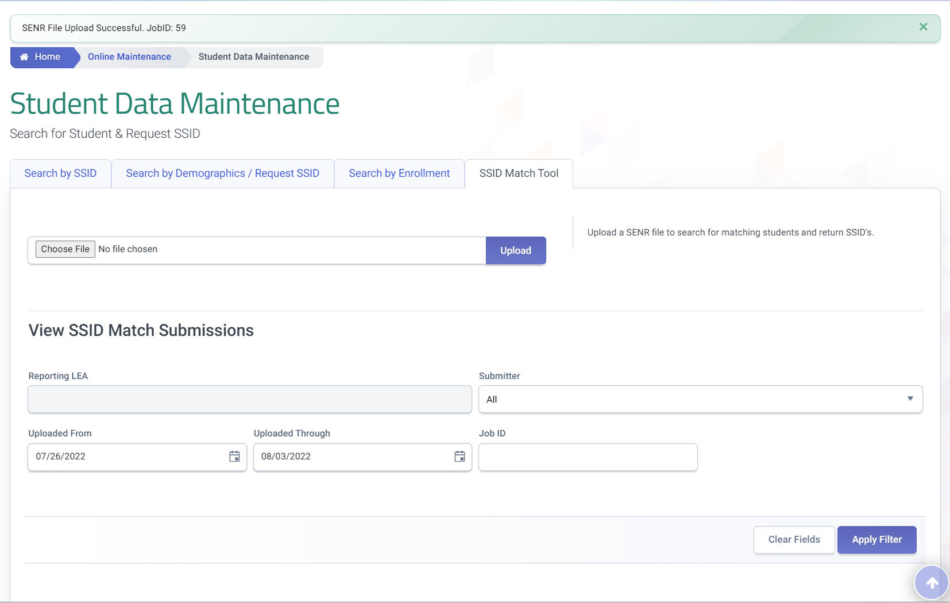
View SSID Match Submissions Screen
A notification of successful upload is displayed at the top of the screen
The Apply Filter button allows you to see submission results

Slide 41
Matching Formula
SSID Matching Criteria
match is based on these submitted SENR fields:
Legal and alias names
Gender
Date of Birth
Birth Country
Birth State
Match Scoring?
Legal names take a higher precedence in scoring. The sequencing for matching on the name fields is:
Perfect match of submitted legal names to legal or alias names in the Operational Data Store (ODS)
Perfect match of submitted Alias names to legal or alias names
Notes:
The match formula compares student demographic data to student data already in CALPADS, and determines potential matches.
SSID Matching Criteria
Matching is done using both the legal and alias names, with the legal names taking a higher precedence. This is in addition to the further demographic elements of gender, DOB, birth country, and Birth state.
Match Scoring
As stated, legal names take higher precedence than alias names. The sequencing for matching on the name fields is:
Perfect match of submitted legal names to legal or alias names in the Operational Data Store (ODS)
Perfect match of submitted Alias names to legal or alias names
NOTE:
Perfect matches maximize the match score, and variations reduce the match score. The further away the potential match student’s birth date is from the submitted student’s birth date, the lower the score.
Probabilistic matching (e.g., “Nick” for Nicolas, or “Bill” for William) is not currently part of the SSID match logic, but will be added as a future enhancement.

Slide 42
Match Result Fields
Field Name | Description
Result Category | The category describing the result of the candidate match. Values: No Match, Single Match, Multiple Match
Result Match Percentage Score | The score representing the percentage of demographic criteria that were matched to the submitted student demographic criteria.
Selection | This is a blank column that allows the user to indicate on hard copy which SSID matches the incoming SENR
Go to CALPADS Flash Update #231 for full Match Results file layout
SSID Request and Enrollment v1.1 September 5, 2024
42

Slide 43
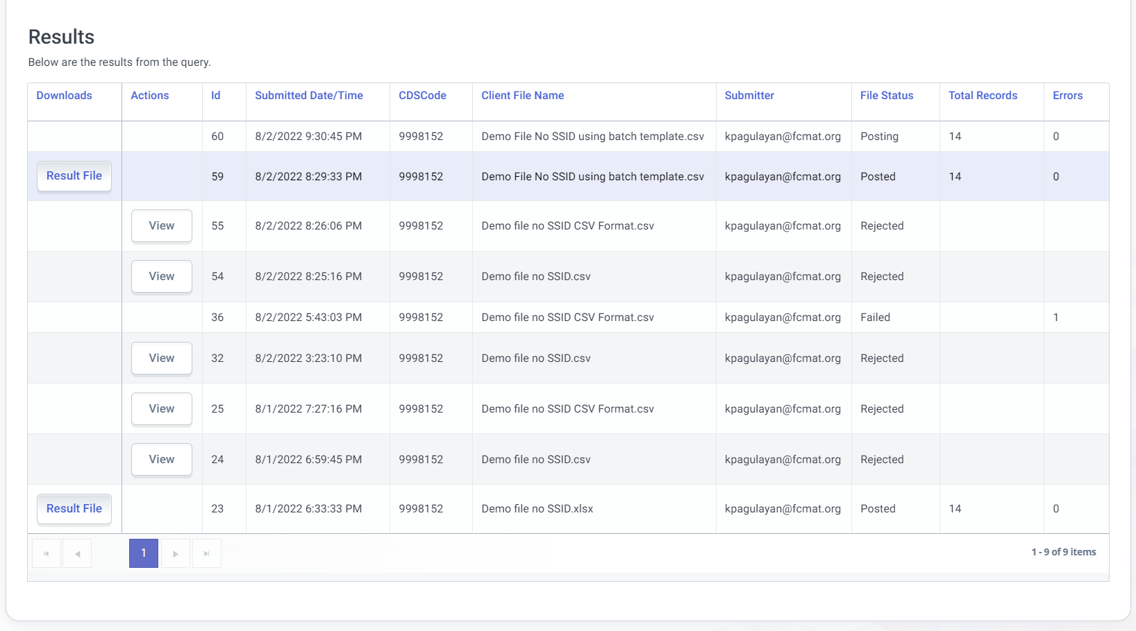
View Match Results
File with no errors will have downloadable results
Files that fail validations are not downloadable, do provide visibility of the rejected records
Notes:
The View Submission container lists the submitted files. If the file passes validation, the match to identify multiple SSID records is performed. Rejected files with failed records can be viewed so that errors can be corrected. Results file with passed records are only retained for 30 calendar days. The ‘Result File’ button allows user to download the match results.

Slide 44
Downloadable file
The downloadable SSID Match Result file output is carat delimited. LEA users must determine the best way to select candidates and then update Local SIS records. Options for making selections include:
Upload the raw file into your SIS and make the appropriate selections within the SIS
Convert the file into excel, make selections and then update student records in your SIS manually
Import the file into excel template (SENR , SSID Extract) to update your SIS to make selections

Slide 45
Match Result File Details
Matching student/candidate results (enrollment demographic, English language acquisition data)
Submitted student details from SENR
Match result category and scoring percentage
Notes:
From left to right the Match Results file provides the submitted student’s or candidate’s details, the match results in the center featuring the match category and the Match percentage score and then finally on the far right, enrollment and demographic details for a single candidate.

Slide 46
Match Result Records
1
2
3
Each row shows a single candidate match. All student records in the multiple match category will have a row for each match result.
Student has two matches, 1 row for each match
Student has three matches, the name and local ID can be used to distinguish students with similar submission details
Student has three matches local ID(11) distinguishes the student form the other two submitted students with similar names
Notes:
Each row shows a single candidate match. All student records in the multiple match category will have a row for each match result.
Student has two matches, 1 row for each match
Student has three matches, the name and local ID can be used to distinguish students with similar submission details
Student has three matches local ID(11) distinguishes the student form the other two submitted students with similar names

Slide 47
Selection Process
The selection column is provided to keep record of the match result selection. The selection column can be populated with the matching records SSID or a boolean, Y or N indication. This column may have different requirements or implementation when vendor import is supported
Notes:
Based on numerous data presented in the resulting report (Result Category, Match Percentage, SINF demographic information), LEA will analyze the results and indicate their selection in the highlighted column using predetermined codes suggested by the sis vendor.
The selection column is provided to keep record of the match result selection. The selection column can be populated with the matching records SSID or a Boolean, Y or N indication. This column may have different requirements or implementation when vendor import is supported
After all selections are done, update the local SIS and generate a new SSID enrollment file for the new academic year that includes the records from the selection process. By now, the only records with blank SSIDs will be for those flagged as no match and therefore will need its own SSID generated by CALPADS.

Slide 48
File Upload
SENR files processes:
Enrollments
Exits
Updates
SSID Requests
Notes:
Student enrollment, updates, exits and SSID request are all processed through an SENR submission.

Slide 49
Upload SSID File
Select a file for upload, matched SSIDs from match tool results must be submitted to CALPADS to enroll students after SIS matching
Notes:
The upload file functionality the same.

Slide 50
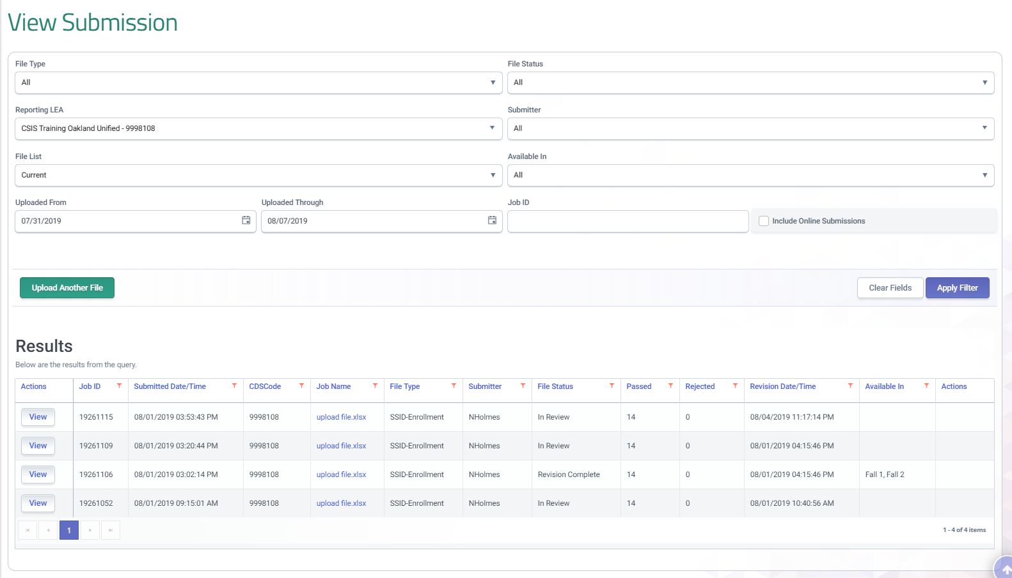
View Submission
The filter options can be used to narrow your search
The results allow you to review information on submitted records
Notes:
The view submission screen provides access to all files submitted within a time period or that have been filtered and meet the criteria.

Slide 51
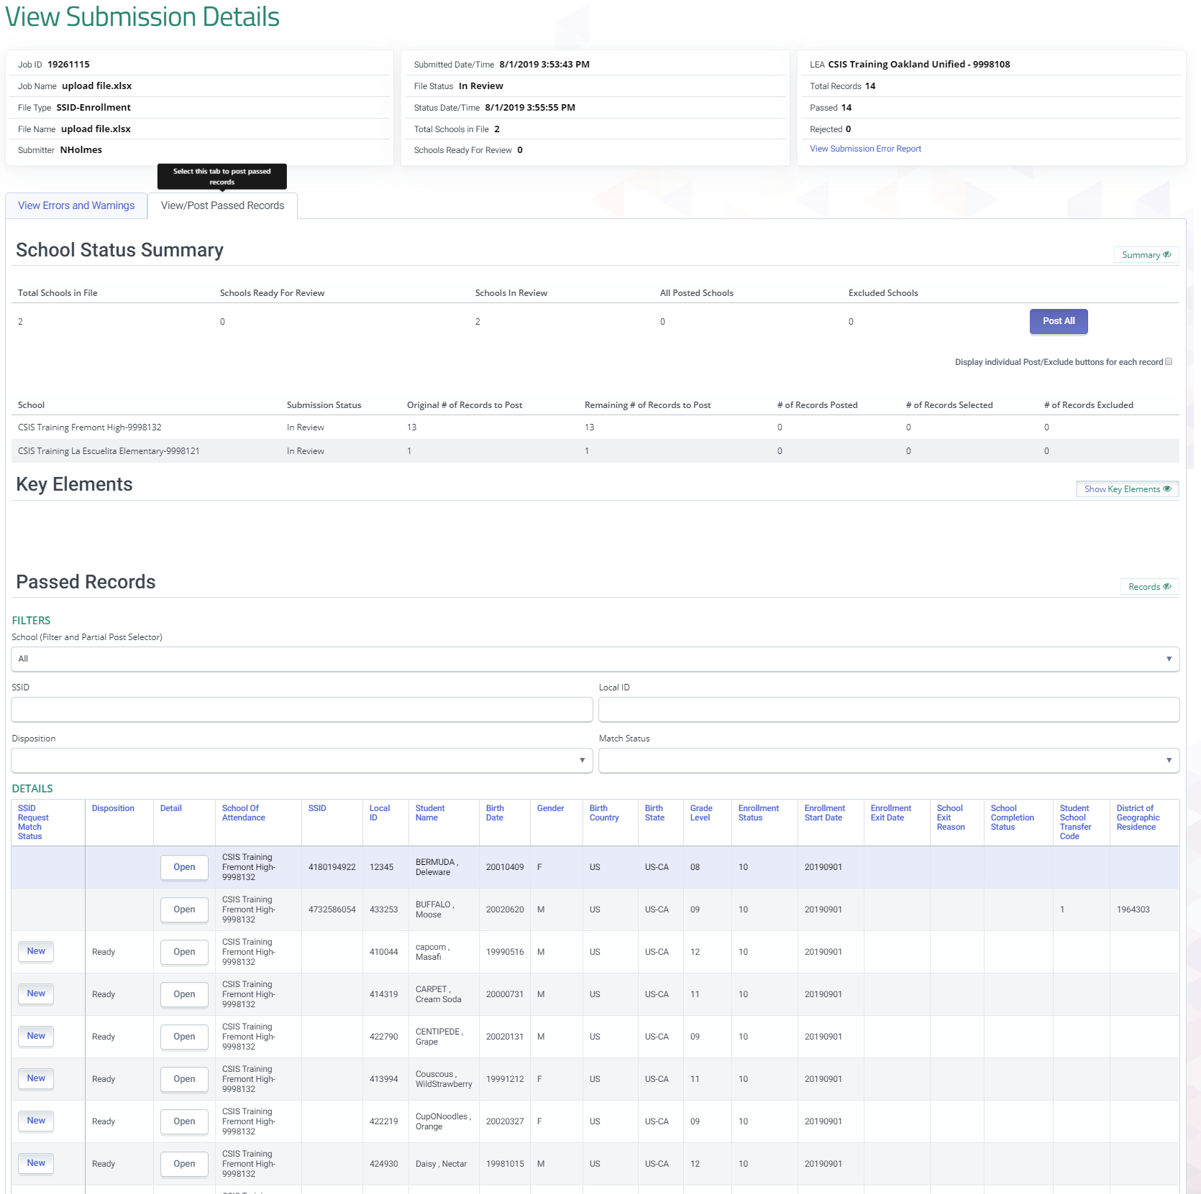
Submission Details
The View Submission details features Summaries for:
Submission
School status
Rejected record
Passed records
Individual rejected and passed record details are available from the results table at the bottom of the screen
Notes:
The view Submission details screen allows for the review of rejected and passed records. Once reviewed the file details can be posted or excluded by the user.

Slide 52
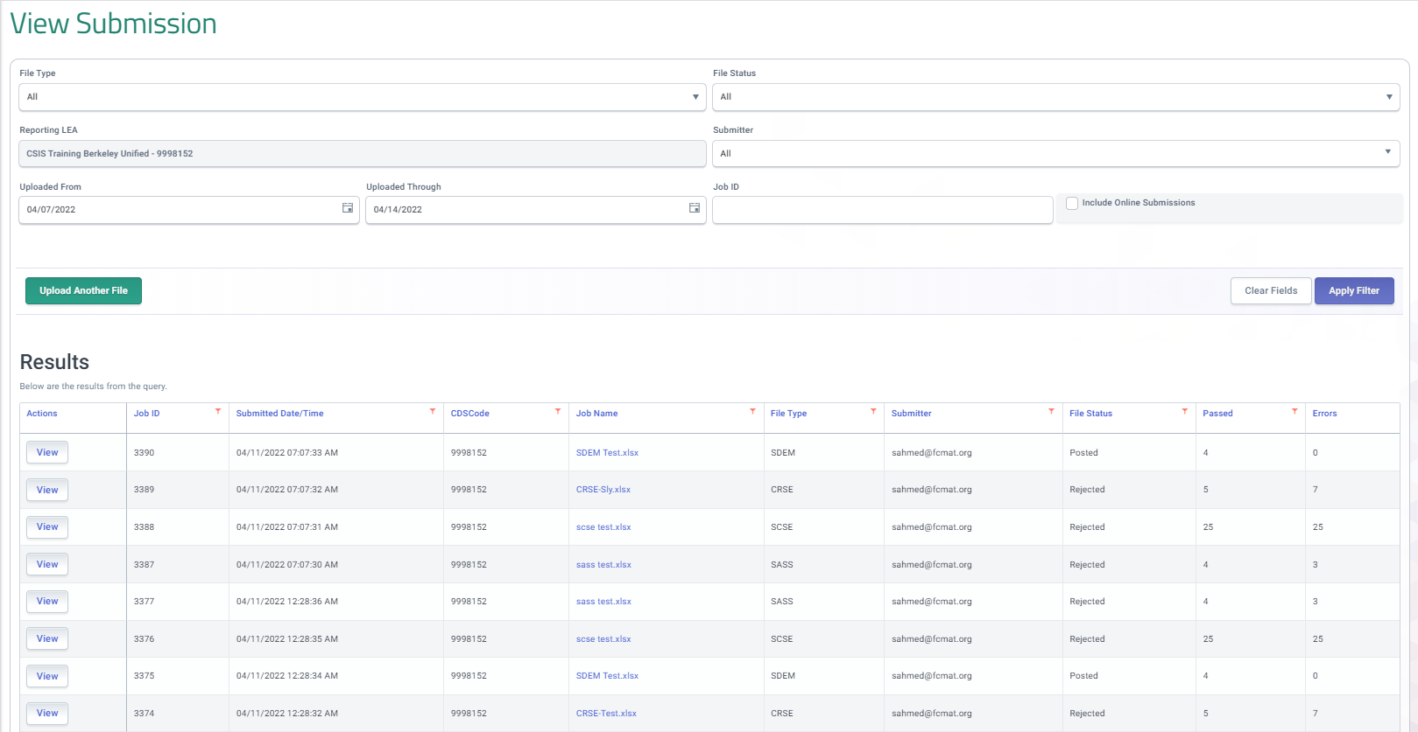
Review Submission
Review the submission on the View submission screen to verify the file passed or examine the rejected records
Notes:
Once the file has posted, Your next step in the process will be to Resolve MIDs on the same day that the SENR records are posted through MID Resolution. We will look at the files details just to reiterate why this is the next step.

Slide 53
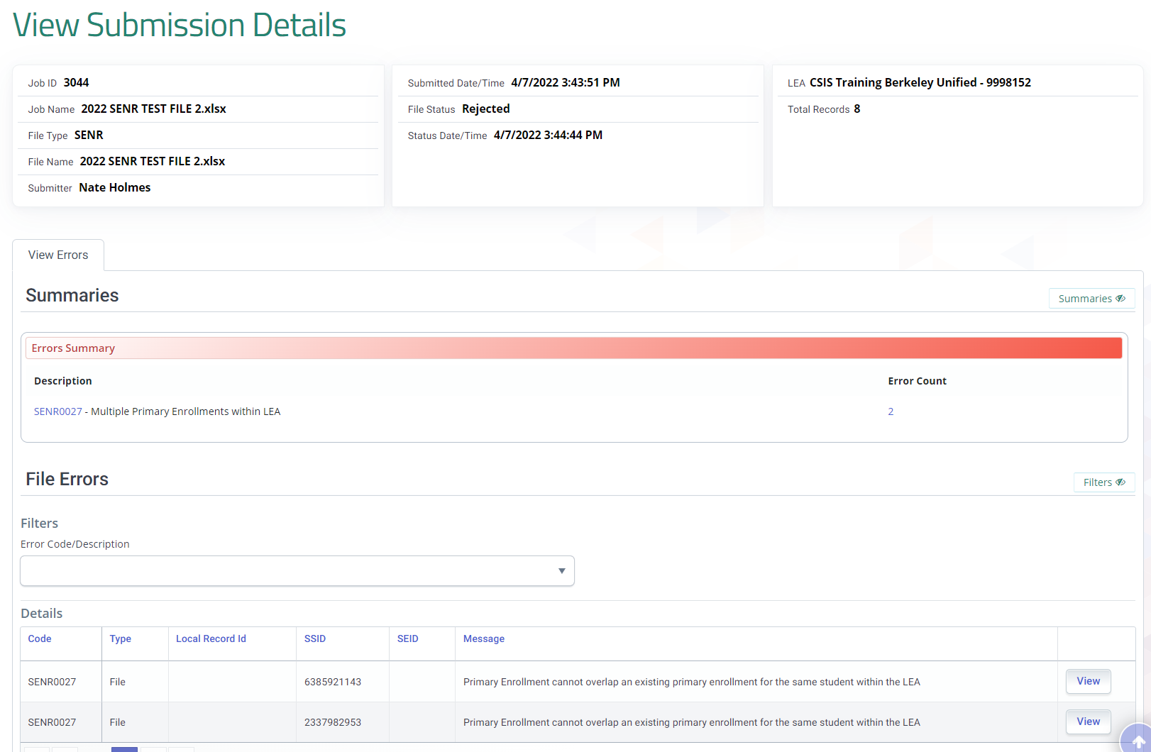
View Submission Details
Files that are rejected can have their errors reviewed but passed records are not available for passed files
Notes:
Again, we see that there are no passed records nor, did we select potential candidate matches for our students. The records were posted automatically. If you take a moment to think about it, the MID resolution process is the candidate selection process of old. If this step is adopted as part of your Student enrollment business practices in CALPADS you will have the opportunity to select candidates and assign the historical SSID as appropriate.

Slide 54
Wrap Up
Key Points, Resources and Support

Slide 55
Summary
The SENR is used to obtain SSIDs and enroll students.
Student enrollment establishes ownership of a student’s records in CALPADS
SSID enrollment using the SSID Match Tool can be done in both online maintenance and batch file upload
LEAs should use caution when obtaining SSIDs to avoid anomalies
The SSID Extract is used to update the SIS after SSIDs are obtained
Some key points to remember
SSID Request and Enrollment v1.1 September 5, 2024

Slide 56
SENR Reference Documentation
SSID Enrollment Procedures
User Manual
Notes:
SSID Enrollment Procedures: https://www.cde.ca.gov/ds/sp/cl/documents/ssidenrollv101b20190503.docx
CALPADS User Manual: https://documentation.calpads.org/

Slide 57
Resources
Here are some important resources related to reporting.
https://documentation.calpads.org/Support/References
https://csis.fcmat.org/resources/
https://bit.ly/4g9isS7
https://learn.fcmat.org/

Slide 58
Support
http://www2.cde.ca.gov/calpadshelp/default.aspx
Web
calpads-support@cde.ca.gov
Email
916-325-9210
Phone
https://csis.fcmat.org/ListServ
You can get help through these channels.
Listserv

Slide 59
Feedback
I have a question…
“
”
Please complete survey…
https://bit.ly/2MXsECg
“
”

Slide 60
Thank You
Presenter Name
916-325-9200
csistraining@fcmat.org
https://csis.fcmat.org/

