Slide 1



Fall 2 Data Population
Record Types
Record Relationships
Submission Sequence
Key Data Elements

Slide 2
Introduction
System Overview
Basics
Submission: Data Population
File Type: Data Population
Data Collections
Fall 1 Reporting and Certification
EOY 1-2 Reporting and Certification
Skill Building
Skill Building
Data Privacy
Data Population
CALPADS Basics
CALPADS Basics (SELPA)
4 Year Cohort
Fall 2 Reporting and Certification
Fall 2 Data Population - Live Training v1.1 – January 9, 2026

Slide 3

Target Audience
Individuals assigned to CALPADS maintenance
Supervisor of staff
assigned to CALPADS
Expectations
This session is meant to reinforce and clarify the concepts, procedures and key points of failure LEAs may encounter during submission.
We recommend you watch the YouTube Fall 2 Data Population videos if you need a basic, detailed discussion of each file type and file submission process.
Fall 2 Data Population - Live Training v1.1 – January 9, 2026

Slide 4





Objective
Identify
Submit
Resolve
Post
Prepare
the record types and relevant data elements required for Fall 2
CALPADS Literacy
the files in sequence for successful data validation
Manage and Maintain Data
with ease, any validation errors that may trigger during the submission
Critical Thinking
Fall 2 data so that the applicable records will be included in the snapshot revisions
Manage and Maintain Data
For Fall 2 Reporting & Certification
Project Management
Fall 2 Data Population - Live Training v1.1 – January 9, 2026

Slide 5







Agenda
Overview
Staff Data
Course & Student Course Data
English Learner Services
Postsecondary Status
Wrap-Up

Slide 6


Overview
Discuss background of Fall 2 submission
Fall 2 Data Population - Live Training v1.1 – January 9, 2026

Slide 7

Data Overview
Involves reporting of Staff employment, job classifications, and course assignments in the context of Assignment monitoring purposes; Postsecondary CTE survey results, and EL services data.
SDEM
  Reporting teacher of record
  End Date Employment for staff no longer employed
SASS
  Job classification and FTE
  Non-Classroom Based Job Assignment
CRSE and SCSE
  Field attributes, standard grade level range, subcategories, SPED & Home and Hospital, English learner services, distance learning, independent study indicators
PSTS
  Post-completion survey results
Fall 2 Data Population - Live Training v1.1 – January 9, 2026

Slide 8
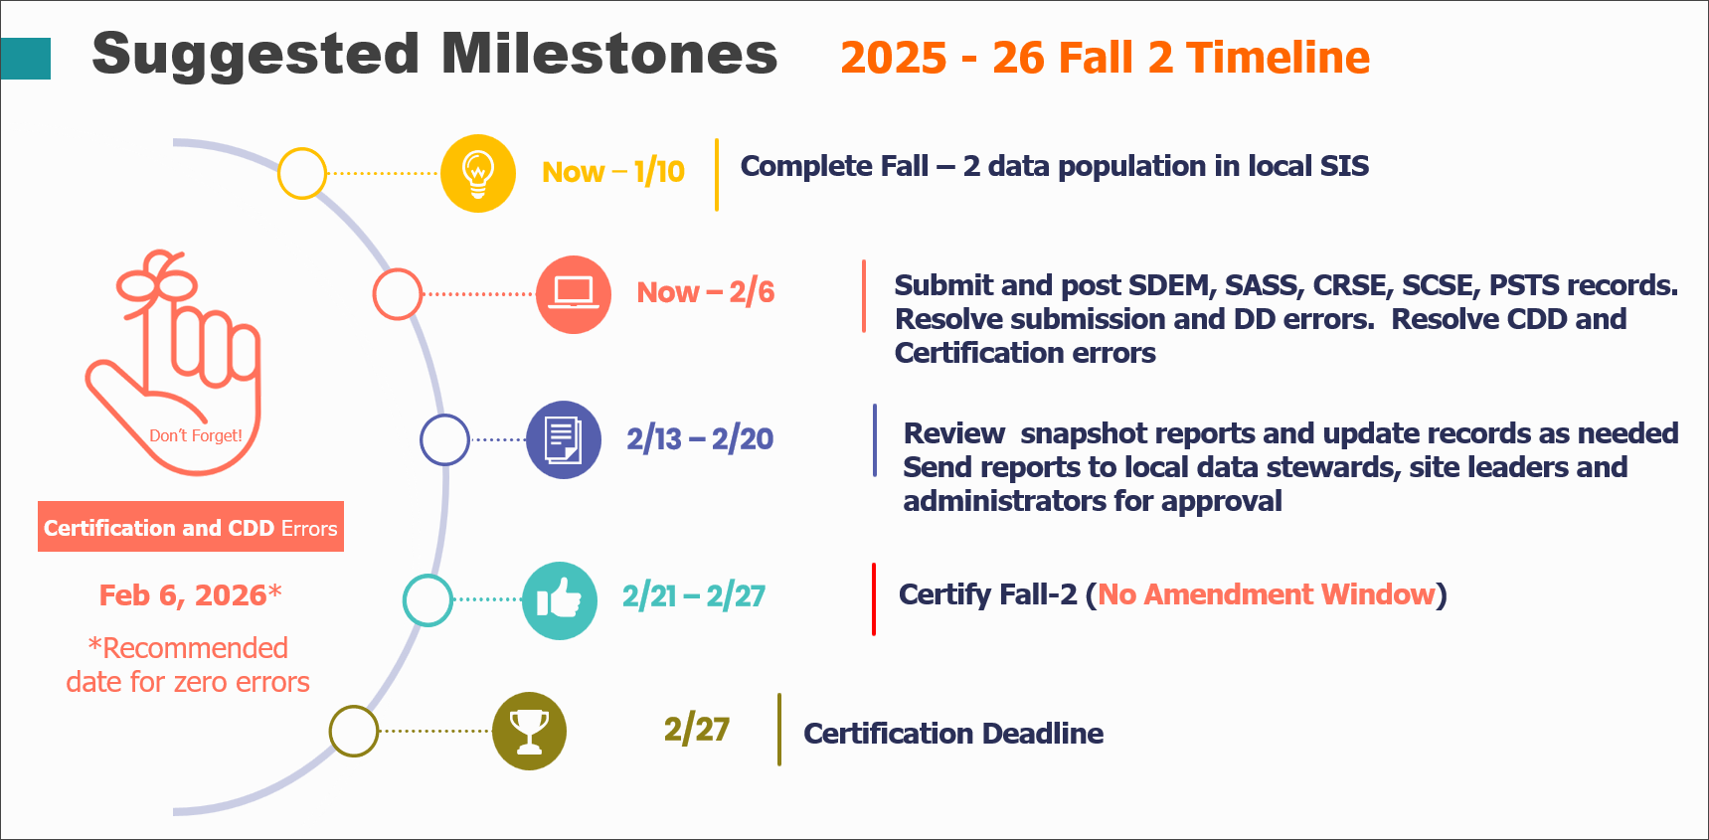
Fall 2 Data Population - Live Training v1.1 – January 9, 2026

Slide 9
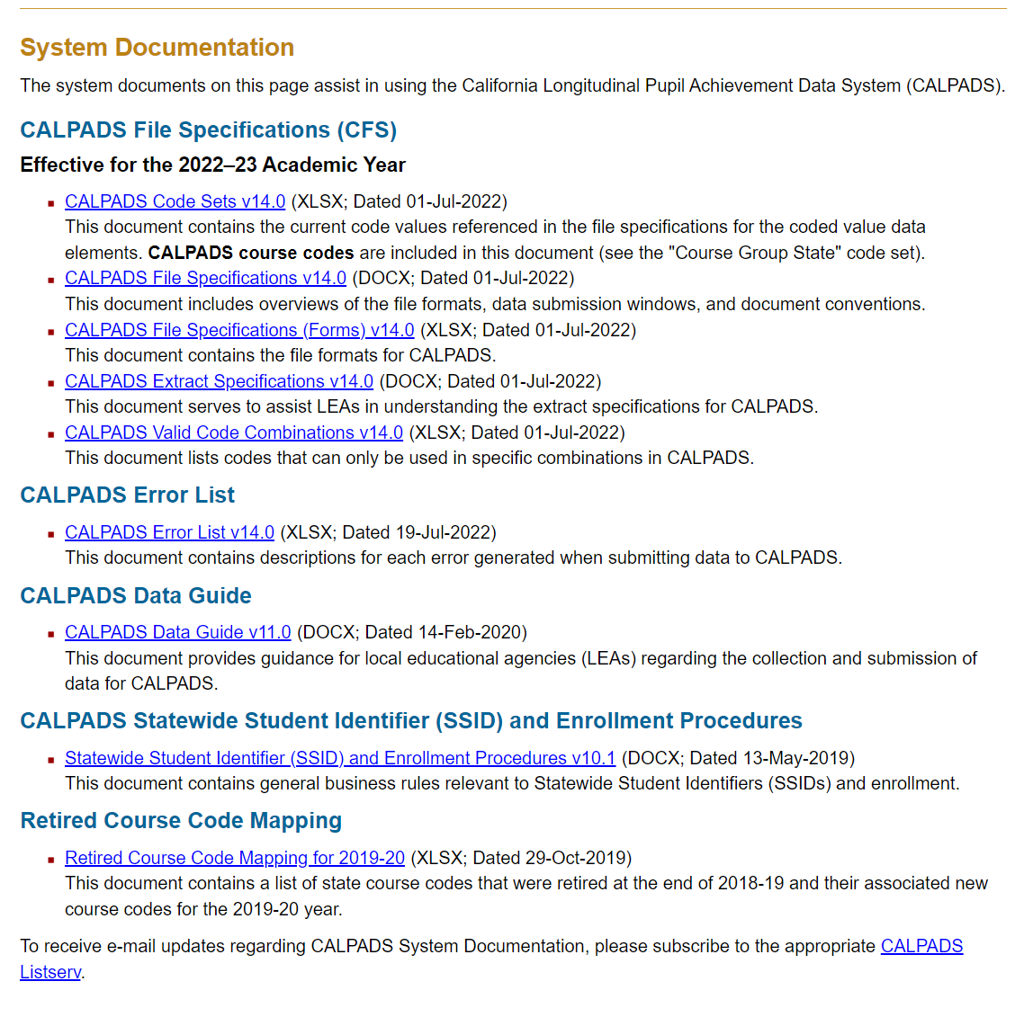
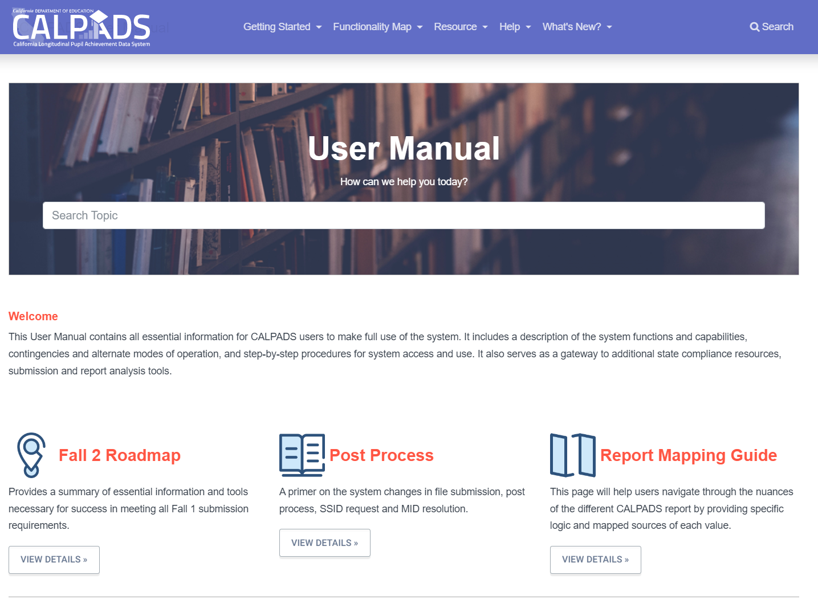
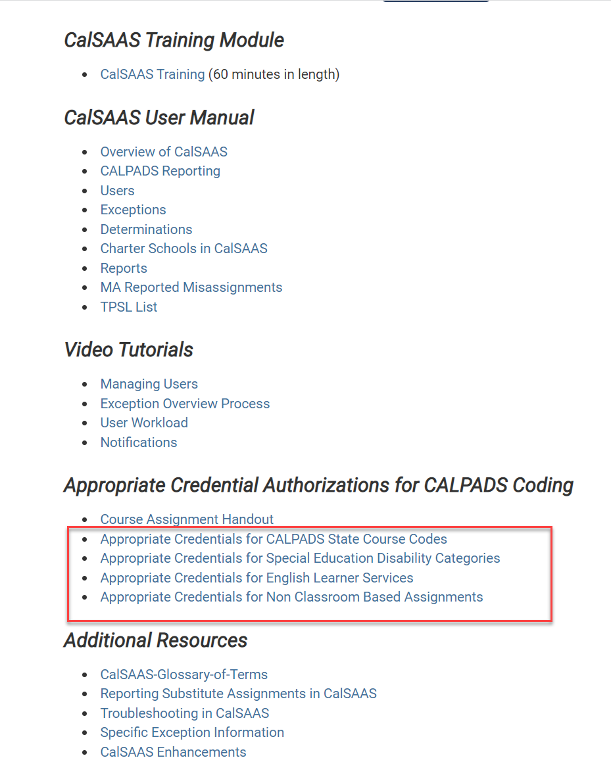
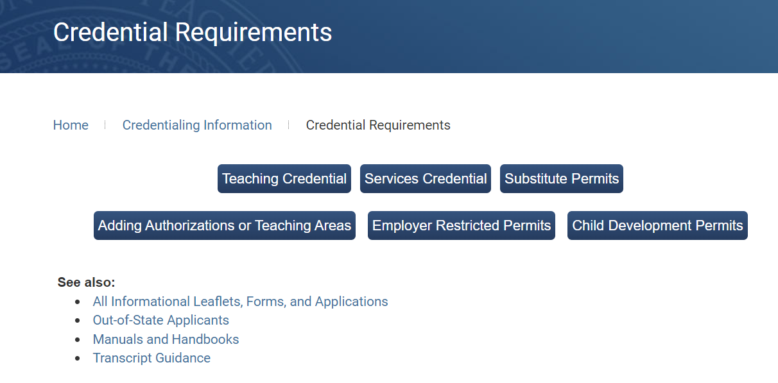
Fall 2 Survival Tool Kit
Fall 2 Data Population - Live Training v1.1 – January 9, 2026

Slide 10




Who are involved in data collection?
School Sites
Help gather and maintain student profile data within SIS.
Human Resource
Help determine the staff credentials appropriate for the courses taught, FTE information
CALPADS
LEA Coordinator
Other Staff
Programs, EL, HR, Curriculum, SPED
Help determine the course content, EL services provided, assign students in courses.
Fall 2 Data Population - Live Training v1.1 – January 9, 2026

Slide 11
What to Submit
Staff Assignment*
(SASS)
Course Section*
Enrollment
(CRSE)
Staff Demographic
(SDEM)
Student Course Section*
Enrollment
(SCSE)
Postsecondary Status*
(PSTS)
File Type | Operational Keys
SASS | School of Assignment, Academic Year ID
CRSE | School of Course Delivery, Academic Year ID, Academic Term Code
SCSE | SSID, School of Course Delivery, Academic Year ID, Academic Term Code
PSTS | Reporting LEA, Education Program Participation Type, Academic Year
File types must be submitted in this sequence.
Records for each file needs to be posted first before uploading the next.
* File types in asterisk(*) are full replacement type files
Fall 2 Data Population - Live Training v1.1 – January 9, 2026

Slide 12
Fall 2 Data Submission
SSID Enrollment
(Census Day)
Staff Demographics
SSID Enrollment
(Prior Year )
SEID
SSID
Staff Assignments
Course Section
SSID
Postsecondary Status
Student Program
Student English Language Acquisition
Student Information
Course Section ID
Student Course Section
Fall 2 Data Population - Live Training v1.1 – January 9, 2026

Slide 13

Staff Demographics
Discuss key SDEM data elements
Fall 2 Data Population - Live Training v1.1 – January 9, 2026

Slide 14


SDEM Notable Points
Know who to involve in this collection
  Human Resource
  Site staff
Start with some housekeeping.
Identify the staff members who are no longer employed by your LEA.
Properly exit their SDEM record.
Identify your reportable staff members
Who should and should not be reported in CALPADS.
Are they directly employed by your LEA?
Are they employed by third party organizations ( i.e. COE, Colleges, Online Education)?
Do they have a SEID? Do you know how and where to search/acquire for their SEID?
Are their credentials appropriate to their work assignments?
Properly report Staff Service Years LEA and Staff Service Years Total
Annually update staff service years count.
Used to determined inexperienced teachers for the ESSA. Teacher with 2 years or less of experience are considered inexperienced
Fall 2 Data Population - Live Training v1.1 – January 9, 2026
14

Slide 15
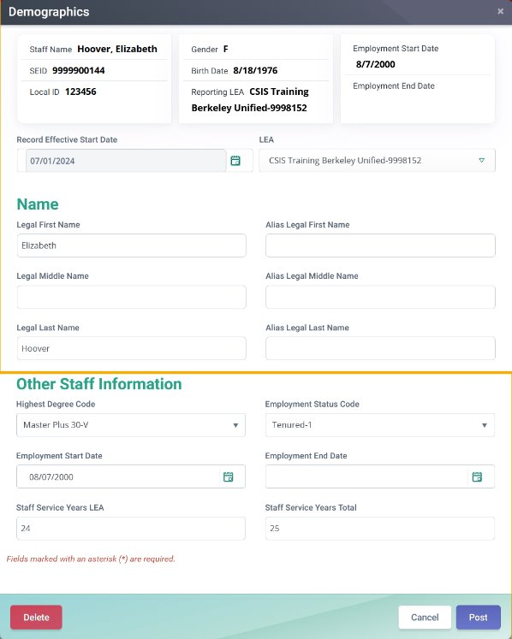

Closing SDEM Records
Staff no longer employed at your LEA should have the employment end date populated in the SDEM record with last date that a staff member was employed by the LEA.
Fall 2 Data Population - Live Training v1.1 – January 9, 2026
Fall 2 Data Population AY 2020-21
15
15

Slide 16
Reportable Staff
Report certificated staff (Do not report classified staff)
University interns or district interns authorized by the Commission on Teacher Credentialing and employed in certificated positions
Non-certificated teachers and administrators who obtain a certificate of clearance and were issued SEIDs
Substitute teachers (long-term and short-term) as defined by the individual districts.
Itinerant teachers teaching at multiple sites within a district. Itinerant teachers may or may not be in the master schedule at a site.
“Pull-out/push-in” teachers, also known as “resource teachers,” teaching at multiple sites or at one site. Generally, these teachers are not in the master schedule.
Individuals on provisional internship permits, short-term staff permits, or teacher/emergency permits.
Fall 2 Data Population - Live Training v1.1 – January 9, 2026
16

Slide 17
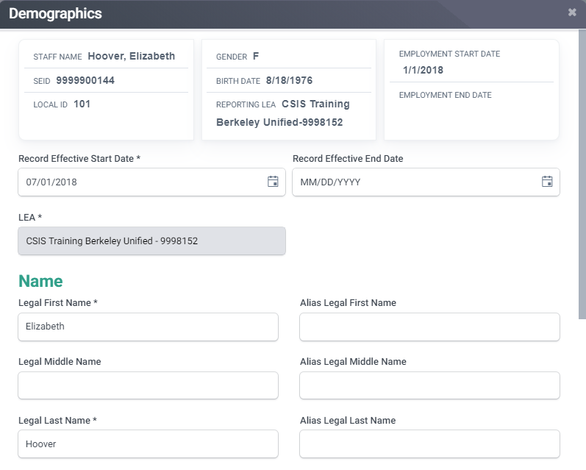
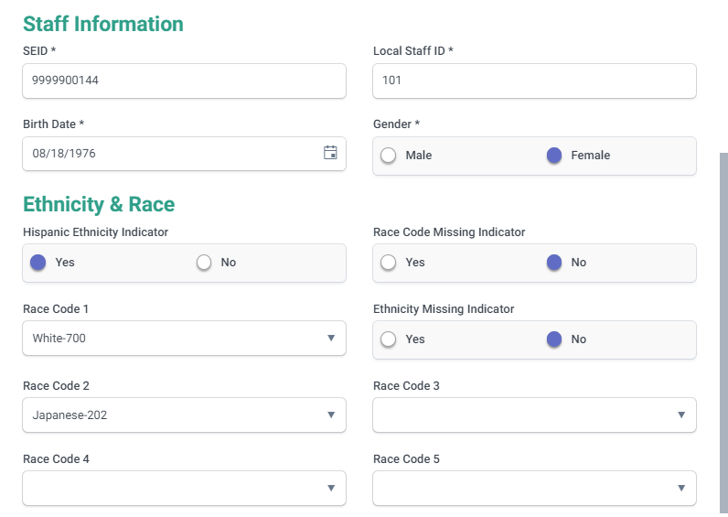
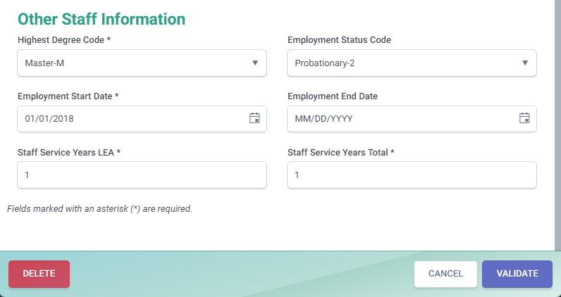
Staff Demographics
B
C
D
E
F
A
G
A. The Effective Start Date represents when the data in the record became effective for the current academic year.
B. Must contain a valid SEID as verified with the CTC. SEID 999999999 should not be used on a SDEM record.
C. The Degree Status Code represents the highest academic degree a given staff member has earned.
D. The Employment Status Code is required for all teachers. Optional for Administrator and Pupil Service job classifications.
E. Represents the first date that a given staff member was employed by the LEA.
F. The Employment End Date is required for staff who is no longer employed by the LEA to exclude them from the Fall 2 data submission.
G. The LEA Service Years and Total Service Years should be updated every year because CALPADS does not have sufficient information to calculate them. It is used to determine inexperienced teachers and calculated for the California School Dashboard.
Fall 2 Data Population - Live Training v1.1 – January 9, 2026

Slide 18
Staff Assignment
Discuss key SASS data elements
Fall 2 Data Population - Live Training v1.1 – January 9, 2026

Slide 19
SASS Notable Points
Know who to involve in this collection
  Human Resource, Site staff
Only report staff with SEID
Do not report a SASS for Staff with no SEID
Do not use of SEID 9999999999 in SDEM and SASS. Only use it in the CRSE for courses taught by teachers not employed by the LEA.
What are their Job classifications?
What are they credentialed for? Teaching? Or Admin/Pupil Services?
Contrasting classroom-based vs non-classroom-based job classification reporting
Reporting Assignments
Know who is the teacher to report.
Know how to report teachers in different assignment scenarios.
Know how to report Special Education Assignments in classroom vs non-classroom setting.
Reporting Librarian Assignments
Reporting Admins and pupil service staff
Determining and Reporting Staff FTE%,
Assigning staff to one or multiple sites (School of Assignment)
Fall 2 Data Population - Live Training v1.1 – January 9, 2026

Slide 20
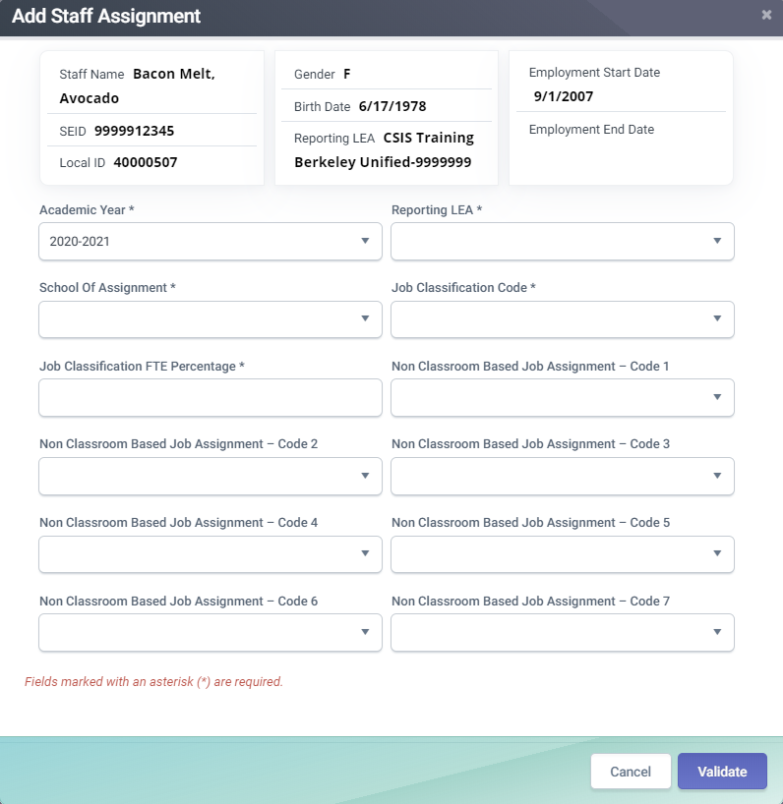
Staff Assignment
1
Populate the Job Classification code based on the staff members Credentials.
10- Admin
11-Pupil Services
12- Teacher
26- Non certificated Charter School Teacher
27- Itinerant Teacher
1
2
2
3
The FTE percentage should be between 5% and 200%.
For Employees on leave (6018), FTE should be greater than 1%
3
Non-Classroom Based Job Assignment is required for Job Classification Code = 10, 11 or 25. Course records associated with SEIDs are “teaching assignments”
Fall 2 Data Population - Live Training v1.1 – January 9, 2026

Slide 21
Job Classification FTE Percentage
The reporting of FTE by classification is and by school of assignment, not by assignment. In addition, the sum of the FTE percentage by job classification for each staff member cannot exceed 200% or be less than 5% total.
If ... | Then ...
All of the staff member’s time is devoted to the job classification of “Administrator,” | Report 100% to the job classification of “Administrator.”
All of the staff member’s time is devoted to teaching, | Report 100% to the job classification of “Teacher.”
Half of the staff time is devoted to administration, and: The other half of the time is devoted to teaching, | Report 50% to the job classification of “Administrator” and 50% to the job classification of “Teacher.”
Fall 2 Data Population - Live Training v1.1 – January 9, 2026

Slide 22
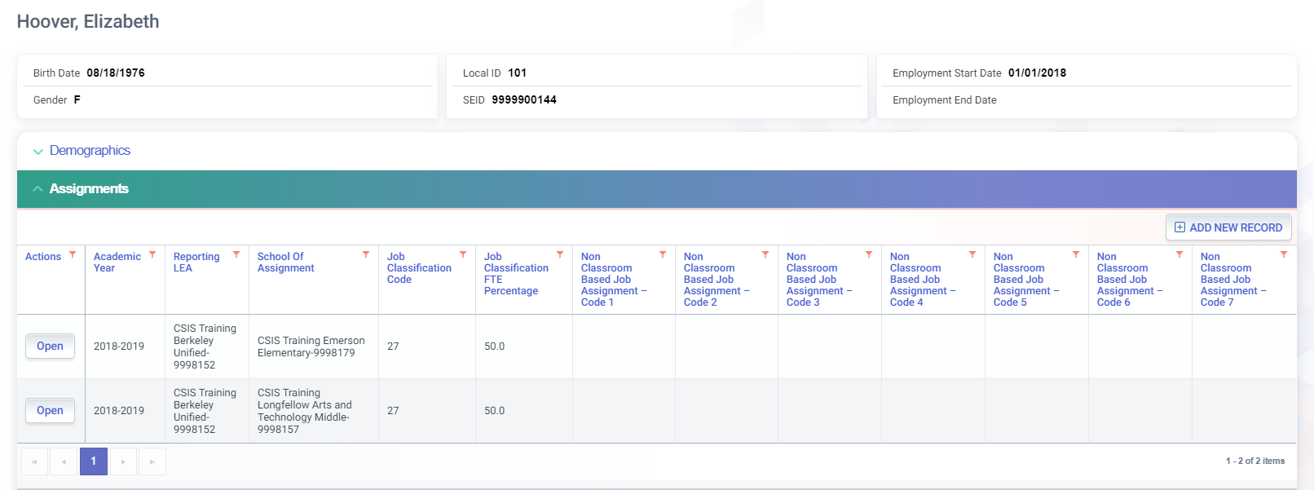
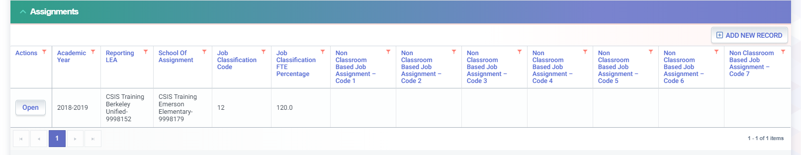
Teacher Assignment
Itinerant Teacher with assignments at multiple schools
Note: classroom assignments for teachers are reported in the Course Section file
Teacher with an FTE percentage for an additional teaching assignment exceeding 100 percent FTE
Fall 2 Data Population - Live Training v1.1 – January 9, 2026

Slide 23
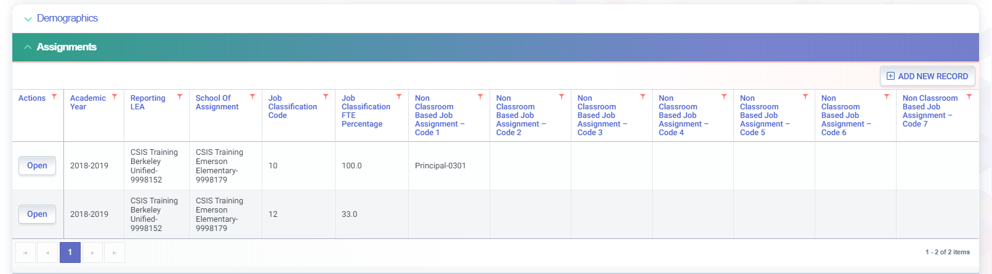
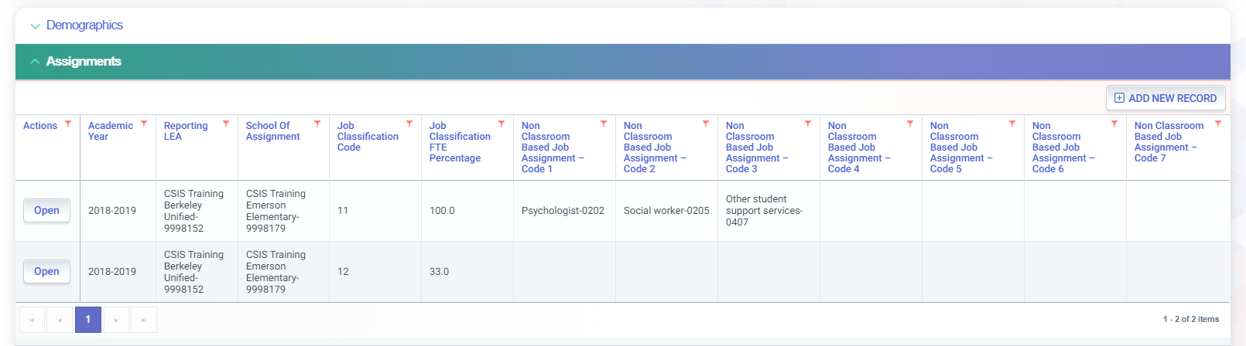
Admin/Pupil Services Assignment
Administrator with a Non-Classroom Based Job Assignment with an additional teaching assignment
Pupil services assignment with multiple Non-Classroom Based Job Assignments
Fall 2 Data Population - Live Training v1.1 – January 9, 2026

Slide 24
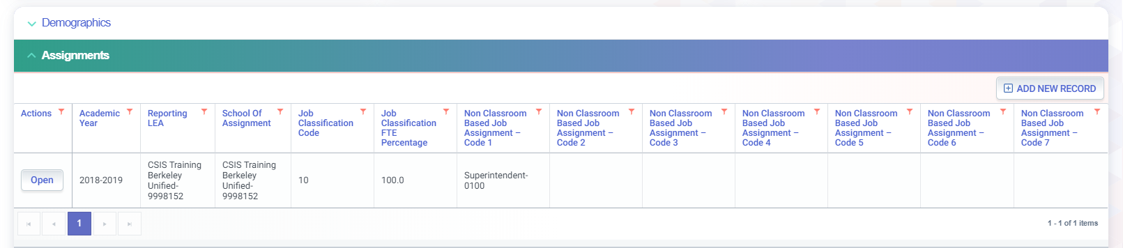
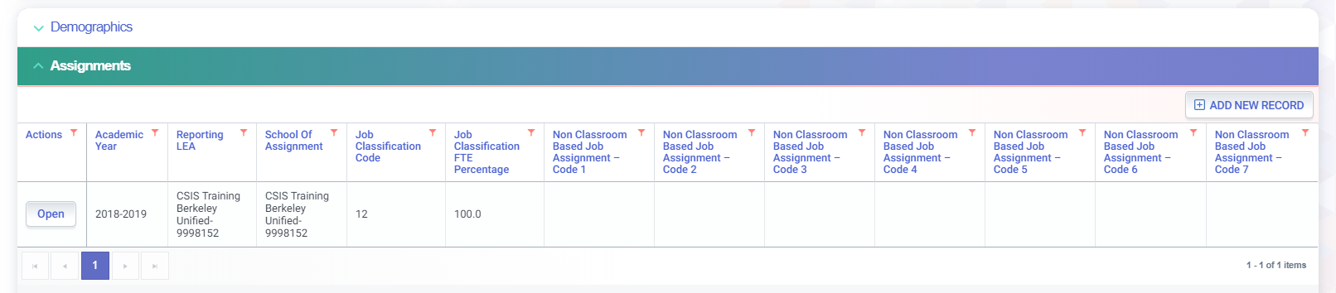
District Level Assignment
Staff assigned to the district office should report the 7-digit county-district code for the School of Assignment.
Note: Charter school Administrators should be reported as Charter School Administrator or Director - 0160
District teaching staff can be reported with the 7-digit county-district code for the School of Assignment or reported with a staff assignment code at each school site
Fall 2 Data Population - Live Training v1.1 – January 9, 2026

Slide 25
Teacher Reporting Scenarios
Teaching Scenarios | SASS Job Classification | SASS Non-Classroom Job Assignment | CRSE
Regular teacher of record | 12 | Optional if teacher ALSO has a non-instructional assignment, otherwise N/A | Assign appropriate state course code for class
Teacher of record (on leave) | 12 | Report Non-classroom job code 6018 (on- leave) with regular designated FTE% when active. | Assign appropriate state course code for class
*Teacher of Record (Special Assignment) | 12 | Report code 6028 – Teacher on Support Assignment | Assign appropriate state course code for class
Charter School Non-Certificated teacher of record | 26 | Optional if teacher ALSO has a non-instructional assignment, otherwise N/A | Assign appropriate state course code for class
Substitute who is teacher of record for the class because there is no permanent hire for that class (vacancy) | 12 or 26 or 27 | Optional if LEA wishes to ADDITIONALLY identify the teacher as a long-term or day-to-day sub use 6014, otherwise N/A | Assign appropriate State course code for class
Permanent employed Substitute who is NOT currently assigned to any course section | 12 or 26 or 27 | 6014 (Day to Day substitute teacher - permanent emp.) | N/A
Pull-Out/ Push-In Teachers | 27 | N/A | Assign appropriate State course code for class For Elementary EL classes, you may use state course code 9103 or 9104 For RSP use state course code 9231
College Teachers NOT employed by LEA | n/a | N/A | Assign appropriate State course code for class and use SEID 9999999999
Teachers not employed by LEA (Teaching ROPC, Distant learning, 3rd party | 12 or 26 or 27 | N/A | Assign appropriate State course code for class and report valid SEID of teacher; or use SEID 9999999999 but will be a misassignment
Fall 2 Data Population - Live Training v1.1 – January 9, 2026
25

Slide 26
Special Education Teachers
Special day classes where Courses specifically designed for students with disabilities where all students enrolled are students with disabilities:
If the teacher is providing instruction in ALL subjects to a group of students in the class all day, then the State Course Code should be 1000 - Self-contained and the Instructional Strategy Code should be populated with 700 - Special Education;
If the teacher is providing the student's primary instruction in ONE subject to multiple groups of students with disabilities throughout the day (departmentalized), then LEAs should select the appropriate State Course Code that aligns with the content that the teacher is teaching. Additionally, the Instructional Strategy Code should be populated with 700 - Special Education;
Special Education Support - Resource Specialist Programs assignments:
If the teacher is providing SUPPORT instruction (supplementary to their primary instruction) in any subject to students with disabilities (pull-out or push-in), the teacher should be reported with:
  State Course Code 9231 - Special Education Support-Resource Specialist Program (RSP)
  Instructional Strategy Code should be populated with 700 - Special Education.
  LEAs may, but are not required to submit Student Course Section Enrollment records for students that are receiving the support instruction from this teacher, as long as the Staff Job Classification Code for the teacher is 27 - Pull-Out/Push-In/Itinerant.
RSP Teachers should NOT be reported as "co-teachers" when they are providing pull-out or push-in support for students with disabilities who have been mainstreamed into general education classes.
Instructional Strategy code 700 should ONLY be used for courses specifically designed for students with disabilities where all students enrolled are students with disabilities
Fall 2 Data Population - Live Training v1.1 – January 9, 2026
26

Slide 27
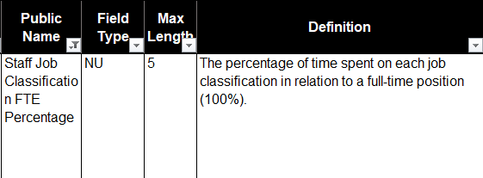
*Modified* Teachers on Leave (6018) and FTE
Full Time Equivalency Percentages (FTE%)*REQUIRED* For teachers on leave (6018)
Full Time Equivalency Percentages (FTE%) *PERMITTED*
for non-instructional staff on leave (6018)
Fall 2 Data Population - Live Training v1.1 – January 9, 2026

Slide 28
Course Section
Discuss CRSE data elements
Fall 2 Data Population - Live Training v1.1 – January 9, 2026

Slide 29
CRSE Notable Points
Know who to involve in this collection
  Human Resource, Curriculum Specialist, Site staff
Relevant data to report
Determine what classes should be reported for Fall 2.
Know the Teacher of Record to report for courses
Reporting Courses
Determine appropriate state course code for each class
College/ Dual Credit Courses
Using SEID 9999999999 and its implications
Itinerant courses
RSP classes
Classes with Multiple teachers
Push-in Pull-out classes
Know your course attributes.
Know how to report SPED classes, distance learning, EL services, UC/CSU
Be knowledgeable of the valid combination of attributes (state course code to sub-groups)
Be comfortable using the CALPADS Valid Code combinations, Code Sets, CFS documents
Zeroing in on the Middle school Core setting
Fall 2 Data Population - Live Training v1.1 – January 9, 2026

Slide 30

Fall 2 Courses Reported
CRSE records should be submitted for Self-contained and Departmentalized courses. The State course codes are grouped by content area:
1000 series – Self-contained (multi-subject)
  TK – 6th grade primary level
  Independent study
7000 – 8000 series – CTE courses
9000 series – Academic content areas (Core/non-core)
The course enrollment data should reflect the courses offered and the students enrolled in those courses on Census Day, the first Wednesday in October.
If Census Day occurs when some enrolled students are in tracks that are off-session, the Fall 2 submission should include the course sections and the students enrolled in those course sections scheduled on the first day that the tracks are in session after Census Day.
Fall 2 Data Population - Live Training v1.1 – January 9, 2026
30

Slide 31

How to pick the correct course code
Determine content of the course
Which standards were used to develop the course?
What are the grade level standards being taught?
DO NOT choose the course code based on the teacher’s credential or student grade levels
Identify the method of online instruction if any part of the course is provider online (pupil and instructor are in different locations and interact through the use of computer and communications technology)
Fall 2 Data Population - Live Training v1.1 – January 9, 2026

Slide 32

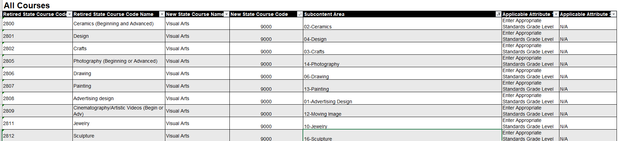
Mapping Courses Tool Kit
Retired Course Mapping
CALPADS File Specifications
Valid Code Combination
CALPADS CODE Sets
Appropriate Credentials for CALPADS Course Codes
Fall 2 Data Population - Live Training v1.1 – January 9, 2026

Slide 33
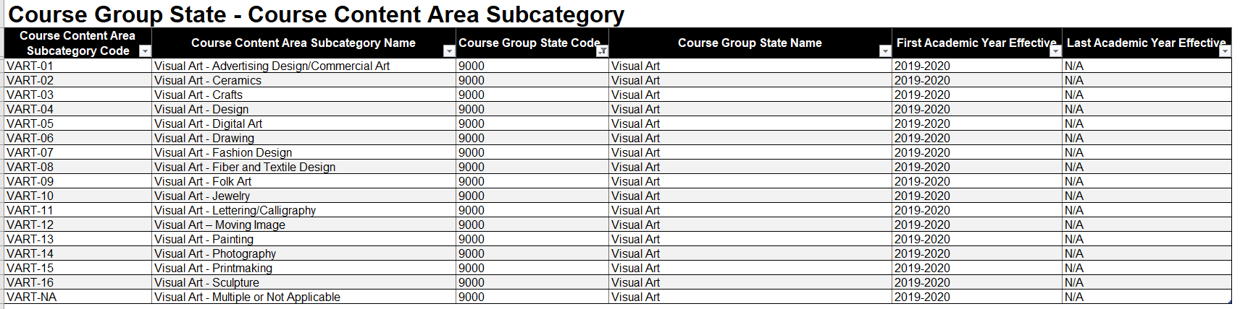
Mapping Courses Tool Kit
Fall 2 Data Population - Live Training v1.1 – January 9, 2026

Slide 34
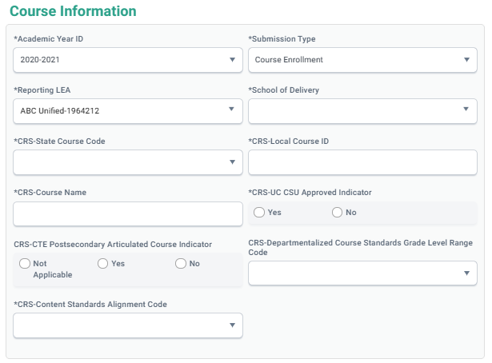
Course Standards
1
CRSE 9.30
Content Standards Alignment Code
- Represents the most current standards of the course content
2
CRSE 9.29
Departmentalized Course Standards-Grade Level Range Code
- Represents the range of grade level standards of the course not the grade level of enrolled students
2
1
Fall 2 Data Population - Live Training v1.1 – January 9, 2026

Slide 35
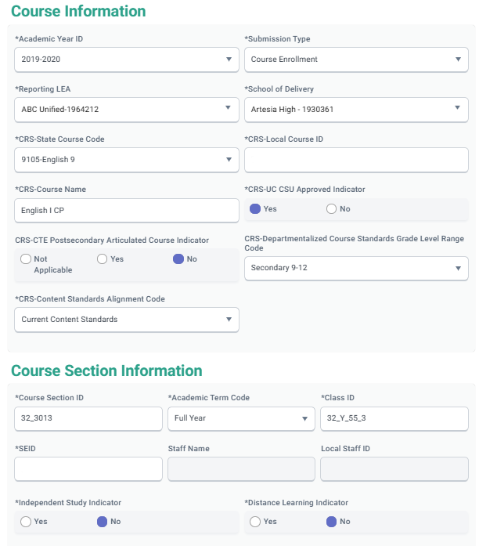
Average Class SIZE
CRSE 9.18
Class ID
This element allows multiple course sections to be counted as one class for class size analysis and enrollment reporting.
The CDE uses these data to determine the number of students in “classes” or class size
The Class ID is not part of the Student Course Section (SCSE) record, corresponding Course Section IDs between the CRSE and SCSE are used to tie records together. It is important that Course Section IDs and Class IDs are unique for each school and academic term.
1
1
Fall 2 Data Population - Live Training v1.1 – January 9, 2026

Slide 36
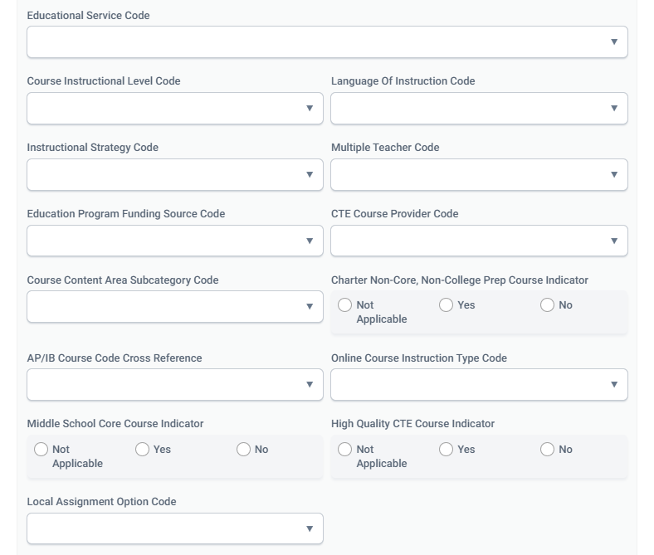
CRSE Attributes
CRSE 9.35
- CTC will use to determine whether a local assignment option is appropriate for the assignment.
4
CRSE 9.28
-CTC will use to determine whether a subject area authorization is required in certain content areas.
- CDE will use to capture and report more detail about course content.
1
5
CRSE 9.33
- CTC will use to determine 1) if the course requires an authorized teacher; and 2) if the teacher has the appropriate authorizations for the content.
- CDE will be able to provide more public information on availability of online course content.
CRSE 9.32
-Allows LEAs to designate a course as both CTE and AP or IB.
1
2
2
5
3
CRSE 9.34
- CTC will use to determine appropriate authorizations in grades 5-8.
3
3
6
6
CRSE 9.36
-Indicates that the course is taught by a credentialed CTE teacher.
Replaces code course content code 154
4
Fall 2 Data Population - Live Training v1.1 – January 9, 2026
36

Slide 37
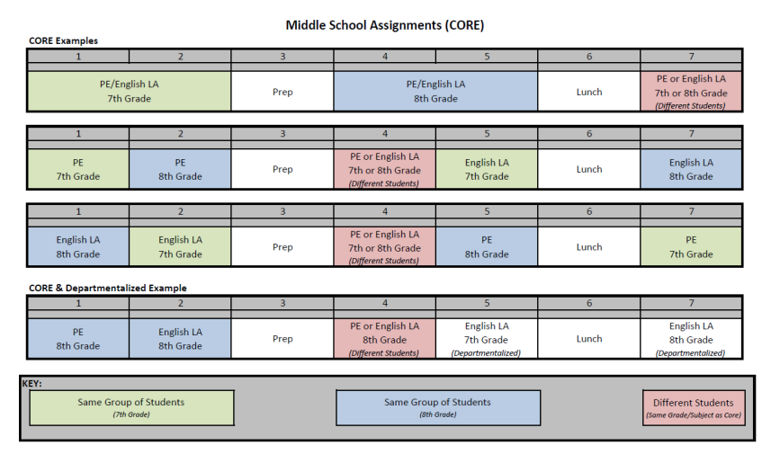
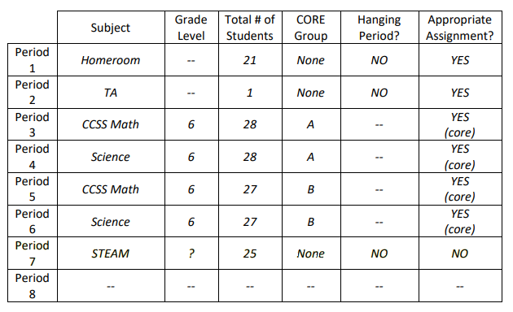
Core Settings
A middle school core setting is a setting in which a teacher teaching any grades five through eight teaches two or more subject areas to the same students in the same day. Teachers in a Middle School Core Setting may teach in these settings with either a multiple subject credential or single subject authorizations.
Fall 2 Data Population - Live Training v1.1 – January 9, 2026
37

Slide 38
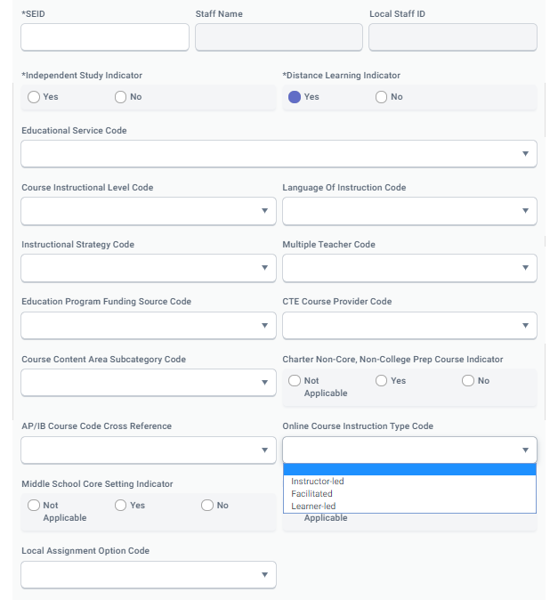
Distance Learning Courses
1
CRSE 9.24
Distance Learning Indicator
An indication of whether Course Section instruction was delivered by way of distance learning full time or part time (any portion of a day or week) via synchronous and/or asynchronous format.
1
CRSE 9.33
Online Course Instruction Type Code
Represents the type of online instruction that is being delivered in a course section. Required if the Distance Learning Indicator, is populated with a "Y"
2
3
Online Course Instruction Type Codes
Instructor-led: Instructor provides all instruction associated with online content
Facilitated: Learner sets the pace of their own instruction, facilitator monitors progress and may provide support
Learner-led: Learner sets the pace of their instruction. Content and instruction are provided solely by the online application
2
3
Fall 2 Data Population - Live Training v1.1 – January 9, 2026

Slide 39
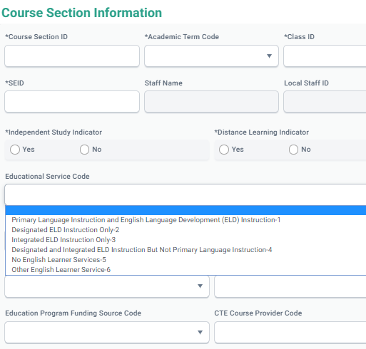
English Learner Services
1
DE 9.20
Education Service Code
Used to describe the English language services being provided by a teacher or received by a student
Is required for all course sections that have EL students
1
Fall 2 Data Population - Live Training v1.1 – January 9, 2026

Slide 40
College Courses
Only the following State course codes listed below may be used for college course reporting.
9020 - College Credit Course - Visual Arts
9082 - College Credit Course - Dance
9096 - College Credit Course - Theatre
9120 - College Credit Course - English
9154 - College Credit Course - World Languages
9200 - College Credit Course - History/Social Science
9227 - College Credit Course - Other
9273 - College Credit Course - Mathematics
9303 - College Credit Course - Music
9358 - College Credit Course – Science
Any CTE State Course Code 7000-8999 with
Course Instructional Level populated with either :
Codes 23 (College Credit Only)
Code 24 (Dual Credit)
OR
Fall 2 Data Population - Live Training v1.1 – January 9, 2026

Slide 41
Use of SEID 9999999999
    SEID 9999999999 may be used without triggering an exception for:
    Courses with Field 9.19 - Course Instructional Level Code populated with:
    Code 23 – College Credit Only, or Code 24 – Dual Credit.
    College Credit Course codes:
    9020, 9082, 9096, 9120, 9154, 9200, 9227, 9273, 9303, and 9358.
    All other Course Scenarios
    SEID 9999999999 is still allowed for other course scenarios. However, using it automatically trigger a Misassignment due to vacancy.
    Suggestion to avoid Exceptions:
    Staff may obtain SEID either as a credentialed staff or by acquiring a Certificate of Clearance from the Commission on Teacher Credentialing.
    Submit Staff Demographic (SDEM) and Staff Assignment (SASS) records for the teacher.
    Make sure the Full-Time Equivalent (FTE) percentage in the SASS should reflect the teacher’s FTE at that specific school of assignment.
Fall 2 Data Population - Live Training v1.1 – January 9, 2026

Slide 42
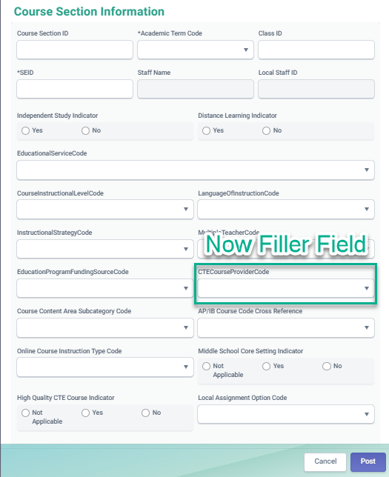
*Update* Couse Section Field 9.27 –
CTE Course Section Provider Code
Now Filler Field – no longer used by CALPADS
Fall 2 Data Population - Live Training v1.1 – January 9, 2026

Slide 43

*Recategorized* CTE Course Code Content Areas 24-25
Content Area Category
  In reports: 2.5, 3.1, 3.2, 3.3, 3.6, 3.7, 3.9, 3.10, 3.11
  Previously, CTE Course Codes 7000-8999 populated as “Career Technical Education” in the Content Area. They will now be categorized as a more specific subject area, e.g., “Computer Education” or “Music”. Other courses (9000+) may be recategorized as well, so that they are in more accurate categories.
  Since Content Area is derived from the Course Group Master Valid Code Combinations, there is no action required on the part of the LEAs. LEAs may review what Content Area courses have been mapped into in the Valid Code Combinations document.
Fall 2 Data Population - Live Training v1.1 – January 9, 2026

Slide 44
Student Course Section Enrollment
Discuss key SCSE data elements
Fall 2 Data Population - Live Training v1.1 – January 9, 2026

Slide 45
SCSE Notable Points
Know who to involve in this collection
  Site staff, Counselors
Relevant data to report
Determine who are the students that should be reported for Fall 2.
How is the class setting for these students (in-class, self-contained, departmental, independent study, push-in/pull-out?
Reporting Records
Ensure some key attributes between the SCSE and CRSE records match to avoid submission error
Know your courses attributes.
Know what fields are relevant to Fall 2 versus EOY 2
Fall 2 Data Population - Live Training v1.1 – January 9, 2026

Slide 46
Student Course Section Enrollments Reported
Enrollment Type
10
20
30
If Census Day occurs when some enrolled students are in tracks that are off-session, the Fall 2 submission should include the course sections and the students enrolled in those course sections scheduled on the first day that the tracks are in session after Census Day.
Grade Level
TK
-
12
Fall 2 Data Population - Live Training v1.1 – January 9, 2026
46

Slide 47
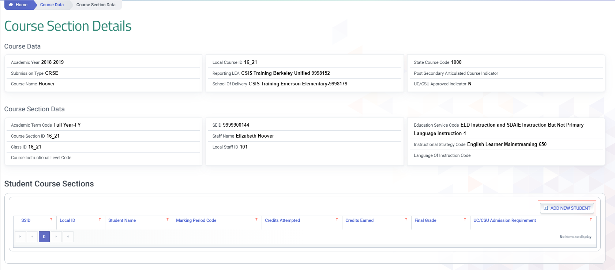
Student Course Section Enrollment (SCSE)
Course Data
Course Section Data
Student Course Section data
Fall 2 Data Population - Live Training v1.1 – January 9, 2026
47

Slide 48
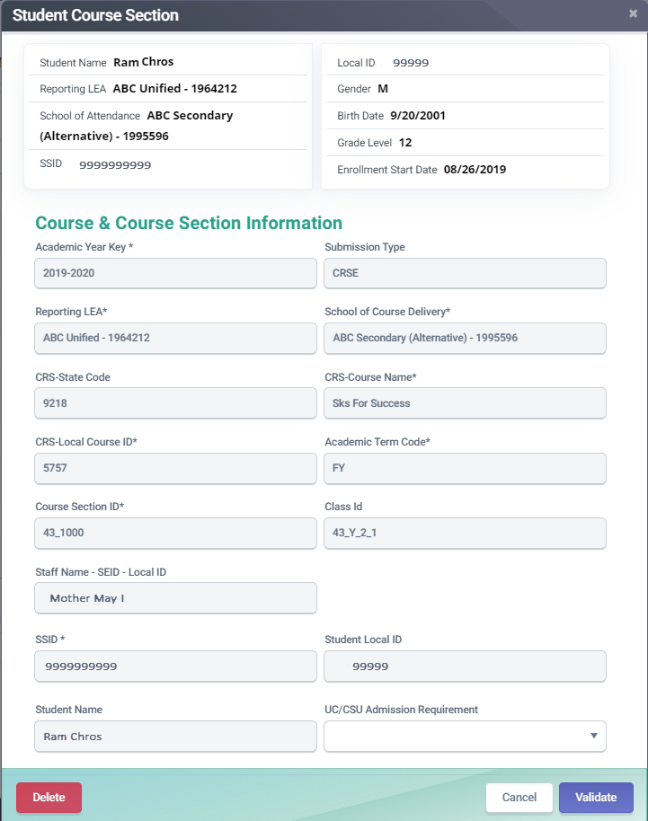
SCSE Attributes
A
Student Course Section records must have a corresponding Course Section record sharing the following attributes
A
1
1
  10.06 Academic Year ID
2
  10.05 School of Course Delivery
2
3
  10.15 Academic Term Code
4
3
  10.14 Course Section ID
4
  10.13 Local Course ID
5
5
B
Student Course Section Enrollment records do not include student outcome information (Grades, Credits, Carnegie Units) related to the course. Student data is only used to enroll the student in the course section
B
Fall 2 Data Population - Live Training v1.1 – January 9, 2026
48

Slide 49

English Learner Services
Key elements to providing services
Fall 2 Data Population - Live Training v1.1 – January 9, 2026

Slide 50
English Learner Key Elements
Components of English Learner Data
CRSE
The course includes the EL services.
SCSE
The following data elements comprises the overall English learner experience. The CRSE, SCSE and SELA EL status records comprises the Fall 2 elements
The student course record links course EL services to the student SSID.
EL Status
SELA record status
LIP Record
Language instruction programs that is provided to the class the student is enrolled in.
SENR
Gains ownership of SSID
Fall 2 Data Population - Live Training v1.1 – January 9, 2026

Slide 51
English Learner Services
DE 9.20
Education Service Code
Used to describe the English language services being provided by a teacher or received by a student
Is required for all course sections that have EL students
1
1
Fall 2 Data Population - Live Training v1.1 – January 9, 2026

Slide 52
English Learner Services
Code​ | Name​ | Description​
1​ | PrimaryLanguage Instruction andDesignated and Integrated EnglishLanguage Development (ELD)Instruction​ | This course section is providing primary language instruction, English Language Development (ELD), and Specially Designed Academic Instruction in English. Primary language instruction is an approach used to teach academic courses in and/or through a primary language other than English.​
2​ | Designated ELD Instruction Only​ | This course section is providing only English Language Development (ELD) instruction, through a primary language other than English, which is an academic subject of English language instruction appropriate for the student's identified level of language proficiency. ​
3​ | IntegratedELD Instruction Only​ | This course section is providing only Specially Designed Academic Instruction in English (SDAIE) services, which is an approach used to teach academic courses to English learner (EL) students in English.​
4​ | Designated and Integrated ELD Instruction But Not Primary Language Instruction​ | The course section is providing English Language Development (ELD) instruction and Specially Designed Academic Instruction in English (SDAIE) but NOT Primary Language Instruction.​
5​ | No English Learner Services​ | The course is not providing any instructional services designed specifically for English learners. All courses not providing EL services should be marked with this.​
6​ | Other English Learner Service​ | The course section is providing some type of instructional service, that, while specifically designed for ELs, is an instructional service that is not narrowly defined in the other English learner services (Primary Language Instruction, English language development, or Specially Designed Academic Instruction in English). ​
Fall 2 Data Population - Live Training v1.1 – January 9, 2026

Slide 53

Postsecondary Status
Key PSTS data elements and collection
Fall 2 Data Population - Live Training v1.1 – January 9, 2026

Slide 54
PSTS Notable Points
Who should be involved in collecting the data?
  CALPADS Data coordinator, Counselors, CTE staff
Knowing who to survey
  Who should be surveyed?
  How to identify who should be surveyed?
Prepare the survey and know how to input results to CALPADS.
  Use modified sample survey template.
  Populating survey results to appropriate CALPADS fields.
  Be aware of the required fields for Fall 2 versus EOY4.
Fall 2 Data Population - Live Training v1.1 – January 9, 2026

Slide 55


Postsecondary Students Reported
Students who exited secondary education in the prior academic year (AY 24-25) that were identified as:
CTE completers or
students who participated in the CA Partnership Academic Program
Fall 2 Data Population - Live Training v1.1 – January 9, 2026

Slide 56

When should LEAs survey students?
FALL 2 CTE Collection
LEAs should survey students in the second quarter following the end of the prior academic year, which will be some time during December – January of the current academic year.
Report survey results in CALPADS during Fall 2 submission.
Fall 2 Data Population - Live Training v1.1 – January 9, 2026

Slide 57

Students Reported for Fall 2
Survey data collected from the subset of students based on the criteria below will be reported.
Any student who :
Completed HS or exited in 2024-25 (at any grade level); AND
Who were or were not part of this year’s 4-year cohort; AND
Who exited with E230 and any of the following:
  Graduated, standard high school (HS) diploma (100)
  Students with Disabilities Certification of Completion (120)
  Adult education HS diploma (250)
  Received a HS Equivalency Certificate (320)
  Passed the California HS Proficiency Exam (and no standard diploma) (330)
  Completed grade twelve without completing graduation requirements, not grad (360) ; and
Completed a CTE pathway completers at any point during HS enrollment at the LEA
Fall 2 Data Population - Live Training v1.1 – January 9, 2026

Slide 58


How to identify CTE students to survey?
Run CALPADS Reports
Run ODS Report 8.1a – Student Profile Exits - List
Run Snapshot Report 3.20 - Career Technical Education Completers - Student List
  for CTE Completers in the following year:
  AY 2024-2025
  AY 2023-2024
  AY 2022-2023
OR
Check SIS
Your SIS may have functionality to identify these students.
Fall 2 Data Population - Live Training v1.1 – January 9, 2026

Slide 59
Survey List in a Nutshell
From Fall 1 ODS Report 8.1a 2024-2025
Enrollment Status: 10, 30
Who exited with E230 and any of the following completion codes:
  (100), (120), (250), (320), (330), (360)
Grade level: 12 and 11
12th Grade CTE Pathway completer
(2024-25)
11th Grade CTE Pathway completer
(2023-24)
10th Grade CTE Pathway completer
(2022-23)
From Report EOY 1 Report 3.20 (2024-2025)​
Filter for​
Perkins/CTEIG Fundable: ALL​
AY 2024-2025 (Filter for 12th grade)​
AY 2023-2024 (Filter for 11th grade)​
AY 2022-2023 (Filter for 10th grade)​
​
Fall 2 Data Population - Live Training v1.1 – January 9, 2026

Slide 60
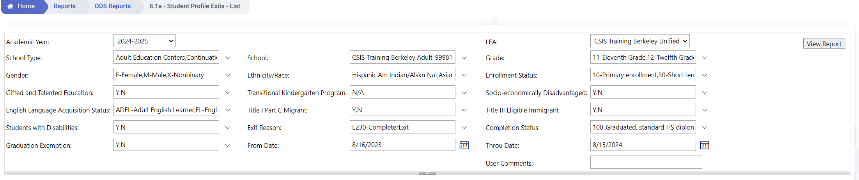
Identifying Student Survey List
LEAs can use CALPADS to assist in identifying these students:
  Step 1: Find students who completed secondary education in 2023-2024
    Use ODS Report 8.1a
    Apply the following filters:
    Academic Year: 2024-2025
    Enrollment Status: 10, 30
    Grades: 12 and 11
    Exit Reason Code: E230
    School Completion Status = 100, 120, 250, 320, 330, or 360
    From Date 8/16 of Prior Year to 8/15 of Current Year
Fall 2 Data Population - Live Training v1.1 – January 9, 2026

Slide 61
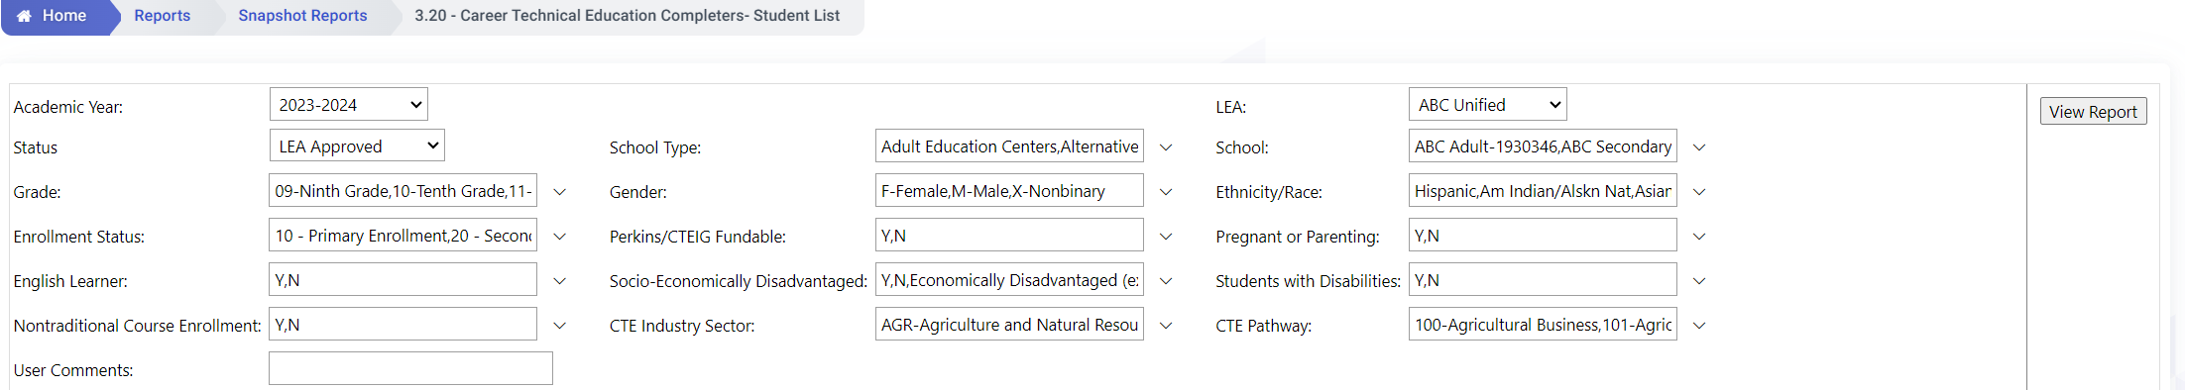
Identifying Student Survey List
  Step 2: Find students who were identified as CTE Completers in any grades 9-12
    Run Snapshot Report 3.20 - Career Technical Education Completers- Student List, and filter as follows:
      Academic Year: 2023-24;
      Grade: 12
      Perkins/CTEIG Fundable: All
    Run Snapshot Report 3.20 - Career Technical Education Completers- Student List multiple times, and filter as follows:
      Academic Year: 2022-23; 2021-22
      Grade: 11; 10
      Perkins/CTEIG Fundable: All
    Make sure to change the Academic Year and Grade filters using these pairings:
      AY 2022-23 & Grade 11; AY 2021-22 & Grade 10
Fall 2 Data Population - Live Training v1.1 – January 9, 2026

Slide 62










How is the survey conducted?
LEAs must establish a process to capture the postsecondary status of the specified students
Traditional
Non-Traditional
Fall 2 Data Population - Live Training v1.1 – January 9, 2026

Slide 63
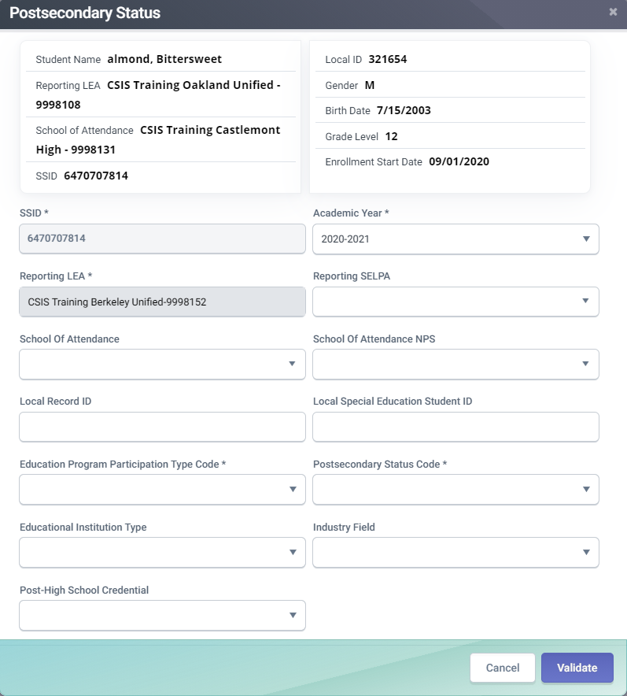
PSTS Details
A
The Academic Year ID would be the current academic year even though you are reporting postsecondary information for students who exited secondary education in the prior school year.
B
CDS code of LEA’s SELPA
Required If Education Program Participation Type Code = 30 (Special Education) Relevant to EOY 4 submission
A
C
Required if Education Program Participation Type Code = 30 (Special Education) Relevant to EOY 4 submission
B
Submit only Education Program Participation Type code 10 (California Partnership Academy) or 20 (Career Technical Education) in the Fall 2 submission.
D
Submit only Education Program Participation Type Code 30 (Special Education) in End-of-Year 4.
C
E
A coded value representing the student's postsecondary status after exiting secondary education.
D
E
F
The type of educational or training institution based on the institution’s tax status
F
G
G
Industry sector that best represents the field in which the respondent is or will be employed in upon completion of training.
H
Could be an industry certification, degree, certificate, license issued by the state of California etc.
Fall 2 Relevant Fields
H
Fall 2 Data Population - Live Training v1.1 – January 9, 2026

Slide 64
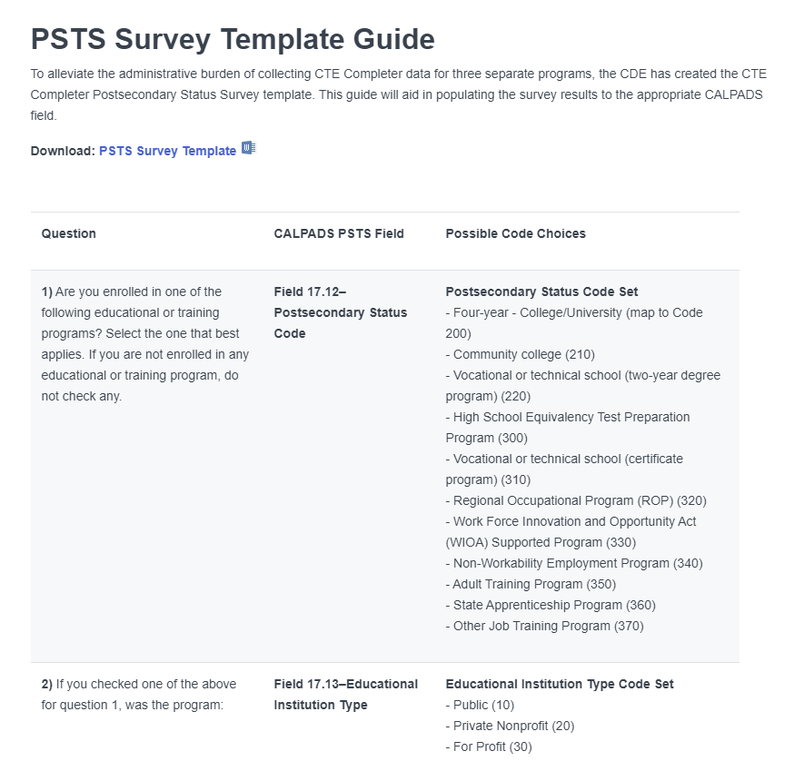
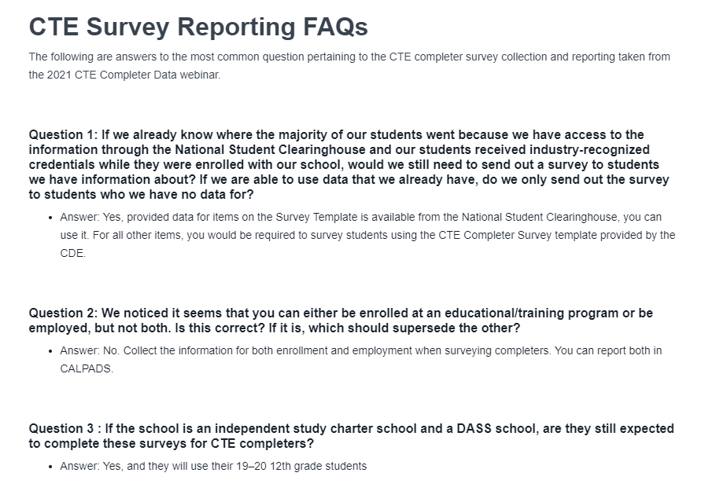
PSTS Toolkit
Please refer to the User Manual PSTS page for additional references.
Fall 2 Data Population - Live Training v1.1 – January 9, 2026

Slide 65

Error Resolution Demonstration
Demonstrate how to resolve common errors in Fall 2
Fall 2 Data Population - Live Training v1.1 – January 9, 2026

Slide 66
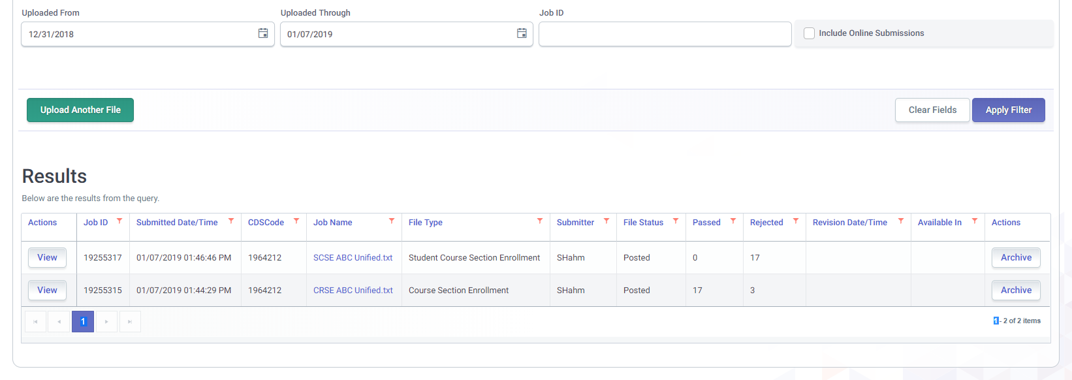
Input validation Error - SCSE0139
SCSE0139 is a common error during the Fall 2 submission process. The primary trigger of this error is the SCSE file being submitted prior to the CRSE being posted.
Fall 2 Data Population - Live Training v1.1 – January 9, 2026
66

Slide 67

Wrap Up
Key Points, Resources and Support
Fall 2 Data Population - Live Training v1.1 – January 9, 2026

Slide 68

Teacher of record should be reported. Substitutes should only be reported for classes with vacancies.
All staff must have an SDEM record submitted every year. If for no other reason than to update the years of service
Staff without SEIDs who needs to be reported may obtain SEIDS from the CTC with a certificate of clearance
Staff assignments are reported by school and job classification
Student Course data should be submitted for all students TK-12 enrolled on census day
EL students must be enrolled in at least 1 course section where the Education Service code is populated, to show they are receiving services
PSTS data should only be for CTE completers, SWD PSTS records should be submitted for EOY
Students may have more than 1 postsecondary outcome
Summary
Some key points to remember
Fall 2 Data Population - Live Training v1.1 – January 9, 2026

Slide 69





Support
http://www2.cde.ca.gov/calpadshelp/default.aspx
Web
calpads-support@cde.ca.gov
Email
916-325-9210
Phone
http://www.cde.ca.gov/ds/sp/cl/listservs.asp#listservs
You can get help through these channels.
Listserv

Slide 70




Resources
Here are some important resources related to Fall 2 reporting.
https://csis.fcmat.org/csis-training
https://csis.fcmat.org/csis-training
https://www.youtube.com/channel/UCA9oRTiyVECCCzOxpmJheZw
https://documentation.calpads.org/Support/References
https://www.ctc.ca.gov/
Fall 2 Data Population - Live Training v1.1 – January 9, 2026

Slide 71
Feedback
I have a question…
“
”
Please complete survey…
https://bit.ly/2MXsECg
“
”
Fall 2 Data Population - Live Training v1.1 – January 9, 2026

Slide 72






Thank You
CSIS Training
+1 916 325 9210
csistraining@fcmat.org
https://csis.fcmat.org/

