Slide 1
Fall 1 Data Population Live Training
Student Profile
Batch File Submission
Error Validation
Online Maintenance

Slide 2
Target Audience
New to CALPADS
Data Coordinators
Notes:
We expect new CALPADS data coordinators to be attending this session but experienced user may attend as well to get a refresher. If you are new to CALPADS, we strongly recommend that you also attend the regular Fall-1 Reporting & Certification training to gain an understanding of the certification reports and certification process.

Slide 3
CALPADS Training Sequence
Orientation
Data Coordinator Orientation
Basics
Fall-1 Data Population (Student Profile)
Fall-2 Data Population
EOY 1-4 Data Population
Data Collections
Fall 1
Reporting and Certification
Advanced
Fall 2
Reporting and Certification
Advanced
EOY
EOY 2 & 3 Reporting and Certification
EOY 1 Reporting and Certification
EOY Advanced
Skill Building
Guide to CALPADS Documentation
Guide to Troubleshooting CALPADS Errors
LEA Admin Data Privacy
SELPA Data Privacy
Data Population
User Management
File Submission
Extracts
Reports
Certifications
Anomalies Management
Features & Navigation
Notes:
The CSIS training model is designed to be segmented to provide organization of specific topics and concise delivery. We aim to provide focused trainings with relevant information and instruction. Fall 1 data population should be followed by Fall 1 reporting and Certification.

Slide 4
Objectives
Identify
Determine
Perform
Resolve
the different file types expected to be reported for Fall 1
Manage & Maintain Data
which SIS fields map to CALPADS file specifications
CALPADS Literacy
the submission process through online maintenance and batch upload
Manage & Maintain Data
submission errors and reporting roadblocks through scenario discussions
Critical Thinking
Notes:
At the end of this session, LEAs should be able to…

Slide 5
Agenda
Online Maintenance
Overview
Batch File Submission
Wrap-Up
Notes:
Here is the agenda for this training. We will discuss the following:
An overview of Fall 1 data population, the student profile records submission.
Demonstrate how to perform online maintenance identifying key fields from data population scenarios.
Demonstrate the batch file process, SSID matching and error correction.
Conclude the training with a wrap up of key points, preview of future training and provide support resources.

Slide 6
Overview
Discuss background of the student profile and the Fall1 data population
Notes:
First we will start with some general information related to student data population and processes while also introducing key concepts related to the data submission.

Slide 7
Data Cycle
TOMS
Receives and transmit relevant student data from and to CALPADS for assessment purposes
SEDS
Transmit SWD data to CALPADS
SIS
Local Systems maintain student data
LEA extract files and send to CALPADS
STATE Database
Matches CALPADS data for Foster Youth, Direct Certification with appropriate state department databases
SSID
A student can only have one SSID.
Allows for longitudinal tracking
CALPADS
Validates & stores incoming student Data
Generates new SSIDs
Matches existing student data to SSID Requests
Sends and receives student profile for state data Matching and ELPAC
Notes:
CALPADS operates much like a student information system. Once a student enrolls into an LEA, whether it be a district or a school the student records must be maintained. Student information Systems or SIS as they are commonly called are designed to meet the schools needs while CALPADS has been designed to meet state and federal reporting requirements. In order to meet the reporting requirements, but also preserve and protect the personal nature of the student data each student must be assigned a Statewide Student Identification number. Once the Statewide Student Identification number or SSID is obtained a student’s enrollment and associated information can be reported in CALPADS. This process of obtaining SSIDs and reporting student information is called SSID enrollment.

Slide 8
Student Profile
Student Profile records are required for each submission, an enrollment record in must exist in CALPADS prior to any other record types being posted
Fall 1
SENR
SINF
Fall 2
SCSE
SCSC
SELA
SPRG
MEET
EOY 1
SCTE
EOY 3
STAS
SINC
EOY 2
SPRG
SIRS
SOFF
EOY 4
MEET
SWDS
PLAN
SPRG
PSTS
WBLR
SENR
SELA
SWDS
PLAN
SERV
SERV
PSTS
New in AY 2023-2024
New in AY 2023-2024
Fall 2 & EOY 1 require staff and/or course records types in addition to student profile data

Slide 9
Student Profile Data for Fall 1
The following file types comprises the Student Profile.
SENR
SELA
SPRG
SWDS
PLAN
MEET
SERV
SINF
Reporting the Student enrollment gives you ownership of the SSID and allows submission of the rest of the student data.
Student with Disabilities files coming from local SEDS system pushed through API
Files extracted from local school information system and uploaded to CALPADS
Notes:
The eight files required for fall 1 are just part of a bigger set of data that comprises the Student Profile.

Slide 10
Student Profile
Fall 1
Student Profile Data
Fall 2
Course Enrollment, EL services. Postsecondary
EOY 1
Course Completion CTE Participation, Concentrators & Completers
EOY 2
Program participation
EOY 3 Discipline Absence Summary, Cumulative Enrollment
EOY 4
SWD
The Student profile data population that is the basis for Fall 1 is the building block for the rest of the data reporting requirements in CALPADS
Notes:
The Student profile Data Population that is the basis for Fall 1 is the building block for the rest of the data reporting requirements in CALPADS. The student profile, the records related to our students determine the services, course enrollment, program eligibility and participation, CTE participation, exemptions and expectations for absence and attendance. These are just a few of the examples of how the record types initially submitted during the Fall 1 data collection are relevant or determine the data in future submissions throughout the year.

Slide 11
Departments Involved
Fall 1
Registrars,
Counselors, and Principals
Fall 2
Curriculum Instruction Directors
Credential Analysts
Human Resources
Staff
EOY 1
EOY 2
EOY 3
EOY 4
Special Education Staff
SELPA Directors
EL Services Staff
Program Staff
Site Staff
CTE Staff
Site Admins
Site Staff
Site Staff
Attendance Supervisors
EL Services Staff
District Admins
NPS School Staff
Special Education Staff
Site Staff
Special Education Staff
SELPA Directors
Counselors
Program Staff
Site Admins
EL Services Staff
NSLP Program Staff
Site Admins

Slide 12
Ongoing Maintenance
Student data changes frequently and should be updated in CALPADS on an ongoing basis. Keeping student enrollment, demographic, information, and program eligibility data current in CALPADS:
Makes it easier to select the correct SSIDs for transferring students.
Ensures that LEAs have access to current data helping the LEAs place new students in appropriate programs.
Minimizes LEA workload during snapshot collection windows.
Ensures that the CALPADS ODS is up-to-date for assessment, state matching and accountability purposes.
Notes:
Student data changes frequently and should be updated in CALPADS on an ongoing basis. Keeping student enrollment, demographic, information, and program eligibility data current in CALPADS:
Makes it easier to select the correct SSIDs for transferring students.
Ensures that LEAs have access to current data helping the LEAs place new students in appropriate programs.
Minimizes LEA workload during snapshot collection windows.
Ensures that the CALPADS ODS is up-to-date for assessment, state matching and accountability purposes.

Slide 13
Key Concept
There are several Factors that impact how often an LEA maintains student data
Local Enrollment Procedures
Local Reporting Needs
Assessments
Management expectations, competing responsibilities
SSIDs for ELPAC, CAASP, Pre ID, Direct Certification & Foster Youth matching, SPED services
Submission timelines and reporting deadlines
How frequent should student data be maintained?
Notes:
There are several factors that impact how often student data is maintained in CALPADS.
Local Enrollment Procedures
Management expectations, competing responsibilities
Local Reporting Needs
SSIDs for ELPAC, CAASP Pre ID, Direct Certification & Foster Youth matching, SPED services
Assessments
Submission timelines and reporting deadlines

Slide 14
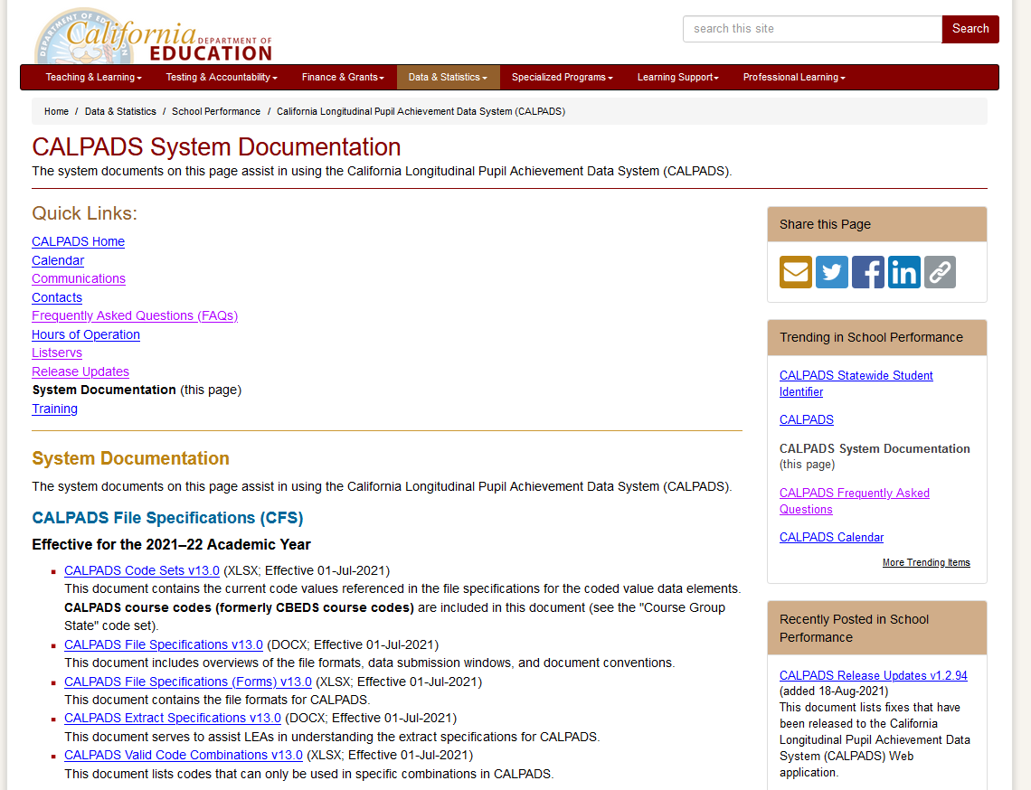
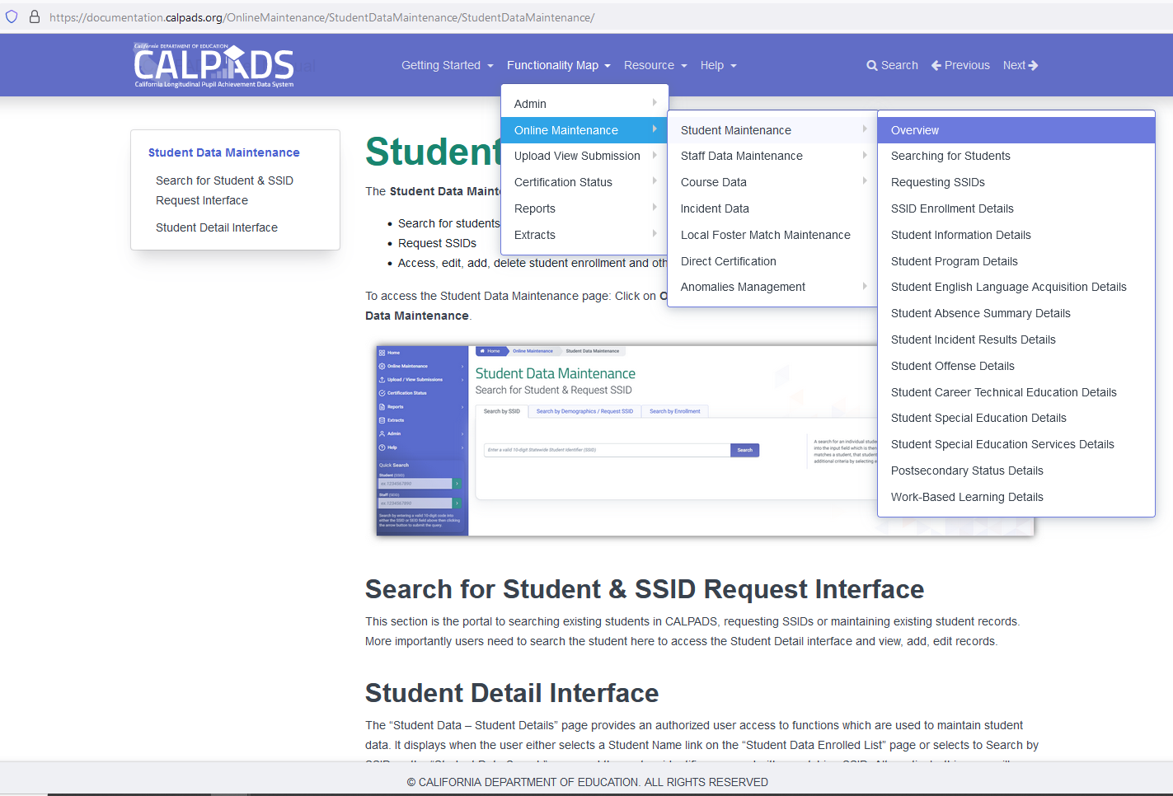
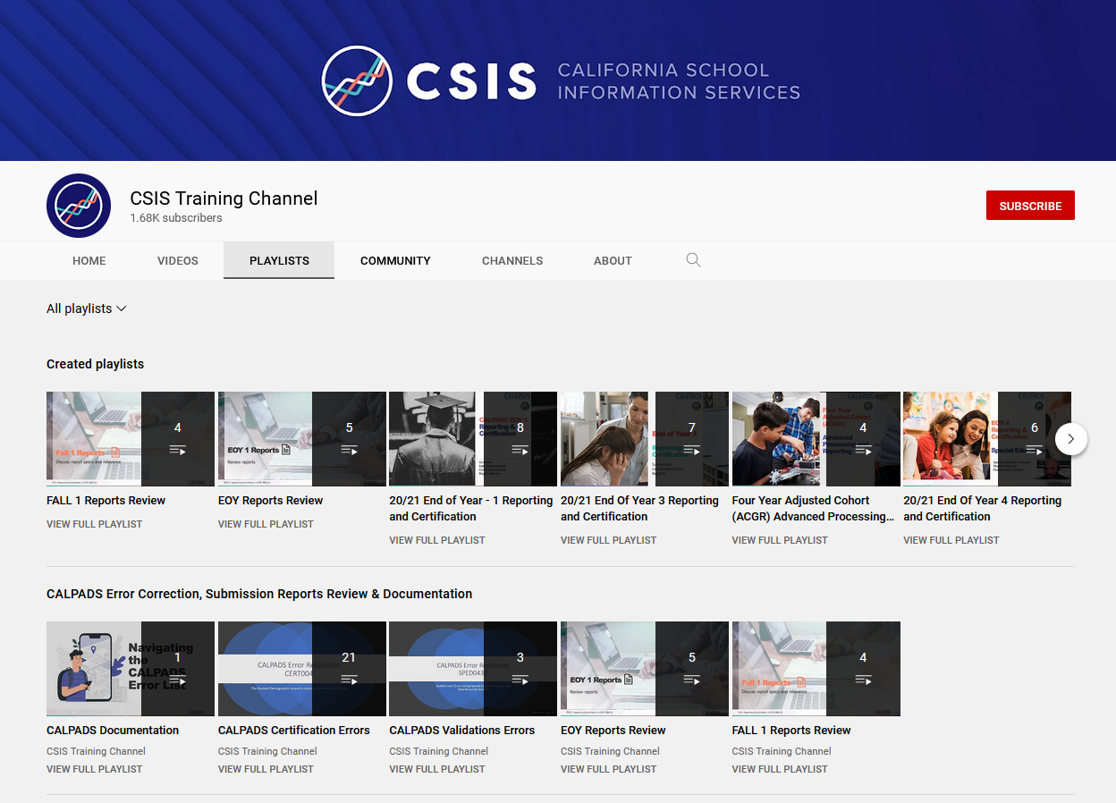
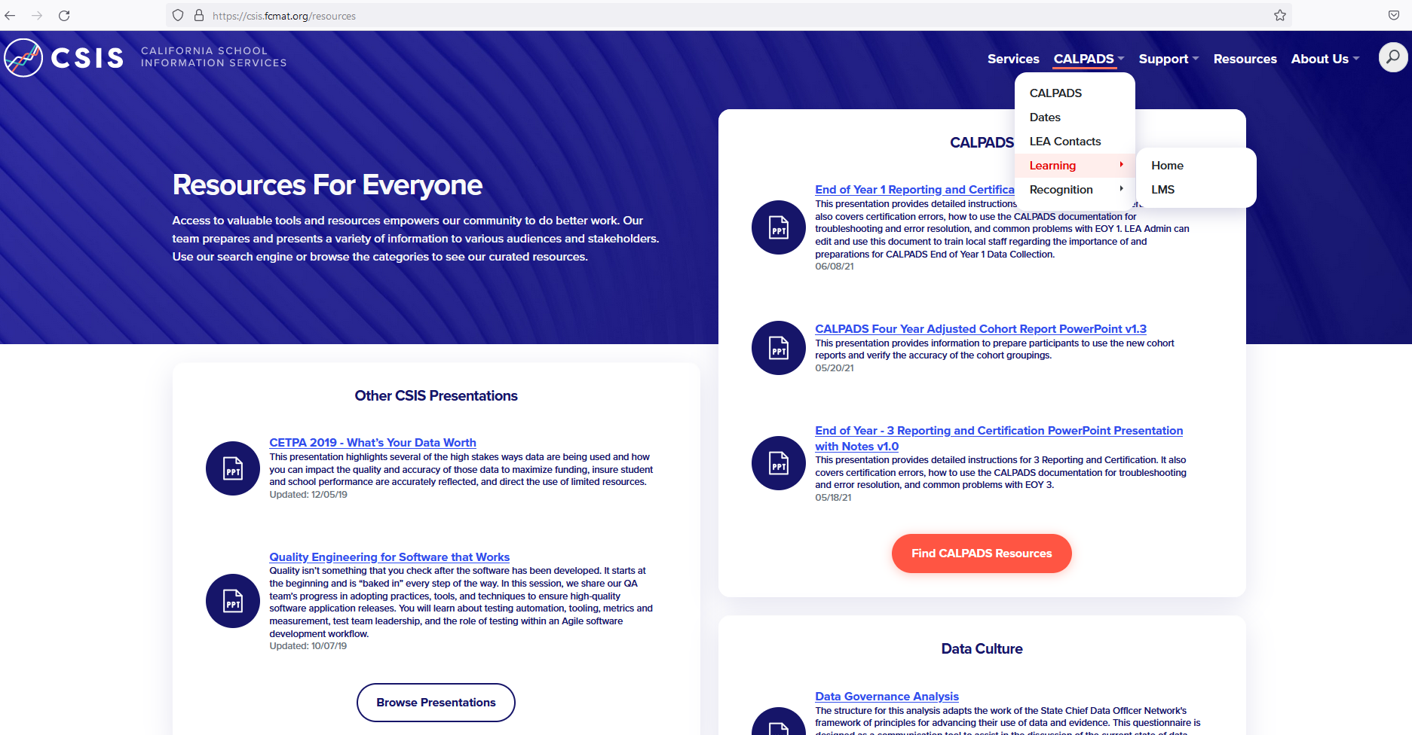
Fall 1 Data Reporting Survival Kit

Slide 15
File Key Details
General Discussion of each file type

Slide 16
SSID Enrollment
KEY POINTS
The student enrollment data is required to obtain SSIDs, enroll or exit students, update students’ grade levels in CALPADS and inclusion for CAASP, LCAP testing
SENR enrollments are used to:
Establishes ownership of a students record in CALPADS
Determines Cohort inclusion and cumulative enrollment
Designate district of geographic residence, transfer reason and enrollment status
SENR Exits are used to
Report graduate, dropouts and completers
Denote returning, transfer and matriculating students
Indicate postsecondary transition, graduation and program completion
Discussion of the SSID enrollment process.

Slide 17
What is Ownership?
Ownership of an SSID allows the LEA to submit and update records related to a student’s profile during the enrollment period
Fall 1 Data Population-Live v1.1 – 09/13/2023
Notes:
Ownership dictates who has the ability to maintain student data. Ownership of an SSID allows the LEA to submit and update records related to a student’s profile during the enrollment period.
SENR Start and End dates determine the period of ownership of student records in CALPADS. To add, update or delete student information, LEAs must have ownership of the student record

Slide 18
New TK Grade Level in 2023-24
Beginning in 2023-24, LEAs must submit a new grade level of Transitional kindergarten (TK) for students attending transitional kindergarten
The new TK grade level will be available on CALPADS by July 1, 2023
The existing program code 185 – Transitional Kindergarten will be retired on June 30, 2023
There will be no migration of data
The system will close out all 185 program records that haven’t been closed based on overlapping SENR exit date
Students 4 years old on September 1, 2023 can be enrolled in CALPADS in order to be tested with the Initial ELPAC
Students 5 years old on April 2, 2024 will be included in funding calculations

Slide 19
Update: Toddler and Infant Grade Levels
Toddler
Infant
Toddler (TD) Grade Level Retired
Infant (IN) Grade Level definition to Include Toddlers

Slide 20
New Completion Status Code Pathway Diploma for SWD
Code: 102
Name: Pathway Diploma for Students with Disabilities
Definition: An alternate diploma given that is: (1) standards-based, and (2) aligned with the State's requirements for the regular high school diploma. This diploma is given to an eligible student with the most significant cognitive disabilities, and only if the student has taken the State's alternate assessment aligned with alternate academic achievement standards under section 1111(b)(2)(D) of the ESEA and met any other State-defined requirements.

Slide 21
SB-532 – Graduation Requirements: Exemptions and Alternatives
LEAs are required to collect data on students who graduated with an exemption from local graduation requirements.
New Exemption for Local Graduation Requirements indicator field (Y/N) in Student Enrollment (SENR) required for all students exited with Exit Reason code E230 (Completer Exit) and School Completion Status Code 100 (High School Graduate)
This indicator field should be marked “Y” for students who, in the prior school year, graduated with an exemption from the LEA’s graduation requirements that are in addition to the statewide coursework requirements.

Slide 22
SSID Match Tool
*NEW* Elasticsearch
*NEW* School Filter

Slide 23
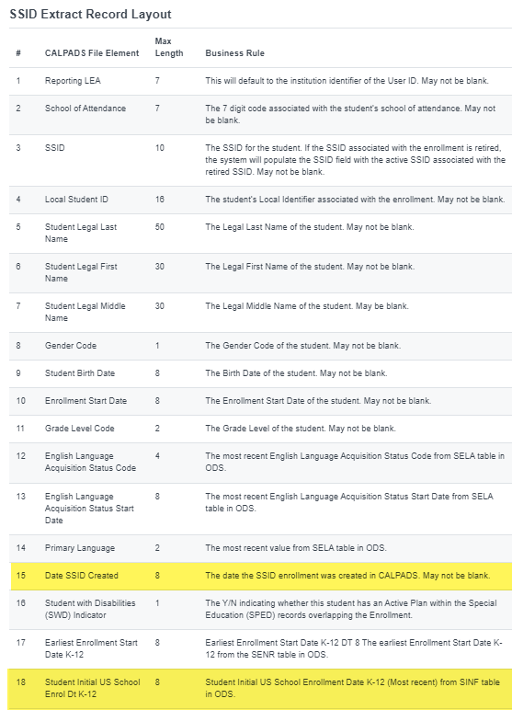
New SSID Extract Fields
Added Date Range by SSID Create Date selection criteria in obtaining new SSIDs
Added Student Initial US Enrollment Date K-12 from SINF

Slide 24
Student Information
KEY POINTS
The student information data is required for all students. Student information is comprised of demographics and address data. These records should be updated with school enrollment changes or when changes or corrections are required
SINF records are used to:
Indicate race & ethnicity
Indicate Student Legal and Preferred Name
Update gender change
Update address history
Identify students for state matching
Determine Title 3 eligible immigrants
Include students in the Socio-economically disadvantage subgroup
Discussion of the SINF reporting process.

Slide 25
Students Demographics are important, how are they used in CALPADS and outside of CALPADS?
Within CALPADS:
Student demographics identify students for subgroup categories (socio-economic disadv, Title 3 eligible imm, CTE non-tradion gender)
Outside of CALPADS
Student demographics are used in accountability analysis
Student demographics are used for State level matching (direct certification, foster youth)

Slide 26
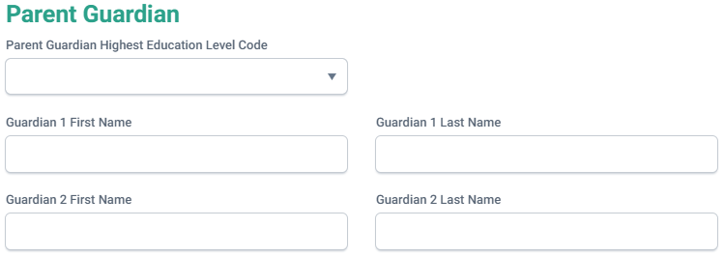
*NEW* Parent/Guardian Highest Education Level for Each Parent/Guardian
LEAs will be required to submit the highest education level for each parent or guardian submitted to CALPADS beginning in September 2023
Students whose parents or guardians (all) are not high school graduates will be counted as “socio-economically disadvantaged” for purposes of accountability
LEAs should incorporate this new collection element to enrollment forms for the 2023-24 academic year

Slide 27
Student Programs
KEY POINTS
The student program data reports students’ eligibility for specific state and federal programs. These data are used to identify students’ in accountability subgroups.
SPRG eligibility records are used to:
Identify student eligibility in federal and state programs and accountability subgroups
Report EL Instructional strategies
Include students in the economically disadvantage subgroup
The following are the programs collected in Fall 1.

Slide 28
Data Collected
Collected in Fall 1
Collected in End of Year
Code | Program | Type
181 | Free Meal Program | Federal
182 | Reduced-Priced Meal Program | Federal
127 | Gifted and Talented Education (GATE) | Federal
135 | Title I Part C Migrant | State
191 | Homeless Program | Federal
193 | Tribal Foster Youth | State
Code | Program | Type
300 | LIP - Developmental Bilingual Program | State
301 | LIP - Dual-Language Immersion Program | State
302 | LIP - Heritage or Indigenous Language | State
303 | LIP - Newcomer Program (Various Models) | State
304 | LIP - One-Way Immersion Program | State
305 | LIP - Structured English Immersion Program or other predominantly English Language Instructional Models | State
306 | LIP - Transitional Bilingual Program | State
Code | Program | Type
122 | Title I Part A Basic Targeted | Federal
174 | Title I Part A Neglected | Federal
191 | Homeless Program | Federal
192 | Armed Forces Family Member | Federal
101 | 504 Accommodation Plan | State
108 | Opportunity Program | State
113 | California Partnership Academy | State
162 | Pregnant or Parenting Programs (formerly Cal-SAFE) | State
185 | Transitional Kindergarten | State
Student Program records should be regularly updated in CALPADS throughout the year regardless of the submission period.
Notes:
This slide list all Program codes that are collected throughout the year. Although, some programs are collected in Fall 1 or in End of Year, it is important to report/update a student’s eligibility or participation in CALPADS as soon as the information is available. Identifying the various program eligibility/participation allows for students to receive additional services.

Slide 29
Eligibility vs Participation
CALPADS automatically designates a program as either eligible or participating.
Eligibility means that a given student has met all of the criteria to receive services for an education program; however, the student may not necessarily be receiving services.
ELIBILITY Programs collected | PARTICIPATION Programs collected
Homeless | Title I Part A Basic Targeted
504 Accommodation Plan | Title I Part A Neglected
Armed Forces Family Member | Opportunity Program
Pregnant or Parenting | California Partnership Academy
Title I Part C Migrant
Free Meal Program
Reduced-Price Meal Program
Gifted and Talented Education (GATE)
Tribal Foster Youth
Participation means that a given student has met all of the criteria to receive services for an education program, and that student is receiving services.

Slide 30
LCFF Eligibility Dates
For students, whose enrollment is between July 1 and October 31 of the current academic year, with the following Free Reduced Priced Meal (FRPM) eligibility dates will be included the LCFF report counts.
Met Eligibility | As of Inclusive date
Homeless | Open record with start date on or before Census day.
Migrant Ed | Open record with start date on or before Census day
Income/ Alternative Income Eligibility Form (Regular School, CEP, Provision 2/3) | NSLP Program Start date should be on or before October 31st.*
Foster Youth | Student must be active Foster Youth on Census day
Tribal Foster Youth | Open SPRG record with start date on or before Census day.
Direct Certification (SNAP, TANF, MediCal Free, Medi-Cal Reduced) | Must be certified between 7/2/2023 to 11/2/2023
Notes:
* NSLP Program Start date should be on or before October 31st. Applications received and date stamped on or before 10/31, regardless if the application was approved before or after 10/31, are eligible.

Slide 31
Student English Language Acquisition Status
KEY POINTS
The student English language acquisition data helps identify a student’s ELAS status needed for assessment, funding and EL services.
SELA records are used to:
Identify students ELAS status eligible for ELPAC
Identify EL services provided
Include students in the economically disadvantage subgroup for LCFF
SELA records include:
Student’s primary language at home
English language acquisition status (ELAS)
ELAS Status Date

Slide 32
Data Collected
English learner program staff must provide any of the appropriate data for submission to CALPADS.
ELAS Status
Primary Language
ELAS Status Date
Correction Code
The current English language acquisition status (ELAS) of each student.
The primary language of each student.
The date a given student’s English language acquisition status changed.
Required when ELAS status progression does not follow the proper sequence.

Slide 33
English Language Acquisition Status Codes
EO
(English or American Sign Language Only)
TBD
(To Be Determined)
ADEL
(Adult English Learner)
Only language reported on the Home Language Survey (HLS) is English or American Sign Language.
Primary language other than English or American Sign Language.
AND
LEA has not completed the assessment process. The assessment process must be completed within 30 days of initial enrollment.
For KN-12 students age 22 and older identified as speaking a foreign language through local process but are not eligible to take the ELPAC due to age restrictions.
IFEP
(Initial Fluent English Proficient)
EL
(English Learner)
RFEP
(Reclassified Fluent English Proficient)
Home Language Survey Primary language other than English or American Sign Language.
AND
Initial ELPAC assessment show proficient in English.
Home Language Survey Primary language other English or American Sign Language.
AND
Initial ELPAC assessment indicates student lacks clearly defined English language skills of listening, speaking, reading, and/or writing necessary to succeed in the school's regular instructional programs.
Identified as an English learner (EL) and
AND
Subsequently reclassified/ redesignated in California, per Education Code 313, as proficient in English. Based on ELPAC Summative test results.

Slide 34
Normal ELAS Status Change
TBD
IFEP
Acceptable Initial Status
Determined based on filled out HLS form
Possible status after Initial Test
Determined based on Initial ELPAC test results.
Home
Language Survey
EL
RFEP
Must be preceded by EL Record
Locally determined based on Summative ELPAC test results and other criteria.
EO
ADEL
Non- eligible adults
For students KN-12 who are 22 yrs old and above who are ineligible for ELPAC testing due to age.

Slide 35
Valid Use of ELAS Correction Codes
The Correction Codes are ONLY available in Online Maintenance.
The codes are only applicable when the prior status being corrected has a date on or after 7/1/2018.
Correction must be done before student takes the summative test.
Most Recent English Language Acquisition Status Code (ODS) | Subsequent English Language Acquisition Status Code | Correction Reason Code on Subsequent ELA record | Correction Reason Code Name on Subsequent ELA record
EO | TBD | 1 | Evidence of Non-English Primary Language
EL | EO | 4 | Ineligible Student Tested
EL | IFEP | 5 | Evidence for EL or IFEP
IFEP | EO | 4 | Ineligible Student Tested
IFEP | EL | 5 | Evidence for EL or IFEP
Notes:
As of June 30, 2021, the following two English Language Acquisition Correction Reason Codes has been retired, and LEAs will no longer be able to use these codes in online maintenance:
2 – Rotating Score Validation Process Error
3 – Home Language Survey Error
The table on this slide displays the correction codes that may be used in lieu of the retired codes.
Flash #208 has details of the ELAS Correction Codes changes - https://www.cde.ca.gov/ds/sp/cl/calpadsupdflash208.asp
Additional Resources:
Refer to the CALPADS Valid Code combinations document for the latest changes related to these code combinations

Slide 36
New Language Code Set for 2023-24
Beginning in Fall 2023, CDE will implement the ISO-639-2 Language Codes as the Language Code Set (also adopted at the federal level as part of the Common Education Data Standards)
This will replace the existing Language Code Set
CDE will provide a mapping of existing Language Codes to their potential new codes
View the new code set at the following web site: https://ceds.ed.gov/iso639-2LanguageCode.aspx

Slide 37
Special Education
KEY POINTS
MEET records are used to:
Capture the dates specific types of meetings were held and is used to monitor timeliness of:
Initial Evaluations
Annual Plan Reviews
Eligibility Re-evaluations (triennials)
Pending meetings
SWDS records are used to:
Determine a student’s eligibility for and participation in special education at any given time for:
Individuals with Disabilities Education Act (IDEA) reporting – child count
Subgroup reporting for Dataquest and CA School Dashboard
PLAN records are used to:
Identify the specific plan and settings a student is on at any given time for:
IDEA Reporting for LRE
CA School Dashboard
SERV records are used to:
Report services for children and students ages 0-22, who on Census day:
Are Eligible and Participating in the SPED program and have Plans effective.
Are Eligible and Participating in the SPED program and have Plans effective on during the reporting year.
Meeting Records (MEET)
Status Records (SWDS)
Plan Records (PLAN)
Services Records (SERV)

Slide 38
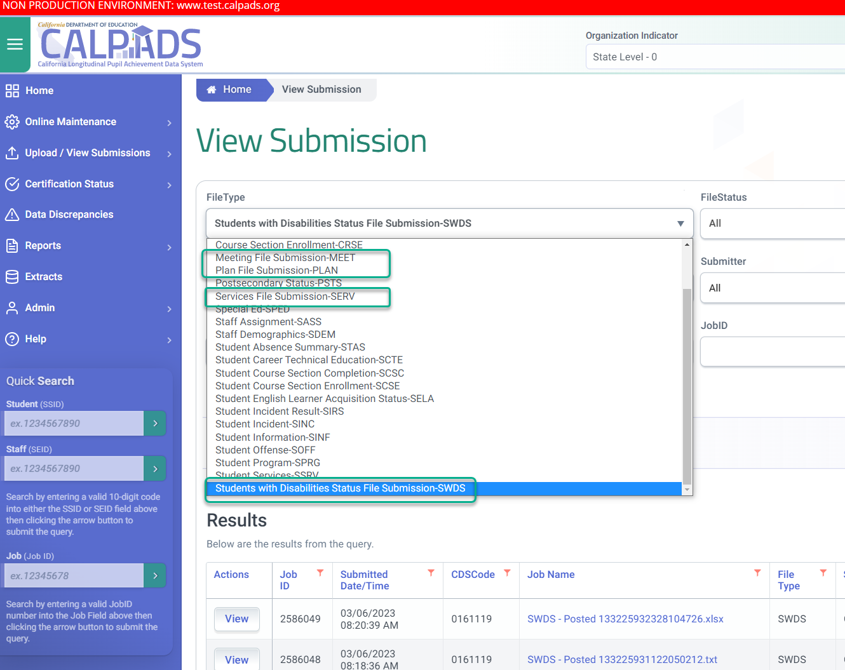
SPED File Redesign as of March 2023
MEET
PLAN
SWDS
SPED
SSRV
SERV

Slide 39
SPED Redesign
SPED broken to 3 files while SSRV was renamed and modified.
Meetings File
(MEET)
New for 23-24
Captures the dates specific types of meetings were held and is used to monitor timeliness of:
Annual Plan Reviews
Status File
(SWDS)
New for 23-24
Used to determine a student’s eligibility status for special education at any given time for:
Plan File
(PLAN)
New for 23-24
Used to identify the specific plan and settings a student is on at any given time for:
Eligibility Re-evaluations (triennials)
Initial Evaluations
Individuals with Disabilities Education Act (IDEA) reporting – child count
Subgroup reporting for Dataquest and CA School Dashboard
IDEA Reporting for LRE
Allows LEAs to submit any plan changes with specific start and end dates independent of meetings
Pending meetings
Services File
(SERV)
Previously SSRV
Report services for children and students ages 0-22, who on Census day:
Are Eligible and Participating in the SPED program and have Plans effective on Census Day.
End of Year 4 Certification: Submit the Services File (SERV) for children and students ages 0-22 who, from July 1 – June 30 of the reporting year:
Are Eligible and Participating in the SPED program and have Plans effective on during the reporting year.

Slide 40
API Process
Application Program Interface (API) enables interaction with an SEDS system pushing the data to CALPADS through automation
Faster processing by reducing the file size (compressed data) prior to pushing the data into CALPADS, featuring auto post of passed records
Provides LEAs with a rejected records report in SEDS system

Slide 41
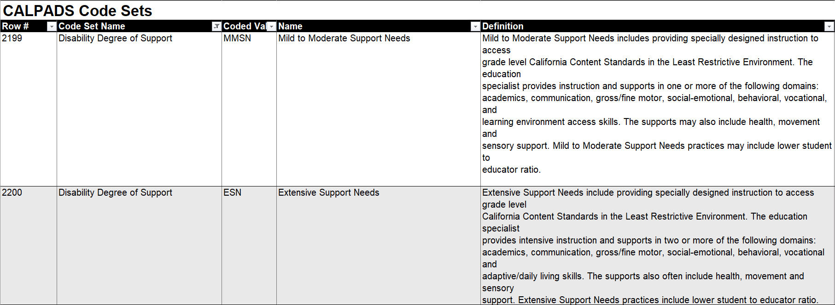
*NEW* Disability Severity Codes

Slide 42
Data Submission
Discuss overview of data submission cycle.

Slide 43
Ways Records are Submitted
Online Maintenance
Mass Upload
Report one student at a time
Edit data manually in CALPADS portal
Ability to use functionalities limited to OM
One or more student records
Enter data in SIS or Excel; then upload file extract to CALPADS portal
API data transfer for SWD records
TOMS ELAS automated transfer for EL and IFEP
CALPADS
Online & batch transactions are processed the same way
Notes:
There are two ways to submit a student data. In CALPADS. Online maintenance is performed only one student at a time. The data is entered manually through a series of screens. Batch file processing allows for one or more student's data to be uploaded in a single transaction. Rather than a series of screens for each student, a series of files must be submitted to complete the student information and program data for several students or an entire student population. Batch file submissions are the most efficient way to manage a large number of students or import Student information system data into CALPADS.
The same validation rules apply to data in online maintenance and file submissions.

Slide 44
Batch File Submission Demo
Demonstrate how to submit student profile records via batch file

Slide 45
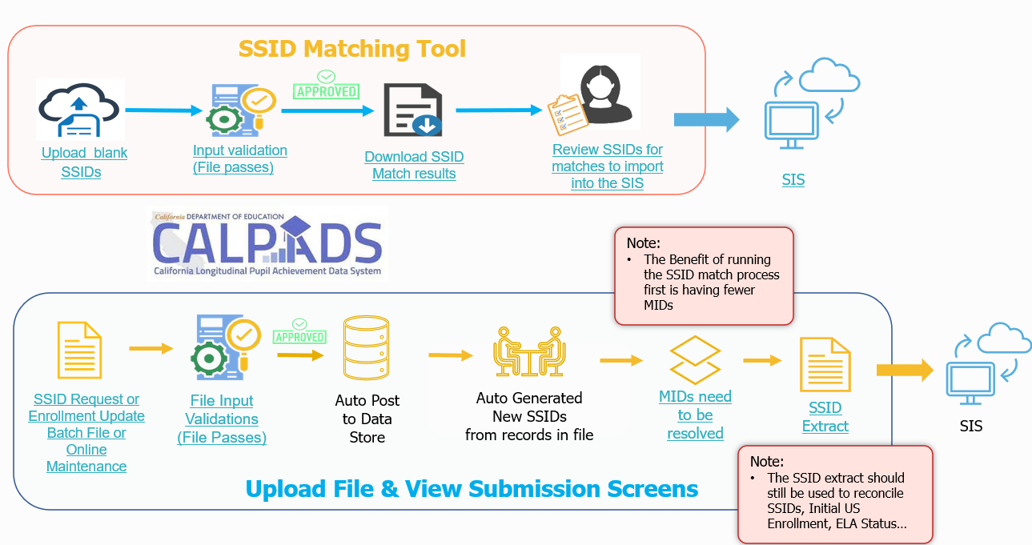
Batch File Submission Process
Gain Ownership
Match to existing SSIDs
Request new SSID
Establish Student Profile
Student Information
Student Programs
Student English Language Acquisition
Special Education
SPED Services
Maintain Student Data
Regularly update student profile and pertinent data
Notes:
This slide illustrates the batch upload process from searching, selecting and generating SSIDs to gain ownership of a student. Once ownership of an SSID is established, the LEA is responsible to maintain the SSID profile throughout the duration the primary enrollment within the LEA.
At the very least the Students profile will include:
Student enrollment data
Student information data
Student program data
Student English language Acquisition data.
Many students have an expanded profile which may also include student course section data, Student career technical education data and student discipline data. LEA ownership of an SSID and the associated student data is only with the start and end dates of an enrollment record. The Student Information record can not have a start date prior to the enrollment start date. A transfer student with existing records can not have those records amended by the new LEA, but new records can be added to the student profile by the new LEA during the period of enrollment.

Slide 46
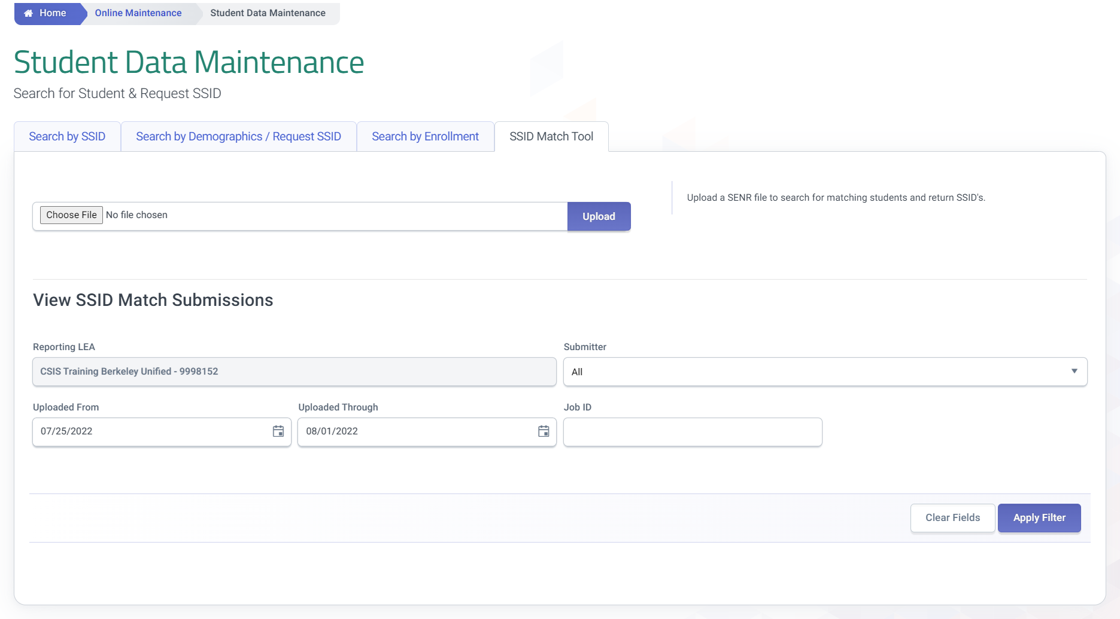
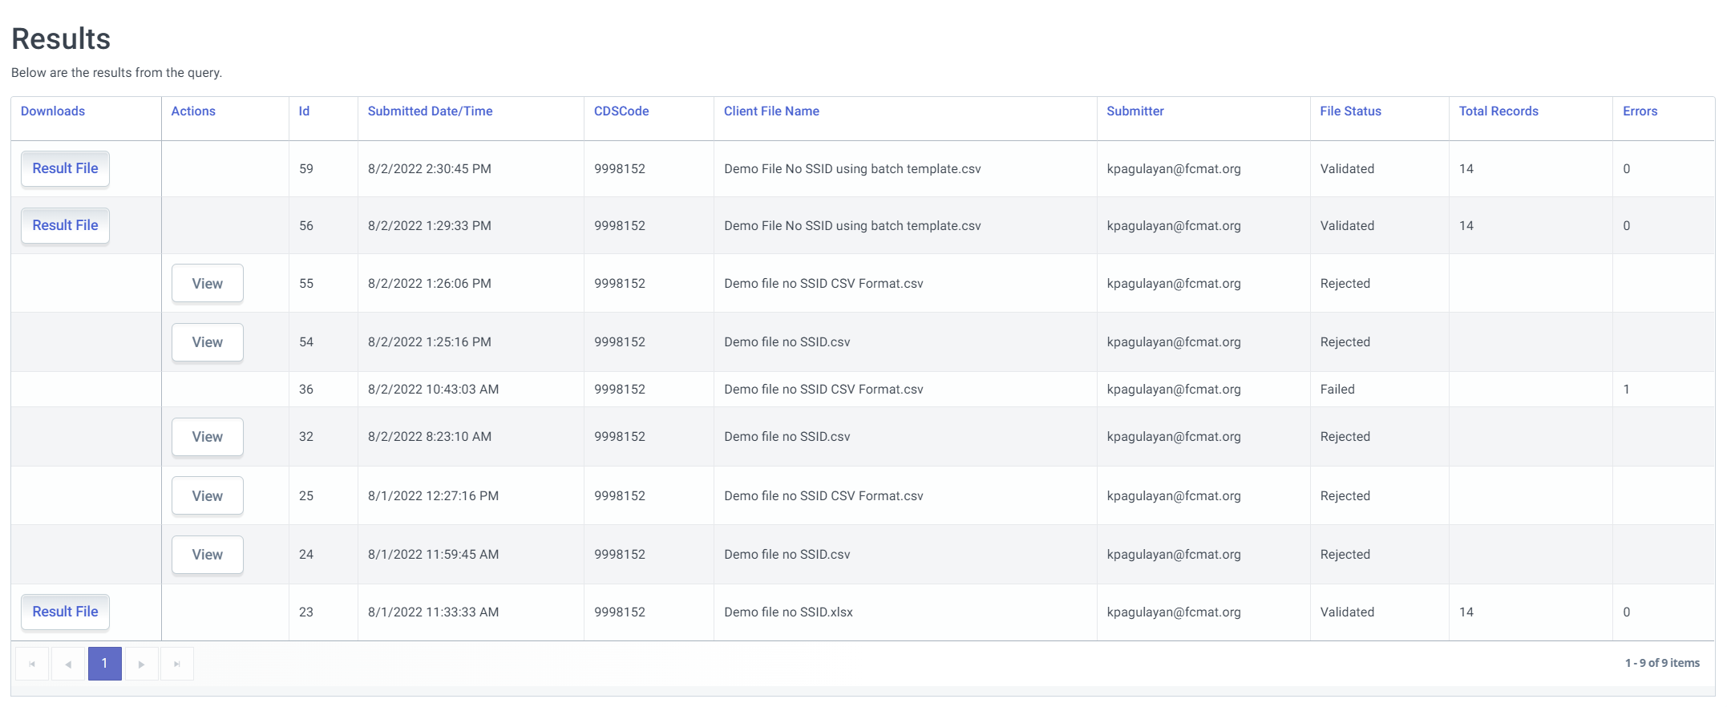
SSID Matching Process
3
1
A
2
B
4
Notes:
Go to the SSID Match Tool Tab within Student Data Maintenance
Upload the File
Depending if the fille passes all validations you will either:
Download the result file
View and resolve validation errors triggered.
4. Based on numerous data presented in the resulting report (Result Category, Match Percentage, SINF demographic information), LEA will analyze the results and indicate their selection in the highlighted column using predetermined codes suggested by the sis vendor.
After all selections are done, upload or hand enter selected SSIDs to SIS and generate a new SSID enrollment file for the new academic year that includes the records from the selection process. By now, main SENR file will have both blank SSIDs for records that had no match and therefore will need its own SSID generated by CALPADS as well as those with ssids from matched and re-enrolling students.

Slide 47
Reminders when selecting SSID Matches
Diligently review and scrutinize demographic data of possible SSID matches to avoid picking up the wrong SSID and hijacking the student record.
If the SSID Match tool show “No match” for students in higher grade levels or who transferred from a different district, you may do a manual student search in Online Maintenance. Doing so will minimize the possibility of creating new SSIDs and causing MID anomalies.

Slide 48
File Upload
Upload SENR File
records with existing SSIDs,
records that recently updated with SSIDs from the SSID Match process
remaining records that still do not have SSIDs (because the SSID match tool did not find a match).
Notes:
A new SSID enrollment file is extracted from the SIS for the new academic year that includes:
records with existing SSIDs,
records that recently updated with SSIDs from the SSID Match process
remaining records that still do not have SSIDs (because the SSID match tool did not find a match).
The user uploads the file to CALPADS which will execute any of the following:
Add new enrollment record for the new year to an existing SSID
Generate new SSID for those records with blank ssids.

Slide 49
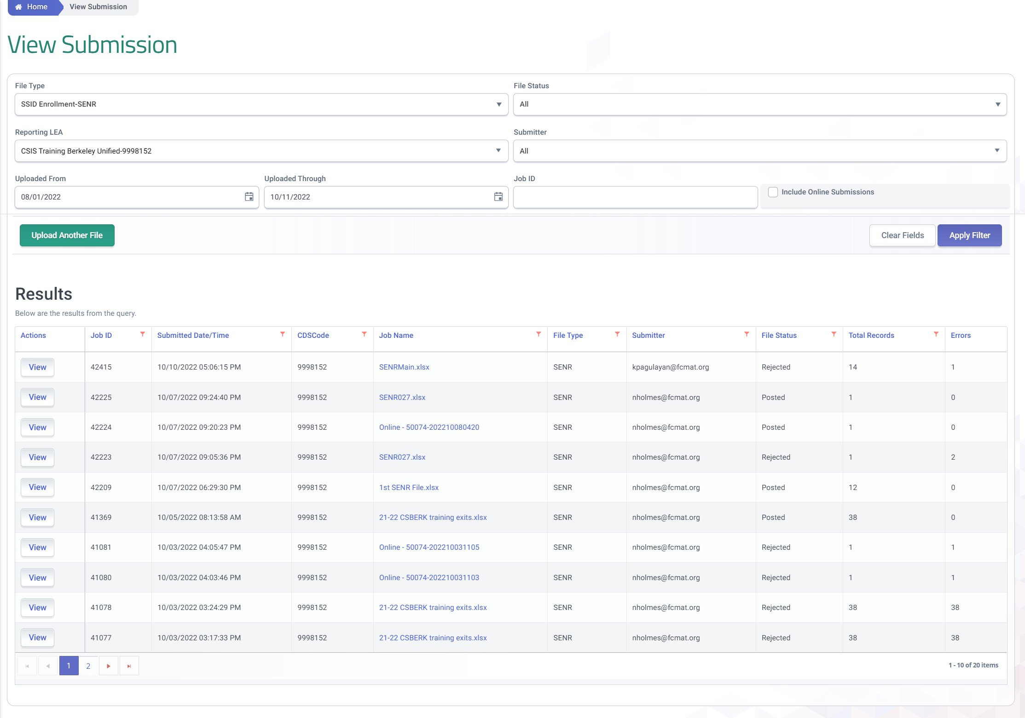
View Submission
File submissions employ a pass or no pass approach. It is
an iterative process. Error correction typically requires the submission of data multiple times until all records pass and are auto posted.
Notes:
The view submission screen provides access to all files submitted within a time period or that have been filtered and meet the criteria.

Slide 50
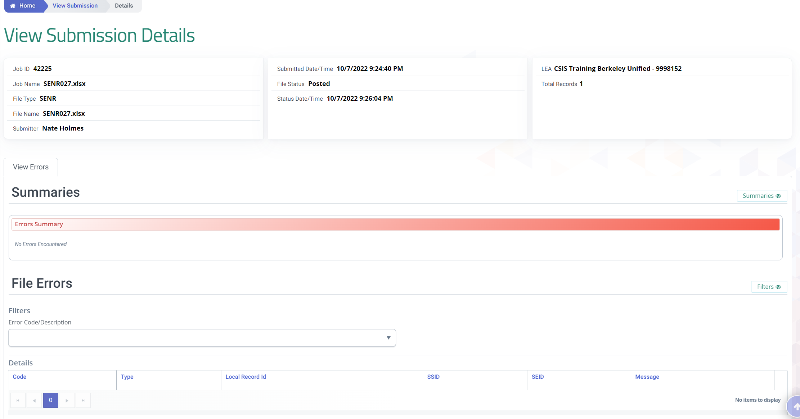
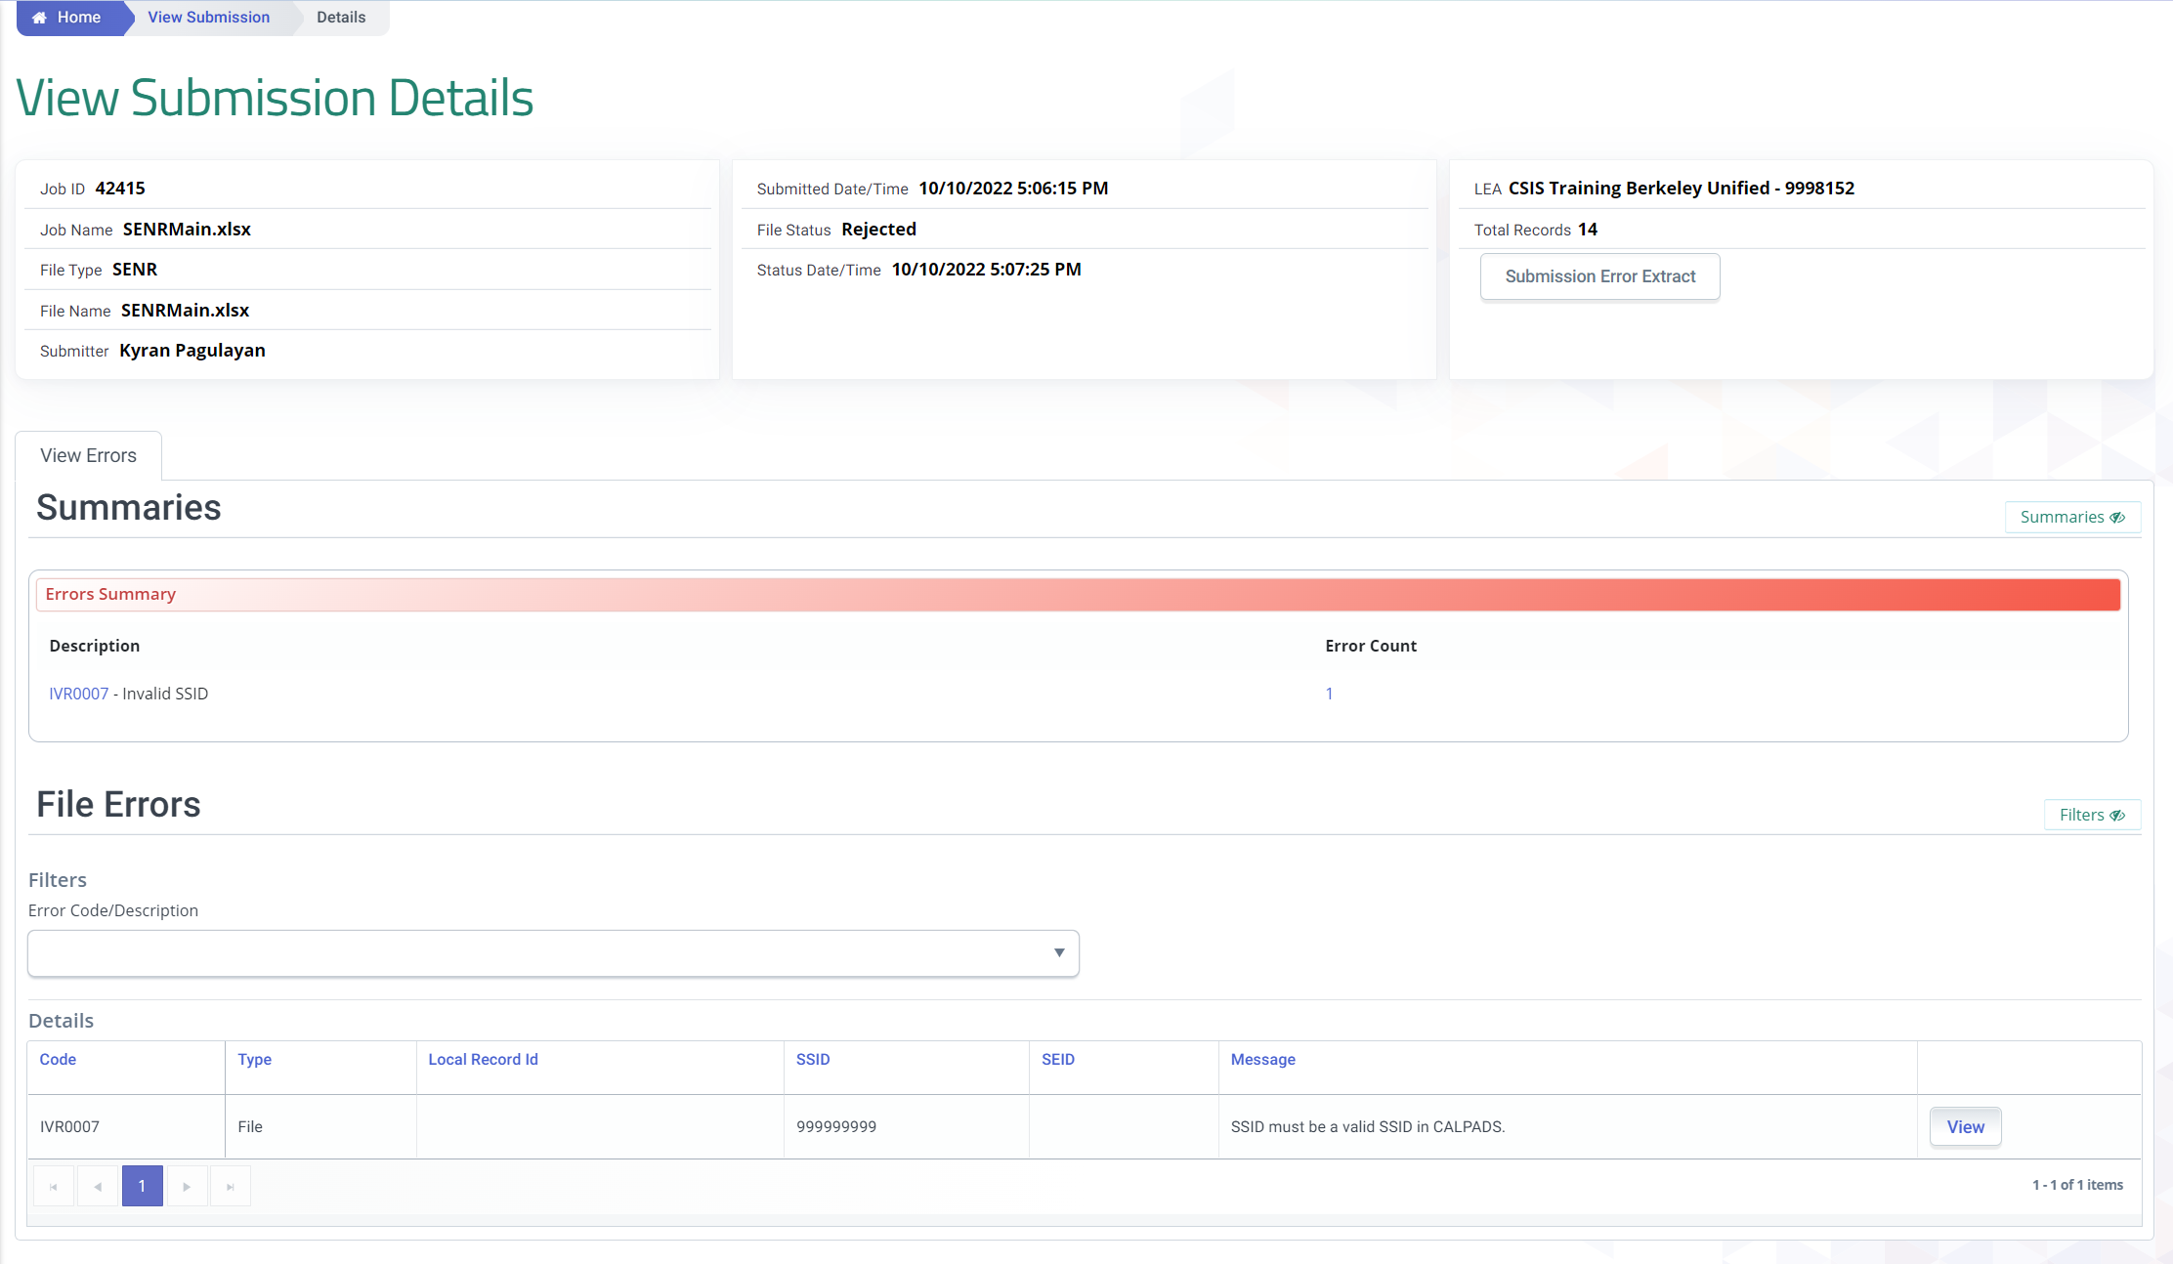
Submission Details
The View Submission details features Summary of Pass or Rejected files. However, only details of Rejected records can be viewed.
Pass File
Rejected File
Notes:
The view Submission details screen allows for the review of rejected records.

Slide 51
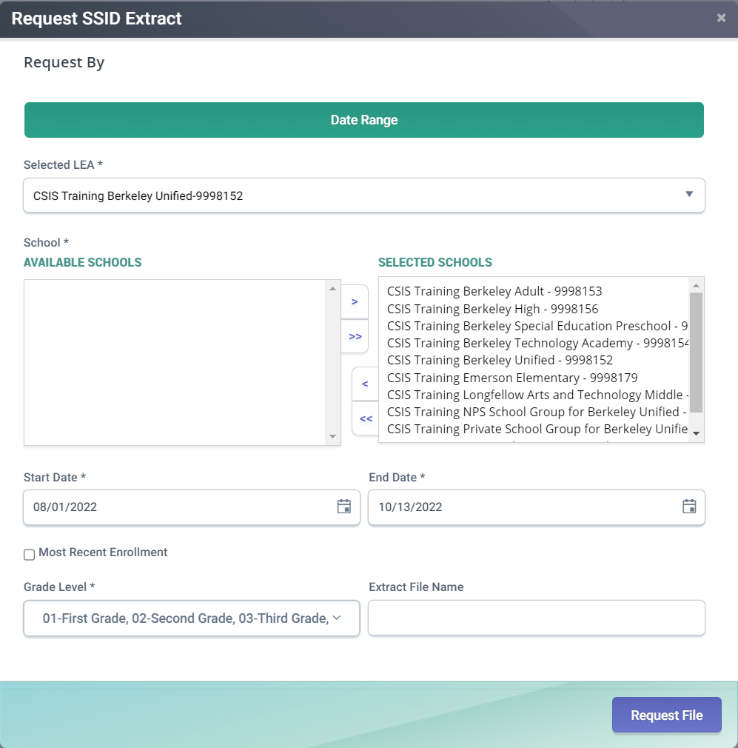
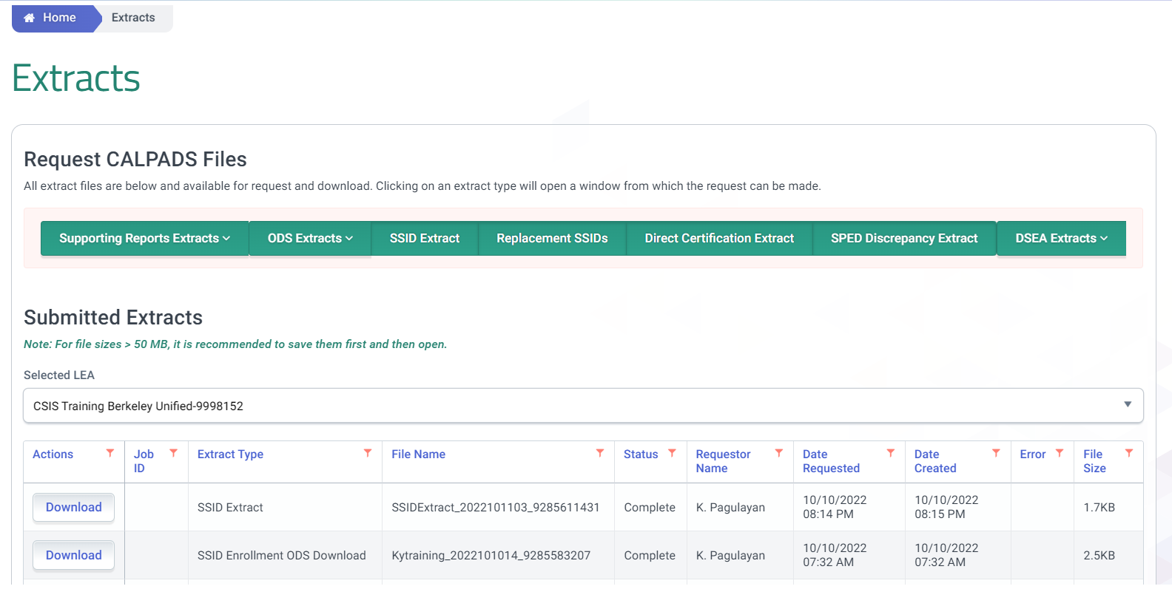
SSID Request Extract for SIS
Use extracts to import new SSIDs to your SIS
2
1
3
Notes:
Resource: https://documentation.calpads.org/Extracts/SSIDExtract/
To download the SSID extract file go to the Reports menu and select Extracts. The Extract page has two sections. There are the Request CALPADS Files links and the Retrieve CALPADS Files links. The bottom half of the screen has the links to retrieve extracts. Click on the SSID Extract link Under retrieve CALPADS Files.
An SSID Extract file is available to download after a user successfully posts a Student Enrollment File with SSID Requests or completes a manual SSID assignment using online maintenance. The SSIDs in the file may be imported into a local student information system and used locally in the user’s local Student Information System.

Slide 52
Complete the Student Profile Submission

Slide 53
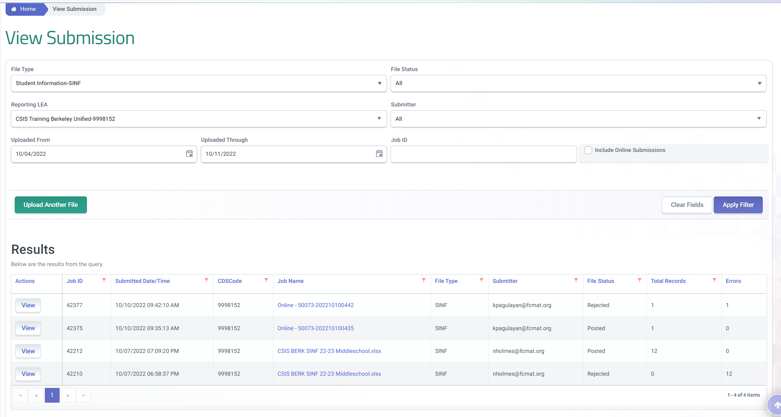
Review & Resolution
File submissions employ a pass or no pass approach. It is
an iterative process. Error correction typically requires the submission of data multiple times until all records pass and are auto posted.

Slide 54
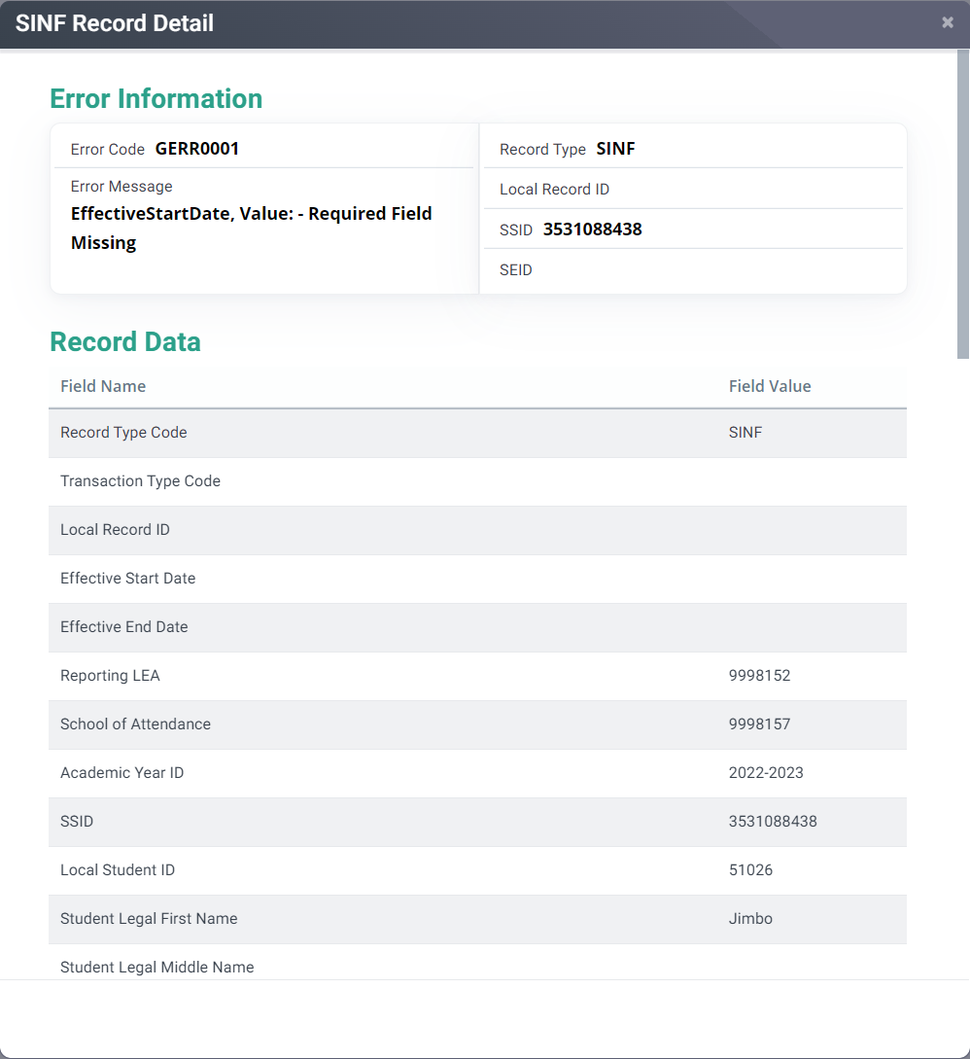
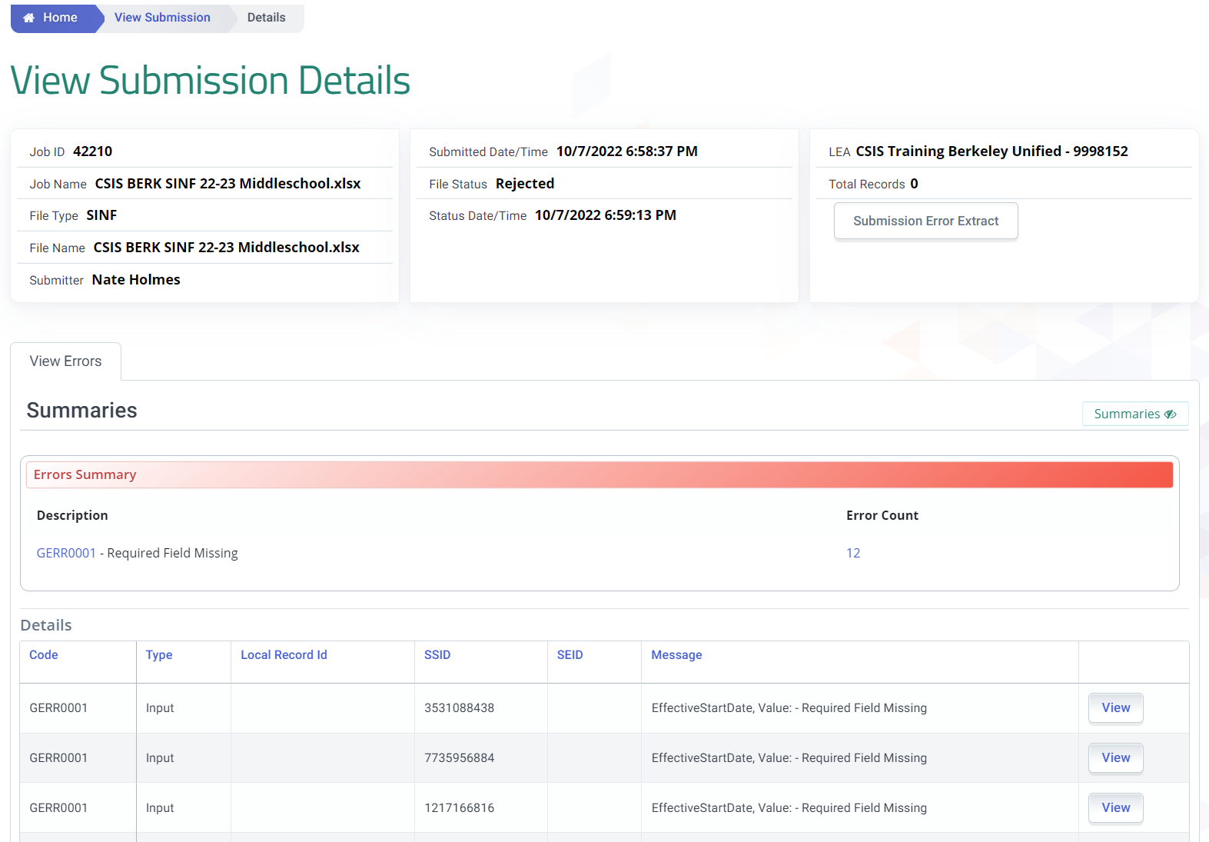
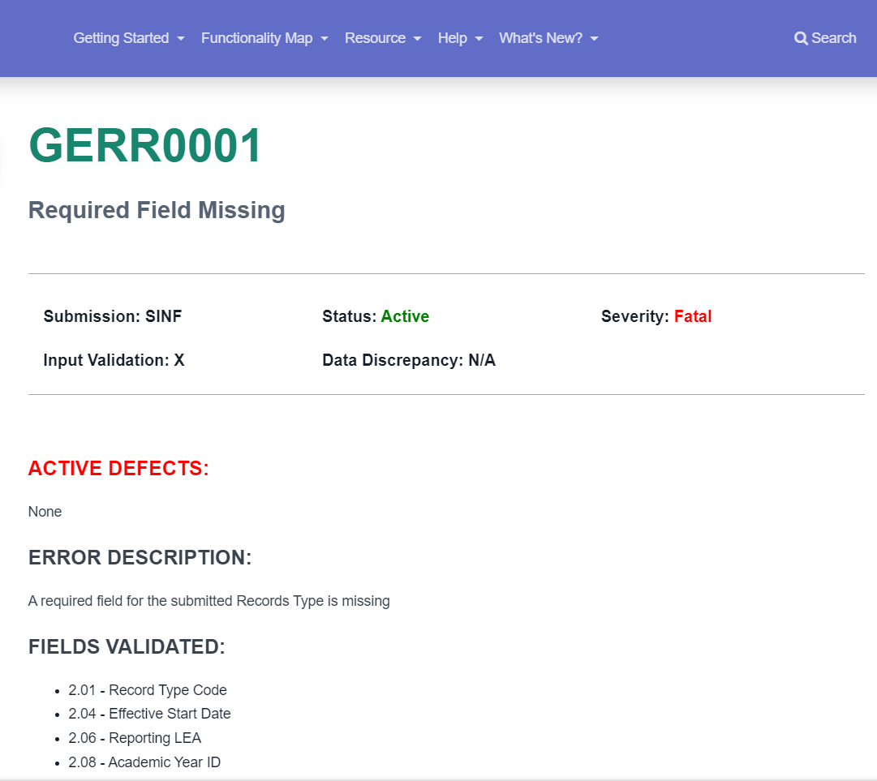
Maintain Students Data (BATCH)
Error Summary
Notes:
Just like the SENR batch process, the same File details are broken to different sections. Also, it defaults to the View Errors and warnings page. So users can see any errors that need to be resolved.
Clicking on the View button enables the user to see the actual record data elements.
Clicking on the linked Error number brings the user to the CALPADS User Manual Error page which is the web version of the Error List spreadsheet.
Users can analyze the problem by reviewing the detailed error description and suggested resolution and checking the actual rejected record for problematic data.

Slide 55
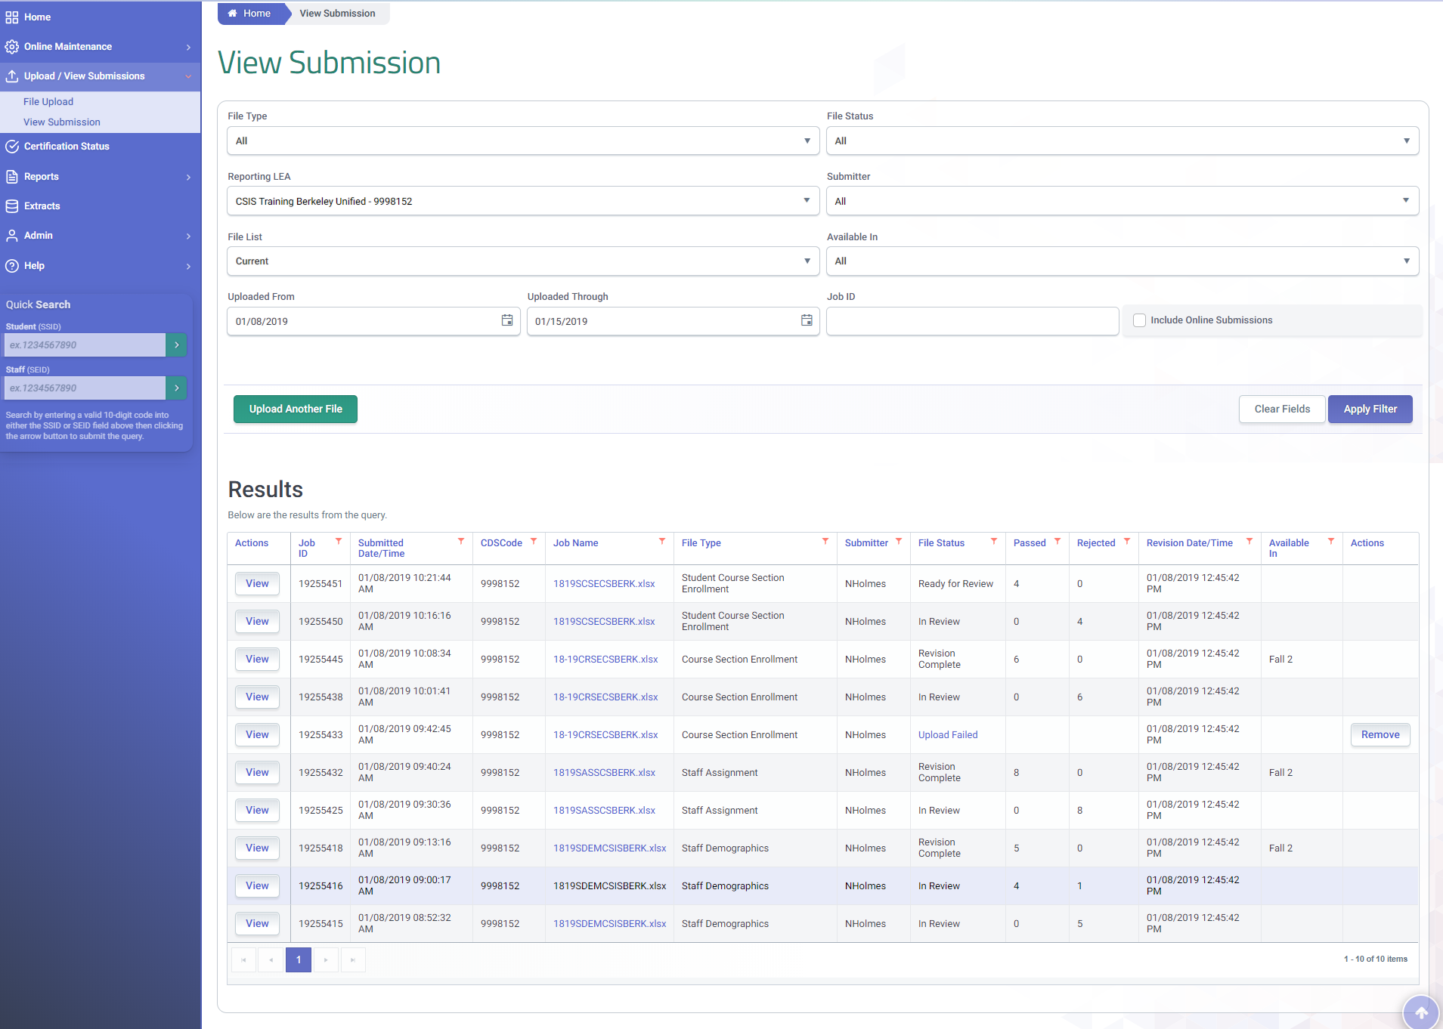
Completing the Fall 1 Submission
When all six record types have been posted and all errors resolved, the certification status should then be reviewed
Addition file submission may be required to resolve Fall 1 Certification error. Cert errors can still trigger even if all submission errors have been resolved

Slide 56
Online Maintenance Demo
Demonstrate how to submit student profile records online

Slide 57
Manual Online Submission Process
Online Maintenance
Manually Search for Student SSID/ Demographics Online
Gain Ownership
Match to existing SSIDs
Request new SSID
Establish Student Profile
Student Information
Student Programs
Student English Language Acquisition
Special Education
SPED Services
Possible Anomaly Resolution
Combine any resulting MIDS triggered and detected after submission
Maintain Student Data
Regularly update student profile and pertinent data
Notes:
This slide illustrates the SSID enrollment process. It contrast the SSID enrollment process between the batch upload and the online maintenance.
It is important to understand that the initial step in the SSID enrollment process is to perform a search for a student to see if the student has an existing SSID. Depending on results you will determine whether to request a new SSID or use an existing SSID. This activity can be executed either by submitting a batch file that generates possible matches or doing a student search through online maintenance.
SSID enrollment is the process that allows an LEA to establish ownership of a SSID and the student data associated with the SSID. Ownership of data is a key concept in CALPADS. The LEA with the a primary enrollment is allowed make changes to student data over the enrollment period. In CALPADS, ownership of data establishes:
Access rights to the student’s historical data
Ability to modify a student’s data – as of Student School Start Date in LEA
Responsibility for data maintenance
Responsibility for accuracy and timeliness of data
A student must be enrolled with a primary enrollment in order to update or add student information.
Once ownership of an SSID is established, the LEA is responsible to maintain the SSID profile throughout the duration the primary enrollment within the LEA. At the very least the Students profile will include: Student enrollment data, Student information data, Student program data and Student English language Acquisition data. Many students have an expanded profile which may also include student course section data, Student career technical education data and student discipline data. LEA ownership of an SSID and the associated student data is only with the start and end dates of an enrollment record. The Student Information record can not have a start date prior to the enrollment start date. A transfer student with existing records can not have those records amended by the new LEA, but new records can be added to the student profile by the new LEA during the period of enrollment.

Slide 58
Demo Search for Student
Search by SSID is an exact search using a state identifier
Search by Demographics locates students who have been enrolled in California public schools when the SSID is unavailable
Notes:
In addition to the Quick in the left navigation, the Student data Maintenance screen allows you to search by SSID, demographics and by enrollment. Additionally the demographic search tab can toggle to request SSID to complete a student enrollment online.

Slide 59
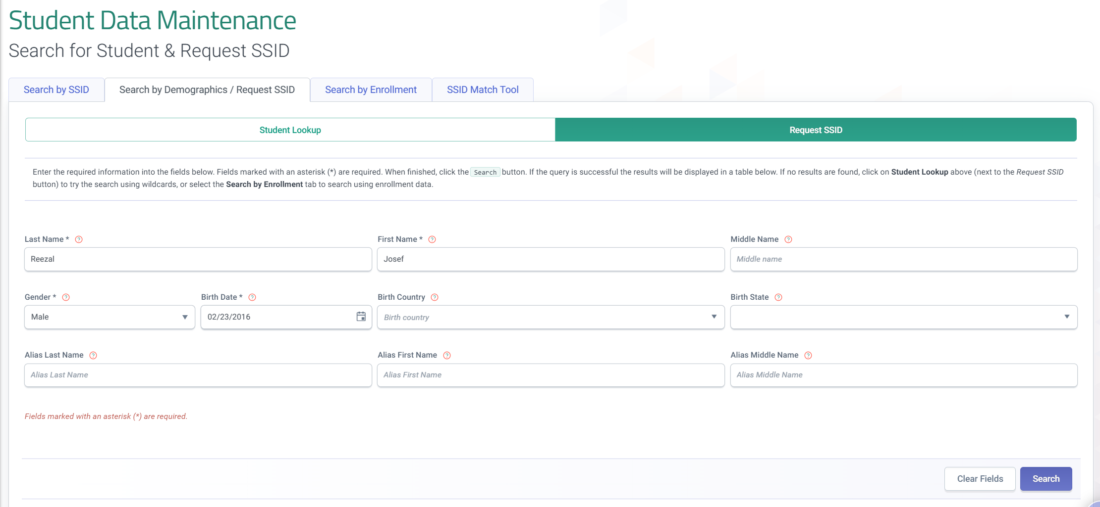
Demo Request SSID
Toggle between Student Search and Request SSID to perform a more advanced search. After an advanced search the option to request an SSID will appear
Notes:
To request an SSID for a newly enrolled student, toggle from Student look up to the Request SSID screen within the Search by Demographics/ Request SSID tab on the Student data Maintenance screen. An SSID request requires several fields to be populated:
Last Name
First name
Gender
Birthdate

Slide 60
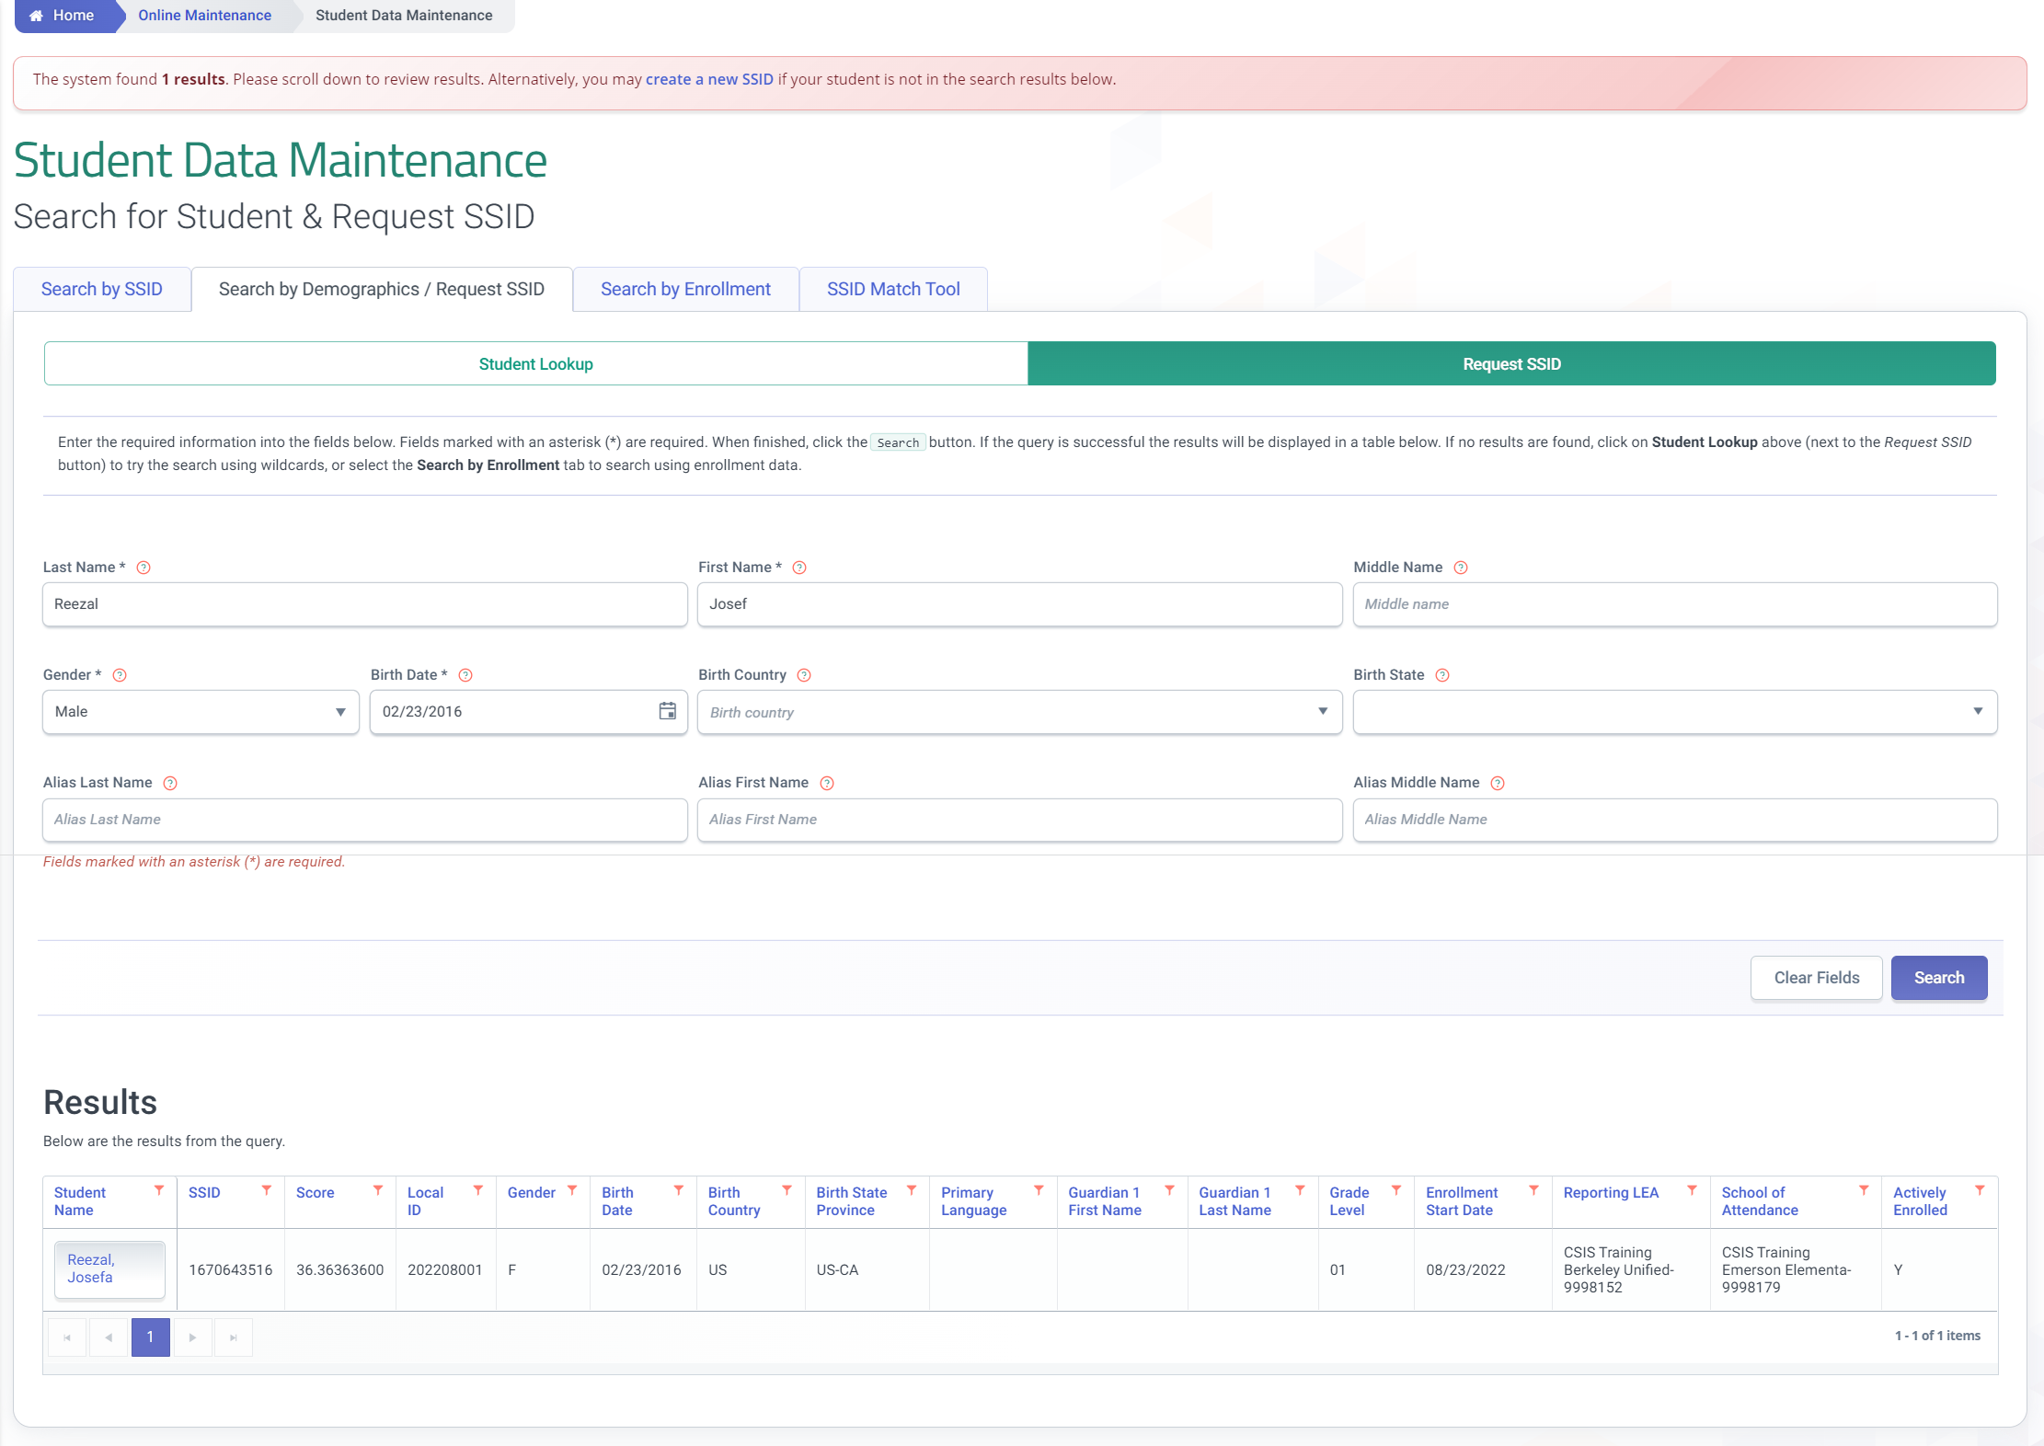
Demo Request SSID
Review all the potential candidates to find the match for your request. Select the name of the student to access the student's profile
Notes:
When a match or multiple matches are found, carefully review the students record to ensure you do not assign a student more than one SSID. Select the student name to access a matching record.

Slide 61
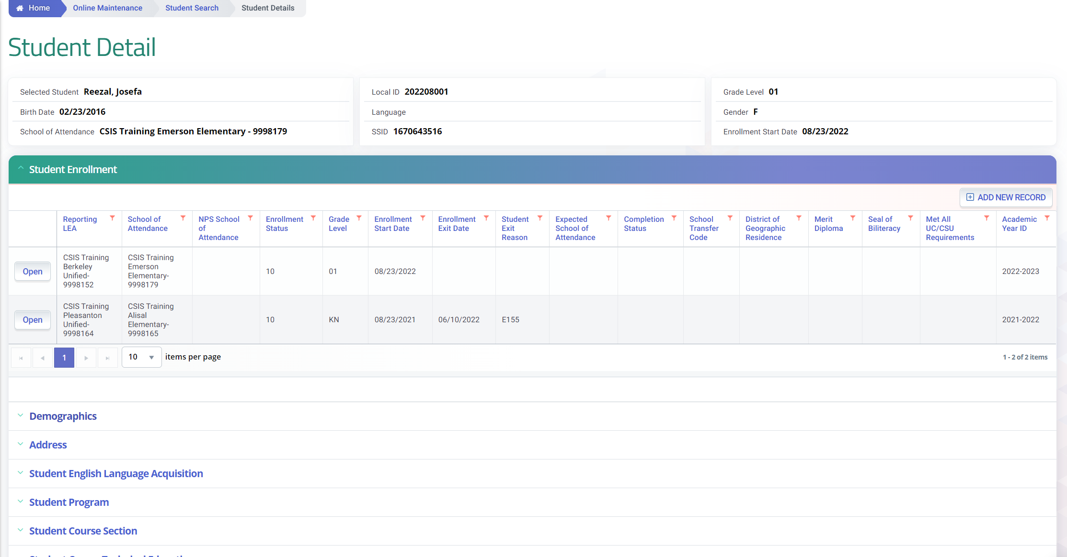
Demo Candidate Details
The Student Detail screen provides access to the complete student profile
Notes:
After selecting a student, you will have access to the student profile through the student detail screen.

Slide 62
Demo Create New SSID
When no records match your search criteria select Create A New SSID
Notes:
Back on the Request SSID screen. The additional fields required can be used to provide an LEA with advance search options, but when no student matches the criteria the option to select a new SSID will appear.

Slide 63
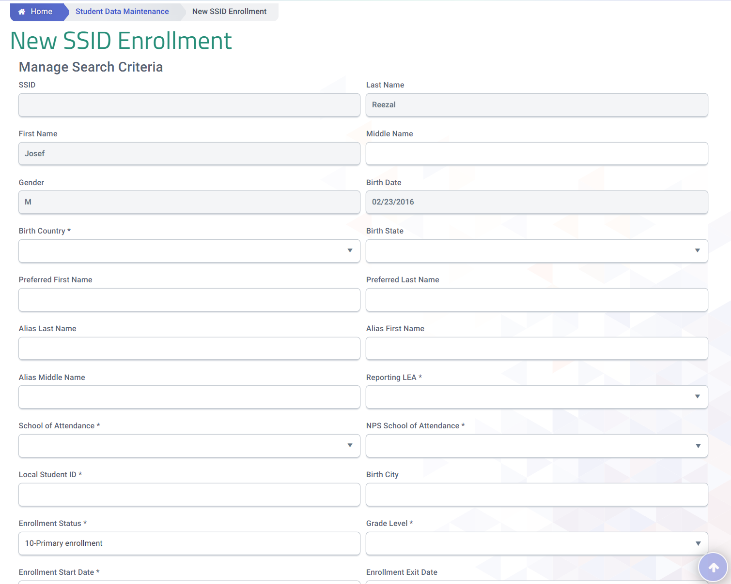
Demo Obtain a New SSID
Students with no previous enrollment in CALPADS
Notes:
After selecting Create a New SSID a blank New SSID Enrollment screen is available to begin the enrollment process.

Slide 64
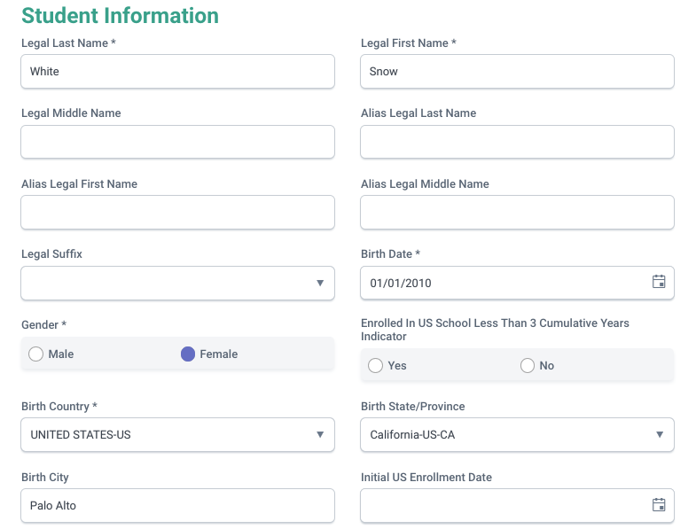
Student Information Details
All fields with an asterisk are required. Foreign born students must have the Enrolled in US field populated.
Gender and Name changes must be done online. They cannot be changed in the same transaction
Notes:
This slide show the modal window displaying the core student demographics fields that need to be populated. Some of the fields are required and must be populated as shown before the record can be posted.

Slide 65
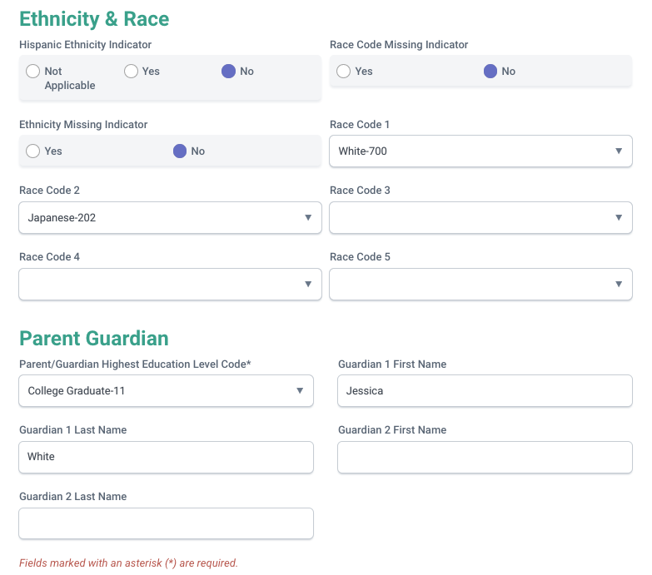
Student Information Details
Required sections for all submissions for all student information records
Notes:
This slide show additional fields related to Ethnicity & Race and Parent/Guardian that are required and must be populated prior to validating and posting the record.

Slide 66
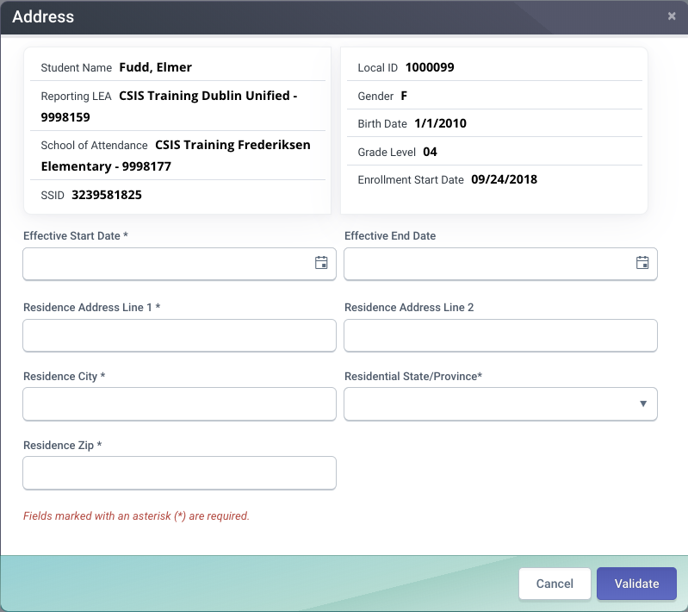
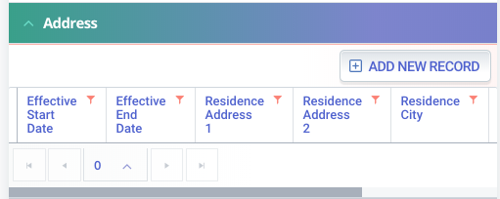
Student Address Details
Address are not validated for correctness. It is dependent on the LEA that the address conforms to US postal standards
Notes:
By clicking on “Add New Record” in the address container, the system will display the ”Address” modal window. You would need to populate the required fields before validating and posting the record.

Slide 67
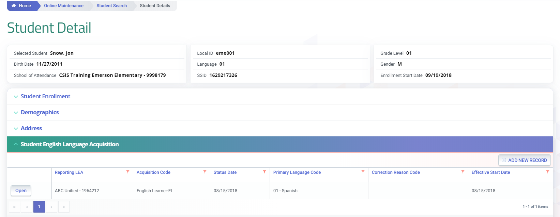
Online Maintenance Process
1
2
3
4
1
5
6

Slide 68
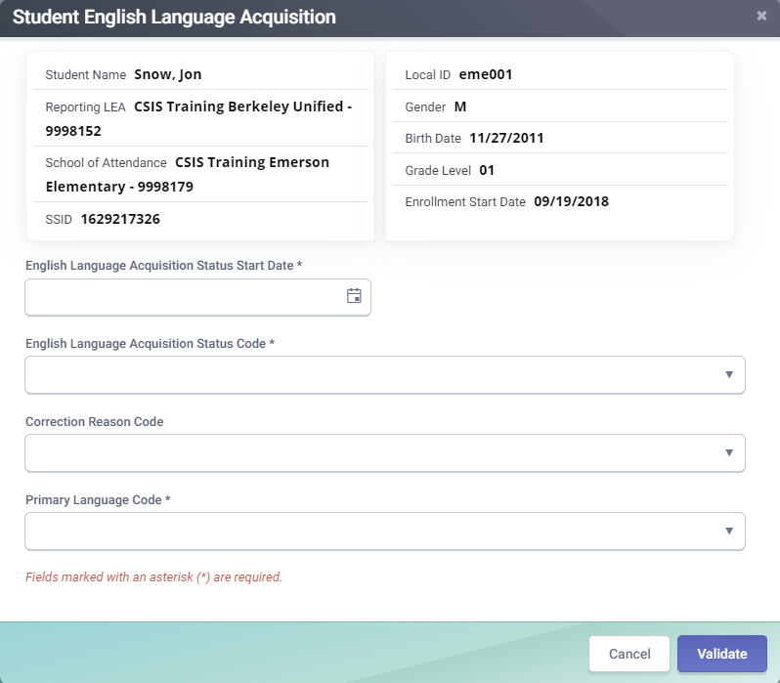
SELA Details
Student summary based on most current SENR and SINF
TBD = Current Date
EO = first day of student enrollment
EL
RFEP within an enrollment period but not within same academic year
Status date = Test completion date
Students enrolled just prior to or on Census day, use Census day or earlier.
A
A
The potential code values include:
- English or American Sign Language only (EO).
- To Be Determined (TBD).
- English Learner (EL).
- Initially Fluent-English Proficient (IFEP).
Reclassified Fluent-English Proficient (RFEP)
ADEL (Adult English Learner)
B
B
C
C
D
Optional and only available in Online Maintenance. Use only when submitting a new ELAS status as correction for a prior reported status
D
Required for all ELAS Status

Slide 69
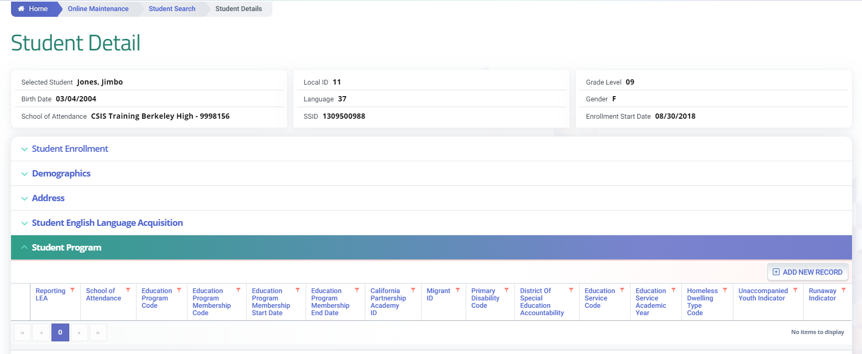
Online Maintenance Process
1
2
3
4
5
1

Slide 70
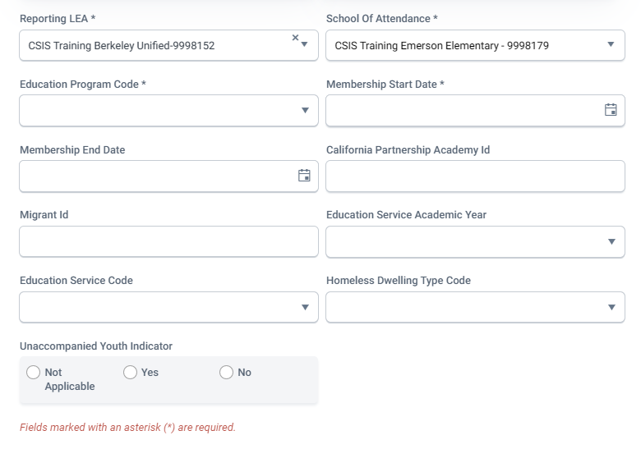
Student Program Modal Details (OM)
Required general fields for all program records
Required with California Partnership Academy (113)
A
A
Required with Migrant Ed (135)
B
C
B
C
Required with Title I Targeted (122)
C
D
Required with Homeless (191)
D
D

Slide 71
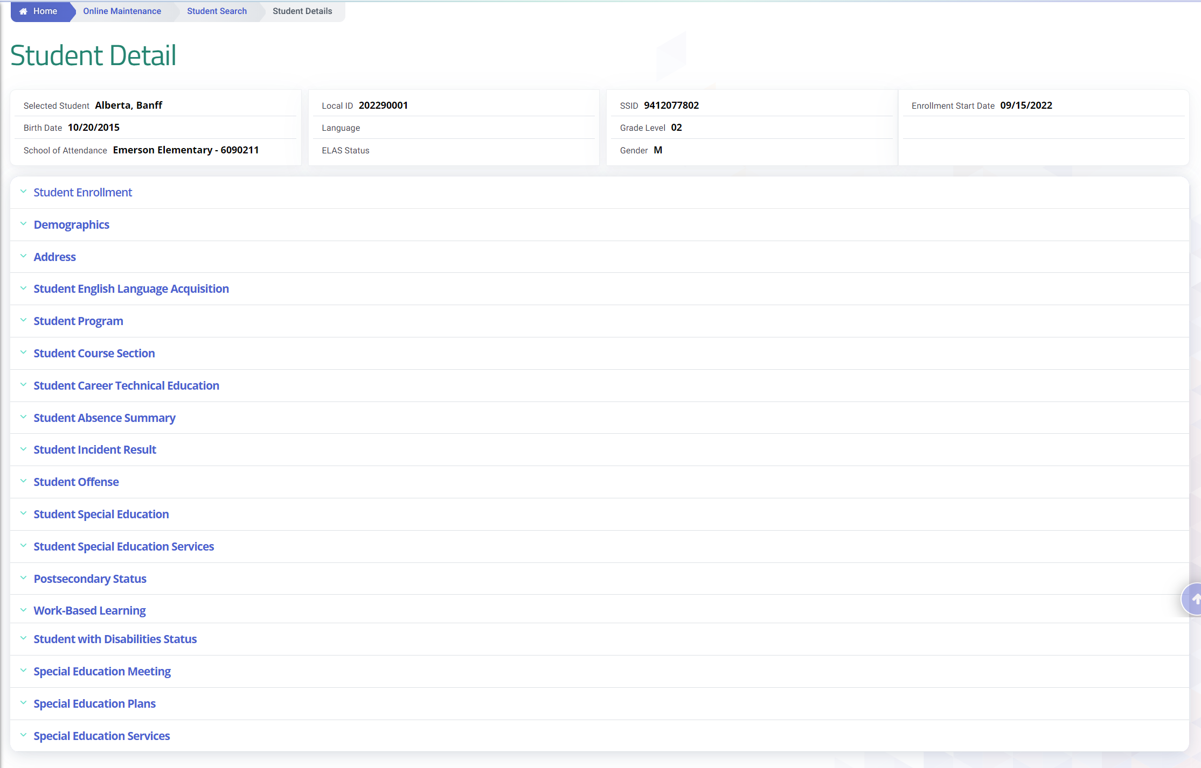
SWDS, MEET, PLAN, SERV Containers
Note: Old SPED and SSRV containers will still be visible to reflect historical records.
NEW SWDS Containers

Slide 72
SWD User Interface
LEAs will now be able to ADD, UPDATE, and DELETE all of the new file types in Online Maintenance
CDE still prefers LEAs that all edits be sent through the SEDS application program interface (API), which ensures the source system and CALPADS reflect the same data
Limit SPED Edit and SSRV Edit roles to actual SPED staff entering in data. To avoid discrepancies between CALPADS and SEDS.
Notes:
- LEAs will now be able to ADD, UPDATE, and DELETE all of the new file types in Online Maintenance!
- CDE still prefers LEAs that all edits be sent through the SEDS application program interface (API), which ensures the source system and CALPADS reflect the same data

Slide 73
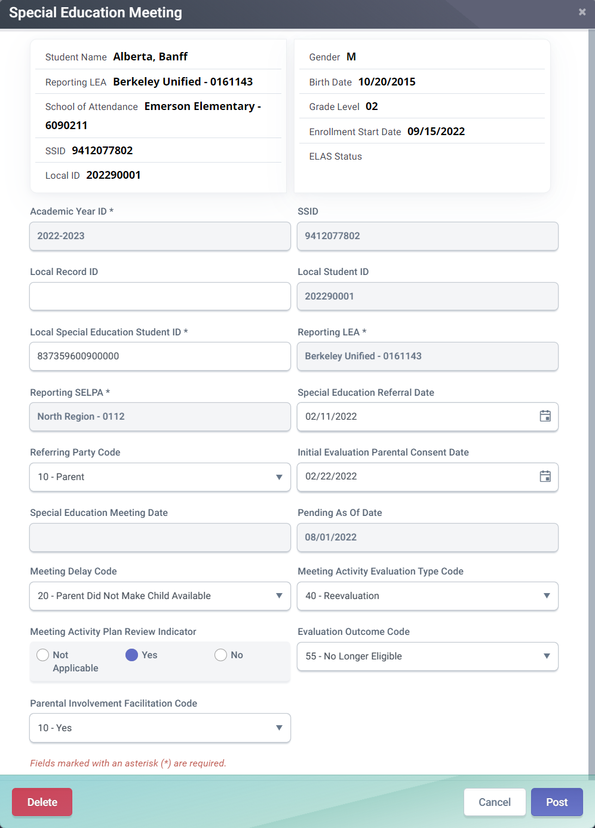
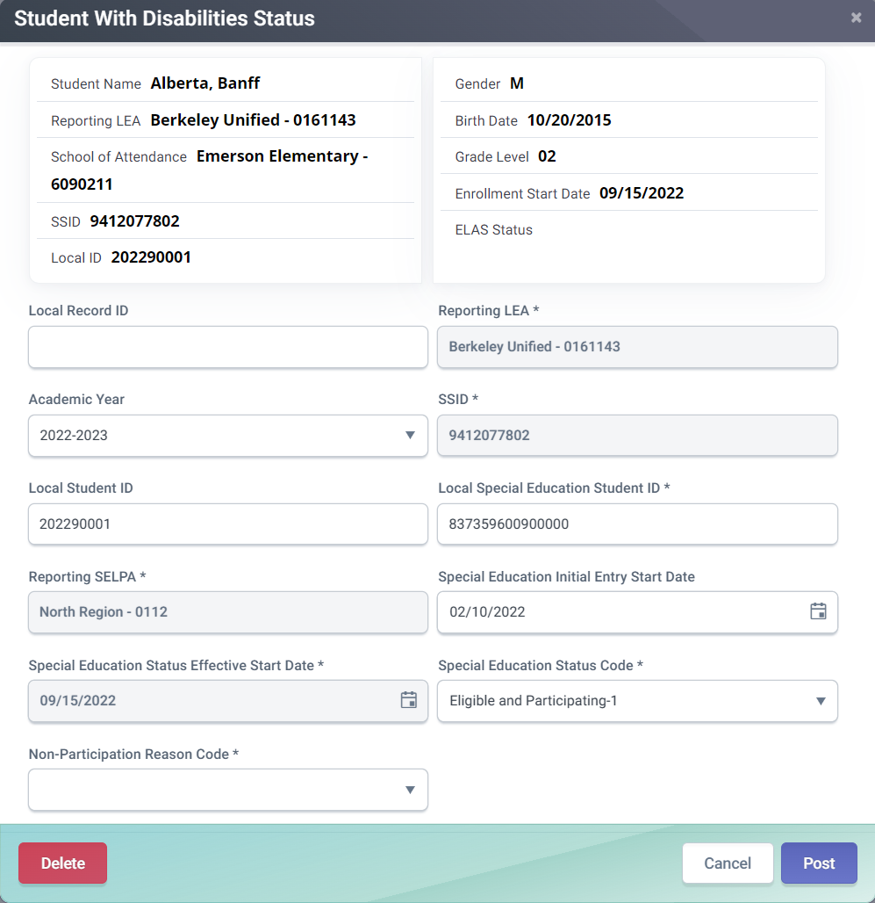
SWDS Modals

Slide 74
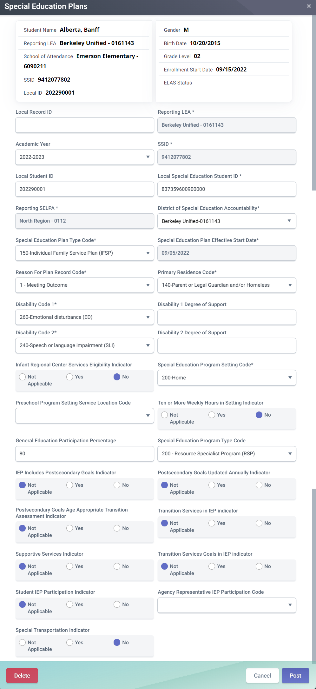
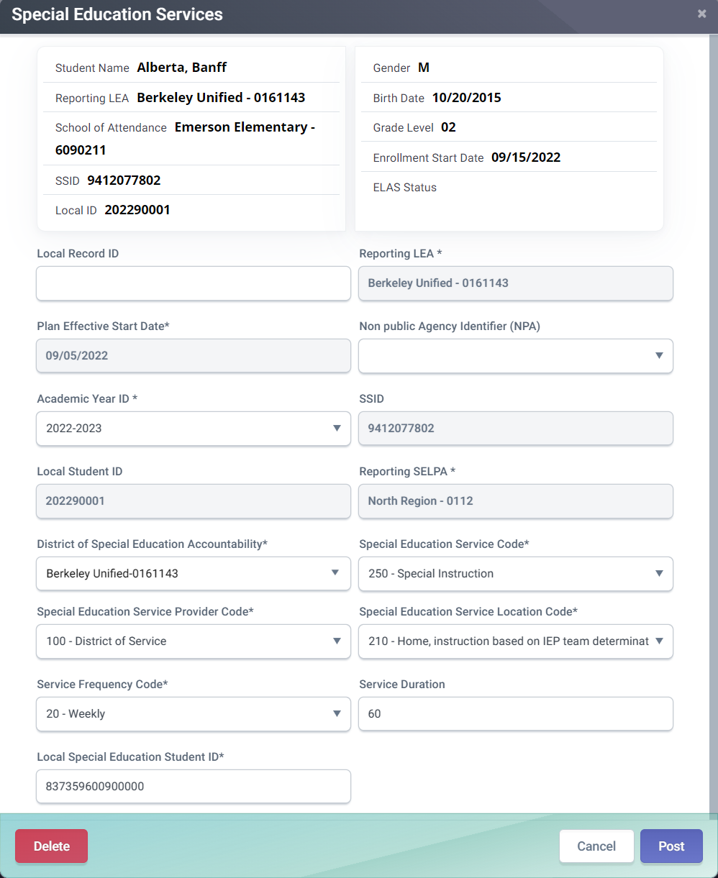
SWDS Modals

Slide 75
Wrap Up
Key Points, Resources and Support

Slide 76
Summary
Enrollment records must be posted first to establish ownership of an SSID
Demographic information is required for all students. State level matching cannot be performed without demographic records
LEAs do not need to update the ELAS of incoming students transferring from another California school whose statuses already exist in CALPADS
Initial ELPAC results (EL and IFEP) status is automatically transmitted to CALPADS by TOMS.
Students age 22 or older must have a current ELAS status of ADEL including students who are EL. IFEP and RFEP students are exempt from this rule.
Program Eligibility is counted if the program start date is on or before census day and there is no end date or the end date is after census day
The new MEET, PLAN, SWDS, and SERV files for SWD submitted from the SEDS to CALPADS through an API
Some key points to remember

Slide 77
Suggested Fall 1 Milestones
Now – 10/4
Complete student profile data population in local SIS. Complete SWD data population in SEDS. Obtain SSIDs for new students in CALPADS
Now – 11/4
Submit and post SENR, SINF, SELA, SPRG, SWDS, MEET, PLAN & SERV records. Review validation errors and reconcile as needed
11/5 – 12/2
Resolve CDDs, Certification errors, and anomalies.
Review snapshot reports and update records as needed
Fall 1
2023 - 2024
12/5 – 12/9
Send reports to local data stewards, site leaders and administrators for approval
12/10 – 12/15
LEA approval (SELPA Approval Optional )
12/16 – 1/26
Amendment and SELPA Approval Window
1/26
Final Certification Deadline

Slide 78
Next Trainings: Fall 1 Reporting and Certification Advanced or Fall 1 Reporting and Certification
Going Forward

Slide 79
Resources
Here are some important resources related to Fall 1 Student Profile reporting.
https://learn.fcmat.org/
https://www.youtube.com/channel/UCA9oRTiyVECCCzOxpmJheZw
https://documentation.calpads.org/Support/References
https://www.elpac.org/

Slide 80
Support
http://www2.cde.ca.gov/calpadshelp/default.aspx
Web
calpads-support@cde.ca.gov
Email
916-325-9210
Phone
https://csis.fcmat.org/ListServ
You can get help through these channels.
Listserv

Slide 81
Feedback
I have a question…
“
”
Please complete survey…
https://bit.ly/2MXsECg
“
”

Slide 82
Thank You
CSIS Training
+1 916 325 9210
csistraining@fcmat.org
https://csis.fcmat.org/

