Slide 1



Fall 1 Data Population
Live Training
Student Profile
Batch File Submission
Error Validation
Online Maintenance
Notes:
Hello everyone
Welcome to Fall 1 Data Population live training with CSIS supporting CALPADS.
This training is set to be about 2 hrs with a break about mid point.
The focus of this training is to provide guidance for the data submission needed to complete Fall 1. We’ll discuss student profile files types, online maintenance, batch file submissions, and resolution of validation errors. We’ll provide a demonstration of the Online Maintenance (batch file submission) process in the second half of the training today.

Slide 2


Target Audience
New to CALPADS
Data Coordinators
Notes:
This training should be attended by users new to CALPADS, and by CALPADS data coordinators. Experienced users may attend as well and treat this session as a refresher. If you are new to CALPADS, we strongly recommend that you also attend the Fall-1 Reporting & Certification training to gain an understanding of Fall 1 certification reports and the certification process.

Slide 3
CALPADS Training Sequence
Introduction
System Overview
Basics
Submission Data Population
File Type Data Population
Data Collections
Fall 1-2 Reporting and Certification
End of Year 1-2 Reporting and Certification
Skill Building
Skill Building
Data Privacy
Data Population
CALPADS Basics (SELPA)
CALPADS Basics
Notes:
The CSIS training model is designed to be segmented to provide organization of specific topics and concise delivery. We aim to provide focused trainings with relevant information and instructionThese sessions are the prerequisite for the remaining Reporting and certification and advanced courses. We are currently designing Skill Building courses which will develop targeted CALPADS competencies and skills.

Slide 4




Objectives
Identify
Determine
Perform
Resolve
the different file types expected to be reported for Fall 1
Manage & Maintain Data
which SIS fields map to CALPADS file specifications
CALPADS Literacy
the submission process through online maintenance and batch upload
Manage & Maintain Data
submission errors and reporting roadblocks through scenario discussions
Critical Thinking
Notes:
These are our objectives for today’s session.

Slide 5




Agenda
Overview
Demonstration
Wrap-Up

Slide 6


Overview
Discuss background of the student profile and the Fall1 data population
Fall 1 Data Population-Live v1 – September 3, 2025
Notes:
Let’s begin with our Overview of the Fall 1 submission. Here, we’ll provide general and background information related to the student profile and fall 1 data population, and introducing key concepts related to the data submission.

Slide 7






Data Cycle
TOMS
Receives and transmit relevant student data from and to CALPADS for assessment purposes
SEDS
Transmit SWD data to CALPADS
SIS
Local Systems maintain student data
LEA extract files and send to CALPADS
STATE Database
Matches CALPADS data for Foster Youth, Direct Certification with appropriate state department databases
SSID
A student can only have one SSID.
Allows for longitudinal tracking
CALPADS
Validates & stores incoming student Data
Generates new SSIDs
Matches existing student data to SSID Requests
Sends and receives student profile for state data Matching and ELPAC

Slide 8
Student Profile Data for Fall 1
The following file types comprises the Student Profile.
SENR
SELA
SPRG
SWDS
PLAN
MEET
SERV
SINF
Reporting the Student enrollment gives you ownership of the SSID and allows submission of the rest of the student data.
Student with Disabilities files coming from local SEDS system pushed through API
Files extracted from local school information system and uploaded to CALPADS

Slide 9

Student Profile
Student Profile records are required for each submission, an enrollment record must exist in CALPADS prior to any other record types being posted
Fall 1
SENR
SINF
Fall 2
SCSE
SELA
SPRG
MEET
STAS
SINC
EOY 1
SPRG
SIRS
SOFF
EOY 1
MEET
SWDS
PLAN
SPRG
PSTS
SENR
SELA
SWDS
PLAN
SERV
SERV
PSTS
EOY 2
SCSC
SCTE
WBLR
Fall 2 & EOY 1 require staff and/or course records types in addition to student profile data
Notes:
In Fall 1, you will submit Student Profile records. Student profile records include Student enrollment (SENR), Student Information (SINF), Student English Language Acquisition (SELA), Student Programs (SPRG), as well as Special Education records types, including the Meetings (MEET) file, the Students with Disabilities status file (SWDS), the Plan file, and the services file (SERV).
There are two main ways data is submitted to CALPADS.
SENR, SINF, SELA, and SPRG records are extracted from the local SIS and submitted either through batch file uploads or directly via online maintenance in CALPADS. The four special education file types are submitted from your SEDS system to CALPADS via the API. Your responsibility is to review any errors, validate the completeness and accuracy of the reports that rely on these files.

Slide 10
Departments Involved
Fall 1
Registrars,
Counselors, and Principals
Fall 2
Curriculum Instruction Directors
Credential Analysts
Human Resources
Staff
EOY 1
EOY 2
EOY 3
EOY 4
Special Education Staff
SELPA Directors
EL Services Staff
Program Staff
Site Staff
CTE Staff
Site Admins
Site Staff
Site Staff
Attendance Supervisors
EL Services Staff
District Admins
NPS School Staff
Special Education Staff
Site Staff
Special Education Staff
SELPA Directors
Counselors
Program Staff
Site Admins
EL Services Staff
NSLP Program Staff
Site Admins
Notes:
Collaboration is key to a successful Fall 1 Submission.
The Fall 1 submission draws from multiple data sources, which means several departments play a critical role in ensuring its accuracy and completeness. Based on the file types and information they contain, the following staff are typically involved.
Again, Forming a collaborative team is not just helpful , it’s a key indicator of success in managing CALPADS submissions. Open communication and shared responsibilities lead to smoother reporting cycles and accurate data.

Slide 11

Ongoing Maintenance
  Student data changes frequently and should be updated in CALPADS on an ongoing basis. Keeping student enrollment, demographic, information, and program eligibility data current in CALPADS:
Makes it easier to select the correct SSIDs for transferring students.
Ensures that LEAs have access to current data helping the LEAs place new students in appropriate programs.
Minimizes LEA workload during snapshot collection windows.
Ensures that the CALPADS ODS is up-to-date for assessment, state matching and accountability purposes.

Slide 12

Key Concept
There are several Factors that impact how often an LEA maintains student data
Local Enrollment Procedures
Local Reporting Needs
Assessments
Management expectations, competing responsibilities
SSIDs for ELPAC, CAASP, Pre ID, Direct Certification & Foster Youth matching, SPED services
Submission timelines and reporting deadlines
How frequent should student data be maintained?

Slide 13
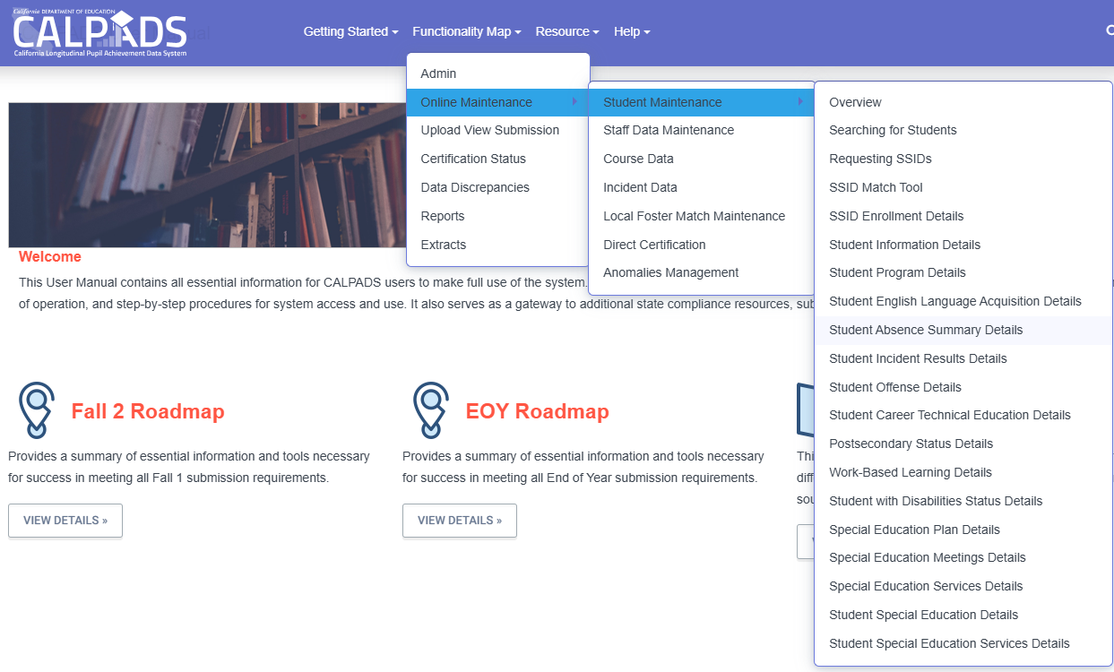
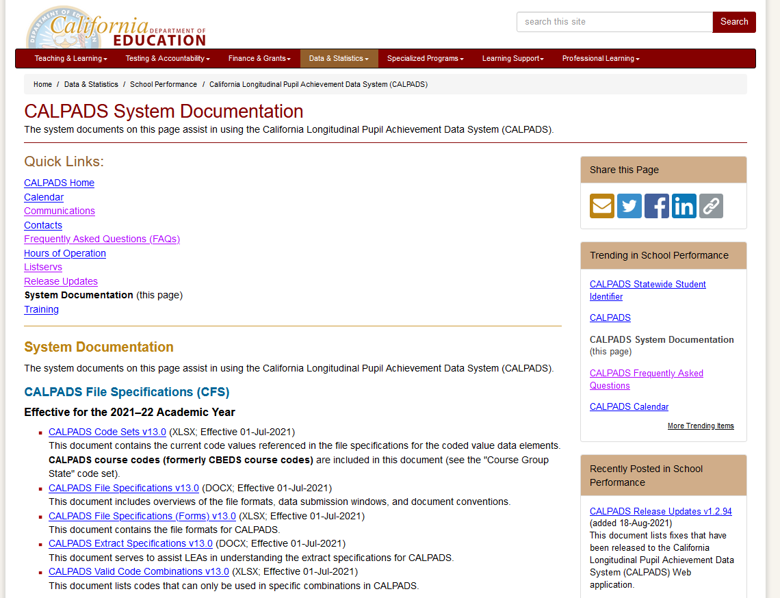
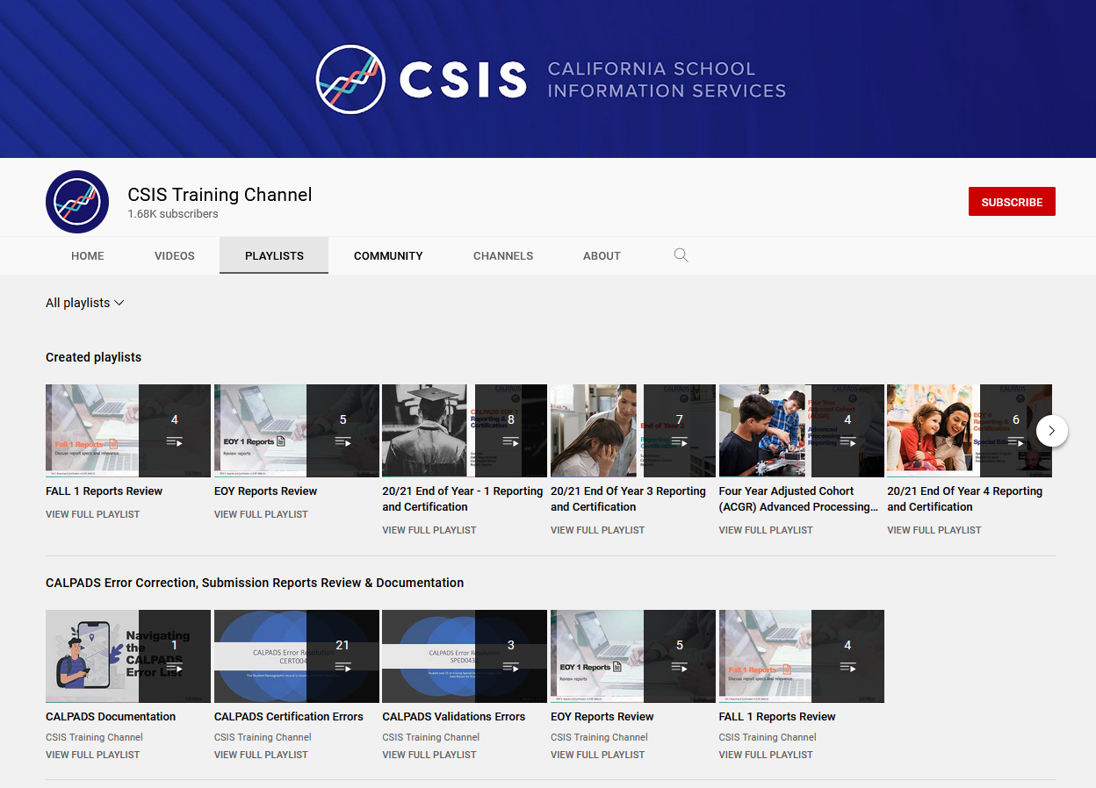
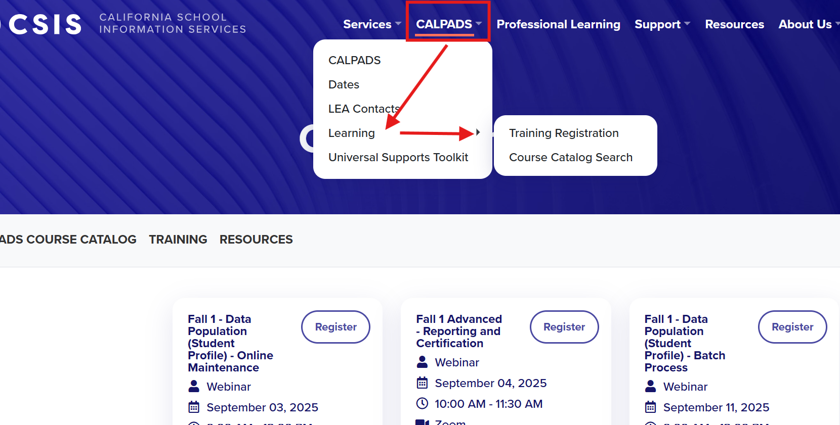
Fall 1 Data Reporting Survival Kit
Notes:
The CALPADS User Manual is a comprehensive guide for all CALPADS users.
It Includes:
System functions and capabilities.
Step-by-step procedures for access and use.
Contingency operations and alternate workflows.
And Links to compliance resources and reporting tools.
Next is the CDE webpage where you will find CALPADS System documentation. This page host several essential documents such as…
The CALPADS Code Sets which contains the current code values in CALPADS for fields with the coded value data elements.
The CALPADS File Specifications in both Word and Excel , Details submission requirements and file processing rules.
Valid Code Combinations this document lists codes that can only be used in specific combinations with other fields/elements, as enforced by validation errors
And a link to the CALPADS Error List which Provides descriptions and suggested resolutions for CALPADS errors.
In addition to this, the CSIS YouTube Training Channel contains recordings of all of our CALPADS training content – including our orientation, basics, data population, reporting and certification, and advanced courses, as well as more specific topics.

Slide 14


File Key Details
General Discussion of each file type
Fall 1 Data Population-Live v1 – September 3, 2025
Notes:
Let’s move on to discuss File Key details. I will provide an overview of the background and essential information for each file type submitted during Fall 1.
We’ll start with the SSID Enrollment file, also known as the SENR file.
While today’s session offers a condensed overview, we encourage you to explore the CSIS YouTube Training Channel for more in-depth guidance.
Each file type is covered in a dedicated video, typically about one hour long, offering detailed explanations and examples.

Slide 15

SSID Enrollment
KEY POINTS
The student enrollment data is required to obtain SSIDs, enroll or exit students, update students’ grade levels in CALPADS and inclusion for CAASP, LCAP testing
SENR enrollments are used to:
Establishes ownership of a students record in CALPADS
Determines Cohort inclusion and cumulative enrollment
Designate district of geographic residence, transfer reason and enrollment status
SENR Exits are used to
Report graduate, dropouts and completers
Denote returning, transfer and matriculating students
Indicate postsecondary transition, graduation and program completion
Fall 1 Data Population-Live v1 – September 3, 2025
Discussion of the SSID enrollment process.
Notes:
The SENR file includes important data elements such as:
District of Geographic Residence
Transfer Reasons and Enrollment Status such as Primary, Secondary, Short-Term
Let's talk about Exit Reasons and Their Impact.
Exit reason codes in the SENR file are especially important as they help determine Graduation status ,Dropouts and completers and are used to denote returning, transferring and matriculating students.
Some examples of Exit reason codes include:
E155 – Year-End Enrollment Exit (expected to return next academic year)
T160 – Transfer to another California public school
E230 – Completer Exit
A full list of student exit reason codes is available in the CALPADS Code Sets documentation.

Slide 16

What is Ownership?
Ownership of an SSID allows the LEA to submit and update records related to a student’s profile during the enrollment period
Fall 1 Data Population-Live v1 – September 3, 2025
Notes:
Ownership dictates who has the ability to maintain student data. Ownership of an SSID allows the LEA to submit and update records related to a student’s profile during the enrollment period.
SENR Start and End dates determine the period of ownership of student records in CALPADS. To add, update or delete student information, LEAs must have ownership of the student record.
If you get a GERR0005 error, you do not have ownership of the student’s records, meaning the student isn’t enrolled at your LEA during the period reported, and you should always check the SENR record start and end dates at your LEA.

Slide 17

Student Information
KEY POINTS
The student information data is required for all students. Student information is comprised of demographics and address data. These records should be updated with school enrollment changes or when changes or corrections are required
SINF records are used to:
Indicate race & ethnicity
Indicate Student Legal and Preferred Name
Update gender change
Update address history
Identify students for state matching
Determine Title 3 eligible immigrants
Include students in the Socio-economically disadvantage subgroup
Discussion of the SINF reporting process.
Fall 1 Data Population-Live v1 – September 3, 2025
Notes:
The Student Information (SINF) record is required for all students in CALPADS. In fact, when you submit an SENR record for the first time for a student, a shell SINF record is created in CALPADS which you have to be sure to update.
The SINF file contains demographic and address information about each student, and is used for the purposes listed on the slide:
SINF data is used to indicate race/ethnicity, legal and preferred names, gender and gender changes, address history, direct certification matching at the state level; it is also used to identify students who are title III eligible immigrants; and includes students in socio-economically disadvantaged subgroups.

Slide 18


Students Demographics are important, how are they used in CALPADS and outside of CALPADS?
Within CALPADS:
  Student demographics identify students for subgroup categories (socio-economic disadv, Title 3 eligible imm, CTE non-tradion gender)
  Outside of CALPADS
    Student demographics are used in accountability analysis
    Student demographics are used for State level matching (direct certification, foster youth)

Slide 19

Student Programs
KEY POINTS
The student program data reports students’ eligibility for specific state and federal programs. These data are used to identify students’ in accountability subgroups.
SPRG eligibility records are used to:
Identify student eligibility in federal and state programs and accountability subgroups
Report EL Instructional strategies
Include students in the economically disadvantage subgroup
The following are the programs collected in Fall 1.
Fall 1 Data Population-Live v1 – September 3, 2025
Notes:
Moving on to Student Program File (SPRG)
In Fall 1, the SPRG file identifies students who are eligible for or participating in specific state or federal programs, report EL Instructional Strategies and help determine inclusion in the socioeconomically disadvantaged subgroup.
Accurate SPRG reporting ensures students are properly counted for funding, services, and accountability.

Slide 20
Data Collected
Collected in Fall 1
Collected in End of Year
Code | Program | Type
181 | Free Meal Program | Federal
182 | Reduced-Priced Meal Program | Federal
127 | Gifted and Talented Education (GATE) | Federal
191 | Homeless Program | Federal
193 | Tribal Foster Youth | State
Code | Program | Type
300 | LIP - Developmental Bilingual Program | State
301 | LIP - Dual-Language Immersion Program | State
302 | LIP - Heritage or Indigenous Language | State
303 | LIP - Newcomer Program (Various Models) | State
304 | LIP - One-Way Immersion Program | State
305 | LIP - Structured English Immersion Program or other predominantly English Language Instructional Models | State
306 | LIP - Transitional Bilingual Program | State
Code | Program | Type
122 | Title I Part A Basic Targeted | Federal
174 | Title I Part A Neglected | Federal
191 | Homeless Program | Federal
192 | Armed Forces Family Member | Federal
101 | 504 Accommodation Plan | State
108 | Opportunity Program | State
113 | California Partnership Academy | State
162 | Pregnant or Parenting Programs (formerly Cal-SAFE) | State
Student Program records should be regularly updated in CALPADS throughout the year regardless of the submission period.
Notes:
Programs that are collected in Fall 1 are listed in the Orange table on this slide.
Examples include:
FRPM (Free/Reduced-Price Meals): Program Codes 181, 182
GATE (Gifted and Talented): Program Code 127
Homeless: Program Code 191
Tribal Foster Youth: Program Code 193
and
Language Instruction Programs (LIP): Program Codes 300–306
Title I Part C Migrant- Program Code 135 –Retired at end of 24-25 Academic year .
See Flash 138 for more details
https://www.cde.ca.gov/ds/sp/cl/calpadsupdflash308.asp
Other programs that students may be participating in will not show up until you see them in EOY reports, even if you submit the data now. This includes Title I part A programs, armed forces, pregnant or parenting, and so on. You may notice that Homeless Program code 191 will appear in both fall 1 and EOY reports.

Slide 21

Student English Language Acquisition Status
KEY POINTS
The student English language acquisition data helps identify a student’s ELAS status needed for assessment, funding and EL services.
SELA records are used to:
Identify students ELAS status eligible for ELPAC
Identify EL services provided
Include students in the economically disadvantage subgroup for LCFF
SELA records include:
Student’s primary language at home
English language acquisition status (ELAS)
ELAS Status Date
Fall 1 Data Population-Live v1 – September 3, 2025
Notes:
A SELA record is expected for ALL students, in ALL enrollment Types (Primary Enrollment (Code 10) , Short-Term Enrollment (Code 30): and in grades TK - 12
The Student English Language Acquisition (SELA) file is used to report the English language status of every student, not just English learners. This information is essential for determining Assessment eligibility (such as the ELPAC) Funding allocations (like LCFF) and Support services for English learners

Slide 22
Data Collected
English learner program staff must provide any of the appropriate data for submission to CALPADS.
ELAS Status
Primary Language
ELAS Status Date
Correction Code
The current English language acquisition status (ELAS) of each student.
The primary language of each student.
The date a given student’s English language acquisition status changed.
Required when ELAS status progression does not follow the proper sequence.
Notes:
When you're preparing to submit or update a SELA (Student English Language Acquisition) record in CALPADS, it’s important to gather all the necessary information from your English Learner (EL) Services department ahead of time. This includes:
✅ ELAS (English Language Acquisition Status)
✅ Primary Language
✅ ELAS Status Date
✅ Correction Reason Code (if applicable)

Slide 23
English Language Acquisition Status Codes
EO
(English or American Sign Language Only)
TBD
(To Be Determined)
ADEL
(Adult English Learner)
Only language reported on the Home Language Survey (HLS) is English or American Sign Language.
Primary language other than English or American Sign Language.
AND
LEA has not completed the assessment process. The assessment process must be completed within 30 days of initial enrollment.
For KN-12 students age 22 and older identified as speaking a foreign language through local process but are not eligible to take the ELPAC due to age restrictions.
IFEP
(Initial Fluent English Proficient)
EL
(English Learner)
RFEP
(Reclassified Fluent English Proficient)
Home Language Survey Primary language other than English or American Sign Language.
AND
Initial ELPAC assessment show proficient in English.
Home Language Survey Primary language other English or American Sign Language.
AND
Initial ELPAC assessment indicates student lacks clearly defined English language skills of listening, speaking, reading, and/or writing necessary to succeed in the school's regular instructional programs.
Identified as an English learner (EL) and
AND
Subsequently reclassified/ redesignated in California, per Education Code 313, as proficient in English. Based on ELPAC Summative test results.

Slide 24
Normal ELAS Status Change
TBD
IFEP
Acceptable Initial Status
Determined based on filled out HLS form
Possible status after Initial Test
Determined based on Initial ELPAC test results.
Home
Language Survey
EL
RFEP
Must be preceded by EL Record
Locally determined based on Summative ELPAC test results and other criteria.
EO
ADEL
Non- eligible adults
For students KN-12 who are 22 yrs old and above who are ineligible for ELPAC testing due to age.

Slide 25
Valid Use of ELAS Correction Codes
The Correction Codes are ONLY available in Online Maintenance.
The codes are only applicable when the prior status being corrected has a date on or after 7/1/2018.
Correction must be done before student takes the summative test.
Most Recent English Language Acquisition Status Code (ODS) | Subsequent English Language Acquisition Status Code | Correction Reason Code on Subsequent ELA record | Correction Reason Code Name on Subsequent ELA record
EO | TBD | 1 | Evidence of Non-English Primary Language
EL | EO | 4 | Ineligible Student Tested
EL | IFEP | 5 | Evidence for EL or IFEP
IFEP | EO | 4 | Ineligible Student Tested
IFEP | EL | 5 | Evidence for EL or IFEP
Notes:
In this slide you will find Valid Use of ELAS Correction Codes table, which you can also be found in the CALPADS User Manual, and provides the scenarios where correction codes are appropriate.
Correction code 1 – Evidence of Non-English Primary Language, should only be used for transition from EO to TBD;
Correction Code 4 – Ineligible Student ELPAC tested should only be used in transitions from EL or IFEP to EO.
Correction Code 5 – Evidence of EL or IFEP should only be used to transition between EL and IFEP statuses.
These correction codes are only applicable when the prior status being corrected has a date on or after July 1, 2018.
Corrections must be done via online maintenance and before student takes the summative ELPAC test.

Slide 26

Student with Disability Status (SWDS)
KEY POINTS
The SWDS File captures the history of a student’s eligibility for and participation in special education
SWDS records are used to:
Qualify student records to be included on reports
Track changes in special education eligibility and participation
Indicate an eligible student’s reason for nonparticipation
Exit students from Special Education
Special Education
Status Records (SWDS)
Meeting Records (MEET)
Plan Records (PLAN)
Services Records (SERV
Notes:
The Students with Disabilities Status allows us to determine if a student is eligible and participating on a specific report date and therefore included on reports. This identification is important because Fall 1 only includes data for students with active plans.
We look at the most recent SWDS record on Census Date, this year it will be on October 1. The student must have a status of “Eligible and Participating”, regardless of the LEA.

Slide 27

Special Education Meetings (MEET)
KEY POINTS
The MEET file provides information about special education program meetings documenting the details of evaluations, reviews, amendments and delays
MEET records are used to:
track timeliness of statutorily meetings
Denote delayed meetings and amendments
Identify reason for delay
Notes:
For CALPADS reporting, LEA’s should submit the MEET record with the date the meeting was initiated even if the meeting is incomplete at that time and
Additional meetings are scheduled to finalize the IEP.
Meet records are used to track
Initial evaluations for both Part C and Part B
Plan Reviews
Eligibility Re-evaluations
Initial evaluations that are pending and are not overdue.
Initial Evaluations, Plan reviews and Eligibility re-evaluations that are pending and are now overdue along with an associated Meeting Delay Code.

Slide 28

Special Education Plans
KEY POINTS
The Special Education Plan (PLAN) file provides details about a student’s special education plan that are necessary for accountability
PLAN records are used to:
identify the specific plan and setting data elements such as:
Primary disability
Plan type
Program setting
Transition services
Notes:
The file captures essential details about a student’s (IEP )Individualized Education Program , (ISP) Individualized Service Plan or (IFSP)Individualized Family Service Plan . It includes information such as: Program setting , General education participation, Parental involvement ,Transition goals and the date that a specific version of a student’s plan became effective.
Key Data elements include:
Primary disability (reason of SPED eligibility)
Plan type (IEP, IFSP, ISP)
Program setting (environment in which SPED services are provided)
General education participation (categorized percentage of time a student is in a traditional non-special education learning environment)
Transition planning

Slide 29

Special Education Services (SERV)
KEY POINTS
The CALPADS Special Education Services (SERV) file, provides information about the prescribed services for students on active plans.
SERV records are used to:
detail services prescribed in an active plan including:
Service
Service provider
Location
Frequency and duration
Notes:
While SERV data is not included in Fall 1 reports, the California Department of Education (CDE) is obligated to monitor and enforce LEA responsibilities under the federal Individuals with Disabilities Education Act (IDEA).
Each SERV record provides details about:
The type of service being provided
The service provider
The location where the service is delivered and the frequency and duration of the service

Slide 30


API Process
Application Program Interface (API) enables interaction with an SEDS system pushing the data to CALPADS through automation
Faster processing by reducing the file size (compressed data) prior to pushing the data into CALPADS, featuring auto post of passed records
Provides LEAs with a rejected records report in SEDS system
Notes:
The four special education file types are not submitted directly to CALPADS. Rather, the SPED data is entered into the local special education data system (SEDS), and transferred directly into CALPADS from the SEDS via the API - Application Program Interface. The API is what allows this automated interaction between the local SEDS and CALPADS. This allows for faster processing of Students With Disabilities records. The local SEDS system will provide a report after each instance of the nightly process with information on rejected records.

Slide 31

Data Submission
Discuss overview of data submission cycle.
Fall 1 Data Population-Live v1 – September 3, 2025
Notes:
Let’s move on to briefly provide an overview of the Fall 1 data submission – namely, let’s discuss the two ways student records are submitted to CALPADS.

Slide 32



Ways Records are Submitted
Online Maintenance
Mass Upload
Report one student at a time
Edit data manually in CALPADS portal
Ability to use functionalities limited to OM
One or more student records
Enter data in SIS or Excel; then upload file extract to CALPADS portal
API data transfer for SWD records
TOMS ELAS automated transfer for EL and IFEP
CALPADS
Online & batch
transactions are processed the same way
Notes:
The two ways to submit a student data in CALPADS are Online Maintenance and Batch File or Mass Upload.
Online maintenance is performed only one student at a time. The data is entered manually through a series of screens.
Batch file processing allows for one or more student's data to be uploaded in a single transaction. Rather than a series of screens for each student, a series of files must be submitted to complete the student information and program data for several students or an entire student population. Batch file submissions are the most efficient way to manage a large number of students or import Student information system data into CALPADS.
The same validation rules apply to data in online maintenance and file submissions.
The remainder of the training today will focus on a (demonstration of)/(step by step walkthrough including screenshots of) the online maintenance and batch file submission processes.

Slide 33
Submission Demonstration
Demonstrate how to submit student profile records via batch file and Online Maintenance
Fall 1 Data Population-Live v1 – September 3, 2025
Notes:
Let’s begin with the Batch File Submission (demonstration)/(walk through).

Slide 34

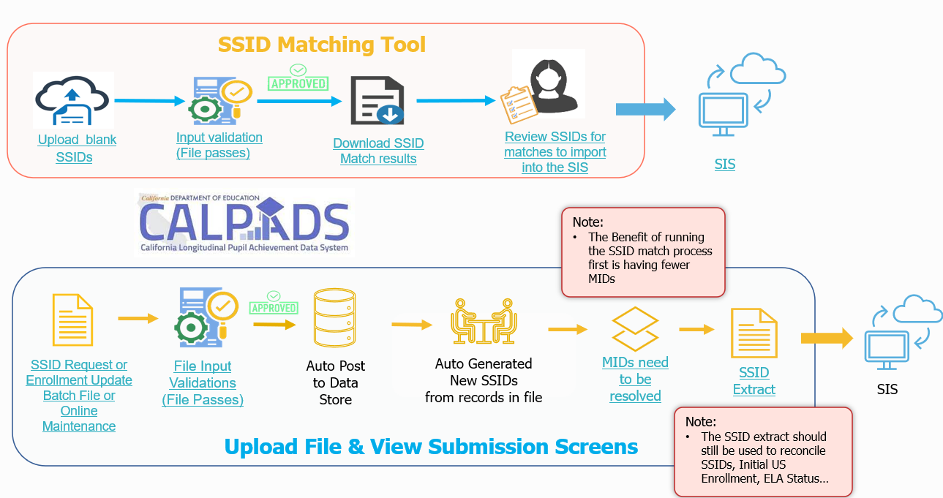
Batch File Submission Process
Gain Ownership
Match to existing SSIDs
Request new SSID
Establish Student Profile
Student Information
Student Programs
Student English Language Acquisition
Special Education
SPED Services
Maintain Student Data
Regularly update student profile and pertinent data

Slide 35

Reminders when selecting SSID Matches
Diligently review and scrutinize demographic data of possible SSID matches to avoid picking up the wrong SSID and hijacking the student record.
If the SSID Match tool show “No match” for students in higher grade levels or who transferred from a different district, you may do a manual student search in Online Maintenance. Doing so will minimize the possibility of creating new SSIDs and causing MID anomalies.
Notes:
We have a couple of reminders on this slide dealing with the SSSID match tool and anomalies in CALPADS.
First is a reminder to review the demographic data for all possible SSID matches and ensure the demographic data represent an exact match, to the best of your ability, such that you do not accidentally pick up the wrong SSID and hijack the student records associated with that SSID.
Second is a reminder that if the SSID Match Tool results show “no match” for students in grades 7-12 or who transferred from another CA school district, it represents due diligence to do a manual student search in OM – this will ultimately guard against MID anomalies through the generation of new SSID duplicating students in CALPADS.

Slide 36
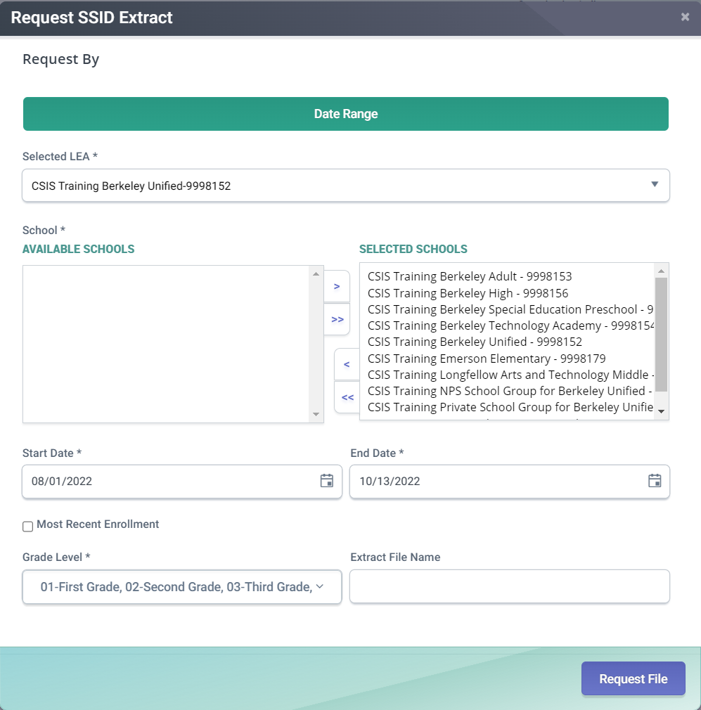
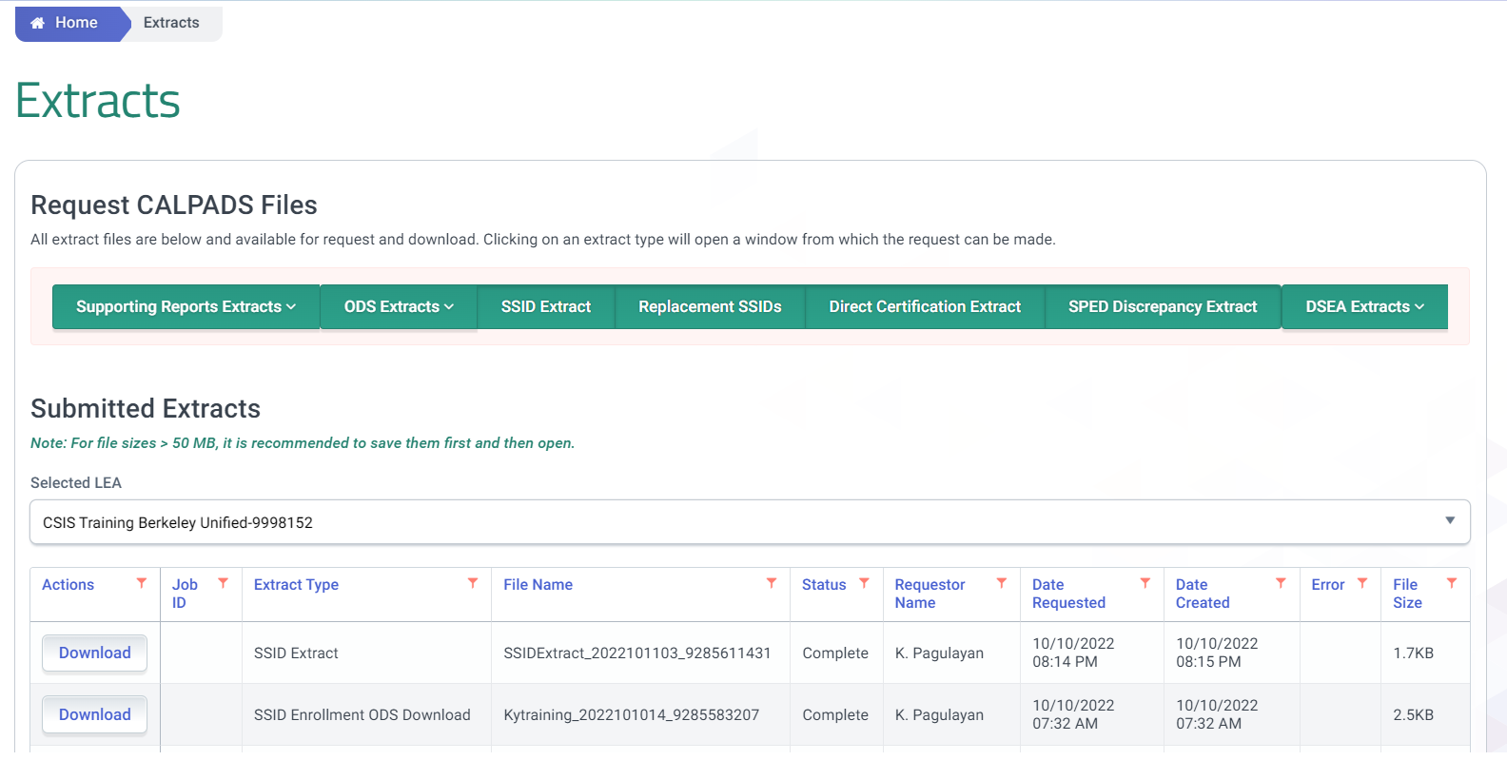
SSID Request Extract for SIS
Use extracts to import new SSIDs to your SIS
2
1
3
Notes:
Resource: https://documentation.calpads.org/Extracts/SSIDExtract/
To download the SSID extract file go to the Reports menu and select Extracts. The Extract page has two sections. There are the Request CALPADS Files links and the Retrieve CALPADS Files links. The bottom half of the screen has the links to retrieve extracts. Click on the SSID Extract link Under retrieve CALPADS Files.
An SSID Extract file is available to download after a user successfully posts a Student Enrollment File with SSID Requests or completes a manual SSID assignment using online maintenance. The SSIDs in the file may be imported into a local student information system and used locally in the user’s local Student Information System.

Slide 37
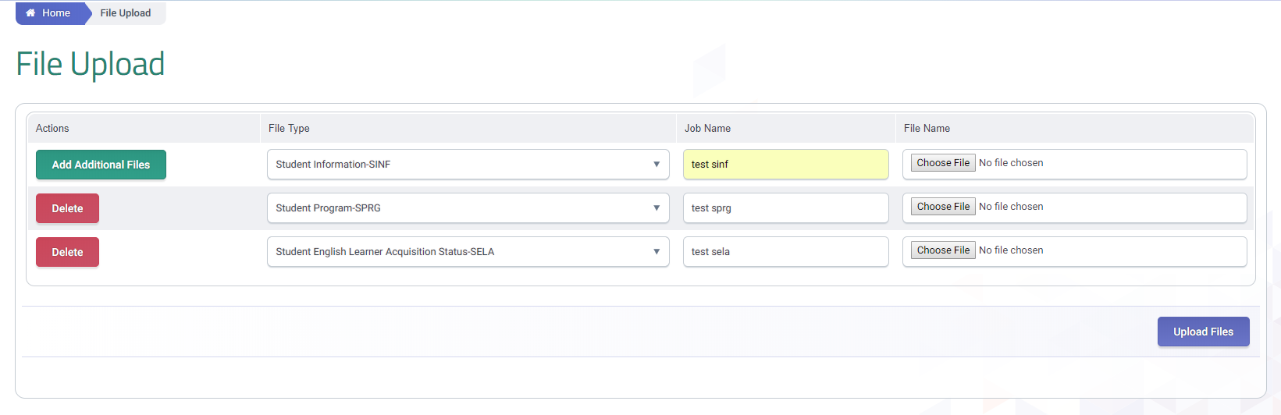
Complete the Student Profile Submission

Slide 38
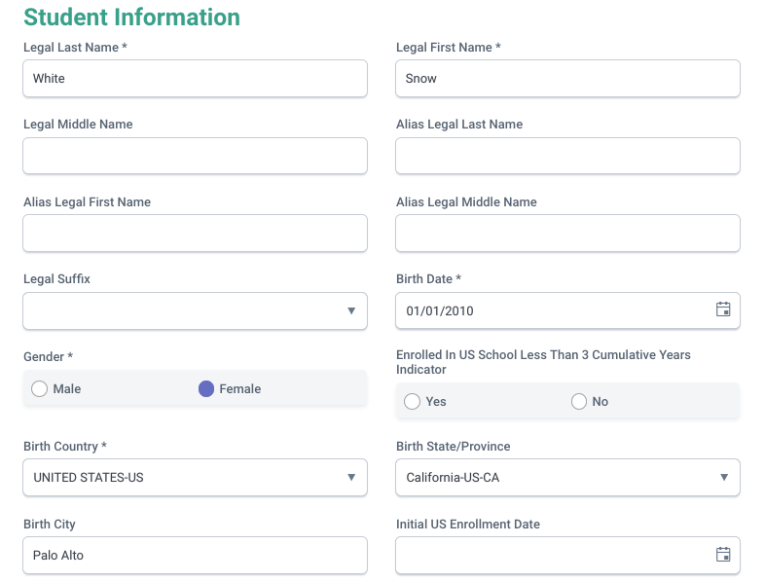
Student Information Details
All fields with an asterisk are required. Foreign born students must have the Enrolled in US field populated.
Gender and Name changes must be done online. They cannot be changed in the same transaction
Notes:
This slide show the modal window displaying the core student demographics fields that need to be populated. Some of the fields are required and must be populated as shown before the record can be posted.

Slide 39
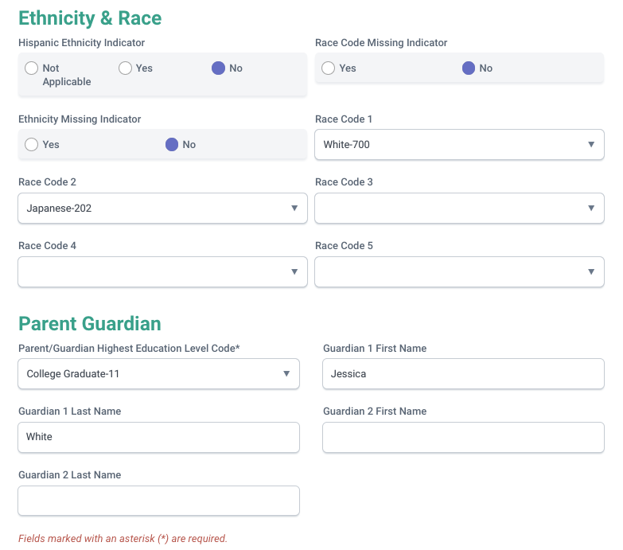
Student Information Details
Required sections for all submissions for all student information records
Notes:
This slide show additional fields related to Ethnicity & Race and Parent/Guardian that are required and must be populated prior to validating and posting the record.

Slide 40

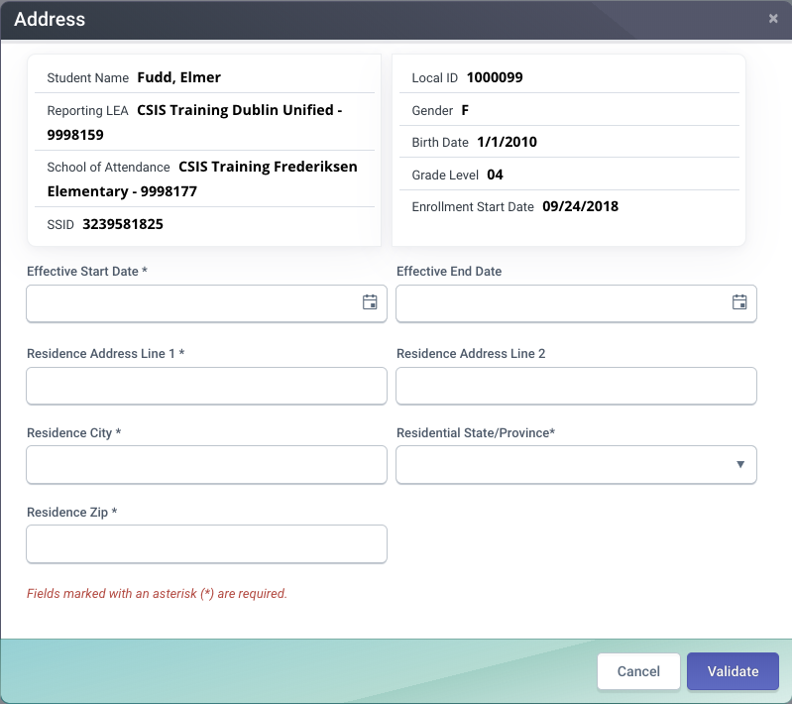
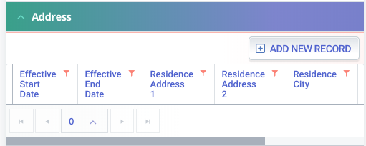
Student Address Details
Address are not validated for correctness. It is dependent on the LEA that the address conforms to US postal standards
Notes:
By clicking on “Add New Record” in the address container, the system will display the ”Address” modal window. You would need to populate the required fields before validating and posting the record.

Slide 41
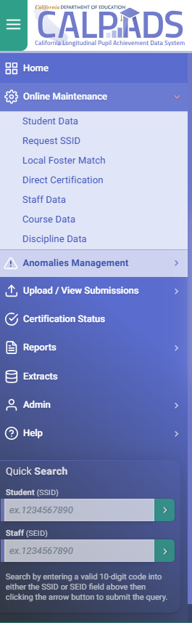
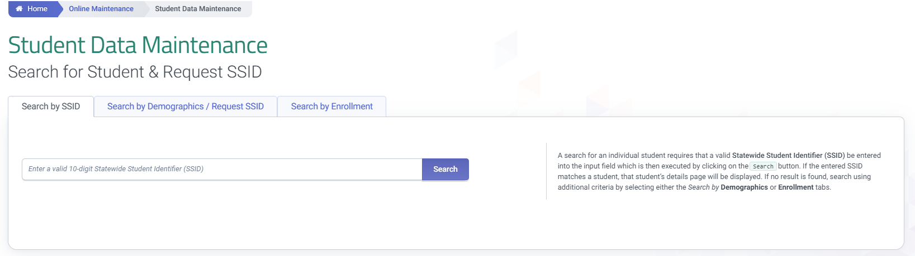
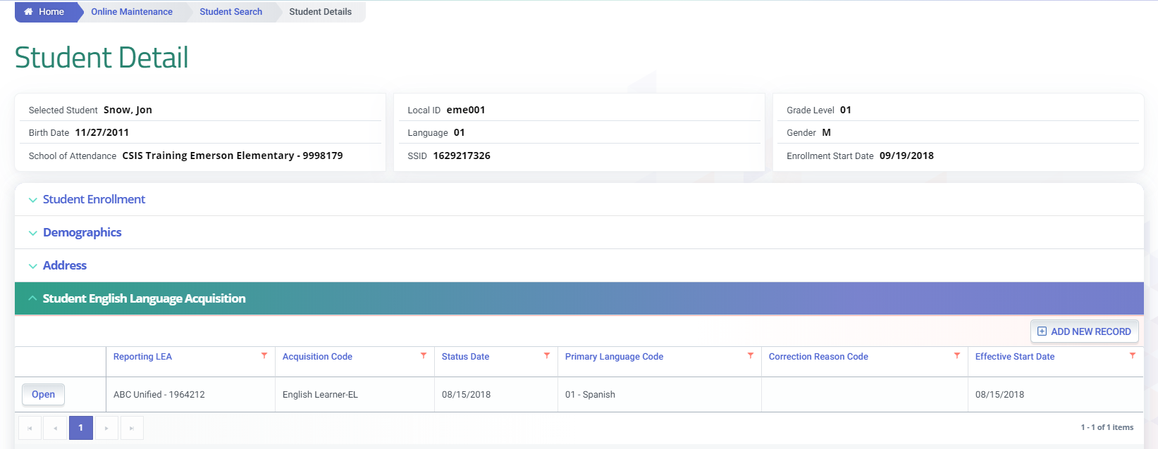
Online Maintenance Process
1
2
3
4
1
5
6

Slide 42
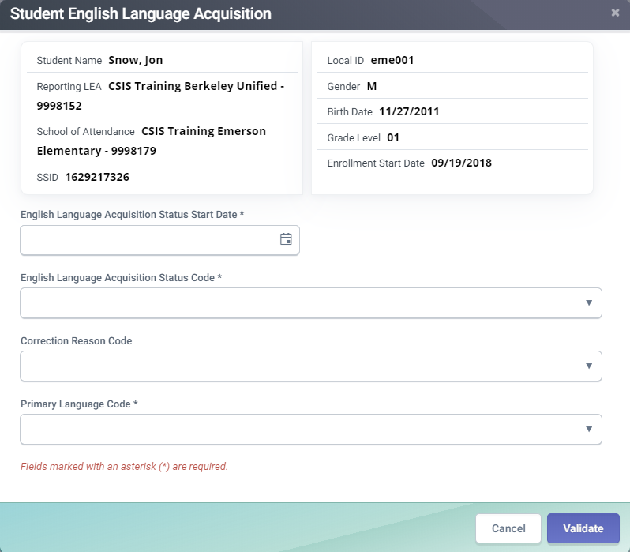
SELA Details
Student summary based on most current SENR and SINF
TBD = Current Date
EO = first day of student enrollment
EL
RFEP within an enrollment period but not within same academic year
Status date = Test completion date
Students enrolled just prior to or on Census day, use Census day or earlier.
A
A
The potential code values include:
- English or American Sign Language only (EO).
- To Be Determined (TBD).
- English Learner (EL).
- Initially Fluent-English Proficient (IFEP).
Reclassified Fluent-English Proficient (RFEP)
ADEL (Adult English Learner)
B
B
C
C
D
Optional and only available in Online Maintenance. Use only when submitting a new ELAS status as correction for a prior reported status
D
Required for all ELAS Status

Slide 43
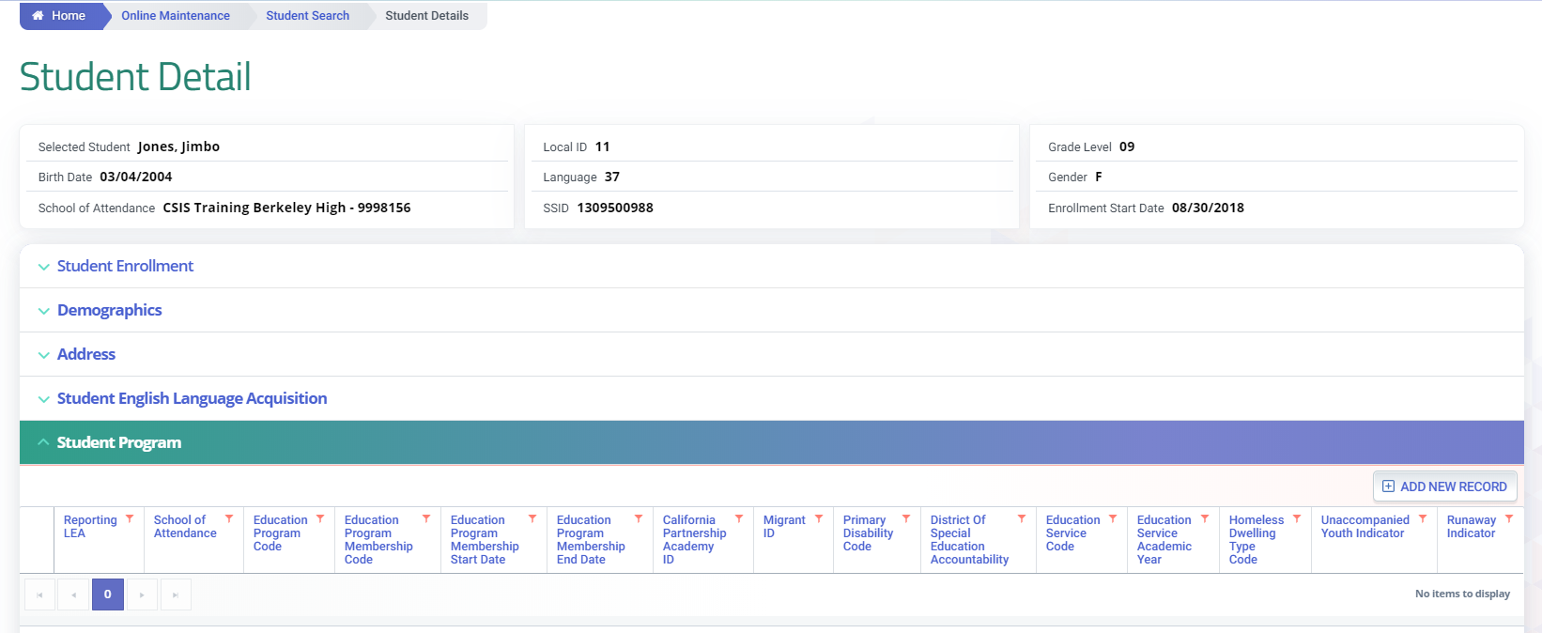
Online Maintenance Process
1
2
3
4
5
1

Slide 44
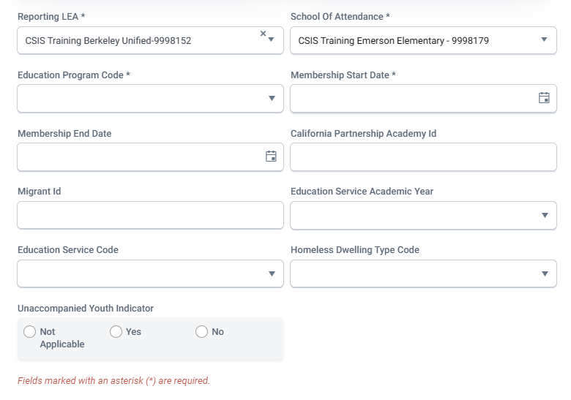
Student Program Modal Details (OM)
Required general fields for all program records
Required with California Partnership Academy (113)
A
A
Required with Migrant Ed (135)
B
C
B
C
Required with Title I Targeted (122)
C
D
Required with Homeless (191)
D
D

Slide 45
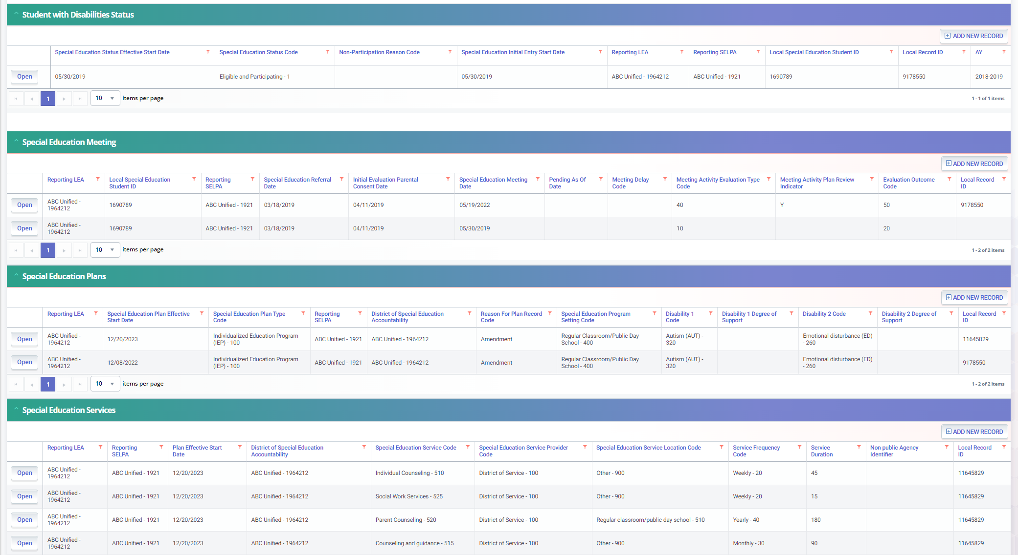
SWD Profile Data
Only Submit SWDS when status changes
MEET records must correspond with the PLAN type
PLAN records can be submitted with enrollment or plan changes
Services should correspond with PLAN changes by date
Fall 1 Data Population-Live v1 – September 3, 2025
Notes:
If LEA submits a SWDS record with a Status of “Eligible and Participating”, student must have a Student Enrollment record at same LEA where the SWDS Status Start Date falls within the Enrollment Start and Exit Dates. Other statuses do not require a SENR. Typically, the only time an LEA would submit a status of Eligible and Participating is after a student is initially evaluated or if they exit then re-enter special education.
Once an INITIAL meeting is held, a SWDS record is expected. MEET records with Pending as of Date populated do NOT require SWDS record. The Meeting Activity - Evaluation Type Code must correspond with the PLAN record’s Special Education Plan Type Code.
Student must have a Student Enrollment record with Enrollment Start and Exit Dates that overlap the Plan Effective Start Date at the same LEA
Student must have SERV records with same SSID, Reporting LEA, SELPA, and Plan Effective Date

Slide 46
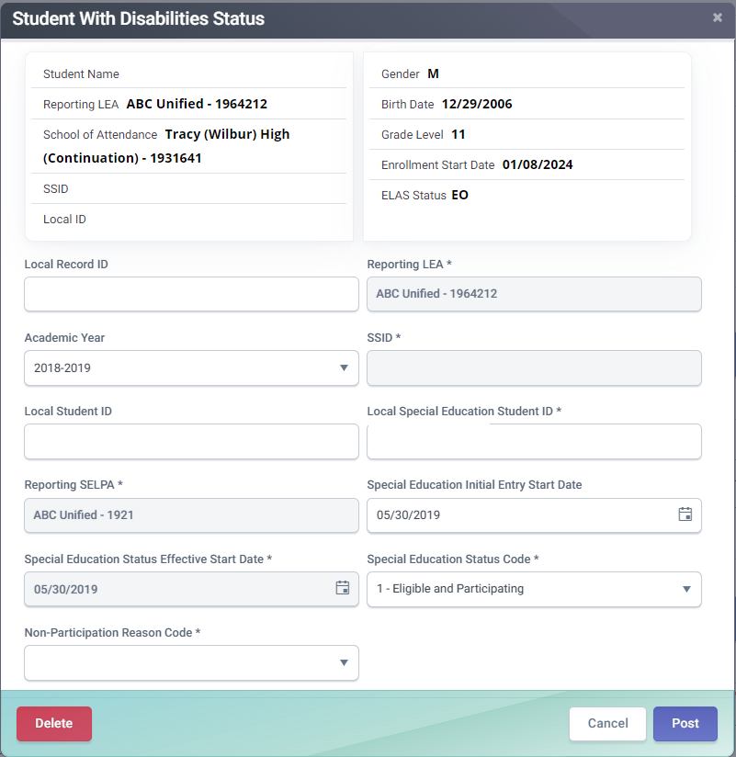
SWDS Details
Special Education Status Effective Start Date is the date when a student's special education status became effective in California
Special Education Status Code represents student's eligibility for special education. Special Education Status Code and Non-Participation Code must be a valid combination
Non-Participation Reason Code represents the reason an evaluated student is not participating in special education.
1
2
3
Fall 1 Data Population-Live v1 – September 3, 2025
Notes:
The Special Education Status Effective Start Date is the date when a student's special education status became effective in California. For students who are being initially evaluated, this would be the date a determination was made.
For students whose status is changing, it would be the date the student's status changed.
For students who are identified as eligible outside of CA and then transfer in, this would be the date the student first entered a CA public school.
For students who were determined eligible in CA, left out of state and were exited from special education out of state, then come back to CA, this would be date the student's exit status was recorded in CA.
The Special Education Status Code is a code value representing the status of a student's eligibility for special education. The Special Education Status Code and Non-Participation Code must be a valid combination as defined in the CALPADS Valid Code Combinations document. The Students must not be enrolled on the Special Education status Effective start date if Special Education Status Code = Eligible and Not Enrolled
The Non-Participation Reason Code A coded value representing the reason a student who was evaluated and is not participating in special education.

Slide 47
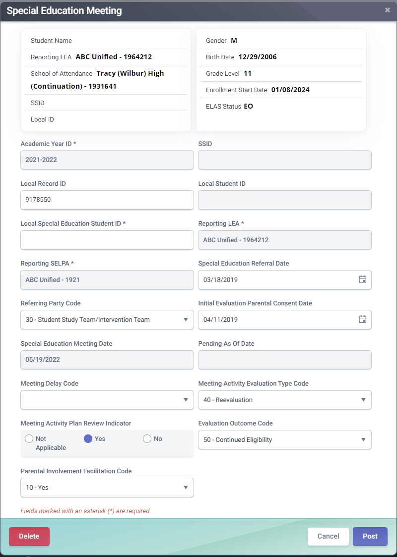
MEET Details
Special Education Meeting Date is used to determine whether or not statutorily required meetings for the student are being held in a timely manner
Meeting Activity Evaluation Type Code represents the type of special education evaluation being held
Evaluation Outcome Code represents the outcome of a student's special education eligibility evaluation
1
1
2
3
Fall 1 Data Population-Live v1 – September 3, 2025
Notes:
The Special Education Meeting Date is the date of the Individualized Family Service Plan (IFSP), Individualized Education Program (IEP), or Individual Service Plan (ISP) team meeting to review the initial evaluation, Annual Education or Service Plan Meeting, or eligibility re-evaluation to determine eligibility for special education services. The date captured in this field is used to determine whether or not statutorily required meetings for the student are being held in a timely manner.
The Meeting Activity - Evaluation Type Code is a coded value representing the type of special education evaluation being conducted during a special education meeting - Initial Part B Evaluation, Initial Part C Evaluation, or Re-evaluation of eligibility. If no evaluation occurred during a meeting, this field should be left blank.
The Evaluation Outcome Code is a coded value representing the outcome of a student's special education eligibility evaluation.

Slide 48
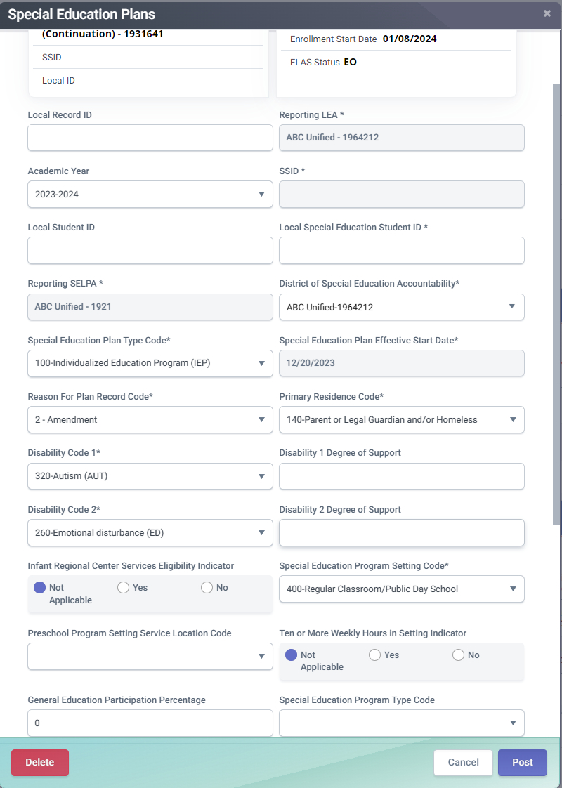
PLAN Details
Special Education Plan Type Code represents the type of special education plan, Individualized Education Program (IEP), Individual Family Service Plan (IFSP), or an Individual Service Plan (ISP)
Special Education Plan Effective Start Date is the date that a student's special education plan (IFSP, IEP, ISP) became effective including any plan changes (amendments, re-affirmed)
Disability 1 Code represents the category of a student's primary disability qualifying the student for services under one of the 13 eligibility categories in the IDEA
Special Education Program Setting Code represents the special education program setting in which the student is receiving or has received the majority of special education and related services
General Education Participation Percentage represents the percentage of time a student with disabilities participates in general education
1
2
3
4
5
Fall 1 Data Population-Live v1 – September 3, 2025
Notes:
The Special Education Plan Type Code is a coded value representing the type of special education plan by which the student is receiving special education services, Individualized Education Program (IEP), Individual Family Service Plan (IFSP), or an Individual Service Plan (ISP), or other code as appropriate.
The Special Education Plan Effective Start Date is the date that a student's special education plan: Individual Family Service Plan (IFSP), Individualized Education Program (IEP), or Individual Service Plan (ISP) became effective. Anytime a student's special education plan either changes (including any plan amendments) or is re-affirmed, LEAs would submit a new PLAN record with a new Special Education Plan Effective Start Date.
The Disability 1 Code is a coded value representing the category of a student's primary disability. A disability means the student has qualified for services under one of the 13 eligibility categories in the IDEA and needs special education or related services.
The Special Education Program Setting Code is a coded value representing the special education program setting in which the student is receiving or has received the majority of special education and related services according to the student's Individual Family Service Plan (IFSP), Individualized Education Program (IEP), or Individual Service Plan (ISP).
The General Education Participation Percentage A numerical value representing the percentage of time a student with disabilities participates in general education.
State Performance Plan (SPP)/Annual Performance Report (APR) information: https://www.cde.ca.gov/sp/se/fp/sppapr-overviewfeedback.asp#:~:text=The%20SPP%20is%20the%20overall,compliance%20indicators%20and%20performance%20indicators.

Slide 49
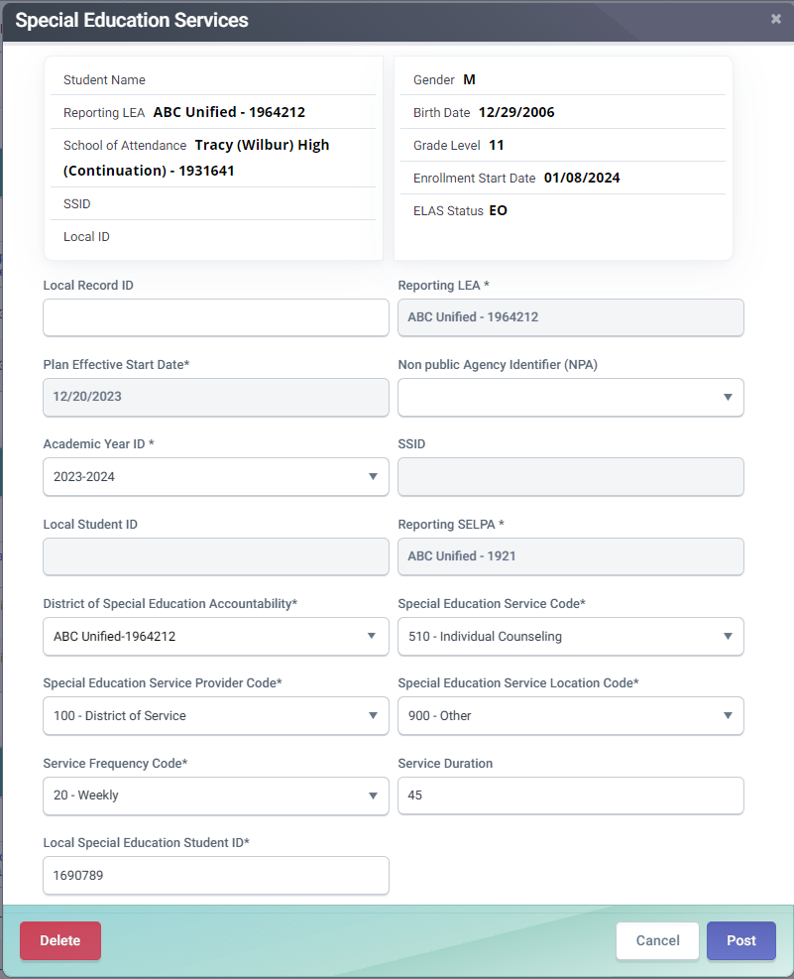
SERV Details
Special Education Service Code represents a special education service or related service received by the student
Special Education Service Provider Code represents the provider of the service
Special Education Service Location Code represents the location where the student receives the service
1
2
3
Fall 1 Data Population-Live v1 – September 3, 2025
Notes:
The Special Education Service Code is a coded value representing a special education service or related service received by the student, regardless of which agency pays for the service. There is no limit on how many services the student or infant can receive. For students receiving a duplicate service, a separate provider must be entered.
The Special Education Service Provider Code is a coded value representing the provider of the service in the Special Education Service Code field.
The Special Education Service Location Code is a coded value representing the location where the student receives the service entered in the Special Education Service Code field, for each service reported

Slide 50

Wrap Up
Key Points, Resources and Support

Slide 51

Summary
Enrollment records must be posted first to establish ownership of an SSID
Demographic information is required for all students. State level matching cannot be performed without demographic records
LEAs do not need to update the ELAS of incoming students transferring from another California Public school whose statuses already exist in CALPADS
Initial ELPAC results (EL and IFEP) status is automatically transmitted to CALPADS by TOMS.
Students age 22 or older must have a current ELAS status of ADEL including students who are EL. IFEP and RFEP students are exempt from this rule.
Program Eligibility is counted if the program start date is on or before census day and there is no end date or the end date is after census day
The MEET, PLAN, SWDS, and SERV files for SWD submitted from the SEDS to CALPADS through an API
Some key points to remember
Fall 1 Data Population-Live v1 – September 3, 2025
Notes:
Let’s take a moment to review a few key points from today’s training.
SSID Ownership & Enrollment
Enrollment records must be posted first to establish ownership of a student's SSID.
Demographic Data Requirements
Demographic information is mandatory for all students.
State-level matching cannot occur without demographic records. This is the SINF Records
ELAS (English Language Acquisition Status) Updates
LEAs do not need to update ELAS for students transferring from another California Public school if their status already exists in CALPADS. The ELAS carries over.
Initial ELPAC results (EL and IFEP) are automatically transmitted to CALPADS via TOMS.
ELAS for Students Age 22+
Students aged 22 or older must have ELAS status of ADEL, even if they are EL.
IFEP and RFEP students are exempt from this requirement.
Program Eligibility Reporting
Program eligibility is counted if:
Start date is on or before Census Day, and No end date or end date is after Census Day.
Students With Disabilities File Submissions
The MEET, PLAN, SWDS, and SERV files for Students with Disabilities (SWD) are submitted from SEDS to CALPADS via API. This is an automated process.

Slide 52



Resources
Here are some important resources related to Fall 1 Student Profile reporting.
https://csis.fcmat.org/csis-training
https://www.youtube.com/channel/UCA9oRTiyVECCCzOxpmJheZw
https://documentation.calpads.org/Support/References
https://www.caaspp-elpac.org/
Notes:
To support your work with Fall 1, here are some key resources offering training, documentation, and reference materials:
CSIS Training website – You will find our latest training offerings
CSIS YouTube Training Channel
Where you can watch helpful video tutorials and walkthroughs. This session is being recorded and will be posted on this channel. Excellent resource.
CALPADS User Manual
Find official CALPADS references and support documentation.
ELPAC Resources
Explore resources related to the English Language Proficiency

Slide 53





Support
http://www2.cde.ca.gov/calpadshelp/default.aspx
Web
calpads-support@cde.ca.gov
Email
916-325-9210
Phone
https://csis.fcmat.org/ListServ
You can get help through these channels.
Listserv
Notes:
These are the avenues to obtain support for reaching the client services team
Web form –Recommended
The web form is the fastest and most direct way to request support. It allows you to submit a ticket that goes straight to the CSIS Client Services team for prompt handling
Support is also available via email and phone. However, these methods are slower than using the web form. Messages sent by email or left as voicemails are transcribed into tickets and processed in the same system as web form submissions, which can take longer.
Stay Connected
We encourage you to sign up for the CSIS CALPADS listserv. This is a valuable resource where LEAs can collaborate, share insights, and receive support not only from each other but also from the CSIS Client Services team and the CDE—both of which actively participate in the listserv. It’s a great way to stay informed and ask questions

Slide 54
Feedback
I have a question…
“
”
Please complete survey…
https://bit.ly/2MXsECg
“
”

Slide 55






Thank You
CSIS Training
+1 916 325 9210
csistraining@fcmat.org
https://csis.fcmat.org/
Notes:
Thank you all for attending our live training today.

