Slide 1
CALPADS EOY 2 Reporting & Certification 2019 - 2020
EOY 2Overview
Data Submission Review
Student Subgroups
Certification Demonstration
Reports Review
Notes:
Welcome to the EOY 2 Reporting and Certification Training.

Slide 2
Training Sequence
CALPADS Intro
Data Coordinator Orientation
CALPADS
CALPADS Basics
Fall-1 Data Population (Student Profile)
Fall-2 Data Population
EOY 1-4 Data Population
Data Privacy
LEA Admin Data Privacy
SELPA Data Privacy
Data Collections
Fall 1
Reporting and Certification
Advanced
Fall 2
Data Population
Reporting and Certification
Advanced
EOY
EOY 2 & 3 Reporting and Certification
EOY 1 Reporting and Certification
EOY Advanced
Advanced
Guide to CALPADS Documentation
Guide to Troubleshooting CALPADS Errors
Notes:
CSIS has developed a new training model. We are hoping to provide more segmented organization that allow for more specific topics and concise delivery. Rather than an information dump lasting 3 or more hours we hope to provide trainings in half that time with less content, but more relevant information or instruction.

Slide 3
Target Audience
Data Coordinators
New to CALPADS
Notes:
This training is intended for data coordinators, those doing the routine maintenance and submission of CALPADS records. This training would also be beneficial for those of you who are new to CALPADS reporting.

Slide 4
Objective
Identify
Resolve
Perform
Approve
the data required to complete CALPADS Submissions for EOY 2
Certification errors related to the EOY 2 data collection
the certification process
the reports required for EOY 2 by the LEA Approve process
Notes:
At the end of this session,
READ SIDE:
Identify the data required to complete CALPADS Submissions for EOY 2
Resolve the Certification errors related to the EOY 2 data collection
Perform the certification process
Approve the reports required for EOY 2 by the LEA process

Slide 5
Agenda
Overview
EOY 2 Data Submission
Student Sub-Groups
Certification Process
Reports
Wrap-Up
Here is the agenda for this training. We will discuss the following
Notes:
Here is the agenda for this training. We will discuss the following:
We will begin with an overview, introducing CALPADS, the people who use CALPADS and their roles and discuss where the data goes.
Next, we will review the EOY 2 submission in some detail, discussing the data collection, timelines and process.
Lastly, we will drive home the key points with a wrap up of today’s content.

Slide 6
Overview
Discuss background of CALPADS submission
Notes:
First, we will start with some general information related to the CALPADS data submission and then introduce key concepts related to the data collected.

Slide 7
Education Legislation
Local Control Funding Formula (LCFF)
2013 - Governs school financing, provided for local decision-making, and measuring school progress broadly.
Every Student Succeeds Act (ESSA)
2015 – Reauthorization of the Elementary and Secondary Education Act (ESEA), replaced NCLB.
No Child Left Behind (NCLB)
2002 - Put measures in place to expose achievement gaps among traditionally underserved students and their peers.
Provides for accountability and action to effect positive change in the lowest-performing schools.
Notes:
One reason we submit data to CALPADS is to meet state and federal reporting requirements.
ESSA
Advances equity by upholding critical protections for America's disadvantaged and high-need students.
Requires—for the first time—that all students in America be taught to high academic standards that will prepare them to succeed in college and careers.
Ensures that vital information is provided to educators, families, students, and communities through annual statewide assessments that measure students' progress toward those high standards.
Helps to support and grow local innovations—including evidence-based and place-based interventions developed by local leaders and educators—consistent with our Investing in Innovation and Promise Neighborhoods
Sustains and expands this administration's historic investments in increasing access to high-quality preschool.
Maintains an expectation that there will be accountability and action to effect positive change in our lowest-performing schools, where groups of students are not making progress, and where graduation rates are low over extended periods of time.

Slide 8
Programs Collected
Fall 1
Fall 2
End of Year 2
Code | Program | Type
181 | Free Meal Program | Federal
182 | Reduced-Priced Meal Program | Federal
127 | Gifted and Talented Education (GATE) | Federal
135 | Title I Part C Migrant | State
185 | Transitional Kindergarten | State
191 | Homeless Program | Federal
Code | Program | Type
300 | LIP - Developmental Bilingual Program | State
301 | LIP - Dual-Language Immersion Program | State
302 | LIP - Heritage or Indigenous Language | State
303 | LIP - Newcomer Program (Various Models) | State
304 | LIP - One-Way Immersion Program | State
305 | LIP - Structured English Immersion Program or other predominantly English Language Instructional Models | State
306 | LIP - Transitional Bilingual Program | State
Code | Program | Type
122 | Title I Part A Basic Targeted | Federal
174 | Title I Part A Neglected | Federal
192 | Armed Forces Family Member | Federal
101 | 504 Accommodation Plan | State
108 | Opportunity Program | State
113 | California Partnership Academy | State
162 | Pregnant or Parenting Programs (formerly Cal-SAFE) | State
185 | Transitional Kindergarten | State
NAME OF THE PRESENTATION
Student Program records should be regularly updated in CALPADS throughout the year regardless of the submission period.
End of Year 3
Code | Program | Type
191 | Homeless Program | Federal
Notes:
This is a list of all Program codes that are collected throughout the year. Although, some programs are collected in Fall 1 and some in End of Year, it is important to report/update a student’s eligibility or participation in CALPADS as soon as the information is available. You do not need to wait until the submission window opens to submit EOY programs.
*Although programs listed are collected in Fall 1, it is important to continually update program records since some programs are used for subgroup reporting in EOY and the CA Dashboard.
Note: Homeless Program has been moved from EOY 2 submission to EOY 3 submission. This move was to ensure the accuracy of the Homeless counts collected for the Academic year.
What are the data used for?
Title I Part A Targeted and Schoolwide Program and Neglected Participation counts for ESSA reporting
Including targeted services
Counts of students participating in the following programs
Opportunity programs
California Partnership Academy
Pregnant or Parenting (proxy for single parents for Perkins)
Transitional Kindergarten
504 Accommodation Plans
Armed Forces Family Member (ESSA student group)

Slide 9
Transitional Kindergarten
Transitional Kindergarten is the first year of a two-year kindergarten experience for children whose 5th birthday is on September 2nd through and including December 2nd.
Students are enrolled in KN grade level.
Education Program Code: 185
Program Start Date: Date a student was identified as participating in the first year of a transitional kindergarten program at a school. Normally first day of school.
Program End Date: The last day of the student’s first year of participation in the transitional kindergarten program
Records must be closed at the end of the student’s first year of participation in the Transitional Kindergarten program or will be auto-closed upon a student’s exit.

Slide 10
504 Accommodation Plan
504 plans are formal plans that schools develop to give kids the support they need. That covers any condition that limits daily activities in a major way.
Education Program Code: 101
Program Start Date: Date the student was identified as having a 504 Accommodation Plan.
Program End Date: Date the student was determined to be ineligible at a school.
A student’s eligibility should be verified annually, however these records are not required to be closed at the end of the year for returning students.
Notes:
Eligible students are reported with a program 101 record. A student’s eligibility should be verified annually,
however LEAs do not have to close these records annually, only when a student is not eligible anymore

Slide 11
Armed Forces Family Member
Used to meet Every Student Succeeds Act (ESSA) reporting requirements. Eligibility is based on the parent’s most recent active military status.
Education Program Code: 192
Program Start Date: Must be on or after the student’s birthdate
Program End Date: Should be populated when a student is identified as being no longer considered armed forces family member, or the last day of the school or Guard duty***
A student is considered to be an Armed Forces Family Member if at least one parent is an Armed Forces* member, on active duty** or serves on full-time National Guard.
* Armed forces means the Army, Navy, Air Force, Marine Corps, and Coast Guard
** Active duty means full-time duty in the active military service of the United States
*** Full-time National Guard duty means training or other duty, other than inactive duty
Notes:
Education Program Code 192 will be used to meet Every Student Succeeds Act (ESSA) reporting requirements. LEAs are asked to submit these data if available.
Eligibility is based on the parent’s most recent active military status
The program start date must be on or after the student’s birthdate
The Program end date should be populated when a student was identified as being no longer considered armed forces family member, or the last day of the school
A student is an Armed Forces Family Member if at least one parent is an Armed Forces* member, on active duty** or serves on full-time National Guard duty***
* Armed forces means the Army, Navy, Air Force, Marine Corps, and Coast Guard
** Active duty means full-time duty in the active military service of the United States
*** Full-time National Guard duty means training or other duty, other than inactive duty

Slide 12
Title I Part A Basic Targeted
Title I, Part A, Improving Basic Programs Operated by Local Educational Agencies ESSA
A program providing services to improve student academic achievement of eligible students in Title I schools.
Education Program Code: 122
Program Start Date: Date the student was identified as participating in the program at a school.
Program End Date: the date a student ceased participating in the program at a school or the last day of school
Each Student may have multiple Program 122 records with diff. education service codes.
For schools that are identified as a Title I, Part A Targeted Assistance School.
TAS Resource:
https://www.cde.ca.gov/sp/sw/t1/tasinfo.asp
Records should be closed out annually and resubmitted the following academic year with a new program start date and Title I Services (Education Service Code) a student is receiving.
Notes:
Students participating in the Title I Part A Basic Targeted are reported with a program 122 record.
A student’s participation should be reported annually.
*Program 122 records should only be reported if the student is enrolled in a school that is identified as a Title I, Part A Targeted Assistance School.
If a school is identified as a Schoolwide school in CARS, Program 122 do not need to be reported since all students are counted as participating.

Slide 13
Title I Part A Targeted vs Schoolwide
Difference between Title I Part A programs
Note: Incorrectly certified CARS designation may possibly trigger CERT097 errors in EOY 2.
Title I Part A Basic Targeted
Submit Program 122 record
Review Report 5.2
Title I Part A Basic School wide
Do not submit program record.
Certify in CARS that school is operating as a school wide school.
Review Report 5.1. Upon CARS certification, total school enrollment count should automatically reflect under the School wide column.
Resource:
CARS:
https://www.cde.ca.gov/fg/aa/co/index.asp
TAS: https://www.cde.ca.gov/sp/sw/t1/tasinfo.asp
SWP:
https://www.cde.ca.gov/sp/sw/t1/schoolwideprograms.asp
Notes:
Students participating in the Title I Part A Basic Targeted are reported with a program 122 record.
A student’s participation should be reported annually.
*Program 122 records should only be reported if the student is enrolled in a school that is identified as a Title I, Part A Targeted Assistance School.
If a school is identified as a Schoolwide school in CARS, Program 122 do not need to be reported since all students are counted as participating.
Identify participating students based on criteria listed in this https://www.cde.ca.gov/sp/sw/t1/tasinfo.asp.
Include the education service code of subject matter where program is provided.
If a school is not correctly classified (NOT A Title I Targeted School but a Title I School Wide school or vice versa), the LEA must open the 2019–20 Title I, Part A Notice of Authorization of School Wide Program form in CARS, then either add or remove the check mark for the school in the “Authorized” column, and then save and certify the data collection.
The CARS certification requires an overnight update before it reflects in CALPADS. Please coordinate with your staff in charged with the Consolidated Application (ConApp) reporting.
Additionally, a student can have more than one Program 122 record reflecting multiple education service codes (subjects) being reported.
Resources:
https://www.cde.ca.gov/sp/sw/rt/index.asp
http://www.cde.ca.gov/fg/aa/co/cars.asp
ConApp Support Desk | conappsupport@cde.ca.gov | 916-319-0297

Slide 14
Title I Part A Neglected
Education Program Code: 174
Program Start Date: Date a student was identified as participating in the program at a school.
Program End Date: Date a student ceased participating in the program at a school. Or the last day of school
Records should be closed annually and resubmitted at the beginning of the school year if the student continues to participate.
Title I, Part D, Subpart 2 Prevention and Intervention Programs for Children and Youth Who Are Neglected, Delinquent, or At-Risk
Notes:
The Title I Part A Neglected Program is funding that districts can allocate from their general Title I Part A allocation to serve neglected students (generally students in group homes or licensed children’s institutions) that are attending non-Title I Targeted Assistance (TAS) or Schoolwide Program (SWP) schools in the district.
Participating students are reported with a program 174 record. The Title I, Part A Neglected is only required by the LEA if there are students in an eligible institution for neglected children and youth and if these neglected children and youth attend a non-Title I school.
Resource: https://www.cde.ca.gov/sp/sw/t1/title1ptaneglected.asp
NOTE: The Title I, Part A neglected reservation should not be confused with the Title I, Part D Neglected or Delinquent or the At-Risk program. Title I, Part D funds are allocated by the California Department of Education to County Offices of Education (COEs) primarily to support COE juvenile detention education programs. https://www.cde.ca.gov/sp/sw/t1/nord.asp

Slide 15
Pregnant or Parenting
Data should be reported even if district is no longer funded for Cal-SAFE. Data are used to identify pregnant or parenting students for Carl Perkins Career Technical Education Program reporting.
Education Program Code: 162
Program Start Date: Date the student was determined to be eligible
Program End Date: Date the student was determined to be ineligible at a school or is no longer parenting.
Records should not be closed annually for returning students. For students exiting the school, these records may, but are not required to be closed.
Notes:
Eligible students are reported with a program 162 record. These records should not be closed annually for returning students.
For students exiting the school, these records may, but are not required to be closed. Eligibility include both student father and mother.
If a district is no longer funded for the California School Age Families Education (Cal-SAFE) Program, but still collects data on those students, the data should still be reported to CALPADS because these data are used to identify pregnant or parenting students for Carl Perkins Career Technical Education Program reporting.

Slide 16
California Partnership Academy
The CPA model is a three-year program (grades ten-twelve) structured as a school-within-a-school. Academies incorporate integrated academic and career technical education, business partnerships, mentoring, and internships
Education Program Code: 113
Program Start Date: First date a student was identified as participating in the program at a school
Program End Date: Date a student ceased to participate in a CPA; or the date the student exited the school
Records are not required to be closed at the end of the year for returning students. However, a student’s eligibility should be verified annually.
Notes:
Participating students are reported with a program 113 record. A student’s eligibility should be verified annually, however these records are not required to be closed at the end of the year for returning students. LEAs must indicate the California Partnership Academy ID assigned to the program as listed in the Academy Directory https://www.cde.ca.gov/ci/gs/hs/documents/cpadirectory.xls

Slide 17
Opportunity Education Program
Opportunity Education schools, classes, and programs provide additional support for students who are habitually truant from instruction, irregular in attendance, insubordinate, disorderly while in attendance, or unsuccessful academically. They are operated either by school districts or county offices of education.
Education Program Code: 108
Program Start Date: First date a student was identified as participating in the program at a school
Program End Date: Date a student ceased to participate in the program; or the date the student exited the school
Records are not required to be closed at the end of the year for returning students.
However, best practice is that this be verified annually, and LEAs can opt to close these records annually if it helps to facilitate the reverification process.
Notes:
Opportunity Education schools, classes, and programs provide additional support for students who are habitually truant from instruction, irregular in attendance, insubordinate, disorderly while in attendance, or unsuccessful academically. They are operated either by school districts or county offices of education. However, the authority for a school district to establish a new opportunity education school, class, or program was repealed effective January 1, 2006.
Participating students are reported with program 108 record. These records are not required to be closed at the end of the year for returning students. However, best practice is that this be verified annually, and LEAs can opt to close these records annually if it helps to facilitate the reverification process.
Resource: https://www.cde.ca.gov/sp/eo/oe/
The desired outcome is fully engaged students who are learning in the manner best suited to their needs. This will also result in:
Closing the achievement gap
Decreasing the dropout rate
Increasing the graduation rate
Students enrolled in grades one through twelve may be assigned to the Opportunity Education environment for all or part of the school day. For identification and referral purposes, students may already exhibit attendance or behavior problems, or they may be at risk of exhibiting behavior problems, such as irregular attendance, insubordination, and/or disorderly conduct while attending school. The intent of the identification and referral process is to provide assistance that will help students succeed in traditional classes or enable them to return to traditional classes as soon as possible.

Slide 18
Certification Errors
Error Code | Severity | Rule
CERT004 | F | Ethnicity / Race Data Missing
CERT073 | W | No Program Data Submitted for a School No EOY 2-related Student programs reported.
CERT097 | F | Missing Title I Targeted Assistance Program Records (122)
CERT103 | W | Invalid Open or Closed Transitional Kindergarten Record TK program from prior academic year (18-19) not closed
Notes:
Here are your EOY 2 certification errors detected during the snapshot revision process.
Fatal certification errors will prohibit you from certifying but warnings won’t.
You still need to review your warnings and make any necessary corrections. Warnings should not be ignore because they can impact the data on the EOY 2 aggregate reports.

Slide 19
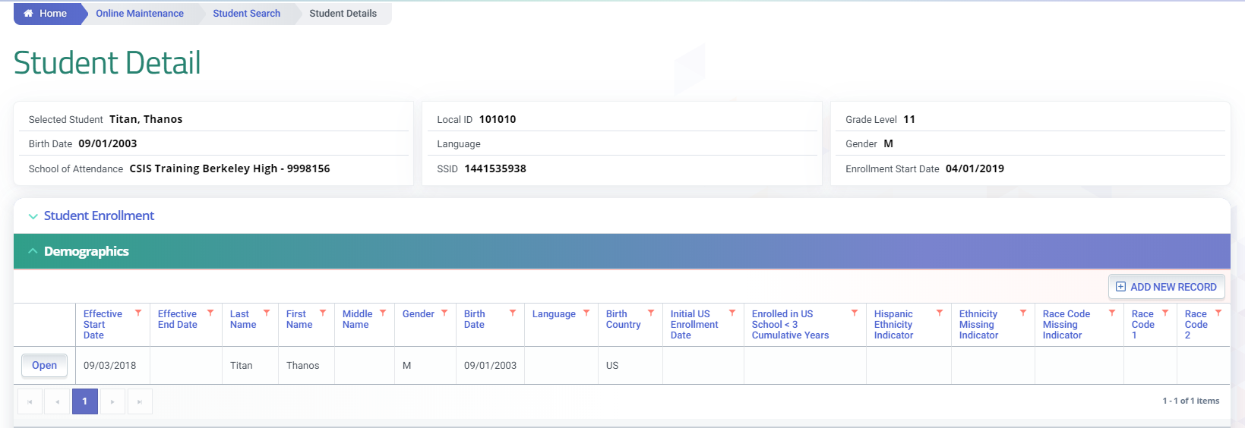
EOY 2: CERT Error Highlights
CERT004
SINF FIELDS TO CHECK
2.23 Student Hispanic Ethnicity Indicator
2.24 Student Ethnicity Missing Indicator
2.25 Student Race 1 Code
Cause of Error
SINF record/s overlapping enrollment record at the LEA is missing Ethnicity/Race data.

Slide 20
EOY 2: CERT Error Highlights
CERT097
DATA TO CHECK
No Program 122 record submitted
CARS certification designation for school
Cause of Error
School certified as Title I Part A Targeted school in CARS (Consolidated Application and Reporting System) but no Program 122 reported.

Slide 21
EOY 2: CERT Error Highlights
CERT073
Cause of Error
No EOY 2 related student program records reported in CALPADS by LEA.

Slide 22
EOY 2 Reports
Report 5.1
Report 5.3
Program Participants - Count
Program Participants - Student List
Report 5.2
Program Participants - NCLB Title I Part A Basic Targeted Education Services
DATAQUEST
Information is not reflected on a specific report but as a sub-group filter.
Notes:
EOY 2 (program participation data) has two Aggregate Reports to be reviewed after all required data has been posted.
5.1 Program Participants Count
There are also supporting reports to assist in reconciling CALPADS to local systems of record.
5.2 & 5.3 Provides supporting student detail data of 5.1
Please review the EOY 2 Data Mapping Guides at https://documentation.calpads.org/Reports/SnapshotODSReports/#eoy-2-report-mapping-guides.
This document will assist on which data elements are used in the counts for the aggregate reports.

Slide 23
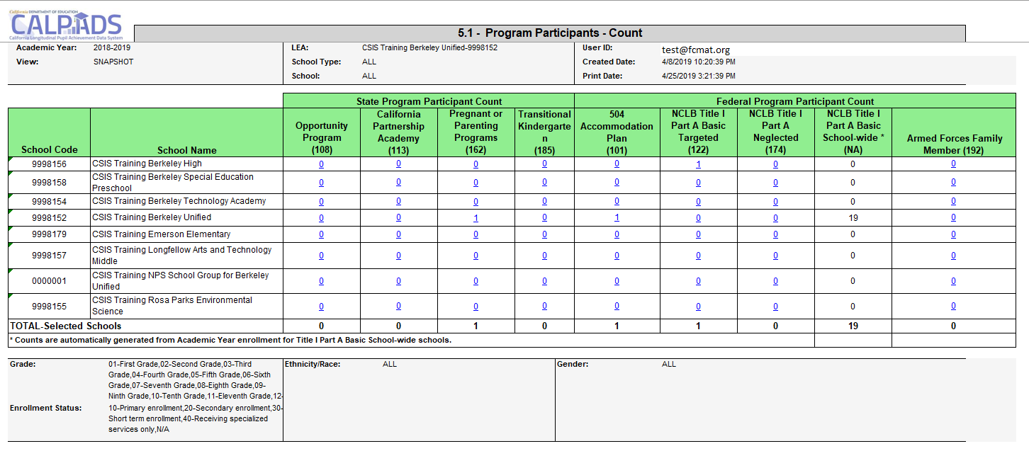
Report 5.1 - Program Participants - Count
Program 174 reports only neglected students attending a non-Title 1 schools are eligible for neglected services through Title I Part A.
For Title I Part A Basic School-wide schools, counts in this column are based on cumulative Academic Year enrollment, not program records. Refer to CALPADS Update Flash #74 for CDE’s process to identify a school-wide site.
Notes:
The 5.1 Program Participants Reports the total number of students with a qualifying enrollment who participated in any of the specified programs at any time during the Report Period. The 5.1 Reporting Period is (July 1 thru June 30 of the reporting year)

Slide 24
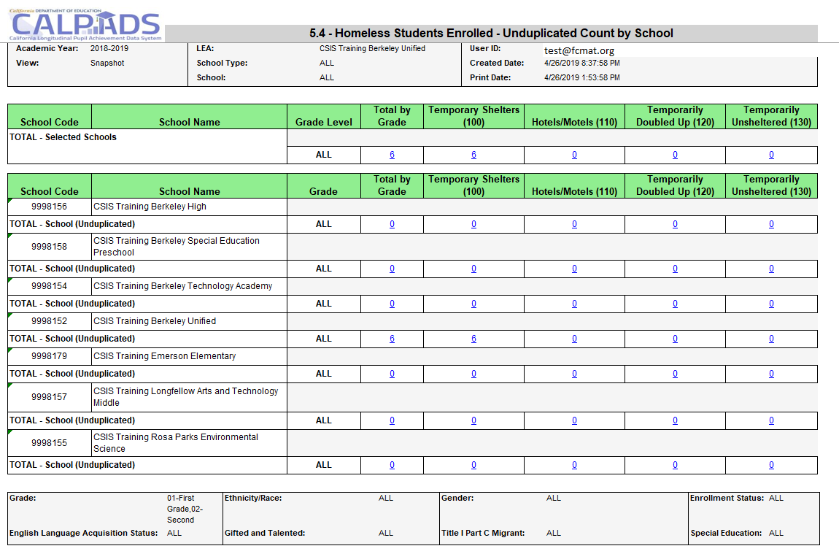
EOY 3 5.4 –Homeless Students Enrolled
Homeless program records should be submitted for any infants, toddlers, and pre-K children who are homeless, as these students are included in all homeless reports in CALPADS.
Notes:
The 5.4 reports your posted homeless program records.
The report first summarizes the data for your LEA.
All the grade levels within your LEA. (Point out TK grade level)
Total by grade level
Total # of students reported homeless with dwelling type 100
Total # of students reported homeless with dwelling type 110
Total # of students reported homeless with dwelling type 120
Total # of students reported homeless with dwelling type 130
And then the individual school sites aggregate data is listed. This allows you to review by each site the homeless data to your local system.
Note: If student moves from 1 district to another during an AY, the student will be reported homeless at both districts. If student moves from 1 site to another, the count will be at the site with the most recent enrollment record.

Slide 25
Case Study #1
Report 5.4 and 5.5 is not accurate. I have a student, SSID 4384084533, who was reported as homeless at Berkeley High-9998156 this year but is not on both reports. Why is that?

Slide 26
Case Study #1
What to consider:
Check EOY 2 report mapping guide for report specifications.
Check enrollment and program data.

Slide 27
Case Study #2
I submitted 2 Program 122 records in CALPADS for my High school, but the 5.1 report shows 1 as the count. Please see SSID 4384084533.

Slide 28
Case Study #2
What to consider:
Check EOY 2 report mapping guide for report specifications.
Check enrollment and program data.
Check report 5.1 Title I schoolwide column if it has counts.

Slide 29
Case Study #3
There is a discrepancy on my report 5.1. My SIS report show Berkeley High School should have 1 count for California Partnership Academy. My student should be counted.

Slide 30
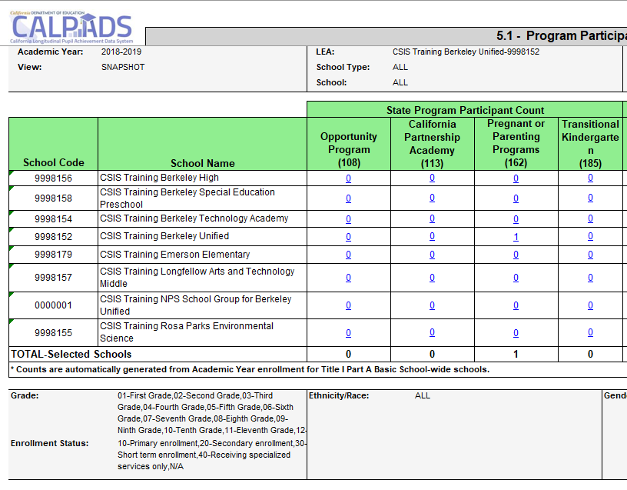
Case Study #3
What to consider:
Check EOY 2 report mapping guide for report specifications.
Check enrollment and program data.
Is the data in CALPADS?

Slide 31
Where the data goes
CA Department of Education
California Dashboard
DataQuest
Student Program
US Department of Education
Title 1 Part A Basic Grant ESSA 1115
(ESSA sections 1113(c)(3)(A)(ii) and (B)(i-ii)
McKinney Vento
Every Student Succeeds Act (ESSA) Section 1111(h)(1)(C)(ii)
Notes:
Here we have provided the funding and legislation related to EOY data and how it will be used. Understanding how the data are used will assist in developing a team effort in reporting accurate timely data.
UPDATE
These counts will be used to meet the:
Foster Youth Services
Grant programs for each county office of education and selected school districts to increase interagency support for foster youth. Foster Youth Services Coordinating (FYSC) Programs provide support services to foster children who suffer the traumatic effects of displacement from family and schools and multiple placements in foster care. FYSC Programs have the ability and authority to ensure that health and school records are obtained to establish appropriate placements and coordinate instruction, counseling, tutoring, mentoring, vocational training, emancipation services, training for independent living, and other related services. FYSC Programs increase the stability of placements for foster children and youth. These services are designed to improve the children's educational performance and personal achievement, directly benefiting them as well as providing long-range cost savings to the state.
Annual Performance Report Measures
The Special Education Annual Performance Report Measures are a series of reports by the California Department of Education (CDE), Special Education Division (SED) to disseminate educational data and improve the quality of education for all students, with an emphasis on students with disabilities.
These reports are required by Individuals with Disabilities Education Improvement Act of 2004 (IDEA) [20 U.S.C. 1416(b)(2)(C)(ii) and 34 CFR 300.602] and are directly connected to the CDE's Goals, Quality Assurance Process, and Focused Monitoring of special education programs. This is the ninth year reports have been prepared. Beginning this year, the report format has been changed to better align with the California Special Education Part B State Performance Plan (SPP) and the subsequent Part B Annual Performance Report (APR) . Local educational agency (LEA) consist of school districts, county offices of education, and charter schools acting as LEAs.
Persistently Dangerous Schools
Provides information regarding persistently dangerous schools. As required by Title IX of No Child Left Behind (NCLB), the State Board of Education (SBE) established a policy for identifying schools that may be “persistently dangerous.” If a school is so designated, students in the school must be allowed to transfer to a safe school under the provisions of the Unsafe School Choice Option required by Title IX.
US Dept. of Education:
Every Student Succeeds Act (ESSA) https://www.ed.gov/essa?src=rn
Gun Free Schools Act (GFSA) https://www2.ed.gov/policy/elsec/leg/esea02/pg54.html#sec4141

Slide 32
Resources
Here are some important resources
https://learn.fcmat.org/
https://www.youtube.com/channel/UCA9oRTiyVECCCzOxpmJheZw
https://documentation.calpads.org/Support/References
https://csis.fcmat.org/resources/

Slide 33
Support
http://www2.cde.ca.gov/calpadshelp/default.aspx
Web
calpads-support@cde.ca.gov
Email
916-325-9210
Phone
https://csis.fcmat.org/ListServ
You can get help through these channels.
Listserv

Slide 34
Feedback
I have a question…
“
”
Please complete survey…
https://bit.ly/2MXsECg
“
”

Slide 35
Thank You
Marshall Isbell & Kryan Pagulayan
916-325-9200
csistraining@fcmat.org
https://csis.fcmat.org/

