Slide 1



CALPADS
EOY Primer
Preparation for the End of Year data Collection

Slide 2




Objective
Identify
Submit
Provide
Take
the key dates, milestones and timeline of the End of Year Submissions
Project Management
data in advance of the data collection window through an understanding of operational keys and processing methods
Manage & Maintain Data
information using report data early in the submission window to encourage investment and cooperation during the EOY Data collection
Coalition Building
advantage of the training resources to educate staff of requirements and functionality
Critical Thinking

Slide 3

Agenda
Overview
EOY 1
EOY 2
EOY 3
EOY 4
Reminders
Wrap-Up

Slide 4


EOY Overview
Discuss background of EOY submissions

Slide 5
EOY Data Collections
EOY 3
July 1–June 30
Student Behavioral Incidents
Course completion
EOY 1
July 1–June 30
Grades 7-12
EOY 2
July 1–June 30
Program
Participation
CTE participants and completers
Student Absence Summary
EOY 4
July 1–June 30
Special Education Plans
Homeless Program
Work-Based Learning
Cumulative Enrollment
RFEP
Grads and Completers
Postsecondary Outcomes
Nonparticipation Status

Slide 6

Quick Reminders
The EOY Data Collections begin on May 6th, this is when revisions and reports become available
The EOY deadline is August 8th, which is one week earlier than the prior year
The graduation cohort cut-off date will remain August 15th, the same as prior years
This means, the EOY deadline and the pull of data for the cohort have been “de-coupled”
As a result, there may be a slight difference between the certified count of graduate and completers and those included in the 4-year ACGR

Slide 7
Data Submission Windows for 2024-25
Census Day
Certification Deadline
Final Deadline
Oct 2, 2024
Dec 13, 2024
January 24, 2025
Cohort Pull
August 15, 2025
Fall 1 Submission
Cohort Processing - ongoing
2024
Nov
Dec
2025
Feb
Mar
Apr
May
Jun
Jul
Aug
Sep
Oct
Jan
Fall 2 Submission
EOY Submissions
Fall 2 Deadline
Start of Submission
Certification Deadline
Final Deadline
Amendment Windows
March 21, 2025
May 6, 2025
July 25, 2025
August 8, 2025

Slide 8
Certification Process
EOY 1 & 2 has ONE level of approval
EOY 3 & 4 have TWO levels of approval
EOY Primer v1.0 AY 2023-24

Slide 9

EOY 1
Course Completion, Career Technical Education, Work-based Learning preparation

Slide 10
EOY 1 Data Collection
Data Submitted
Student Enrollment (SENR)
Files Submitted
Course Completion (CRSC)
Student Crs. Completion (SCSC)
Student CTE (SCTE)
Work-based Learning (WBLR)
Staff Demographics (SDEM)
Career Technical Education
Work Based learning
Course Completion
Perkins
CCI
CCI
Perkins
CCI
Site Staff
Staff Involved with Submission
Registrars
Program staff
CTE
Site Administrators
Student System Support Staff

Slide 11
EOY 1 Pre-snapshot Submission Activities
Record Type | Activity | Reasoning | Processing Method | Record Operation Keys
SENR | Ongoing | Enrollment records should be updated with student movement | Transaction | School of Attendance SSID Enrollment Start Date
SDEM | Now | Teachers already in master schedule and assigned to courses | Transaction | Reporting LEA SEID
CRSC | Now | Course records for entire AY in master schedule | Replacement | School of Course Delivery Academic Year ID Academic Term Code
SCSC | Submit all completed grading periods* | Students have or nearly completed ¾ quarters, 1 of 2 semesters 2/3 trimesters GRADES are Available Now | Replacement | SSID School of Course Delivery Academic Year ID Academic Term Code Marking Period Code (For SCSC ONLY)
SCTE | Submit after SCSC is complete | CTE completers must have a capstone course in a corresponding pathway reported in the SCSC | Replacement | School of Attendance Academic Year ID
WBLR | Can Submit a test file | Likely that students are still earning WBLR hours | Replacement | School of Attendance Academic Year ID

Slide 12
CCI Course Completion
CCI Measure | Field Number in CALPADS | Starting in 2019–2020
College Credit Courses | 9.07 | CALPADS Field #9.07 (CRS-State Course Code) is used CCI College Credit Courses. Starting in 2019–2020, the following codes are used for Academic College Credit Courses: • 9020: College Credit Course – Visual Arts • 9082: College Credit Course – Dance • 9096: College Credit Course – Theatre • 9120: College Credit Course – English • 9154: College Credit Course – World Language
 |  | The 7000-8999 codes are used for CTE College Credit Courses Course Section Instructional Level Code [Field #9.19] of “23-College and Credit only” and “24 – Dual Credit” must be selected in conjunction with 7000-8999 codes to be counted CALPADS Data Field #10.18 (Student Course Final Grade): A+, A, A-, B+, B, B-, C+, C, C-, P (passing)
Leadership/ Military Science | 9.07 | For the current year, both of the following course codes are available for use to denote the completion of Leadership/ Military science: State Course Code 9373 – Leadership/Military Science (as of July 1, 2019) State Course Code 9374 – Junior Reserve Officers Training Corps (JROTC) (starting July 1, 2021)
• 9200: College Credit Course – History/Social Science
• 9227: College Credit Course – Other
• 9273: College Credit Course – Mathematics
• 9303: College Credit Course – Music
• 9358: College Credit Course – Science
12

Slide 13
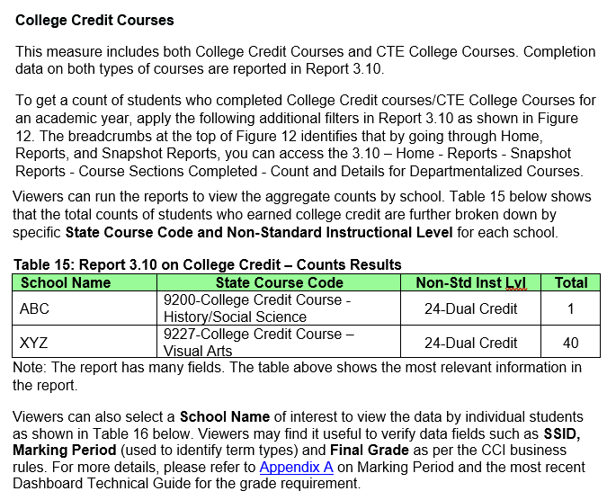
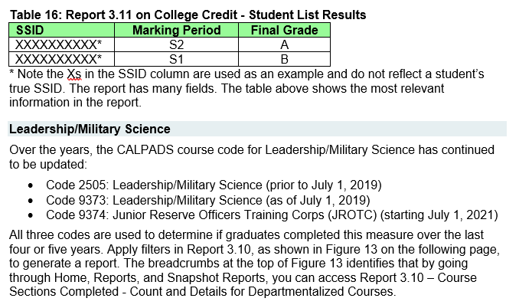
23-24 Handbook:
Connecting CALPADS to the Dashboard
13
Notes:
https://www.cde.ca.gov/ta/ac/cm/documents/caldashhandbook24.docx

Slide 14
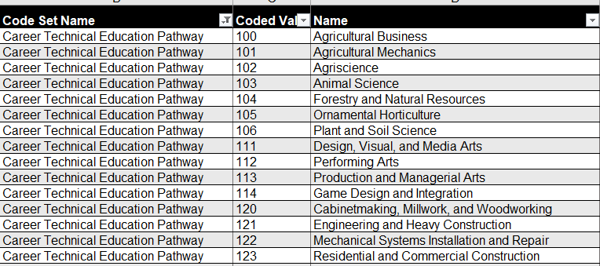
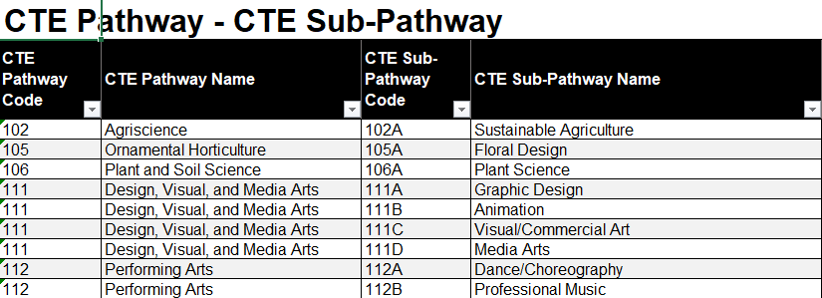
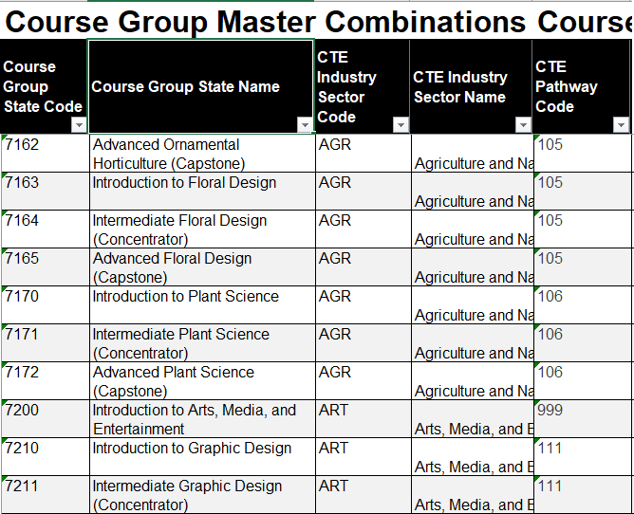
Pain Points
CTE Pathway Mapping
SCTE0698E1 (CERT123)
At least one SCSC record with a Course Section ID at the same Reporting LEA for the student that is mapped to a CRS-State Course Code in a CRSC record that can then be mapped to the CTE Pathway specified for the student in the SCTE file and the SCSC record must have a Capstone Course Indicator = Yes.

Slide 15




Tracking Student WBLR Participation
Categorizing WBL Experiences
Identify opportunities and employers
Document dates, hours, performance
Preserve longitudinal records

Slide 16
Work-Based Learning vs Work Experience
Key Differences
 | Work-Based Learning | Work Experience
Focus | Educational approach, integrating learning with work | Broad term for any paid or unpaid work
Structure | Often structured, aligned with curriculum and industry standards | Can be structured or unstructured
Goal | To connect school experiences with real-life work activities and future careers | To gain practical skills, explore career paths, and develop employability skills
Examples | Internships, apprenticeships, job shadowing, school-based enterprises | Internships, volunteer work, part-time jobs, community service

Slide 17
EOY 1 Reports
Report 3.9
Report 3.10
Report 3.11
Course Sections Completed – Count by Content Area for Departmentalized Courses
Course Sections Completed – Count and Details for Departmentalized Courses
Course Sections Completed – Student List for Departmentalized Courses
Report 3.16
Educational Options Course Completion – Student Count
Report 3.14
Report 3.15
  Career Technical Education Noncompleter Participants - Count
  Career Technical Education Noncompleter Participants– Student List
Legend
Aggregate Report
Supporting Report
Report 3.19
Report 3.20
  Career Technical Education Completers – Count by Pathway
  Career Technical Education Completers– Student List
Report 18.1
Report 18.2
  Work-Based Learning -Count
  Work-Based Learning – Student List
Notes:
EOY 1 Data Mapping Guides in the user manual -- https://documentation.calpads.org/Reports/SnapshotODSReports/#eoy-1-report-mapping-guides

Slide 18
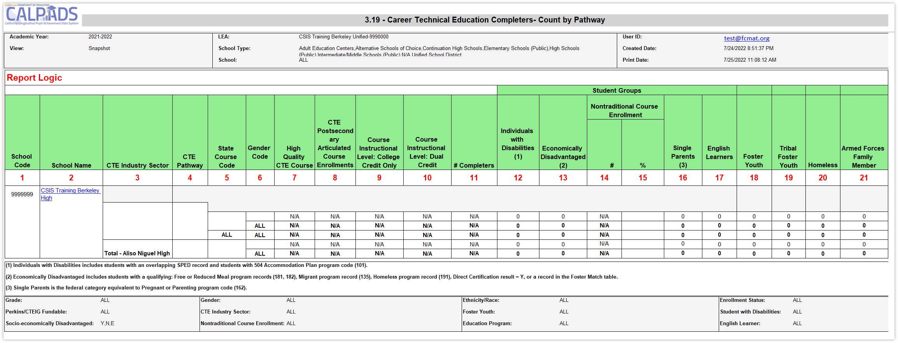
Identify Completers or Misaligned Pathways
Submit SCSC and SCTE files to estimate completer counts prior to EOY

Slide 19

Available
EOY 1 Training
CALPADS User Manual
EOY Road Map
Staff Demographics
Student Course Section
Student Career Technical Education
Work-based Learning
CSIS YouTube Training Channel
End of Year (EOY) Trainings
Other Information
CALPADS Update Flash #229 (WBLR)
SCTE FAQ
CTE FAQ
Course Completion FAQ

Slide 20

EOY 2
Program Participation preparation

Slide 21
EOY 2 Data Collection
Files Submitted
STUDENT PROGRAM (SPRG)
Program
CARS
Student subgroups
Schoolwide programs
Data
Submitted
External Data
SCHOOLWIDE PROGRAM
Site Staff
Program staff
Site Administrators
Student System Support Staff
Staff Involved with Submission

Slide 22
EOY 2 Pre-snapshot Submission Activities
Record Type | Activity | Reasoning | Processing Method | Record Operational Keys
SPRG | Ongoing | Program data should be updated as students start and end participation with a particular school. Most records should have been submitted prior to the EOY submission. Certify the schoolwide status in CARS | Transaction | School of Attendance SSID Education Program Code Education Program Membership Start Date Education Service Academic Year Education Service Code

Slide 23
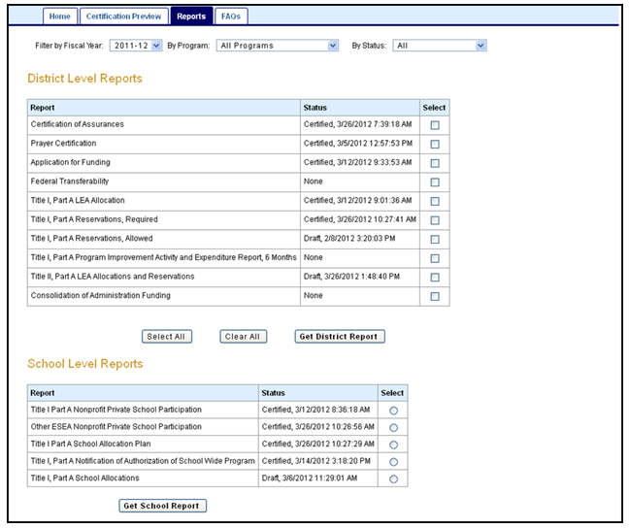
Pain Points
Consolidated Application and Reporting System
A local education agency (LEA) that receives Title I, Part A funds operates one of two programs:
Targeted assistance school (TAS) program,
  Must identify and submit student program records
or
Schoolwide program (SWP)
  Not required to identify individual students or submit records
To be identified in CALPADS, schools operating schoolwide programs must be CERTIFIED in CARS
Notes:
CARS guidance and updates: https://www.cde.ca.gov/fg/aa/co/cars.asp

Slide 24
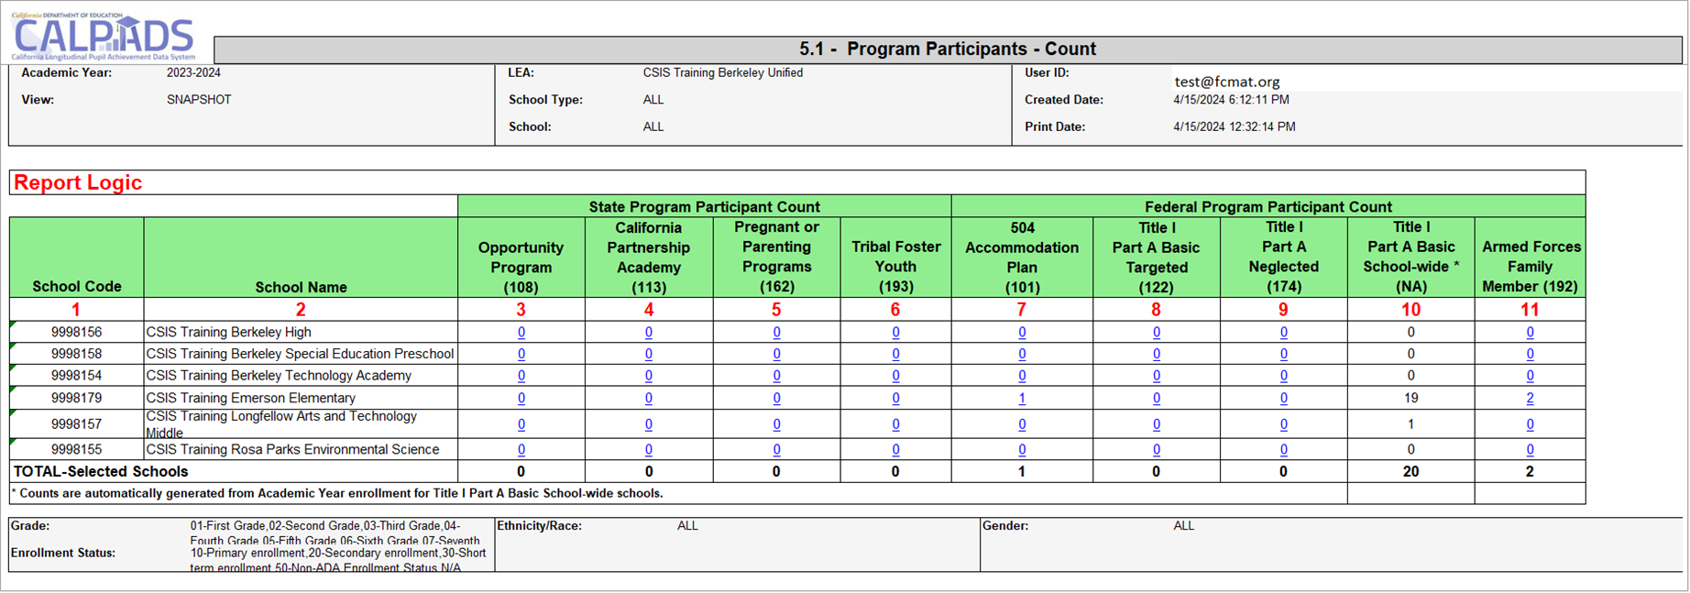
Early Program Counts

Slide 25
EOY 2 Reports Program Participation
Report 5.2
Program Participants - NCLB Title I Part A Basic Targeted Education Services
Legend
Aggregate Report
Supporting Report
Report 5.1
Program Participants - Count
Report 5.3
Program Participants - Count
Notes:
EOY 2 Data Mapping Guides in the user manual -- https://documentation.calpads.org/Reports/SnapshotODSReports/#eoy-1-report-mapping-guides

Slide 26

EOY 2 Training
CALPADS User Manual
EOY Road Map
Student Programs
CSIS YouTube Training Channel
Student Program (SPRG) Data Population
End of Year (EOY) Trainings
Other Information
CALPADS Update Flash #228 (TK)
CALPADS Data Guide v11.0
  Section 2.1.3 Student program

Slide 27

EOY 3
Behavioral Incidents, Absenteeism, Cumulative Enrollment preparation

Slide 28
EOY 3 Data Collection
Student Incident (SINC)
Data Submitted Via
Student Incident Results (SIRS)
Student Offense (SOFF)
Student Absenteeism (STAS)
Cumulative Enrollment (SENR)
Graduates and Completers (SENR)
RFEP (SELA)
Homeless Program (SPRG)
Incidents
Absence Summary
RFEP
Homeless
Cumulative Enrollment
One Year Grads & Completer
State Indicator
UMIRS
Subgroup data
State indicator
DASS
Suspension Rate
Absenteeism Rate
Subgroup Data
IDEA
Stability Report
Data Submitted
Site Administrators
Staff Involved with Submission
District Administrators
EL Coordinator
Special Ed staff
Attendance Clerks
Attendance Supervisor
NPS School Staff

Slide 29
EOY 3 Pre-snapshot Submission Activities
Record Type | Activity | Reasoning | Processing Method | Record Operational Keys
SENR | Ongoing | Enrollments records are used to determine cumulative enrollments and every student should be exited by the end of the AY | Transaction | School of Attendance SSID Enrollment Start Date
SELA | Ongoing | Reclassified EL students should have their status updated withing an enrollment period | Transaction | Effective Start Date SSID
SPRG | Ongoing | Homeless student data should be verified annually and updated when the student is rehoused | Transaction | School of Attendance SSID Education Program Code Education Program Membership Start Date Education Service Academic Year Education Service Code

Slide 30
More Pre-snapshot Submission Activities
Record Type | Activity | Reasoning | Processing Method | Record Operational Keys
STAS | End of Year | Stas is calculated from attendance. Students may need exit dates to extract the data | Replacement | School of Attendance Academic Year ID SSID
SINC | Now | SINC, SIRS and SOFF must be posted in succession and completely, but there is benefit to submitting them prior to school ending to resolve the majority of errors that may arise. Files submission can be completed by school if schools have different end dates or by incident if Q allows for only new incidents to be extracted | Replacement | School of Attendance Academic Year ID Incident ID Local
SIRS | Now |  | Replacement | School of Attendance Academic Year ID Incident Local ID
SOFF | Now |  | Replacement | School of Attendance Academic Year ID Incident ID Local
EOY Primer v1.0 AY 2023-24

Slide 31

Pain Points
NPS School Incident Reporting
LEAs and NPS schools must have policies and procedures in place to identify, document, and report incidents involving restraint and seclusion for students with disabilities
LEAs have the burden of submission, therefore must facilitate data collection and verify completeness prior to submission
Notes:
NPS School discipline training: https://www.youtube.com/watch?v=82aN0lgEUPU
NPS Student Incident Guide (excel): https://csis.fcmat.org/workflows/Invoke?token=CfDJ8MbNe0Ae_LFBoPfpP1jvtSmxmu7qbjW-c1uSicJPlmqwR-CgJVhel1kaJ5qb6R3_-8lsYLbLC_RN3J-kq4S5ignEEH2yHgmQIURR44Q1euVK7S7chJIj_xrh6Uuox8-OF5oe6D00znyQyDpW8ni5slc4v4PxO0ooCmsf06fnB3Ozez9cqyMBK_wyMFEmoO0hZdkVFPRQ2ICZIsmdt0NrkNZq5738ZaGl6bcrao61hoyE&FilePath=CALPADSResources/NPS-Student-Incident-Guide.xlsx

Slide 32

Restraint And Seclusion
The Special Education Division use certified Restraint and Seclusion data when making its annual monitoring determinations:
LEAs reporting more than 2:1 ratio of restraints or seclusion per pupil will be asked to perform student record reviews
LEAs that :
  Report zero incidents of restraint or seclusion and have greater than 100 students with disabilities; or
  Report zero incidents of restraint or seclusion and have greater than 100 students with disabilities enrolled at Nonpublic Nonsectarian Certified Schools (NPS); or
  Fail to certify the CALPADS EOY 3 submission
  will be flagged for questionable data quality and will have to complete monitoring activities associated with data quality

Slide 33

Homeless Students
CALPADS administrators should coordinate with their local homeless liaisons to identify homeless students
LEAs should submit a Student Program (SPRG) record reflecting an Education Program Code of 191 – Homeless Program
EOY cumulative homeless counts are the basis for federal funding
Update your data in CALPADS as frequently as possible to help county and state liaisons better plan and provide support to districts experiencing significant increases in homeless student enrollment
Notes:
CALPADS Update Flash #295 - California Fires and Homeless Education Program, https://www.cde.ca.gov/ds/sp/cl/calpadsupdflash295.asp

Slide 34
Long Term English Learners (LTEL)
Report | LTEL Grade level | LTEL Definition
Dashboard | Transitional Kindergarten (TK) through grade twelve | An EL student who has not attained English language proficiency within seven years of initial classification
DataQuest | Grades six through twelve) | An EL student who meets all of the following: Enrolled on Census Day (the first Wednesday in October) in grade six through twelve, inclusive; and Enrolled in a US school for six or more years; and Remained at the same English language proficiency level for two or more consecutive prior years, or has regressed to a lower English language proficiency level, as determined by the ELPAC; and For students enrolled in grades six through nine, inclusive: Scored "Standard Not Met" on the previous year’s administration on the English Language Arts (ELA) CAASPP

Slide 35

RFEP Students
It is recommended that LEAs Update RFEP Status in CALPADS by May 15, 2025
24-25 Summative ELPAC or Summative Alternate ELPAC Ends May 31, 2025
  Students will no longer be able to use 2023–24 results for reclassification after May 31, 2025
    For students who may be reclassified based on their 2023–24 Summative ELPAC or Summative Alternate ELPAC scores we recommend testing them no later than May 15, 2025 this will ensure that all eligible students are tested as required by law
  Ensure students transferring have updated records in CALPADS within 10 days
Notes:
CALPADS Update Flash #277 - Reclassifying and Reporting Reclassified Fluent English Proficient (RFEP) Students During the Summer When Students are not Enrolled, https://www.cde.ca.gov/ds/sp/cl/calpadsupdflash277.asp.

Slide 36
EOY 3 Reports
Report 1.21
Report 8.1 (EOY 3)
Cumulative Enrollment – Count
Student Profile - List (EOY3)
Report 7.10
Report 7.12
Incident Count
Incident Results - Student List
Report 1.22
Report 1.23
Graduates and Completers Count
Graduates and Completers Student List
Report 7.11
Incident Result – Count
Report 7.13
Report 7.14
Student Offense - Count by Offense
Incident Offense– Student List
Legend
Report 2.16
Report 2.17
ELA Status – ELs Reclassified RFEP (EOY 3)
ELA Status – ELs Reclassified RFEP Student List (EOY 3)
Aggregate Report
Supporting Report
Report 7.15
Incident Results- Persistently Dangerous Offense Expulsions
Report 5.4
Report 5.5
Homeless Students Enrolled - Unduplicated Count by School
Homeless Student List
Report 7.16
Report 7.18
Incident Removals for Students with Disabilities – Count
Incident Removals for Students with Disabilities – Student List
Report 14.1
Report 14.2
Student Absenteeism - Count
Student Absences – Student List
Report 7.17
Unilateral Removals for Students with Disabilities - Count
Notes:
EOY 3 Data Mapping Guides in the user manual -- https://documentation.calpads.org/Reports/SnapshotODSReports/#eoy-1-report-mapping-guides

Slide 37
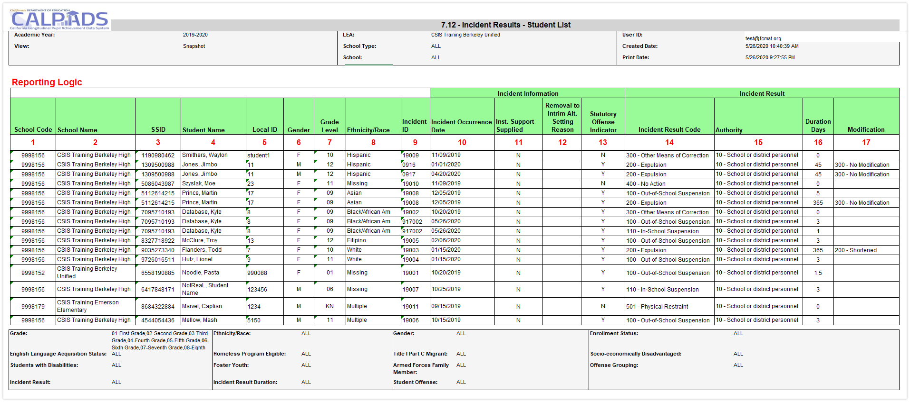
Identify which Report Provides Pertinent Information
Report 7.12 can be used to count individual suspensions and expulsions as well as other results
Notes:
https://www.cde.ca.gov/nr/el/le/yr21ltr0819.asp
https://www.cde.ca.gov/nr/el/le/yr23ltr0221.asp

Slide 38

Available EOY 3 Training
CALPADS User Manual
Student Absence Summary
Incident
Reclassified EL
Student Program
Student Enrollment
Other Information
Relevant FAQ
CALPADS Update Flash #295 (Homeless)
CALPADS Update Flash #277 (RFEP)
Incident Data Collection from Nonpublic Nonsectarian Certified Schools in the California Longitudinal Pupil Achievement Data System
CSIS YouTube Training Channel
End of Year (EOY) Data Population Trainings
End of Year (EOY) Reporting & Certification Trainings

Slide 39

EOY 4
Special Education Program, Services, Postsecondary preparation

Slide 40
EOY 4 Data Collection
SWD Status (SWDS)
Data Submitted Via
Post Secondary Status (PSTS)
SWD Meetings (MEET)
SWD Plan (PLAN)
SWD Services (SERV)
Data Submitted
Special Education
Postsecondary status
Nonparticipation
Eligibility/Participation status
SWD Status
Nonparticipation reason
Plans and Program settings
Statutory Meetings
Exit Reason, Completion status
Employment and educational status
Site Staff
Staff Involved with Submission
Special Ed staff
Site Administrators
Student System Support Staff
SELPA Directors
Student Families

Slide 41
EOY 4 Pre-snapshot Submission Activities
Record Type | Activity | Reasoning | Processing Method | Record Operational Keys
SWDS, PLAN, MEET | Ongoing | Special Education data is updated as students are tested, meetings are held, records are amended, or eligibility ends. Students' records must be up to date for CAASPP and ELPAC testing | Transaction/ Effective Date | Reporting LEA (District of Service) SSID Reporting SELPA Special Education Meeting Date Student Special Education Meeting or Amendment Identifier Education Plan Type Education Plan Amendment Date
PSTS | Now | Student surveys can be submitted as they are received. The operational key includes the SSID and status code so new records can be submitted with minimal risk to replacing others | Replacement | Academic Year ID Reporting LEA Education Program Participation Type SSID Postsecondary Status Code

Slide 42
SWD Enrollments
Age | Enrollment Status | Enrollment Start Date | Grade Level | School of Enrollment
Zero to 35 months | 50 – Non- ADA Enrollment | Date of parental consent for Part C initial evaluation | IN - Infant | District-level enrollment
3 to 5 years, public preschool OR private preschool serving preschoolers only (served by district on IEP) | 10 - Primary | Date of child’s third birthday for infants turning 3, otherwise Parent Consent Date | PS - Preschool | Preschool with specific CDS code – Enroll at preschool If no specific preschool CDS Code - District-level enrollment
3 to 5 years, private preschool additionally serving grades TK and higher (served by private school on ISP) | 50 – Non-ADA Enrollment | Date of parental consent | PS - Preschool | School 0000002 – Private School Group
5-21, Kindergarten (inc. TK) through 12 (public) | 10 - Primary | First day of enrollment | K-12 – Kindergarten through 12 | School of enrollment
5-21, Kindergarten (inc. TK) through 12 (private) | 50 – Non- ADA Enrollment | Date of parental consent | K-12 – Kindergarten through 12 | School 0000002 – Private School Group

Slide 43

Fall 2 Is Over, Now What?
  Resolve common/ frequently occurring errors
    SENR0606E4 – Missing PLAN record for enrolled Eligible and Participating Student
    PLAN0390E4-0397E4 – Missing Transition Indicators
    SENR04391 - Adult Age Students with Disabilities in Transition Status is required for this record
Use Monitoring Report 16.21 to monitor timelines
Account for SWD completers
  Graduates (Alternate Pathways)
  Certificate of completion

Slide 44

Pain Points SWD PSTS Survey
LEAs are required to report outcomes for SWD who exited secondary education and did not re-enroll
When must data be reported?
For whom must the data be reported?
How many outcomes can be reported for a student?
Can a student be submitted in Fall 2 and EOY 4?
Is there are hierarchy for multiple outcomes?
Are transition students reported?

Slide 45
EOY 4 Reports Students with disabilities
All Reports will be available to both LEA and SELPA Users
Report 16.14
Students with Disabilities - Plan Student list (EOY4)
Report 16.12
Students with Disabilities - Education Plan by Disability (EOY4)
Report 17.3
Postsecondary Survey Outcome for SWDs - Count
Report 17.4
Postsecondary Survey Outcome for SWDs - Student List
Legend
Aggregate Report
Supporting Report
Report 16.13
Students with Disabilities - Federal Setting Count (EOY4)
Report 16.22
Students with Disabilities - Non- Participating Status Report – Count (EOY4)
Report 16.23
Students with Disabilities - Non- Participating Status Report - Student Details (EOY4)
All Reports will be available to both LEA and SELPA Users

Slide 46
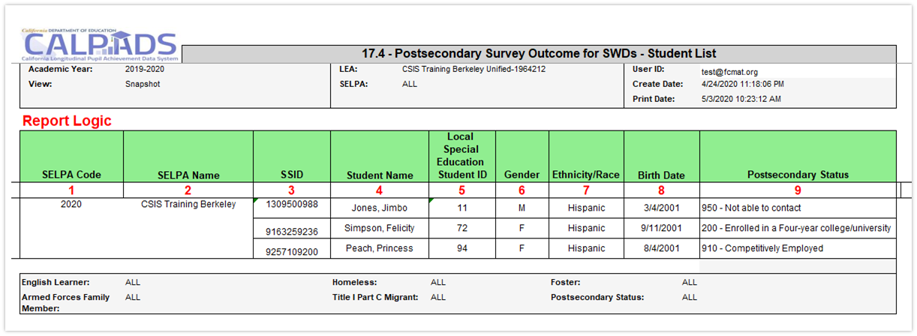
Postsecondary Status Data Analysis
Supporting Report 17.4 will list SWD and their postsecondary outcomes. Detail data is often found in supporting reports, data coordinators should ensure that the proper report is reviewed early in the submission window so there is time to reconcile data

Slide 47

Available EOY 4 Training
CALPADS User Manual
Students with Disabilities Status (SWDS)
Special Education Plan (PLAN)
Special Education Meetings (MEET)
Special Education Services (SERV)
Postsecondary Status
CDE Guidance
Reporting Data for Students with Disabilities
Special Education File Submission Scenarios
Special Education Data FAQs
Appropriate SWDS Status and NonPart Reason for Student Exit Categories and Completion Statuses.xlsx
CSIS YouTube Training Channel
CALPADS Special Education Roadshow 2024
Creating and Maintaining Statewide Student Identifiers for Students with Disabilities in CALPADS

Slide 48

Reminders
Additional CALPADS Activity

Slide 49

CALPADS Work Continues
Regularly update student data in SIS and in CALPADS
Monitor SPED students’ meetings
Coordinate with business office on CARS certification
Prepare and Test students for:
  Summative ELPAC
  CAASPP
  CAST
Stay current with training and Flash communications
Attend CALPADS Q&A
Attend SPED Office Hours
Vacation?

Slide 50
CALPADS to TOMS
Nightly extraction from CALPADS
TOMS determines updates, deletions, and additions
LEAs review data uploaded to TOMS
Process continues through testing window
CALPADS sends the most current open primary and short-term enrollments (Enrollment Status = 10 or 30) for grades K-12
If a student is concurrently enrolled, CALPADS sends the enrollment with the most recent start date
Therefore, concurrent enrollments (CCEs) do not need to be resolved for a student to test unless the latter LEA enrolled the student in error
Updates in CALPADS on . . . | TOMS updated . . .
Thursday | Monday
Friday | Tuesday
Monday | Wednesday
Tuesday | Thursday
Wednesday | Friday
Notes:
ELPAC Student Data layout reference: https://www.elpac.org/s/pdf/ELPAC.student-data-layout.2022-23.pdf

Slide 51
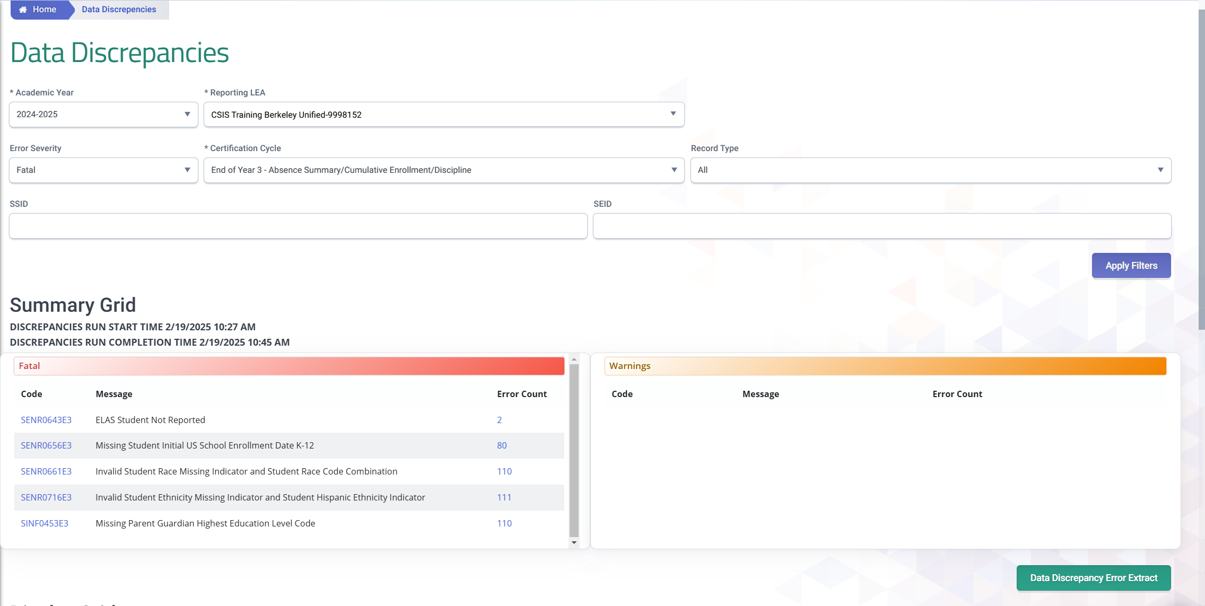
Data Discrepancies Dashboard
LEAs should take advantage of the CALPADS Data Discrepancies Dashboard to anticipate and correct potential CDDs without waiting for a new snapshot revision. DD refresh is quicker than the snapshot revision refresh.
Video Tutorial Resource https://documentation.calpads.org/DataDiscrepancies/DataDiscrepancies/

Slide 52
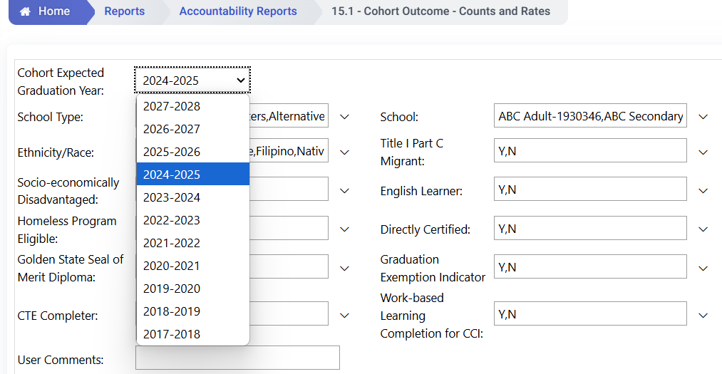
Cohort Reports
4 different cohort years to processing concurrently:
2024-2025
2025-2026
2026-2027
2027-2028
Reminder
Allow a user to select a future cohort year.
  (Report 15.1 and 15.2)
Users can see their cohorts earlier and will be able to verify their first-time 9th grade records sooner.
Will be accessible continuously throughout the whole year
Anticipate students who may potentially be completers versus still enrolled.

Slide 53

Direct Cert, Foster Youth Data Purge
Local educational agencies (LEAs) should download the Direct Certification results prior to June 30, 2025
  All students exited with a Student Exit Reason Code of anything other than an E155 – Year End Enrollment Exit or E156 – Grade 12 Continuing will not be sent over for direct certification matching
You must download report 5.9 Former Foster Youth prior to June 30, 2025
  The Former Foster Youth report does not span academic years. On July 1, 2025, the report will be refreshed and will begin to show only students who continue to be foster or become foster in the 2025–26 academic year

Slide 54

Wrap Up
Key Points, Resources and Support

Slide 55

Summary
Understanding the processing method and the operational keys will allow you to submit targeted data and assist in trouble shooting
Early submission of EOY 1 data will allow you to verify completer to pathway mapping
Ensure that schoolwide programs are certified in CARS to overcome the biggest impediment of EOY 2
EOY 3 is the single largest data collection yet every file type other than STAS can be submitted in advance of the snapshot running
Approve EOY 4 early so that SELPAs have time to review reports
CALPADS work is constant, data submission is required for testing, cohort and SWD monitoring
CSIS & CDE monitoring whether LEA’s are error free by July 12, so…
Some key points to remember

Slide 56



Suggested Milestones
Now – 5/6
Complete Data Population in local SIS
Now – 6/19
Submit and post files. Review IVR and Data Discrepancy errors and reconcile as needed.
6/20 – 7/10
Resolve Certification and Data Discrepancy errors. Review snapshot reports and update records as needed
EOY
2024-2025
0
7/11
Recommended Date for Zero Errors
7/11– 7/18
Send reports to local data stewards, site leaders and administrators for approval (Send earlier if possible)
7/22 – 7/25
LEA Approve by Certification Deadline
(EOY 3 & 4 should be SELPA Approved if possible)
Amendment Deadline
(EOY 3 & 4 require SELPA Approval)
7/26 – 8/8

Slide 57


CALPADS Special Education Data Roadshows
COE/SELPA | Date
San Bernardino | Tuesday, April 8, 2025
Riverside | Wednesday, April 9, 2025
Sonoma | Monday, April 21, 2025
Santa Clara | Tuesday, April 22, 2025
Shasta | Friday, April 25, 2025
Ventura | Monday, April 28, 2025
Los Angeles | Tuesday, April 29, 2025
Orange | Tuesday, April 29, 2025
Tulare | Monday, May 5, 2025
Fresno | Thursday, May 8, 2025
Contra Costa | Monday, May 12, 2025
Sacramento | Monday, May 19, 2025
San Joaquin | Monday, May 19, 2025
Madera | Tuesday, May 20, 2025
San Diego | Friday, May 23, 2025

Slide 58

Future Training
CALPADS End-of-Year (EOY) 1 - 4 Reporting & Certification training begins 4/24/25
May Regional Meetings 5/21/25 - 5/22/25

Slide 59




Resources
Here are some important resources related to CALPADS reporting.
  https://learn.fcmat.org/
https://www.youtube.com/channel/UCA9oRTiyVECCCzOxpmJheZw
https://documentation.calpads.org/Support/References
https://www.cde.ca.gov/ds/sp/cl/systemdocs.asp
https://csis.fcmat.org/resources

Slide 60





Support
http://www2.cde.ca.gov/calpadshelp/default.aspx
Web
calpads-support@cde.ca.gov
Email
916-325-9210
Phone
https://csis.fcmat.org/ListServ
https://www.cde.ca.gov/ds/sp/cl/listservs.asp
You can get help through these channels.
Listserv

Slide 61
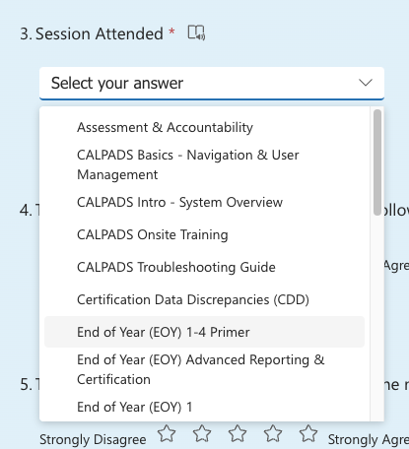
Feedback
I have a question…
“
”
Please complete survey…
https://bit.ly/2MXsECg
“
”

Slide 62






Thank You
CSIS Training
+1 916 325 9210
csistraining@fcmat.org
https://csis.fcmat.org/

