Slide 1
EOY 1- 4 Advanced Reporting and Certification
EOY 1-4 Overview
2023-24 Changes
Common Problems
Wrap-Up
Notes:
Welcome to the EOY Advanced training for experienced CALPADS users. In this training, we will provide a brief overview of the EOY submissions and go over the EOY changes for this year.

Slide 2
CALPADS Training Road Map
Introduction
System Overview
Basics
Submission: Data Population
File Type: Data Population
Data Collections
Fall 1-2 Reporting and Certification
EOY 1-4 Reporting and Certification
Skill Building
Skill Building
Data Privacy
Data Population
CALPADS Basics
CALPADS Basics (SELPA)
4 Year Cohort
Notes:
The CSIS training model is designed to be segmented to provide organization of specific topics and concise delivery. We aim to provide focused trainings with relevant information and instruction.
- This slide reflects the CALPADS course catalog. In the top we have the various Subject Areas and their respective Programs shown below each one. The first three skill areas contain programs that are the prerequisite for the Data Collection programs and the EOY Advanced is part of the EOY 1-4 Reporting and Certification program, which you are attending today. We also have the Skill Building program consisting of courses which are available in self-paced format.

Slide 3
Target Audience
Experienced CALPADS
Users
New to CALPADS?
Attend EOY R&C Trainings
Notes:
We expect experienced CALPADS data Coordinators to be attending this session.
If you are new to CALPADS, we strongly recommend that you attend the regular EOY Reporting & Certification trainings as this session's main focus is on the changes only and we would not be discussing the data requirements and population in this course.

Slide 4
Objective
Identify
Prepare
Coordinate
Certify
the changes for EOY 1-4 submissions
for system changes and local readiness & establish submission strategy
with other staff to ensure everyone is aware of new changes and certification process
EOY 1-4 on time or before the final submission deadline
Project Management
Manage & Maintain Data
Data Literacy
Coalition Building
Notes:
At the end of this session, with the information provided, LEAs should be able to:
Identify the the changes for EOY submission
Learn about the system changes and establish a submission strategy that works best for your LEA
Coordinate with other staff to ensure everyone is aware of new changes
Lastly, certify EOY 1- 4 reports on or before the final submission deadline
In support of the CSIS mission of increasing local capacity among our LEAs, our trainings have a focus on skill development, and so throughout this training we will provide information and guidance to help you develop some of the skills shown on this slide.

Slide 5
Agenda
EOY 1-4 Overview
2023-24 Changes
Certification Review
Common Problems
Wrap-Up
Notes:
Here is the agenda for this training. We will discuss the following:
An overview of the submission
Discuss the details of this year’s EOY changes
Review the certification process
Cover some common problems and wrap up

Slide 6
Key Dates
Reporting Period
7/1/2023 - 6/30/2024
Resolve Cert/DD Errors & Review Reports
7/12/2024
EOY Certification Deadline
7/26/2024
Amendment Window Deadline
8/16/2024
NOTE: CALPADS Calendar
http://www.cde.ca.gov/ds/sp/cl/rptcalendar.asp
Notes:
Our goal is to help LEAs build their local capacity. Therefore:
The expectation is for each LEA to resolve all fatal errors by July 12th and Approve by end of July.
The EOY snapshot reports will generate on — May 7th
The EOY error resolution is — July 12th
The EOY submission window deadline is — July 26th
The FINAL amendment deadline is August 16th
Also, these dates can change so it is best to check the CDE’s calendar using the link on this slide.
Minimize data cleanup in CP. If you are cleaning data (resolving validation and CDDs) for more than 2 weeks in CALPADS, that is an indication there are local issues that need to be addressed. CDE will always reconsider the timelines if the system is not performing as expected.

Slide 7
EOY Preparation
CALPADS Activities
determine data stakeholders you need to collaborate with
Local Systems Activities
Check with vendors for updates
Verify sites and district on same SIS version
Audit SIS and SEDS records to ensure required data are populated
Review upcoming EOY changes internally
Audit CALPADS accounts and roles
Build EOY calendar using EOY Task List
Plan for clearing all EOY errors by July 12th!
Run validations locally in SIS before uploading files to CALPADS
Update Student Enrollment and Information now
Establish error correction strategy with SPED Coordinator
NOTE: EOY Checklist - https://documentation.calpads.org/Training/doc/2023-24EOYChecklistwithCertificationReportSummary.xlsx

Slide 8
EOY 1- 4 Highlights
Course Completion
CTE Participants and Completers
Work Based Learning
Program Participants
Student Incident, Restraints & Seclusion
Student Absenteeism
Cumulative Enrollment
Homeless Counts
Reclassified Fluent English Proficient (RFEPs)
Graduate and Completer Counts
Special Education
SWD Postsecondary Status
Notes:
Let's start with the overview of the EOY Submissions and look at what is changing and what is remaining the same.

Slide 9
EOY Data Collections
EOY 3
July 1–June 30
Student Behavioral Incidents
Course completion
EOY 1
July 1–June 30
Grades 7-12
EOY 2
July 1–June 30
Program​
Participation​
​
Title I Part A Basic Targeted ​
​
Title I Part A Neglected ​
​
Armed Forces Family Member ​
​
504 Accommodation Plan ​
​
Opportunity Program ​
​
California Partnership Academy ​
​
Pregnant or Parenting Programs​
CTE participants and completers (Perkins Report)
Student Absence Summary
EOY 4
July 1–June 30
SWD Status
SWD Services
(Not Reported AY23-24)
PSTS for SPED
Homeless Program
Carnegie Units
College Credit
Work-Based Learning
Cumulative Enrollment
RFEP
Grads and Completers
Leadership/Military Science
SWD Plans
SWD Meetings
Notes:
These are the current CALPADS EOY Data Collections and a high level view of the data collected in each.
Unlike Fall 1 and Fall 2, EOY reports on the entire year from 7/1 of prior year to 6/30 of the current year, which means any new students or students who have left during this timeline will be reported.
Participant reads slide on their own
Notes:
Student Enrollment (SENR) and Student Information (SINF) must be up-to-date in CALPADS before uploading EOY files.
For EOY-1, do not submit staff assignment or SASS. It is not used in EOY reporting. It may cause a problem with Fall 2 staff assignment data if replaced.

Slide 10
EOY 2 – All LEAs
Program Participation
Notes:
Now we will move on to the individual submissions. The first submission we will cover is EOY 2 required for all LEAs -- Program Participation

Slide 11
Data Collected for EOY 2
108 - Opportunity Program
113 - California Partnership Academy
162 - Pregnant or Parenting Programs
122 - NCLB Title I Part A Basic Targeted
FEDERAL
174 - NCLB Title I Part A Neglected
192 - Armed Forces Family Member
STATE
101 - 504 Accommodation Plan
Data Submitted Via
STUDENT PROGRAM (SPRG)
Site Staff
Program staff
Site Administrators
Student System Support Staff
Staff Involved with Submission
🖌 NOTE: Programs should be reported at each school a student attends except for summer schools
Notes:
Reminders:
EOY 2 counts all students reported for the 8 programs and identifies students from 7/1 prior year to 6/30 current year.
Check Title I status for your schools.
Program code 162 is also used in Perkins reporting as the “Single Parent” count for CTE reporting

Slide 12
Title 1 Reporting Reminders
CERTIFY
SCHOOLS OPERATING TARGETED PROGRAMS
SCHOOLS THAT ARE TITLE I SCHOOLWIDE
CALPADS WILL ACCEPT
Consolidated Application Reporting System (CARS) data first
Submit Title I Basic Targeted program records
Don’t report Title I Basic Targeted program records
Multiple SPRG Title 1 record for the same student, in the same reporting period, with different Education Services
Notes:
To avoid CERT097, LEAs must annually report whether schools are operating a schoolwide or targeted program in the Consolidated Application Reporting System (CARS)
Only schools being reported as operating targeted programs should submit Title I Basic Targeted program records
LEAs should not report Title I Basic Targeted program records for schools that are Title I Schoolwide
LEAs can report multiple Educational Services for a student under Title1 Targeted
CALPADS will accept multiple SPRG Title 1 records for the same student, in the same reporting period, with different Education Services

Slide 13
EOY 2 Reports
Program Participation
Report 5.2
Program Participants - NCLB Title I Part A Basic Targeted Education Services
Legend
Aggregate Report
Supporting Report
Report 5.1
Program Participants - Count
Report 5.3
Program Participants - Count
Notes:
EOY 2 Data Mapping Guides in the user manual -- https://documentation.calpads.org/Reports/SnapshotODSReports/#eoy-1-report-mapping-guides

Slide 14
EOY 3 – All LEAs
Student Behavioral Incidents
Student Absence Summary
Grads and Completers
Homeless Program
RFEP
Cumulative Enrollment
Notes:
Now we are going to review the EOY 3 - Absence Summary/Cumulative Enrollment/Discipline/Homeless submission that is required for all LEAs.

Slide 15
Data Collected for EOY 3
Student Incident (SINC)
Data Submitted Via
Student Incident Results (SIRS)
Student Offense (SOFF)
Student Absenteeism (STAS)
Cumulative Enrollment (SENR)
Graduates and Completers (SENR)
RFEP (SELA)
Homeless Program (SPRG)
FEDERAL & STATE
Incidents
Use of Physical Restraint
Mechanical Restraint
Statutory Offenses committed
Incident Result (one or more)
Student Offense
All Suspensions & Expulsions
Student Absenteeism
Cumulative Enrollment
All Incident resulting in:
Graduates and Completers
Seclusion
RFEP Students
Program 191 – Homeless
Site Administrators
Staff Involved with Submission
District Administrators
SIS Support Staff
Special Ed staff
Attendance Clerks
Attendance Supervisor
🖌 NOTE: EOY-4 Requires Both LEA and SELPA Approvals
Notes:
Discipline file restructured into three files referred to as “Incident” submission, in order to collect the use of:
Behavioral Restraint, which includes
Mechanical Restraint – Use of a device or equipment to restrict a pupil’s freedom of movement (with exceptions)
Physical Restraint – A personal restriction that immobilizes or reduces the ability of a pupil to move his or her torso, arms, legs, or head freely (with exceptions)
Seclusion, which means the involuntary confinement of a pupil alone in a room or area from which the pupil is physically prevented from leaving
The homeless subgroup is part of many DataQuest and Dashboard accountability metrics that are sourced from EOY 3 (e.g., suspension and chronic absenteeism rates that both depend on the EOY 3 cumulative enrollment).
Reminders:
All students who committed an offense (defined in Ed Code 48900 or 48915) are reported regardless of outcome or duration
All students who committed firearm offenses (codes 100, 101, 103, 104 & 105) reported regardless of outcome
Deciding the most severe offense is a local decision. Refer to the guidelines found in section 2.1.4 of the data guide.

Slide 16
Reportable Incidents
Report ALL INCIDENTS as a Result of Offenses Defined in Education Code 48900 or 48915
Students without disabilities
Students with Disabilities
Weapons Offenses
Grade Level:
IN, TD, PS, K-12
Grade Level:
K-12
Grade Level:
IN, TD, PS, K-12
SPED record
Any offense regardless of outcome and duration days
Removal to Interim Alternative setting code in SDIS
Weapon offense (Student Offense Codes 100, 101, 103, 104, 105) regardless, of outcome
Any restraint or seclusion regardless if as a result of 48900 or 48915 violation
Any offense regardless of outcome and duration days
Any restraint or seclusion regardless if as a result of 48900 or 48915 violation
🖌 NOTE: Summer school discipline incidents must be reported in CALPADS
Notes:
For students committing an offense that ties to Ed Codes 48900 or 48915 you will want to make sure student profile data are current in CALPADS.
The SINC, SIRS, SOFF files will report:
ALL INCIDENTS for students that are a result of offenses outlined in Education Code 48900 and 48915
The associated outcome (disciplinary actions) associated with each student for a particular incident, even if it did not result in suspension or expulsion
Any restraint or seclusion regardless if it was as a result of 48900 or 48915 violation
Disciplinary actions (including “other means of correction” or no action) of ANY duration (including ZERO) for ALL students
Note: Removal to Interim Alternative Setting should be rare (see flash # 119 for more details).
Reminders:
-Students with Disabilities must have an active SPED record
-Summer school Incidents - see Data Guide section 2.1.4 - LEAs should also submit any offenses committed by students enrolled in a summer school program, even if that school is not the school where the student is primarily enrolled during the regular school year. The LEA should create a secondary enrollment for the student and submit the disciplinary incident to CALPADS.

Slide 17
NPS Reporting Expectations
LEAs and NPS schools must have policies and procedures in place to identify, document, and report incidents involving restraint and seclusion for students with disabilities
LEAs and NPS schools should ensure that all staff are appropriately trained
CALPADS Administrators should not have to determine what discipline records are reportable incidents
🖌 NOTE: STAS data is not expected for NPS and a fatal validation error (STAS0651) will trigger if submitted.
Notes:
Are LEAs required to submit data for students at Nonpublic schools?
YES – LEAs are required to submit incident data that occurred at Nonpublic schools
LEA need to work with the NPS to collect and report the data that reflects the time the student attended the NPS during the school year

Slide 18
EOY 3 Reports
Report 1.21
Report 8.1 (EOY 3)
Cumulative Enrollment – Count
Student Profile - List (EOY3)
Report 7.10
Report 7.12
Incident Count
Incident Results - Student List
Report 1.22
Report 1.23
Graduates and Completers Count
Graduates and Completers Student List
Report 7.11
Incident Result – Count
Report 7.13
Report 7.14
Student Offense - Count by Offense
Incident Offense– Student List
Legend
Report 2.16
Report 2.17
ELA Status – ELs Reclassified RFEP (EOY 3)
ELA Status – ELs Reclassified RFEP Student List (EOY 3)
Aggregate Report
Supporting Report
Report 7.15
Incident Results- Persistently Dangerous Offense Expulsions
Report 5.4
Report 5.5
Homeless Students Enrolled - Unduplicated Count by School
Homeless Student List
Report 7.16
Report 7.18
Incident Removals for Students with Disabilities – Count
Incident Removals for Students with Disabilities – Student List
Report 14.1
Report 14.2
Student Absenteeism - Count
Student Absences – Student List
Report 7.17
Unilateral Removals for Students with Disabilities - Count
Notes:
EOY 3 Data Mapping Guides in the user manual -- https://documentation.calpads.org/Reports/SnapshotODSReports/#eoy-1-report-mapping-guides

Slide 19
EOY 4 – All LEAs
Students with Disabilities Status
SWD Plans and Meetings
Postsecondary Status for SPED
Notes:
Now we are going to review the EOY 4 - Students with Disabilities and Postsecondary Status submission that is required for all LEAs.

Slide 20
Data Collected for EOY 4
Special Education (SWDS)
Data Submitted Via
Special Education Services (SERV)
Post Secondary Status (PSTS)
Special Education Meetings (MEET)
Special Education Plan (PLAN)
Between July 1, 2023 and June 30, 2024 - Children and students ages zero – 21 (inclusive) who:
Postsecondary Status
The Postsecondary Status (PSTS) file is used by LEAs to submit postsecondary outcome data to CALPADS for students who have exited secondary education in the prior school year
SWD
Were ELIGIBLE AND PARTICIPATING in special education on an IEP, ISP, or IFSP
Were evaluated for special education but were determined to be:
Eligible, Not Participating
Not Eligible
Exited the special education program
Site Staff
Staff Involved with Submission
Special Ed staff
Site Administrators
Student System Support Staff
SELPA Directors
🖌 NOTE: EOY-4 Requires Both LEA and SELPA Approvals
Notes:
LEAs should only submit Postsecondary Status (PSTS) records for students with disabilities with Education Plan Type 100 (IEP) who exited secondary education in the prior year, with the exception of a few circumstances. Do not report those students who:
returned to regular education
transferred to another program, or
are deceased
Education Program Participation Type - Program Participation Type Code = 30 (SPED), then a SENR record for the prior Academic Year with a valid Student School Completion Status (100, 120, 250, 320, 330, 360 or Student Exit Category (E125, E140, E230, E300, E400, E410, T260, T270, T280, T310, T370, T380) must exist.
Postsecondary Status - Student's postsecondary status after exiting secondary education
Training Video: https://www.youtube.com/playlist?list=PLsnFpLOXpp4L9MlVjpW9tANzckYJ8PwQT
User Manual: https://documentation.calpads.org/OnlineMaintenance/StudentDataMaintenance/StudentDetailsPSTS/#which-students-require-postsecondary-status-records-in-the-eoy-4-submission

Slide 21
EOY 4 Reports Students with disabilities
Report 16.12
Students with Disabilities - Education Plan by Disability (EOY4)
Report 16.14
Students with Disabilities - Plan Student list (EOY4)
Report 16.13 *
Students with Disabilities - Federal Setting Count (EOY4)
Legend
Report 16.22
Report 16.23
Students with Disabilities - Non- Participating Status Report – Count (EOY4)
Students with Disabilities - Non- Participating Status Report - Student Details (EOY4)
Aggregate Report
Supporting Report
Report 17.3
Report 17.4
Postsecondary Survey Outcome for SWDs - Count
Postsecondary Survey Outcome for SWDs - Student List
🖌 NOTE: * Report 16.13 may not be available for AY 23-24
Notes:
EOY 4 Data Mapping Guides in the user manual -- https://documentation.calpads.org/Reports/SnapshotODSReports/#eoy-1-report-mapping-guides

Slide 22
EOY 1 – For Grades 7-12
Course Completion
CTE Status
Work Based Learning
Notes:
EOY 1 submission is for schools with grades 7-12 that offer departmentalized courses. In a few minutes or so we will get to the upcoming changes section which applies to all the LEAs. So, please tune back in soon if this section doesn’t apply to you. Now we will cover End of Year 1 which includes Course Completion and Career and Technical Education, also known as CTE.

Slide 23
Data Collected for EOY 1
Staff Demographics (SDEM)
Data Submitted Via
Course Completion (CRSC)
Student Crs. Completion (SCSC)
Student CTE (SCTE)
Work Based Learning (WBLR)
a-g Requirements
Credits
Grades
Pathways
Teacher Demographics
Completers and Participants
State course codes
Student Course Completion
Postsecondary Articulated Course Indicator
Course Completion
Course Attributes
Carnegie Units
College Credit
CTE
Work Based Learning
Site Staff
Staff Involved with Submission
Registrars
Program staff
CTE
Site Administrators
Student System Support Staff
🖌 NOTE: Courses completed are not compared to course enrollment reported during Fall 2
Notes:
Review items on the slide.
LEAs are required to submit the Student Course Section (SCSC) file with the number of Carnegie Units a student earned for a course. For more information on this data element, you may refer to the CALPADS File Specification or CFS document.
Reminders:
Course completion for End of Year 1 is not compared to Course enrollment from Fall 2
Course completion is only required for departmentalized classes in grades 7-12
CTE Participants are reported in the CRSC file only while Completers are determined using the SCTE file
SEIDs submitted in Course Section Completion (CRSC) records are checked to make sure a corresponding Staff Demographic (SDEM) record exists in CALPADS (unless SEID is 9999999999)
Do not submit the SASS file. Staff Assignment data is not required for EOY and submitting a file may wipe out previously submitted data
Work Based Learning is a new collection to help expand indicators for the College & Career Indicators on the Dashboard

Slide 24
WBLR Data Collected
LEAs are required to submit work-based learning completion information for:
All students that complete an internship
Include all Work-Based Learning completion for students enrolled at any time during the Reporting Year
Data will come from SIS but gathered by a team of CTE, SPED and CALPADS coordinators
LEA Admins will need to assign the WBLR Edit, View, and Extract roles to account and other user accounts.
SELPAs will need to request the state to add the WBLR Extract role to their account.
Reference Available: CALPADS Flash 184, 229, 265 WBRL Data Population Videos CALPADS User Manual
24
Notes:
LEAs must submit Work Based Learning or WBLR records to CALPADS for all students in grades 9-12 who participate in an internship or other work-based learning program while enrolled at the LEA.
This includes completion of any work-based learning for students enrolled at the LEA at any time during the reporting year. Work-based learning data is found in the local SIS and gathered by a team of CTE, SPED, and CALPADS coordinators. Though you will commonly find work-based learning data within CTE and Special Education, it is not exclusive to these two areas, and students can be in work-based learning programs with any measure of curriculum throughout your schools. Because of this, it is important to have a process in place for identifying and reporting work-based learning programs.
LEA Admins will need to assign the WBLR Edit, View, and Extract roles to their account and other user accounts working with the WBLR file. SELPAs will need to request the state to add the WBLR Extract role to their account.
References:
CALPADS Flash 184: https://www.cde.ca.gov/ds/sp/cl/calpadsupdflash184.asp
CALPADS Flash 229: https://www.cde.ca.gov/ds/sp/cl/calpadsupdflash229.asp
CALPADS Flash 265: https://www.cde.ca.gov/ds/sp/cl/calpadsupdflash265.asp
CSIS WBLR Data Population: https://www.youtube.com/playlist?list=PLsnFpLOXpp4KDvoW_Hg8BenKP53bv3MGl
CALPADS User Manual: https://documentation.calpads.org/OnlineMaintenance/StudentDataMaintenance/StudentDetailsWBLR/
Work-Based Learning Measures for the CCI:
https://www.cde.ca.gov/ta/ac/cm/workbasedcci.asp#newmeasures
References:
CSIS WBLR Data Population: https://www.youtube.com/playlist?list=PLsnFpLOXpp4KDvoW_Hg8BenKP53bv3MGl
CALPADS User Manual: https://documentation.calpads.org/OnlineMaintenance/StudentDataMaintenance/StudentDetailsWBLR/

Slide 25
EOY 1 Reports
Course Completion
CTE
Work Based Learning
Report 3.9
Report 3.10
Report 3.11
Course Sections Completed – Count by Content Area for Departmentalized Courses
Course Sections Completed – Count and Details for Departmentalized Courses
Course Sections Completed – Student List for Departmentalized Courses
Report 3.16
Educational Options Course Completion – Student Count
Report 3.14
Report 3.15
Career Technical Education Noncompleter Participants - Count
Career Technical Education Noncompleter Participants– Student List
Legend
Aggregate Report
Supporting Report
Report 3.19
Report 3.20
Career Technical Education Completers – Count by Pathway
Career Technical Education Completers– Student List
Report 18.1
Report 18.2
Work-Based Learning -Count
Work-Based Learning – Student List
Notes:
EOY 1 Data Mapping Guides in the user manual -- https://documentation.calpads.org/Reports/SnapshotODSReports/#eoy-1-report-mapping-guides.

Slide 26
EOY Checklist
EOY Data Uses
EOY Checklist

Slide 27
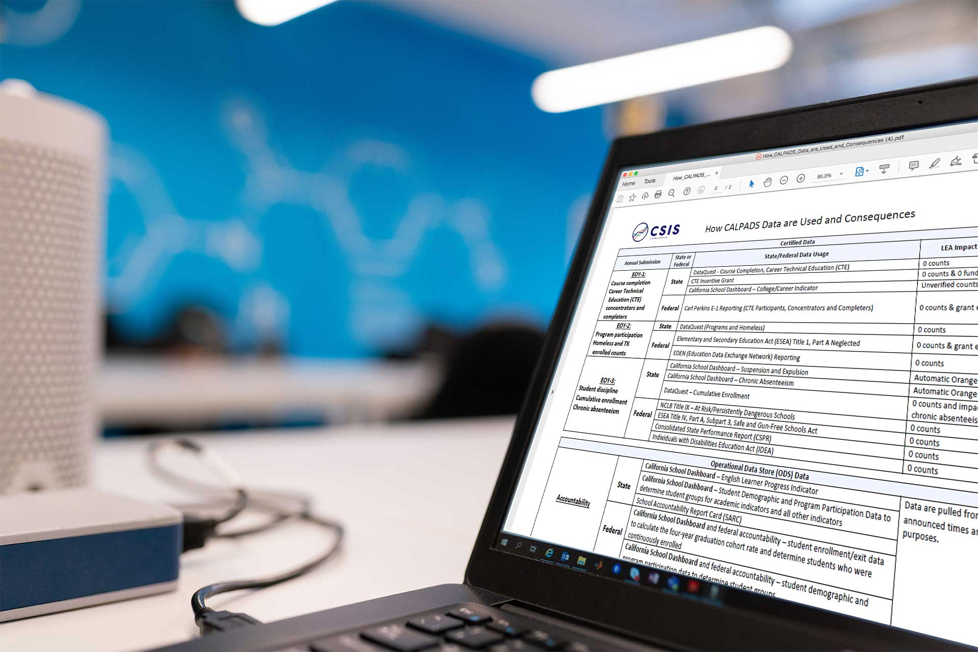
EOY 1 – What are the data used for?
CTE
Completer counts for Perkins V
Completer counts for CCI Dashboard
Course Completion
Counts of students earning college credit for the Dashboard
Counts of students completing Leadership/Military Science courses for the Dashboard
Work Based Learning

Slide 28
EOY 1 – Checklist
Ensure CTE Completers have been appropriately identified in your student information system
Ensure all students completing College Credit courses have been reported
Ensure all students completing Leadership/Military Science courses have been reported
Ensure your vendor has translated credits earned into Carnegie Units
Ensure Work Based Learning data submitted

Slide 29
Dashboard CCI Courses
State Course Code | State Course Code Name
9020 | College Credit Course – Visual Arts
9082 | College Credit Course – Dance
9096 | College Credit Course – Theatre
9120 | College Credit Course – English Language Arts
9154 | College Credit Course – World Languages
9200 | College Credit Course – History/Social Science
9227 | College Credit Course – Other
9273 | College Credit Course – Mathematics
9303 | College Credit Course – Music
9358 | College Credit Course – Science
9373 | Leadership/Military Science
7000–8999 | Any CTE course code indicated in Nonstandard Instructional Level as College Credit Only (23) or Dual Credit (24)
Notes:
Data submitted in the CRSC and SCSC files as part of the EOY 1 submission are used to identify whether students in the 4-year Adjusted Cohort Graduate Rate (ACGR) are prepared for college/career as measured by the College/Career Indicator (CCI) on the California School Dashboard.

Slide 30
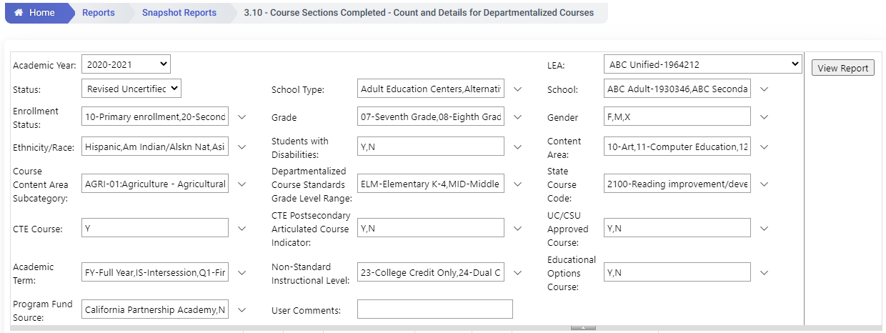
EOY 1 - Reviewing College Credit Courses
Review Report 3.10 - Course Sections Completed - Count and Details for Departmentalized Courses
The report should be requested twice with different filters.
To find college credit courses and Leadership/Military Science in the 9x series select the State Course codes of 9020, 9082, 9096, 9120, 9154, 9200, 9227, 9273, 9303, 9358, 9373
To find the CTE courses with the Non Standard Instructional codes of 23 and 24 select the CTE Course = Y and Non Standard Instructional Level to 23 and 24
Notes:
To find both sets of courses that satisfy the college credit and Leadership/Military Science the report should be request twice with different filters.
To find college credit courses and Leadership/Military Science in the 9x series select the State Course codes of 9020, 9082, 9096, 9120, 9154, 9200, 9227, 9273, 9303, 9358, 9373
To find the CTE courses with the Non Standard Instructional codes of 23 and 24 select the CTE Course = Y and Non Standard Instructional Level to 23 and 24

Slide 31
EOY 1 - Reviewing CTE Data
Review Report 3.14 Career Technical Education Noncompleter Participants- Count
Filter on 12th graders to verify students who completed or were participants in 12th grade
Set Perkins/CTEIG Fundable to ALL to capture all students. Otherwise, it will default to courses only flagged a HQ CTE.
Filter for other specific sub-groups that comprise the core indicators (optional)

Slide 32
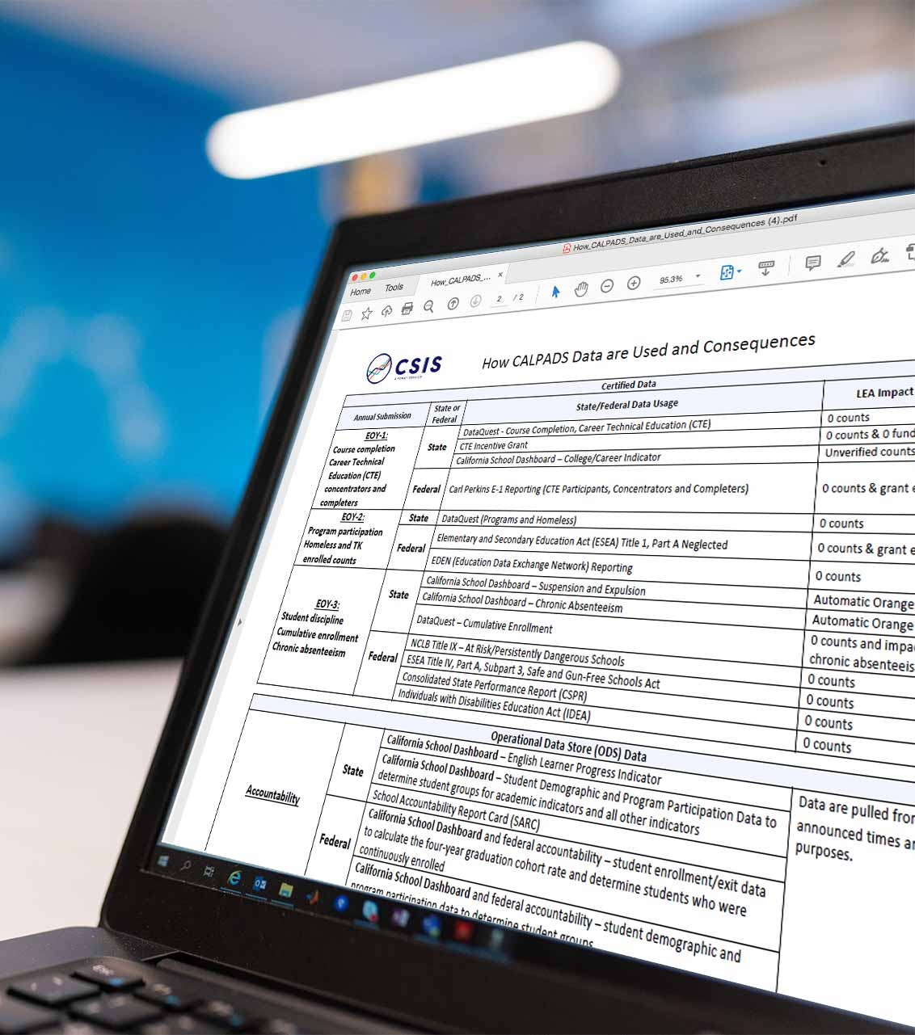
EOY 3 – What are the data used for?
Cumulative Enrollment (SENR)
Basis for denominators for cohort graduation, suspension and chronic absenteeism rates for Dashboard and DataQuest
Identification of students groups for accountability and federal reporting
Socioeconomically disadvantaged, special education, English Learners, Homeless, Foster, Migrant, Military Family
Incident Data (SINC, SOFF, SIRS)
Suspension rate for Dashboard, ESSA, IDEA and DataQuest
Restraint and seclusion data for state and federal reporting, and DataQuest
Student Attendance Summary Data (STAS)
Chronic absenteeism rate for Dashboard and ESSA reporting

Slide 33
EOY 3 – What are the data used for?
RFEP (SELA)
English Learners reclassified from July 1 to June 30
Homeless Students (SPRG)
Federal reporting
Accountability subgroups
Graduates and Completers (SENR)
One-year Graduate and Completer Counts for federal reporting and public reporting on DataQuest
Notes:
See Flash 191

Slide 34
EOY 3 Checklist – Cumulative Enrollment
Ensure all students with primary enrollments anytime from July 1 – June 30th are reflected in the Cumulative Enrollment Reports
Ensure your cumulative enrollment is GREATER than your Census Day Enrollment
Notes:
Use the Cumulative Enrollment Type filter to view different cumulative counts
Adjusted Enrollment, Cumulative Enrollment and Completer Enrollment
Adjusted Cumulative Enrollment is only those records that have an Enrollment Start Date > = July 1 of the Report Academic Year.
For example: Report Academic Year = 2021-2022
Enrollment Start Date => July 1, 2021 would be Adjusted Cumulative Enrollment
One-year completers = to include in revisions to pull through 8/15 for grad/completers only

Slide 35
EOY 3 Checklist – Incidents
Ensure all incidents resulting from violations of Education Code Sections 48900 and 48915 have been reported for all students (including students attending NPS schools) regardless of the outcome and duration of a removal
Report all instances of restraint or seclusion even if it was not the result of a violation of 48900 or 48915 (including students attending NPS schools)
LEAs required to report incidents that occurred at Nonpublic, Nonsectarian Schools: https://www.youtube.com/watch?v=q8IEYoqlwCE
Double check schools that generate a CERT0071 error (No Discipline Data Submitted for a School)
Accountability can elect to assign an automatic color or Orange or Red for the suspension indicator in the Dashboard for specific schools not submitting ANY Incident data.

Slide 36
EOY 3 Checklist – Incidents
Report all results for each incident for each student
Report any increment of a day for suspensions for all students
Report the duration of all:
Suspensions (in and out of school)
Expulsion
Ensure a site is not expelling any students solely for Defiance or Disruption (E.C. 48900 (k))
Ensure the site is not suspending (unless under E.C. 48910) or expelling TK-12 students solely for Defiance or Disruption

Slide 37
EOY 3 - Incident Data Tips
Review report 7.10 – Incident Results – Count
What are your total expulsions? (DQ)
What are your total in and out of school suspensions? (DQ and Dashboard)
What are your total suspensions by subgroup (using filters)? (DQ and Dashboard)
Compare these totals to your Cumulative Enrollment report (1.21)
Did you collect/report restraint/seclusion data for general education students?

Slide 38
Revised Student Absence Summary (STAS) File (2)
Chronic Absenteeism will now be calculated using the following formula:
Non-ADA-Generating Independent Study Days + In-Person Days Absent Excused + In-Person Days Absent Unexcused + Out-of-School Suspension Days
DIVIDED BY
Expected In-Person Attendance Days (includes in-school suspension days) + ADA-Generating Independent Study Days + Non-ADA Generating Independent Study Days
The sum of 13.21 – Non-ADA Generating Independent Study Days and 13.22 – ADA-Generating Independent Study Days will be used to calculate the days a student participated in independent study for purposes of:
AB 130/AB 167 – Students participating in independent study >= 15 days

Slide 39
EOY 3 Checklist – Chronic Absenteeism
Ensure staff have been appropriately identifying students as present or absent in your local SIS
Ensure ADA-generating and Non-ADA-generating Independent Study Days are accurate (remember this will be used to determine number of days a student participated in independent study)
Follow up with schools with any schools with 100% perfect attendance to ensure data are correct
Make sure adjustments are made to expected attendance days for students that were on maternity or paternity leave to exclude those days from the expected
Ensure any student reported as being absent for out-of-school suspension has a SINC, SIRS, and SOFF record
Ensure students who are exempted from attendance reporting are appropriately identified in the STAS File

Slide 40
EOY 3 Checklist – Homeless and RFEP Students and Graduates and Completers
Use report 2.16/2.17 to verify RFEP student counts
Ensure when RFEP record is submitted, the student has an overlapping enrollment record (Flash#219) - Validation will be in place in May 2024
Verify Homeless counts on report 5.4
Use report 1.22/1.23 to confirm one-year graduate and completer counts
Notes:
This is part of the work to move one-year grad reports from Fall 1 to EOY to be consistent with the pulling of the data for the cohort.
One-year completers are to be included in revisions to pull through 8/15 for grad/completers only

Slide 41
EOY 4 – What are the data used for?
Special Education (SWDS, MEET, PLAN)
Student counts for IDEA
Special Education Monitoring
DSEA – Dashboard accountability
Special Education Services (SERV)
No Collection this year
Special Education Monitoring
Postsecondary Status (PSTS)
Post-school outcomes for IDEA; outcomes of SWD who exited secondary education in 2022-23
Notes:
The SPED data collected for SWD provides information for accountability and is required by legislation.
Special Education (SPED)
Student counts and program exits for IDEA
Special Education Monitoring
DSEA – Dashboard accountability
Special Education Services (SSRV)
Special Education Monitoring
Postsecondary Status (PSTS)
Post-school outcomes for IDEA; outcomes of SWD who exited secondary education in 2019-20

Slide 42
EOY 4 Checklist
Use SEDS searches (custom or vendor-created) to monitor your data
Ensure teachers and case managers have saved or locked IEPs and amendments, even in cases where a meeting took place but parent has not signed the plan
Review any transactions that you have marked as “Do Not Report” in your SEDS
Is this a reportable transaction? If so, correct the error and submit the transaction to CALPADS
Check with case manager and ensure any students who were exited from Special Education, have all necessary exit information populated in the SEDS
Exit Date
Exit Reason
Eligibility Status
Ensure the SSID and Local ID fields are both populated in the SEDS (file will fail in CALPADS if not populated)

Slide 43
Submit Postsecondary Follow-up Results
Sent to CALPADS by special education data system (SEDS)
Ensure all students with disabilities who have exited secondary education in 2022-23 have been surveyed for their postsecondary outcomes and responses have been recorded in the special education data system
For students who refused to answer or the LEA was unable to contact – record those results as well
Flash 203 provides a survey template for providing Postsecondary Status information for students with disabilities as part of EOY 4: https://www.cde.ca.gov/ds/sp/cl/calpadsupdflash203.asp
If special education vendor does not allow population of multiple postsecondary status codes, they may be entered via online maintenance

Slide 44
Identify Students Completing Work-Based Learning Programs
Work with case managers to identify SWDs who have completed at least 100 hours of any work-experience program in any grades 9-12 :
Workability
Department of Rehabilitation Student Services
Assist your CALPADS Administrator in identifying any courses for SWDs that focus on classroom-based work exploration
Ensure these data are entered into the SIS for work-based learning reporting

Slide 45
How do I verify the DSEA information in CALPADS?
Accountability DSEA Extract
-SWDs reported by other LEAs with the requestor as the DSEA (receiving)
-SWDs reported by the requestor with a different DSEA (sending)
-Limited in grade level and enrollment status.
- Does not include charter schools
Informational DSEA Extract
- SWDs not enrolled in the requestor’s LEA but have their LEA populated as the DSEA
- All grade levels and enrollment statuses
-Includes charter schools
Definition of DSEA: https://documentation.calpads.org/Glossary/CASEMIS/DSEA/
CALPADS User Manual: https://documentation.calpads.org/Extracts/DSEAExtract/#district-of-special-education-accountability-dsea-extract

Slide 46
Review the CALPADS DSEA Accountability Extract
Verify your LEA is correctly SENDING accountability to another LEA
If not, modify this in the student’s PLAN record
If you are RECEIVING accountability for a student, verify that your district is the DSEA
If not, contact the Reporting LEA and ask that they correct the record
Verify that your LEA is accountable for all SSIDs in this extract
If not, contact the Reporting LEA and ask them to modify the DSEA in the PLAN record
Work with your group to find the kids your LEA is accountable for!

Slide 47
CHANGES
Discuss changes for EOY 1-4
Notes:
Let’s now take a closer look at the EOY 1-4 changes for this year.

Slide 48
2023-24 – EOY Document Changes
Functionality | Change
Code Sets | New - Internship Employer Performance Evaluation Code Set code 5 - Not Provided by Employer Modified – 330 - School Completion Status Code name and definition updated to Received a CA Certificate of Proficiency (and no standard HS diploma) Education Program code names updated: 121: NCLB Title I Part A Basic School-wide -> Title I Part A Basic School-wide 122: NCLB Title I Part A Basic Targeted -> Title I Part A Basic Targeted 174: NCLB Title I Part A Neglected -> Title I Part A Neglected
Notes:
Here are the code set changes as a result of the changes for EOY.
5 - Not Provided by Employer - The student did not receive a rating because the employer: (1) failed to provide an evaluation or (2) did not evaluate the student’s performance on the internship
Flash#265 has more details about the WBLR changes for this year and next AY - https://www.cde.ca.gov/ds/sp/cl/calpadsupdflash265.asp
The School Completion Status Code 330 name and definition has been updated to account for the replacement of the California High School Proficiency Exam (CHSPE) with the California Proficiency Program (CPP) based on Education Code Section 48412:
330 - Received a CA Certificate of Proficiency (and no standard HS diploma) - The student withdrew from/left school and the district has acceptable documentation that the student received a California Certificate of Proficiency issued by the State Board of Education by passing a California proficiency test authorized by Education Code Section 48412, which includes the California High School Proficiency Exam (CHSPE), or a test that is part of the California Proficiency Program (CPP). Currently, the CPP includes passage of the mathematics and English language arts subtests of the HiSET®-Proficiency. Note: The CHSPE has been replaced by the CPP; prior passage of the CHSPE remains valid for students opting to leave school before meeting graduation requirements.

Slide 49
2023-24 – EOY Document Changes
Functionality | Change
UI & System | Modified – Certification Detail Page - Revision Default Status - “Revised Uncertified” when LEA/SELPA Disapproves View Submission Page - Filter defaults to current user Student Details Page will now: Display the SINC/SOFF/SIRS data in separate containers Show Orphan records CLOSED Schools - will be denoted with asterisk in school dropdown selection SELA - OM form will have Kendo Component in Primary Language Dropdown Filter to Allow for Searches/Filters
Help Resources | Modified – User manual and reference documents updated to include new EOY related content EOY Roadmap - https://documentation.calpads.org/Training/EOYReportingRoadmap/
Notes:
Here are the document changes as a result of the changes for EOY.

Slide 50
2023-24 – EOY Validation Error Changes
Functionality | Change
Validations | New - SCSE/C#### (F) - SCSE/C records cannot have a future Academic Year WBLR0649E1 (W) - Missing State Course Code - Embedded Work-Based Learning for Internships SELA0652 (F) - Missing Enrollment for RFEP Student
 | Modified - SELA0280 (F) - Validation logic updated to NOT allow TBD for Primary Language = 00/eng, 37/sng (will be reverted to original trigger to allow TBD with 00/37 in July) WBLR0564 (F) & WBLR0565 (F) - Updated to make State Course Code-Embedded Work-Based Learning field required if the Work-Based Learning Type Code is equal 10 (Internship) GERR0005 (F) - SELA logic to exclude RFEP from Summer Date Parameters (July 1st - August 31st)
Notes:
Here we will discuss the validation changes for this year and their impact.
SELA0280 - this will be reverted back to allow for TBD because of sign language students. See CR 2590...will likely implement before July 2024.
WBLR0649E1 (W) - Missing State Course Code - Embedded Work-Based Learning for Internships - If Work-Based Learning Type Code is equal to 10 (Internship), then State Course Code - Embedded Work-Based Learning must be populated with a CTE or Work Experience Course.
GERR0005 - For students, RFEPed after July 1 but before school starts for the next school and there is no enrollment in CALPADS, submit an ELAS of RFEP with/ a start date equal to the last day the student was enrolled in the prior school year where the student was enrolled.
Students will be counted as RFEPed in the school where they were last enrolled and LEAs will need to verify and certify the count in report 2.16 for EOY 3.

Slide 51
2023-24 – EOY Certification Error Changes
Functionality | Change
Certification - EOY-3 | Modified - CERT0156 (F) - to be more precise on ensuring suspension results are reported CERT152 (W) - Invalid Incident Result Code and Grade Level Combination for Student Offense Code 511 (disruption, defiance). Logic was updated to include grades IN, PS, TK, KN, 01-12 CERT157 and 158 - Logic modified CERT126, CERT128 - Logic changed to include grade level KN
 | New - CERT113 (F) - US Missing Student Initial US School Enrollment Date K-12 Disabled - CERT0159 (F) - Removal to Interim Alt Setting Populated for Non-Special Education Student
Certification - EOY-4 | New - CERT112 (F) - Student Enrollment Record in Previous AY not exited
Notes:
Here we will discuss the validation changes for this year and their impact.
CERT156 (F) - Background - Currently CERT156 is not triggering for students who have only an Incident Results code - 300-other means of correction and no other suspension-specific results. This CERT now triggers for students reported as being suspended in the STAS and has NO suspension specific results codes submitted.
CERT157 and CERT158 - Background: modified to only trigger if the student has a SWDS record effective on the incident occurrence date where the status is = 1 Eligible and Participating.

Slide 52
2023-24 – EOY DD/CDD Error Changes
Functionality | Change
DDs/CDDs - EOY-3 | New - SENR0519E3 (F) - Special Education Exit Code for General Education Student. Same as F1 but the logic changed to look for exits for the span of the entire AY SINC00652E3 (W) - Student should not have the same Incident ID in two different schools SINC0499E3 (W) - Removal to Interim Alt Setting Populated for Non-Special Education Student SELA0054E3 (F) - English Language Acquisition Status Start Date Less Than Birth Date SINF0060E3 (F) - Student Initial US School Enrollment Date K-12 Greater than Students Earliest TK-12 Enrollment Start Date. Re-enabled - SINF0452E3 (F) - Missing Student Birth Country Code. Was disabled due to performance issues
NOTE: Check latest Error List Document for a list of all new/updated errors
Notes:
Here we will discuss the DD changes for this year and their impact.
SINC0652E3 (W) - CDE was looking into the data from EOY3 and found some students having the same incident ID in the same district but different schools. The team agreed to create a warning-only DD to let users know of the possible issue. SELA0054E3 - This error’s trigger logic has been updated to only look at the current AY records.
Changed SINF0060E2 to E3 and severity to Fatal

Slide 53
2023-24 – EOY Extract Changes
Functionality | Change
Extracts | New – EOY-4 Supporting Extract - 16.14 - Students with Disabilities Plan Student List (LEA/SELPA) Modified – SSID extract - SWD Indicator modified to indicate SWD for only eligible and participating AND most recent status during enrollment (not anytime during enrollment) Supporting Extract 14.2 - TK Grade Level filter - updated to include TK grade level SWD Filter - name changed to Student with Disabilites and point to new data source SED Filter - Parent Ed. Level calculations modified Absenteeism Category Filter - modified to have 0% value and <5% value changed to >0%<5% Foster Youth filter - new and visible starting AY23-24 Supporting Extract 1.23 - New Graduates with Local Exemptions filter and column - with Y, N values/indicators
Notes:
Here are the document changes as a result of the changes for EOY.

Slide 54
2023-24 – EOY Extract Changes
Functionality | Change
Extracts | Modified – Supporting Extract 2.17 - TK Grade Level filter - updated to include TK grade level SED Filter - Parent Ed. Level calculations modified Supporting Extract 8.1 EOY3 - TK Grade Level filter - updated to include TK grade level Transitional Kindergarten Program filter removed for AY 23-24 and onward New Parent Guardian 1 Highest Ed Level Column New Parent Guardian 2 Highest Ed Level Column Transitional Kindergarten (TK) Column for AY 23-24 and onward removed Name of Field "English Learner" to changed "English Learner + Reclassified Fluent English Proficient" and the calculation to include both EL and RFEP students who reclassified in the reporting period modified
Notes:
Here are the document changes as a result of the changes for EOY.

Slide 55
2023-24 – EOY Reports Changes
Functionality | Change
Reports - EOY - 1 | Modified - Completer reports 3.19 & 3.20 and glossary term to be limited to 9-12th grade to match the expected schools information
Notes:
Here we will discuss the reports changes for this year and their impact.
Currently, the reports and glossary term have a range of 7-12th grade, but should be limited to 9-12th grade to match the expected schools information

Slide 56
2023-24 – EOY Reports Changes
Functionality | Change
Reports - EOY - 3 | Modified - Reports 1.22 Graduate/Completer – Counts, 1.23 - Graduate/Completer, and C/A 1.22 Graduate/Completer New Graduate with Local Exemptions Indicator New Alternative Diploma Pathway (School Completion Status = 102) Modification on different completer categories New Prior Year Graduate Count Reports 15.1 and 15.2 Graduate/Completer - Counts and 1.23 - Graduate/Completer New Graduate with Local Exemptions Indicator New Completion Status E230/102 (Alternative Diploma Pathway) to HS Diploma outcome status and Still Enrolled outcome status Report 8.1 Graduate/Completer - Counts and 1.23 - Graduate/Completer EL (Y/N) indicator is for whether or not the student was EL at ANY time during report period Report 14.1 Student Absenteeism - Count and 14.2 - Student Absences Student List New Foster Youth Filter Zero Absences (Perfect Attendance) Column Report 1.21 - Cumulative Enrollment New Foster Youth Filter
Notes:
Here we will discuss the reports changes for this year and their impact.

Slide 57
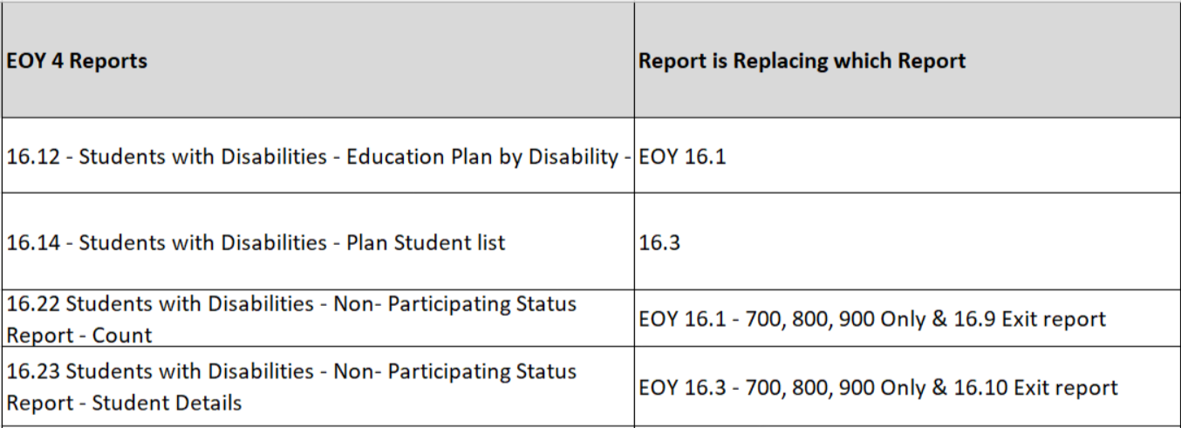
2023-24 – EOY Reports Changes
Functionality | Change
Reports - EOY - 4 | EOY Report Changes (SN, SELPA, C/A)
Notes:
Here we will discuss the reports changes for this year and their impact.

Slide 58
Certification Process Reminder
EOY 1 and 2 has ONE level of approval
LEA Approval
EOY 3 and 4 have TWO levels of approval
LEA Approval
SELPA Approval
Notes:
Some reminders…

Slide 59
Common Problems
Discuss EOY Common Problems
Notes:
Let’s review some of the common problem.

Slide 60
EOY Common Problems
CERT067 - F
ELAS Student Not Reported - triggered for EOY-3
Solution
You must submit a SELA record for a student enrolled who has no SELA record.

Slide 61
EOY Common Problems
CERT127 - F
Missing Student Discipline Data for a student who was reported as absent due to either out-of-school suspension or in-school suspension
Solution
Students who are reported as having in-school or out-of-school suspensions in the absence summary file must have associated SINC data

Slide 62
EOY Common Problems
CERT097 – F
Missing Title I Targeted Assistance Program Records
Solution
Annual CARS update for Title 1 Schools (Targeted vs. Schoolwide) should be done early on
Notes:
Ensure your annual school designation in CARS is done early on to avoid CERT097 fatal certification error.

Slide 63
EOY Common Problems
CERT131 - F
Triggers when Student Enrollment Record in current active AY is not exited prior to EOY-3 certification.
Solution
All active academic year enrollments must be exited to clear this fatal error and to be able to certify EOY-3

Slide 64
Wrap Up
Key Points, Resources and Support

Slide 65
Suggested Milestones
Now – 6/28
Complete Data Population in local SIS
Now – 6/28
Submit and post files. Review Validation errors and reconcile as needed
7/1 – 7/12
Resolve Certification and Data Discrepancy errors. Review snapshot reports and update records as needed
EOY
2023-2024
7/15– 7/19
Send reports to local data stewards, site leaders and administrators for approval
7/22 – 7/26
LEA Approve by Certification Deadline
(EOY 3 & 4 should be SELPA Approved if possible)
Amendment Deadline
(EOY 3 & 4 require SELPA Approval)
7/29 – 8/16

Slide 66
Strategies

Slide 67
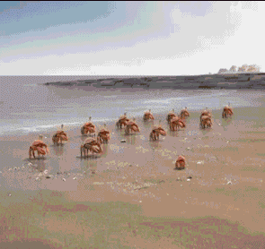
EOY Considerations
Things to consider prior to submitting and certifying EOY:
Personal considerations
Ease of submission, workload, summer break/vacation
Local factors
Availability of school site staff and district personnel, internal deadlines
Priority of data submitted
Perkins funding data, Public data statistics, Cohort results
Potential reporting milestones
Last day of new enrollments, When are final grades available, last day of school
CALPADS deadlines
Benefits and consequences of meeting the initial EOY deadline and amendment window deadline
Notes:
As part of improving your project management skills, here are some things to consider prior to submitting and certifying EOY…

Slide 68
EOY Planning
Identify Stakeholders, contributors, subject matter experts
Brainstorm, list and the owners of EOY data and the stewards
Define stakeholder responsibilities and participation
Use RACI, Roles are responsibility charts to outline submission and certification duties for EOY stakeholders, site leaders
Clearly define your role
Set expectations for submission and reporting
Make a training calendar
Create timeline for local milestones, use submission checklist
Create an understanding what success is
Find a consensus on a reasonable certification date
Explain the consequences of failing to review reports (dashboard, cohort)

Slide 69
Strategize
Submit data and certify individually depending on priority
Which data collection is most important?
EOY 4 (SWDS, PLAN, MEET, PSTS)
EOY 3 Absence Summary/ Cumulative Enrollment/ Discipline (4yr cohort, suspension rate, chronic absenteeism, ESSA, UMIRS, IDEA, homeless).
EOY 1 Course Completion/ CTE (CTEIG Perkins data, College Career Indicators);
EOY 2 Program Participation (Title 1)
Submit data and certify concurrently
When is the soonest data can be submitted based on availability? Is the data ready? Who needs to review the reports? Can the data be processed according to business rules and CALPADS input validations?
Complete enrollment updates (SENR, SINF, SPRG and SELA records as part of ongoing maintenance will allow your to certify EOY 2)
Submit course and staff data early in the submission window (SDEM & CRSC files can be submitted based on master schedules). Finish submission when final grades are released (Final grades may be available prior to last day of school).
Submit and certify student discipline and absence summary after the last day of school (STAS and SDIS may have unexpected changes up until the last day of school)
Have Sped person submit (SWDS, PLAN, MEET and PSTS) and certify

Slide 70
Strategize
Submit data and certify by ease or proficiency
Which data collection are you most familiar with?
Who is available to review the reports?
How much time is required to complete the submission?
What is included in the submission?
EOY 2 has the least amount of changes and records may have already been submitted if ongoing maintenance is up to date, students participating at anytime during the year submitted
EOY 3 may be most important and time consuming. SELPAs need to review discipline reports, all primary and short term enrolled student attendance reported and all enrolled students with disciplinary incident.
EOY 1 is directly related to Perkins funding, data affects the CA school dashboard CCI, only data for 7-12 grades submitted
EOY 4 reports on students with disabilities during the entire school year
Notes:
The strategy you implement should be made between now and the start of the official submission widow. Consult with the subject area experts, site staff and district admin to determine how best to complete the EOY submission.

Slide 71
Cohort Readiness & Considerations
Will you be the person handling the cohort processing? If yes:
Have you attended cohort training or are you planning?
Are you familiar with the new changes this year?
Have you downloaded the Cohort Checklist (in User Manual)?
Do you have a plan to work on Cohort parallel to EOY?
Do you need input/assistance from other staff from your LEA?
If so, are you aware of their summer schedule?
Are you aware that the cohort and EOY deadlines are the same?
Notes:
Change Cohort Process and reconcile earlier by end of July and work on remaining few at the end because Cohort ends one day prior to the deadline day. Check updated Checklist for information and tips.

Slide 72
Impact of not certifying
Annual Submission | State or Federal | State/Federal Data Usage | LEA Impact if Not Certified
EOY-1: Course completion Career Technical Education (CTE) participants and completers | State | DataQuest (Course Completion & CTE) | 0 counts
 |  | CTE Incentive Grant | 0 counts & grant eligibility
 |  | California School Dashboard (College/Career Indicator) | Potential Orange Indicator
 | Federal | Carl Perkins Program (CTE Participants and Completers) | 0 counts & grant eligibility
EOY-2: Program participation Homeless & TK enrolled counts | State | DataQuest (Programs such as Homeless and TK) | 0 counts
 | Federal | Elementary and Secondary Education Act (ESEA) Title 1, Part A Neglected | 0 counts & grant eligibility
 |  | EDEN (Education Data Exchange Network) Reporting | 0 counts
 |  | Consolidated State Performance Report (CSPR) | 0 counts
EOY-3: Absence Summary/Cumulative Enrollment/Behavioral Incident | State | DataQuest (Discipline, Chronic Absenteeism, Cumulative Enrollment) | 0 counts
 |  | California School Dashboard (Suspension & Chronic Absenteeism indicators) | Potential Red Indicator
 | Federal | NCLB Consolidated State Performance Report (CSPR) | 0 counts
 |  | NCLB Title IX - At Risk/Persistently Dangerous Schools | 0 counts
 |  | ESEA Title IV, Part A, Subpart 3, Section 4141 (e) - Firearm Offenses | 0 counts
 |  | Individuals with Disabilities Education Act (IDEA) | 0 counts
 |  | Gun Free Schools Act Annual Survey | 0 counts
Notes:
This slide shows what data is submitted for EOY and what it is used for both at the state and federal levels. It also shows what impact it will have if your LEA does not certify EOY.
Reminder – Please note that your EOY 1 and 3 data submission is the data source for some of the indicators of the Ca. School Dashboard. Therefore, it is becoming even more critical to complete and certify the EOY submissions on time.

Slide 73
Summary
The data in EOY is reflective of entire academic year.
Review EOY changes internally with other staff as needed.
It will greatly benefit you to clear all Certification and CDDs by middle of July to ensure reports are checked for accuracy before they are approved.
Use the EOY Checklist to plan for and meet the submission milestones and deadline.
LEAs should plan certify all EOY submissions by the submission window deadline.
Amendment window should only be used for minor updates and corrections to data.
There will be no deadline extension!
Attend the CALPADS Q&A when feasible
Communicate, Collaborate and Coordinate!!
Some key points to remember

Slide 74
Resources
Here are some important resources related to EOY reporting.
https://learn.fcmat.org/
https://www.youtube.com/c/CSISCALPADSTrainingChannel
https://documentation.calpads.org/Support/References
https://www.cde.ca.gov/ds/sp/cl/systemdocs.asp
https://csis.fcmat.org/resources

Slide 75
Support
http://www2.cde.ca.gov/calpadshelp/default.aspx
Web
calpads-support@cde.ca.gov
Email
916-325-9210
Phone
https://csis.fcmat.org/ListServ
https://www.cde.ca.gov/ds/sp/cl/listservs.asp
You can get help through these channels.
Listserv

Slide 76
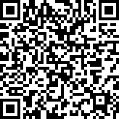
Feedback
Please complete survey…
https://bit.ly/2MXsECg
“
”
Notes:
Please take the time to complete our training survey. Your responses assist in improving our trainings.
We review these surveys on a regular basis—in fact due to LEAs’ suggestions we have changed our survey, have included more visual aids, and demonstrations in our trainings.
If you experience any technical difficulty with accessing the survey, please try the alternative long URL:
Long URL: https://forms.office.com/Pages/ResponsePage.aspx?id=k1b3XxqV6E2E3dWxsESwNX2FYi3dRZNNt8LpvkF_wmhUNVRLOVBDVkoySE01UTJSRk42VTlaUUFIQi4u
Short URL: https://bit.ly/2MXsECg
Thank you for providing us the opportunity to evaluate our trainings.

Slide 77
Thank You
CSIS Training
+1 916 325 9210
csistraining@fcmat.org
https://csis.fcmat.org/

