Slide 1
CALPADS EOY 1 Reporting & Certification
Overview
Data Requirements
Certification Errors
Reports Review

Slide 2
CALPADS Training Sequence
Orientation
Data Coordinator Orientation
Basics
Fall-1 Data Population (Student Profile)
Fall-2 Data Population
EOY 1-4 Data Population*
*Self-paced video
Data Collections
Fall 1
Reporting and Certification
Advanced
Fall 2
Reporting and Certification
Advanced
EOY
EOY 1, 2*, 3, 4 Reporting and Certification
EOY Advanced
Skill Building
Guide to CALPADS Documentation
Guide to Troubleshooting CALPADS Errors
LEA Admin Data Privacy
SELPA Data Privacy
Data Population
User Management
File Submission
Extracts
Reports
Certifications
Anomalies Management
Features & Navigation
*Self-paced video

Slide 3
Target Audience
Data Coordinator
Administrators

Slide 4
Objective
Identify
Perform
Resolve
Analyze
key data and stakeholders in preparation of the the EOY 1 submission
the EOY 1 submission process based on an internal schedule considering staff availability and competing priorities
certification errors using analytical mindfulness and review reports for completeness and reasonability
Critical Thinking
certification reports to assess the flow of data across the ecosystem and evaluate how well data is leverage in informed decision making
Data Leadership & Coalition Building
Project Management
Coalition Building &
Critical Thinking

Slide 5
Agenda
Overview
Data Collected
Certification Errors
Reports Review
Wrap-Up

Slide 6
Overview
Discuss the big picture of EOY 1 submission

Slide 7
Remaining Timeline for 2022-23
Initial ELPAC Testing Window opens
July 1, 2023
ODS 22-23 Cohort Pull
Census Day
Initial Deadline
Final Deadline
Cohort Processing
Oct 5, 2022
Dec 16, 2022
Jan 20, 2023
continuous
August 25, 2023
July 1, 2020
Amendment
Fall 1 Submission
Cohort Processing
Nov
Dec
Jan
Feb
Mar
Apr
May
Jun
Jul
Aug
Sep
Oct
2022
2023
Fall 2 Submission
EOY Submission
Submit Fall 2 Data
Snapshot Available
ONE Deadline
Start of Submission
Certification Deadline
Final Deadline
Jan 3, 2023
March 10, 2023
May 8, 2023
August 25, 2023
July 28, 2023
https://www.cde.ca.gov/ds/sp/cl/rptcalendar.asp
Notes:
The End of Year (EOY) 1 – Course Completion / Career Technical Education Data Submission has these important functions:
Provide LEA course section completer counts by State Course Code for courses completed at any time during the current academic year
Provide counts of CTE participants, and completers for Perkins reporting
Provide counts of student completion of specific work-based learning programs
https://www.cde.ca.gov/ds/sp/cl/rptcalendar.asp
Modeling the 23-24 Academic calendar based on 22-24

Slide 8
End of Year 1
Course Completion
Career Technical Education
Work-Based Learning
Provide LEA course section completer counts by State Course Code for courses completed at any time during the current academic year
Provide counts of CTE participants, and completers for Perkins reporting
Provide counts of student completion of specific work-based learning programs
Provides class size counts for DataQuest

Slide 9
The Big Picture
Federal System
EDFacts file submissions and the Consolidated State Performance Report (CSPR)
Migrant Student Information Exchange (MSIX) - Course Completion, Carnegie Unit
Titles VI & IX reports for the Civil Rights Act of 1964
Carl Perkins V Reporting
(CTE Participants and Completers)
Section 1418 of the Individuals with Disabilities Education Act (IDEA) 2004 of the federal statutes (Title 20 USC Chapter 33), Individual with Disabilities Education Act (IDEA)
ESSA sections 1112, 2103,4203
WIOA sections 148,159418,422
State System
CALPADS
CDSS
TOMS
DataQuest
California Dashboard
Ed-Data
Local Systems
Enrollment
Student demographics
Student programs (homeless, migrant ed, FRPM eligible, pregnant and parenting, etc)
Career Technical Education (CTE)
Students with Disabilities (SWD)
Credentialed Staff Demographics
Course Section attributes
Student Course enrollments
Notes:
Under Perkins V, all LEAs providing CTE programs are required to report CTE data regardless of whether they are receiving federal Perkins funding. Perkins V requirements are aligned with reporting under the federal Every Student Succeeds Act (ESSA). In addition to federal Perkins funding, California provides funds to support CTE education through the Career Technical Education Incentive Grant (CTEIG) and Strong Workforce Program (SWP) programs. CTE and Course completion data is used for the Cohort graduation rate and on the California School Dashboard.
WORK-BASED LEARNING IN FEDERAL LEGISLATION
Federal legislation references work-based learning (WBL) in the Strengthening Career and Technical Education for the 21st Century Act (Perkins V), the Every Student Succeeds Act of 2015 (ESSA), and the Workforce Innovation and Opportunity Act of 2014 (WIOA).. Reference the https://cte.ed.gov/wbltoolkit/ for more information

Slide 10
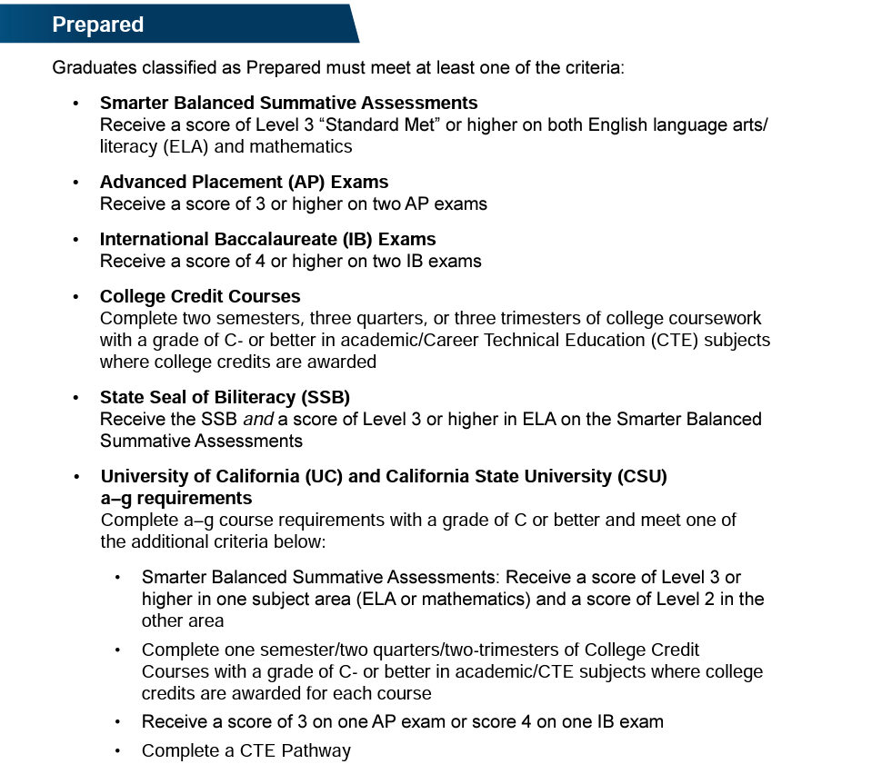
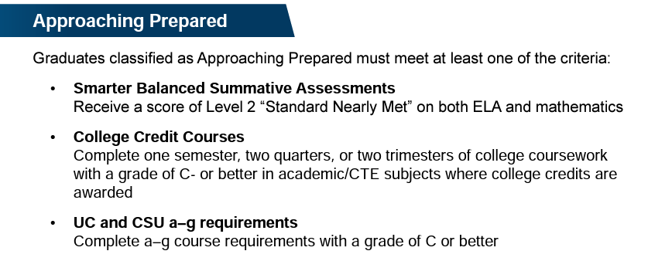
CCI Measures of College Readiness*
*Based on 2021 CCI Metric Guidelines
Notes:
Discuss:
Different datapoints coming from CALPADS EOY 1 Data.
Criteria Key difference between Assessment and Coursework
The College/Career Indicator
https://www.cde.ca.gov/ta/ac/cm/dashboardccr.asp
https://www.cde.ca.gov/ta/ac/cm/documents/ccicollege.pdf

Slide 11
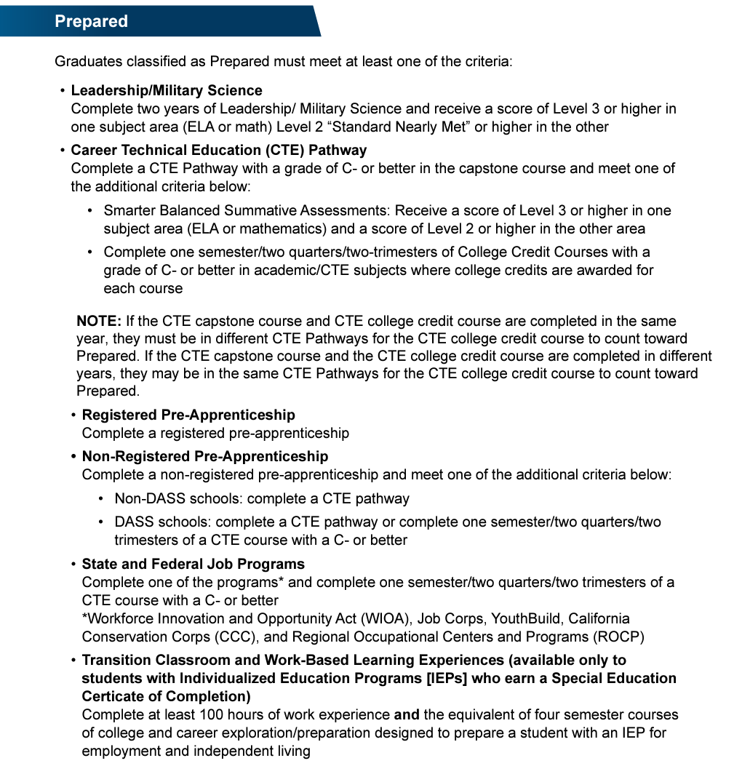
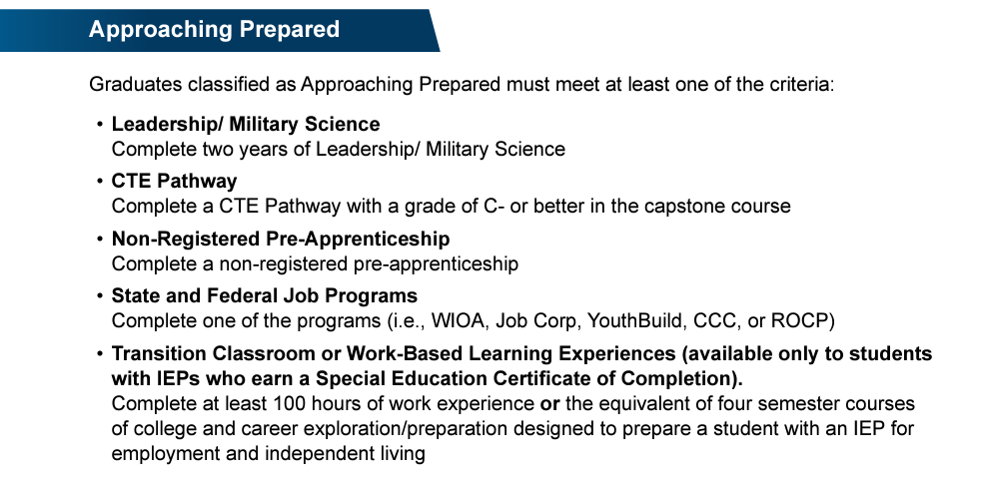
CCI Measures of Career Readiness*
*Based on 2021 CCI Metric Guidelines
Notes:
Discuss:
Different datapoints coming from CALPADS EOY 1 Data.
Criteria Key difference between Assessment and Coursework
The College/Career Indicator
https://www.cde.ca.gov/ta/ac/cm/documents/ccicareer.pdf
Leadership and Military Science includes State Course Codes 9373 (Leadership/Military science) and 9374 (Junior Reserve Officers Training Corps (JROTC))

Slide 12
EOY 1 Reporting Survival Kit
User Roles Needed
CALPADS Documentation
Data Population
Student Search
SENR (Edit and View)
SCTE (Edit and View)
CRSC (Edit and View)
SCSC (Edit and View)
SDEM (Edit and View)
WBLR (Edit and View)
WBLR Extract
Viewing Reports
EOY 1 Reports
User Manual
CALPADS Code Sets
File Specifications Form
Error List
Data Guide
Valid Code Combinations
Retired Code Mapping Guide

Slide 13
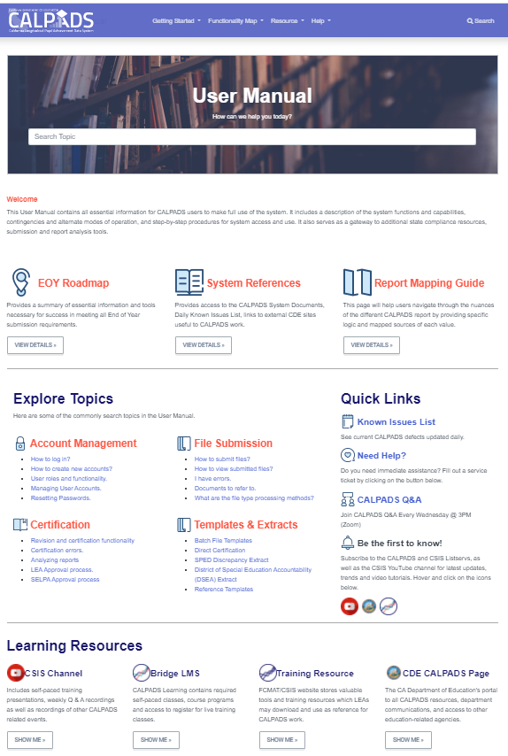
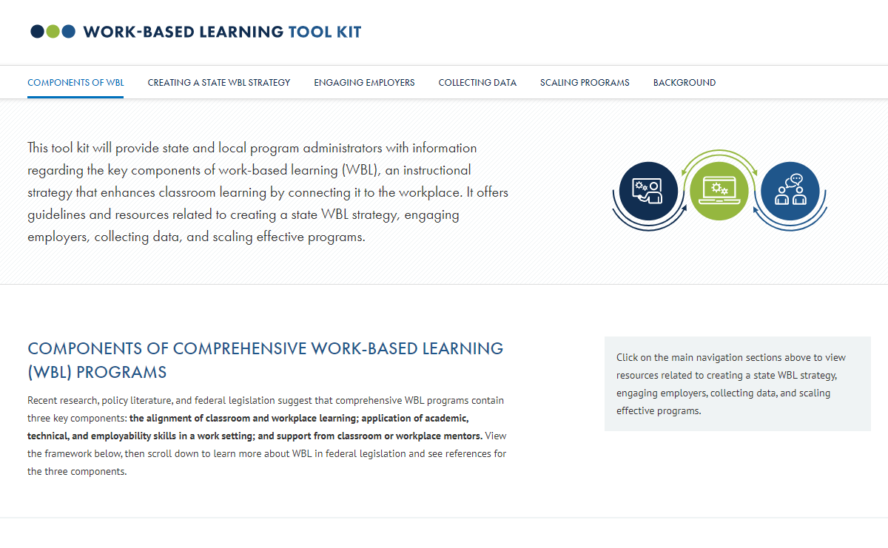
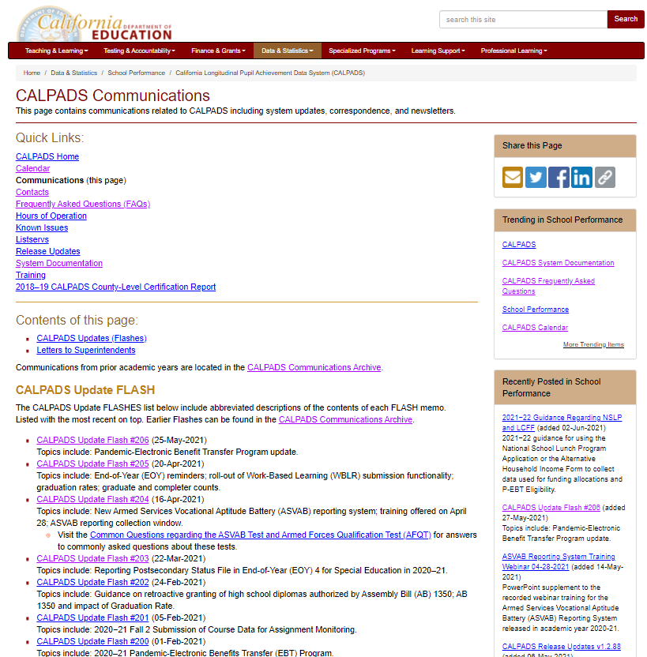
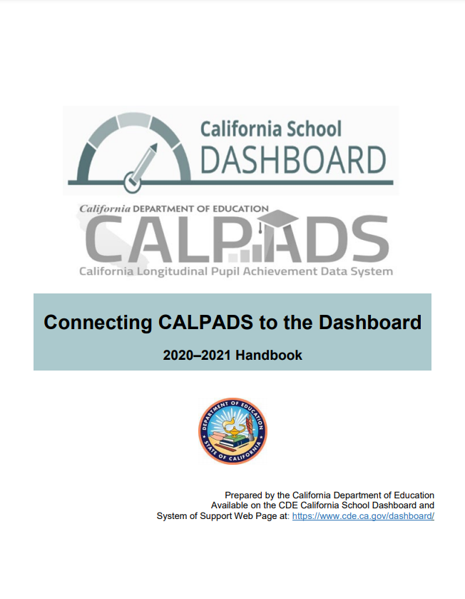
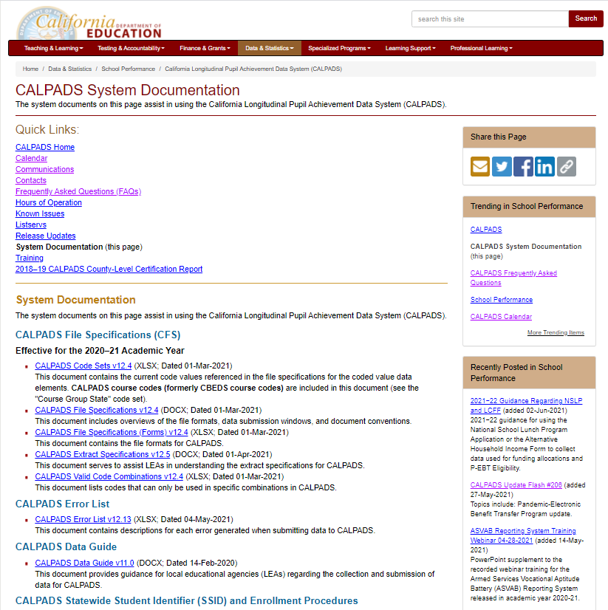
Resources
Notes:
Developing referential knowledge of each document will increase your capacity as a data coordinator allowing you to resolve problems and answer questions independent of support. So, lets look at the EOY 1 resources.
CALPADS User Manual: https://documentation.calpads.org/
CALPADS System Documentation Page: https://www.cde.ca.gov/ds/sp/cl/systemdocs.asp
CALPADS Communications: https://www.cde.ca.gov/ds/sp/cl/communications.asp
https://www.cde.ca.gov/ds/sp/cl/calpadsupdflash184.asp
CA School Dashboard Handbook (https://www.cde.ca.gov/ta/ac/cm/documents/caldashhandbook21.pdf): https://www.cde.ca.gov/ta/ac/cm/
US Dept of ED. Work–based learning tool kit: https://cte.ed.gov/wbltoolkit/collecting.html.

Slide 14
Data Collected
Discuss data requirements

Slide 15
Data Collected
a-g Requirements
Credits
Grades
CTE (SCTE)
Pathways
Student Enrollment (SENR)
Completers
State Course codes
Student Course Completion (SCSC)
Postsecondary Articulated Course Indicator
Course Completion (CRSC)
Course Attributes (AP/IB, College Credit Course, Met UC/CSU Req, HQ CTE)
Work-based Learning
Carnegie Units
(SEIDs)
Work-Based Learning Types
Internship Attributes
Hours
Teachers Demographics (SDEM)
Seal of Biliteracy, Golden State Seal, A–G Completion
CTE Participants
Student Enrollment (SENR)
Files Submitted
Course Completion (CRSC)
Student Crs. Completion (SCSC)
Student CTE (SCTE)
Work-based Learning (WBLR)
Staff Demographics (SDEM)
Site Staff
Staff Involved with Submission
Program staff
CTE
Site Administrators
Student System Support Staff
🖌 NOTE: Courses completed are not compared to course enrollment reported during Fall 2

Slide 16
Record Relationships
1
Staff Demographics
1
Student Enrollment
SEID
2
SSID
Course Section
Completion
SSID
2
Work-Based Learning
Course Section ID
Course Pathway Code
3
4
Student Course Section Completion
Student Career Technical Education
Order of submission

Slide 17
File Reporting Matrix
Details School types and grade levels expected to report specific files related to EOY 1
School Type | CRSC/ SCSC | SDEM | CTE/ WBLR
Traditional (non-educational options schools) | Y | Y | Y
District Level Programs (Independent Study and Home Hospital Programs) | P | P | P
County Community | P | P | Y
District Community Day | P | P | Y
Youth Authority Schools (currently called Division of Juvenile Justice) | P | P | Y
Juvenile Court Schools | P | P | Y
Continuation High Schools | P | P | Y
Opportunity | P | P | Y
Alternative Schools of Choice | Y | Y | Y
State Special Schools | Y | Y | Y
Home and Hospital Schools(5) | P | P | Y
Department of Development Services | N | N | N
Department of State Hospitals | N | N | N
Special Education Consortium | P | P | Y(1)
Special Education | P | P | Y(1)
Non-Public School Group (0000001) (2) | N | N | N
Private School Group (0000002) (2) | N | N | N
ROP/ROC(4) | N | N | N
Grade Levels | CRSC/ SCSC | SDEM | CTE/WBLR
Infants - IN | N | N | N
Toddlers - TD | N | N | N
Prekindergarten - PS | N | N | N
Kindergarten - KN | N | N | N
First Grade - 01 | N | N | N
Second Grade – 02 | N | N | N
Third Grade – 03 | N | N | N
Fourth Grade – 04 | N | N | N
Fifth Grade – 05 | N | N | N
Sixth Grade – 06 | N | N | N
Seventh Grade – 07 | P | P | P
Eighth Grade – 08 | P | P | P
Ninth Grade – 09 | Y | Y | Y
Tenth Grade – 10 | Y | Y | Y
Eleventh Grade – 11 | Y | Y | Y
Twelfth Grade – 12 | Y | Y | Y
Adult – AD | N | N | N
Legend:
Y = Required: Schools are expected to submit data and will receive validation errors if data are not submitted. N = No: Schools should NOT submit data.
P = Permitted: Schools are permitted, but not expected to submit data
Notes:
These tables identify which schools and grade levels will be expected or required to report which EOY 1 files.
Table Value Legend:
Y = Required: Schools are expected to submit data and will receive validation errors if data are not submitted. N = No: Schools should NOT submit data.
P = Permitted: Schools are permitted, but not expected to submit data, but if SSIDs are obtained for students enrolled within those schools, then the data required to maintain those SSIDs must be submitted and will receive validation errors if data are not submitted. Additionally, for “P” schools, certification validations will only be processed if data is submitted.

Slide 18
Reporting Reminder
Do Not Report:
EOY 1 data for Grades KN – 8 in Self Contained Classes
Grades 7 – 8 in Departmentalized Courses Optional to report.
Ignore CERT099 Warnings if you opt not to submit data
Report:
Grades 9 - 12 in Departmentalized Courses
SDEM
CRSC
SCSC (Only for students who completed a course)
WBLR
SCTE (Only for CTE Pathway Completers)

Slide 19
Course Completion
LEAs must submit information on courses that students have completed during the year.
Course completion data is required for students in departmentalized classroom settings in grades 9–12 attending traditional schools.
Grades, credits attempted, and credits earned
Submit data for all departmentalized courses completed including special education courses, independent study courses, home hospital courses.
EOY1 is optional for Grades 7-8 in departmentalized courses.
Report grades only.
Submit student course completion data from all official grading periods for the school year
By submitting course completion data for students in departmentalized courses in grades 7 – 12, LEAs identify CTE participants.
Course and Student Course completion data.

Slide 20
CRSC Attributes
Course Content
The State course code describes the course content and identifies:
CTE Courses
College courses
Leadership/Military Science courses
High Quality CTE Courses
Courses that have been developed with the CTE Pathway Standards (even standalone courses)
Are taught by a CTE-credentialed teacher
Example: CTE-IG funded
The following are the important CRSC fields relevant to EOY 1 aggregates.
College Courses
A subset of courses that are identified either through
Specific state course codes designate college courses
Non-Standard Instructional Level code used to identify college CTE courses
23 – College Credit only
24 – Dual Enrollment
CTE Attributes
Data submitted in the CRSC and SCSC files as part of the EOY 1 submission are used to identify whether students in the 4-year Adjusted Cohort Graduate Rate (ACGR) are prepared for college/career as measured by the College/Career Indicator (CCI) on the California School Dashboard.
Notes:
For more CTE information visit:
https://www.cde.ca.gov/ci/ct/sf/ctemcstandards.asp
https://www.ctc.ca.gov/docs/default-source/leaflets/cl888.pdf?sfvrsn=88065bf8_18
https://www.ctc.ca.gov/credentials/req-teaching

Slide 21
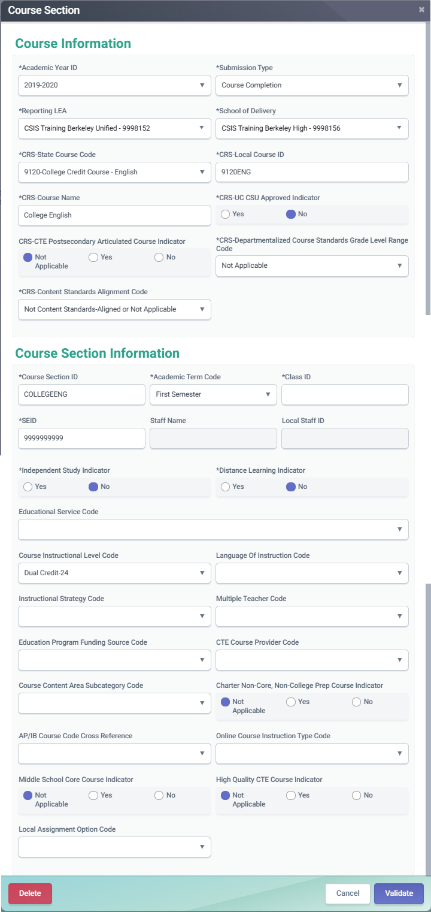
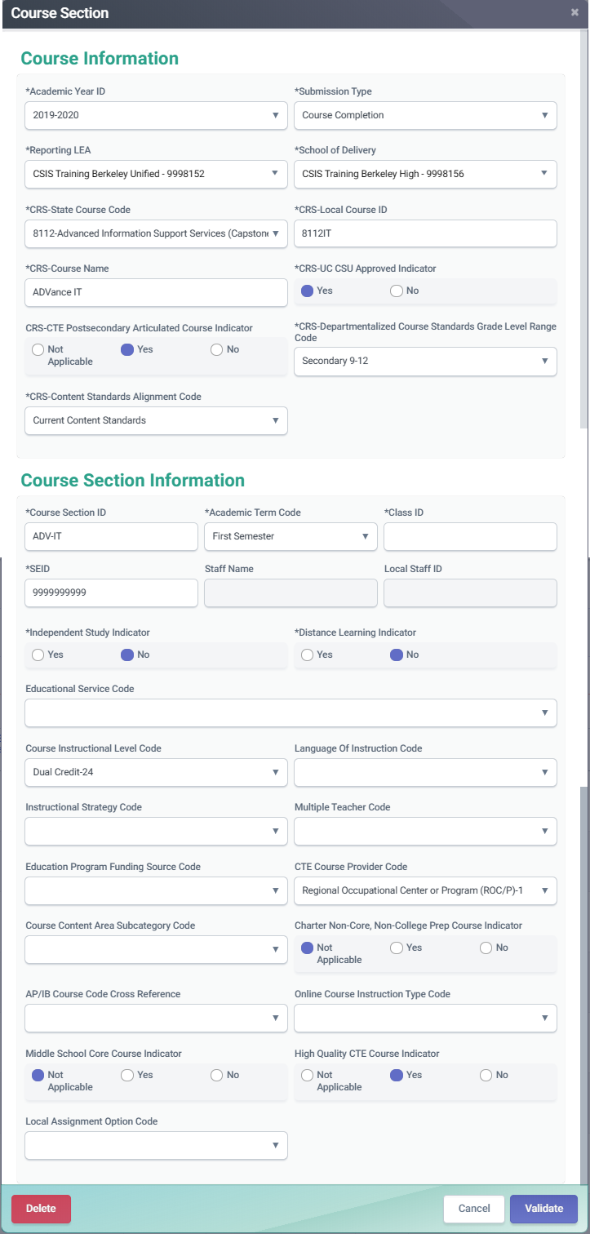
Course Completion (CRSC)
College courses should be reported using the designated state course codes. Those courses can be used as CCI indicators
OR
CTE courses for which a student earns college credit should have the Course Instructional Level code populated with 23 - College Credit or 24 - Dual credit

Slide 22
Dashboard CCI Courses
State Course Code | State Course Code Name
9020 | College Credit Course – Visual Arts
9082 | College Credit Course – Dance
9096 | College Credit Course – Theatre
9120 | College Credit Course – English Language Arts
9154 | College Credit Course – World Languages
9200 | College Credit Course – History/Social Science
9227 | College Credit Course – Other
9273 | College Credit Course – Mathematics
9303 | College Credit Course – Music
9358 | College Credit Course – Science
9373 | Leadership/Military Science
7000–8999 | Any CTE course code indicated in Nonstandard Instructional Level as College Credit Only (23) or Dual Credit (24)

Slide 23
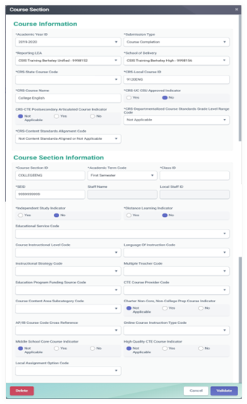
Course Completion (CRSC)
Advanced Placement (AP) courses should have the appropriate state course code to align with a specific content area
International Baccalaureate (IB) courses must be reported with the appropriate state course code, unless they are Middle school IB courses.
Use the course instructional level field to indicate IB courses to Middle school as well as to the appropriate CTE course.

Slide 24
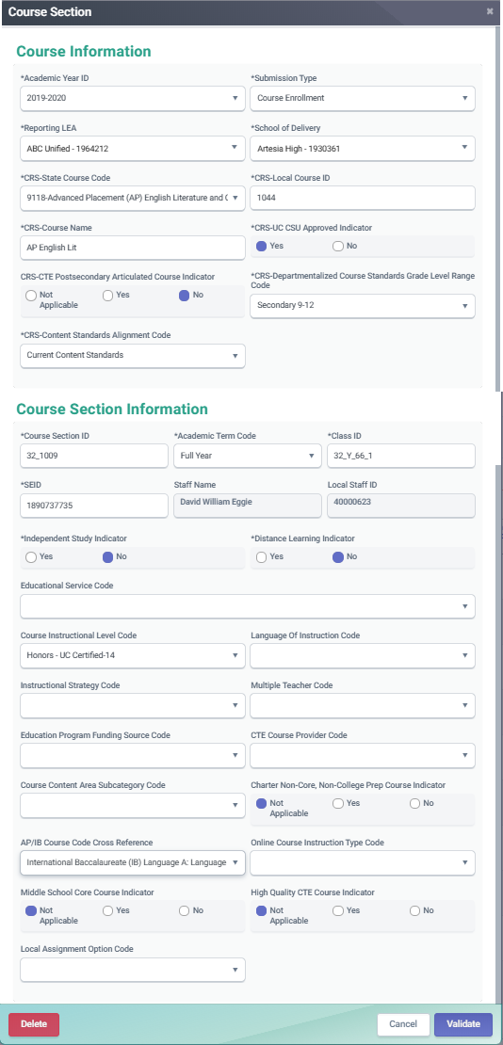
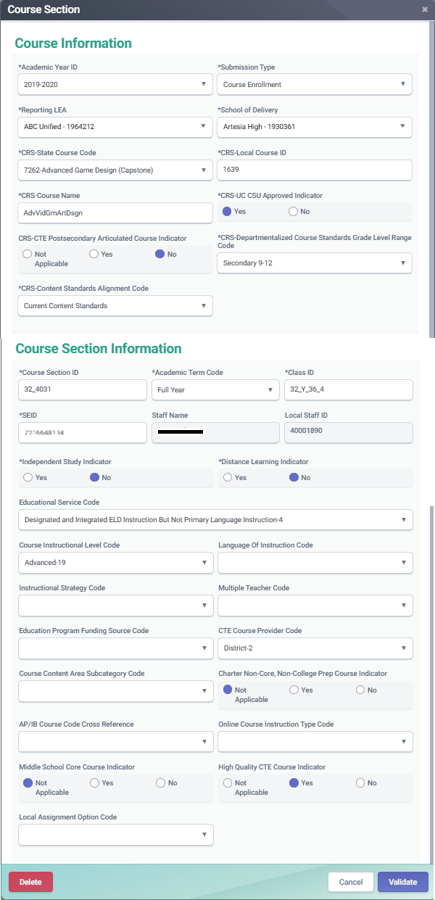
Course Completion (CRSC)
CTE completers and non-completers must have SCSC records that correspond to the appropriate CTE course
CTE courses that are also AP or IB courses can have the AP/IB code cross reference populated so that the course maps to both content areas

Slide 25
SCSC Attributes
Grades
Standard and nonstandard grades accepted
The final grade a student received after completing a specific Course Section
LEAs should not submit “progress report” grades, but only grades earned when credits are awarded.
Can be Alpha numeric or special character
Limited to three characters
UC/CSU Admission Requirement Code
Not a required field, but should be populated for courses students take that have been approved by UC/CSU institutions.
Course determination is made by the UC/CSU systems
Describes the requirement that a high school course has been determined to meet.
Applicable in departmentalized courses in grade 7-12
Credits
Student Credits Attempted and Student Credits Earned help LEAs view courses transferring students have completed in other LEAs.
Used to determine total credit requirements are met for graduation.
Carnegie Units
Granted to a student completing approximately 120 hours of class in one subject over the course of one year
SIS vendors will calculate the value
Required for the federal Migrant Student Information Exchange (MSIX)

Slide 26
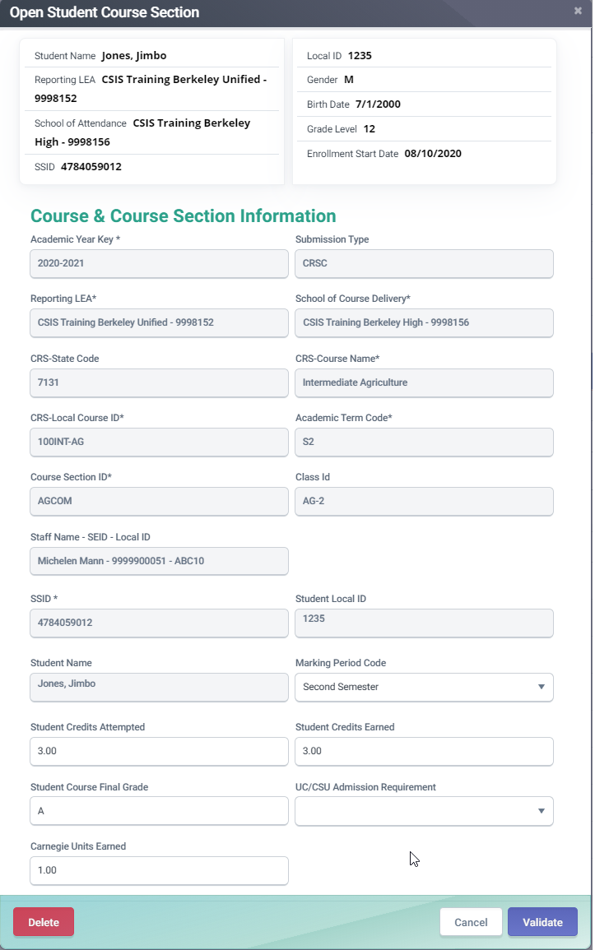
Course Completion (SCSC)
The UC/CSU Admission Requirement Code represents the category of University of California or California State University College Admission Course requirement that a high school course has been determined to meet.
A Carnegie Unit represents a student completing approximately 120 hours of class in one subject over the course of one year. Typically, 10 high school credits equal 1 Carnegie Unit, 5 high school credits are normally equal to 0.5 Carnegie units.

Slide 27
Student Career Technical Education
LEAs must submit information on CTE Pathways that students have completed during the year.
Students who have completed a CTE Pathway during the Reporting Year, are included in the Student Career Technical Education (SCTE) file.
If a student has completed more than one Pathway during the Reporting Year, a record is reported for each completed Pathway.
CTE participants who are non-completers MUST NOT be included in the SCTE file, as the data collected for course sections and student course sections includes the information needed to identify them.
Course and Student Course completion data.

Slide 28
SCTE Data Collected
Along with key data from the CRSC and SCSC, the following data are collected
CTE Completer Info
CTE Pathway Code
CTE Completion Year
Identifies student who has completed a minimum of 300 hours in a state-approved CTE pathway.
Indicates the specific career pathway the student participated in and completed.
Indicates the academic year the student completed the capstone course for the pathway being reported

Slide 29
CTE Student Groups
CTE Participant:
The CDE counts as a participant, any student who has completed a CTE course (includes CTE Non-completers and Completers).
Non-Completer Participant: Is a student who:
has completed a CTE course who may or may not be participating in a pathway but does not meet the definition of a CTE completer below
Reported and determined through the CRSC and SCSC records
CTE Completer: A CTE completer is identified locally and is a student who has:
completed a minimum of 300 hours in a state-approved CTE pathway and has successfully passed the capstone course in that sequence with a grade of C minus or better.
Reported through submission of the CRSC, SCSC and SCTE records

Slide 30
Mapping CTE information
Below is a summary of how different CTE student groups are reported in CALPADS.
CTE Participants
Non-completers
CRSC
Report CTE course
State course 7000-8999
SCSC
Submit SCSC associated to the CTE course
SCTE
Do not submit SCTE
CRSC
Report Capstone course appropriate to CTE Pathway
SCSC
Submit SCSC associated to the CTE course
SCTE
Submit SCTE
State course 7000-8999
CTE Pathway Completion Academic Year ID must be populated
CTE Pathway Completion Academic Year ID must be current year.
Report CTE Pathway Code
CTE Pathway Completers

Slide 31
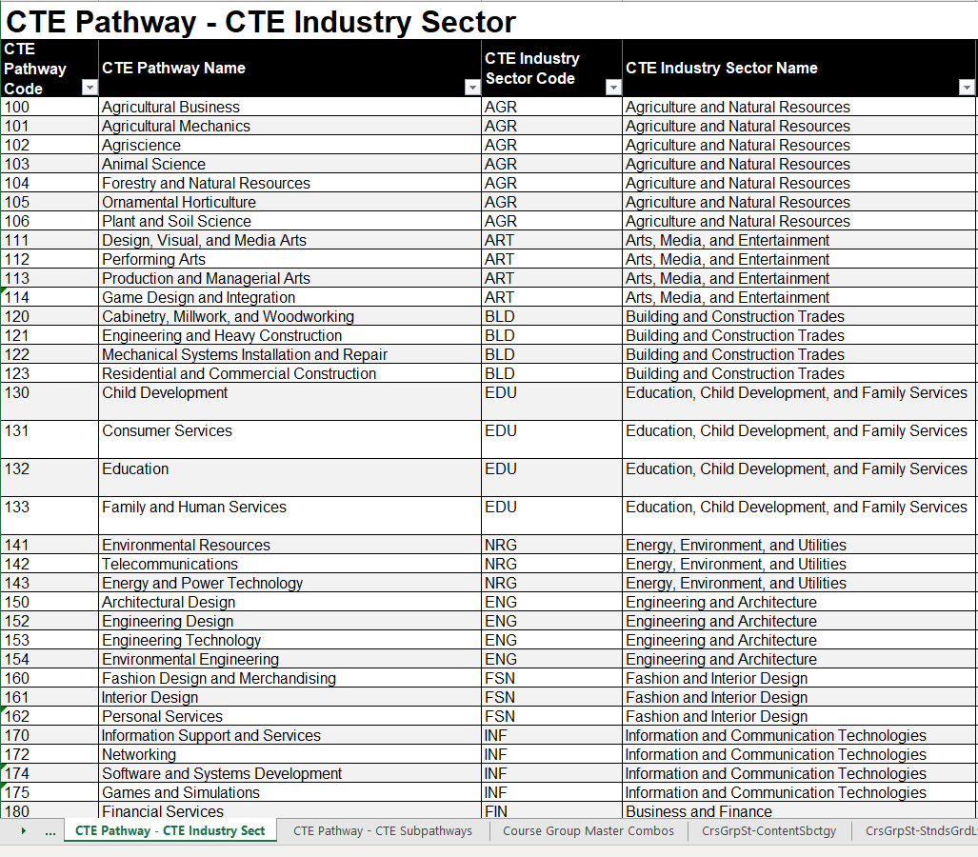
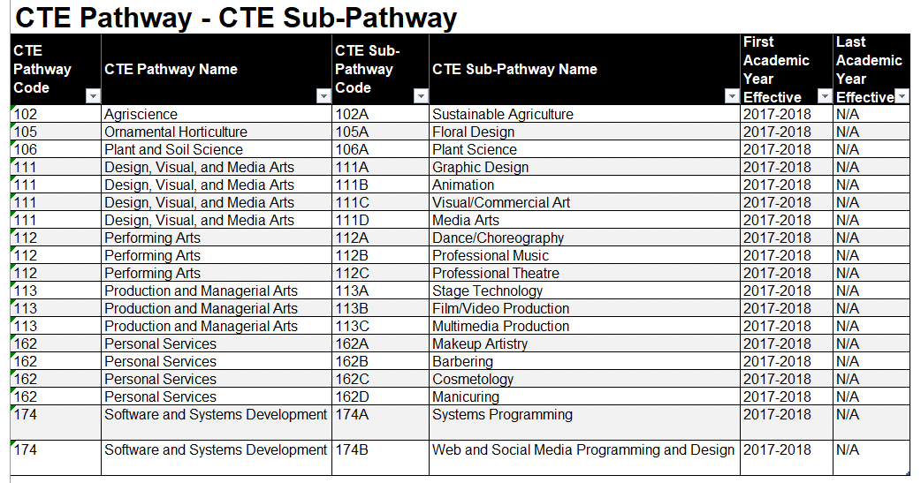
Valid Code Combo CTE Resources

Slide 32
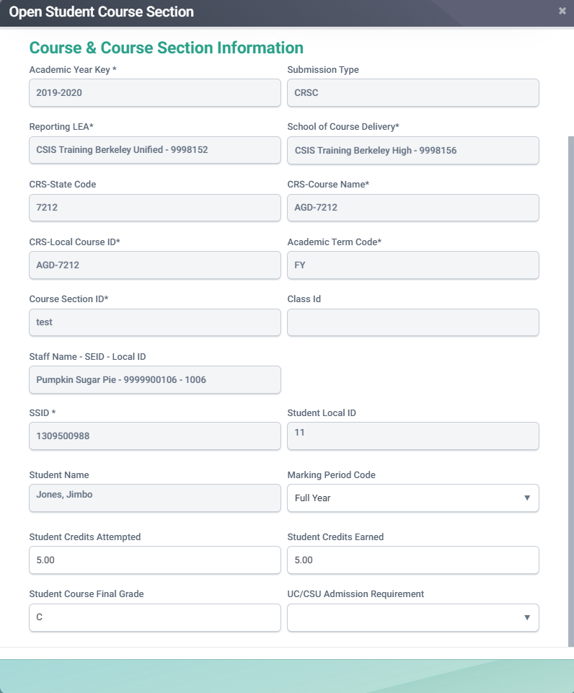
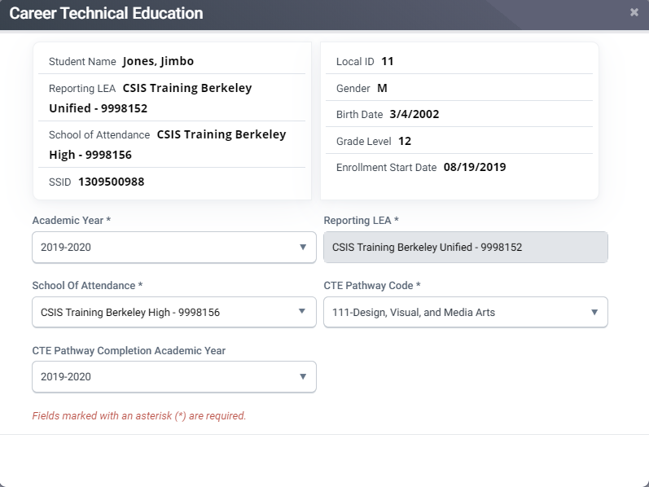
Reporting a CTE Completer
Below are the elements that comprise the CTE Completer data of a student.
Must have a SCSC record associated to a CTE Capstone course.
A SCTE record must be submitted reflecting the CTE pathway code.
Completion Academic Year must be 2022-2023.

Slide 33
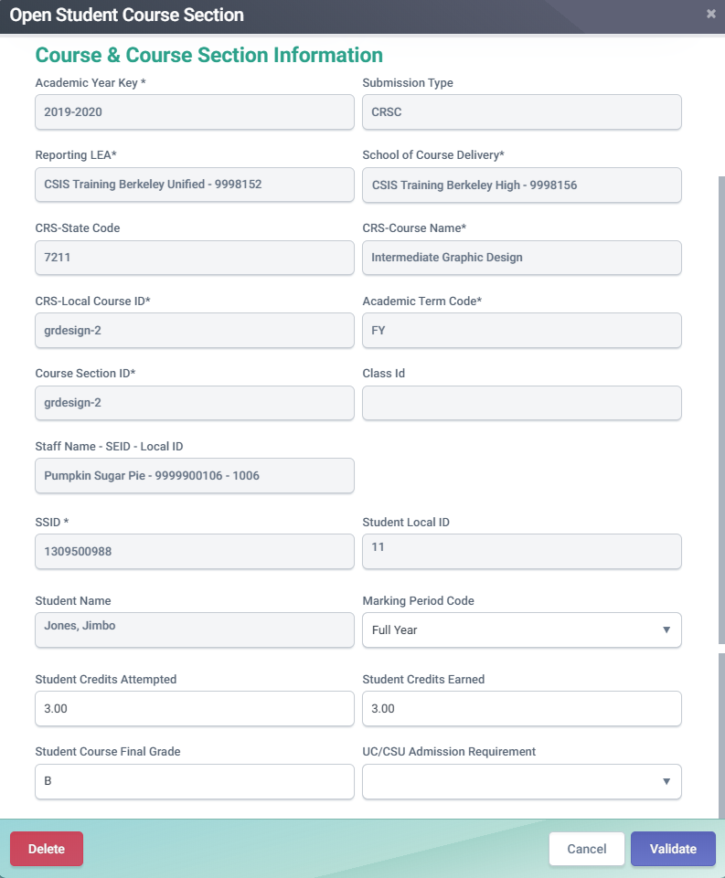
How CTE Non-Completers are determined
Below are the elements that CALPADS will use to determine a student as a CTE Non-Completer participant.
SCSC Record
For CTE Pathway Participants: Must have a SCSC record associated to a CTE course that is identified as Intro or Concentrator course
For Non-CTE Pathway Participants: Must have a SCSC record associated to any CTE course.

Slide 34
Work-Based Learning
LEAs must submit work-based learning data that will provide additional opportunities for students (grades 9-12) to demonstrate their preparedness for college/career through the College/Career Indicator (CCI) on the California School Dashboard.
There are twelve work-based learning programs/activities that LEAs should track and report to CALPADS on the WBLR file.
The WBLR uses the Replacement processing method by Academic Year and School of Attendance and is used for batch processing.

Slide 35
WBLR Data Collected
LEAs are required to submit work-based learning completion information for:
All students that complete an internship
Include all Work-Based Learning completion for students enrolled at any time during the Reporting Year
Data will come from SIS but gathered by a team of CTE, SPED and CALPADS coordinators
LEA Admins will need to assign the WBLR Edit, View, and Extract roles to account and other user accounts. SELPAs will need to request the state to add the WBLR Extract role to their account.
Reference Available: CALPADS Flash 184 & 229 WBRL Data Population CALPADS User Manual
35
Notes:
References:
CALPADS Flash 184: https://www.cde.ca.gov/ds/sp/cl/calpadsupdflash184.asp
CALPADS Flash 229: https://www.cde.ca.gov/ds/sp/cl/calpadsupdflash229.asp
CSIS WBLR Data Population: https://www.youtube.com/playlist?list=PLsnFpLOXpp4KDvoW_Hg8BenKP53bv3MGl
CALPADS User Manual: https://documentation.calpads.org/OnlineMaintenance/StudentDataMaintenance/StudentDetailsWBLR/
Work-Based Learning Measures for the CCI:
https://www.cde.ca.gov/ta/ac/cm/workbasedcci.asp#newmeasures

Slide 36
Work-Based Learning Type Code
Code | Name | Previous
10 | Internship | New
15 | Student-led Enterprise | New
20 | Virtual/Simulated Work-Based Learning | New
25 | Registered Pre-Apprenticeship Program | SENR
30 | Non-registered Pre-Apprenticeship Program | SENR
35 | Job Corps | SENR
40 | Workforce Innovation and Opportunity Act (WIOA) | SENR
45 | YouthBuild | SENR
50 | California Conservation Corps | SENR
60 | Transition Work-Based Experience | SPED
65 | Transition Classroom-Based Work Exploration | SPED
The Work-Based Learning Type Code represents the work-based learning that the student completed during the academic year.
Students may have multiple work-based learning codes
Include summer work-based learning
Exclude summer internships that occur after the student has graduated
36

Slide 37
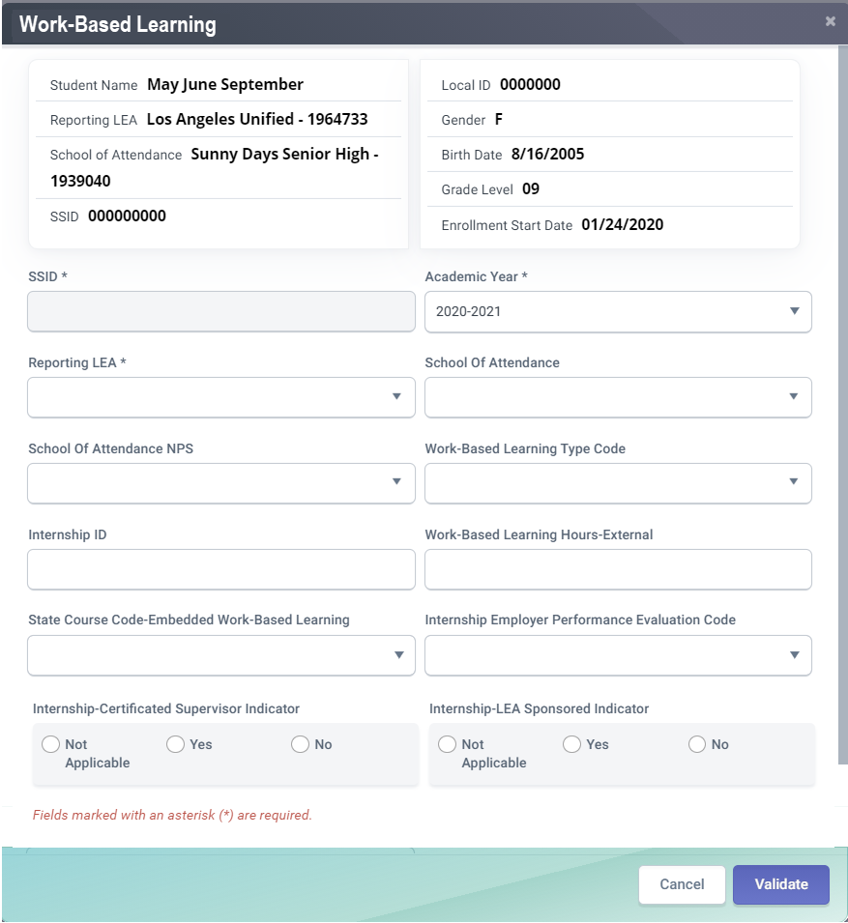
WBLR Data Fields
CFS# | Field Name
21.09 | Work-Based Learning Type Code
21.10 | Internship ID
21.11 | Work-based Learning Hours - External
21.12 | State Course Code -Embedded Work-based Learning
21.13 | Internship -Employer Performance Evaluation Code
21.14 | Internship -LEA Sponsored Indicator
21.15 | Internship –Certificated Supervisor Indicator
21.09
21.10
21.11
21.12
21.13
21.14
21.15
37
37

Slide 38
Checklist
All reportable courses are mapped to the State Course codes
All required fields for courses are populated and up to date, including:
Content Sub-Category
Standards Grade Range
Content Standards Alignment
Middle School Core (Yes/No)
AP/IB Course Code Cross Reference - if needed
SIS vendor has translated credits earned into Carnegie Units
The following have been identified and reported in the SIS:
CTE Completers
Students completing Leadership/Military Science courses
Students who have received Seal of Biliteracy and/or Golden State Seal
Students completing College Credit courses
Work-Based Learning (WBL) Types for all grade 9-12 students who participated entered in SIS
In addition to WBL Type, all WBL Internships (Type 10) also have the following populated:
Internship ID
Work based Learning Hours - External
Employer Performance Evaluation Codes
LEA Sponsored Indicator
Certificated Supervisor Indicator
In addition to WBL Type, all WBL Student-Led Enterprise (Type 15) and Virtual/Simulated Work-Based Learning (Type 20) also have the following populated:
Work-based Learning Hours - External
State Course Code - Embedded Work-based Learning

Slide 39
Certification
Process overview and error resolution

Slide 40
Certification Workflow
Error Correction
Resolve Cert and CDD errors before reviewing reports.
Refer to the downloadable CALPADS Error List on suggest resolutions
Review Reports
LEA Approval
LEA Submission Process
CERT Error Correction
Report Review
Generate reports and disseminate to appropriate staff responsible for the data.
Utilize report mapping guide to check for data inclusion and column count source
Submit files
Be aware of replacement type processing
Be aware of order of submission
You may now submit SDEM, CRSC files and available SCSC records
Approval
Generate reports and disseminate to appropriate staff responsible for the data.
Review all aggregate reports to activate checkbox
Check box to activate approval button

Slide 41
EOY 1 Certification Errors
Error # | Error Name | Severity
CERT004 | Ethnicity / Race Data Missing | Fatal
CERT054 | Staff Demographics Missing | Fatal
CERT055 | High school with No Enrollment in Career Technical Education | Warning
CERT081 | No Student Course Section Data for a Secondarily or Short Term Enrolled Student | Warning
CERT098 | Student Course Section for SSID Not Enrolled during Report Period | Fatal
CERT099 | No Student Course Section Data for a Primarily Enrolled Student | Warning
CERT100 | No Enrollment for Course Section (CRSC) | Warning
CERT102 | No CTE Completer Data | Warning
CERT123 | Missing or invalid SCSC record for CTE Completer | Fatal
CERT169 | No WBLR Data Submitted for a School | Warning

Slide 42
EOY 1 CDD Errors
Error # | Error Name | Severity
SCSC0128E1 | Invalid CRS-State Course Code Grade Level Combination | Warning
SCSE0139E1 | Missing Course Section Record | Fatal
SCSC0140E1 | Missing Student Credits Attempted | Fatal
SCSC0141E1 | Missing Student Credits Earned | Fatal
SCSC0512E1 | Missing Carnegie Units Earned | Fatal
CRSC0231E1 | Mismatch of Course (CRS) Attributes | Fatal
WBLR0576E1 | SPED record must exist for this Work-Based Learning Type | Fatal

Slide 43
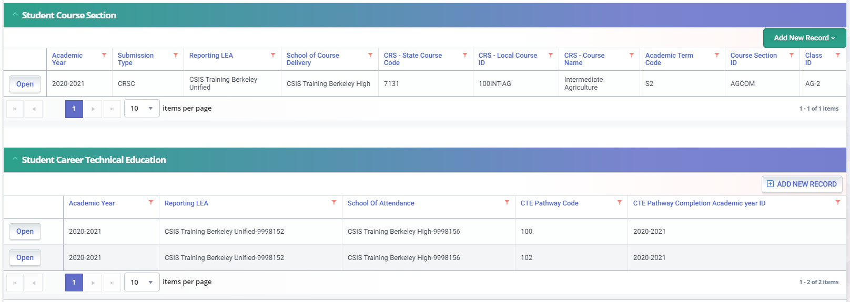
CERT123
Scenario 1
No SCSC record submitted to reflect a CTE Capstone Course code for indicated pathway.
SCSC file not uploaded
SCSC file uploaded but file rejected
Inadvertently posted a SCTE record.
Scenario 2
No SCSC record submitted to reflect a CTE Capstone Course code for indicated pathway.
SCSC file not uploaded
SCSC file uploaded but not posted
SCSC file posted but linked to a non-Capstone course.
Inadvertently posted a SCTE record

Slide 44
EOY 1 Reports
Review reports

Slide 45
EOY 1: Reports
Report 3.9
Report 3.10
Course Sections Completed – Count by Content Area for Departmentalized Courses
Course Sections Completed – Count and Details for Departmentalized Courses
Report 3.11
Course Sections Completed – Student List for Departmentalized Courses
Report 3.14
Report 3.15
Career Technical Education Noncompleter Participants – Count
Career Technical Education Noncompleter Participants– Student List
Report 3.16
Educational Options Course Completion – Student Count
Report 3.19
Report 3.20
Career Technical Education Completers – Count by Pathway
Career Technical Education Completers – Student List
Report 18.1
Report 18.2
Work-Based Learning -Count
Work-Based Learning – Student List

Slide 46
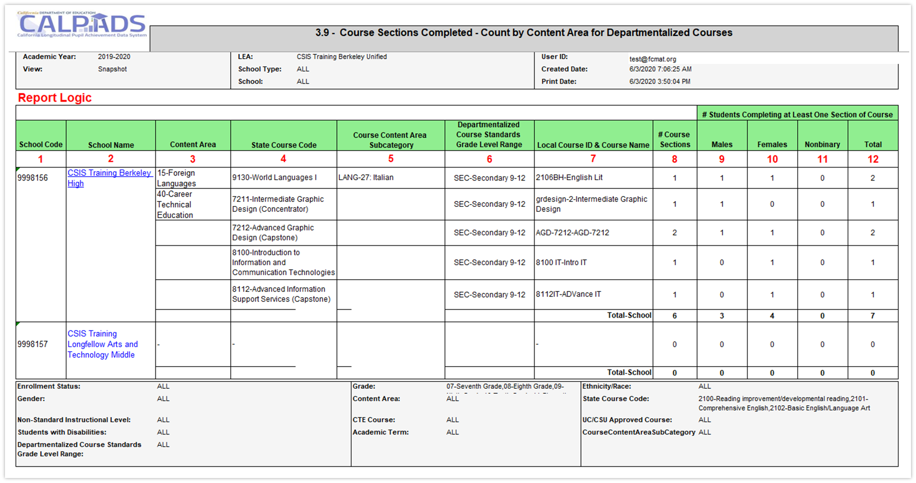
Report 3.9 Course Sections Completed
Count by Content Area for Departmentalized Courses

Slide 47
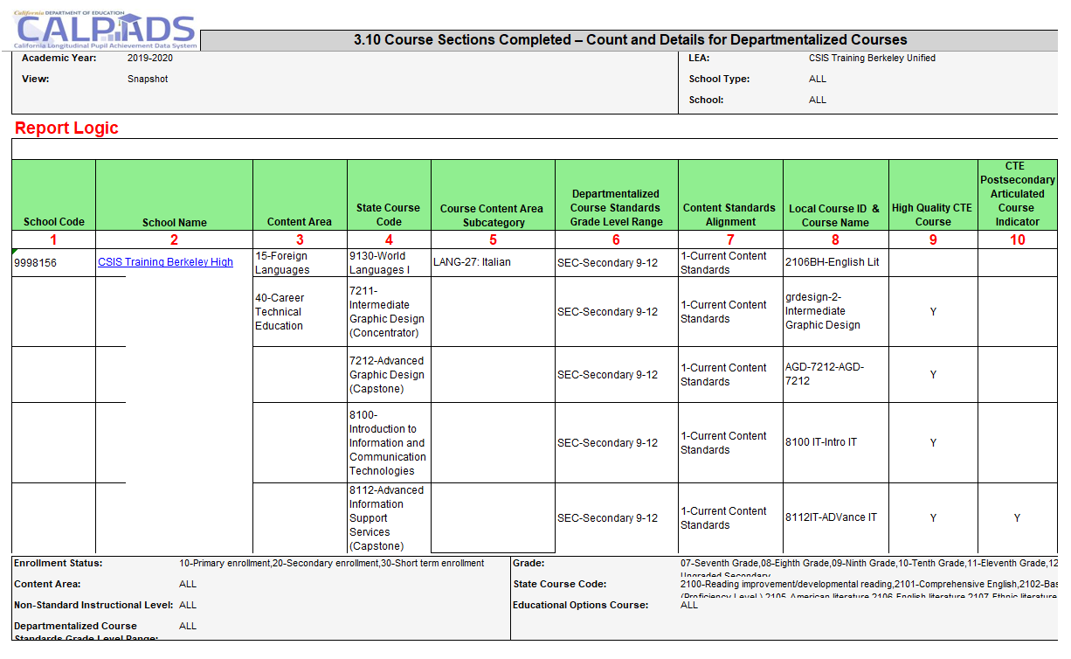
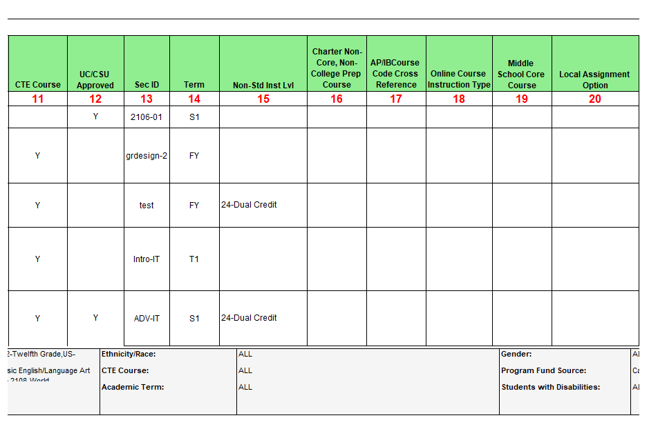
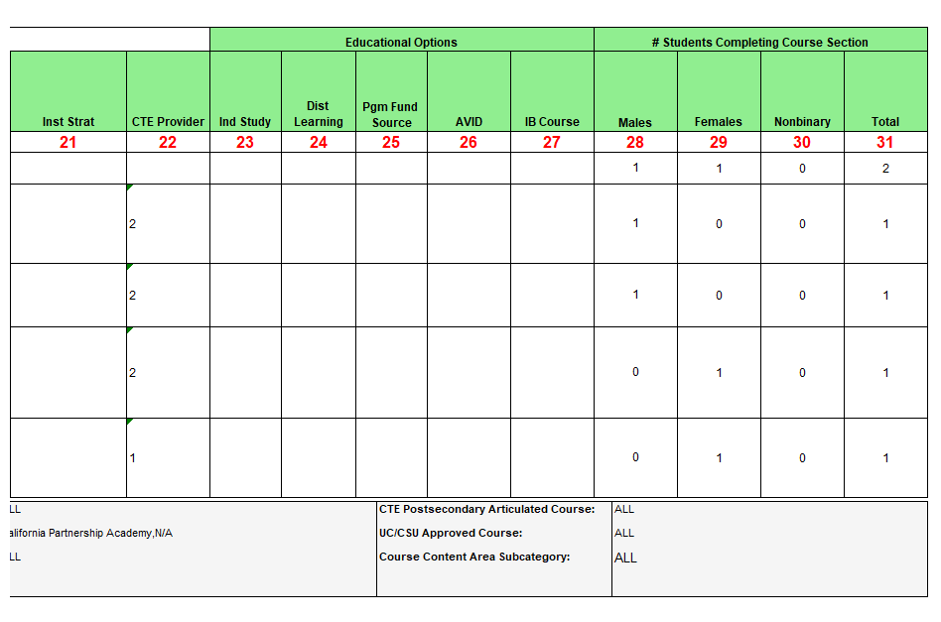
Report 3.10 Course Sections Completed
Count and Details for Departmentalized Courses

Slide 48
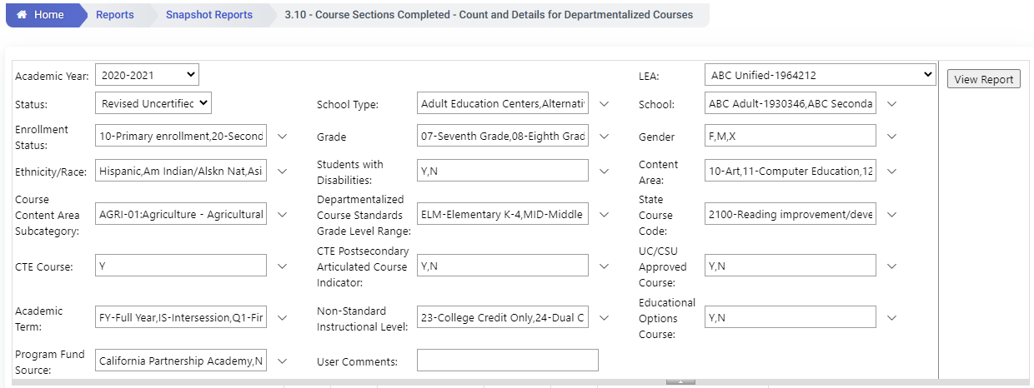
EOY 1 - Reviewing CTE Data
Review Report 3.10 - Course Sections Completed - Count and Details for Departmentalized Courses
The report should be requested twice with different filters.
To find college credit courses and Leadership/Military Science in the 9x series select the State Course codes of 9020, 9082, 9096, 9120, 9154, 9200, 9227, 9273, 9303, 9358, 9373
To find the CTE courses with the Non Standard Instructional codes of 23 and 24 select the CTE Course = Y and Non Standard Instructional Level to 23 and 24

Slide 49
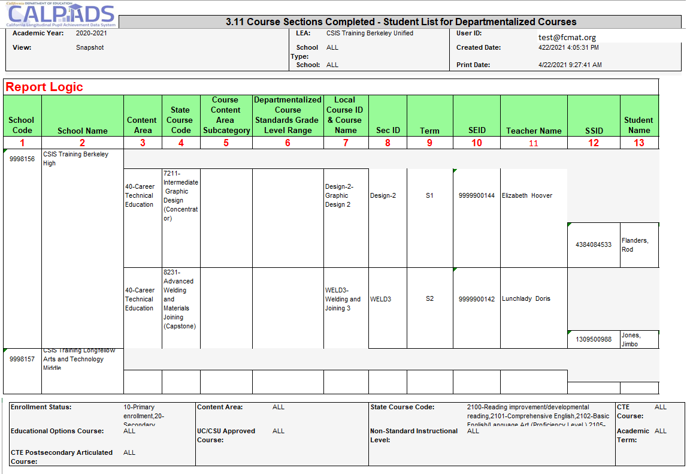
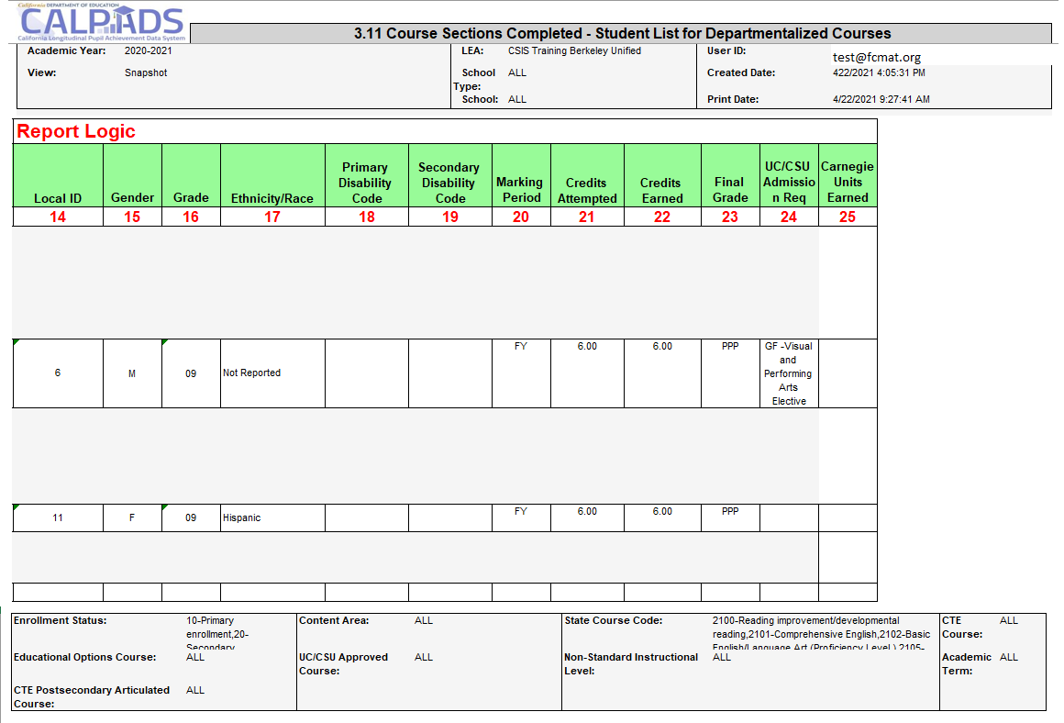
Report 3.11 Course Sections Completed
Student List for Departmentalized Courses

Slide 50
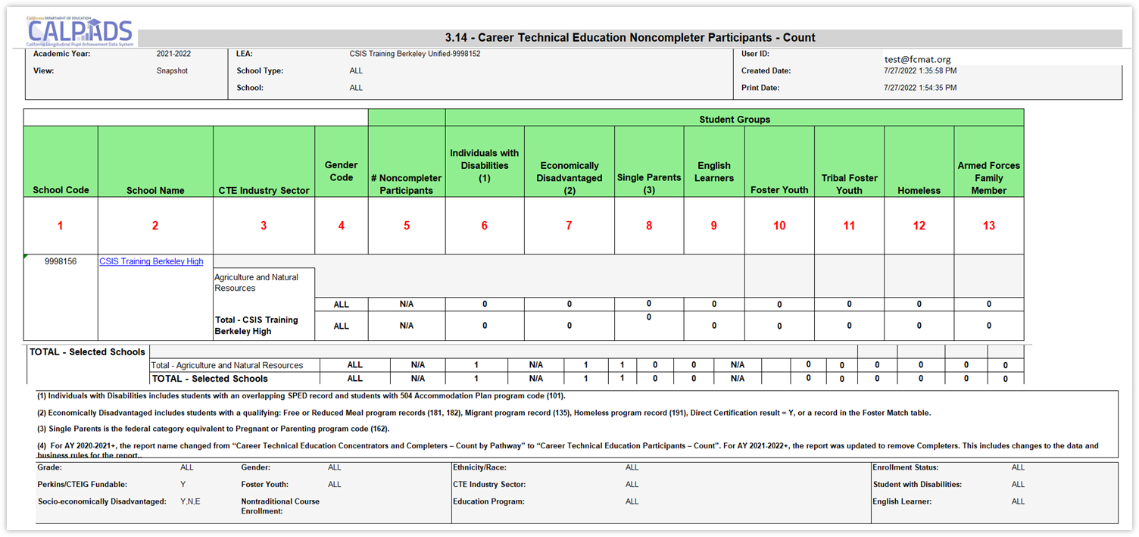
Report 3.14 CTE Noncompleter Participants – Count
Report defaults to counting Perkins/CTEIG fundable students in courses flagged with a High Quality CTE Course Indicator equal to Y. Switching the Perkins/CTEIG Fundable filter to ALL will include all other CTE courses not flagged.

Slide 51
EOY 1 - Reviewing CTE Data
Review Report 4.14 Career Technical Education Noncompleter Participants – Count
Filter on 12th graders to verify students who completed or were participants in 12th grade
Set Perkins/CTEIG Fundable to ALL to capture all students. Otherwise, it will default to courses only flagged a HQ CTE.
Filter for other specific sub-groups that comprise the core indicators (optional)

Slide 52
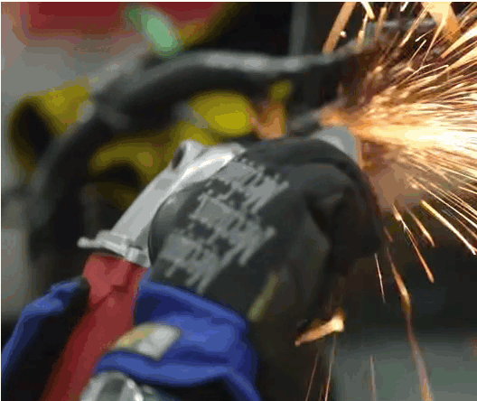
CTE Core Indicators
Individuals with Disabilities
Economically Disadvantaged: includes students with a qualifying: Free or Reduced Meal program record (181, 182), Migrant program record (135), Homeless program record (191), Direct Certification result = Y, or a record in the Foster Match table
Single Parents: is the federal category equivalent to Pregnant or Parenting program code (162)
Non-traditional Gender: gender less commonly associated with a field

Slide 53
Report 3.15 CTE Noncompleter Participants– Student List
Report defaults to counting Perkins/CTEIG fundable students in courses flagged with a High Quality CTE Course Indicator equal to Y. Switching the Perkins/CTEIG Fundable filter to ALL will include all other CTE courses not flagged.
Notes:
Report 3.15 lists Career Technical Education (CTE) Participants and the Pathway they are pursuing, as well as completers if applicable. Report 3.15 provides the core indicators mentioned on the previous slide for these students.

Slide 54
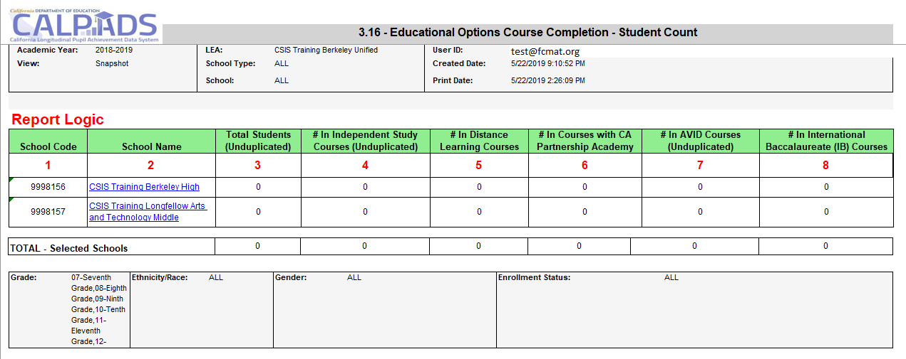
Report 3.16 – Educational Options Course Completion
Student Count
Notes:
Reports the number of students who have completed Educational Options courses during the Report Period.

Slide 55
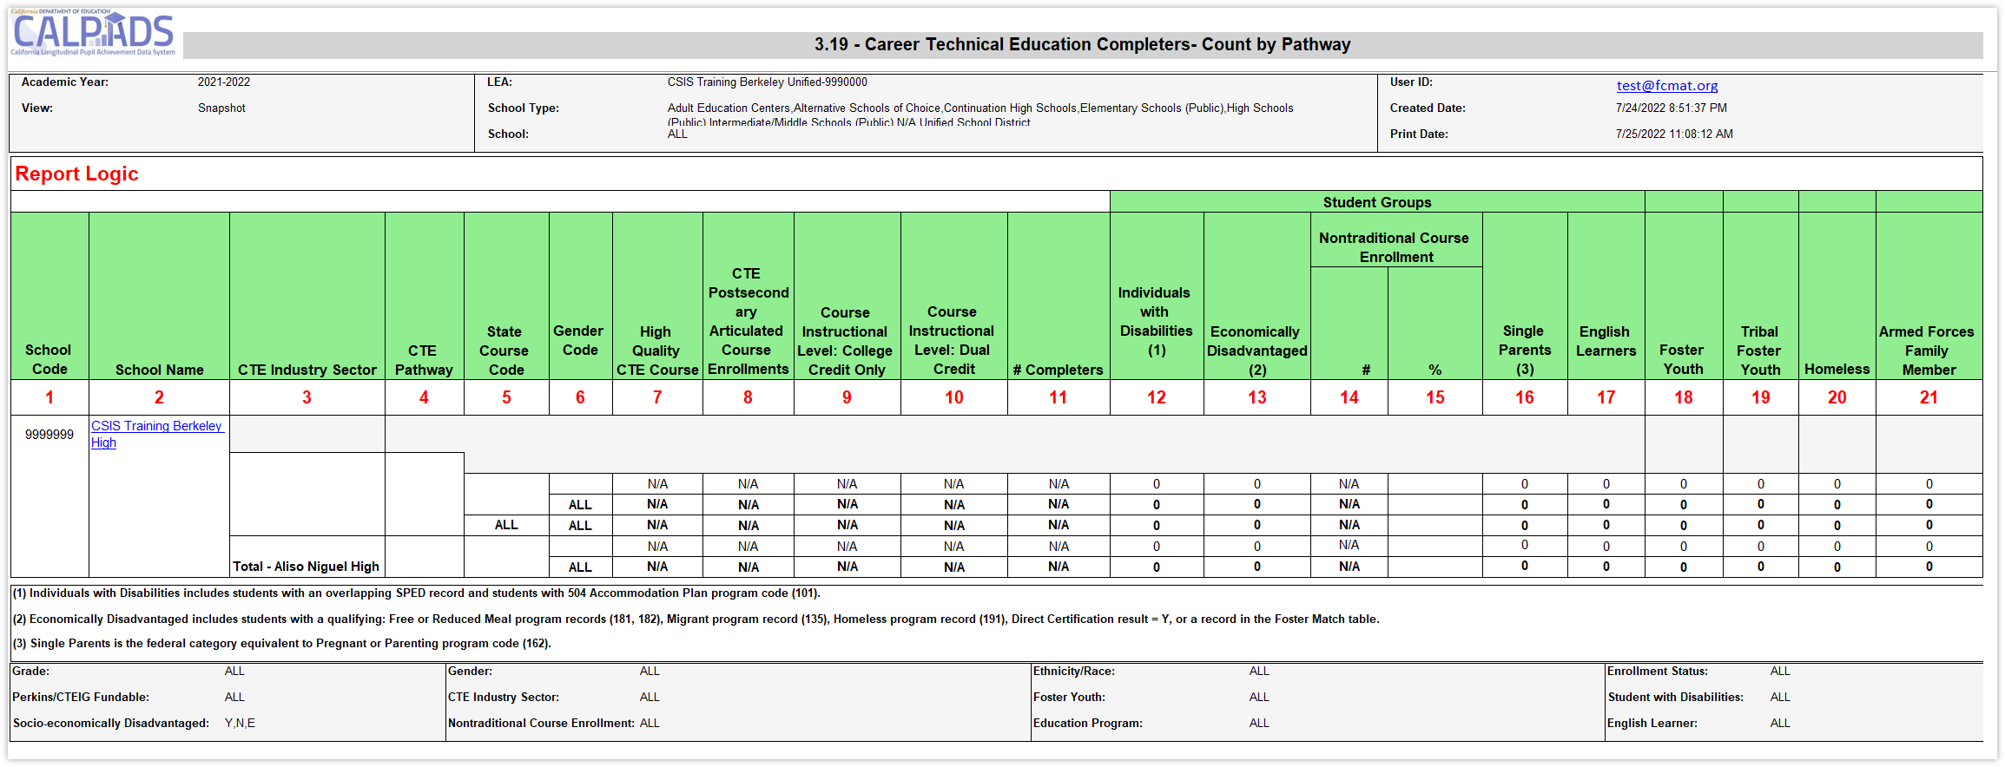
Report 3.19 CTE Completers – Count by Pathway
Notes:
Reports the total number of CTE Completers by Pathway at the school level, by gender. School level data is also aggregated at the LEA level. In addition, the number of Completers within each Core Indicator group are counted.
Students and Student Data to be Included:
Qualifying Enrollment:
Enrollment at a school any time during the Report Period
Enrollment Status Code = Primary (10), Secondary (20), or Short-Term (30)
Default Grade Level = 07-12 and US
Qualifying Data:
CTE Completer - See CALPADS Glossary: CTE Completer
CTE Course – See CALPADS Glossary: CTE Course
Use CTE Pathway Code and CTE Pathway Completion Academic Year ID from SCTE file. Use Valid Code Combos, Pathway-Ind Sector to select Industry Sector
Course completion record (CRSC) must map to a state course code within the pathway code reported from SCTE file in order for the student to be counted as a completer.
Student Data Rules, if applicable to report:
A student may have more than one CTE Pathway Code for the Reporting Year. All SCTEs are examined to determine the number of unique CTE Pathway Codes for each student. For each unique CTE Pathway Code value where the Enrollment Period overlaps the Reporting Year of the SCTE containing the CTE Pathway Code (Field 11.13) and the associated CTE Pathway Completion Academic Year ID (if exists), count the student in that Pathway. Specific/Exception rules:
A student who has different CTE Pathways (SCSC & SCTE) at the same school during the Reporting Period should be counted for each CTE Pathway.
A student who has the same CTE Pathway (SCSC & SCTE) at the same school during the Reporting Period should only be counted once for that CTE Pathway.
At the school level, a student who has the same or different CTE Pathways (both schools hold a SCSC & SCTE) for two different schools within the same LEA during the Reporting Period should be counted for each CTE Pathway (count in both schools).
At the school level, a student who has an SCSC at one school and SCTE at one school during the Reporting Period (within the same Reporting LEA and for the same SCTE Pathway), the student should only count once at the school where the student is primarily enrolled.
In the case where the student has two primary enrollments during the Reporting Period, and one school holds the SCSC and one school holds the SCTE, the school where the student took the Capstone course (SCSC/CRS) should receive the Completer count.
The total for selected schools (LEA level) should represent an unduplicated count of students across the LEA identified as CTE Completers.
Only students who have completed a CTE course and who have an associated SCTE record should be included in this report.
For counting within a Core Indicator, unduplicate at the State Course Code and School level.
For Nontraditional Course Enrollment only, count students where student gender = gender specified in CTE Non-Traditional Gender for State Group Course Code in each course for which a nontraditional gender has been established.

Slide 56
Report 3.20 - Career Technical Education Completers - Student List
Lists Career Technical Education (CTE) Completers and the Pathway they are pursuing. Also provides core indicators on these students.
Notes:
Reports the list of student Completers by Pathway at the school level, by gender. School level data is also aggregated at the LEA level. In addition, the number of Completers within each Core Indicator group are counted.
Students and Student Data to be Included:
Qualifying Enrollment:
Enrollment at a school any time during the Report Period
Enrollment Status Code = Primary (10), Secondary (20), or Short-Term (30)
Default Grade Level = 07-12 and US
Qualifying Data:
Completer - See CALPADS Glossary: CTE Completer
CTE Course – See CALPADS Glossary: CTE Course
Use CTE Pathway Code and CTE Pathway Completion Academic Year ID from SCTE file. Use Valid Code Combos, Pathway-Ind Sector to select Industry Sector
Course completion record (CRSC) must map to a state course code within the pathway code reported from SCTE file in order for the student to be counted as a completer.
Student Data Rules:
A student may have more than one CTE Pathway Code for the Reporting Year. All SCTEs are examined to determine the number of unique CTE Pathway Codes for each student. For each unique CTE Pathway Code value where the Enrollment Period overlaps the Reporting Year of the SCTE containing the CTE Pathway Code (Field 11.13) and the associated CTE Pathway Completion Academic Year ID (if exists), count the student in that Pathway. Specific/Exception rules:
A student who has different CTE Pathways (SCSC & SCTE) at the same school during the Reporting Period should be counted for each CTE Pathway.
A student who has the same CTE Pathway (SCSC & SCTE) at the same school during the Reporting Period should only be counted once for that CTE Pathway.
At the school level, a student who has the same or different CTE Pathways (both schools hold a SCSC & SCTE) for two different schools within the same LEA (no overlapping enrollment) during the Reporting Period should be counted for each CTE Pathway (count in both schools).
At the school level, a student who has an SCSC at one school and SCTE at one school during the Reporting Period (within the same Reporting LEA and for the same SCTE Pathway), the student should only count once at the school where the student is primarily enrolled.
In the case where the student has two primary enrollments during the Reporting Period, and one school holds the SCSC and one school holds the SCTE, the school where the student took the Capstone course (SCSC/CRS) should receive the Completer count.
Only one record per State Course Code per SSID should populate. If the student is counted in multiple pathways (in 3.19) as listed in the previous section, each of those records should show up on this report.
Only students who have completed a CTE course and who have an associated SCTE record should be included in this report.
For counting within a Core Indicator, unduplicate at the State Course Code and School level.
For Nontraditional Course Enrollment only, count students where student gender = gender specified in CTE Non-Traditional Gender for State Group Course Code in each course for which a nontraditional gender has been established.

Slide 57
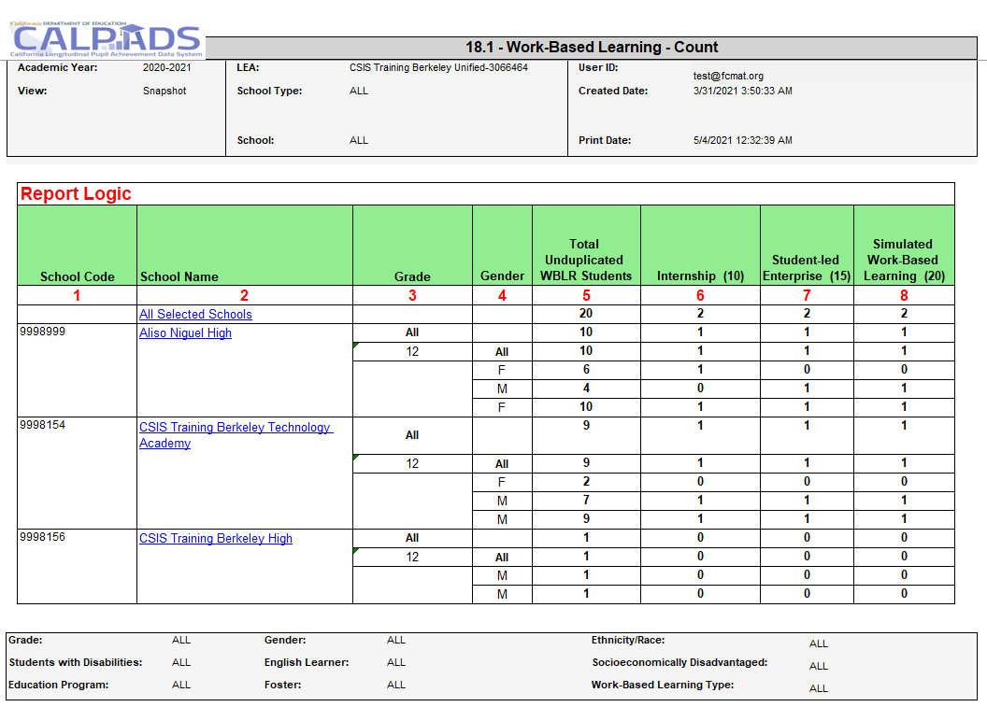
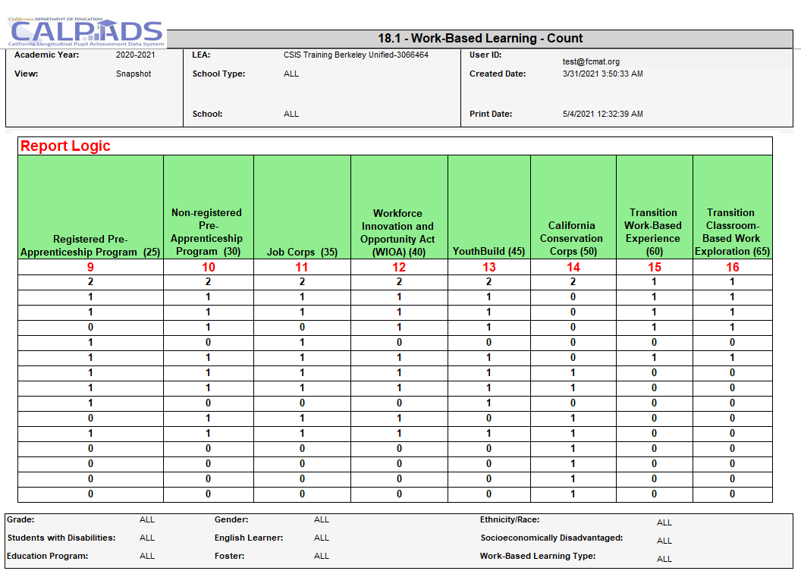
Report 18.1 Work-Based Learning - Count
Notes:
Reports the total number of students with a Work-Based Learning record and the count for each Work-Based Learning Type.
Students and Student Data to be Included: Students who have a qualifying enrollment and associated Work-Based Learning (WBLR) record:
Qualifying Enrollment:
Enrollment at the School of Attendance that overlaps the selected Academic Year
Enrollment Status Code = Primary Enrollment (10), Secondary Enrollment (20), Short-Term Enrollment (30)
Grade Level = 9, 10, 11, or 12
Qualifying Work-Based Learning:
Work-Based Learning records in the selected Academic Year at the School of Attendance from the Enrollment record
Rules specific to this report:
Student Information (SINF) data reported or used for selecting student subgroups (e.g. Race/ethnicity, Gender, etc.) are selected from the most recent SINF record that overlaps the qualifying enrollment.
Student Program (SPRG) data used for selecting student subgroups (e.g., Homeless, Migrant, etc.) are selected from the most recent SPRG record that overlaps the qualifying enrollment record.
Student English Language Acquisition Status (SELA) data reported or used for selecting student subgroups (e.g. English Learner) are selected from the most recent SELA record that overlaps with the qualifying enrollment.
Foster: see CALPADS Glossary for Foster Program Eligible for criteria.
Status options to be Included:
Certified – If the selected LEA has a certified snapshot, present this option of the certified revision in Status dropdown
Revised Uncertified– Present most recent revision that is not already Certified, In Review Uncertified, or Decertified
In Review Uncertified-The revision that is manually flagged by the LEA as currently under review for potential certification.
Decertified- If the selected LEA has any decertified revisions, and no certified revisions, this option will be available in the Status dropdown to render the report with the most recent decertified revision.

Slide 58
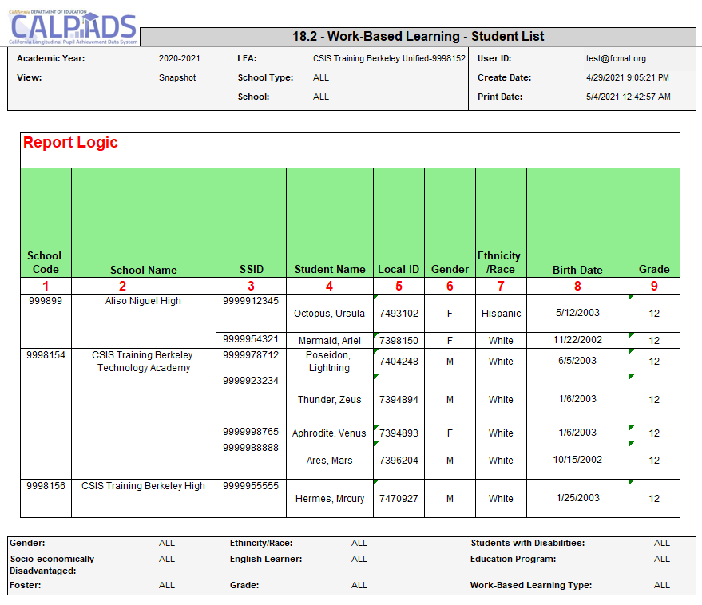
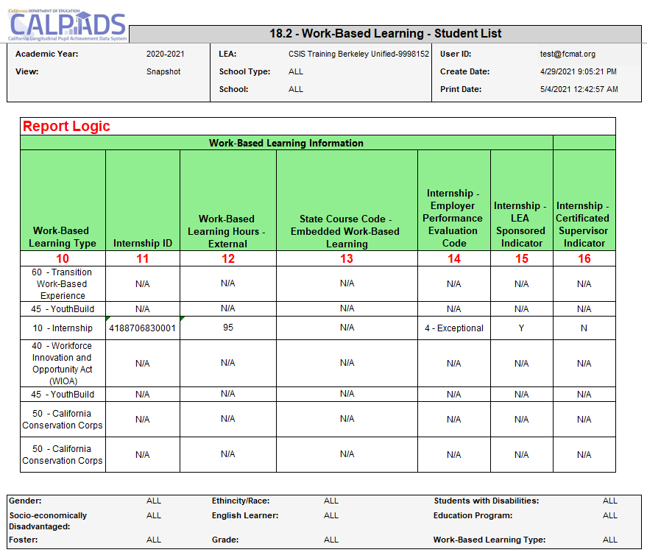
Report 18.2 Work-Based Learning – Student List
Notes:
Reports the details for students with a Work-Based Learning record.
Students and Student Data to be Included: Students who have a qualifying enrollment and associated Work-Based Learning (WBLR) record:
Qualifying Enrollment:
Enrollment at the School of Attendance that overlaps the selected Academic Year
Enrollment Status Code = Primary Enrollment (10), Secondary Enrollment (20), Short-Term Enrollment (30)
Grade Level = 9, 10, 11, or 12
Qualifying Work-Based Learning:
Work-Based Learning records in the selected Academic Year at the School of Attendance from the Enrollment record
Rules specific to this report:
Student Information (SINF) data reported or used for selecting student subgroups (e.g. Race/ethnicity, Gender, etc.) are selected from the most recent SINF record that overlaps the qualifying enrollment.
Student Program (SPRG) data used for selecting student subgroups (e.g., Homeless, Migrant, etc.) are selected from the most recent SPRG record that overlaps the qualifying enrollment record.
Student English Language Acquisition Status (SELA) data reported or used for selecting student subgroups (e.g. English Learner) are selected from the most recent SELA record that overlaps with the qualifying enrollment.
Foster: see CALPADS Glossary for Foster Program Eligible for criteria.
Status options to be Included:
Certified – If the selected LEA has a certified snapshot, present this option of the certified revision in Status dropdown
Revised Uncertified– Present most recent revision that is not already Certified, In Review Uncertified, or Decertified
In Review Uncertified-The revision that is manually flagged by the LEA as currently under review for potential certification.
Decertified- If the selected LEA has any decertified revisions, and no certified revisions, this option will be available in the Status dropdown to render the report with the most recent decertified revision.

Slide 59
Wrap Up
Key Points, Resources and Support

Slide 60
Submission Summary
EOY 1 requires the SDEM, CRSC, SCSC, SCTE and WBLR records be posted
Course completion (CRSC) data is required for students in departmentalized classroom settings in grades 9–12 attending traditional schools. Optional for 7-8 grades
Grades, credits attempted, and credits earned are required for grade levels 9–12. Only grades are required for 7–8 should you opt to report.
Submit student course completion (SCSC) data from all official grading periods for the school year
LEAs identify CTE participants by submitting course completion (SCSC) data
SCTE records must only be submitted for CTE Pathway completers who finished the capstone course in the current academic year.
Some key points to remember

Slide 61
What are the data used for?
State
DataQuest
California Dashboard
SARC
Ed-Data
Federal
EDFacts file submissions and the Consolidated State Performance Report (CSPR)
Migrant Student Information Exchange (MSIX) - Course Completion, Carnegie Unit
Titles VI & IX reports for the Civil Rights Act of 1964
Carl Perkins Reporting (CTE Participants and Completers)
Section 1418 of the Individuals with Disabilities Education Act (IDEA) 2004 of the federal statutes (Title 20 USC Chapter 33), Individual with Disabilities Education Act (IDEA)
EOY 1- Reports and Certification v1.0 May 8, 2023

Slide 62
Suggested Milestones
Now – 5/8
Complete Data Population in local SIS
Now – 6/23
Submit and post files. Review Validation errors and reconcile as needed
6/26 – 7/14
Resolve certification errors. Review snapshot reports and update records as needed
EOY
2022-2023
7/17– 7/21
Send reports to local data stewards, site leaders and administrators for approval
7/24 – 7/28
Certify by Certification Deadline
(EOY 3 & 4 should be SELPA Approved)
Amendment Deadline
(EOY 3 & 4 require SELPA Approval)
7/29 – 8/25

Slide 63
Impact of not certifying
Annual Submission | State or Federal | State/Federal Data Usage | LEA Impact if Not Certified
EOY-1: Course completion Career Technical Education (CTE) participants and completers | State | DataQuest (Course Completion & CTE) | 0 counts
 |  | CTE Incentive Grant | 0 counts & grant eligibility
 |  | California School Dashboard (College/Career Indicator) | Potential Orange Indicator
 | Federal | Carl Perkins Program (CTE Participants and Completers) | 0 counts & grant eligibility
EOY-2: Program participation Homeless & TK enrolled counts | State | DataQuest (Programs such as Homeless and TK) | 0 counts
 | Federal | Elementary and Secondary Education Act (ESEA) Title 1, Part A Neglected | 0 counts & grant eligibility
 |  | EDEN (Education Data Exchange Network) Reporting | 0 counts
 |  | Consolidated State Performance Report (CSPR) | 0 counts
EOY-3: Absence Summary/Cumulative Enrollment/Student discipline | State | DataQuest (Discipline, Chronic Absenteeism, Cumulative Enrollment) | 0 counts
 |  | California School Dashboard (Suspension & Chronic Absenteeism indicators) | Potential Red Indicator
 | Federal | NCLB Consolidated State Performance Report (CSPR) | 0 counts
 |  | NCLB Title IX - At Risk/Persistently Dangerous Schools | 0 counts
 |  | ESEA Title IV, Part A, Subpart 3, Section 4141 (e) - Firearm Offenses | 0 counts
 |  | Individuals with Disabilities Education Act (IDEA) | 0 counts
 |  | Gun Free Schools Act Annual Survey | 0 counts

Slide 64
Resources
Here are some important resources related to EOY reporting.
https://learn.fcmat.org/
https://www.youtube.com/c/CSISCALPADSTrainingChannel
https://documentation.calpads.org/Support/References
https://www.cde.ca.gov/ds/sp/cl/systemdocs.asp
https://csis.fcmat.org/resources

Slide 65
Support
http://www2.cde.ca.gov/calpadshelp/default.aspx
Web
calpads-support@cde.ca.gov
Email
916-325-9210
Phone
https://csis.fcmat.org/ListServ
https://www.cde.ca.gov/ds/sp/cl/listservs.asp
You can get help through these channels.
Listserv
Notes:
By the end of this session, participants will be able to:
Identify key data and stakeholders in preparation of the EOY 1 submission (Data Leadership & Coalition Building)
Perform the EOY 1 submission process based on an internal schedule considering staff availability and competing priorities. (Project Management)
Resolve certification errors using analytical mindfulness and review reports for completeness and reasonability. (Critical Thinking)
Analyze certification reports to assess the flow of data across the ecosystem and evaluate how well data is leverage in informed decision making (Coalition Building & Critical Thinking)

Slide 66
Feedback
I have a question…
“
”
Please complete survey…
https://bit.ly/2MXsECg
“
”
Notes:
Long URL: https://forms.office.com/Pages/ResponsePage.aspx?id=k1b3XxqV6E2E3dWxsESwNX2FYi3dRZNNt8LpvkF_wmhUNVRLOVBDVkoySE01UTJSRk42VTlaUUFIQi4u
Short URL: https://bit.ly/2MXsECg
Thank you for providing us the opportunity to evaluate our trainings.

Slide 67
Thank You
CSIS Training Team
916-325-9200
csistraining@fcmat.org
https://csis.fcmat.org/

