Slide 1
CALPADS EOY 1 Reporting & Certification
Overview
Data Requirements
Certification Errors
Reports Review

Slide 3
Target Audience
Data Coordinator
Administrators

Slide 4
Objective
Identify
Perform
Resolve
Analyze
key data and stakeholders in preparation of the the EOY 1 submission
the EOY 1 submission process based on an internal schedule considering staff availability and competing priorities
certification errors using analytical mindfulness and review reports for completeness and reasonability
Critical Thinking
certification reports to assess the flow of data across the ecosystem and evaluate how well data is leverage in informed decision making
Data Leadership & Coalition Building
Project Management
Data Leadership &
Critical Thinking

Slide 5
Agenda
Overview
Data Collected
Certification Errors
Reports Review
Wrap-Up

Slide 6
Overview
Discuss the big picture of EOY 1 submission

Slide 7
Data Collection Window for 2023-24
Census Day
Certification Deadline
Final Deadline
Initial ELPAC Testing Window opens
July 1, 2024
ODS Cohort Pull
Oct 4, 2023
Dec 15, 2023
January 26, 2024
August 16, 2024
CAASPP Testing
Amendment
2/26 to 5/31
Fall 1 Submission
ELPAC Summative Testing
2/1 to 5/31
Cohort Processing - ongoing
Nov
Dec
Jan
Feb
Apr
May
Jun
Jul
Aug
Sep
2023
AY 24-25
Oct
Mar
Fall 2 Submission
EOY Submissions
Submit Fall 2 Data
Amendment
Fall 2 Deadline
Start of Submission
March 15, 2024
May 7, 2024
Certification Deadline
Final Deadline
July 26, 2024
August 16, 2024
https://www.cde.ca.gov/ds/sp/cl/rptcalendar.asp
Notes:
https://www.cde.ca.gov/ds/sp/cl/rptcalendar.asp

Slide 8
Key Dates
Snapshot
starts
May 7, 2024
Certification Deadline
July 26, 2024
Amendment Window Deadline August 16, 2024
Error Free & Review Reports July 12, 2024
The End of Year reporting period is July 1, 2023– June 30, 2024

Slide 9
End of Year 1
Course Completion
Career Technical Education
Work-Based Learning
Provide LEA course section completer counts by State Course Code for courses completed at any time during the current academic year
Provide counts of CTE participants, and completers for Perkins reporting
Provide counts of student completion of specific work-based learning programs
Provides class size counts for DataQuest

Slide 10
The Big Picture
Federal System
EDFacts file submissions and the Consolidated State Performance Report (CSPR)
Migrant Student Information Exchange (MSIX) - Course Completion, Carnegie Unit
Titles VI & IX reports for the Civil Rights Act of 1964
Carl Perkins V Reporting
(CTE Participants and Completers)
Section 1418 of the Individuals with Disabilities Education Act (IDEA) 2004 of the federal statutes (Title 20 USC Chapter 33), Individual with Disabilities Education Act (IDEA)
ESSA sections 1112, 2103,4203
WIOA sections 148,159418,422
State System
CALPADS
CDSS
TOMS
DataQuest
California Dashboard
Ed-Data
Local Systems
Enrollment
Student demographics
Student programs (homeless, migrant ed, FRPM eligible, pregnant and parenting, etc)
Career Technical Education (CTE)
Students with Disabilities (SWD)
Credentialed Staff Demographics
Course Section attributes
Student Course enrollments

Slide 11
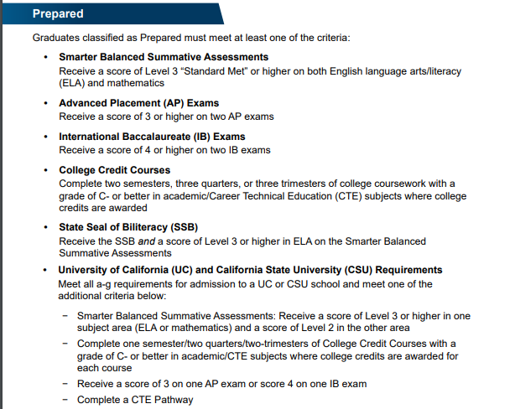
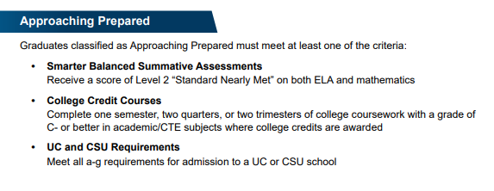
CCI Measures of College Readiness*
Notes:
https://www.cde.ca.gov/ta/ac/cm/documents/dbguidecci23.docx

Slide 12
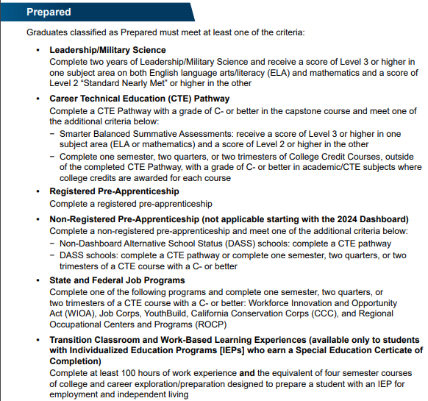
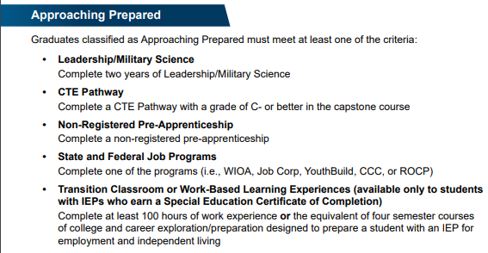
CCI Measures of Career Readiness*
Notes:
https://www.cde.ca.gov/ta/ac/cm/documents/dbguidecci23.docx

Slide 13
DASHBOARD College/Career Indicator Clarification
College Credit Courses: Courses which students have taken and completed independently, which have no association or oversight by the school, will not contribute to a school’s CCI.
2023 Dashboard Technical Guide: College/Career Indicator (CCI) - Page 8 https://www.cde.ca.gov/ta/ac/cm/dashboardguide23.asp
CTE Pathway Criteria: To be considered “prepared” on the CCI using the CTE Pathway criteria, students must…
complete the Pathway capstone course with a grade of C- or better AND
Score Level 3 or higher in one Smarter Balanced Summative Assessments subject area (ELA or math) and Level 2 or higher in the other, OR
Complete one semester/two quarters/two-trimesters of College Credit Courses with a grade of C- or better in academic/CTE subjects where college credits are awarded for each course.

Slide 14
EOY 1 Reporting Survival Kit
User Roles Needed
CALPADS Documentation
Data Population
Student Search
SENR (Edit and View)
SCTE (Edit and View)
CRSC (Edit and View)
SCSC (Edit and View)
SDEM (Edit and View)
WBLR (Edit and View)
WBLR Extract
Viewing Reports
EOY 1 Reports
User Manual
CALPADS Code Sets
File Specifications Form
Error List
Data Guide
Valid Code Combinations
Retired Code Mapping Guide

Slide 15
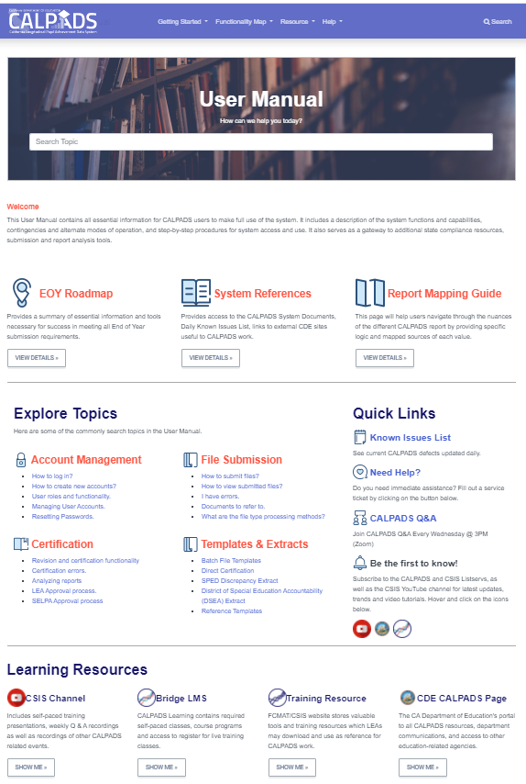
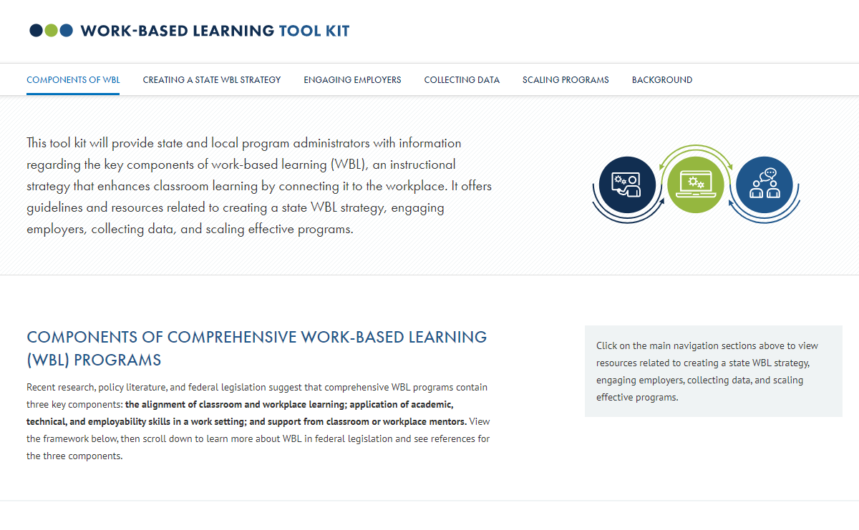
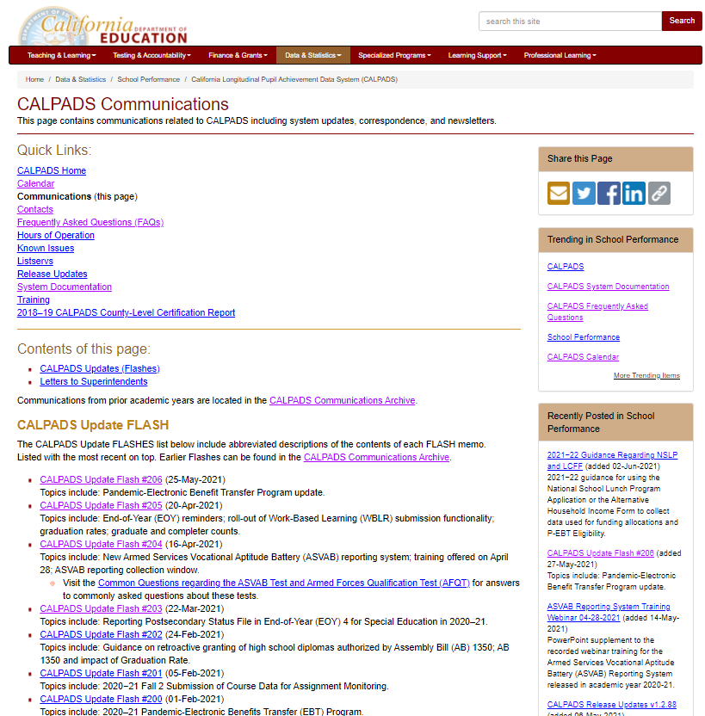
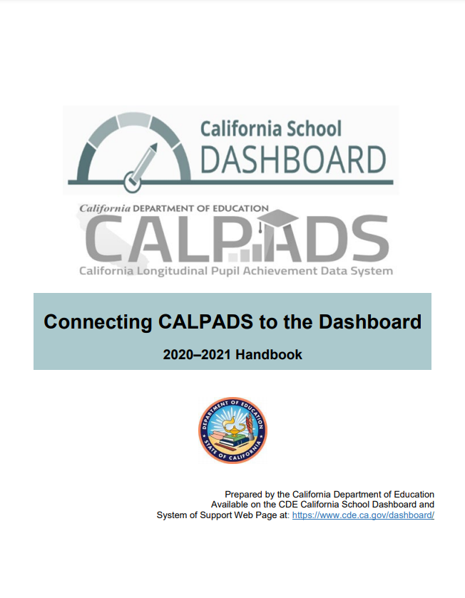
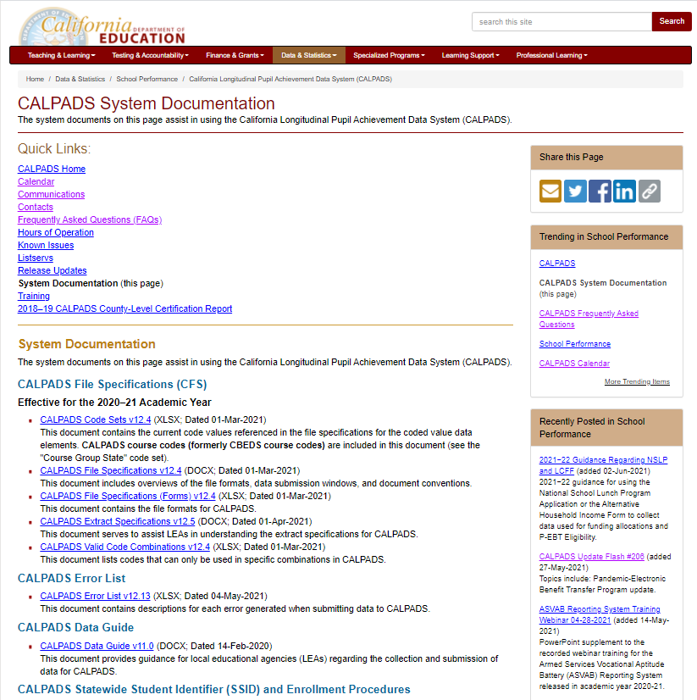
Resources
Notes:
CALPADS User Manual: https://documentation.calpads.org/
CALPADS System Documentation Page: https://www.cde.ca.gov/ds/sp/cl/systemdocs.asp
CALPADS Communications: https://www.cde.ca.gov/ds/sp/cl/communications.asp
https://www.cde.ca.gov/ds/sp/cl/calpadsupdflash184.asp
CA School Dashboard Handbook (https://www.cde.ca.gov/ta/ac/cm/documents/caldashhandbook21.pdf): https://www.cde.ca.gov/ta/ac/cm/
US Dept of ED. Work–based learning tool kit: https://cte.ed.gov/wbltoolkit/collecting.html.

Slide 16
Data Collected
Discuss data requirements

Slide 17
Data Collected
a-g Requirements
Credits
Grades
CTE (SCTE)
Pathways
Student Enrollment (SENR)
Completers
State Course codes
Student Course Completion (SCSC)
Postsecondary Articulated Course Indicator
Course Completion (CRSC)
Course Attributes (AP/IB, College Credit Course, Met UC/CSU Req, HQ CTE)
Work-based Learning
Carnegie Units
(SEIDs)
Work-Based Learning Types
Internship Attributes
Hours
Teachers Demographics (SDEM)
Seal of Biliteracy, Golden State Seal, A–G Completion
CTE Participants
Student Enrollment (SENR)
Files Submitted
Course Completion (CRSC)
Student Crs. Completion (SCSC)
Student CTE (SCTE)
Work-based Learning (WBLR)
Staff Demographics (SDEM)
Site Staff
Staff Involved with Submission
Program staff
CTE
Site Administrators
Student System Support Staff
🖌 NOTE: Courses completed are not compared to course enrollment reported during Fall 2

Slide 18
Record Relationships
1
Staff Demographics
1
Student Enrollment
SEID
2
SSID
Course Section
Completion
SSID
2
Work-Based Learning
Course Section ID
Course Pathway Code
3
4
Student Course Section Completion
Student Career Technical Education
Order of submission

Slide 19
File Reporting Matrix
Details School types and grade levels expected to report specific files related to EOY 1
School Type | CRSC/ SCSC | SDEM | CTE/ WBLR
Traditional (non-educational options schools) | Y | Y | Y
District Level Programs (Independent Study and Home Hospital Programs) | P | P | P
County Community | P | P | Y
District Community Day | P | P | Y
Youth Authority Schools (currently called Division of Juvenile Justice) | P | P | Y
Juvenile Court Schools | P | P | Y
Continuation High Schools | P | P | Y
Opportunity | P | P | Y
Alternative Schools of Choice | Y | Y | Y
State Special Schools | Y | Y | Y
Home and Hospital Schools(5) | P | P | Y
Department of Development Services | N | N | N
Department of State Hospitals | N | N | N
Special Education Consortium | P | P | Y(1)
Special Education | P | P | Y(1)
Non-Public School Group (0000001) (2) | N | N | N
Private School Group (0000002) (2) | N | N | N
ROP/ROC(4) | N | N | N
Grade Levels | CRSC/ SCSC | SDEM | CTE/WBLR
Infants - IN | N | N | N
Prekindergarten - PS | N | N | N
Kindergarten - KN | N | N | N
First Grade - 01 | N | N | N
Second Grade – 02 | N | N | N
Third Grade – 03 | N | N | N
Fourth Grade – 04 | N | N | N
Fifth Grade – 05 | N | N | N
Sixth Grade – 06 | N | N | N
Seventh Grade – 07 | P | P | P
Eighth Grade – 08 | P | P | P
Ninth Grade – 09 | Y | Y | Y
Tenth Grade – 10 | Y | Y | Y
Eleventh Grade – 11 | Y | Y | Y
Twelfth Grade – 12 | Y | Y | Y
Adult – AD | N | N | N
Legend:
Y = Required: Schools are expected to submit data and will receive validation errors if data are not submitted. N = No: Schools should NOT submit data.
P = Permitted: Schools are permitted, but not expected to submit data
Notes:
For specifications refer to the CALPADS CFS: https://www.cde.ca.gov/ds/sp/cl/documents/cfsv124-20210301.docx

Slide 20
Reporting Reminder
Do Not Report:
EOY 1 data for Grades TK – 8 in Self Contained Classes
Grades 7 – 8 in Departmentalized Courses Optional to report.
Ignore CERT099 Warnings if you opt not to submit data
Report:
Grades 9 - 12 in Departmentalized Courses
SDEM
CRSC
SCSC (Only for students who completed a course)
WBLR
SCTE (Only for CTE Pathway Completers)

Slide 21
Course Completion
LEAs must submit information on courses that students have completed during the year.
Course completion data is required for students in departmentalized classroom settings in grades 9–12 attending traditional schools.
Grades, credits attempted, and credits earned
Submit data for all departmentalized courses completed including special education courses, independent study courses, home hospital courses.
EOY1 is optional for Grades 7-8 in departmentalized courses.
Report grades only.
Submit student course completion data from all official grading periods for the school year
By submitting course completion data for students in departmentalized courses in grades 9 – 12, LEAs identify CTE participants.
Course and Student Course completion data.

Slide 22
CRSC Attributes
Course Content
The State course code describes the course content and identifies:
CTE Courses
College courses
Leadership/Military Science courses
High Quality CTE Courses
Courses that have been developed with the CTE Pathway Standards (even standalone courses)
Are taught by a CTE-credentialed teacher
Example: CTE-IG funded
The following are the important CRSC fields relevant to EOY 1 aggregates.
College Courses
A subset of courses that are identified either through
Specific state course codes designate college courses
Non-Standard Instructional Level code used to identify college CTE courses
23 – College Credit only
24 – Dual Enrollment
CTE Attributes
Data submitted in the CRSC and SCSC files as part of the EOY 1 submission are used to identify whether students in the 4-year Adjusted Cohort Graduate Rate (ACGR) are prepared for college/career as measured by the College/Career Indicator (CCI) on the California School Dashboard.
Notes:
High quality CTE courses and pathways are developed based on the framework of 12 CTE Model Curriculum Standards and the Common Core State Standards: https://www.cde.ca.gov/ci/ct/sf/documents/ctescrpposter.pdf]
For more CTE information visit:
https://www.cde.ca.gov/ci/ct/sf/ctemcstandards.asp
https://www.ctc.ca.gov/docs/default-source/leaflets/cl888.pdf?sfvrsn=88065bf8_18
https://www.ctc.ca.gov/credentials/req-teaching

Slide 23
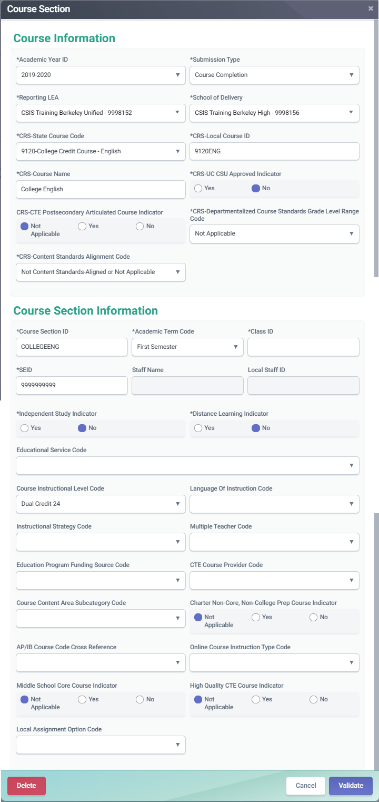
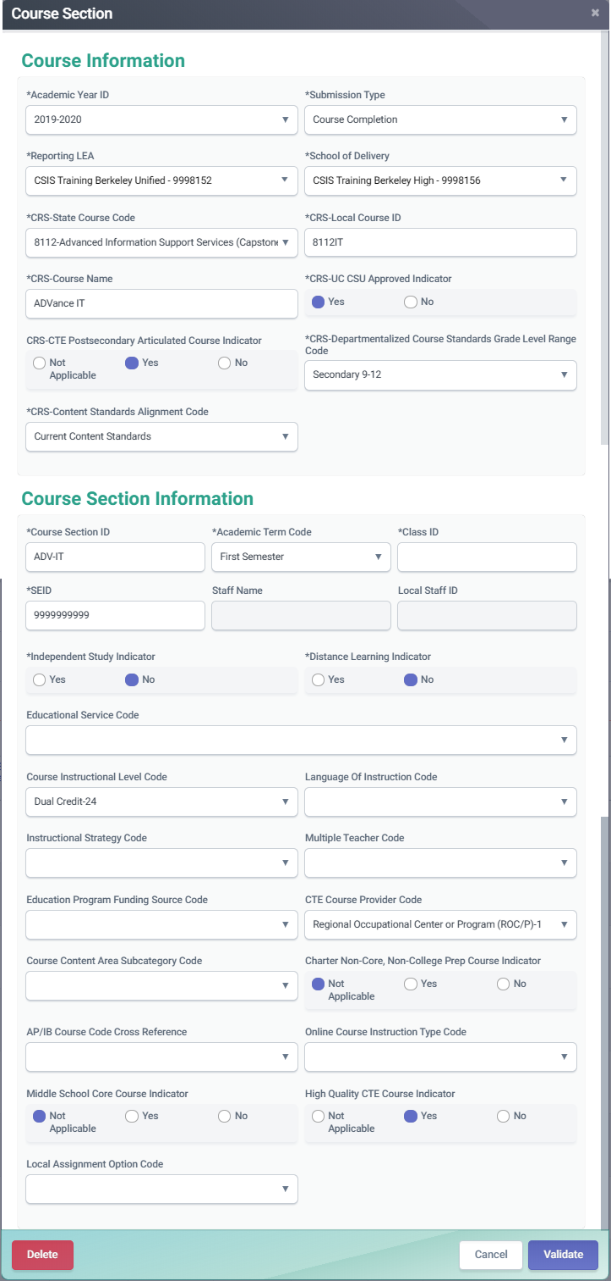
Course Completion (CRSC)
College courses should be reported using the designated state course codes. Those courses can be used as CCI indicators
OR
CTE courses for which a student earns college credit should have the Course Instructional Level code populated with 23 - College Credit or 24 - Dual credit

Slide 24
Dashboard CCI Courses
State Course Code | State Course Code Name
9020 | College Credit Course – Visual Arts
9082 | College Credit Course – Dance
9096 | College Credit Course – Theatre
9120 | College Credit Course – English Language Arts
9154 | College Credit Course – World Languages
9200 | College Credit Course – History/Social Science
9227 | College Credit Course – Other
9273 | College Credit Course – Mathematics
9303 | College Credit Course – Music
9358 | College Credit Course – Science
9373 | Leadership/Military Science
7000–8999 | Any CTE course code indicated in Nonstandard Instructional Level as College Credit Only (23) or Dual Credit (24)

Slide 25
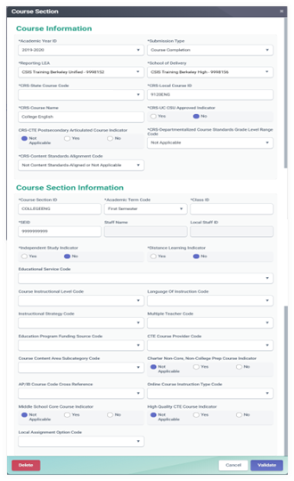
Course Completion (CRSC)
Advanced Placement (AP) courses should have the appropriate state course code to align with a specific content area
International Baccalaureate (IB) courses must be reported with the appropriate state course code, unless they are Middle school IB courses.
Use the course instructional level field to indicate IB courses to Middle school as well as to the appropriate CTE course.

Slide 26
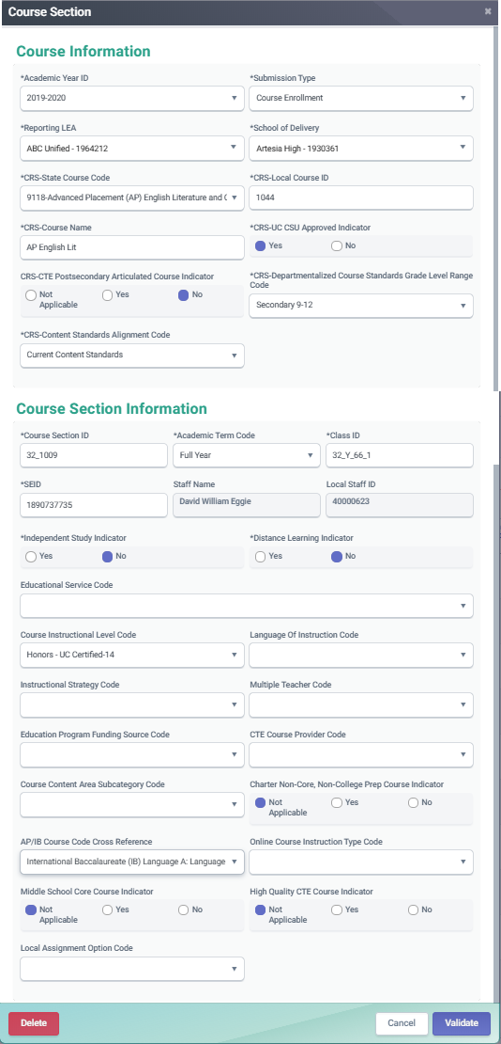
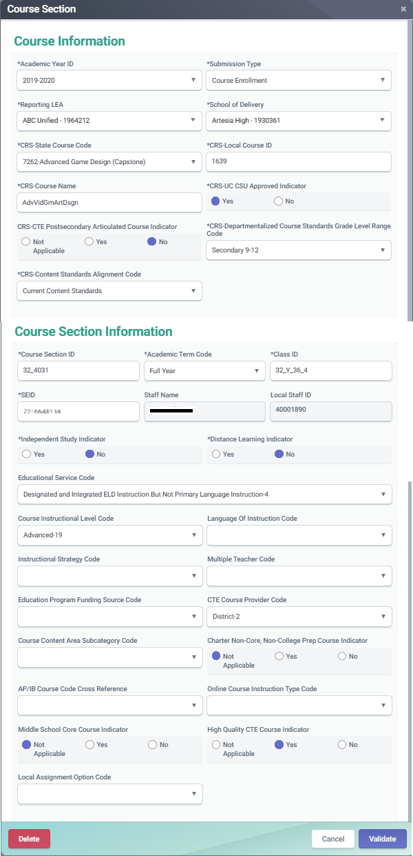
Course Completion (CRSC)
CTE completers and non-completers must have SCSC records that correspond to the appropriate CTE course
CTE courses that are also AP or IB courses can have the AP/IB code cross reference populated so that the course maps to both content areas

Slide 27
SCSC Attributes
Grades
Standard and nonstandard grades accepted
The final grade a student received after completing a specific Course Section
LEAs should not submit “progress report” grades, but only grades earned when credits are awarded.
Can be Alpha numeric or special character
Limited to three characters
UC/CSU Admission Requirement Code
Not a required field, but should be populated for courses students take that have been approved by UC/CSU institutions.
Course determination is made by the UC/CSU systems
Describes the requirement that a high school course has been determined to meet.
Applicable in departmentalized courses in grade 9-12
Credits
Student Credits Attempted and Student Credits Earned help LEAs view courses transferring students have completed in other LEAs.
Used to determine total credit requirements are met for graduation.
Carnegie Units
Granted to a student completing approximately 120 hours of class in one subject over the course of one year
SIS vendors will calculate the value
Required for the federal Migrant Student Information Exchange (MSIX)

Slide 28
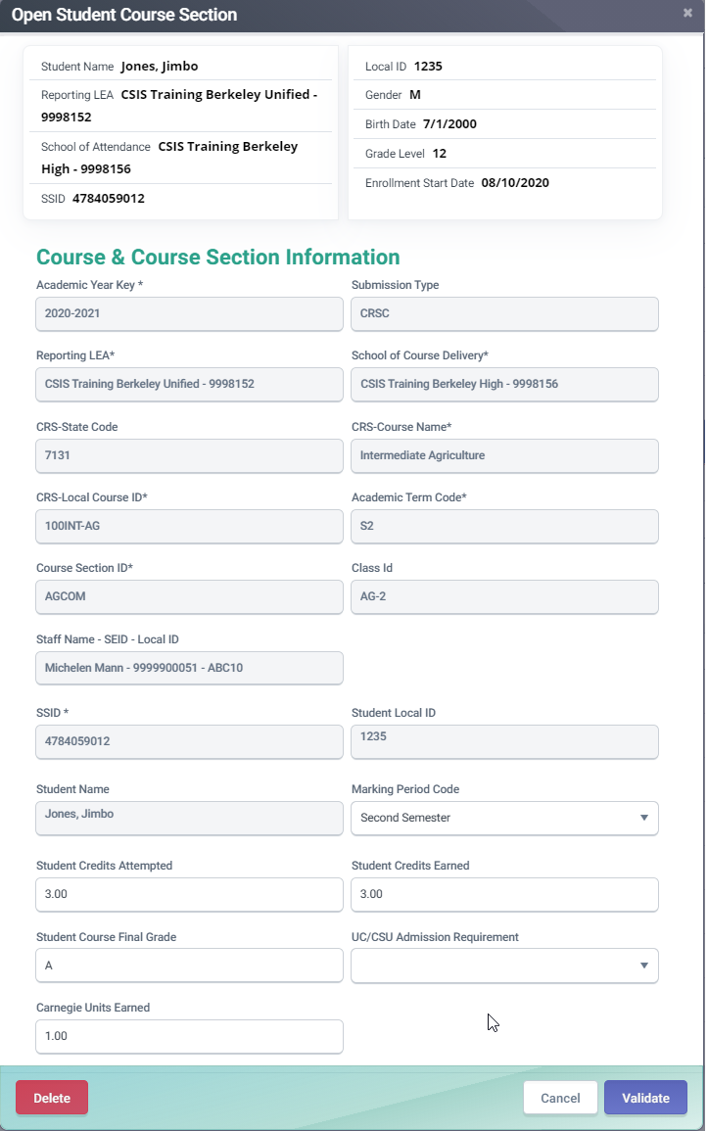
Course Completion (SCSC)
The UC/CSU Admission Requirement Code represents the category of University of California or California State University College Admission Course requirement that a high school course has been determined to meet.
A Carnegie Unit represents a student completing approximately 120 hours of class in one subject over the course of one year. Typically, 10 high school credits equal 1 Carnegie Unit, 5 high school credits are normally equal to 0.5 Carnegie units.

Slide 29
Student Career Technical Education
LEAs must submit information on CTE Pathways that students have completed during the year.
Students who have completed a CTE Pathway during the Reporting Year, are included in the Student Career Technical Education (SCTE) file.
If a student has completed more than one Pathway during the Reporting Year, a record is reported for each completed Pathway.
CTE participants who are non-completers MUST NOT be included in the SCTE file, as the data collected for course sections and student course sections includes the information needed to identify them.
Course and Student Course completion data.

Slide 30
SCTE Data Collected
Along with key data from the CRSC and SCSC, the following data are collected
CTE Completer Info
CTE Pathway Code
CTE Completion Year
Identifies student who has completed a minimum of 300 hours in a state-approved CTE pathway.
Indicates the specific career pathway the student participated in and completed.
Indicates the academic year the student completed the capstone course for the pathway being reported

Slide 31
CTE Student Groups
CTE Participant:
The CDE counts as a participant, any student who has completed a CTE course (includes CTE Non-completers and Completers).
Non-Completer Participant: Is a student who:
has completed a CTE course who may or may not be participating in a pathway but does not meet the definition of a CTE completer below
Reported and determined through the CRSC and SCSC records
CTE Completer: A CTE completer is identified locally and is a student who has:
completed a minimum of 300 hours in a state-approved CTE pathway and has successfully passed the capstone course in that sequence with a grade of C minus or better.
Reported through submission of the CRSC, SCSC and SCTE records

Slide 32
Mapping CTE information
Below is a summary of how different CTE student groups are reported in CALPADS.
CTE Participants
Non-completers
CRSC
Report CTE course
State course 7000-8999
SCSC
Submit SCSC associated to the CTE course
SCTE
Do not submit SCTE
CRSC
Report Capstone course appropriate to CTE Pathway
SCSC
Submit SCSC associated to the CTE course
SCTE
Submit SCTE
State course 7000-8999
CTE Pathway Completion Academic Year ID must be populated
CTE Pathway Completion Academic Year ID must be current year.
Report CTE Pathway Code
CTE Pathway Completers

Slide 33
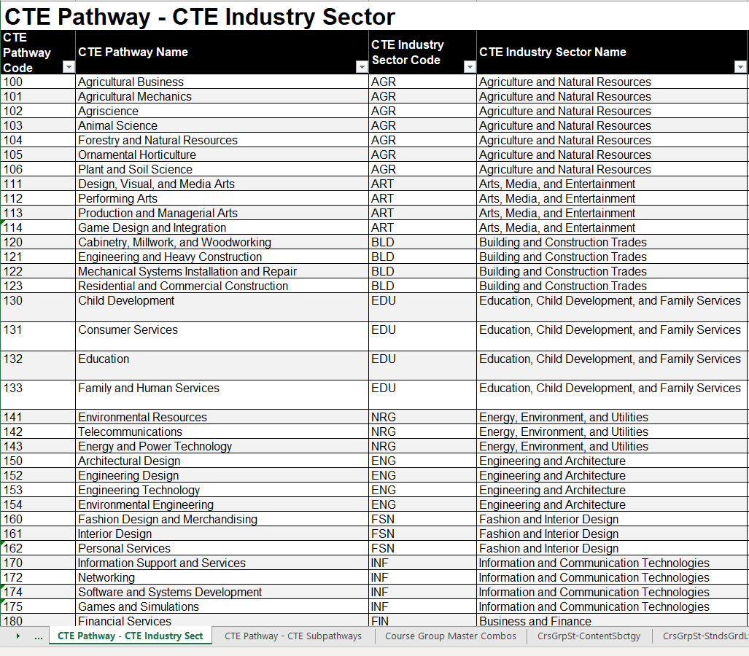
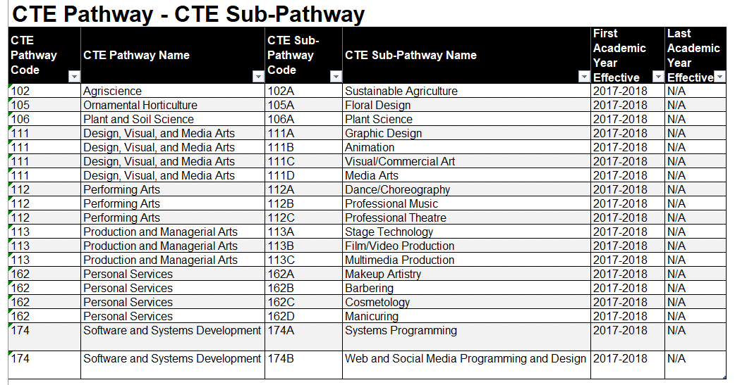
Valid Code Combo CTE Resources

Slide 34
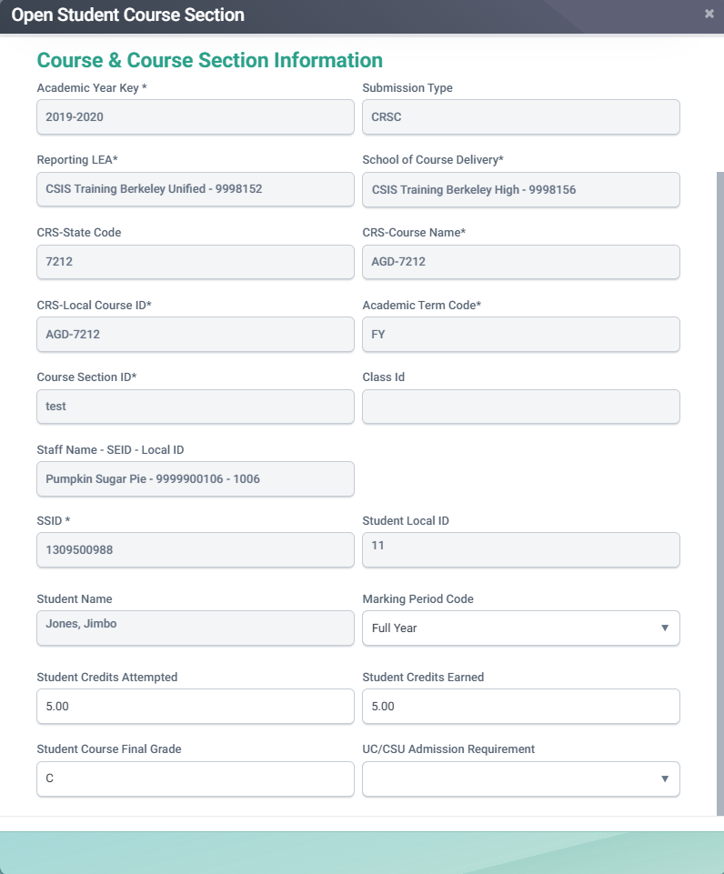
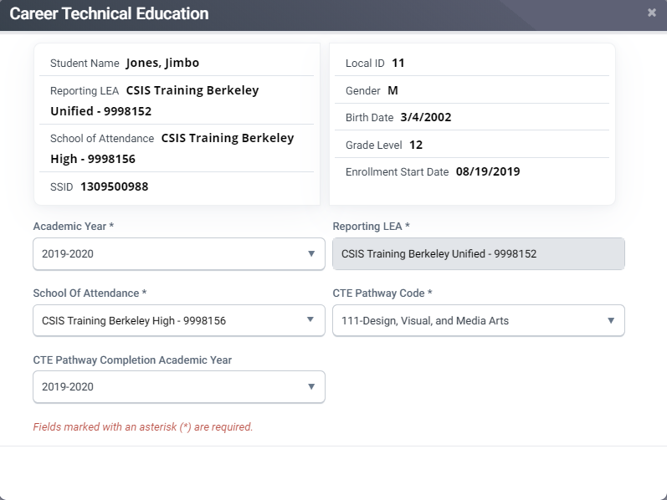
Reporting a CTE Completer
Below are the elements that comprise the CTE Completer data of a student.
Must have a SCSC record associated to a CTE Capstone course.
A SCTE record must be submitted reflecting the CTE pathway code.
Completion Academic Year must be 2023-2024.

Slide 35
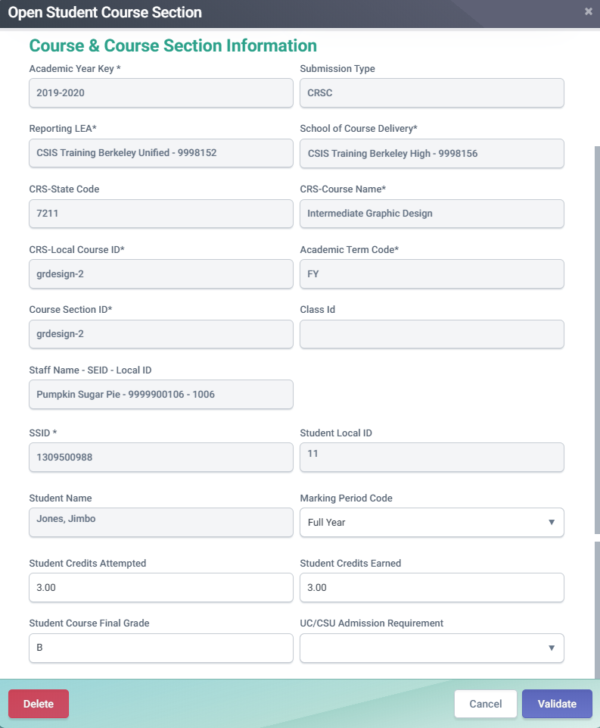
How CTE Non-Completers are determined
Below are the elements that CALPADS will use to determine a student as a CTE Non-Completer participant.
SCSC Record
For CTE Pathway Participants: Must have a SCSC record associated to a CTE course that is identified as Intro or Concentrator course
For Non-CTE Pathway Participants: Must have a SCSC record associated to any CTE course.

Slide 36
Work-Based Learning
LEAs must submit work-based learning data that will provide additional opportunities for students (grades 9-12) to demonstrate their preparedness for college/career through the College/Career Indicator (CCI) on the California School Dashboard.
There are twelve work-based learning programs/activities that LEAs should track and report to CALPADS on the WBLR file.
The WBLR uses the Replacement processing method by Academic Year and School of Attendance and is used for batch processing.

Slide 37
WBLR Data Collected
LEAs are required to submit work-based learning completion information for:
All students that complete an internship
Include all Work-Based Learning completion for students enrolled at any time during the Reporting Year
Data will come from SIS but gathered by a team of CTE, SPED and CALPADS coordinators
LEA Admins will need to assign the WBLR Edit, View, and Extract roles to account and other user accounts. SELPAs will need to request the state to add the WBLR Extract role to their account.
Reference Available: CALPADS Flash 184 & 229 WBRL Data Population CALPADS User Manual
37
Notes:
References:
CALPADS Flash 184: https://www.cde.ca.gov/ds/sp/cl/calpadsupdflash184.asp
CALPADS Flash 229: https://www.cde.ca.gov/ds/sp/cl/calpadsupdflash229.asp
CSIS WBLR Data Population: https://www.youtube.com/playlist?list=PLsnFpLOXpp4KDvoW_Hg8BenKP53bv3MGl
CALPADS User Manual: https://documentation.calpads.org/OnlineMaintenance/StudentDataMaintenance/StudentDetailsWBLR/
Work-Based Learning Measures for the CCI:
https://www.cde.ca.gov/ta/ac/cm/workbasedcci.asp#newmeasures

Slide 38
Work-Based Learning Type Code
Code | Name | Previous
10 | Internship | New
15 | Student-led Enterprise | New
20 | Virtual/Simulated Work-Based Learning | New
25 | Registered Pre-Apprenticeship Program | SENR
30 | Non-registered Pre-Apprenticeship Program | SENR
35 | Job Corps | SENR
40 | Workforce Innovation and Opportunity Act (WIOA) | SENR
45 | YouthBuild | SENR
50 | California Conservation Corps | SENR
60 | Transition Work-Based Experience | SPED
65 | Transition Classroom-Based Work Exploration | SPED
The Work-Based Learning Type Code represents the work-based learning that the student completed during the academic year.
Students may have multiple work-based learning codes
Include summer work-based learning
Exclude summer internships that occur after the student has graduated
38

Slide 39
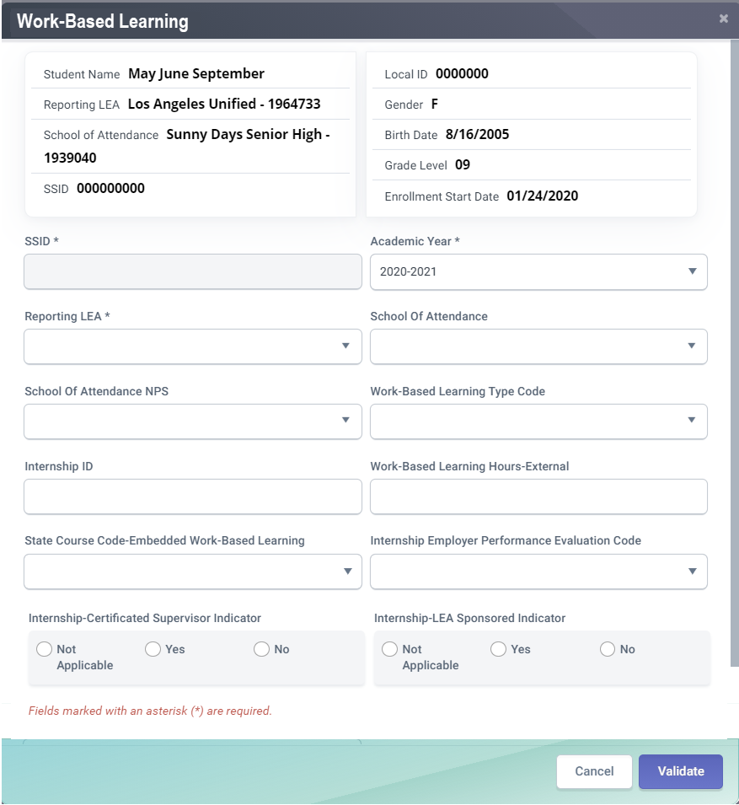
WBLR Data Fields
CFS# | Field Name
21.09 | Work-Based Learning Type Code
21.10 | Internship ID
21.11 | Work-based Learning Hours - External
21.12 | State Course Code -Embedded Work-based Learning
21.13 | Internship -Employer Performance Evaluation Code
21.14 | Internship -LEA Sponsored Indicator
21.15 | Internship –Certificated Supervisor Indicator
21.09
21.10
21.11
21.12
21.13
21.14
21.15
39
39

Slide 40
*NEW* Employer Performance Evaluation Code in AY2023-2024
Code | Name | Definition
5 | Not Provided by Employer | The student did not receive a rating because the employer: (1) failed to provide an evaluation or (2) did not evaluate the student’s performance on the internship
*Upcoming* Work-Based Learning Type Code Retiring in AY2024-2025
Code | Name | Definition
30 | Non-Registered Pre-Apprenticeship | The student successfully completed, during the academic year, a non-registered pre-apprenticeship program, is recognized by business but is not registered at the state or national level. These pre-apprenticeships provide employer-designed coursework and job-learning activities that prepare students for an existing apprenticeship program.
CALPADS Update Flash #265
Notes:
This and further information on WBLR changes contained in Flash #265 here: https://www.cde.ca.gov/ds/sp/cl/calpadsupdflash265.asp

Slide 41
Checklist
All reportable courses are mapped to the State Course codes
All required fields for courses are populated and up to date, including:
Content Sub-Category
Standards Grade Range
Content Standards Alignment
Middle School Core (Yes/No)
AP/IB Course Code Cross Reference - if needed
SIS vendor has translated credits earned into Carnegie Units
The following have been identified and reported in the SIS:
CTE Completers
Students completing Leadership/Military Science courses
Students who have received Seal of Biliteracy and/or Golden State Seal
Students completing College Credit courses
Work-Based Learning (WBL) Types for all grade 9-12 students who participated entered in SIS
In addition to WBL Type, all WBL Internships (Type 10) also have the following populated:
Internship ID
Work based Learning Hours - External
Employer Performance Evaluation Codes
LEA Sponsored Indicator
Certificated Supervisor Indicator
In addition to WBL Type, all WBL Student-Led Enterprise (Type 15) and Virtual/Simulated Work-Based Learning (Type 20) also have the following populated:
Work-based Learning Hours - External
State Course Code - Embedded Work-based Learning

Slide 42
Certification
Process overview and error resolution

Slide 43
Certification Workflow
Error Correction
Resolve Cert errors before reviewing reports.
Refer to the downloadable CALPADS Error List on suggest resolutions
Review Reports
LEA Approval
LEA Submission Process
CERT Error Correction
Report Review
Generate reports and disseminate to appropriate staff responsible for the data.
Utilize report mapping guide to check for data inclusion and column count source
Submit files
Be aware of replacement type processing
Be aware of order of submission
You may now submit SDEM, CRSC files and available SCSC records
Approval
Generate reports and disseminate to appropriate staff responsible for the data.
Review all aggregate reports to activate checkbox
Check box to activate approval button
Notes:
Resource:
Certification Process: https://documentation.calpads.org/CertificationStatus/CertificationStatusLEAApproval/
Video: https://www.youtube.com/playlist?list=PLsnFpLOXpp4Itub_qeFnInTgT0zJulxUb

Slide 44
EOY 1 Certification Errors
Error # | Error Name | Error Description | Severity
CERT004 | Ethnicity / Race Data Missing | A student has no Ethnicity/Race data. | Fatal
CERT054 | Staff Demographics Missing | A Course Section includes a SEID for which there is no demographic information. | Fatal
CERT055 | High school with No Enrollment in Career Technical Education | This high school did not submit any students as enrolled in Career-Technical Education courses. | Warning
CERT081 | No Student Course Section Data for a Secondarily or Short-Term Enrolled Student | No Student course section data was submitted for a student with Enrollment Status of Secondary or Short Term. | Warning
CERT098 | Student Course Section for SSID Not Enrolled during Report Period | A student course section record was submitted for an SSID that was not enrolled at any time during the Report Period | Fatal
CERT099 | No Student Course Section Data for a Primarily Enrolled Student | No End of Year student course section data were submitted for an enrolled student with enrollment status of Primary | Warning
CERT100 | No Enrollment for Course Section (CRSC) | A course section does not have any associated student course section records. | Warning
CERT102 | No CTE Completer Data | No Student Career Technical Education records were submitted for this school. | Warning
CERT123 | Missing or invalid SCSC record for CTE Completer | No Student Course Section Completion record (SCSC) was submitted for a CTE Capstone course at the same Reporting LEA or associated State Course Code submitted is not valid for SCTE Pathway Code | Fatal
CERT169 | No WBLR Data Submitted for a School |  | Warning
Notes:
Certification error videos can be found on the CSIS YouTube training channel, certification errors playlist: https://www.youtube.com/c/CSISCALPADSTrainingChannel/playlists?view=50&sort=dd&shelf_id=5

Slide 45
EOY 1 CDD Errors
Error # | Error Name | Severity
SCSE0139E1 | Missing Course Section Record | Fatal
SCSC0140E1 | Missing Student Credits Attempted | Fatal
SCSC0141E1 | Missing Student Credits Earned | Fatal
SCSC0512E1 | Missing Carnegie Units Earned | Fatal
CRSC0231E1 | Mismatch of Course (CRS) Attributes | Fatal
CRSC0545E1 | Invalid SEID in Course Section record | Warning
WBLR0576E1 | SWDS record must exist for this Work-Based Learning Type | Fatal
CRSC0640E1 | Course identified as Special Education with Gen Ed Students enrolled | Fatal
WBLR0649E1 | Missing State Course Code - Embedded Work-Based Learning for Interships | Warning

Slide 46
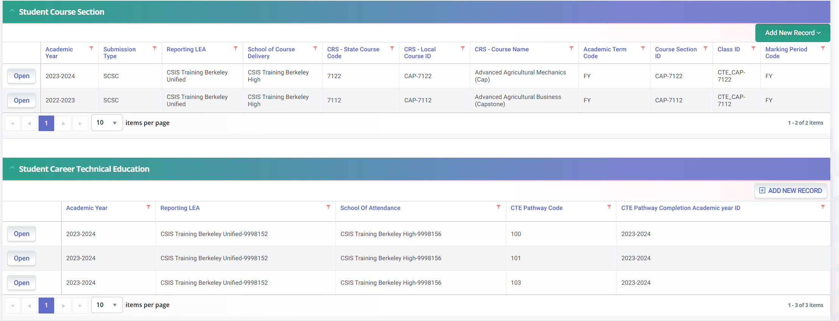
CERT123
No SCSC record submitted to reflect a CTE Capstone Course code for indicated pathway
Trigger reasons
SCSC file not uploaded
SCSC file uploaded but record rejected.
Posted a SCTE record this year but completed Pathway last year.
Inadvertently posted a SCTE record

Slide 47
EOY 1 Reports
Review reports

Slide 48
EOY 1 Reports
Course Completion
CTE
Work Based Learning
Report 3.9
Report 3.10
Report 3.11
Course Sections Completed – Count by Content Area for Departmentalized Courses
Course Sections Completed – Count and Details for Departmentalized Courses
Course Sections Completed – Student List for Departmentalized Courses
Report 3.16
Educational Options Course Completion – Student Count
Report 3.14
Report 3.15
Career Technical Education Noncompleter Participants - Count
Career Technical Education Noncompleter Participants– Student List
Legend
Aggregate Report
Supporting Report
Report 3.19
Report 3.20
Career Technical Education Completers – Count by Pathway
Career Technical Education Completers– Student List
Report 18.1
Report 18.2
Work-Based Learning -Count
Work-Based Learning – Student List
Notes:
Please review the EOY 1 Data Mapping Guides in the user manual -- https://documentation.calpads.org/Reports/SnapshotODSReports/#eoy-1-report-mapping-guides

Slide 49
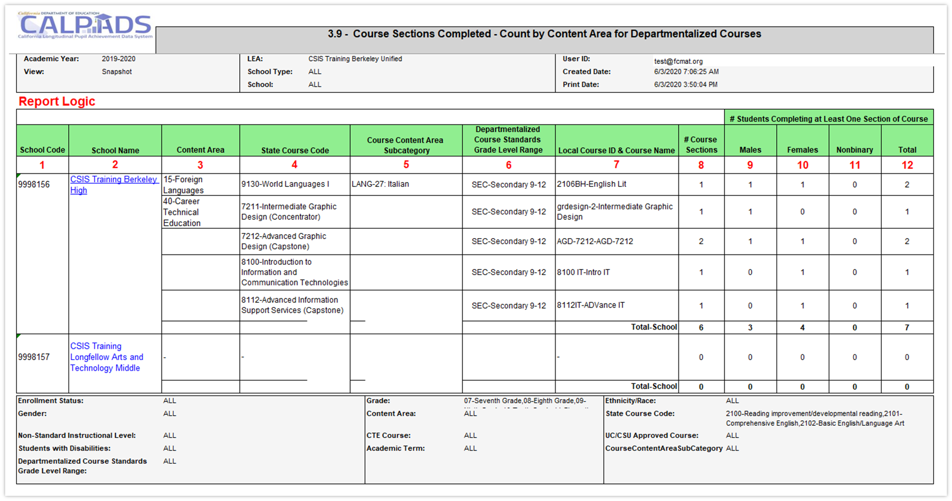
Report 3.9 Course Sections Completed
Count by Content Area for Departmentalized Courses

Slide 50
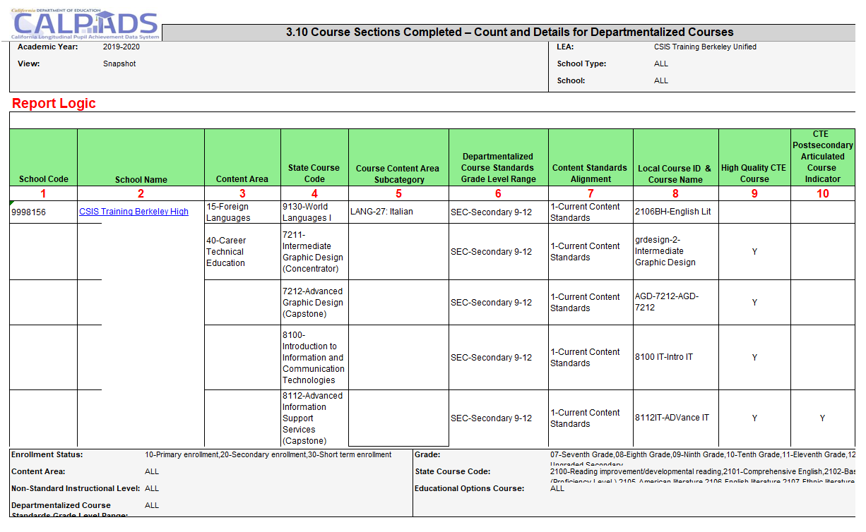
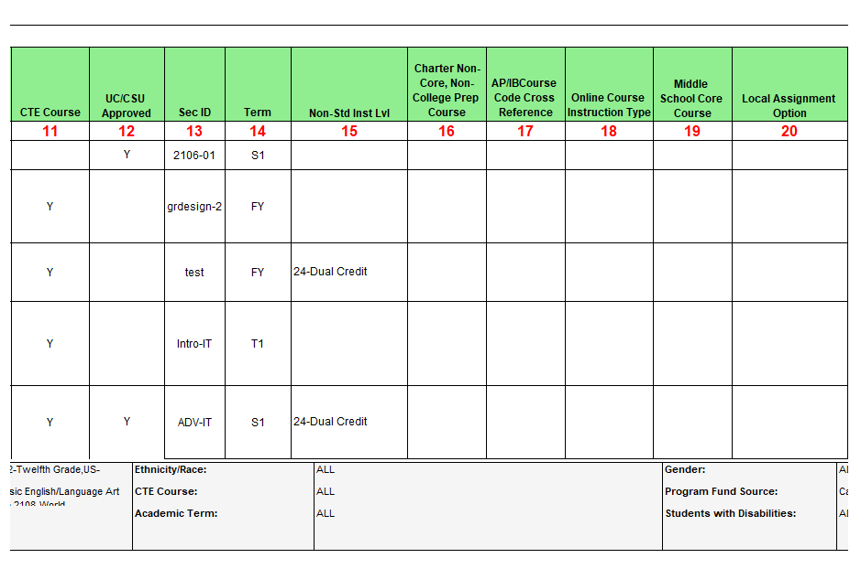
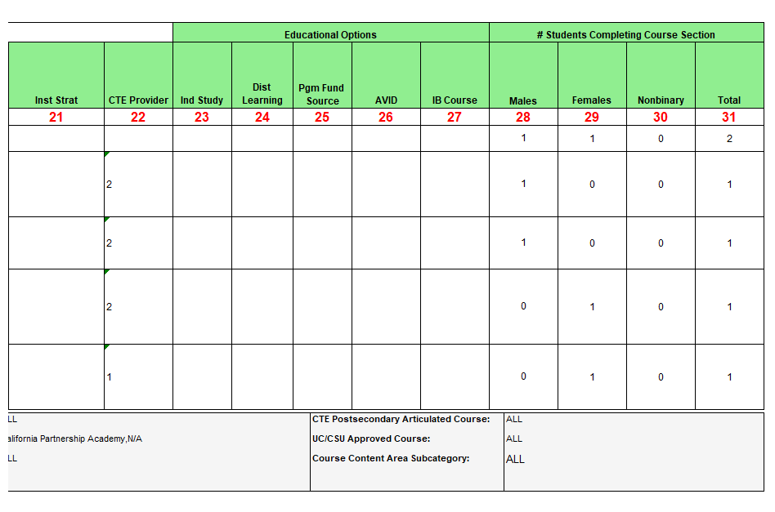
Report 3.10 Course Sections Completed
Count and Details for Departmentalized Courses

Slide 51
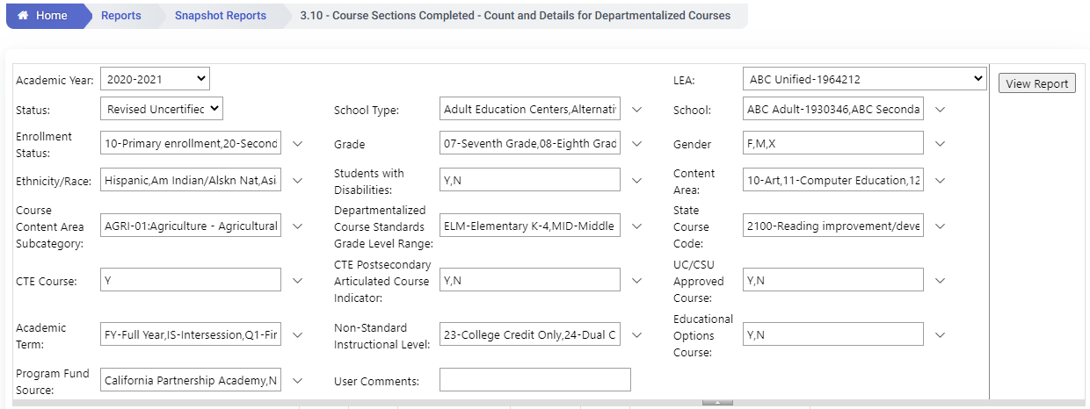
EOY 1 - Reviewing CTE Data
Review Report 3.10 - Course Sections Completed - Count and Details for Departmentalized Courses
The report should be requested twice with different filters.
To find college credit courses and Leadership/Military Science in the 9x series select the State Course codes of 9020, 9082, 9096, 9120, 9154, 9200, 9227, 9273, 9303, 9358, 9373
To find the CTE courses with the Non Standard Instructional codes of 23 and 24 select the CTE Course = Y and Non Standard Instructional Level to 23 and 24

Slide 52
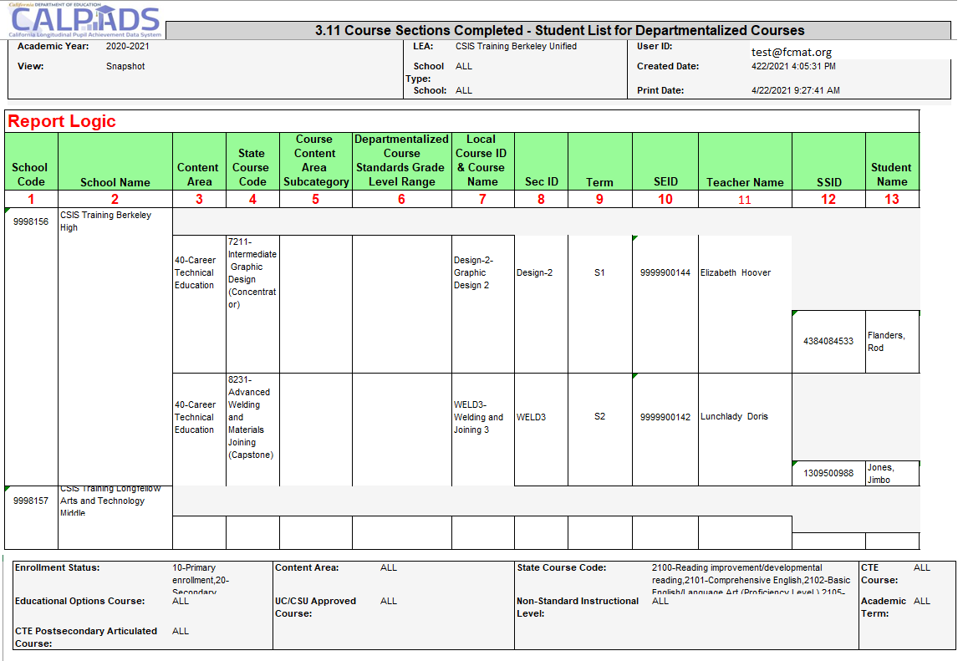
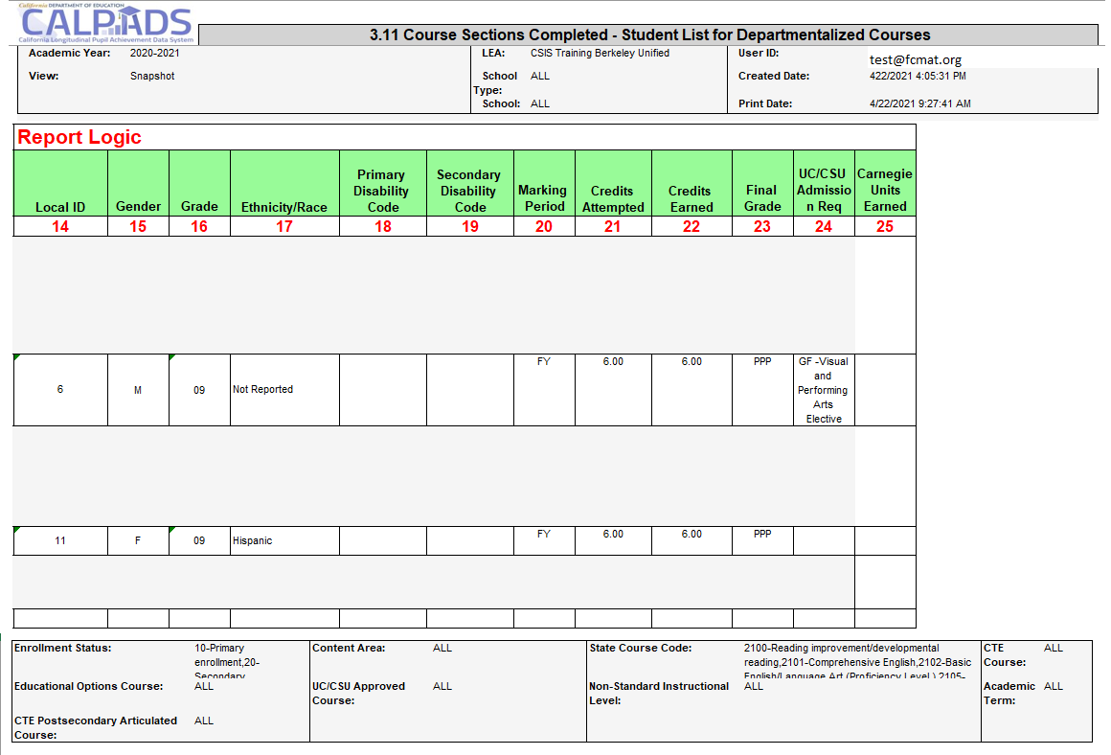
Report 3.11 Course Sections Completed
Student List for Departmentalized Courses

Slide 53
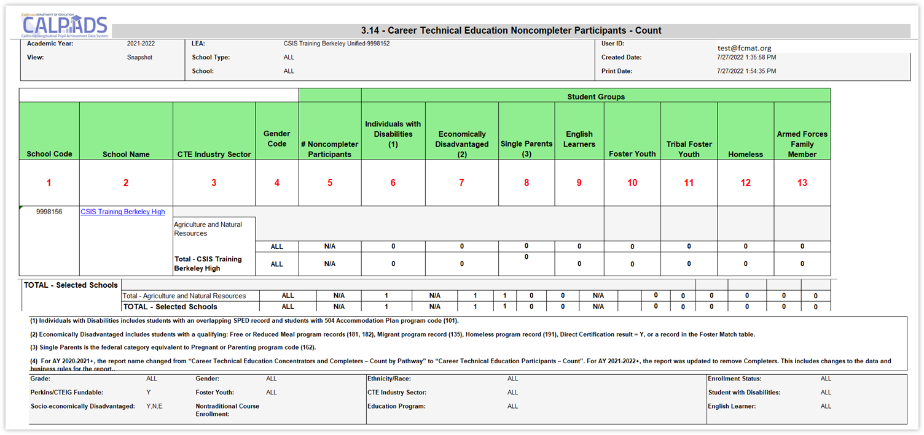
Report 3.14 CTE Noncompleter Participants – Count
Report defaults to counting Perkins/CTEIG fundable students in courses flagged with a High Quality CTE Course Indicator equal to Y. Switching the Perkins/CTEIG Fundable filter to ALL will include all other CTE courses not flagged.

Slide 54
EOY 1 - Reviewing CTE Data
Review Report 3.14 Career Technical Education Noncompleter Participants – Count
Filter on 12th graders to verify students who completed or were participants in 12th grade
Set Perkins/CTEIG Fundable to ALL to capture all students. Otherwise, it will default to courses only flagged a HQ CTE.
Filter for other specific sub-groups that comprise the core indicators (optional)

Slide 55
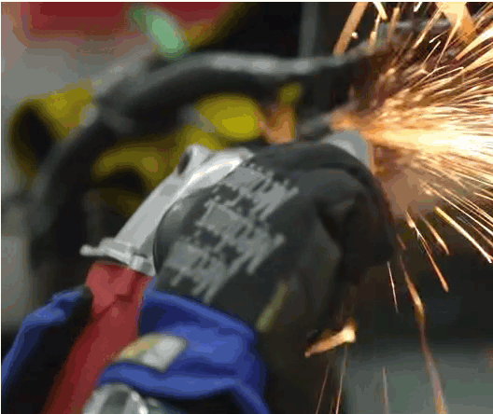
CTE Core Indicators
Individuals with Disabilities
Economically Disadvantaged: includes students with a qualifying: Free or Reduced Meal program record (181, 182), Migrant program record (135), Homeless program record (191), Direct Certification result = Y, or a record in the Foster Match table
Single Parents: is the federal category equivalent to Pregnant or Parenting program code (162)
Non-traditional Gender: gender less commonly associated with a field
EOY 1- Reports and Certification v1.0 AY 2023-24

Slide 56
Report 3.15 CTE Noncompleter Participants– Student List
Report defaults to counting Perkins/CTEIG fundable students in courses flagged with a High Quality CTE Course Indicator equal to Y. Switching the Perkins/CTEIG Fundable filter to ALL will include all other CTE courses not flagged.

Slide 57
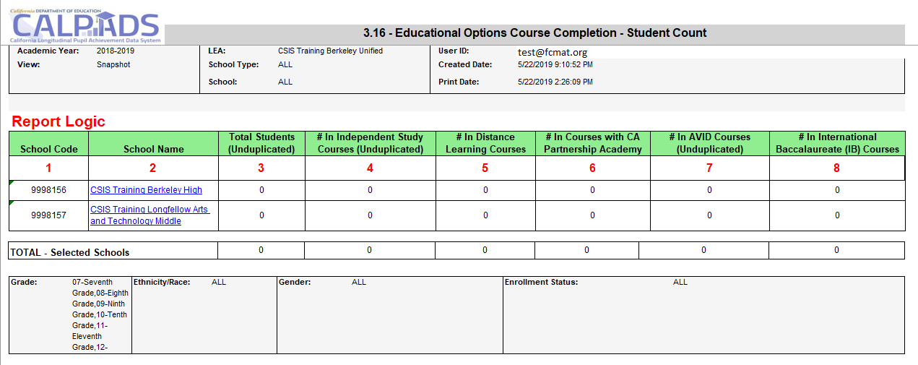
Report 3.16 – Educational Options Course Completion
Student Count

Slide 58
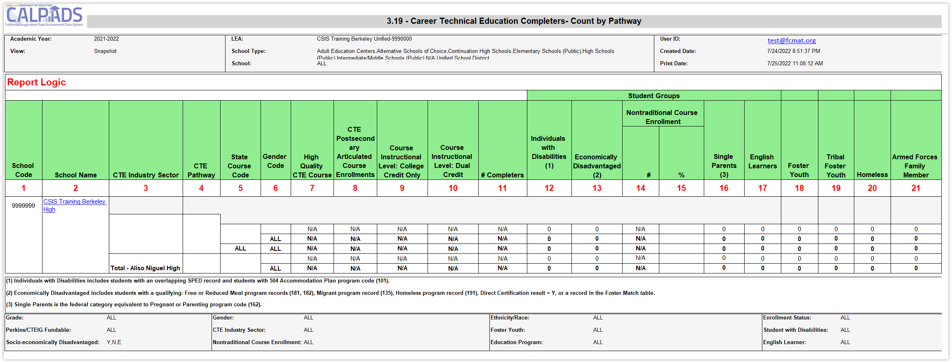
Report 3.19 CTE Completers – Count by Pathway
*NEW* in AY2023-2024: report 3.19 restricted to grades 9 -12

Slide 59
Report 3.20 - Career Technical Education Completers - Student List
Lists Career Technical Education (CTE) Completers and the Pathway they are pursuing. Also provides core indicators on these students.
*NEW* in AY2023-2024: report 3.20 restricted to grades 9 -12

Slide 60
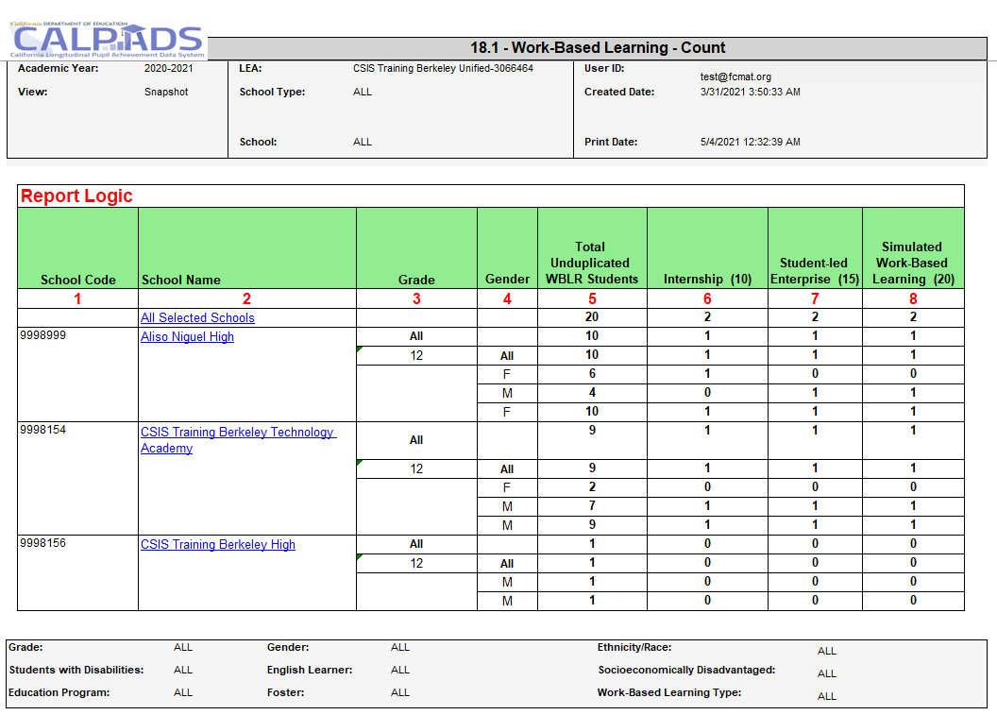
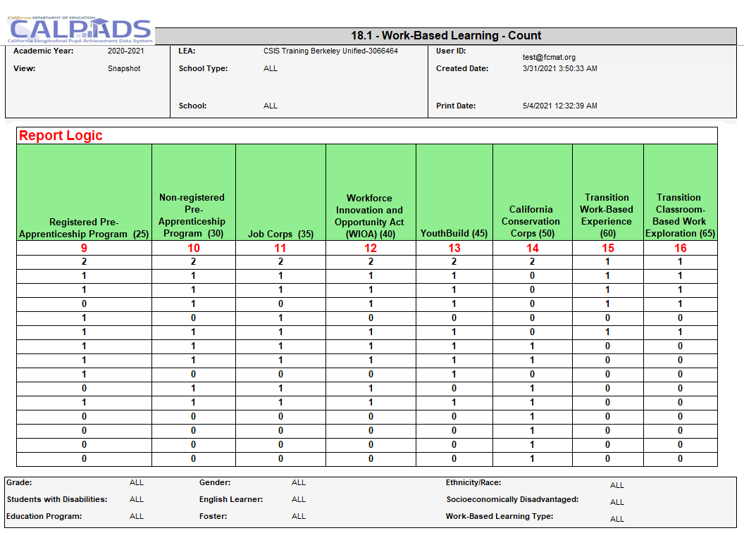
Report 18.1 Work-Based Learning - Count

Slide 61
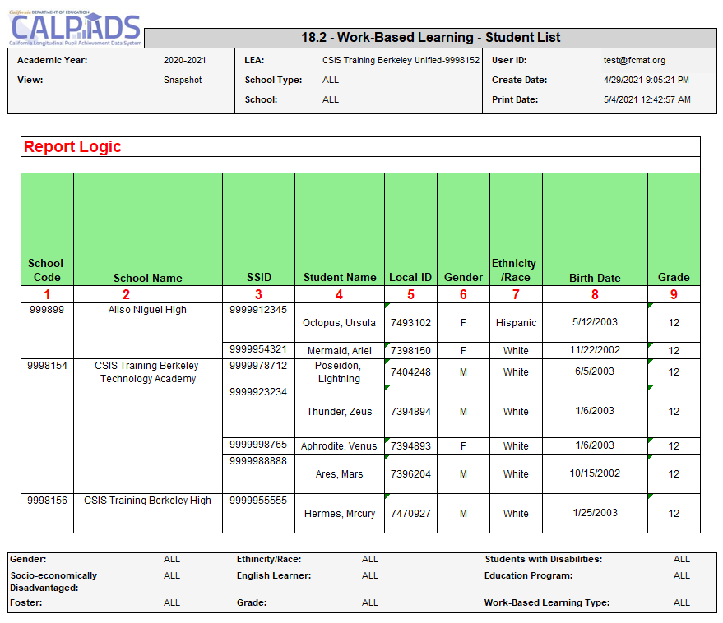
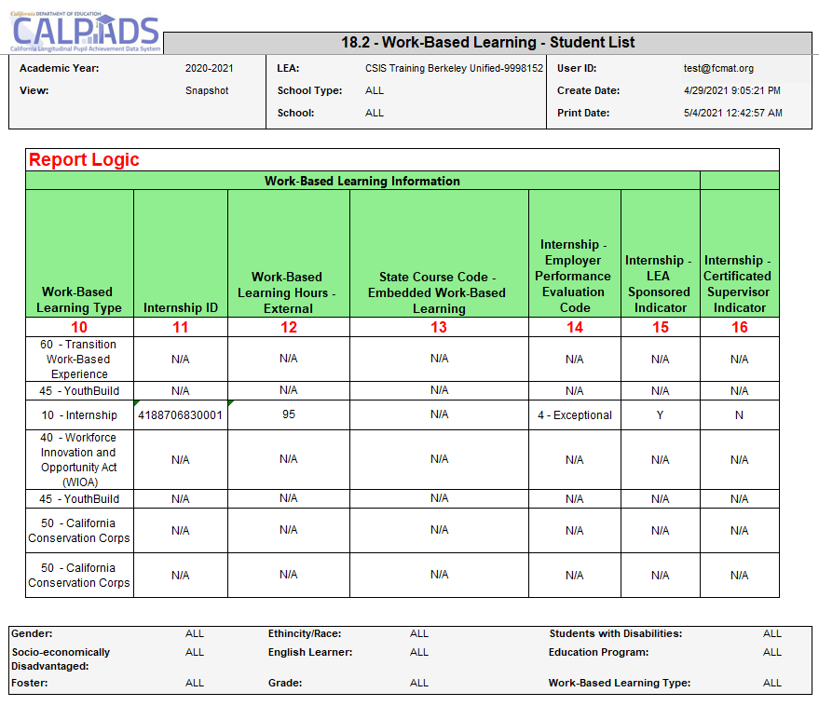
Report 18.2 Work-Based Learning – Student List

Slide 62
Wrap Up
Key Points, Resources and Support

Slide 63
Submission Summary
EOY 1 requires the SDEM, CRSC, SCSC, SCTE and WBLR records be posted
Course completion (CRSC) data is required for students in departmentalized classroom settings in grades 9–12 attending traditional schools. Optional for 7-8 grades
Grades, credits attempted, and credits earned are required for grade levels 9–12. Only grades are required for 7–8 should you opt to report.
Submit student course completion (SCSC) data from all official grading periods for the school year
LEAs identify CTE participants by submitting course completion (SCSC) data
SCTE records must only be submitted for CTE Pathway completers who finished the capstone course in the current academic year.
Some key points to remember
EOY 1- Reports and Certification v1.0 AY 2023-24

Slide 64
What are the data used for?
State
DataQuest
California Dashboard
SARC
Ed-Data
Federal
EDFacts file submissions and the Consolidated State Performance Report (CSPR)
Migrant Student Information Exchange (MSIX) - Course Completion, Carnegie Unit
Titles VI & IX reports for the Civil Rights Act of 1964
Carl Perkins Reporting (CTE Participants and Completers)
Section 1418 of the Individuals with Disabilities Education Act (IDEA) 2004 of the federal statutes (Title 20 USC Chapter 33), Individual with Disabilities Education Act (IDEA)
EOY 1- Reports and Certification v1.0 AY 2023-24

Slide 65
Suggested Milestones
Now – 6/28
Complete Data Population in local SIS
Now – 6/28
Submit and post files. Review Validation errors and reconcile as needed
7/1 – 7/12
Resolve Certification and Data Discrepancy errors. Review snapshot reports and update records as needed
EOY
2023-2024
7/15– 7/19
Send reports to local data stewards, site leaders and administrators for approval
7/22 – 7/26
LEA Approve by Certification Deadline
Amendment Deadline
7/29 – 8/16

Slide 66
Impact of not certifying EOY 1
Resource: https://csis.fcmat.org/document/CALPADSResources/How_CALPADS_Data_are_Used_and_Consequence.pdf

Slide 67
Resources
Here are some important resources related to EOY reporting.
https://learn.fcmat.org/
https://www.youtube.com/c/CSISCALPADSTrainingChannel
https://documentation.calpads.org/Support/References
https://www.cde.ca.gov/ds/sp/cl/systemdocs.asp
https://csis.fcmat.org/resources

Slide 68
Support
http://www2.cde.ca.gov/calpadshelp/default.aspx
Web
calpads-support@cde.ca.gov
Email
916-325-9210
Phone
https://csis.fcmat.org/ListServ
https://www.cde.ca.gov/ds/sp/cl/listservs.asp
You can get help through these channels.
Listserv

Slide 69
Feedback
I have a question…
“
”
Please complete survey…
https://bit.ly/2MXsECg
“
”
Notes:
Long URL: https://forms.office.com/Pages/ResponsePage.aspx?id=k1b3XxqV6E2E3dWxsESwNX2FYi3dRZNNt8LpvkF_wmhUNVRLOVBDVkoySE01UTJSRk42VTlaUUFIQi4u
Short URL: https://bit.ly/2MXsECg

Slide 70
Thank You
CSIS Training Team
916-325-9200
csistraining@fcmat.org
https://csis.fcmat.org/

