Slide 1

CALPADS EOY 1
Reporting & Certification
EOY 1 Overview
Data Submission Review
Certification Process
Reports Review
Notes:
Welcome to the EOY 1 Reporting and Certification Training.

Slide 2
CALPADS Training Road Map
Introduction
System Overview
Basics
Submission: Data Population
File Type: Data Population
Data Collections
Fall 1-2 Reporting and Certification
EOY 1-2 Reporting and Certification
Skill Building
Skill Building
Data Privacy
Data Population
CALPADS Basics
CALPADS Basics (SELPA)
4 Year Cohort
Notes:
The CSIS training model is designed to be segmented to provide organization of specific topics and concise delivery. We aim to provide focused trainings with relevant information and instruction.
- This slide reflects the CALPADS course catalog. In the top we have the various Subject Areas and their respective Programs shown below each one. The first three skill areas contain programs that are the prerequisite for the Data Collection programs and the EOY Advanced is part of the EOY 1-2 Reporting and Certification program, which you are attending today. We also have the Skill Building program consisting of courses which are available in self-paced format.

Slide 3




Objective
Identify
Perform
Resolve
Analyze
key data and stakeholders in preparation of the the EOY 3 submission
the EOY 3 submission process based on an internal schedule considering staff availability and competing priorities
certification errors using analytical mindfulness and review reports for completeness and reasonability
(Critical Thinking)
certification reports to assess the flow of data across the ecosystem and evaluate how well data is leverage in informed decision making
(Data Leadership & Coalition Building)
(Project Management)
(Coalition Building & Critical Thinking)
Notes:
Today’s training has been developed with specific objectives in mind that highlight essential skills needed during the CALPADS Submission process.
(Data Leadership)
Identify key data and stakeholders in preparation of the EOY 1submission
(Project Management)
Perform the EOY 3 submission process based on an internal schedule considering staff availability and competing priorities
(Critical Thinking)
Resolve certification errors using analytical mindfulness and review reports for completeness and reasonability
(Coalition Building)
Analyze certification reports to assess the flow of data across the ecosystem and evaluate how well data is leverage in informed decision making

Slide 4


Agenda
Overview
Reporting Requirements
Certification Process
Wrap-Up
Where do we go from here?

Slide 5


Overview
Discuss background of CALPADS submission
Notes:
First, we will start with some general information related to the CALPADS data submission and then introduce key concepts related to the data collected.

Slide 6

Changes in EOY Data Collection
EOY 1
Program Eligibility/Participation
Student Incidents
Cumulative Enrollment
Student Absence Summary
Count of Reclassifications (RFEP)
Homeless Students
Special Education
Postsecondary Outcomes for Students with Disabilities (SWD) Prior Year Completers
Expanded Learning (LEAP)
Attendance Recovery (thru STAS)
EOY 2
Course Completion for Grades 7–12
Career Technical Education (CTE) Participants, Completers
Work-Based Learning Indicators
One-Year Graduate and Completer Counts
Notes:
TCALPADS End‑of‑Year (EOY) Data Collections has been consolidated into EOY 1 and EOY 2, simplifying the submission process while still capturing all required data.
EOY 1, covering July 1 through June 30, includes a broad range of student program and support‑related data. This includes:
Program Eligibility/Participation
Homeless Program counts
RFEP counts
Student Behavioral Incidents (restraint/seclusion, suspensions, expulsions)
Student Absence Summary , including Attendance Recovery
Cumulative Enrollment
Special Education counts, services and postsecondary outcomes
Expanded Learning Programs via LEAP file
EOY 2, also spanning July 1 through June 30, focuses specifically on Grades 7–12 and collects instructional and outcome‑based data. This includes:
Course Completion
CTE Participants and Completers
Work‑Based Learning
Graduates and Completers
Together, these two collections replace the previous four EOY submissions and provide a more streamlined approach while still capturing all the critical data needed for state reporting
Please note that Student Enrollment (SENR) and Student Information (SINF) must be up-to-date in CALPADS before uploading EOY files.
OLD NOTES
EOY 1 contains course completion information, including Carnegie units and college credits earned, as well as leadership and military science course completions. EOY 1 also contains CTE participant and completer information, and the Work Based Learning (WBLR) file.
EOY 2 contains program participation information that is submitted in Student Program (SPRG) files.
EOY 3 Contains information on cumulative enrollment, student behavioral incidents, the student absence summary, graduates and completes, homeless youth, and students who take the Summative ELPAC and test as RFEP. EOY 3 contains the Student Incident, Student Incident Results, Student Offense, and Student Absence Summary file types.
EOY 4 contains information on students with disabilities, including plans, statuses (specifically nonparticipation statuses) and postsecondary outcomes. These are reported in SWDS, MEET, PLAN, SERV and PSTS files.
Please note that Student Enrollment (SENR) and Student Information (SINF) must be up-to-date in CALPADS before uploading EOY files.

Slide 7
Data Submission Windows for 2025-26
Census Day
Certification Deadline
Final Deadline
Initial ELPAC Testing Window opens
July 1, 2024
Oct 1, 2025
Dec 12, 2025
January 23, 2026
Cohort Pull
August 17, 2026
CAASPP Testing
1/20 to 6/30/2026
Fall 1 Submission
ELPAC Summative Testing
Fall 1
2/2 to 5/31/2026
Cohort Processing - ongoing
2025
Nov
Dec
2026
Feb
Mar
Apr
May
Jun
Jul
Aug
Sep
Oct
Jan
Fall 2 Submission
GAP
EOY Submissions
EOY 1
Fall 2 Deadline
Start of Submission
Certification Deadline EOY 1
Final Deadline EOY 1
Final Deadline EOY 2
Amendment Windows
Feb 27, 2026
May 5, 2026
July 17, 2026
July 31, 2026
August 17, 2026
Notes:
This slide outlines the full data submission calendar for the 2025–26 year. However, we will be focusing on the End‑of‑Year submissions.
The EOY submissions officially open on May 5, 2026. That’s the point when the snapshot revisions for EOY are activated and reports reflect counts based on currently uploaded data. Considering the shorter EOY 1 deadline, LEAs are encouraged to start uploading relevant data to CALPADS as data is available and clear any Data Discrepancy errors.
EOY 1 has a certification deadline on July 17, followed by its final deadline on July 31, which requires SELPA approval.
EOY 2 has a single Final certification deadline on August 17, and there is no amendment window for EOY 2.

Slide 8

  EOY 1 Key Dates
Snapshot
starts
May 5, 2026
Certification Deadline
July 17, 2026
Amendment Window Deadline July 31, 2026
Error Free & Review Reports June 26, 2026
The End of Year reporting period is July 1, 2025– June 30, 2026
Notes:
Our goal is to help LEAs build their local capacity. Therefore:
The expectation is for each LEA to resolve all fatal errors by June 26th and Approve by July 17th.
The EOY snapshot reports will generate on — May 5th
The EOY error resolution is — June 26th
The EOY submission window deadline is — July 17th
The FINAL amendment deadline is July 31st
Also, these dates can change so it is best to check the CDE’s calendar using the link on this slide.
Minimize data cleanup in CP. If you are cleaning data (resolving validation and CDDs) for more than 2 weeks in CALPADS, that is an indication there are local issues that need to be addressed. CDE will always reconsider the timelines if the system is not performing as expected.

Slide 9
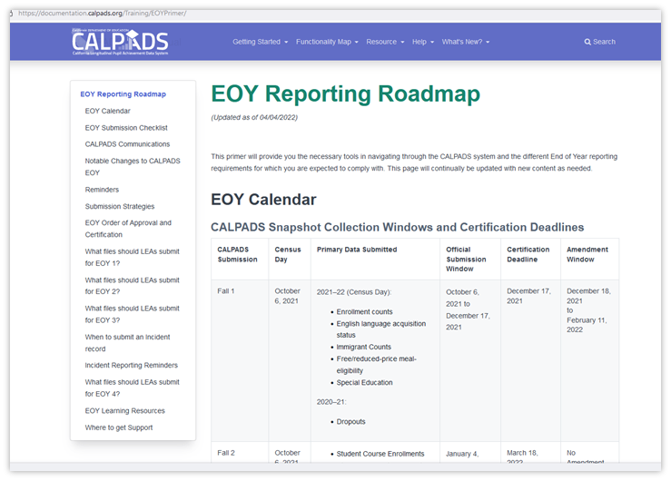
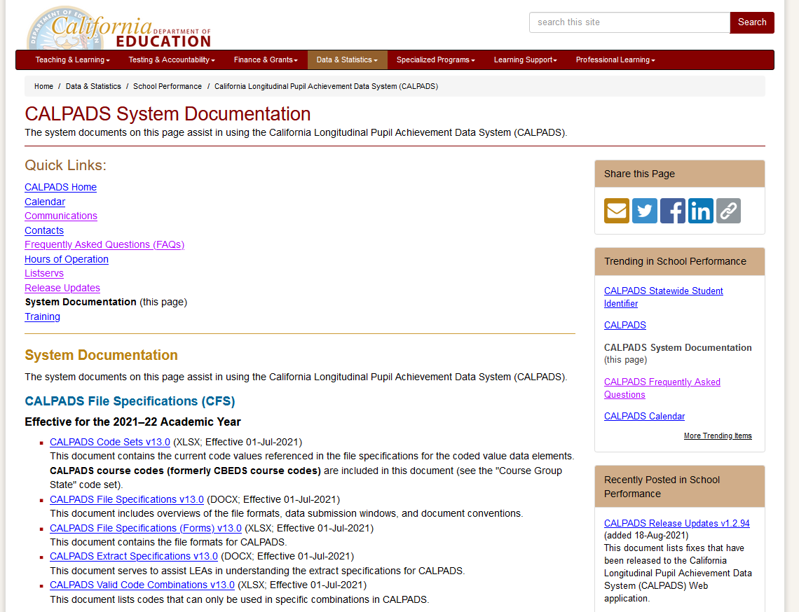
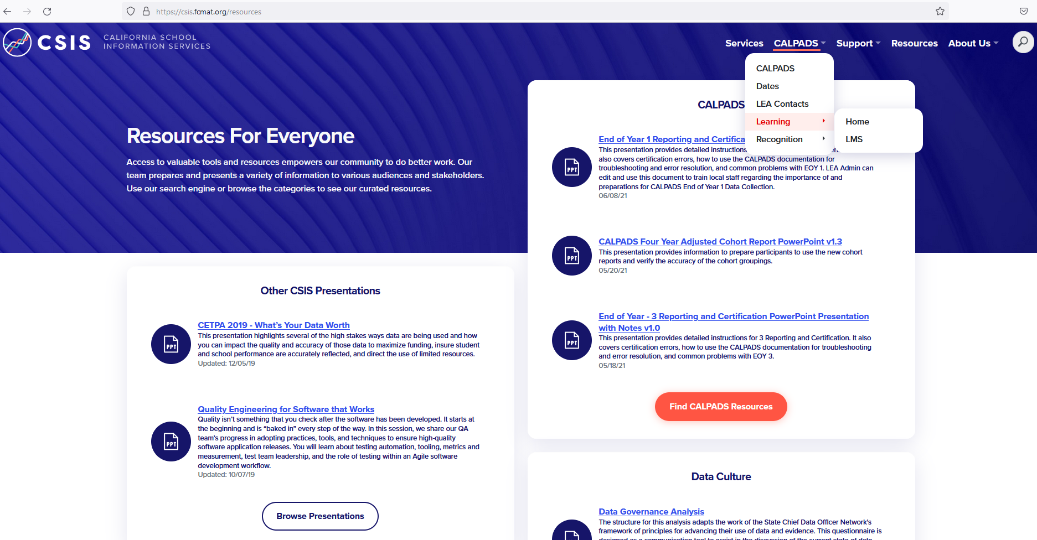
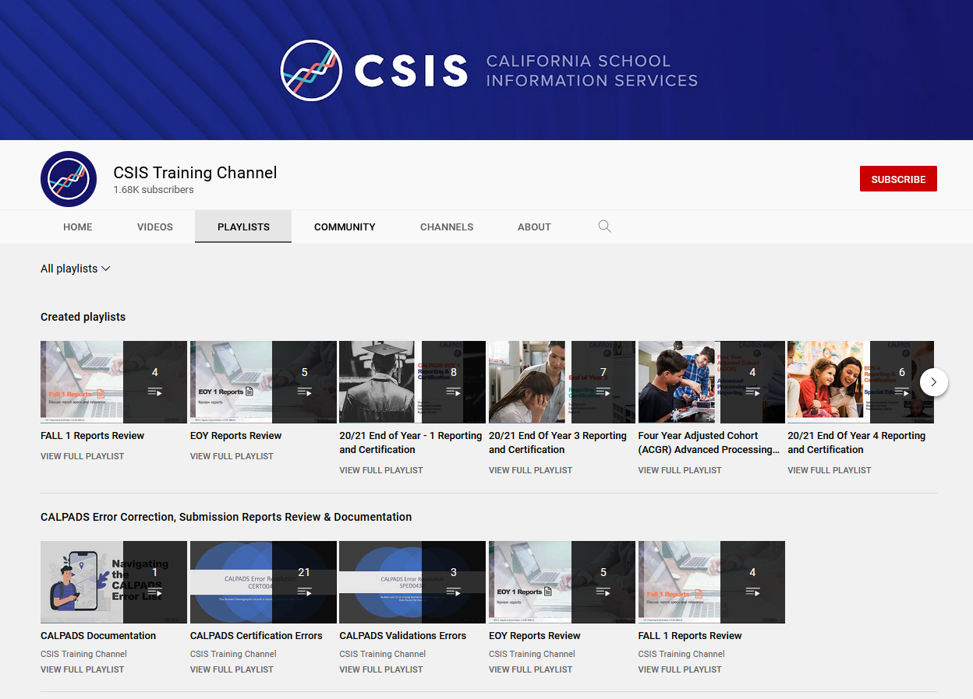
EOY 1 Survival Kit
Let’s build your CALPADS Data Literacy!
Where do I find information about the data collection?
Where are the key dates and submission timeline located?
How can I audit or track the tasks involved for completion?
Notes:
LEAs should also be aware that there are excellent reference documents available to download for guidance on different aspects of CALPADS reporting.
Getting started let us look at a few places to find information that will assist in data population.
Documentation
User Manual
CALPADS Code Sets
File Specifications Form
Error List
Data Guide
Valid Code Combinations
Every submission requires some planning to be successful. EOY typically requires more planning because of the size of the data collection and limited staff availability. Here are some questions that need to be answered prior to the start of your EOY submission.
Where do I find information about the data collection?
Where are the key dates and submission timeline located?
How can I audit or track the tasks involved for completion?
It is important to know which resources that provide this information and have a referential understanding of the contents. You should know which document to go to when researching, not specifically recalling the answer.
Instructions for the presenter:
Introduce the CALPADS system documents page and the CALPADS User Manual
Show the EOY 3 details in the CFS (docx)
Show the EOY timeline in the CALPADS Calendar
Highlight the EOY Roadmap
Walk through the EOY checklist

Slide 10


Collection Purpose
CA Dashboard and DataQuest
Dashboard State Indicators
Academic Performance
English learner Progress
Chronic Absenteeism
Graduation Rate
Suspension Rate
College/Career
Provide Student expulsion and suspension information to satisfy requirements related to "persistently dangerous" schools
Provide student suspension and expulsion counts and related information for students with disabilities
CA AB 2657
CA Dashboard will use Chronic Absenteeism and suspensions
Provide information on the use of restraint and seclusion for students fulfill statutory requirements of
Title 1 Part A Basic Grant ESSA 1115
Every Student Succeeds Act (ESSA) Section 1111(h)(1)(C)(ii)
(ESSA sections 1113(c)(3)(A)(ii) and (B)(i-ii)
McKinney Vento
Notes:
The behavioral incident submission
Provides student expulsion and suspension information to satisfy Every Student Succeeds Act (ESSA) requirements related to "persistently dangerous" schools and the Uniform Management Information Reporting System (UMIRS)
To determine persistently dangerous schools
Provides student suspension and expulsion counts and related information for students with disabilities for federal Individuals with Disabilities Education Act (IDEA) reporting.
Provides information regarding the use of restraint and seclusion for students receiving either general education or special education to the fulfill statutory requirements of AB 2657
Chronic absenteeism is one of the state indicators California School dashboard as such is one of the measures used to meet the requirements of the Every Student Succeeds Act (ESSA)

Slide 11

Student Programs
Discuss student program eligibilities/ participation

Slide 12
Programs Collected
Fall 1
Fall 1
End of Year
Code | Program | Type
181 | Free Meal Program | Federal
182 | Reduced-Priced Meal Program | Federal
127 | Gifted and Talented Education (GATE) | Federal
Code | Program | Type
300 | LIP - Developmental Bilingual Program | State
301 | LIP - Dual-Language Immersion Program | State
302 | LIP - Heritage or Indigenous Language | State
303 | LIP - Newcomer Program (Various Models) | State
304 | LIP - One-Way Immersion Program | State
305 | LIP - Structured English Immersion Program or other predominantly English Language Instructional Models | State
306 | LIP - Transitional Bilingual Program | State
Code | Program | Type
122 | Title I Part A Basic Targeted | Federal
174 | Title I Part A Neglected | Federal
191 | Homeless Program | Federal
192 | Armed Forces Family Member | Federal
193 | Tribal Foster Youth | Federal
101 | 504 Accommodation Plan | State
108 | Opportunity Program | State
113 | California Partnership Academy | State
162 | Pregnant or Parenting Programs (formerly Cal-SAFE) | State
194* | Expanded Learning Program | State
Student Program records should be regularly updated in CALPADS throughout the year regardless of the submission period.
*Expanded Learning programs will be submitted through LEAP file type
Notes:
This is a list of all Program codes that are collected throughout the year. Although, some programs are collected in Fall 1 and some in End of Year, it is important to report/update a student’s eligibility or participation in CALPADS as soon as the information is available. You do not need to wait until the submission window opens to submit EOY programs.
*Although programs listed are collected in Fall 1, it is important to continually update program records since some programs are used for subgroup reporting in EOY and the CA Dashboard.
What are the data used for?
Title I Part A Targeted and Schoolwide Program and Neglected Participation counts for ESSA reporting
Including targeted services
Counts of students participating in the following programs
Opportunity programs
California Partnership Academy
Pregnant or Parenting (proxy for single parents for Perkins)
Transitional Kindergarten
504 Accommodation Plans
Armed Forces Family Member (ESSA student group)

Slide 13

Title I Part A Basic Targeted
Title I, Part A, Improving Basic Programs Operated by Local Educational Agencies ESSA
A program providing services to improve student academic achievement of eligible students in Title I schools.
Education Program Code: 122
Program Start Date: Date the student was identified as participating in the program at a school.
Program End Date: the date a student ceased participating in the program at a school or the last day of school
Each Student may have multiple Program 122 records with diff. education service codes.
For schools that are identified as a Title I, Part A Targeted Assistance School.
TAS Resource:
https://www.cde.ca.gov/sp/sw/t1/tasinfo.asp
Records should be closed out annually and resubmitted the following academic year with a new program start date and Title I Services (Education Service Code) a student is receiving.
Notes:
Students participating in the Title I Part A Basic Targeted are reported with a program 122 record.
A student’s participation should be reported annually.
*Program 122 records should only be reported if the student is enrolled in a school that is identified as a Title I, Part A Targeted Assistance School.
If a school is identified as a Schoolwide school in CARS, Program 122 do not need to be reported since all students are counted as participating.

Slide 14
Title I Part A Targeted vs Schoolwide
Difference between Title I Part A programs
Title I Part A Basic Targeted
Submit Program 122 record
Review Report 5.2
Title I Part A Basic School wide
Do not submit program record.
Certify in CARS that school is operating as a school wide school.
Review Report 5.1. Upon CARS certification, total school enrollment count should automatically reflect under the School wide column.
Resource:
CARS:
https://www.cde.ca.gov/fg/aa/co/index.asp
TAS: https://www.cde.ca.gov/sp/sw/t1/tasinfo.asp
SWP:
https://www.cde.ca.gov/sp/sw/t1/schoolwideprograms.asp
Note: Incorrectly certified CARS designation may possibly trigger CERT097 errors in EOY 1.
Notes:
Title I Part A Schoolwide programs (SWP) allows schools with poverty threshold of 40% or higher to use funds to upgrade the entire educational program for all students, whereas Targeted Assistance Schools (TAS), which requires the Program 122 records, use funds only for specific students identified as failing or at risk of failing to meet state academic standards. SWP offers more flexibility to blend resources, while TAS requires strict tracking of eligible students.
Students participating in the Title I Part A Basic Targeted are reported with a program 122 record.
A student’s participation should be reported annually.
*Program 122 records should only be reported if the student is enrolled in a school that is identified as a Title I, Part A Targeted Assistance School.
If a school is identified as a Schoolwide school in CARS, Program 122 do not need to be reported since all students are counted as participating.
Identify participating students based on criteria listed in this https://www.cde.ca.gov/sp/sw/t1/tasinfo.asp.
Include the education service code of subject matter where program is provided.
If a school is not correctly classified (NOT A Title I Targeted School but a Title I School Wide school or vice versa), the LEA must open the 2019–20 Title I, Part A Notice of Authorization of School Wide Program form in CARS, then either add or remove the check mark for the school in the “Authorized” column, and then save and certify the data collection.
The CARS certification requires an overnight update before it reflects in CALPADS. Please coordinate with your staff in charged with the Consolidated Application (ConApp) reporting.
Additionally, a student can have more than one Program 122 record reflecting multiple education service codes (subjects) being reported.
Resources:
https://www.cde.ca.gov/sp/sw/rt/index.asp
http://www.cde.ca.gov/fg/aa/co/cars.asp
ConApp Support Desk | conappsupport@cde.ca.gov | 916-319-0297

Slide 15
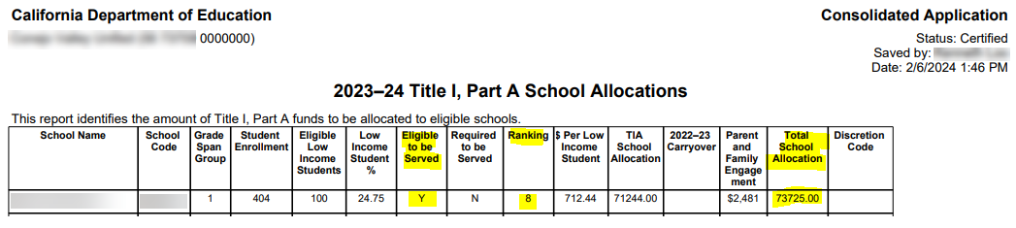
How to check your CARS status
Coordinate with your CARS person and double check what school have been determined as Eligible to served.
For Eligible schools, determine if a school is a SchoolWide school or Targeted Assistance School (TAS)
If designations were incorrect, your CARS person will recertify CARS certification.
Notes:
Since the 6 schools were allocated funds and has school rankings of 1-6 for Eligible to be Served the school must be identified as SchoolWide or TAS in CARS. If the school is identified as SchoolWide no program records are required in CALPADS. If the school is identified as TAS at least one student must have a Program 122 Record in CALPADS. If the school was not serviced at all please advise ASAP and explain the reasoning, even if this was completed in error/oversight. Thank you in advance for your responses.

Slide 16

CARS Game Plan
Run Report 5.1 certified in EOY 2
2024-2025
Determine who is responsible for Title I funding/ CARS. Verify each schools’ current designation.
CARS person must accurately certify CARS flagging each school as either Schoolwide or not
Report Program 122 records of eligible students of Title I Part A Targeted schools. Schoolwide schools automatically count all enrolled students.
Run Snapshot 5.1 for EOY 1 2025-26.
Confirm counts for Targeted and Schoolwide schools.
Review all other columns too.
CERTIFY!
WINNING!
Remember:
Check CARS certification deadline.
CARS certification does not reflect immediately in CALPADS.
Start ASAP!
Notes:
This is a simple game plan to make sure your CARS and CALPADS reporting align smoothly for EOY.

Slide 17

504 Accommodation Plan
504 plans are formal plans that schools develop to give kids the support they need. That covers any condition that limits daily activities in a major way.
Education Program Code: 101
Program Start Date: Date the student was identified as having a 504 Accommodation Plan.
Program End Date: Date the student was determined to be ineligible at a school.
A student’s eligibility should be verified annually, however these records are not required to be closed at the end of the year for returning students.
Notes:
Eligible students are reported with a program 101 record. A student’s eligibility should be verified annually,
however LEAs do not have to close these records annually, only when a student is not eligible anymore

Slide 18

Armed Forces Family Member
Used to meet Every Student Succeeds Act (ESSA) reporting requirements. Eligibility is based on the parent’s most recent active military status.
Education Program Code: 192
Program Start Date: Must be on or after the student’s birthdate
Program End Date: Should be populated when a student is identified as being no longer considered armed forces family member, or the last day of the school or Guard duty***
A student is considered to be an Armed Forces Family Member if at least one parent is an Armed Forces* member, on active duty** or serves on full-time National Guard.
* Armed forces means the Army, Navy, Air Force, Marine Corps, and Coast Guard
** Active duty means full-time duty in the active military service of the United States
*** Full-time National Guard duty means training or other duty, other than inactive duty
Notes:
“This slide covers reporting for students identified as Armed Forces Family Members.
This data is collected to meet Every Student Succeeds Act (ESSA) reporting requirements and is reported using Education Program Code 192.
A student qualifies if at least one parent is an Armed Forces member—meaning active duty military or full‑time National Guard service. Eligibility is based on the parent’s most recent active status.
The program start date must be on or after the student’s birthdate and should reflect when the student was identified as eligible. The program end date should be populated when the student is no longer considered an Armed Forces family member or on the last day of school.
LEAs are asked to report these records when the information is available, as they support federal reporting and student group identification.
The key takeaway is accuracy—report eligibility when known, use correct dates, and exit the record when eligibility ends to ensure clean EOY reporting.”
Education Program Code 192 will be used to meet Every Student Succeeds Act (ESSA) reporting requirements. LEAs are asked to submit these data if available.
Eligibility is based on the parent’s most recent active military status
The program start date must be on or after the student’s birthdate
The Program end date should be populated when a student was identified as being no longer considered armed forces family member, or the last day of the school
A student is an Armed Forces Family Member if at least one parent is an Armed Forces* member, on active duty** or serves on full-time National Guard duty***
* Armed forces means the Army, Navy, Air Force, Marine Corps, and Coast Guard
** Active duty means full-time duty in the active military service of the United States
*** Full-time National Guard duty means training or other duty, other than inactive duty

Slide 19

Title I Part A Neglected
Education Program Code: 174
Program Start Date: Date a student was identified as participating in the program at a school.
Program End Date: Date a student ceased participating in the program at a school. Or the last day of school
Records should be closed annually and resubmitted at the beginning of the school year if the student continues to participate.
Title I, Part D, Subpart 2 Prevention and Intervention Programs for Children and Youth Who Are Neglected, Delinquent, or At-Risk
Notes:
Speaker Notes:
“This slide explains reporting for the Title I Part A Neglected program.
This program supports students who are neglected, typically those living in group homes or licensed children’s institutions, and who attend non‑Title I schools within the district.
Eligible students are reported using Education Program Code 174. The program start date reflects when the student began participating, and the program end date is when the student stopped participating or the last day of school. These records must be closed annually and resubmitted in the new school year if the student continues to qualify.
It’s important to note that Program 174 is only required if the LEA has students in eligible neglected institutions and those students attend non‑Title I schools.
Also, this program should not be confused with Title I Part D, which is reported separately and primarily applies to county office juvenile court programs.
The key takeaway is to verify student eligibility, use correct dates, and close records annually to ensure accurate EOY reporting and avoid certification errors.”
The Title I Part A Neglected Program is funding that districts can allocate from their general Title I Part A allocation to serve neglected students (generally students in group homes or licensed children’s institutions) that are attending non-Title I Targeted Assistance (TAS) or Schoolwide Program (SWP) schools in the district.
Participating students are reported with a program 174 record. The Title I, Part A Neglected is only required by the LEA if there are students in an eligible institution for neglected children and youth and if these neglected children and youth attend a non-Title I school.
Resource: https://www.cde.ca.gov/sp/sw/t1/title1ptaneglected.asp
NOTE: The Title I, Part A neglected reservation should not be confused with the Title I, Part D Neglected or Delinquent or the At-Risk program. Title I, Part D funds are allocated by the California Department of Education to County Offices of Education (COEs) primarily to support COE juvenile detention education programs. https://www.cde.ca.gov/sp/sw/t1/nord.asp

Slide 20

Pregnant or Parenting
Data should be reported even if district is no longer funded for Cal-SAFE. Data are used to identify pregnant or parenting students for Carl Perkins Career Technical Education Program reporting.
Education Program Code: 162
Program Start Date: Date the student was determined to be eligible
Program End Date: Date the student was determined to be ineligible at a school or is no longer parenting.
Records should not be closed annually for returning students. For students exiting the school, these records may, but are not required to be closed.
Notes:
Speaker Notes:
“This slide covers reporting for students who are pregnant or parenting.
These data are reported using Education Program Code 162 and should be submitted even if the district is no longer funded for Cal‑SAFE. The reason is that these records are used for Carl Perkins Career Technical Education reporting, not just program funding.
The program start date is the date the student was determined to be eligible, and the program end date is when the student is no longer eligible or no longer parenting. These records do not need to be closed annually for returning students. For students exiting the school, records may be closed, but it is not required.
Eligibility includes both student mothers and student fathers, so it’s important to ensure all eligible students are identified and reported.
The key takeaway is that Program 162 should be reported when eligibility is known, kept open for continuing students, and updated only when eligibility changes, to ensure accurate EOY reporting and support statewide CTE accountability.”
Eligible students are reported with a program 162 record. These records should not be closed annually for returning students.
For students exiting the school, these records may, but are not required to be closed. Eligibility include both student father and mother.
If a district is no longer funded for the California School Age Families Education (Cal-SAFE) Program, but still collects data on those students, the data should still be reported to CALPADS because these data are used to identify pregnant or parenting students for Carl Perkins Career Technical Education Program reporting.

Slide 21



California Partnership Academy
The CPA model is a three-year program (grades ten-twelve) structured as a school-within-a-school. Academies incorporate integrated academic and career technical education, business partnerships, mentoring, and internships
Education Program Code: 113
Program Start Date: First date a student was identified as participating in the program at a school
Program End Date: Date a student ceased to participate in a CPA; or the date the student exited the school
Records are not required to be closed at the end of the year for returning students. However, a student’s eligibility should be verified annually.
Notes:
Speaker Notes:
“This slide covers reporting for the California Partnership Academy program.
The CPA is a three‑year school‑within‑a‑school model, typically serving grades 10 through 12, and integrates academic instruction, career technical education, business partnerships, mentoring, and internships.
Students participating in a CPA are reported using Education Program Code 113. The program start date is the first date the student was identified as participating, and the program end date is when the student stops participating or exits the school.
These records do not need to be closed at the end of the year for returning students, but eligibility should be verified annually. LEAs must also report the California Partnership Academy ID assigned to the program, as listed in the CDE Academy Directory.
The key takeaway is to report Program 113 accurately, keep records open for continuing students, and verify participation each year to ensure correct EOY reporting.”
Participating students are reported with a program 113 record. A student’s eligibility should be verified annually, however these records are not required to be closed at the end of the year for returning students. LEAs must indicate the California Partnership Academy ID assigned to the program as listed in the Academy Directory https://www.cde.ca.gov/ci/gs/hs/documents/cpadirectory.xls

Slide 22

Opportunity Education Program
Opportunity Education schools, classes, and programs provide additional support for students who are habitually truant from instruction, irregular in attendance, insubordinate, disorderly while in attendance, or unsuccessful academically. They are operated either by school districts or county offices of education.
Education Program Code: 108
Program Start Date: First date a student was identified as participating in the program at a school
Program End Date: Date a student ceased to participate in the program; or the date the student exited the school
Records are not required to be closed at the end of the year for returning students.
However, best practice is that this be verified annually, and LEAs can opt to close these records annually if it helps to facilitate the reverification process.
Notes:
Speaker Notes:
“This slide explains how to report students participating in Opportunity Education programs.
Opportunity Education schools, classes, and programs provide extra support for students who are habitually truant, irregular in attendance, insubordinate, disorderly, or academically unsuccessful. These programs are operated by school districts or county offices of education.
Students are reported using Education Program Code 108. The program start date is when the student begins participating, and the program end date is when they stop participating or exit the school. Records do not need to be closed annually for returning students, but eligibility should be verified each year. LEAs can opt to close records annually if it helps with reverification.
The key takeaway is to ensure accurate reporting—verify eligibility annually, keep records open for continuing students, and update when participation changes. This helps track support for at-risk students and ensures compliance with CALPADS requirements.”
Opportunity Education schools, classes, and programs provide additional support for students who are habitually truant from instruction, irregular in attendance, insubordinate, disorderly while in attendance, or unsuccessful academically. They are operated either by school districts or county offices of education. However, the authority for a school district to establish a new opportunity education school, class, or program was repealed effective January 1, 2006.
Participating students are reported with program 108 record. These records are not required to be closed at the end of the year for returning students. However, best practice is that this be verified annually, and LEAs can opt to close these records annually if it helps to facilitate the reverification process.
Resource: https://www.cde.ca.gov/sp/eo/oe/
The desired outcome is fully engaged students who are learning in the manner best suited to their needs. This will also result in:
Closing the achievement gap
Decreasing the dropout rate
Increasing the graduation rate
Students enrolled in grades one through twelve may be assigned to the Opportunity Education environment for all or part of the school day. For identification and referral purposes, students may already exhibit attendance or behavior problems, or they may be at risk of exhibiting behavior problems, such as irregular attendance, insubordination, and/or disorderly conduct while attending school. The intent of the identification and referral process is to provide assistance that will help students succeed in traditional classes or enable them to return to traditional classes as soon as possible.

Slide 23

Homeless Students
CALPADS administrators should coordinate with their local homeless liaisons to identify homeless students
LEAs should submit a Student Program (SPRG) record reflecting an Education Program Code of 191 – Homeless Program
EOY cumulative homeless counts are the basis for federal funding
Update your data in CALPADS as frequently as possible to help county and state liaisons better plan and provide support to districts experiencing significant increases in homeless student enrollment
Notes:
CALPADS administrators should coordinate with the local homeless liaison to ensure students are identified and updated in CALPADS.
When a student is identified, the LEA submits an SPRG record using Program Code 191 with the date the student became homeless.
Timely updates help ensure students receive services, support accurate statewide counts, and inform federal funding.
Eligible students may qualify for supports including Title I service, LCFF funding, free meals, SUN Bucks as well as local benefits like free bus passes

Slide 24
Required Annual Closure of Homeless Records
Scenario | Record Condition | System Behavior / Requirement | Action Required by LEA | Error Code
Student Homeless Across School Years | Homeless record has a start date before 7/1/25, no exit date, and the student is still enrolled in the LEA. | CALPADS will force the LEA to close the record at EOY with 6/30/25 end date or before. | Review and close the record with the appropriate exit date prior to or at EOY. If student is still homeless this year (25-26), create a new homeless record with start date 7/1/25 or later. | SPRG0747E1
Current-Year Homeless Record Still Open | Homeless record has a start date of 7/1/25 or later (AY 2025–26) and no exit date. | CALPADS will force the LEA to close the record at EOY. | Ensure the record is closed with the appropriate exit date when the student is no longer homeless or at EOY. | SPRG0746E1
Prior-Year Homeless Record Still Open | Student has a homeless record in prior AY and is not currently enrolled with your LEA. | Once EOY closes, CALPADS will auto-close records with 6/30/25 end date. | Nothing. Unless you want to update the program end dates based on the data in your SIS. | N/A
Notes:
“This table outlines how CALPADS handles different homeless record scenarios at End-of-Year and what actions LEAs need to take. DD errors will only trigger for current actively enrolled students with open homeless records.
First, when an actively enrolled student has a homeless record that started in a prior year and has no exit date,—CALPADS will automatically close that record at the end of the year using a date of June 30, 2025 or earlier.
In this case, LEAs should review the record and close it appropriately. If the student remains homeless into the new school year, a new record should be created starting July 1, 2025 or later.
Second, for current-year homeless records that are still open—meaning they started July 1, 2025 or later and have no exit date—CALPADS will also force those records to close at EOY.
LEAs should make sure these records are closed with the correct exit date when the student is no longer homeless, or by the end of the year.
Finally, for prior-year homeless records where the student is no longer enrolled in your LEA—CALPADS will automatically close those records after EOY with a June 30, 2025 end date. In this scenario, no action is required unless you want to update the dates based on your local data.

Slide 25

Expanded Learning Programs
Beginning in the 2025−26 academic year, CALPADS will collect annual participation in any one of the following expanded learning programs:
  Expanded Learning Opportunities Program (ELO-P)
  21st Century Community Learning Centers (CCLC) and the After School Safety and Enrichment for Teens (ASSETS) program
  The After School Education and Safety (ASES) program
Submission & Roles
Expanded Learning data will be submitted on a new LEA Program (LEAP) file as part of EOY 1 submission
The LEAP file will require a new LEAP View or LEAP Edit role assigned to LEA level users
Since the file does not have a School field, the roles cannot be given to School level users
Notes:
Flash 305 https://www.cde.ca.gov/ds/sp/cl/calpadsupdflash305.asp

Slide 26
Expanded Learning Details
Program Characteristic | Details
File type | LEAP File
Level of reporting | LEA level
What does “one” day represent? | One ELP day equals a student attending an ELP for any amount of time during a single day
May “0” days be submitted? | Yes. If the student did not attend any ELPs during the Academic Year, then Field 26.07 should be populated with “0.”
How many days may be submitted? | 0 – 300 days
How must attendance be tracked and maintained locally? | LEAs must track student attendance as may be required for the specific ELP program reporting requirements. For CALPADS reporting purposes, LEAs must track whether a student “attended” an ELP on a given day
Notes:
This table just list basic information essential to Expanded Learning reporting.
Refer to Flash #305 - https://www.cde.ca.gov/ds/sp/cl/calpadsupdflash305.asp

Slide 27

Behavioral Incidents
Discuss background of behavioral incidents submission
Notes:
Let’s look at the Behavioral incident submission.

Slide 28
Terminology
Incident - An event resulting in the use of physical restraint, mechanical restraint, or seclusion or a statutory offense is committed. Each incident may have multiple students involved, and each student may commit multiple offenses during a single incident
Incident Result - Outcome or result of an incident for a specific student
Statutory Offense – Student violations outlined in Education Code Sections 48900 and 48915 (Student Offenses in the CALPADS Code Set document)
Seclusion - the involuntary confinement of a pupil alone in a room or area from which the pupil is physically prevented from leaving
Behavioral Restraint
  Mechanical Restraint – Use of a device or equipment to restrict a pupil’s freedom of movement
  Physical Restraint – A personal restriction that immobilizes or reduces the ability of a pupil to move his or her torso, arms, legs, or head freely
Notes:
Discuss the terms relevant to the audience.

Slide 29



Incident Reporting Basics
What is the reporting period?
From July 1, 2025 – June 30, 2026
Incident records are reported for:
Enrollment:
  Primary enrolled (10)
  Secondary enrolled (20) and
  Short term enrolled (30) students
Grade Level: TK-12
Who can report Incident data?
All School sites within a LEA
NPS schools are expected to gather the data but LEA will report to CALPADS on their behalf*
* See Notes
Notes:
This covers the basic rules for reporting behavioral incidents in CALPADS for EOY 1.

Slide 30

Reporting Incidents
Report all 48900 and 48915 violations even if it did not result in suspension or expulsion
Report all instances of restraint or seclusion even if it was not the result of a violation of 48900 or 48915
Report all results for each incident for each student
Report any increment of a day for suspensions for all students
Report the duration of all:
  Suspensions (in and out of school)
  Expulsion
Duration is not required for any other incident results
California Education Code Section 49005.1 for specific definitions of restraint and seclusion
Notes:
Behavioral incidents that must be reported in CALPADS
All Education Code 48900 and 48915 violations must be reported, even if the incident did not result in a suspension or expulsion.
The absence of a disciplinary action does not mean the incident is excluded from reporting.
In addition, every instance of restraint or seclusion involving students with disabilities and general ed students must be reported, even when it is not connected to a 48900 or 48915 offense. These incidents are reportable on their own.

Slide 31
Restraint and Seclusion
All incidents occurring in the academic year resulting in the use of behavioral restraints or seclusion even if they were not a result of a violation of Education Code Sections 48900 and 48915 (suspension and expulsion offenses)
This collection is one piece of larger annual collection of incidents
Incidents involving violations of Education Code 48900 and 48915
Incidents resulting in restraint or seclusion even if they were not associated with E.C. 48900 or 48915
Restraint and Seclusion data should be reported to fulfill the statutory requirements of Education Code § 49005.1.
Involved students (Gen Ed or SWD) must be reported.
Notes:
All incidents involving behavioral restraint or seclusion must be reported to meet the requirements of Education Code Section 49005.1. This applies to both general education students and students with disabilities.
Purpose of Restraint and Seclusion Data Collection
CDE collects information regarding the use of restraint and seclusion for students receiving either general education or special education to fulfill the statutory requirements of Education Code § 49005.1
Data certified in the 2024-25 EOY 3 submission will be used to make monitoring determinations in the 2026 monitoring year.
Downloadable Restraint and Seclusion files can be found at the following web page:
https://www.cde.ca.gov/ds/ad/filesrsd.asp

Slide 32

Monitoring Restraint and Seclusion Data
The Courts have mandated that the Special Education Division use certified Restraint and Seclusion data as an additional data point in making its annual monitoring determinations:
LEAs reporting more than 2 restraints or seclusions per pupil (>2:1 ratio) will be asked to perform student record reviews
LEAs that:
  Report zero incidents of restraint or seclusion and have greater than 100 students with disabilities; or
  Report zero incidents of restraint or seclusion and have greater than 100 students with disabilities enrolled at Nonpublic Nonsectarian Certified Schools (NPS); or
  Fail to certify the CALPADS EOY 1 submission
  will be flagged for questionable data quality and will have to complete monitoring activities associated with data quality
Notes:
The courts have directed the Special Education Division to use certified restraint and seclusion data as part of its annual monitoring determinations.
LEAs that report more than two restraints or seclusions per student—that is, a greater than 2‑to‑1 ratio—may be required to complete student record reviews as part of monitoring.
LEAs may also be flagged for questionable data quality if they:
– Report zero incidents of restraint or seclusion while serving more than 100 students with disabilities,
– Report zero incidents while serving more than 100 students with disabilities in Nonpublic Schools, or
– Fail to certify their EOY 1 submission.
Being flagged doesn’t automatically mean something was done wrong—but it does mean the LEA will be required to complete additional monitoring activities to validate data quality.
The key takeaway here is that zeroes matter just as much as high counts. LEAs should make sure incidents are being identified, documented, and reported consistently, and that certification reflects what actually occurred during the year.”

Slide 33

Defiance Law
Since July 1, 2020, the law prohibits*:
  Suspending students in grades TK-5 for committing defiance
  Suspending students in grades 6-12 for committing defiance,
  Charter schools from suspending and expelling students for defiance
    The same law is applied to charter schools
*Except as provided in the authority provided to teachers in EC Section 48910
DD Warning!
Error # | Error Name | Error Description | Severity
SOFF0710E1 | Invalid Incident Result Code and Grade Level Combination for Student Offense Code 511 (disruption, defiance) | Students in Grades IN, PS, TK, KN, 01-12 should not be suspended for disruption or defiance (Student offense code = 511) | Warning
Notes:
Key Aspects of the California Defiance Ban:
Scope: The law applies to all K-12 public schools, including charter schools.
Definition: "Willful defiance" generally refers to disrupting school activities or defying the authority of teachers or administrators, such as refusing to follow directions.
Exceptions: Suspension is still permitted for severe, specific acts of violence, bullying, or drug possession as defined in the Education Code.
Alternatives: Schools are expected to use restorative justice, positive behavior interventions, and counseling instead of suspending students for minor behavioral issues.
See https://leginfo.legislature.ca.gov/faces/billNavClient.xhtml?bill_id=202120220AB181 for ed code. In addition to adding TK grade level, SB- 274 is amending to include grades 9-12 (previously grades K-8 were included in 2020).

Slide 34

Clarifying Teacher Suspension
Defined in EC section 48910, a teacher may suspend any pupil from class, for any of the acts in section 48900, for the day of the suspension and the day following.
The teacher shall immediately report the suspension to the principal for appropriate action.
Notes:
SB 274 Section 48900 excerpts
(1) Disrupted school activities or otherwise willfully defied the valid authority of supervisors, teachers, administrators, school officials, or other school personnel engaged in the performance of their duties.
(2) Except as provided in Section 48910, a pupil enrolled in kindergarten or any of grades 1 to 5, inclusive, shall not be suspended for any of the acts specified in paragraph (1), and those acts shall not constitute grounds for a pupil enrolled in kindergarten or any of grades 1 to 12, inclusive, to be recommended for expulsion.
(3) Except as provided in Section 48910, a pupil enrolled in any of grades 6 to 8, inclusive, shall not be suspended for any of the acts specified in paragraph (1). This paragraph is inoperative on July 1, 2029.
(4) Except as provided in Section 48910, commencing July 1, 2024, a pupil enrolled in any of grades 9 to 12, inclusive, shall not be suspended for any of the acts specified in paragraph (1). This paragraph is inoperative on July 1, 2029.
California Education code section 48910 states:
(a) A teacher may suspend any pupil from class, for any of the acts enumerated in Section 48900, for the day of the suspension and the day following. The teacher shall immediately report the suspension to the principal of the school and send the pupil to the principal or the designee of the principal for appropriate action. If that action requires the continued presence of the pupil at the school site, the pupil shall be under appropriate supervision, as defined in policies and related regulations adopted by the governing board of the school district. As soon as possible, the teacher shall ask the parent or guardian of the pupil to attend a parent-teacher conference regarding the suspension. If practicable, a school counselor or a school psychologist may attend the conference. A school administrator shall attend the conference if the teacher or the parent or guardian so requests. The pupil shall not be returned to the class from which he or she was suspended, during the period of the suspension, without the concurrence of the teacher of the class and the principal.
(b) A pupil suspended from a class shall not be placed in another regular class during the period of suspension. However, if the pupil is assigned to more than one class per day this subdivision shall apply only to other regular classes scheduled at the same time as the class from which the pupil was suspended.
(c) A teacher may also refer a pupil, for any of the acts enumerated in Section 48900, to the principal or the designee of the principal for consideration of a suspension from the school.

Slide 35

Incidents for SWDs
Work with your CALPADS Administrator to make sure all incidents for students with disabilities are documented in the student information system. This includes any incidents occurring for students enrolled at including Nonpublic Nonsectarian Certified (NPS) schools:
  Check with special education administrators for any Behavioral Emergency Reports (BER) with evidence of:
    Violations of Education Code § 48900 or 48915
    In- or Out-of-School Suspensions
    Expulsions
    Physical restraint
    Mechanical restraint
    Seclusion
Notes:
LEAs should coordinate with special education administrators and case managers to identify any Behavioral Emergency Reports, or BERs, that may indicate a reportable incident.
These include incidents involving:
– Violations of Education Code 48900 or 48915,
– In‑school or out‑of‑school suspensions,
– Expulsions,
– Physical restraint,
– Mechanical restraint, or
– Seclusion.

Slide 36

NPS Reporting Expectations
LEAs and NPS schools must have policies and procedures in place to identify, document, and report incidents involving restraint and seclusion for students with disabilities
LEAs and NPS schools should ensure that all staff are appropriately trained
CALPADS Administrators should not have to determine what discipline records are reportable incidents
See Notes for resources.
Notes:
Are LEAs required to submit data for students at Nonpublic schools?
YES – LEAs are required to submit incident data that occurred at Nonpublic schools
LEA need to work with the NPS to collect and report the data that reflects the time the student attended the NPS during the school year
Video: https://youtu.be/82aN0lgEUPU?si=FTlqDuzCczHPTuoq
PPT Resource: https://documentation.calpads.org/Support/docs/2021-22/StudentDisciplineNPSReporting.pptx

Slide 37



Student Incident Submission
CONTEXT
Student enrollment must exist in the CALPADS ODS at the school of attendance for the academic year
SENR
Student Incident (SINC) File, LEAs will report all incidents at the school of attendance
Student Incident Results (SIRS) File, LEAs will report all results for each incident
SINC
SIRS
SOFF
Student Offense (SOFF) File, LEAs will report the statutory offense committed
A combination of a SINC and SIRS is required for an incident to be visible in CALPADS Student Details and Incident Data UIs
Notes:
Let’s now highlight the relationships between different file types involved in incident reporting. This is key when troubleshooting possible error during submission and certification.
The Incident submission, first requires student enrollment at the LEA. The Incident must be reported at the corresponding school of attendance in the enrollment record using the Student Incident file. After the incident has been posted to CALPADS the Student Incident Results (SIRS) File and the Student Offense (SOFF) File can be submitted. The values for student’s SSID as well as the Incident ID, School of attendance and Academic year are used to tie the students to incidents offenses and results.
The SINC is required to report all incidents and students involved in the incident. Each student involved in an incident will also be required to have at least one results record. Students who commit a statutory offenses should also have a student offense record. Student offenses are mapped to Ed codes 48900 and 48915.
Article 48900 reads:
ARTICLE 1. Suspension or Expulsion [48900 - 48927]
A pupil shall not be suspended from school or recommended for expulsion, unless the superintendent of the school district or the principal of the school in which the pupil is enrolled determines that the pupil has committed an act as defined pursuant to any of subdivisions (a) to (r), inclusive…
https://leginfo.legislature.ca.gov/faces/codes_displaySection.xhtml?sectionNum=48900.&lawCode=EDC
So, you can see that in most cases, one would expect to see a student offense record for students with incident records. Of course, incidents involving restraints or seclusions not with standing. They key is to ask yourself, if a student did not commit a statutory offense, meaning they did not have commit any violations that are described in the ed code, does this record need to be reported.

Slide 38
Incident Data Gathering
Incident
Incident date
Students involved
Incident Results
Suspension, expulsion, restraint, seclusion, etc.
Student Offense
Reportable E.C. 48900 or 48915
LEAs should record the detailed information for each incident
Notes:
Incident reporting has three related components: Incident, Offense, and Result
Incident = the event that occurred (for example, fight, altercation, restraint)
Offense = the student’s violation tied to Education Code 48900 or 48915
Result = the outcome or action taken (for example, suspension, expulsion, restraint, seclusion)
An incident may occur with or without an offense A student may have multiple offenses within one incident
A student may have multiple results tied to one incident
This structure requires multiple CALPADS files to accurately report incidents Federal discipline reporting is collected at the incident level
Key takeaway: accurate reporting depends on capturing all three components correctly

Slide 39
Incident Scenarios
Result
Scenario 2
Student
Student
Offense 2
Offense 1
Results
Incident
Incidents may be reported for a single student with no offense or with multiple students and multiple offenses
Student
Offense
Result
Scenario 1
Student 2
Student 1
Result 1
Result 1
Scenario 3
Offense 1
Result 2
Scenario 4
Offense 2
Offense
Notes:
Incidents can be reported any number of ways, with multiple students, multiple offenses. Conversely an incident may consist of a single student with no offense.
Scenarios:
A single student incident where the student committed multiple offensives.
A single student incident where no offenses (violation of ed code 48915 0r 48900) was committed.
A single student incident with a single offense.
A multiple student incident, with multiple offense committed.

Slide 40

Student Absenteeism
Discussion of the STAS submission
Notes:
The Student Absenteeism submission has gone unchanged but let's review the business rules related to the submission to make sure that we have a clear understanding.

Slide 41
Chronic Absenteeism Defined
A student who is a "chronic absentee“ misses 10% of the school year for any reason including excused and unexcused absences.
The student is a Chronic Absentee
Student misses 18 days during a 180-day school year. All absences unexcused.
The student is a Chronic Absentee
Student misses 18 days during a 180-day school year. Half the absences are excused, half are unexcused.
The student is a Chronic Absentee
Student misses 18 days during a 180-day school year. All absences are excused.
Notes:
A student who is a "chronic absentee“ misses 10% of the school year for any reason including excused and unexcused absences.
A "chronic absentee" has been defined in California Education Code (EC) Section 60901(c)(1) as "a pupil who is absent on 10 percent or more of the school days in the school year when the total number of days a pupil is absent is divided by the total number of days the pupil is enrolled and school was actually taught in the regular day schools of the district, exclusive of Saturdays and Sundays."

Slide 42




STAS Reporting Basics
What is the reporting period?
From July 1, 2025 – June 30, 2026
STAS from NPS schools should no longer be submitted.
STAS records are required for enrollment:
Primary enrolled (10) and
Short term enrolled (30) students
Grade Level: TK-12, who attended at least 1 day during the academic year
Who may be reported with a Y Exempt Indicator ?
Home Hospital students can be exempted
Student only attending college classes
Students who come back and have an enrollment to annotate a graduation
Adult-age SWDs enrolled in Transition Services
What Attendance type is included?
Include all students for whom attendance is reported as daily, hourly or project-based/coursework (independent study)
Notes:
STAS reporting is part of the EOY 3 data collection. Students included in the STAS reports will have an enrollment that was open at some point in the EOY reporting window. That is any enrollment that overlaps this reporting period of 7/1/2025 – 6/30/2026.
STAS record required for primary enrolled (10) and short term enrolled (30) students in grade levels TK-12, who attended at least a single day during the academic year. Adult, preschool, toddlers and infants are excluded.
The STAS record is required for students enrolled at all school types. Students enrolled at NPS schools and Home Hospital students are expected to be reported but use the exempt indicator if appropriate .

Slide 43

STAS Data 101
Exemptions are records that do not have attendance and absence fields populated
STAS in school and out of school suspension days are validated against the SINC record
In-school-suspensions count as attendance days
Out-of-school suspension days are added to absences
Emergencies and disasters should not count negatively against students, the expected attendance days should be adjusted
Notes:
Information about STAS records:
Exemptions are records that do not have attendance and absence fields populated
STAS in school and out of school suspension days are validated against the SINC record
In-school-suspensions count as attendance days
Out-of-school suspension days are added to absences
Emergencies and disasters should not count negatively against students, the expected attendance days should be adjusted

Slide 44
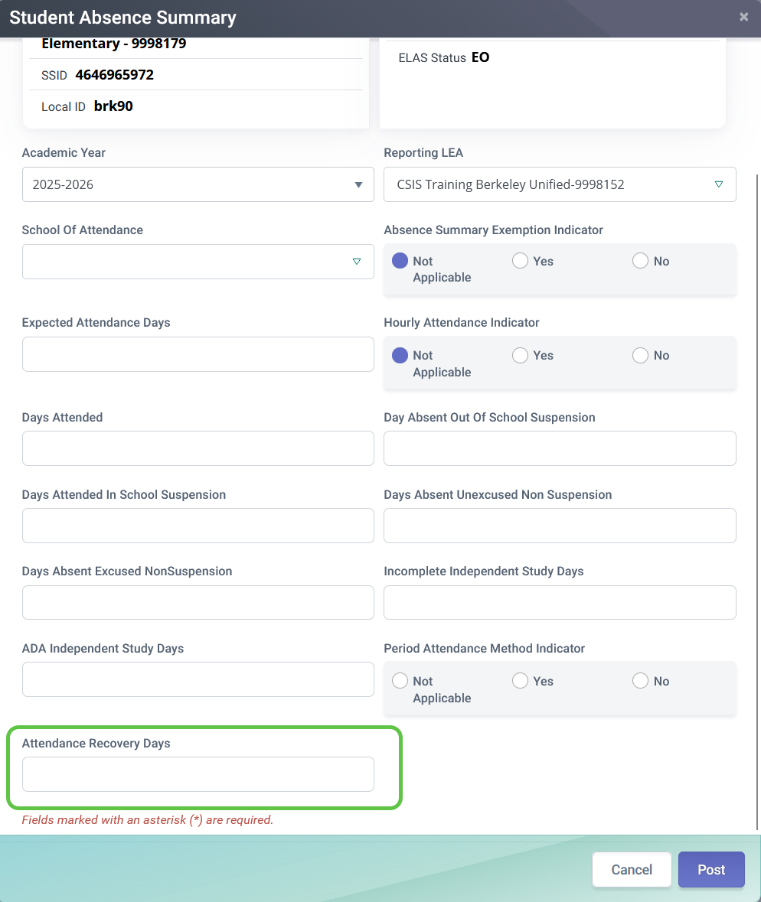
STAS Data
Data indicators
Data collection exemption
Hourly attendance school type
Period by Period Attendance Method
Attendance information
Expected attendance days
Days Attended
Days Attended In School Suspension
ADA-Generating Independent Study Days
Attendance Recovery Days
Absence information
Excused
Unexcused
Days absent out of school suspension
Non-ADA Generating Independent Study Days
Attendance Recovery Days
NEW!
Notes:
Each STAS record features data indicators, attendance information and absence information

Slide 45
Independent Study Days
Field # | Field Name | Description
13.21​ | Non-ADA-Generating Independent Study Days​ | Total number of days the student did not satisfy statutory and regulatory requirements necessary to generate a day of attendance for either traditional (Education Code Section 51747.5) or course-based (Education Code Section 51749.5) independent study.​
13.22​ | ADA-Generating Independent Study Days​ | Total number of days the student satisfied statutory and regulatory requirements necessary to generate a day of attendance for either traditional (Education Code Section 51747.5) or course-based (Education Code Section 51749.5) independent study.​ ​

Slide 46
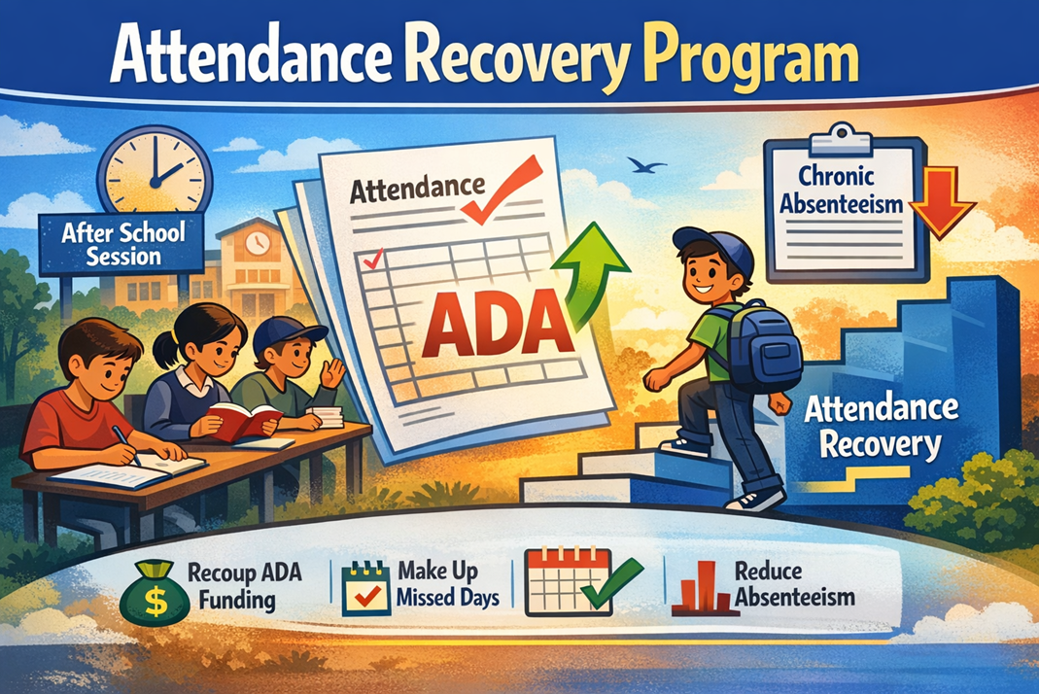
Attendance Recovery
Data will be reported in the STAS as new Field 13.24 – Attendance Recovery Days
This data is certified during the "new" End-of-Year (EOY) 1 submission
AR data is reported at the school of attendance where the absences occurred
LEAs can report a maximum of 10 AR days per student, per academic year, within the LEA
The number of AR days reported for a student at a school cannot exceed the student’s total number of excused and unexcused absences
Absences due to out-of-school suspensions are not eligible for recovery through AR
AR reporting is restricted to students in grades TK through 12
Attendance Recovery Days will not be part of the chronic absenteeism rate. Therefore, it not affect the Chronic Absenteeism data reported on the Dashboard or DataQuest.
Visit the CDE Attendance Recovery page for FAQs and details: https://www.cde.ca.gov/fg/it/aarecovery.asp
Notes:
New for this submission is the Attendance Recovery program
Attendance Recovery is optional, and it applies to students in grades TK through 12. The purpose is to give students an opportunity to make up missed instructional time so that the LEA can recoup ADA for absences.
It’s important to note that AR sessions have to be held outside of the regular school day. LEAs must follow all the statutory rules about how these sessions are run, including the length of the sessions. Beyond ADA recovery, the AR program is also intended to support efforts to reduce chronic absenteeism. By offering students a structured way to earn back time, it may help reduce the number of students who fall into the chronic absentee category.
For CALPADS the only new reporting element is that the STAS file will now include the number of Attendance Recovery days earned by each student. It is very important that your existing absence counts should not be adjusted based on AR days. You don’t subtract AR days from absences. Instead, AR days are reported in their own field, and CALPADS will use that information to calculate an alternative chronic absenteeism rate.
You can find additional information on Flash #305 and on the (CDE’s) Attendance Recovery web page to see FAQs and information on this new program: https://www.cde.ca.gov/fg/it/aarecovery.asp

Slide 47
Attendance Recovery Details
Program Characteristic | Attendance Recovery
How are data submitted to CALPADS? | On the STAS File
Are data reported based on what school the student is attending? | Yes, data are reported at the school level
What does “one” day represent? | One AR day equals a student attending an AR program for the number of hours required in statute for the student’s grade level and/or school setting (EC Section 46211(e)). The hours can occur over more than one day.
May “0” days be submitted? | LEAs do not have to populate Field 13.24 – Attendance Recovery Days, on the STAS file if the student did not earn any AR days and may leave the field blank. However, LEAs may populate the field with “0” and no error will trigger.
How many days may be submitted? | 10 days, or the total number of absences in an LEA, whichever is less
Notes:
You can find additional information on Flash #305 and on the (CDE’s) Attendance Recovery web page to see FAQs and information on this new program: https://www.cde.ca.gov/fg/it/aarecovery.asp

Slide 48
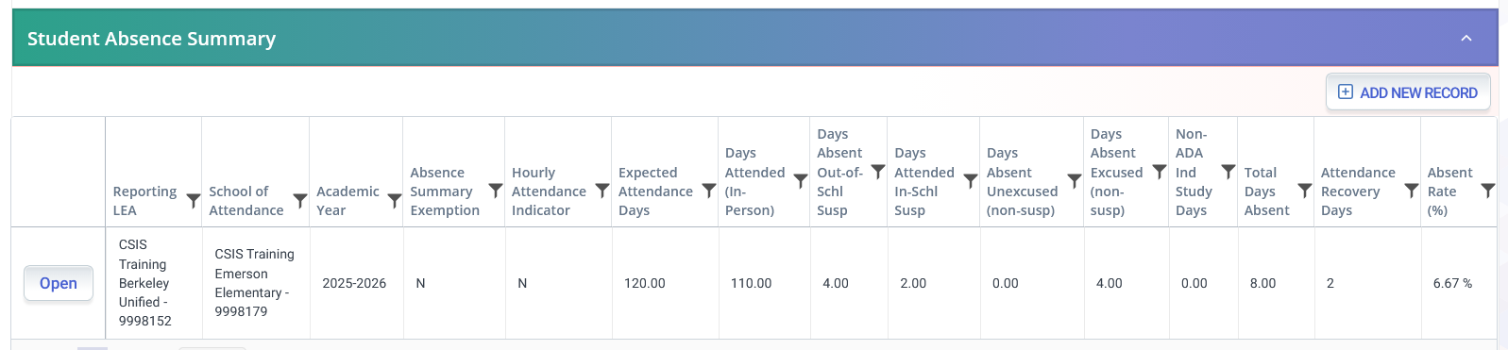
STAS Summary
Absent Rate is calculated by dividing the Expected Attendance Days by the Total Days Absent
Expected Attendance Days must equal Total Days Attended and Total Days Absent
Days Attended In-School Suspension are added with the Days Attended in calculations.
Total days absent is a calculation of the
days absent fields and Incomplete Independent Study Days
Days Attended are reported from SIS data
Absent categories are reported from SIS data
Notes:
The Student Absence Summary allows you to see a students Absence Summary History. All the fields displayed are populated from LEA submission with the exceptions of the two fields on the far right of the screen. The Total Days Absent and Absent Rate are calculations by the system derived from the data submitted.

Slide 49
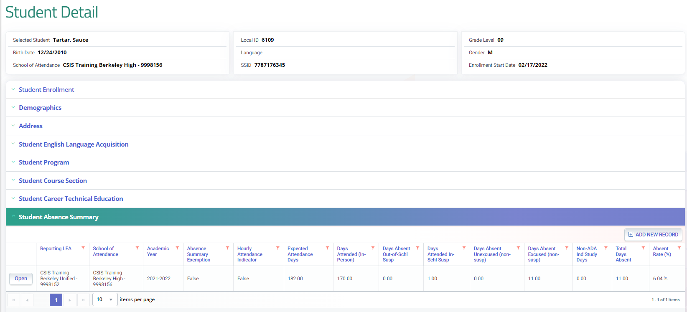
STAS Calculation
Total Days Absent divided by Expected Attended Days is calculated by the system to determine the Absent Rate
Notes:
Like other files the STAS has data fields that are used to match LEA and School as well as student demographic information.
All these fields are explained in the data population course and the CALPADS File Specifications.
As a Reminder:
The Data Collection Exemption Indicator allows you to identify NPS and home hospital students that should be excluded from STAS reporting. If the field is blank or has a N (No) value, all other fields below it are required to be populated. If the filed is populated with a Y (Yes), then all fields below should be empty.

Slide 50

Cumulative Enrollment, Reclassified Fluent Proficient
Discuss Cumulative Enrollment, RFEP, program

Slide 51

Cumulative Enrollment
  Cumulative Enrollment is a count of all students with an open enrollment at any time during the report period. It may include enrollments from prior academic year with exits extending until 8/15
  Adjusted Cumulative Enrollment is a count of students with an open enrollment that starts in the current academic year (07/01).
Note: Cumulative enrollment counts are determined by the SENR records submitted throughout the year. LEAs that perform ongoing maintenance of student data will not need to re-submit enrollment records for EOY 3, however SENR records will be required to exit students
Notes:
Cumulative Enrollment is a count of all students with an open enrollment at any time during the academic year. EOY 1 reports have a filter for the adjusted cumulative enrollment. The Adjusted Cumulative Enrollment is a count of students with an open enrollment that starts in the current academic year (07/01). The adjusted count is a subset of the Cumulative Enrollment that excludes students whose enrollment started in the previous academic year. e.g., students attending summer school to Complete 12th grade graduation requirements
The adjusted count is a subset of the Cumulative Enrollment that excludes students whose enrollment started in the previous academic year.

Slide 52

Cumulative Enrollment Uses
The cumulative enrollment count is used as a measurement of school and district size and in several data rate calculations
Suspension Rate
Expulsion Rate
Chronic Absenteeism Rate
Truancy Rate
Stability Rate
Notes:
Cumulative enrollment is used as a measurement of school and district size, by CalEdfacts. https://www.cde.ca.gov/ds/sd/cb/ceflargesmalldist.asp and also used as the denomitaor when calculating:
Suspension Rate Formula
Number of Students Suspended for an Aggregate Total of One Full Day in Current Year divided by Cumulative Enrollment
Expulsion rate Formula
The unduplicated count of students expelled divided by the cumulative enrollment at the selected entity for the selected student population
Chronic Absenteeism Rate
The unduplicated count of students determined to be chronically absent (Chronic Absenteeism Count) divided by the Chronic Absenteeism Enrollment at the selected entity for the selected population using the available filters.
Truancy Rate
The number of truant students divided by the cumulative enrollment, multiplied by 100.

Slide 53


RFEP Status
When an EL student has met all four criteria specified in Education Code section 313(f) for being reclassified including receiving an Overall Performance Level of 4 on the Summative ELPAC
Upon reclassifying students to Fluent English Proficient (RFEP), LEAs should update CALPADS with a SELA update
RFEP students will be exempt from any future Summative ELPAC
No longer “At Risk” of becoming a LTEL
Notes:
These RFEP counts will be reported as part of EOY 3 on reports:
2.16 - English Language Acquisition Status - ELs Reclassified RFEP
2.17 - English Language Acquisition Status - ELs Reclassified RFEP Student List
This will align the RFEP count with the timeframe used for the English Learner Progress Indicator (ELPI) on the California School Dashboard. In the past the CDE has received many questions regarding differences between the reclassified fluent English proficient (RFEP) counts posted on DataQuest compared to those RFEP counts posted on the California School Dashboard.
https://www.cde.ca.gov/ds/sp/cl/calpadsupdflash126.asp
EL policy is part of federal law. As required by the Every Student Succeeds Act (ESSA) in 2015, accountability for EL progress toward and attainment of English language proficiency is integrated into Title I accountability. Identifying RFEPs provides evidence of student learning outcomes.
RFEP’d students are redesignated from EL to FEP status according to the multiple criteria, standards, and procedures adopted by the district and demonstrate that students being redesignated have an English language proficiency comparable to that of average native English speakers.
https://dq.cde.ca.gov/dataquest/gls_learners.asp
English learners come from a range of educational and learning histories; districts and schools can vary considerably in the composition of their English learners. The state data system has made available a differentiated view of English learners with varying number of years in EL programs or services (“EL 0–3 years,“ “At-Risk 4–5 years,“ and [Long-Term English Learner] “LTEL 6+ years,“ “EL 4+ years not at risk of LTEL,“ [Reclassified Fluent English Proficient] “RFEP,“ and “Ever-EL“ [current plus former English learners]), as well as various state-specified statuses.
https://cabe2018.gocabe.org/wp-content/uploads/2018/03/CDE_EL_Roadmap_Guidance.pdf
EL4+ is an EL student in kindergarten through grade 12 who has been enrolled in a U.S. school for 4+ years and who has been determined to not meet the criteria for being “At-Risk” or LTEL, either because they are not in the applicable grade levels or because they have made progress on the English language development test and English language arts standards-based achievement test.
https://www.cde.ca.gov/Ds/sd/sd/fsltel.asp
Regardless of the reason that LTEL students have not reached grade-level proficiency or acquired necessary language skills, the primary defining characteristic of a LTEL student is that he or she struggles academically, rather than an inability to communicate in English more broadly (as may be the case with newcomer EL students). These students are not “progressing in English language development as would normatively be expected, and they struggle with the academic work expected of them. Typically, the gaps in performance are usually too wide to overcome using standard means.
https://portal.ct.gov/-/media/SDE/ESSA-Evidence-Guides/Effective_Interventions_for_Long-Term_English_Learners

Slide 54

SELA Status Reminders
2025–26 Summative ELPAC or Summative Alternate ELPAC Ends May 31, 2025
  Students will no longer be able to use 2024–25 results for reclassification after May 31, 2025.
  For students who may be reclassified based on their 2024–25 Summative ELPAC or Summative Alternate ELPAC scores we recommend testing them no later than May 15, 2025 this will ensure that all eligible students are tested as required by law.
Recommend LEAs Update RFEP Status in CALPADS by May 15, 2026
  Ensure students transferring have updated records in CALPADS within 10 days
Reminder to Assess TBD Students with Initial ELPAC Within 30 Days of Enrollment
Refer to CALPADS Flash #322 for more details.
Notes:
Student RFEP statuses are sent from CALPADS to TOMS on a nightly basis. For students who are reclassified, LEAs should upload their new RFEP statuses to CALPADS by May 15, 2026 to ensure the statuses are in TOMS by May 31, 2026. This is important because students who are RFEP in TOMS as of May 31, 2026 do not need to be tested.

Slide 55

Reclassification for any summer RFEPS
Key points:
Students should be reclassified when they meet all four criteria for reclassification and the English Language Acquisition Start Date should reflect that.
Students reclassified after last day of school who WILL NOT be returning should have RFEP date = last day of school.
Students reclassified after last day of school who WILL be returning should have RFEP date = must be at least one day after the Enrollment Start Date, regardless of time period.
Notes:
Students should be reclassified as soon as they meet all four reclassification criteria, and the English Language Acquisition Start Date must reflect when that actually happens.
The key takeaway is that RFEP dates must align with enrollment status. Correct dating ensures students are counted accurately and prevents reporting issues later.”
Flash 219 (https://www.cde.ca.gov/ds/sp/cl/calpadsupdflash219.asp) gives guidance on when to submit RFEP records and when they will be counted for state reporting purposes

Slide 56
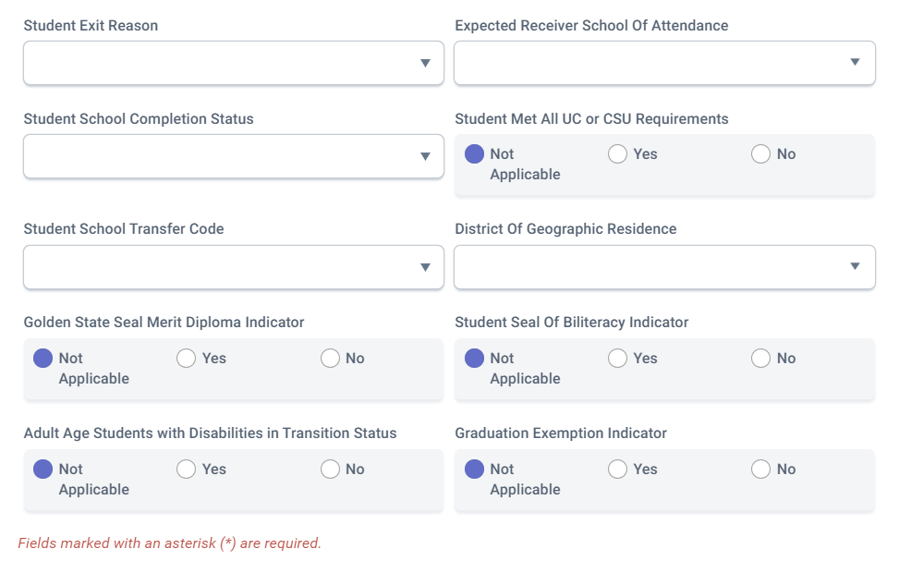
SB – 532 Graduation Exemptions
LEAs are required to collect data on students who graduated with an exemption from local graduation requirements.
  This indicator field should be marked “Y” for students who, in the current school year, graduated with an exemption from the LEA’s graduation requirements that are in addition to the statewide coursework requirements.
  Students should be exited with an E230/100 exit reason completion status combination
Eligible Student Sub-Group | Eligible Time for Exemption
Foster | Entered the school After 2nd year of High school
Homeless | Entered the school After 2nd year of High school
Former Juvenile Court school | Entered the school After 2nd year of High school
Military Family | Entered the school After 2nd year of High school
Migrant | Entered the school After 2nd year of High school
EL | New Immigrant and in 3rd or 4th Year of High school
Notes:
SB 532 Resource: https://legiscan.com/CA/text/SB532/id/2609430
Flash 260 : https://www.cde.ca.gov/ds/sp/cl/calpadsupdflash260.asp

Slide 57

SWD Submission
Special education exits and postsecondary status
Notes:
The Postsecondary submission is for students who were CTE pathway completers at any time during high school.

Slide 58




How Is The Data Used?
Special Education (SWDS, MEET, PLAN)
  Student counts for IDEA
  Special Education Monitoring
  DSEA – Dashboard accountability
Special Education Services (SERV)
  Special Education Monitoring
Postsecondary Status (PSTS)
  Post-school outcomes for IDEA; outcomes of SWD who exited secondary education in
Notes:
The purpose of the End-of-Year (EOY) special education data collection in CALPADS is to meet federal and state reporting requirements, facilitate compliance monitoring, and provide data for state accountability metrics. The Individuals with Disabilities Education Act (IDEA) is the primary driver of the data collection but data is also used to satisfy requirements for ESSA and California Education Code (EC) Sections 56600–56606. Edfacts makes the data publicly available as well. The EOY submission requires the SWDS (Status), PLAN, MEET, SERV (Services), and PSTS (Postsecondary Status) files.
End of Year Special education data is used to meet the reporting and monitoring mandates under the federal Individuals with Disabilities Education Act (IDEA). It provides cumulative, unduplicated counts of children and students (ages 0–22) who received special education services at any point during the academic year. The data also is used to monitor whether students are receiving a Free and Appropriate Public Education (FAPE) in the Least Restrictive Environment (LRE) and the specific special education services prescribed in a student’s plan (IEP, IFSP, or ISP). Data from the special education EOY collection identifies members of the "Students with Disabilities" student subgroup for all Dashboard indicators, including Suspension Rate, and Chronic Absenteeism. Additionally, students with disabilities who exited the program as graduates or dropouts for state graduation rate indicators.
The collection includes data from the Special Education Meetings (MEET) file to ensure LEAs are holding required meetings within legal timeframes:
Annual Reviews: IEPs must be reviewed at least once every 365 days.
Triennial Reevaluations: Students must be reassessed for eligibility at least once every three years.
Initial Evaluations: Evaluations for Part B services must be held within 60 days of receiving parental consent.
This data is vital for Child Find and transition reporting. State Performance Plan (SPP) and Annual Performance Report (APR) Indicators 11 and 12 measure whether initial evaluations are completed within the 60-day statutory timeline and whether children transitioning from Part C to Part B have plans in place by their third birthday.
A component of the EOY submission data is used to derive the percentage of services prescribed in an IEP that students actually received, helping the state identify systemic barriers or staff shortages that prevent students from receiving necessary supports.
LEAs must report on the activities of students with disabilities one year after they exit secondary education. This data is used to calculate State Performance Plan Indicator 14, which measures the percentage of youth who are enrolled in higher education or competitively employed after leaving high school.

Slide 59

EOY SWD Data Required Disabilities
Data is required for all children and students ages 0–21 who were evaluated for special education regardless of determination:
  ELIGIBLE AND PARTICIPATING in special education on an IEP, ISP, or IFSP
  Eligible, Not Participating
  Not Eligible
  Or exited the special education program
Postsecondary Status data for students with disabilities who exited secondary education in the 2024–25 academic year
Notes:
Records must be submitted for all students who received services at any point during the year, were referred but not yet evaluated, were found ineligible, or had a meeting (evaluation, plan review, or reevaluation). This includes students who:
Were ELIGIBLE AND PARTICIPATING in special education on an IEP, ISP, or IFSP
Were evaluated for special education but were determined to be:
Eligible, Not Participating
Not Eligible
Exited the special education program
Postsecondary Status data for students with disabilities who exited secondary education in the 2023–24 academic year

Slide 60
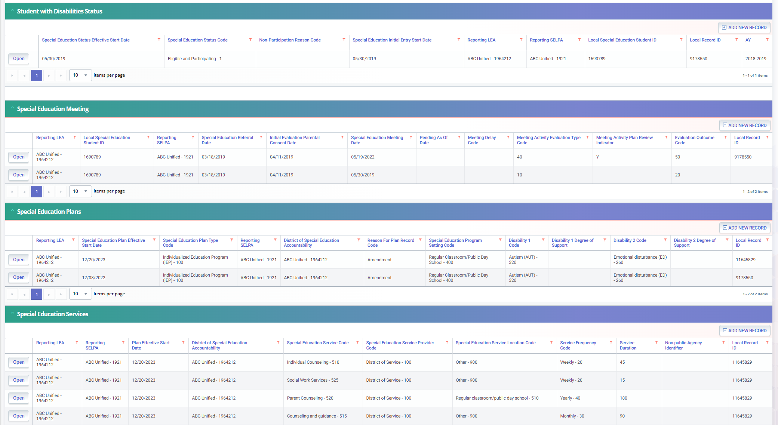
SWD Profile Data
Only Submit SWDS when status changes
MEET records must correspond with the PLAN type
PLAN records can be submitted with enrollment or plan changes
Services should correspond with PLAN changes by date
Notes:
So, the expectation is that CALPADS administrators (SIS) and Special Education coordinators (SEDS) must meet regularly. Special education records cannot be posted unless a matching enrollment (SENR) record exists in CALPADS. LEAs must affirm/lock all IEPs and amendments. Unlocked records in the SEDS will not transfer to CALPADS, leading to missing data and timeline compliance errors.
Here we have a screen shot of the Student detail screen where you can find the special education records. Again, If LEA submits a SWDS record with a Status of “Eligible and Participating”, student must have a Student Enrollment record at same LEA where the SWDS Status Start Date falls within the Enrollment Start and Exit Dates. Other statuses do not require a SENR. Typically, the only time an LEA would submit a status of Eligible and Participating is after a student is initially evaluated or if they exit then re-enter special education.
Once an INITIAL meeting is held, a SWDS record is expected. MEET records with Pending as of Date populated do NOT require SWDS record. The Meeting Activity - Evaluation Type Code must correspond with the PLAN record’s Special Education Plan Type Code.
Student must have a Student Enrollment record with Enrollment Start and Exit Dates that overlap the Plan Effective Start Date at the same LEA
Student must have SERV records with same SSID, Reporting LEA, SELPA, and Plan Effective Date

Slide 61

Compare Students in SEDS Against Students in the Student Information System
  Parents do not always disclose that a student has an Individualized Education Program (IEP) upon enrollment
  CALPADS requires a matching enrollment record (SENR) from the SIS to be posted before it will accept any special education files (SWDS, MEET, PLAN, or SERV)
Discrepancies between the SIS and SEDS can lead to an LEA being incorrectly identified as "disproportionate"
Missing exit information in one system can lead to students erroneously appearing on monitoring reports and flagged as overdue
Notes:
Local Educational Agencies (LEAs) should compare students in their Special Education Data System (SEDS) against those in their Student Information System (SIS) to ensure data synchronization, identify transferring students with disabilities, and maintain accurate accountability records.
Parents do not always disclose that a student has an Individualized Education Program (IEP) upon enrollment. Comparing SIS enrollments against CALPADS data allows LEAs to identify these students immediately.
CALPADS requires a matching enrollment record (SENR) from the SIS to be posted before it will accept any special education files (SWDS, MEET, PLAN, or SERV)
The SIS is the authoritative source for race and ethnicity data, while the SEDS is the source for disability and setting information. Discrepancies between these systems can lead to an LEA being incorrectly identified as "disproportionate" in its special education identifications or disciplinary actions.
Missing exit information in one system can lead to students erroneously appearing on monitoring reports, such as Report 16.21, which flags overdue annual plan reviews or triennial reevaluations
Investigate students who are in one system and not the other.

Slide 62
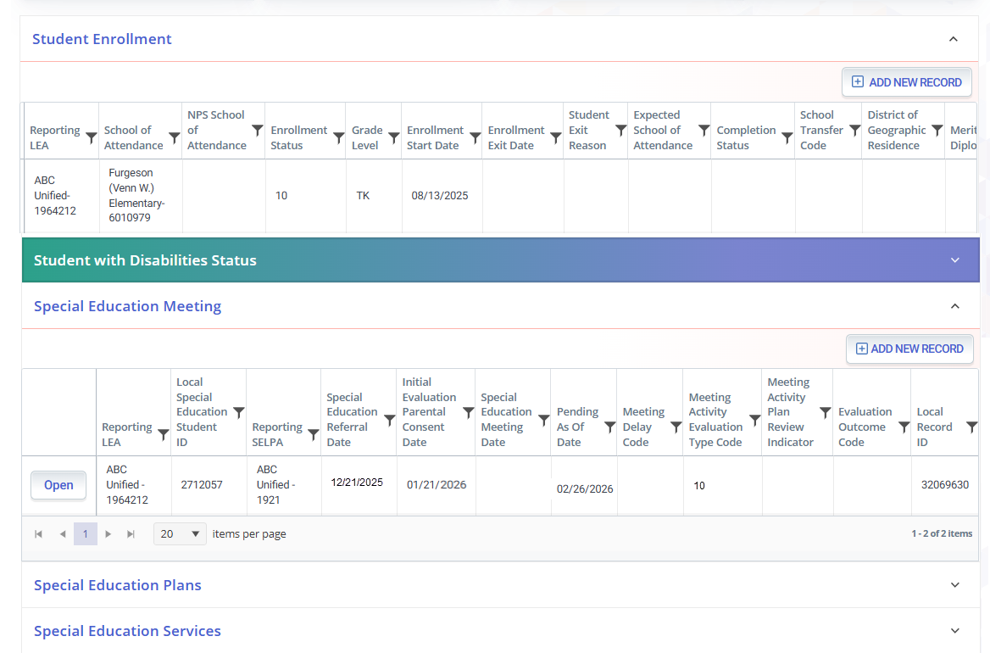
Review Pending Meeting Types
Ensure a pending MEET record is submitted for any student who received parental consent for initial evaluation who is PENDING INITIAL EVALUATION as of June 30, 2026.
If meetings have been held for these students, generate a transaction with the appropriate outcome of the initial evaluation
If parents revoked consent and the student will not be assessed, deactivate the student’s SEDS record and DELETE the pending record from CALPADS
Notes:
Ensure a pending MEET record is submitted for any student who received parental consent for initial evaluation who is PENDING INITIAL EVALUATION as of June 30, 2025.
Ensure these records have the following fields populated:
Referral Date
Referring Party
Meeting Type = Part B Initial Evaluation
If meetings have been held for these students, generate a transaction with the appropriate outcome of the initial evaluation.
If parents revoked consent and the student will not be assessed, deactivate the student’s SEDS record and DELETE the pending record from CALPADS.

Slide 63

Proactive Steps
  Resolve common/ frequently occurring errors
    SENR0606E1 – Missing PLAN record for enrolled Eligible and Participating Student
    PLAN0390E4-0397E1 – Missing Transition Indicators
    SENR04391 - Adult Age Students with Disabilities in Transition Status is required for this record
Use Monitoring Report 16.21 to monitor timelines
Account for SWD completers
  Graduates (Alternate Pathways)
  Certificate of completion
Notes:
Resolve common/ frequently occurring errors
SENR0606E1 – Missing PLAN record for enrolled Eligible and Participating Student
PLAN0390E4-0397E1 – Missing Transition Indicators
SENR04391 - Adult Age Students with Disabilities in Transition Status is required for this record
Use Monitoring Report 16.21 to monitor timelines
Account for SWD completers
Graduates (Alternate Pathways)
Certificate of completion

Slide 64
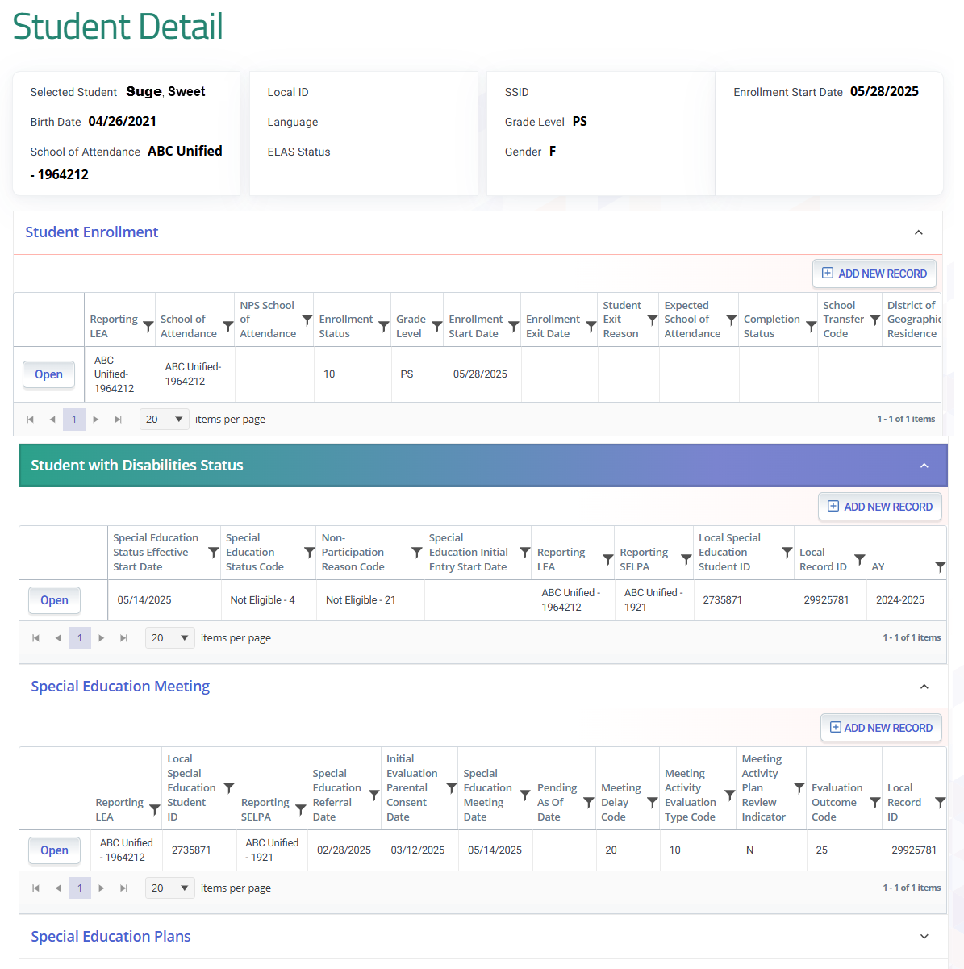
Properly Exit Students from Special Education
Check with case manager and ensure any students who were exited from Special Education, have all necessary exit information populated in the SEDS
Exit Date
Exit Reason
Eligibility Status
Run a search in your SEDS for active records that contain an exit date and/or reason, and process the exit if necessary
Notes:
Ensure Students are Properly Exited from Special Education
If a student is exited in the SIS, they may need to be exited in the SEDS.
If a student is exited from special education in the SEDS (Not eligible), ensure that they are not still showing as a SWD in the SIS.
If a preschooler or private school student has exited special education in the SEDS, ensure that their CALPADS enrollment is also exited.
Check with case manager and ensure any students who were exited from Special Education, have all necessary exit information populated in the SEDS
Exit Date
Exit Reason
Eligibility Status
Run a search in your SEDS for active records that contain an exit date and/or reason, and process the exit if necessary

Slide 65
Exiting Enrollments for SWDs
Age | Enrollment Status | Grade Level | Eligibility Determination | Exit Code | Exit Date
Zero to 35 months | 50 – Non- ADA Enrollment | IN - Infant | Eligible and participating | E170 – Non-Primary Enrollment Exit | Exited annually at the end of the year
3 to 5 years, preschool (public) | 10 - Primary | PS - Preschool | Eligible and participating | E450 – Pre-K Exit OR any other appropriate exit | Exited annually at the end of the year
3 to 5 years, preschool (private schools additionally serving grades TK and above– student served on ISP) | 50 – Non- ADA Enrollment | PS - Preschool | Not Eligible | N470 – No Show | Same date as Enrollment Start Date
5-21, Kindergarten (inc. TK) through 12 (public) | 10 - Primary | K-12 – Kindergarten through 12 | Eligible and participating | Appropriate exit code | Exited annually at the end of the year
5-21, Kindergarten (inc. TK) through 12 (private) | 50 – Non- ADA Enrollment | K-12 – Kindergarten through 12 | Eligible and participating | E170 – Non-Primary Enrollment Exit | Exited annually at the end of the year
ALL | ALL | ALL | Not Eligible or Not Participating | N470 – No Show | Same date as Enrollment Start Date
Notes:
This table outlines the specific Exit Reason codes that should be used to exit the student’s enrollment and when the students should be exited.

Slide 66

12th Grade SWD Exits
  High School Graduate (100)
    Students who graduate with a standard diploma should have a SWDS record, effective the day after their enrollment exit
  Alternate Pathway Graduate (102)
  Certificate of Completion (120)
  High School Equivalency Certificate (320)
  California High School Proficiency Exam, CHSPE (330)
  Completed Grade 12 without completing graduation requirements (360)
  Grade 12 Continuing Education (156)
    Transition indicator (SENR) must be Y/N for all grade 12 SWD
Notes:
SWD who complete high school can be exited as a Standard High School Graduate (100), however they should have a SWDS record, effective the day after their enrollment exit. Alternatively SWD may earn a Pathway Diploma for Students with Disabilities (School Completion Status Code 102).
Student who have completed their initial cohort year, are no longer in pursuit of a high school diploma, and will continue to enroll annually until they exit special education or age out of the program at age 22. should have an enrollment status of primary – 10, and a grade level of 12. Field 1.34 – Adult Age Student with Disabilities in Transition Status is a field that is NOT reported by the SEDS, but rather the SIS. This field is captured in the Student Enrollment (SENR) file. CALPADS administrators should coordinate with their special education data coordinators to ensure this field is populated correctly.
If a student with disabilities has not earned a standard high school diploma and has not yet reached the maximum age (22), the student may re-enroll with the LEA even if the student has earned some other type of high school completion. A SWD may re-enroll using the following exits reason or completion statuses:
Certificate of Completion (School Completion Status Code 120)
High School Equivalency Certificate, (TASC or GED) (School Completion Status Code 320)
California High School Proficiency Exam (CHSPE) (School Completion Status Code 330)
Pathway Diploma for Students with Disabilities (School Completion Status Code 102)
Work with your SIS administrator and identify any SWDs that are high school graduates (or other completers that will NOT be returning the following year)
Ensure that these students are exited from special education in the SEDS
Students who graduate with a standard diploma should have a SWDS record, effective the day after their enrollment exit:
Status = 4 – Not Eligible
Non-Participation Reason Code = 30 – No Longer Eligible

Slide 67

Transition Services Exits
Once students end transition services or reaches maximum age, LEAs have two options:
Exit the student with an E230 – Completer Exit Reason Code and a School Completion Status Code of 125 – Prior special education; or
Exit the student with an E230 – Completer Exit Reason Code and a School Completion Status Code of 120 – Special Education Certificate of Completion (if the student has not already been exited with a 120 in the initial cohort year
Notes:
When a student with disabilities finally exits the special education program ending transition services or reaches maximum age, LEAs have two options:
Exit the student with an E230 – Completer Exit Reason Code and a School Completion Status Code of 125 – Prior special education; or
Exit the student with an E230 – Completer Exit Reason Code and a School Completion Status Code of 120 – Special Education Certificate of Completion (if the student has not already been exited with a 120 in the initial cohort year.

Slide 68

Postsecondary Status
Postsecondary status data provides insight into how effectively schools prepare students with disabilities to transition to adulthood by identifying gaps in services or supports
Counts of former students with disabilities Enrolled in higher education
Counts of students with disabilities enrolled in higher education B or competitively employed
Counts of students with disabilities enrolled in higher education, or some other postsecondary education/training program; or competitively employed or in some other employment
File extracted from SEDS.
If SEDS do not have the ability to store multiple responses, add additional responses directly in CALPADS.
Notes:
EOY 4 Postsecondary Status records provides data for the State Performance Plan Indicator 14: Post-School Outcomes.
Monitors outcomes of students with disabilities one year after leaving high school. It examines whether these students are enrolled in higher education, have competitive employment, or are in some other form of education or training.
Read Slide
Postsecondary status data provides insight into how effectively schools prepare students with disabilities to transition to adulthood by identifying gaps in services or supports
Counts of former students with disabilities Enrolled in higher education
Counts of students with disabilities enrolled in higher education B or competitively employed
Counts of students with disabilities enrolled in higher education, or some other postsecondary education/training program; or competitively employed or in some other employment
https://www.cde.ca.gov/sp/se/fp/sppapr-overviewfeedback.asp

Slide 69

Which Students Require Postsecondary Status in EOY 1?
Students who exited secondary education in AY 24-25 with one of the following exit or school completion status codes and who did not re-enroll in any CA public school in AY 2025-26:
School Completion Status Code
  Graduated, standard HS diploma (100)
  Students with Disabilities Certification of Completion (120)
  Adult Ed High School Diploma (250)
  Received a High School Equivalency Certificate (and no standard diploma) (320)
  Passed CHSPE (and no standard diploma) (330)
  Completed grade 12 without completing graduation requirements, not grad (360)
Or alternatively, if a student exits using one of the following exit reasons:
  No known Enrollment – Truant (E140)
  Prior completion of Special Education (E125)
  Expelled No known Enrollment (E300)
  Other or Unknown (E400)
  Medical Reasons (E410)
  Transferred to College (T280)
Resources:
User Manual PSTS Page
PSTS Survey Template Guide
PSTS for SPED Survey Template
Notes:
Instructions for presenter:
Got to Flash #203 Reporting Postsecondary Status (PSTS) File in End-of-Year 4 for Special Education in 2020-21. https://www.cde.ca.gov/ds/sp/cl/calpadsupdflash203.asp and to the PSTS DP, https://www.youtube.com/watch?v=-96LrPQNFwg&list=PLsnFpLOXpp4L9MlVjpW9tANzckYJ8PwQT.
The Postsecondary Status (PSTS) file is used by LEAs to submit postsecondary outcome data to CALPADS for students who have exited secondary education in the prior school year. In End-of-Year (EOY) 4, outcomes are collected for students with disabilities (SWD) who exited secondary education in the prior year. LEAs are required to survey SWD who exited secondary education in 2019−20 with one of the following exit or school completion status codes:
School Completion Status Code
Graduated, standard High School (HS) diploma (100)
Students with Disabilities Certification of Completion (120)
Adult Ed High School Diploma (250)
Received a High School Equivalency Certificate (and no standard diploma) (320)
Passed California High School Proficiency Exam (CHSPE) (and no standard diploma) (330)
Completed grade 12 without completing graduation requirements, not grad (360)
Or alternatively, if a student exits using one of the following exit reasons:
No known Enrollment – Truant (E140)
Prior completion of Special Education (E125)
Expelled No known Enrollment (E300)
Other or Unknown (E400)
Medical Reasons (E410)
Transferred to College (T280)

Slide 70
EOY 1 Certification Process
CERT and CDD Error Resolution
LEA and SELPA Approval

Slide 71
Certification Workflow
Error Correction
Resolve Cert errors and CDDs before reviewing reports.
Refer to the downloadable CALPADS Error List on suggested resolutions
Report Review
Generate reports and disseminate to appropriate staff responsible for the data.
Utilize report mapping guide to check for data inclusion and column count source
Review Reports
LEA Approval
LEA Submission Process
CERT Error Correction
SELPA Approval
Submit files
All files are submitted from your SIS
Any corrections should be done in the SIS system and resubmitted to CALPADS.
LEA & SELPA Approvals
Generate reports and disseminate to appropriate staff responsible for the data.
Review all aggregate reports to activate checkbox
Check box to activate approval button
Click on LEA Approve to signal SELPA your data is ready for their approval
Notes:
EOY 1 has a streamlined certification process, the LEA will:
Submit student records and resolve validation errors
After the submission is complete the LEA will resolve certification errors including anomalies
Once all certification errors are resolved the LEA will disseminate reports for review
After the reports have been reviewed, the LEA can click on LEA Approve which signals the SELPA that they need to review the reports and consequently Approve.
Resource:
Certification Process: https://documentation.calpads.org/CertificationStatus/CertificationStatusLEAApproval/
Video: https://www.youtube.com/playlist?list=PLsnFpLOXpp4Itub_qeFnInTgT0zJulxUb

Slide 72
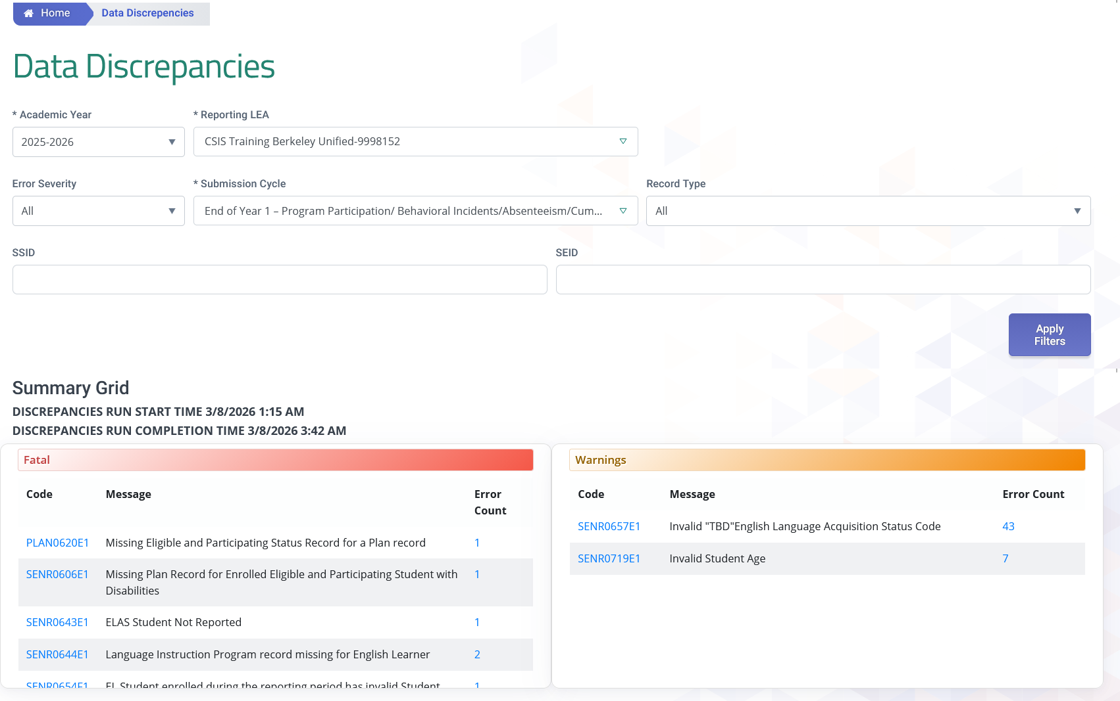
2025-26 EOY Data Discrepancies Now Visible
LEAs may now view their EOY 2025-26 Data Discrepancies (DDs) in the DD screen
Notes:
After submitting available EOY 1 data to CALPADS, LEAs can begin reviewing, investigating, and resolving DDs early as part of EOY preparation. This will help clear errors way ahead of the official window and give you time to work with school sites prior to staff leaving for summer vacation.

Slide 73
Program Certification Errors
Error # | Error Name | Severity | Error Type
CERT073 | No Program Data Submitted for a School | W | CVR
CERT097 | Missing Title I Targeted Assistance Program Records | F | CVR
CERT111 | Homeless Program Eligibility Data Expected | W | CVR
SPRG076E1 | Education Program Membership Start Date Less Than Birth Date | F | CDD
SPRG0148E1 | Education Program Membership End Date Less Than Birth Date | F | CDD
SPRG0295E1 | Invalid Title I Part A Neglected Program Record | F | CDD
SPRG0247E1 | Title I Targeted Records Submitted for a Title I Schoolwide School | W | N/A
SENR0661E1 | Invalid Student Race Missing Indicator and Student Race Code Combination | F | CDD
SENR0716E1 | Invalid Student Ethnicity Missing Indicator and Student Hispanic Ethnicity Indicator | F | CDD
SENR0717E1 | Missing overlapping SINF record | F | CDD
Notes:
Here are your EOY 1 program certification errors detected during the snapshot revision process.
Fatal certification errors will prohibit you from certifying but warnings won’t.
You still need to review your warnings and make any necessary corrections. Warnings should not be ignored because they can impact the data on the EOY 1 aggregate reports.

Slide 74
General EOY 1 Errors
Error # | Error Name | Severity | Error Type
CERT001 | Enrollment Data Missing for Expected Open School | F | CVR
CERT148 | No Student Incident Data Submitted for a School | W | CVR
SELA0054E1 | English Language Acquisition Status Start Date Less Than Birth Date | F | CDD
SENR0026E1 | Invalid Birth Date or Grade for CHSPE Completion | F | CDD
SENR0286E1 | E150 exit requires new enrollment at same school within 1 day | F | CDD
SENR0317E1 | Student Enrollment Record in Previous AY Not Exited | F | CDD
SENR0320E1 | Missing Student School Transfer Code for District of Choice Transfer | F | CDD
SENR0454E1 | Student must have previous Grade 12 SENR record | F | CDD
SENR0519E1 | Special Education Exit Code for Student without Disabilities | F | CDD
SENR0526E1 | Invalid "EL" English Language Acquisition Status Code | F | CDD
SENR0607E1 | Invalid Adult Age with Students with Disabilities Transition | F | CDD

Slide 75
General EOY 1 Errors (more)
Error # | Error Name | Severity | Error Type
SENR0643E1 | ELAS Student Not Reported | F | CDD
SENR0654E1 | EL student enrolled during the reporting period has invalid Student Initial US School Enrollment Date K-12 | F | CDD
SENR0656E1 | Missing Student Initial US School Enrollment Date | F | CVR
SENR0660E1 | Invalid "TBD" English Language Acquisition Status Code | F | CDD
SENR0661E1 | Invalid Student Race Missing Indicator and Student Race Code Combination | F | CDD
SENR0696E1 | Student Enrollment Record in Active AY Not Exited | F | CDD
SENR0714E1 | Invalid "TBD" English Language Acquisition Status Code | W | DD
SENR0715E1 | Student Enrollment Record in Active AY Not Exited | F | CDD
SENR0716E1 | Invalid Student Ethnicity Missing Indicator and Student Hispanic Ethnicity Indicator | F | CDD
SINF0452E1 | Missing Student Birth Country Code | F | CDD

Slide 76
Incident Errors
Error # | Error Name | Severity | Error Type
SENR0697E1 | Missing Expulsion Incident Result Record | W | DD
SENR0712E1 | Missing Expulsion or Suspension Incident Result Record | W | DD
SINC0699E1 | Missing Student Incident Result (SIRS) Record for Student | F | CVR
SINC0700E1 | Missing Student Offense (SOFF) Record for Student | F | CDD
SINC0701E1 | Invalid Incident Result Code and Removal to Alternative Setting Reason Code combination | F | CVR
SINC0702E1 | Missing Removal to Interim Alternative Setting Reason Code | F | CVR
SIRS0703E1 | Missing Student Incident (SINC) Record for Student with Student Results Record (SIRS) | F | CDD
SIRS0704E1 | Missing Student Offense (SOFF) Record for suspended and/or Expelled Student | F | CVR
SIRS0705E1 | Missing Student Instructional Support Indicator | F | CDD
SOFF0709E1 | Invalid Student Offense and Incident Result Code Combination | W | DD
SOFF0710E1 | Invalid Incident Result Code and Grade Level Combination for Student Offense Code 511 (disruption, defiance) | W | DD

Slide 77
More Incident Errors
Error # | Error Name | Severity | Error Type
SOFF0711E1 | Missing Student Incident (SINC) Record for Student with Student Offense Record (SOFF) | F | CDD
SINC0494E1 | Duplicate Student Incident Record Exist for the Same Student | F | CDD
SINC0499E1 | Removal to Interim Alt Setting Populated for Non-Special Education Student | W | DD
SINC0516E1 | Mismatch of Student Incident Attributes | F | CDD
SINC0653E1 | Student should not have the same Incident ID in two different schools | W | DD
SIRS0488E1 | Invalid Incident Local ID | F | CDD
SIRS0490E1 | Missing Incident Result Authority Code | F | CDD
SIRS0505E1 | Invalid No Action (400) Incident Result Code | F | CDD
SIRS0506E1 | Invalid Law Enforcement Referral Incident Result Code | F | CDD
SOFF0502E3 | Invalid Incident ID | F | CDD

Slide 78
STAS Errors
Error # | Error Name | Severity | Error Type
SENR0695E1 | Missing Absence Summary Data for Student | F | CDD
STAS0706E1 | Missing Primary or Short-term Enrollment record for a student with Absence Summary Data | F | CDD
STAS0707E1 | Expected Attendance Days is greater than Total Enrollment Days | F | CDD
STAS0708E1 | Missing Suspension Data for a student who was reported as absent due to either out-of-school suspension or in-school suspension | F | CDD

Slide 79

EOY 1 Reports
Review reports

Slide 80
EOY 1 Reports
Report 1.21
Report 8.1 (EOY 3)
Cumulative Enrollment – Count
Student Profile - List (EOY3)
Report 7.10
Report 7.12
Incident Count
Incident Results - Student List
Report 2.16
Report 2.17
ELA Status – ELs Reclassified RFEP (EOY 3)
ELA Status – ELs Reclassified RFEP Student List (EOY 3)
Report 7.11
Incident Result – Count
Report 5.1
Report 5.3
Program Participants - Count
Program Participants List
Report 7.13
Report 7.14
Student Offense - Count by Offense
Incident Offense– Student List
Legend
Report 5.4
Report 5.5
Homeless Students Enrolled - Unduplicated Count by School
Homeless Student List
Report 7.15
Incident Results- Persistently Dangerous Offense Expulsions
Aggregate Report
Supporting Report
Report 14.1
Report 14.2
Student Absenteeism - Count
Student Absences – Student List
Report 7.16
Report 7.18
Incident Removals for Students with Disabilities – Count
Incident Removals for Students with Disabilities – Student List
Report 19.1
Report 19.2
Expanded Learning Program Participants – Count
Expanded Learning Program Participants –Student List
Report 7.17
Unilateral Removals for Students with Disabilities - Count

Slide 81
More
EOY 1 Reports
Report 16.12
Report 16.27
Report 16.28
  Students with Disabilities - Education Plan By Primary Disability Count (EOY 1)
  Students with Disabilities – Completer and Dropout Count
  Students with Disabilities – Completers and Dropouts Student List
Report 16.14
  Students with Disabilities) Plan Student List
Legend
Report 16.13
  Students with Disabilities - Count by Federal Setting (EOY 1)
Aggregate Report
Supporting Report
Report 17.3
Report 17.4
  Postsecondary Survey Outcome for SWDs - Count
  Postsecondary Survey Outcome for SWDs - Student List
Report 16.22
Report 16.23
  Students with Disabilities - Non- Participating Status Report – Count (EOY1)
  Students with Disabilities - Non- Participating Status Report - Student Details (EOY1)

Slide 82
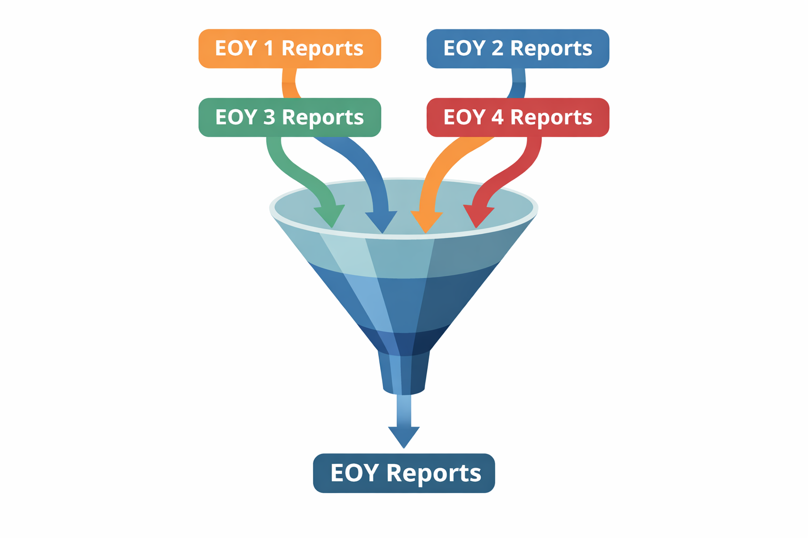
EOY Reports Role changes
A new EOY Reports role will replace the old individual EOY 1-4 Reports role.
LEA Admins must ensure the proper role is added to users needing to review reports.

Slide 83
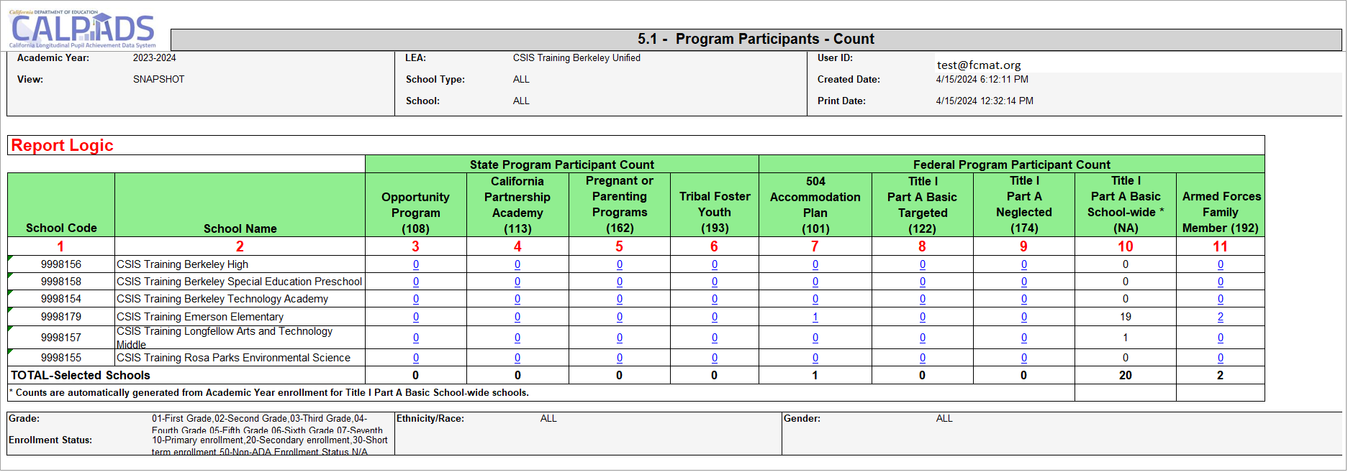
Report 5.1 - Program Participants - Count
Program 174 reports only neglected students attending a non-Title 1 schools are eligible for neglected services through Title I Part A.
For Title I Part A Basic School-wide schools, counts in this column are based on cumulative Academic Year enrollment, not program records. Refer to CALPADS Update Flash #74 for CDE’s process to identify a school-wide site.
Notes:
CARS-CALPADS sync starts running on 3/1 until the end of EOY. The ODS 5.1 report can be ran as early as March 1st to get a sense of Schoolwide schools, as per CARS.

Slide 84
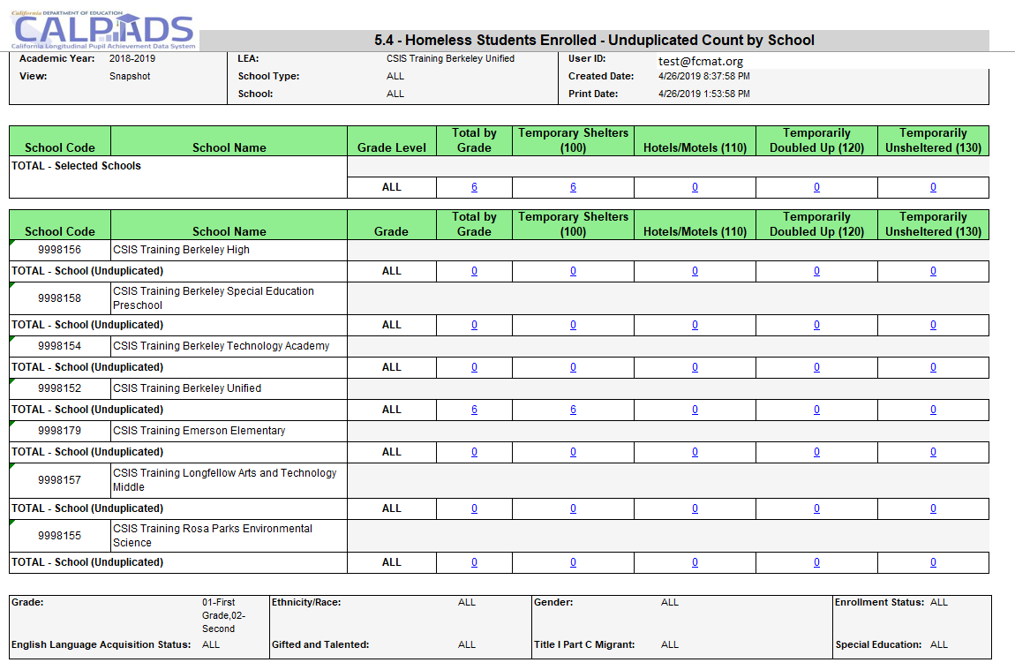
Report 5.4 –Homeless Students Enrolled
Homeless program records should be submitted for any infants, toddlers, and pre-K children who are homeless, as these students are included in all homeless reports in CALPADS.
Notes:
The 5.4 reports your posted homeless program records.
The report first summarizes the data for your LEA.
All the grade levels within your LEA. (Point out TK grade level)
Total by grade level
Total # of students reported homeless with dwelling type 100
Total # of students reported homeless with dwelling type 110
Total # of students reported homeless with dwelling type 120
Total # of students reported homeless with dwelling type 130
And then the individual school sites aggregate data is listed. This allows you to review by each site the homeless data to your local system.
Note: If student moves from 1 district to another during an AY, the student will be reported homeless at both districts. If student moves from 1 site to another, the count will be at the site with the most recent enrollment record.

Slide 85
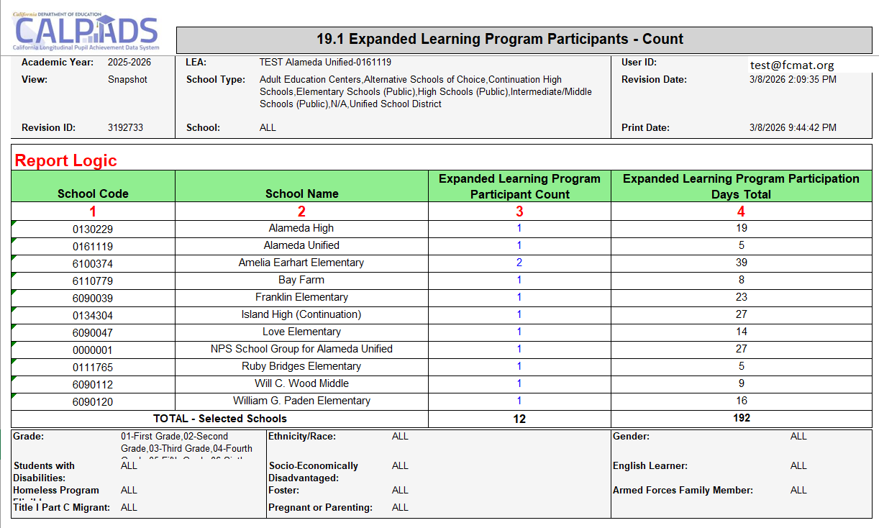
Report 19.1 – Expanded Learning Program Participants - Count
Notes:
CARS-CALPADS sync starts running on 3/1 until the end of EOY. The ODS 5.1 report can be ran as early as March 1st to get a sense of Schoolwide schools, as per CARS.

Slide 86
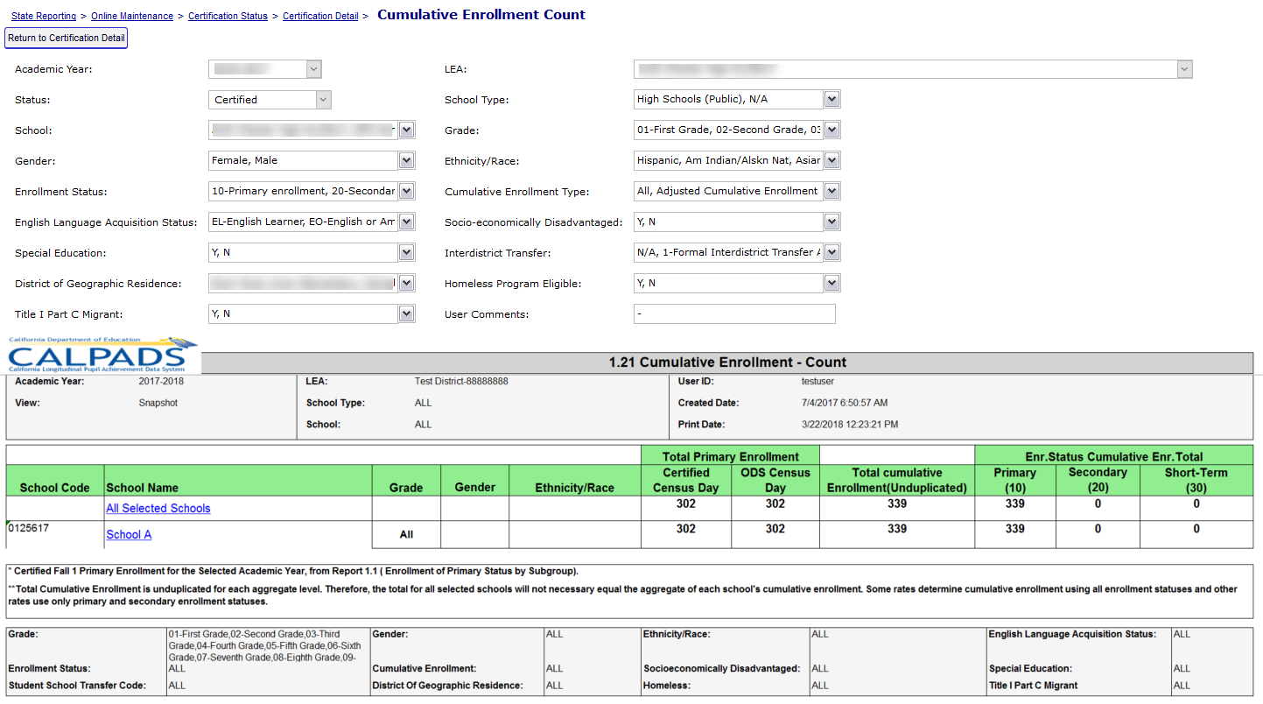

Report 1.21 Cumulative Enrollment - Count
Notes:
Report 1.21, Cumulative Enrollment counts the number of students with an enrollment record in the academic year. The total primary, secondary and short term enrollment counts are grouped. All students with enrollment at any time during the Report Period for the Academic Year are included. Primary, Secondary, Short-term cumulative count is used to calculate suspension/expulsion rates. Just primary and short-term cumulative count is used to calculate attendance rates.
The certified census day enrollment count column is listed for comparison. The cumulative enrollment should be greater than or equal to certified primary enrollment.
A new filter on the Cumulative enrollment report in EOY 3 will be provided to view one-year graduate counts

Slide 87
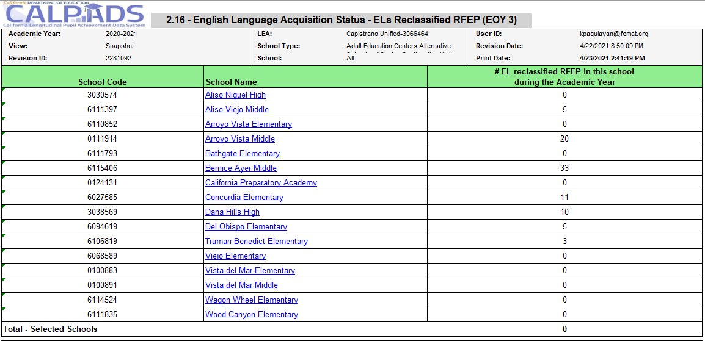
Report 2.16 ELA Status – Els Reclassified RFEP (EOY 3)

Slide 88
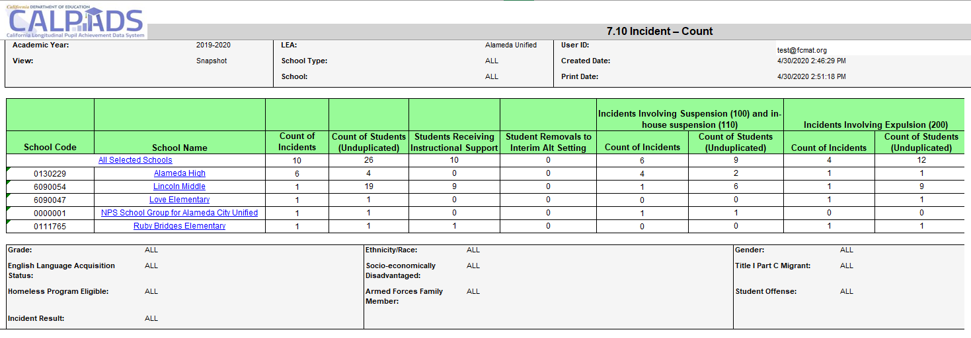
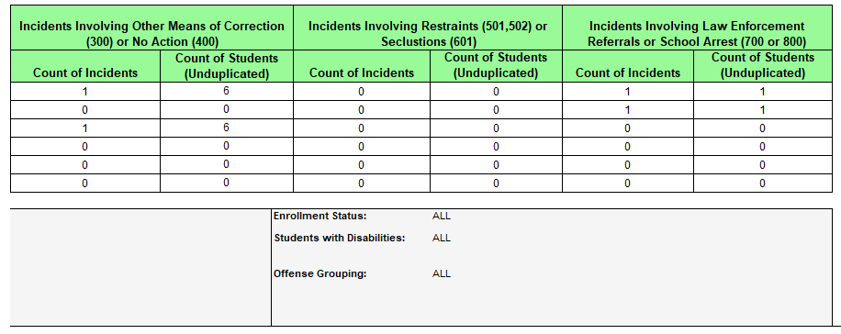
Report 7.10 Incident - Count
Notes:
Reports the counts of incidents occurring at the LEA by each school of attendance, the number of students involved an incident, the number of students receiving instructional support, and the number of students removed to interim alternative setting. Counts of incidents and students involved in incidents are displayed by Incident Result categories.

Slide 89
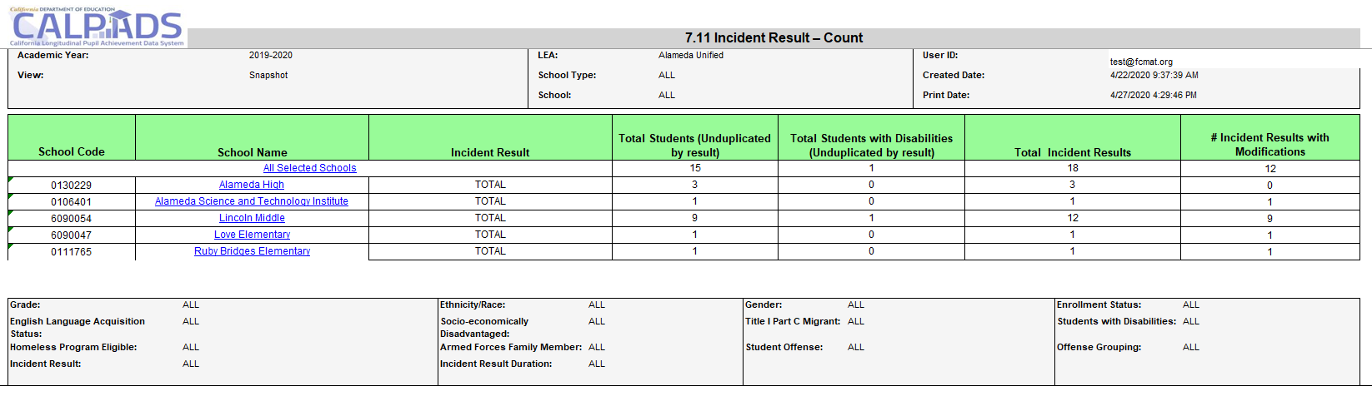
Report 7.11 Incident Result - Count
Notes:
Reports an unduplicated count of students and Students with Disabilities by Incident Result type, total of count of each incident result, and the number of incident results that were modified all by School of Attendance.

Slide 90
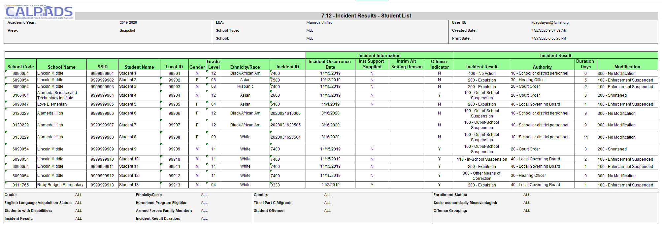
Report 7.12 Incident Results –Student List
Notes:
Reports students regardless of enrollment status, who were involved in an incident. Also reports information about each incident, including the incident result, duration days, and cumulative duration days.

Slide 91
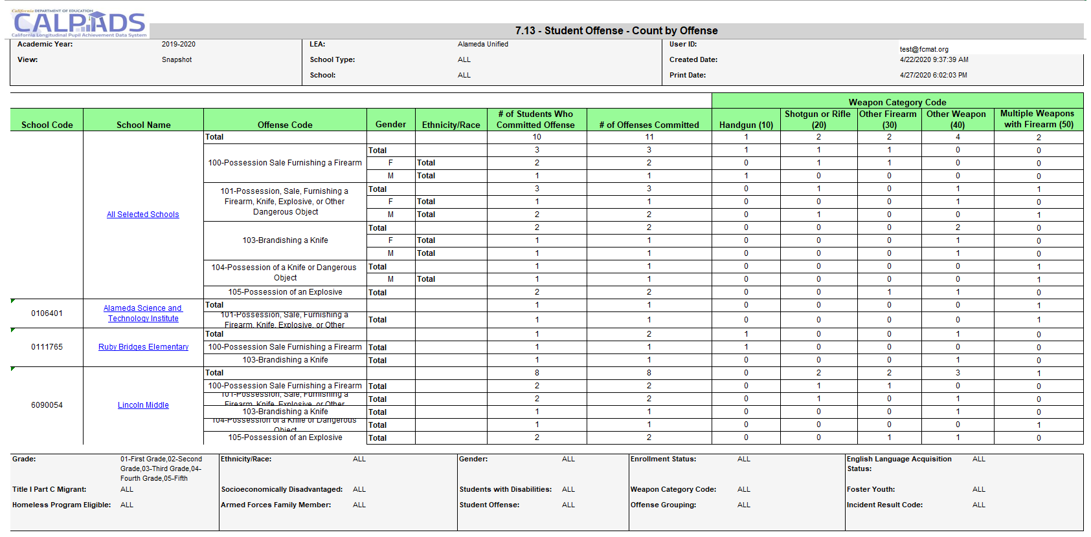
Report 7.13 Student Offense – Count by Offense
Notes:
Reports an unduplicated count of students who committed offenses, total count of offenses committed by each offense code, and a breakdown of offenses involving a weapon by gender and ethnicity/race

Slide 92
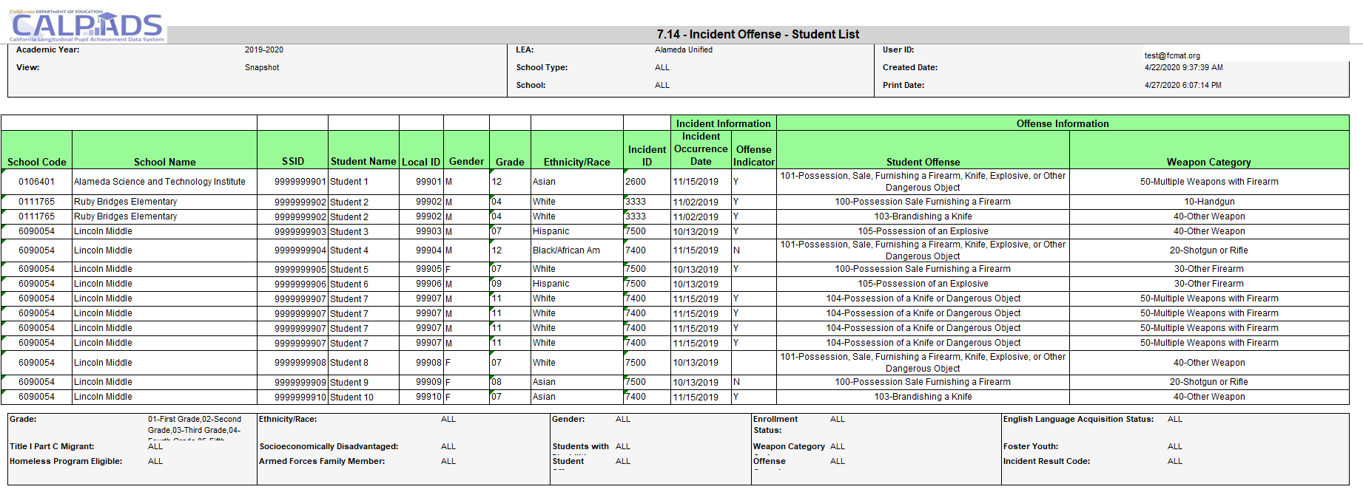
Report 7.14 Incident Offense – Student List
Notes:
Reports students in grades TK, 01-12, who were involved in discipline incidents including the disciplinary action taken. (Drill down from report 7.13)

Slide 93
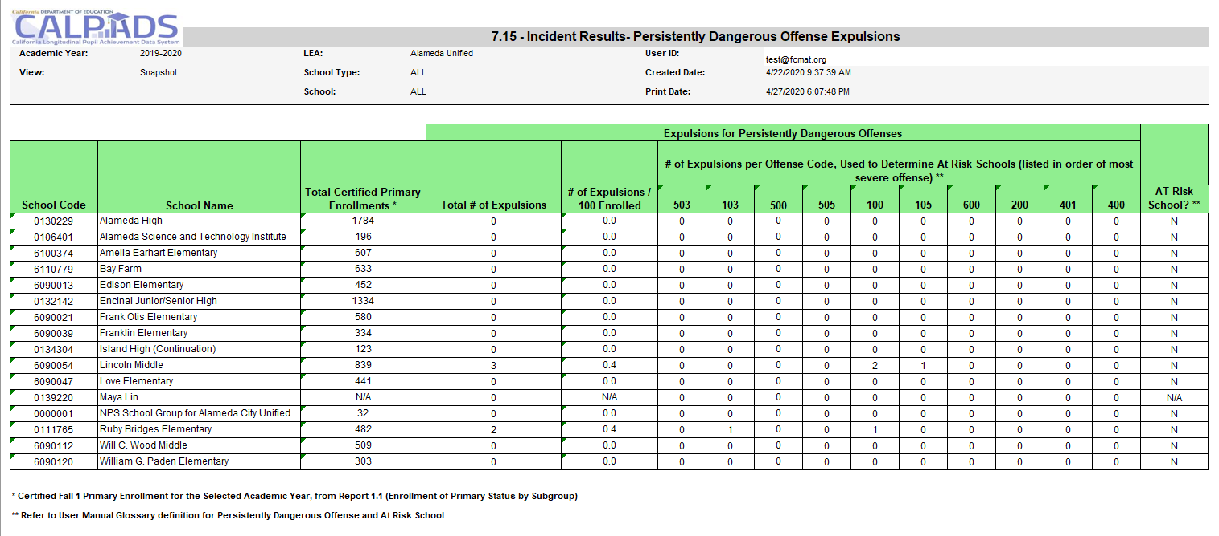
Report 7.15 Incident Results Persistently Dangerous Expulsions
Notes:
Reports the counts of TK-12 expulsions for the applicable Persistently Dangerous Schools California Education Code violations. Reports the counts of expulsions for the Persistently Dangerous Schools California Education Code violations. By school, it includes the total number of expulsions, the # of expulsions per 100 enrolled students (based on the selected year’s certified Fall 1 enrollment), and the # of expulsions per offense codes that are applicable in determining At-Risk Schools. It also indicates whether a school is an At-Risk School.

Slide 94
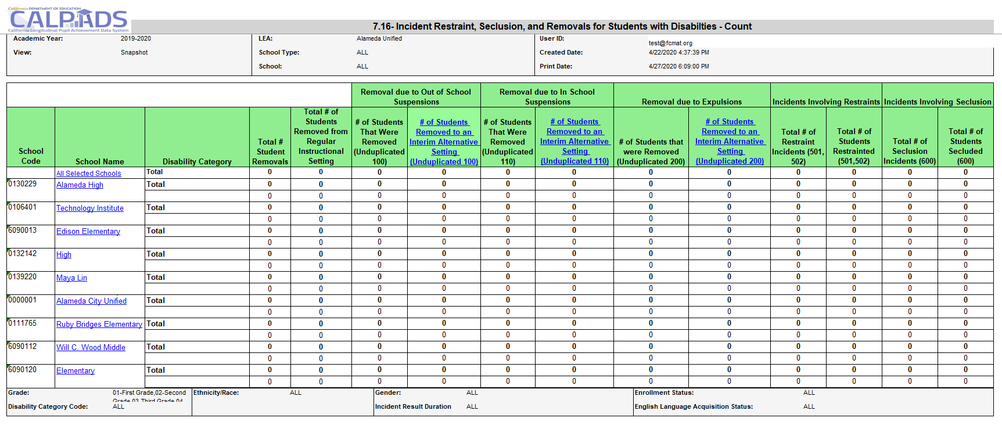
Report 7.16 Incident Restraints, Seclusion, and Removals for Student with Disabilities - Count
Notes:
Reports the number of students with disabilities who were removed from their regular instructional setting for disciplinary reasons, regardless of enrollment status. It also reports the total number of removals and the number of students with disabilities who commit offenses that resulted in no suspension or expulsion, by disability category.

Slide 95
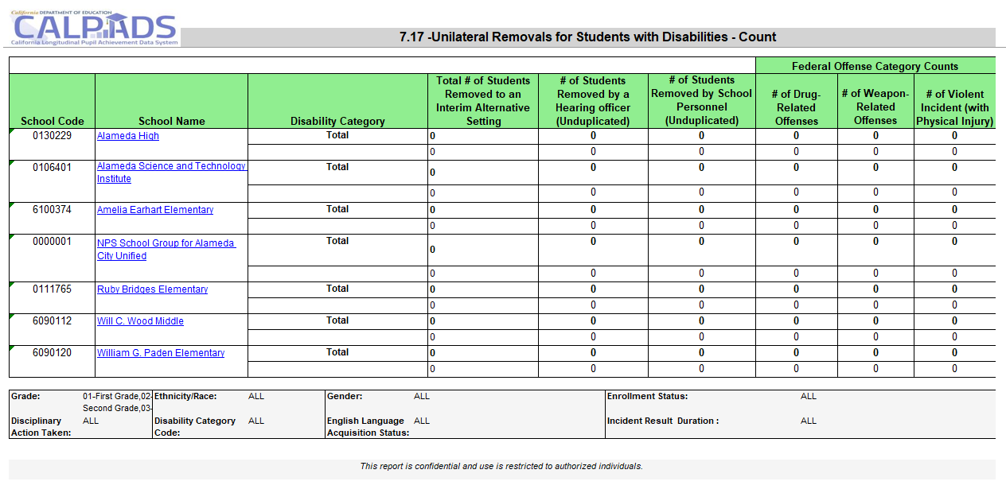
Report 7.17 Unilateral Removals for Students with Disabilities - Count
Notes:
Reports the number of students with disabilities (by Primary Disability Category) who were removed from their regular instructional setting to an interim alternative setting for disciplinary reasons, regardless of enrollment status. It also reports the counts of removals to interim alternative setting by federal offense category.

Slide 96
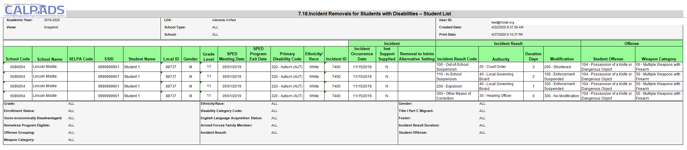
Report 7.18 Incident Removals for Students with Disabilities – Student List
Notes:
Reports students with disabilities who were removed from their regular instructional setting for disciplinary reasons, regardless of enrollment status. It also reports characteristics about each student and each incident including the Incident Results and Incident Result modifications.

Slide 97
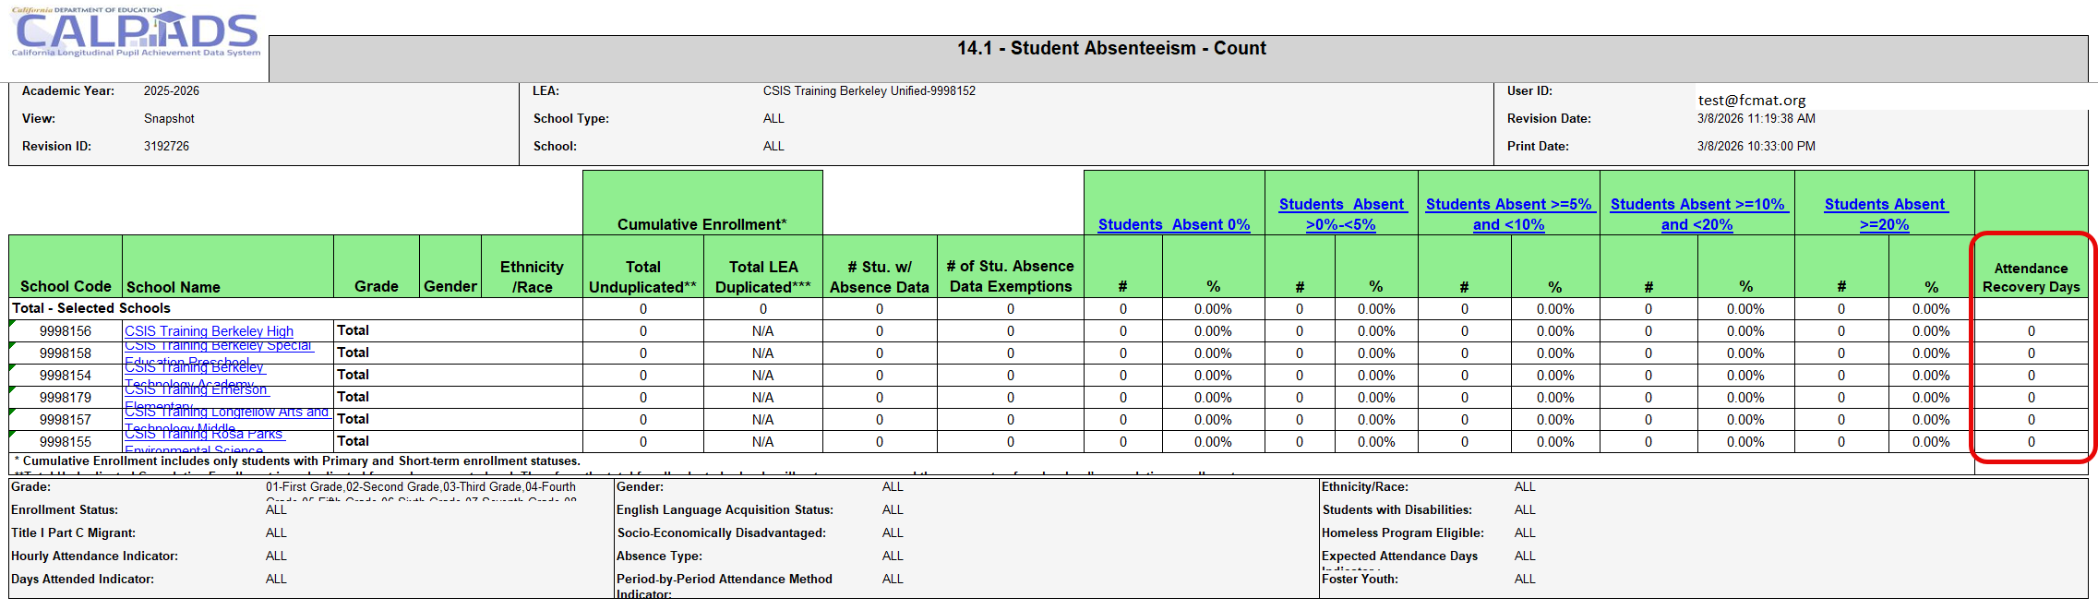
Report 14.1– Student Absenteeism – Count
Note: Days Attended Indicator Defaults to All
- Includes all Students groups including 100% ADA Independent Study
- Picking >0: Excludes 100% ADA Independent Study
Attendance Recovery Days Column
- Will include all indicated AR days. But will not be part of any absence rate calculation.
Notes:
Report 14.1, Student Absenteeism counts positive attendance and student absenteeism as a percentage of the total cumulative enrollment by school for the LEA. The report includes all students with a primary or short- term enrollment at any time during the Academic Year. The report shows counts by school, with grade level and student demographic filters. Calculations for absenteeism rates of less than 5 percent, 5 to 10 percent, 10 to 20 percent and 20 percent or more are provided.

Slide 98
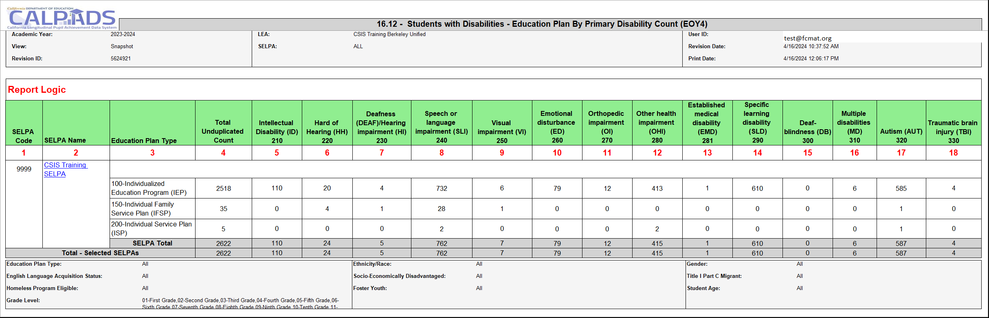
Report 16.12 – Students with Disabilities – Education Plan by Primary Disability Count
Description: Reports unduplicated counts of Students with Disabilities by Education Plan Type and Primary Disability Category
Notes:
End of Year Special education data is used to meet the reporting and monitoring mandates under the federal Individuals with Disabilities Education Act (IDEA). It provides cumulative, unduplicated counts of children and students (ages 0–22) who received special education services at any point during the academic year. The data also is used to monitor whether students are receiving a Free and Appropriate Public Education (FAPE) in the Least Restrictive Environment (LRE) and the specific special education services prescribed in a student’s plan (IEP, IFSP, or ISP).

Slide 99
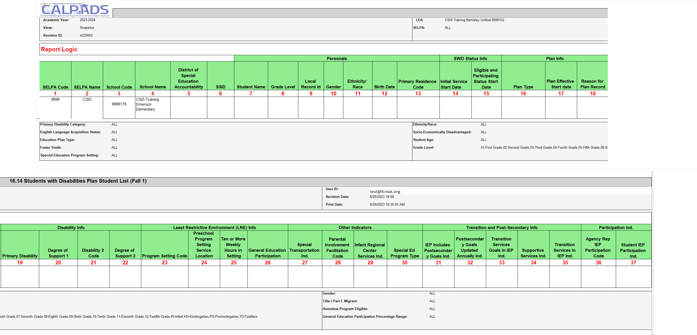
Report 16.14 Students with Disabilities Plan Student List
Notes:
Reports a list of students with disabilities and associated meeting, plan, and other SPED-related information.

Slide 100
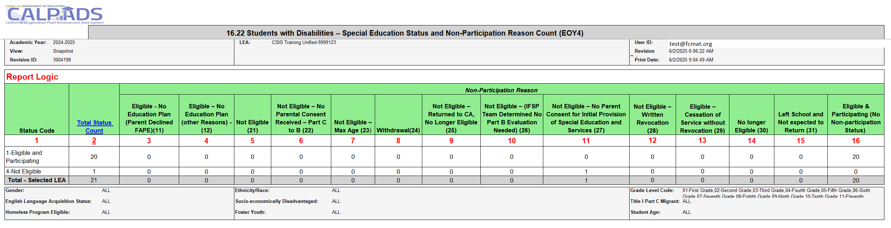
16.22 - Students with Disabilities Non-Participation Status Count
Notes:
Reports of Students with Disabilities by Primary Disability Category who have exited from the Special Education program due to no longer being eligible, reaching maximum age, withdrawal, or not receiving parental consent to continue from Part C to Part B.

Slide 101
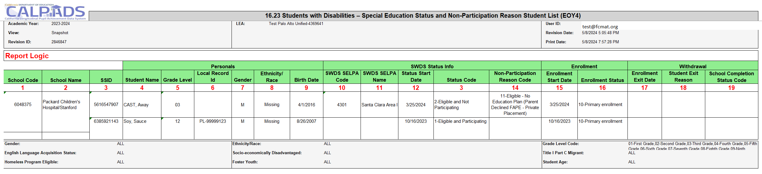
16.23 SWD – Special Education Status and Non - Participation Reason
Notes:
The intent of report 16.23 - Students with Disabilities Special Education Status and Non-Participation Reason – Student List is to assist LEAs in verifying counts and details for students by Special Education Status and their Non-Participation Reasons. LEAs should use the report to verify counts of students who, at some point during the 2023−24 academic year, were exited from special education with any of the following Special Education Statuses:
2 – Eligible, Not Participating
3 – Eligible, Not Enrolled
4 – Not Eligible

Slide 102
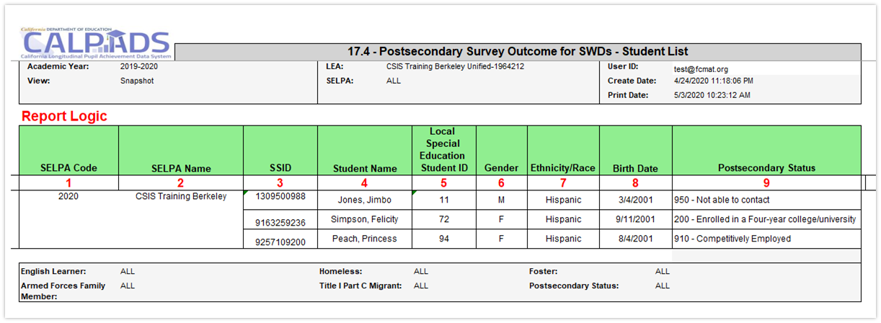
17.4 Postsecondary Status List
Notes:
Indicator 14: Post-School Outcomes:

Slide 103
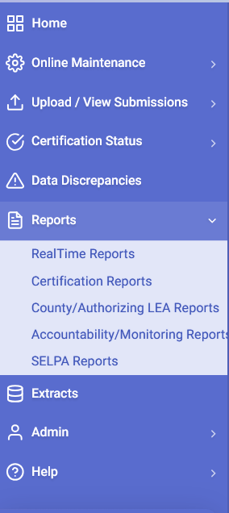
One Year Students with Disabilities – Completer and Dropout Collection
16.27 Students with Disabilities – Completer and Dropout Count
Report Period: 7/1/2025 to 6/30/2026
Reports will show:
SWDS Graduates/Completers: Regular High School Diploma, Proficient Completers, Adult Education High School Diploma, Special Education Certificate of Completion and Equivalency Completers
SWDS Dropouts: did not graduate or complete and did not re-enroll in another California public school
16.28 Students with Disabilities – Completers and Dropouts Student List
Notes:
LEA version - Reports the number of students with disabilities whose last enrollment in selected AY is a Regular High School Diploma Graduate, Alternate Pathway Diploma, Certificate, Reached Maximum Age, or Dropped out. These counts are by SELPA and School for the LEA.
SELPA Version - Reports the number of students with disabilities whose last enrollment in selected AY is a Regular High School Diploma Graduate, Alternate Pathway Diploma, Certificate, Reached Maximum Age, or Dropped out. These counts are by SELPA and School for the LEA. These counts are by Schools and LEA for the SELPA.
Reports can be used to verify Indicator 1 (Graduates) and Indicator 2 (Dropouts) for special education federal reporting.
Reports will show:
SWDS Graduates/Completers: Regular High School Diploma, Proficient Completers, Adult Education High School Diploma, Special Education Certificate of Completion and Equivalency Completers
SWDS Dropouts: did not graduate or complete and did not re-enroll in another California public school

Slide 104




EOY 3 – What are the data used for?
Let’s build your CALPADS Data Literacy!
Notes:
What is the data used for?
Provide student expulsion and suspension information to satisfy Every Student Succeeds Act (ESSA) requirements related to "persistently dangerous" schools and the Uniform Management Information Reporting System (UMIRS)
To determine persistently dangerous schools
Provide student suspension and expulsion counts and related information for students with disabilities for federal Individuals with Disabilities Education Act (IDEA) reporting.
Provide chronic absenteeism rates to satisfy federal requirements under Every Student Succeeds Act (ESSA) and to calculate a statewide performance indicator as required by the Local Control Funding Formula (LCFF) statute.
Provide an LEA count of homeless students enrolled over the course of the academic year
Provide the number of English Learner (EL) students reclassified FEP (i.e. RFEP) during the academic year (See CALPADS User Manual Glossary: Reclassified Fluent English Proficient Count)
Provide an LEA count of student who graduated from LEA schools during the academic year, as well as other school completers (see the CALPADS User Manual Glossary for a definition of Graduates and Completers)

Slide 105
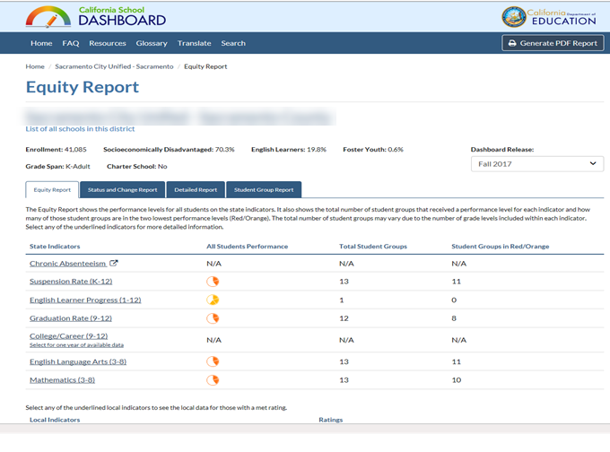
EOY 3 and the CA Dashboard (Chronic Absenteeism)
Chronic absenteeism rate calculation
Non-ADA-Generating Independent Study Days + In-Person Days Absent Excused + In-Person Days Absent Unexcused + Out-of-School Suspension Days
DIVIDED BY
Expected In-Person Attendance Days (includes in-school suspension days) + ADA-Generating Independent Study Days
EOY 1
Report 14.1 Student Absenteeism counts
CA Dashboard
Chronic Absenteeism rate compares with previous year
DataQuest
Reflects chronic absenteeism rate based certified EOY 3 reports
Chronic Absenteeism Rate Change Formula
Status (2025–26 Chronic Absenteeism Rate) minus 2024–25 Chronic Absenteeism Rate
Fall 2026 Chronic Absenteeism rates on the dashboard WILL NOT be a one-to-one reflection of STAS records certified in EOY 1 AY 2025-26, it is a trend comparison between last academic year’s Chronic Absenteeism rates to certified EOY 1 data this year.
So how are you trending?
Notes:
This slide illustrates the relationship of your AY 2024-25 STAS data to the CA Dashboard.
Your certified EOY 3 student absence summary data will be posted in Dataquest which will reflect your Chronic Absenteeism rate for 2024-25. The CA dashboard will then show in Fall 2025 report a trend comparison chronic absenteeism rate change between AY 2023-24 and AY 2024-25.
CA dashboard Resources:
https://www.cde.ca.gov/ta/ac/cm/
https://www.caschooldashboard.org/#/resources

Slide 106
EOY 3 and the CA Dashboard (Suspension Rate)
CALPADS Suspension rate calculation
Total unduplicated number of students suspended at a school
Total unduplicated number of students enrolled at the school during the year (cumulative enrollment)
EOY 1
Report 7.12 Incident Results –Student List
CA Dashboard
Include Out-of-School and In-school Suspensions in rate computation
DataQuest
Reflects suspension rate based certified EOY 3 reports
Suspension Rate Change Formula
Status (2025–26 Suspension Rate) minus 2024–25 Suspension Rate
Fall 2025 Suspension rates on the dashboard is NOT a one-to-one reflection of incident record certified in EOY 1 AY 2025-26, it is a trend comparison between last academic year’s suspension rates to certified EOY 1 data this year.
So how are you trending?
Notes:
This slide illustrates the relationship of your AY 2023-2024 suspension data to the CA Dashboard.
Your certified EOY 3 suspensions will be posted in Dataquest which will reflect your suspension rate for 2023-2024. The CA dashboard will then show in Fall 2024 report a trend comparison suspension rate change between AY 2022-23 and AY 2023-24.
CA dashboard Resources:
https://www.cde.ca.gov/ta/ac/cm/
https://www.caschooldashboard.org/#/resources

Slide 107

Wrap Up
Key Points, Resources, Support
Notes:
First, we will start with some general information related to the CALPADS data submission and then introduce key concepts related to the data collected.

Slide 108

Summary
EOY 1 requires the SINC, SIRS, SOFF, STAS, SPRG, SELA, LEAP and SENR records be posted
Behavioral Incidents for Student with disabilities requires EOY 1 to be approved by the SELPA
The data in EOY 1 is reflective of the entire academic year
STAS exemptions are submitted in a STAS record. Every primary and short-term enrolled student must have a STAS record
STAS records should NOT be reported for NPS students
Students that have a program 191 record during the year will be counted as homeless regardless of their current living situation. Homeless records must be exited annually.
Student participating in Attendance Recovery are reported through the STAS file.
Students who are enrolled in Expanded Learning Program will be reported through the new LEAP File
Newly determined RFEP students must be reported preferably before May 30, 2026.
All student enrollment records must be exited at the end of the year. However, do not submit a students exit record if they still testing for CAASPP or ELPAC or if you are still waiting for SPED to send up updates to CALPADS.

Slide 109
Suggested Milestones - EOY 1 - 2025-2026
Now – 5/5
Complete Data Population in local SIS
Now – 6/12
Submit and post files. Review IVR and Data Discrepancy errors and reconcile as needed.
6/15 – 6/26
Resolve Certification and Data Discrepancy errors. Review snapshot reports and update records as needed
0
6/26
Recommended Date for Zero Errors
Jun 26, 2026
Recommended date for zero errors
6/29– 7/10
Send reports to local data stewards, site leaders and administrators for approval (Send earlier if possible)
7/13 – 7/17
LEA Approve by Certification Deadline
(Should be SELPA Approved if possible)
Amendment Deadline
(SELPA Approval Required)
7/18 – 7/31
Notes:
On this slide you will find the suggested milestones for EOY 1
Starting May 5 snapshot reports will begin , Be proactive start early, communicate with the appropriate staff. Recommended date for zero errors is June 26, your CSIS monitor will be in contact and by the way we don’t send automated emails, it really is us reaching out. In case you are wondering. Certification deadline July 17 with amendment and final deadline on July 31, Selpa approvals are required for EOY 1

Slide 110



Resources
Here are some important resources.
  https://csis.fcmat.org/csis-training
https://www.youtube.com/channel/UCA9oRTiyVECCCzOxpmJheZw
https://documentation.calpads.org/Support/References
https://www.cde.ca.gov/ds/sp/cl/index.asp

Slide 111
Support
http://www2.cde.ca.gov/calpadshelp/default.aspx
Web
calpads-support@cde.ca.gov
Email
916-325-9210
Phone
https://csis.fcmat.org/ListServ
You can get help through these channels.
Listserv

Slide 112
Feedback
I have a question…
“
”
Please complete survey…
https://bit.ly/2MXsECg
“
”
Notes:
Long URL: https://forms.office.com/Pages/ResponsePage.aspx?id=k1b3XxqV6E2E3dWxsESwNX2FYi3dRZNNt8LpvkF_wmhUNVRLOVBDVkoySE01UTJSRk42VTlaUUFIQi4u
Short URL: https://bit.ly/2MXsECg

Slide 113

Thank You
CSIS Training
(916) 325- 9210
Calpads-support@fcmat.org
https://csis.fcmat.org/

