Slide 1
CALPADS and Data Privacy
MJ Vincent
Field Support Specialist
FCMAT/CSIS
Notes:
Hello and Welcome to todays training, CALPADS and Data Privacy. I am MJ Vincent from FCMAT/CSIS, I am a Field Support Specialist and work in Client Services for CALPADS. Todays training is meant for CALPADS LEA Admin Account holders and focuses on Student Data Privacy and the specifics their obligations under CALPADS User Responsibilities and Rules of Behavior Agreement.

Slide 2

Objectives:
Know our obligations and protections:
  Federal Law
    FERPA
  State Law
  Local Boards/LEA Policy
Understand CALPADS Application
  LEA Admin
    Appendix A/B
  Roles and Security levels
Introduce Data Governance terms
Define our own Local Practices
  Roles & Resources
  Next steps…
Notes:
Objective:
To become more aware of issues around Data Privacy by summarizing laws, reviewing the CALPADS LEA Admin Application Rules for Behavior agreement, and having a discussion of resources and concepts of Data Privacy.
Talking Points:
Know our obligations and protections:
SO many individual Board or LEA policies, as well as State and Federal Laws, we will not cover in great detail, but an overview
Understand CALPADS Application
LEA Admin application process
The application itself
Security and Roles of LEA accounts under the prevue of the LEA Admin
Introduce Data Governance:
We need to clarify vocabulary and be on the same page
Define our own Local Practices
Roles
Checklists
Resources

Slide 3
Disclaimer
This training should not be considered legal advice. If you have specific legal questions, they should be directed to your legal counsel. The purpose of this presentation is to give a general overview, to help you ask the right questions when consulting with your legal counsel.
The intent is to impart a basic understanding of what must be done to protect data privacy. Questions related to options for encryption and secure electronic transfer of data should be directed to your IT support.
There are MANY data privacy laws and statutes. While this presentation will highlight a few of them, you should consult legal counsel to determine the specific legal implications of any given situation.
Notes:
READ THIS WHOLE SLIDE, PER CDE
This training isn’t meant to be legal advice, but to understand what to ask any legal consultation in your LEA. Many ideas in today’s training could illicit questions which maybe best answered by your local legal consultation.

Slide 4

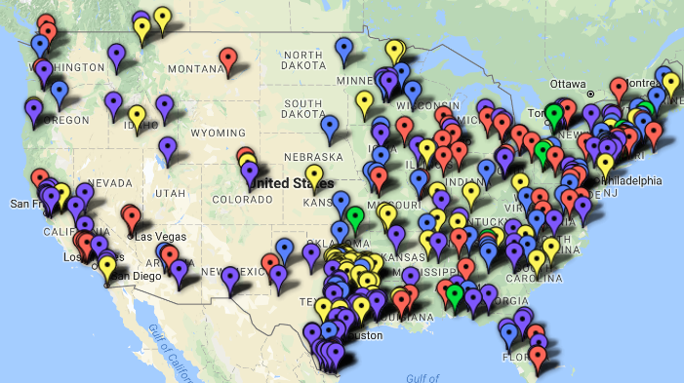
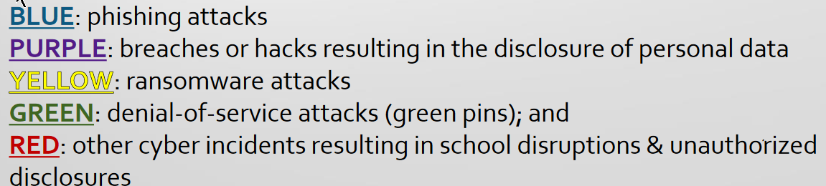
K-12 Cyber
Attacks
Jan 2016 to May 2018
339
https://k12cybersecure.com/map/
Notes:
Objective:
This map is an awesome visualization of the problem we face daily. As public education increasingly relies on technology for teaching, learning, assessment and state and federal reporting, it is imperative that effective policy and practice are in place to protect children and youth, school employees, and taxpayer-funded equipment and services.
FROM EDTECH Strategies- Why Was this map created?
to build a data-based awareness of the scope and variety of digital security and privacy threats facing K-12 public schools and districts
It also is intended to shed a light on the need for uniform standards for disclosing cyber incidents affecting schools, students, and educators.
Talking Points:
You have seen the headlines: Social Security numbers breached. Credit card numbers stolen. Email addresses accessed and misused. Data breach events affect thousands, hundreds of thousands, and sometimes millions of people. Most often, the data breaches making news are suffered by companies like Target and Home Depot, or colleges and universities and the U.S. Government. But local school districts are no less susceptible to data breaches than these high-profile entities. And they may face similar consequences: regulatory scrutiny, private lawsuits, and distrust of stakeholders like parents, students, teachers, or administrators
EXPLAIN: The K-12 Cyber Incident Map
cybersecurity-related incidents reported about U.S. K-12 public schools and districts from 2016 to the present.**
‘Cyber’ incidents include:
phishing attacks resulting in the disclosure of personal data (blue pins);
other unauthorized disclosures, breaches or hacks resulting in the disclosure of personal data (purple pins);
ransomware attacks (yellow pins);
denial-of-service attacks (green pins); and
other cyber incidents resulting in school disruptions and unauthorized disclosures (red pins).
Twitter updates- follow @K12CyberMap

Slide 5
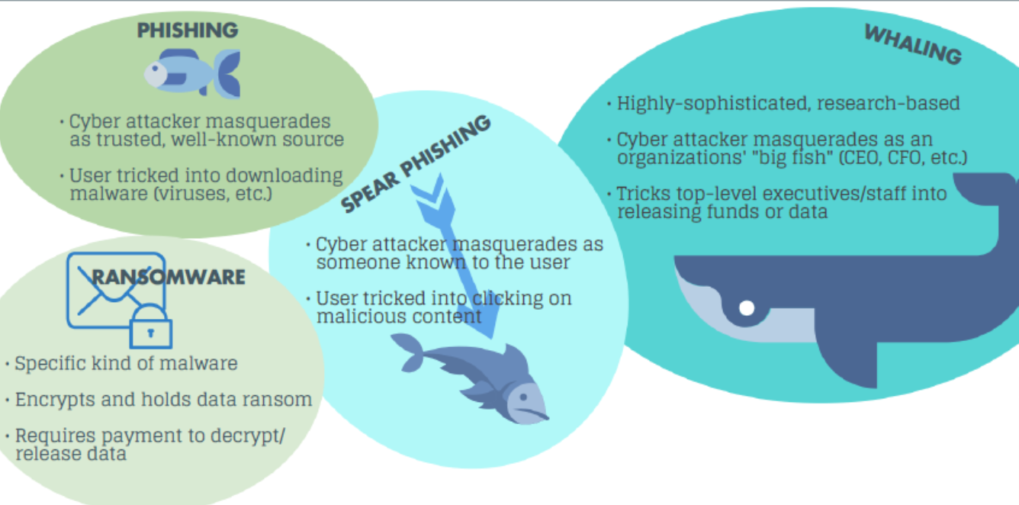
COMMON TYPES
OF SCAMS
Notes:
THIS SLIDE IS INCLUDED for those of you who may want to share quick explanations of these common types of scams- this is not a comprehensive list as the scams are evolving and becoming more sophisticated with users knowledge.
Phishing: a cybercrime in which a target or targets are contacted by email, telephone or text message by someone posing as a legitimate institution to lure individuals into providing sensitive data such as personally identifiable information, banking and credit card details, and passwords.
Spear Phishing: just like phishing, but targeted to a specific individual or department within an organization. Its tactics include impersonation, enticement and access-control bypass techniques like email filters and antivirus.
Whaling: a whaling email scam email is often written as a legal subpoena, customer complaint, or executive issue. Whaling scam emails are designed to masquerade as a critical business email, sent from a legitimate business authority.
Ransomware: type of malware that prevents or limits users from accessing their system, either by locking the system's screen or by locking the users' files unless a ransom is paid.
Denial of Service Attack: (not pictured) is typically accomplished by flooding the targeted machine or resource with superfluous requests in an attempt to overload systems and prevent some or all legitimate requests from being fulfilled.

Slide 6

FERPA 101
YouTube
Notes:
https://youtu.be/nhlDkS8hvMU
The descriptive information is available on how FERPA defines the obligations of LEAs, particularly regarding Directory Information and Opt-Out requirements of the LEA. Resources abound; educate yourself, at least to the basics.
Key talking Points:
CSIS YouTube channel has a Data Privacy Playlist with variety of FERPA and Student Data Privacy Videos
YouTube has many FERPA videos
Select reputable organizations with Educational/Research based affiliations.
FERPA gives parents access to their child's education records, an opportunity to seek to have the records amended, and some control over the disclosure of information from the records.
With several exceptions, schools must have a student's consent prior to the disclosure of education records after that student is 18 years old.
The law applies only to educational agencies and institutions that receive funding under a program administered by the U.S. Department of Education.
Other regulations under this act, effective starting January 3, 2012, allow for greater disclosures of personal and directory student identifying information and regulate student IDs and e-mail addresses.
Generally, schools must have written permission from the parent or eligible student in order to release any information from a student's education record.

Slide 7



FERPA –
Family Educational Rights and Privacy Act
Schools MUST develop a directory information policy
Schools MUST notify parents and eligible students of their right to opt out of data release
Directory information
EC 49073.5 - districts can't purposefully exclude the military from disclosing per directory policy
Records can be shared without consent under specific circumstances
Flag students in SIS whose parents have opted out
Notes:
FERPA the main law protecting student data
PARENT RIGHTS, either in handbook or in the registration forms
Directory information – can be defined as PII that is generally not considered harmful or an invasion of privacy if released.
Districts typically use directory information for school-related purposes, such as the following : sport activities, yearbooks, playbill, honor roll or other recognition lists, graduation programs
Names
Addresses
Phone
Email
Photographs
Birthdate
Grade level
Honors, awards, etc.
Under most circumstances directory information may be disclosed without consent but there are some important exceptions.
Directory information cannot be shared if 1) parent has opted out and 2) they are a homeless family that has not "opted in".
California law defines what is included at section 49061.
Military
Congress has passed two major pieces of legislation that generally require local educational agencies (LEAs) receiving assistance under the Elementary and Secondary Education Act of 1965 (ESEA) [1] to give military recruiters the same access to secondary school students as they provide to postsecondary institutions or to prospective employers. LEAs are also generally required to provide students’ names, addresses, and telephone listings to military recruiters, when requested.
Under § 9528 of the ESEA, what notification must LEAs provide to parents before disclosing names, addresses, and telephone numbers of secondary students to military recruiters and officials of institutions of higher education?
Under FERPA, an LEA must provide notice to parents of the types of student information that it releases publicly. This type of student information, commonly referred to as “directory information,” includes such items as names, addresses, and telephone numbers and is information generally not considered harmful or an invasion of privacy if disclosed. The notice must include an explanation of a parent’s right to request that the information not be disclosed without prior written consent. Additionally, § 9528 requires that parents be notified that the school routinely discloses names, addresses, and telephone numbers to military recruiters upon request, subject to a parent’s request not to disclose such information without written consent. A single notice provided through a mailing, student handbook, or other method that is reasonably calculated to inform parents of the above information is sufficient to satisfy the parental notification requirements of both FERPA and § 9528. The notification must advise the parent of how to opt out of the public, nonconsensual disclosure of directory information and the method and timeline within which to do so.
Under § 9528 of the ESEA, what notification must LEAs provide to parents before disclosing names, addresses, and telephone numbers of secondary students to military recruiters and officials of institutions of higher education?

Slide 8

Legitimate Educational Interest
Districts must use “reasonable methods” to assure that school officials have access to only those records in which they have a “legitimate educational interest”
Notes:
This is required by FERPA...
From Department of Education FAQ:
These officials may be considered “school officials” with “legitimate educational interests” and have access to students’ education records, but only if they:
Perform an institutional service or function for which the agency or institution would otherwise use employees;
Are under the direct control of the agency or institution with respect to the use and maintenance of education records;
Are subject to the requirements in § 99.33(a) that the personally identifiable information (PII) from education records may be used only for the purposes for which the disclosure was made, e.g., to promote school safety and the physical security of students, and governing the disclosure of PII from education records; and
Meet the criteria specified in the school or LEA’s annual notification of FERPA rights for being a school official with a legitimate educational interest in the education records.

Slide 9
Federal
Privacy Laws
Health Insurance Portability and Accountability Act
Children’s Online Privacy Protection act
National School Lunch Act
Protection of Pupil Rights Amendment
Individuals with Disabilities Act
Children’s Internet Protection Act
Notes:
HIPPA
Applies only to health information created or maintained by “health care providers” who engage in electronic transactions including health plans and health care clearinghouses
Records protected under FERPA and not subject to HIPAA (student health records, health related records in an IEP)
If record is from a health care provider not acting on behalf of a school and you are concerned as to whether HIPPA applies, check with legal counsel
PPRA –
Applies to programs and activities of LEAs receiving USDE funding
Governs the administration of surveys, analyses, or evaluations in one or more of eight protected areas
NSLA –
Governs the disclosures of information about a student’s free- or reduced-price meal status
If a student’s FRL eligibility status or the income information collected in order to determine the status is maintained as part of the student’s education record, FERPA disclosure rules apply in addition to NSLA guidelines
IDEA –
Federal legislation that ensures students with a disability are provided with Free Appropriate Public Education (FAPE) tailored to their individual needs
Throughout the IEP process, schools must protect the confidentiality of the student
COPPA –
Federal law governed by the Federal Trade Commission
Limits information collected from children under the age of 13
School districts are authorized to provide consent on parents’ behalf – information must be used for educational purposes only and not for any commercial use
LEAs should closely review the terms and conditions of websites and applications to ensure adherence with law
CIPA –
Federal law to address children’s access to obscene or harmful content on the web
LEAs that receive E-Rate funding must certify that they have an Internet safety policy that block or filter content that is obscene, child pornography, or harmful to minors; monitors minors’ online activities on the LEA network, and educates students about appropriate online behavior
Sample CIPA-Compliant Policy: Data Privacy Handbook

Slide 10
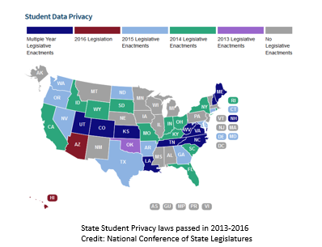
State Level
Response
Multiple Years of Legislation
2016 Legislation
2015 Legislation
2014 Legislation
2013 Legislation
No Legislation
Notes:
Objective:
Introduce the two tier system of state and federal applicable laws; demonstrate the severity of the problem nationwide with a state response.
We all hear people talk about data breaches and privacy laws, but here is a visual of how prevalent the response has been.
Since 2013, 39 states have introduced or passed laws specific to Student Data Privacy. All the others have introduced and discussed student data privacy, except Vermont, at least as described on this map.
With the massive amount of data we collect on each student in the US, this repository is attractive to criminals. These students likely would not know their information was violated until later, when they look for credit or apply for jobs and the unauthorized usage of their Personal identity information becomes apparent. These data are at a great value because these students don’t monitor their information the same was adults do.

Slide 11

CALIFORNIA
EDUCATION
CODES
Education Code Sections 49079.5 -.7 ,
CALPADS data are available and accessible to researchers
Education Code Section 49558 –
Provides some guidance and restrictions for interagency data sharing of school lunch information
Education Code Section 60607 –
Provides specific restrictions on the release of assessment data
Notes:
Objective:
State law makers knew the data would be key to be used for improving and quantifying public education in CA, so knowing the federal laws and in consideration of FERPA, we enacted Education Code whereby research and public policy can use the data.
Education Code (EC) Sections 49079.5 -.7
49079.5.
The Legislature recognizes that a longitudinal pupil data system provides direct and tangible benefits to pupils, educators, policymakers, and the public. The Legislature intends to make statewide longitudinal education data accessible to, and used to inform and engage, authorized stakeholders in an effort to support the continuous improvement of instruction, operations, management, and resource allocation, and in a manner that complies with all federal and state privacy laws. The Legislature intends to make statewide longitudinal education data available and accessible to researchers so they may evaluate the effectiveness of instructional materials, strategies, and approaches for educating different types of pupils in a manner that complies with federal and state privacy laws, including, but not limited to, the Family Educational Rights and Privacy Act of 2001 (20 U.S.C. Sec. 1232g) (FERPA). It is the intent of the Legislature, in enacting this section, to accomplish all of the following:
(a) Comply with the United States Constitution and all applicable federal laws, including FERPA and its implementing regulations (34 C.F.R. 99).
(b) Comply with the California Constitution and all applicable state laws and their implementing regulations, including, but not limited to, Section 1798.24 of the Civil Code.
(c) Further an environment in which the department and the California Longitudinal Pupil Achievement Data System (CALPADS) serve as resources for local educational agencies.
(d) Promote a culture of continuous improvement through collaboration and informed decision making at the classroom, school, district, state, and policymaker level.
(e) Minimize the anticipated workload increase on the department that may be generated by an increased number of data requests as CALPADS becomes operational, by establishing clear guidance on data access and an efficient process for responding to requests for access.
(f) Pursuant to FERPA and as defined in Section 1798.24 of the Civil Code, make pupil data available to qualified researchers from nonprofit organizations while appropriately protecting the privacy of individual pupils.
(Added by Stats. 2010, 5th Ex. Sess., Ch. 1, Sec. 4. (SB 2 5x) Effective April 12, 2010.)
49558. Related to NSLP data
(a) All applications and records concerning any individual made or kept by any public officer or agency in connection with the administration of any provision of this code relating to free or reduced-price meal eligibility shall be confidential, and may not be open to examination for any purpose not directly connected with the administration of any free or reduced-price meal program, or any investigation, prosecution, or criminal or civil proceeding conducted in connection with the administration of any free or reduced-price meal program.
Ed Code Section 60607
Provides specific restrictions on the release of assessment data
restrictions greatly limit access to this data without parental consent
60607. Assessment Information is NOT directory information, so there had to be education code related to how and when Assessment data can be shared.
(a) Each pupil shall have an individual record of accomplishment by the end of grade 12 that includes the results of the achievement test required and administered annually as part of the California Assessment of Student Performance and Progress (CAASPP), or any predecessor assessments, established pursuant to Article 4 (commencing with Section 60640), results of end-of-course examinations he or she has taken, and the vocational education certification examinations he or she chose to take.
(b) It is the intent of the Legislature that local educational agencies and schools use the results of the academic achievement tests administered annually as part of the CAASPP to provide support to pupils and parents or guardians in order to assist pupils in strengthening their development as learners, and thereby to improve their academic achievement and performance in subsequent assessments.
(c) (1) Except for research provided for in former Section 49079.6, as it read on December 31, 2013, a pupil’s results or a record of accomplishment shall be private, and may not be released to any person, other than the pupil’s parent or guardian and a teacher, counselor, or administrator directly involved with the pupil, without the express written consent of either the parent or guardian of the pupil if the pupil is a minor, or the pupil if the pupil has reached the age of majority or is emancipated.
(2) (A) Notwithstanding paragraph (1), a pupil or his or her parent or guardian may authorize the release of pupil results or a record of accomplishment to a postsecondary educational institution for the purpose of credit, placement, or admission.
(B) Notwithstanding paragraph (1), the results of an individual pupil on the CAASPP may be released to a postsecondary educational institution for the purpose of credit, placement, or admission.
(Amended by Stats. 2014, Ch. 327, Sec. 19. (AB 1599) Effective January 1, 2015. Inoperative July 1, 2020. Repealed as of January 1, 2021, pursuant to Section 60601.)

Slide 12


State Privacy Laws
Public Records and Confidentiality
Title 12 of Part 2 of the Penal Code California Electronic Communications Act
Imposes significant limitations of school districts to compel the production of, or access to, information on an electronic device
AB 1584, EC 490731
Protecting Pupil Records Privacy in 3rd-party Contracts –
Designed to ensure vendors are complying with privacy protections enumerated in FERPA (CSPA)
Student Online Personal Information Protection Act
Notes:
(This slide has a variety of elements which touch on student data and its use/sharing under law)
Title 12 of Part 2 of the Penal Code California Electronic Communications Act (was SB178, passed in 2014)
Chapter 3.6 (commencing with Section 1546) to Title 12 of Part 2 of the Penal Code, relating to privacy.
Even though the LEA may own the electronic equipment or devices, the student has specific rights to privacy within those devices.
Imposes significant limitations on the ability of a state government entity (including school districts) to compel the production of, or access to, information on an electronic device, including cellphones, laptop computers, tablets or any other device that stores, generates or transmits information in electronic forms.
CALIFORNIA Student Privacy Alliance (CSPA) The CSPA is a collaboration of California school districts that share common concerns around student privacy and share contracts with vetted language which complies with State and Federal regulations, in order to save time and money. There are resources and collaborative efforts around these requirements.
Since the passage of AB 1584, EC 490731
school districts have struggled to incorporate its required provisions in their contracts with digital providers. Two reasons account for a large portion of these difficulties:
School districts often do not have the legal resources to negotiate with legally compliant privacy provisions.
Other school districts are often reluctant to adopt the products for their school district, especially if they do not know whether these other agreements have been legally reviewed, and by persons who are comfortable in the new law of data privacy.
SOPIPA-
Student Online Personal Information Protection Act
Prohibits education technology service providers from selling student data, using that information to advertise to students or their families, or "amassing a profile" on students to be used for non-educational purposes

Slide 13
Recommendations from the
CA Attorney
General’s Office
Data Collection and Retention
Minimization is the goal
Data Use
Data disclosure
Keep it educational
Make protections stick
Individual Control
Respect users’ rights
Data Security
Implement reasonable and appropriate safeguards
Transparency
Provide a meaningful privacy policy
Source: Ready for School (Issued Nov. 2016 by California Attorney General’s Office) : Recommendations for the Ed Tech Industry to Protect the Privacy of Student Data
Notes:
Student Privacy and Data Collection the recommendations from the Attorney General:
In the midst of so many laws, both federal and state mandates, the attorney for the State of CA only recommends these “common sense” approaches to student data.
These are the types of precautions we take daily, and following these common sense recommendations can go a long way in our obligation to protect student data.
What kinds of things happen where student data is compromised?
Believe it or not, it isn’t always the BIG data breaches, but instead just lack of attention or human error.
Some examples we commonly see:
Sending attachments of raw data via email
Screenshot of CALPADS/SIS information and emailing it
Saving extracts of massive amounts of raw data to a public folder
Leaving printed CALPADS detail reports on your desk
Allowing a student to work at the desk with an active CALPADS session
Sharing userID/Passwords

Slide 14

Notes:
A keyboard image with the words “Data Privacy” on one of the keys

Slide 15
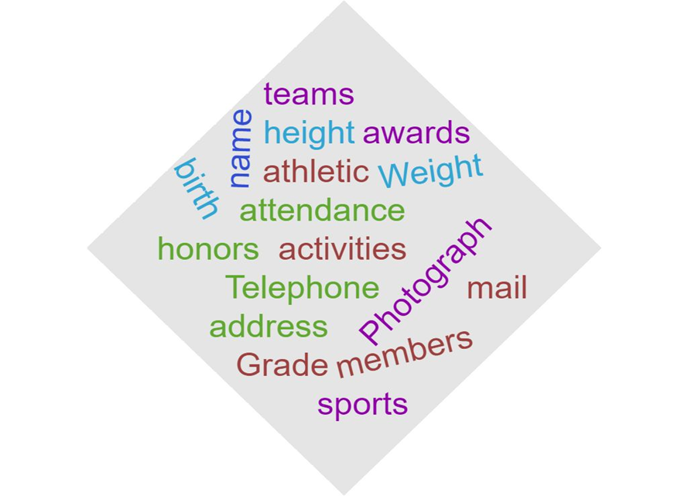

Data Privacy
Policies and Procedures
Data Privacy Policy and Privacy Procedures:
  usually focus on adhering to the legal and ethical requirements for protecting confidentiality of data
Notes:
Compare/Contrast Data Policy and Data Security
Talking Points:
Data privacy relates to the collection and use of personal information of both students and staff.
Schools collect student names, addresses, dates of birth, Social Security numbers, demographic, contact, academic, and other identifying information for each student’s record.
Schools also collect employees’ personal information, compiled into each employee’s personnel record.
Schools monitor use of such data carefully — data privacy would include an assessment, for example, of whether student names and email addresses should be shared with a third party vendor which then uses that information to send marketing materials to the students
Data privacy also can include how student records are shared with the student, his or her parent or guardian, teachers and other school staff, and other third parties, consistent with the requirements of the Family Educational Rights and Privacy Act (FERPA) and state laws.

Slide 16


Data Security
Policies and Procedures
Data Security Policies and Procedures
focus on technical aspects of protecting the data within the information technology infrastructure
Notes:
Data Security Policies and Data Security Procedures specifically address the ability to access the electronic records.
password strength
Mechanisms used to share and store data
Do you save extracts on your laptop?
How do you dispose of thumb drives or electronic media
Emailing Screenshots of Personally Identifiable Information (PII) is NOT secure.
Service Requests are NOT secure messages; this is why we ask you NOT to send anything but the SSID or SEID

Slide 17
Email Protections
Anti-Virus
WI-FI Encryption
Cloud Data Storage Systems
Secured Network Access
Hardware Firewall Systems
Data Security
Technology
Components
Depending on your role in the organization, these Information Technology functions relating to Privacy may NOT be your DIRECT responsibility, BUT….
Notes:
Objective: Compare/Contrast Data Policy and Data Security
Talking points:
Data security describes the protections in place to prevent unauthorized access to or acquisition of personal student and staff information.
The LEA data security measures might include keeping student and staff personal data in locked filing cabinets, and limiting access to those filing cabinets to people within the school district who need that data in order to do their jobs
BUT Data security also includes using encryption when transmitting personal data electronically, requiring school district employees to use passwords to access files containing personal data, and installing software that detects intruders in the computer network and preventing cyber attacks whenever possible using infrastructure and industry best practices.

Slide 18
Data Privacy vs.
Data Security
Privacy | Security
POLICY/PROCEDURES | POLICY/PROCEDURES
State/Federal Laws | HARDWARE/SOFTWARE
Local practices/ access rights decisions | Encryption Methods/Access Rights process
Individual Best Practices | Infrastructure Best Practices
Most cyber attacks target human behavior
A few precautions can go a long way to protect data and privacy
Notes:
Give an example:
Food Services asks for a list of NSLP, how do you get that Direct Certification list to them? Do you know if the request is truly from them? Maybe walking the thumb drive to them is more secure. Maybe you have a password protected folder on a secure network? It is an important conversation to investigate the legitimate business need for the data, the local policies as well as the security infrastructure in place when sharing data.
We were recently notified here at CSIS that our parent organization had a data breech. Our employee data was compromised because someone received an email, which looked like it came from the supervisors email address, with a request to send personal identifying information, and that person who received the request emailed employee SSN#s and addresses. Unfortunatly, this wasn’t the first time- some staff have had one going issues with tax returns and identity theft from these types of incidents.

Slide 19

Accessing
CALPADS
Notes:
How does security awareness/controls relate to CALPADS access
In order to comply with federal and state privacy las and regulations, CALPADS is to be used only by authorized users and only for legitimate business needs. We know that you work in your SIS with student data daily, and that accessing CALPADS to report and extract information is a critical part of the important work you do. Today we will look closely at the process of getting the LEA Admin Account, how the procedure is meant to protect and inform both you, the account holder as well as your supervisor, as well as the expectations for the role as the LEA Admin.

Slide 20
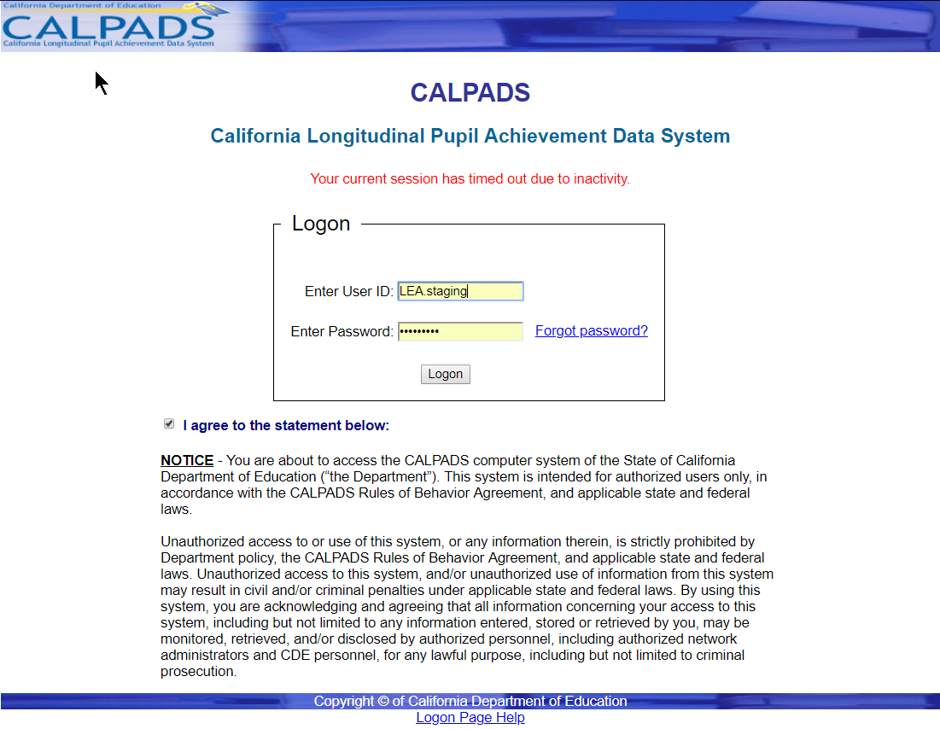
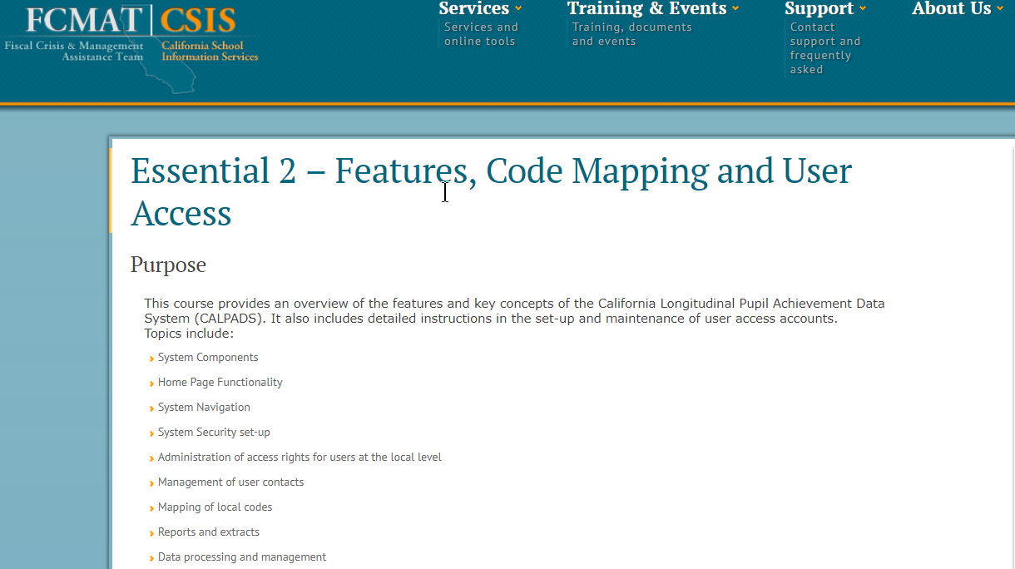
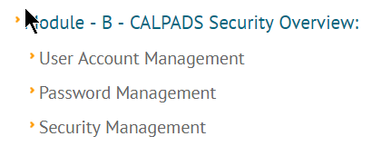
Navigation in CALPADS
www.csis.fcmat.org/pages/self-paced-training.aspx
Notes:
Just a quick sidebar, when we talk about access to CALPADS, we wont be talking about how to login or move around in CALPADS. You can learn more about the Navigation and login protocols in CALPADS from the CSIS Self Paced training, Essentials 2, found on the CSIS website, link is on this slide. Essential 2 provides key functionality concepts, navigation, code mapping and security features of CALPADS.

Slide 21
CALPADS
LEA ADMIN
Application process
LEA Admin requests the LEA Admin Application from the CALPADS Help Desk
Application is forwarded from CDE; then Superintendent or Charter School Administrator signs
Annually, LEA Admins complete Data Privacy Training, review the training materials with LEA/School Level users.
Notes:
Objective: clarify the process to obtain an LEA Admin application/account
Each LEA has at least one person who is the central coordinator for the LEA accounts the LEA Admin. They are assigned this responsibility by the Superintendent or a designee.
Talking points:
Changes effective as of now
LEA Admin has this account to maintain the roles and security levels of others in the LEA
More information about the security and roles in Essentials 2
Responsible to ensure that OTHER Accounts within the LEA know and understand appendix A
Responsible to ensure the individuals with accounts have a legitimate business need for the information they will have access to

Slide 22
CALPADS LEA
Admin Application
Change in Superintendents or Charter School Administrator, or
LEA administrators during the school year
Mid-year personnel change
Accounts for new CALPADS LEA administrators will be provided when requested
New applications will be required when there is a change in Superintendent or Charter School administrator, but this will not impact the CALPADS LEA Administrator’s login credentials
Notes:
Accounts for new CALPADS LEA administrators will be provided when requested.
New applications will be required when there is a change in Superintendent or Charter School administrator, but this will not impact the CALPADS LEA Administrator’s login credentials

Slide 23

CALPADS
LEA
Admin
Application
CALPADS LEA Administrator Application and Guidelines
** Revised **
The Purpose of the document is to outline the application procedures the CDE uses to grant CALPADS LEA Administrators access to CALPADS
18 pages of:
  Overview
  Responsibilities
  Behaviors
  Instructions
  Application
  Appendix A & B
Notes:
Accepting Responsibilities
The CALPADS LEA Administrator must abide by the agreement set forth in Appendix B and is responsible for ensuring Local users abide by the agreement set forth in Appendix A.
It is imperative that the CALPADS LEA Administrator align the legitimate business needs of the potential user with the functionality and purpose of the CALPADS system
Outlines the application procedure the CDE uses to grant CALPADS LEA Administrators access to CALPADS.
Requires that all CALPADS users review and consent to the appropriate Confidentiality and Security Agreement before receiving access to CALPADS
Responsible for overseeing the use of CALPADS by their local users, ensuring the local users have privacy and security training as outlined in Appendix A.
The purpose of the document is an overview! But it is 18 pages, so the assumption is users understand and know the details of these items

Slide 24
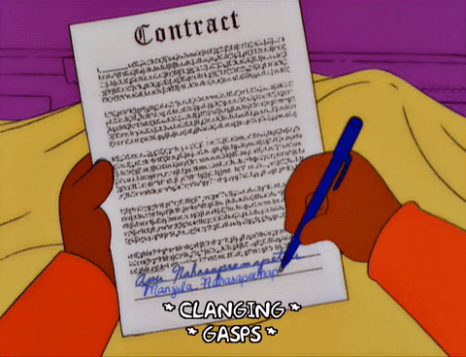
Appendix
A & B
Appendix A:
Tool for LEA Admin to share with
LEA and SCHOOL level account holders
Appendix B:
Rules of Behavior Agreement for CALPADS LEA Administrators
By signing the CALPADS LEA Administrator Application, I, as a CALPADS LEA Administrator, agree to abide by the terms and conditions of usage and accept all ramifications of the policies and am acknowledging the following information…
Notes:
Objectives: To use the LEA Admin application Appendix A & B as a launching pad for conversations.
Talking Point:
As the LEA Admin, you can have two conversations;
one with your supervisor regarding those staff needing access to CALPADS and what tasks require which levels of security and what roles
They have signed the application and authorized you to act in accordance with the items we are about to cover
second with those individuals to whom you assign those LEA and SCHOOL level accounts
The appendix specifies you will ensure the LEA/School site user are knowledgeable and agree to the provisions of Appendix A
LEA Admin is the point of contact between the LEA and CALPADS Service Desk, so that there is one clear representative providing guidance and communications throughout the LEA.

Slide 25
LEA/School
CALPADS Users
CALPADS user accounts are restricted to those currently employed school, district, or county office personnel or personnel contracted by the LEA with a legitimate business need to input data, or access data in CALPADS
Notes:
Objective: To tie FERPA, federal laws to the use of CALPADS.
Talking Points:
Quick reminder of that FERPA Language, that a “legitimate business need” is handled by the LEA Admin in their user security module, assigning appropriate security levels and roles for specific job tasks.

Slide 26
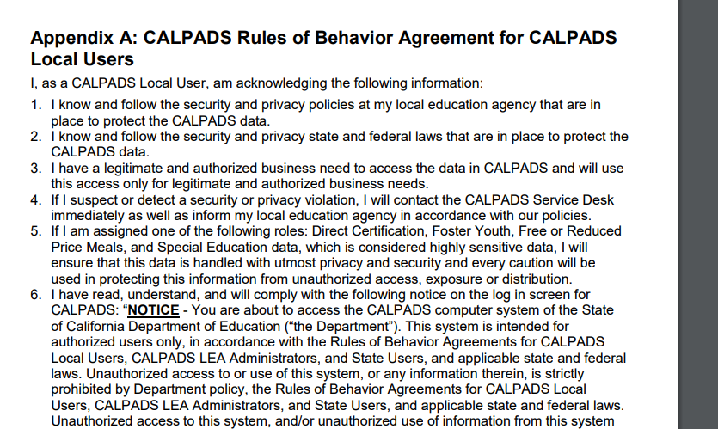
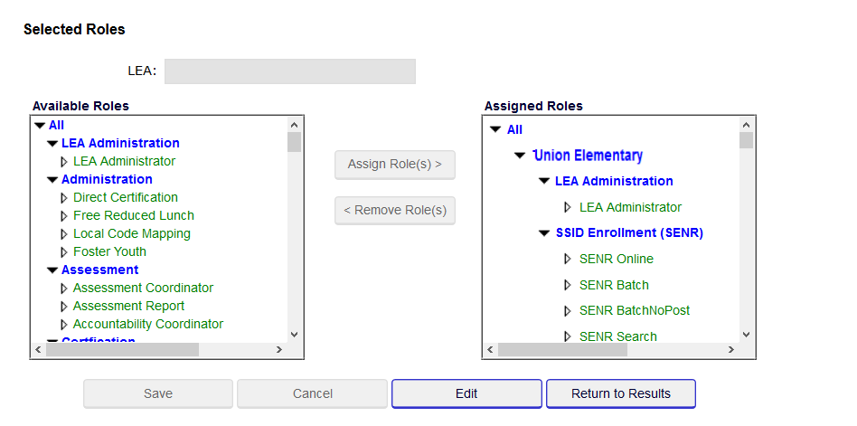
Maintain
CALPADS
User Accounts
Notes:
Objective:
Connect the Appendix A with the assignment of User Security and Roles in CALPADS
This screen in CALPADS User Security is where the Data Privacy and Security are maintained
Talking Points:
The responsibilities of the LEA Admin include ensuring the user is aware of the Appendix information
Once the LEA Admin is assured the user has reviewed and agrees, the functions can be assigned within the User Security Module in CALPADS
More information on HOW to do this is in Essentials 2 Self Paced or Webinar.
Appendix A can be signed and filed with the LEA Admin for the protection and assurance of the LEA Admin
Roles and accounts can be managed (or revoked) as job duties change.

Slide 27

What EXACTLY am I agreeing to?
Notes:
OBJECTIVE: to introduce the idea that each of the 17 items in the LEA ADMIN APP is meant to explicitly cover an area of work in CALPADS in Data Privacy, Security, comply with FEDERAL and State Laws
CAVEAT- We know that you already consider these things daily; The Appendix contains common sense guidance around Student Data privacy and security and asks you to consider uncovering areas of local ambiguity or confusion, as well as begin a discussion about data governance with other staff. Todays presentation is a chance to step back and dig deeper into each of the items to understand where the agreements come from.
Talking Points:
This agreement has roots in actual areas of Data Privacy Laws and Policies
Real world Examples, Common sense practices,
Uncover areas of local ambiguity or confusion,
Framework for discussion with other staff who primarily DO NOT work with Data Privacy or Data Security
YOU ARE NOT ALONE.
LEA Admin Application is sponsored by your superintendent
CALPADS Support
Etc…

Slide 28

LEA Admin
Application
Appendix B
1. I know and follow (and will review at least once a year) the security and privacy policies at my local education agency that are in place to protect the CALPADS data.
Notes:
Talking Points:
Every LEA has local site training, as well as LEA/District wide trainings to discuss security and privacy policies. Know when yours happen and use those opportunities to learn more about the protections and responsibilities of the policies.
(see above)
Control the access to PII and SI by using a policy for assigning access to all account holders. Ensure that people who have access to PII and SI (Sensitive Information)need that access for their work,

Slide 29
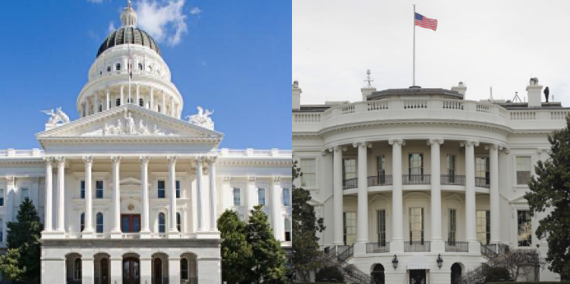
2. I know and follow the security and privacy state and federal laws that are in place to protect the CALPADS data.
LEA Admin
Application
Appendix B
Notes:
We want to recognize and acknowledge that each of us is at different places in our learning about FERPA, and the other Federal/State laws. Each local area has their own trainings on these topics and each of us brings a unique experience to the table. Use what you have and seek out more information when needed, and when it makes sense.
It is important to note, that lack of knowledge or understanding does not eliminate the need to follow the laws in place which govern the work we do, which is why we are hosting this training. We hope to spark questions and conversations that continue into your LEA. Access to Student Data is a privilege and we expect people with access to protect the data as they would other commodities.

Slide 30

3. I have a legitimate and authorized business need to access the data in CALPADS and will use this access only for legitimate and authorized business needs.
LEA Admin
Application
Appendix B
Notes:
We saw in FERPA the explicit language regarding a legitimate and authorized business need to access data. The National School Lunch Program records, those student who receive Free and Reduced price lunches, has a very specific role in CALPADS attached to it. Only those staff whom have a legitimate business need, such as the SIS admin, or the Nutrition staff need to have access to that information.

Slide 31

4. If I suspect or detect a security or privacy violation, I will contact the CALPADS Service Desk immediately as well as inform my local education agency in accordance with our policies.
LEA Admin
Application
Appendix B
Notes:
Objective: To review, in depth, at least once a year, the details and requirements of the LEA ADMIN in order to meet the obligations contained within.
What are my local policies about misuse of information or data?
Whom am I to contact if I suspect or know that data is being misused or mistreated?
Where are the guidelines locally for release of Student data?

Slide 32

5. I understand that this role has access to Direct Certification, Foster Youth, Free or Reduced Price Meals, and Special Education data, which is considered highly sensitive data. I will ensure that this data is handled with utmost privacy and security and every caution will be used in protecting this information from unauthorized access, exposure or distribution.
LEA Admin
Application
Appendix B
Notes:
Sneaking a look or social engineering to determine whom in your school site or LEA is on reduced or free meals is a violation of law.
Sensitive information should be treated as such and it is important to ask yourself, and others , why the information is being released, and who will have access once the information is given. Legitimate Business needs could be to share information with Nutrition folks, EL program mangers, and administrators for migrant education programs, as the data relates to their business needs.
People are curious by nature and staff know you have access to sensitive information about the folks in your community. Is there a legitimate business need for this information? If not, give them no data, just the side eye.

Slide 33
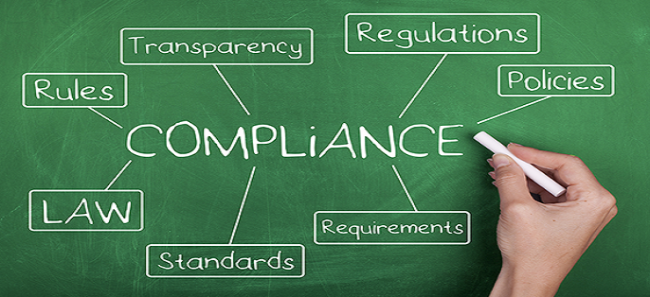
6. I have read, understand, and will comply with the notice on the log in screen for CALPADS.
LEA Admin
Application
Appendix B

Slide 34

CALPADS
NOTICE
SCREEN
“NOTICE - You are about to access the CALPADS computer system of the State of California Department of Education (“the Department”). This system is intended for authorized users only, in accordance with the Rules of Behavior Agreements for CALPADS Local Users, CALPADS LEA Administrators, and State Users, and applicable state and federal laws.
Unauthorized access to or use of this system, or any information therein, is strictly prohibited by Department policy, the Rules of Behavior Agreements for CALPADS Local Users, CALPADS LEA Administrators, and State Users, and applicable state and federal laws. Unauthorized access to this system, and/or unauthorized use of information from this system may result in civil and/or criminal penalties under applicable state and federal laws.
By using this system, you are acknowledging and agreeing that all information concerning your access to this system, including but not limited to any information entered, stored or retrieved by you, may be monitored, retrieved, and/or disclosed by authorized personnel, including authorized network administrators and CDE personnel, for any lawful purpose, including but not limited to criminal prosecution.”
Notes:
Objective: To review, in depth, at least once a year, the details and requirements of the LEA ADMIN in order to meet the obligations contained within.

Slide 35
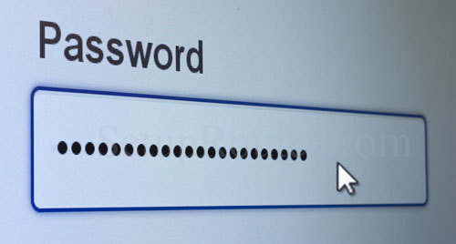
7. I understand that I am responsible for the security and privacy of my password. I will adhere to the following minimum requirements for a password: It must be at least eight (8) characters in length and must include at least one uppercase letter, at least one lowercase letter, and at least one of the following non-alphanumeric characters: ! ? @ # $ ^ & * - = _ +.
LEA Admin
Application
Appendix B
Notes:
More importantly than the protocols for passwords is that the length of the password should be long; at minimum 8 characters. The longer the password is, the less likely that password can be cracked. Again, 8 is the minimum, so try and think of a phrase you can strong together which meets the password protocol and exceeds 8 characters.

Slide 36

8. I will comply with the following rules governing user credentials: I will protect my logon credentials at all times, never share my user ID and/or password with anyone, avoid using a feature in my local browser which automatically fills in passwords, and avoid writing my password down.
(If I need to write my password down, I will keep this information in a secure area.)
LEA Admin
Application
Appendix B
Notes:
We have had email conversations with LEAs, and we come to find out they have loose User Id practices, such as sharing one general login or giving one another access to their account while they are away from the office for a prolonged time. If the account is too general, such as REGISTRAR.LEA, no one person would be accountable for the actions taken by that account, which makes it less than secure. Similarly, if you allow someone to access your LEA Admin account in your absence, whatever they do with that access will appear to be you. It is VERY easy to create an account for someone, and the Rules and Behaviors agreement stipulates each user have their own account.
Again, if you MUST write your password down, keep it in a secure location, away from your desk. Better yet, think of a phrase or several words that make a strong, easy to remember password and avoid writing it out.

Slide 37

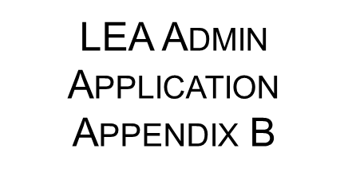
9. I will protect CALPADS information in any form, including information contained on printed reports, data downloaded onto computers and computer media (e.g., diskettes, tapes, compact discs, thumb drives, etc.), user computer monitors, or any other format. Data which is saved to portable storage devices, such as laptops, USB thumb drives, DVD’s, and discs will be encrypted.
Notes:
Number 9 talks about the ways in which we protect data we share.
How do you protect printed copies of snapshot reports? ODS downloads?
Are there students working near or at your desk when CALPADS is open?
What portable devices have CALPADS access and data stored to them- laptops are portable devices, but so are thumb drives and DVDs.
DO you know where a password protected folder is on your network?
Does your LEA have encryption software or email encryption?

Slide 38
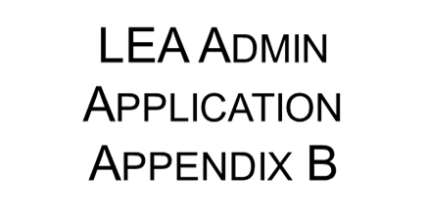
10. I will log out of CALPADS if I am going to be away from my computer log out of CALPADS or lock my computer before I leave it unattended, remove CALPADS media information from my desktop when I am away from my desk, store media containing CALPADS information in a locked container during non-business hours, properly cleanse or destroy media containing CALPADS information, and shred paper media and compact discs prior to disposal. I will cleanse diskettes and other magnetic media using appropriate software or a magnetic field with sufficient strength so as to make the information unreadable. I understand that simply deleting files from magnetic media does not remove the information from the media.
Notes:
Number 10 speaks to security of data. We will Log out and LOCK COMPUTER, keep printed documents or other media with CALPADS data in a LOCKED drawer and CLEANSE/DESTROY media with CALPADS data prior to throwing it away

Slide 39

11. I am aware of the security issues of snooping, shoulder surfing, social engineering, faxing, virus scanning and patching, phishing, spear phishing, and whaling, and I will prevent breaches from these issues to the best of my ability.
Notes:
Slide 6 is a visual explanation of the types of common cyber attacks, however number 11 asks us to stay abreast of security issues in general. Some people are curious and know that you and other staff have access to sensitive information. If someone asks for data you have in CALPADS, knowing why they want it and for what school business they need it is a perfectly fair question. Social Engineering, shoulder surfing- watching over your shoulder as you work or trying to glance at printed reports are also breech of data. Stay current with cyber security issues and don’t be afraid to challenge ‘nosey’ individuals who have no business need for data they want to see.

Slide 40

12. I will complete the annual CALPADS LEA Administrator application process (at least once a year) and will attend and complete the annual CALPADS training on privacy and security.
Notes:
CSIS anticipates giving this training annually and/or as needed for each LEA Admin prior to renewal of their LEA Admin application.
While all the items we have covered so far are for everyone who has access to CALPADS, items 12 -17 focus on the LEA Admin Rules for Behavior agreement.
The LEA and School level users are held to the Rule of Behavior outlined in Appendix A is basically each item we have already covered, and we have a PowerPoint created for you to use in sharing these responsibilities with those LEA and School Level staff whose accounts you will create and maintain.

Slide 41
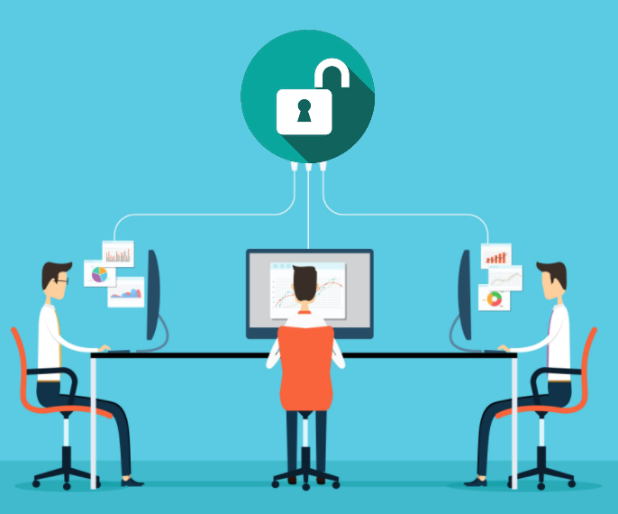
13. I will configure available LEA system features (at least once a year) to make certain that appropriate local security controls and processes are in place.
Notes:
Once job tasks and roles for those who need access to CALPADS data have been established; based on some formal, documented analysis of the tasks performed by each staff, the individual needs an account. Getting into CALPADS begins with the creation of the users account- done by the LEA Admin. This person will assign the roles and security level for each person in their LEA based on those legitimate business needs of their positions.
At least annually, but always as needed, when staff changes when responsibilities change - the LEA Admin will ensure the right people have the right access.

Slide 42

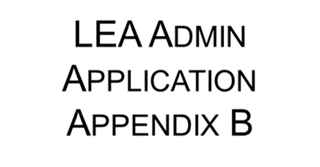
14. I will monitor Local Users for compliance with CALPADS data security and privacy requirements (at least once a year).
Notes:
Know who your LEA users are and what business they have in CALPADS, monitor and maintain their use, and remind them, at least annually of their responsibilities to uphold Data Privacy and security.

Slide 43
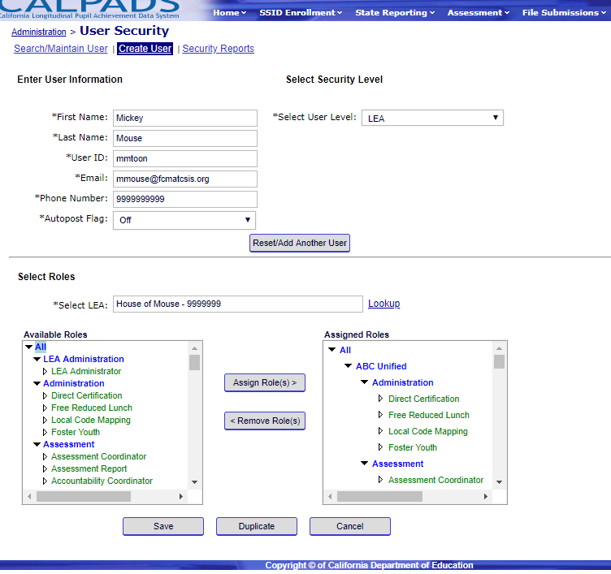
15. I will assign, maintain, and review Local User access privileges and accounts to ensure that only users with a required business need have access to CALPADS.
Notes:
To that end, I will take it upon myself to ensure that the appropriate people have the appropriate level of access to CALPADS, at least once a year. This means that you will revoke users who leave your LEA, more information in Essential 2.

Slide 44
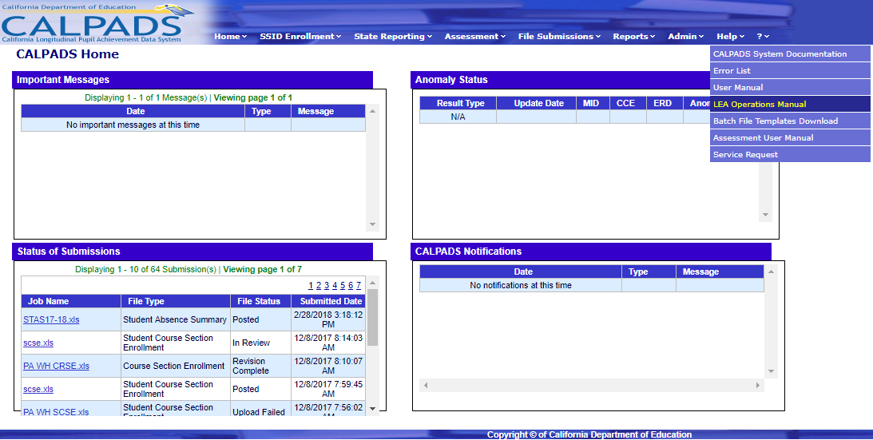
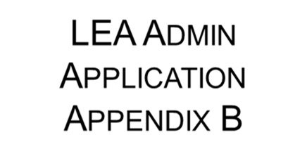
16. I will review the LEA Operations Manual in CALPADS and comply with all CALPADS requirements as a CALPADS LEA Administrator.

Slide 45

17. If the Superintendent or Charter School Administrator that signed my application is no longer in that position due to retirement, termination, death or any other reason, I will complete a new CALPADS LEA Administrator application with the signature of the new Superintendent or Charter School Administrator as required.
Notes:
Objective: To review, in depth, at least once a year, the details and requirements of the LEA ADMIN in order to meet the obligations contained within.

Slide 46
LEA ADMIN: Appendix B-
obligations to know, read, follow and comply with state and federal laws pertaining to student data
Access and use data for legitimate business needs
CALPADS Login Notice
Password/Computer privacy
Be aware of Data Privacy; snooping, shoulder surfing, social engineering, phishing, whaling, etc…
Keep up to date with security training, both local and state level offerings. (CDE Data Privacy and Essentials 2)
Prepare your position and LEA with policy and procedures to protect the data you steward
  Local breach protocol
Notes:
How familiar are you with FERPA and other Federal laws? Have you accessed studentprivacy.ed.gov FERPA 101/201 trainings? Did you know FERPA before you came to this training?
What are YOUR legitimate business needs? What are the specific roles and tasks of those LEA daily user and School level account holders have? Are you, the LEA Main, the one to divvy out account? DO those individuals have Appendix A? have they signed a paper copy for you?
Look at the CALPADS Login Notice and talk about the aspects…. EVERY TIME you login, you agree to the info contained within.
GENERAL, standard password security
DO NOT “LOAN” your email, or any login, for ANY REASON- give maternity leave example, do not operate with a “general mailbox” as the login

Slide 47

Best Practice
And
Resources

Slide 48
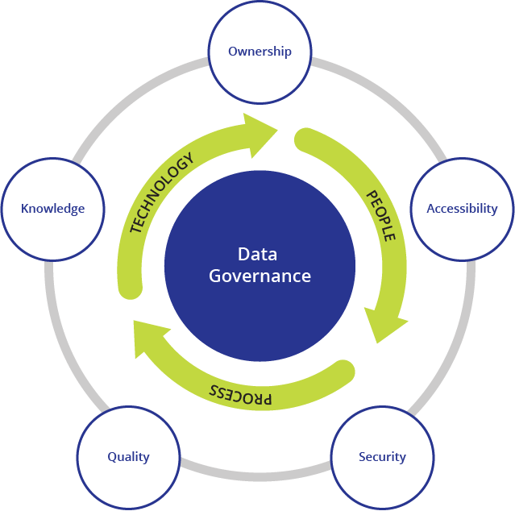
Data governance:
Encompasses the People, Policies & Procedures and
Information Technology
required to create a consistent handling of Student Data across all functions of the LEA.
Ownership of the Certified Data belongs to ALL Staff across the LEA.
Best
Practices
Notes:
DATA GOVERNANCE:
Good governance assures accuracy, timeliness, usability, and security in data. Governance plans should define roles and responsibilities when it comes to data access, disclosure, and use; ensure data management and monitoring; and describe and set up parameters on how data is collected, accessed, and used.*
WHAT DOES GOOD DATA GOVERNACE LOOK LIKE?
Data requests are handled using established data governance procedures.
• There are documented data system and compliance audit processes, and they are reviewed and updated at least annually.
• There are reviews of privacy implications associated with new data sharing or analysis opportunities.
• There are documented rules for disclosure avoidance (i.e., processes to avoid unintentionally releasing PII) before publishing data (in accordance with FERPA), and they are reviewed and updated at least annually.

Slide 49
Data
Stewardship
Data Stewardship
Manage
Data
into systems
Check Accuracy with stakeholders
Knowledgeable with Data Sets and Resources
Project Deadlines to stakeholders
Understanding Data Privacy and Security responsivities
Documentation of local Policies and Procedures
Annual Data Privacy Review
Best
Practices
Notes:
“organizational commitment
to ensure that identifiable information is
collected, maintained, used, and disseminated
in a way that respects privacy,
ensures confidentiality and security,
reduces reporting burdens, and promotes access to statistical data for public policy.”
- National Center for Education Statistics, SLDS Technical Brief, #2, November 2010

Slide 50
Questions for Data Stewardship
Does the LEA have a system of governance that designates rules, policy and procedures for decision making regarding data collection, use, access, sharing, and security?
Does the LEA have a policy for notification of any misuse or breach of information and available remedies? Where is the documentation for these procedures?
Does the LEA maintain a security process that follows widely accepted industry best practices?
Does the LEA provide a designated place or contact where students and families can go to learn of their rights and have their questions about student data collection, use, and security answered?
Best
Practices

Slide 51
Local Privacy Program Guidelines
General business use of data has policies and procedures documented
We have an active Data Governance team
State and Federal Laws are in place and have documented procedures
There is a method documented and in place to ensure we are following the procedures and policies
We train data users on policy and procedures regularly
We convey policy and procedures to parents and students, including on our website
We utilize and understand the student data life cycle
There is a designated Individual responsible for LEA/Local data use and policies
Best Practices
Source: Privacy Technical Assistance Center ptac.ed.gov
Notes:
What does our Data Privacy Program look like?
Work with, or form, a data governance team
Users and managers of student information, such as data managers, IT staff, school administrators
Designate an individual to be responsible for policies relating to data use and privacy
Develop a monitoring plan to ensure policies and procedures are being followed
Adopt any additional necessary policies and procedures for the use of student data throughout the data life cycle
Determine which policies and procedures are already in place
Train data users on relevant policies and procedures
Determine how to convey privacy policies to parents and students, including publicizing on your website
Source: Privacy Technical Assistance Center ptac.ed.gov

Slide 52
Local LEA Data Life Cycle
Creation or Collection
Storage
Usage
Sharing
Disposition
Source: NCES Forum Guide
to Education Data Privacy
Best
Practices
Notes:
Source: NCES Forum Guide to Education Data Privacy - Refer to Forum guide p10

Slide 53
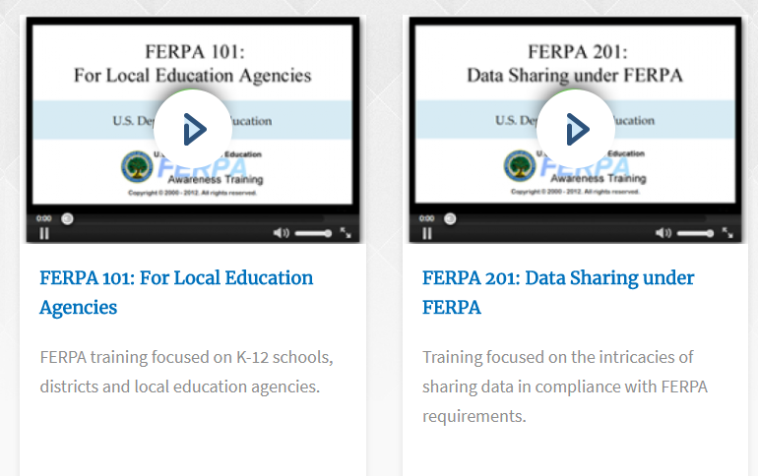
Protecting Student Privacy:
https://studentprivacy.ed.gov/content/online-training-modules
Additional
Training:
Data Privacy

Slide 54
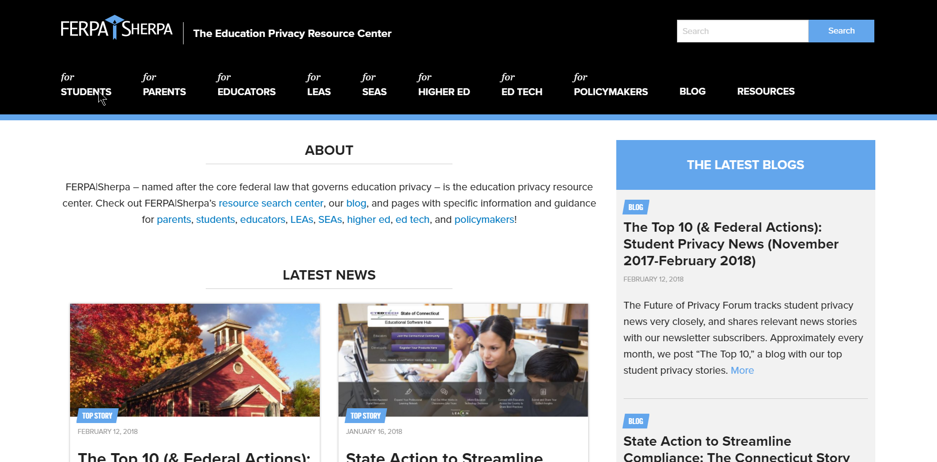
FERPA Sherpa
https://ferpasherpa.org
Additional
Training:
Data Privacy
Notes:
FERPA|Sherpa –
This site is named after the core federal law that governs education privacy – is the education privacy resource center; it is a name which is hard for forget now that you have heard it!
Check out FERPA|Sherpa’s resource search center, our blog, and pages with specific information and guidance for parents, students, educators, LEAs, SEAs, higher ed, ed tech, and policymakers!

Slide 55
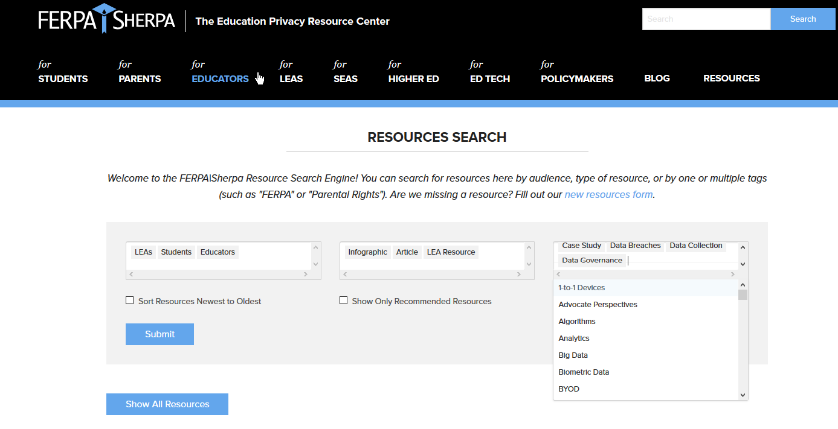
Additional
Training:
Data Privacy
Notes:
The resources section has a robust search feature, which allows for an LEA, Parent, Student or educator to search by type of resource; Blog, articles, Case studies, etc… and also by topic. This makes it very easy to find specific information about FERPA which would apply to a particular group or issue.

Slide 56
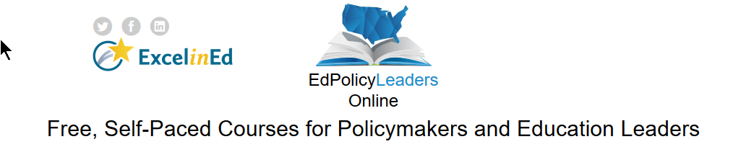
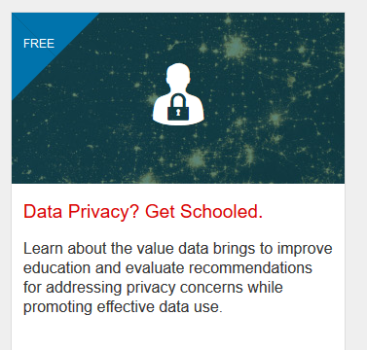
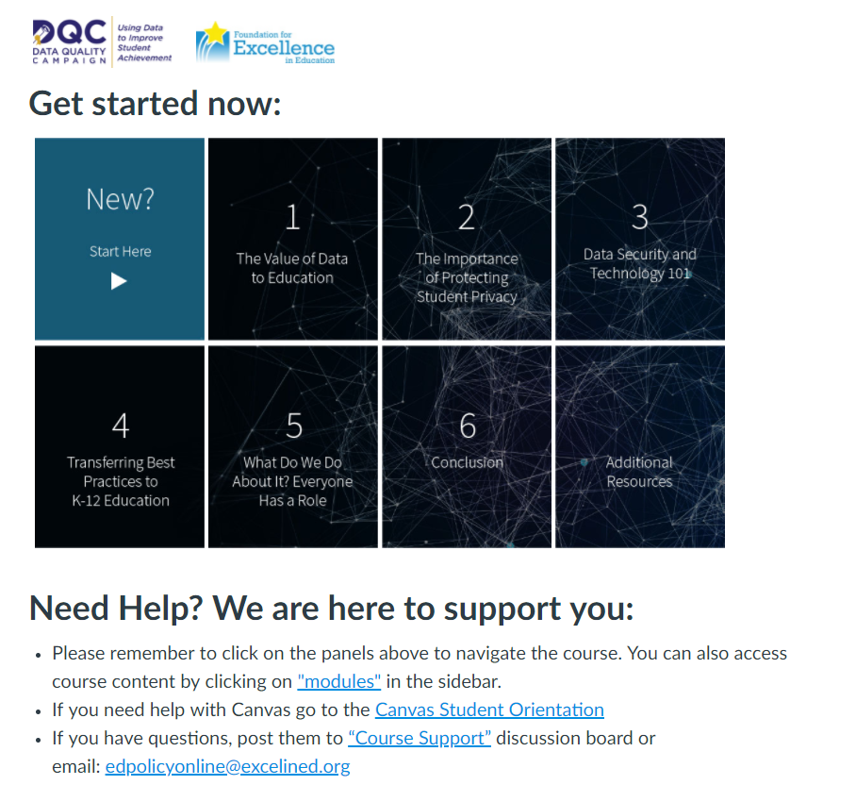
Additional
Training:
Data Privacy
Notes:
Foundation for Excellence in Education offers a FREE Self Paced Privacy Training, given in the Canvas platform which discusses the value data brings to improve education, offer recommendations for addressing privacy concerns while promoting effective data use, and explore lessons learned from existing and emerging policies in education and other sectors.
Each module takes less than one hour and has captioned video and written materials along with resources. They also offer a digital badge and a certificate once you have completed the course.

Slide 57
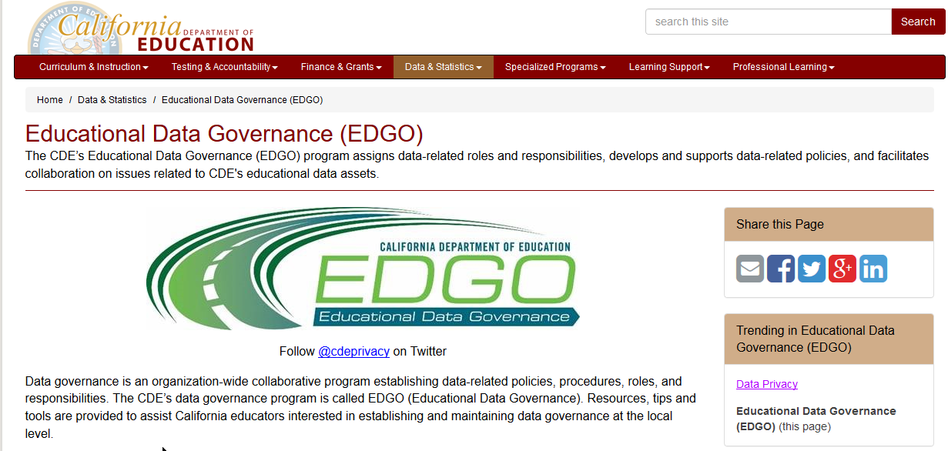
CDE: Educational Data Governance
https://www.cde.ca.gov/ds/ed/
Notes:
The California Department of Education’s (CDE’s) Educational Data Governance (EDGO) Program is a department-wide program that assigns data-related roles and responsibilities, develops and enforces data-related policies, and resolves issues related to the CDE’s educational data assets. The purpose of the EDGO Program is to establish data priorities that support/align with the CDE’s vision, mission, goals, and strategic plans. The EDGO Program is an ongoing, collaborative effort to ensure data quality, privacy, and security throughout the CDE.

Slide 58

Model Notification of Rights under FERPA
US Department of Education
https://www2.ed.gov/policy/gen/guid/fpco/ferpa/lea-officials.html
Notes:
The Model Notification of Rights under FERPA for Elementary and Secondary Schools very helpful to understand student and parent rights.
National Center for Education Statistics (NCES)
Forum Guide to Education Data Privacy – highlights common privacy issues related to use of student data and presents basic approaches to manage those issues
https://nces.ed.gov/forum/pub_2016096.asp

Slide 59
Data Privacy Resources
US Department of Education
  http://tech.ed.gov/privacy/
Protecting Student Privacy: A Service of the Privacy Technical Assistance Center and the Family Policy Compliance Office
  https://studentprivacy.ed.gov/
CA Department of Education
  Data Privacy Laws
  http://www.cde.ca.gov/ds/dp/
Data Privacy Guide: a collaborative project between the CETPA, CCSESA and Fagen Friedman & Fulfrost
https://www.f3law.com/privacy
CA Attorney General
  Ready for School: Recommendations for the Ed Tech Industry to Protect the Privacy of Student Data
  https://bit.ly/2IUdARg

Slide 60
Data Privacy
Resources
Data Privacy Guidebook | Summary of relevant laws and CA ed code, includes sample policies, assessments, and data breach protocols | Collaborative project between CSESSA, CETPA, and Fagen Friedman & Fulfrost LLP. | http://www.f3law.com/downloads/COMPLETE%20Privacy%20Guidebook%2009_18_15.pdf
California Student Privacy Alliance | Searchable database of AB1584 compliant education applications | Partnership with CETPA, Ventura COE, Access 4 Learning Community's Student Data Privacy Consortium and the Massachusetts Student Privacy Alliance (MSPA). | https://secure2.cpsd.us/cspa/agreement_info.php
Access 4 Learning | Collaborative to collectively address all aspects of learning information management and access to support learning. | Non-profit collaboration of schools, districts, local authorities, states, US and International Ministries of Education, software vendors and consultants | https://www.a4l.org/
Future of Privacy Forum | FERPA/SHERPA , Educator’s Guide to Student Privacy, resources for parents | Think tank and advocacy group focused on issues of data privacy | https://fpf.org
iKeepSafe | FERPA, COPPA, and CSDPA-certified complant products | Certifies technology used by children and in educational settings with qualified experts | https://ikeepsafe.org/
Common Sense Media | Family guides, research, concerns (e.g. cyberbullying, trolls, social media) | Nonprofit dedicated to helping kids thrive in a world of media and technology | https://www.commonsensemedia.org/

Slide 61
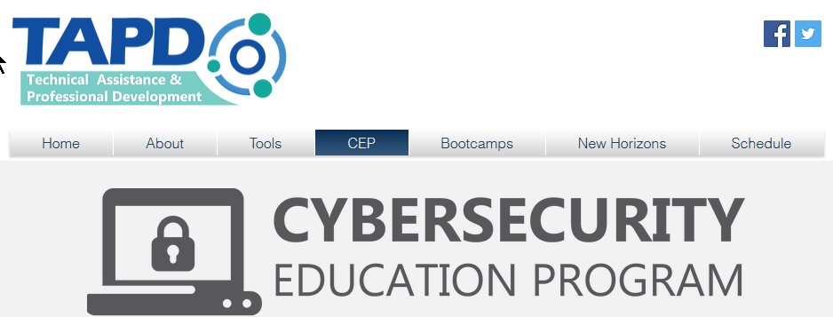

Technical Assistance and Professional Development- TAPD
https://www.k12tapd.org/cep
Notes:
AB104 was included in the 2015-16 California budget bill and appropriated one-time funds for professional development and technical assistance within K-12 schools. K12HSN was selected to help organize this important work in a way that leverages existing resources and partners. The Technical Assistance and Professional Development (TAPD) program, as you will find in the Budget Bill Language, highlights the importance of IT support and network management for schools and districts.
The Cybersecurity Education Program (CEP) is a research-based, proven. and comprehensive program designed to engender a culture of cybersecure, cyber-aware, and cyber-enabled work force.
The program provides every member of your California K-12 public education agency with a robust set of resources at NO COST including:
Engaging, bite-sized, video-based online learning modules
Monthly newsletter for printing and distribution to targeted employee groups
Full color, print-ready posters for use in creating a cyber-aware environment
Managed, ongoing assessment program to determine your organization's vulnerability to phishing campaigns
Quarterly analytic reports regarding the progress your organization is making toward improved cybersecure behavior
Advanced communications training for locally designated cybersecurity awareness coordinators (Sentinels)
Annual cybersecurity education summit for your district's designated liaison
Monthly webinars regarding trending issues in the cybersecurity threat landscape

Slide 62
Data Security
Resources
  http://www.k12tapd.org/
  No-cost program targets IT Professionals for training in Network Management, Security, Procurement, and Diagnostics, and also provides cybersecurity awareness courses for users
  Funded through AB104, as part of the 2015-16 California budget bill, appropriated one-time funds for professional development and technical assistance within K-12 schools
  TAPD program highlights the importance of IT support and network management for schools and districts
  Partnership of CETPA, K12HSN – managed by the Imperial County Office of Education
Notes:
AB104: Adult Education Block Grant
TAPD has been extended until June 2020. It is important to take advantage of these opportunities as soon as possible, due to limited funding.

Slide 63
Wrap Up
Summary
Understand the ideas of Data Governance and Data Stewardship and how they apply to the LEA Admin role
Awareness of LEA obligations under Federal Law, State Law and Local Boards/LEA Policy
Know where to find more information about the intersection of my specific duties and Federal and State laws as well as local policies.
Asses my obligations under the CALPADS LEA Application, including the review of responsibilities with School level and LEA level account holders.
Locate my own position and role within the LEA Data Privacy Practices.
Locate best practices and industry standards for further training related to overall School Data Privacy

Slide 64
Reminders
LEA Administrators are responsible for awareness and understanding of, and compliance with, applicable data privacy laws
  Multiple federal and state laws govern data privacy and confidentiality
Beginning in the 2019-20 school year, the LEA Admin will need to complete a new application annually and complete required data privacy training
  Superintendent to verify qualifications
  Audit users and roles annually
As a best practice, LEAs should develop a privacy program and train all data users on relevant policies and procedures
Multiple state and federal resources are available to help with understanding relevant laws, compliance, staff development and developing local programs
Notes:
Summary or best practices?

Slide 65

Moving forward:

Slide 66
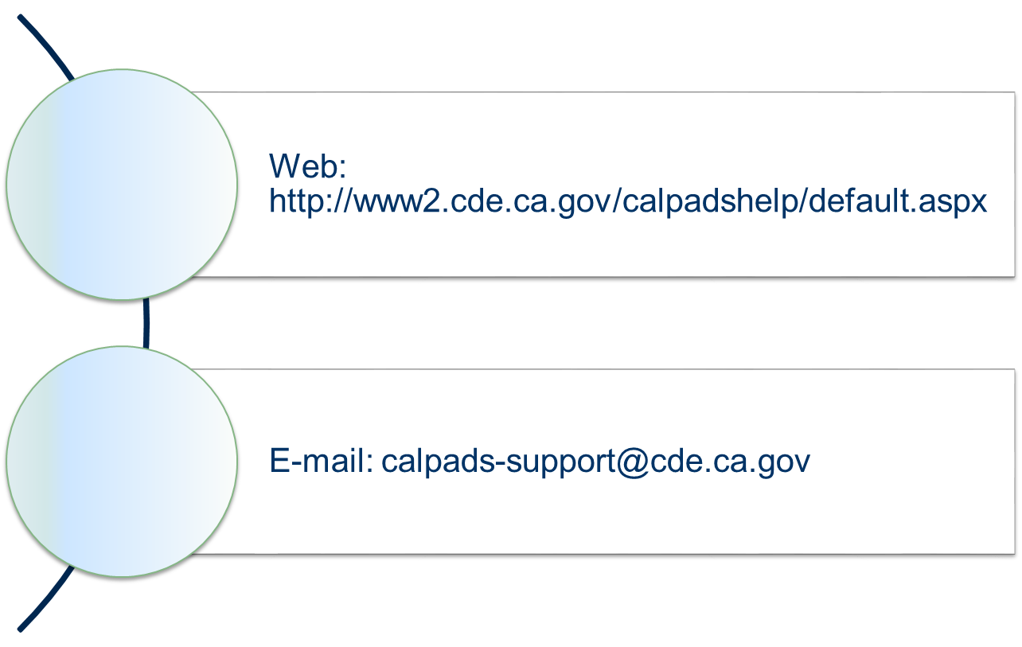
CALPADS
Service Desk
Support

Slide 67
Questions?

Slide 68

Please take our training survey
https://bit.ly/2ulnmbR
Notes:
https://forms.office.com/Pages/ResponsePage.aspx?id=k1b3XxqV6E2E3dWxsESwNX2FYi3dRZNNt8LpvkF_wmhUMjhHNEU1S1JYTTUzU1hFWkNaQjVWRlBKTi4u
(long link for survey)
https://bit.ly/2ulnmbR
(shortened version URL for survey)

