Slide 1
Four Year Adjusted Cohort (ACGR) Advanced Processing and Reporting
Notes:
*Greetings
*Welcome to the Advanced 4-Year Cohort ACGR training

Slide 2
About Us
Here is our team that will be interacting with you today:
Paul Higgins
Alex Manriquez
Garry Gerwer
Notes:
Introductions

Slide 3
A short poll to get a feel for who is with us today

Slide 4
Completed the initial self-paced cohort trainings in Bridge (i.e. the two videos: membership and outcomes)
Attended or watched recording of 19-20 ACGR live training on CSIS YouTube channel
Downloaded Advanced ACGR Training Workbook (provide link to handbook in chat)
Pencil/Pen
Notes:
*Print out / download workbook – will be required throughout session
So before we jump into the training session today, we want to first make sure everyone is prepared, and you understand the expectations for today.
Those of you who have taken any training sessions from us before realize that our format has changed quite a bit, and this is due to an effort to enhance the learning process. Rather than us lecturing to you for 2 ½ hours we have asked that you first complete the Initial Four-Year Cohort (ACGR) training, which includes pre-work (2 videos – Membership and Outcomes) and a broader, more complete version of Cohort training. We will utilize the skills learned in these activities during our advanced session today
Expectation: go over slide
Possible poll results/outcomes:
All attendees have complete initial ACGR training – no action
Some attendees have not completed initial ACGR training – encourage to leave and attend initial ACGR training
No attendees have completed initial ACGR training – stop session.

Slide 5
Objectives
Review of process and timelines​
Identify 20-21 changes​
Analyze case studies
Notes:
Today’s training has three objectives:
To review the process and timelines associated to the 4-year cohort data,,
To identify the changes in the 4-year cohort process in CALPADS, and
To analyze and discuss case studies intended to challenge your understanding of the process.

Slide 6
Membership - Overview
Locate first instance of high school enrollment – grade levels 09, 10, 11, or 12​
Verify enrollment status Primary (10) or Short-Term (30)
(status 30 enroll requires > 30 days enrollment to be used to establish the Cohort Memberships)​
Check enrollment start date against Cohort Membership Job Aid to determine expected completion year​
Notes:
Page 4 of the Advanced Workbook
Quick overview of the Cohort Membership
The Cohort Membership is determined by the first instance of a high school enrollment in CALPADS that was either
1. a Primary enrollment, or
2. a Short-Term enrollment that exceeds 30 days in duration
The Cohort Membership is the foundation of all else that follows for the student.

Slide 7
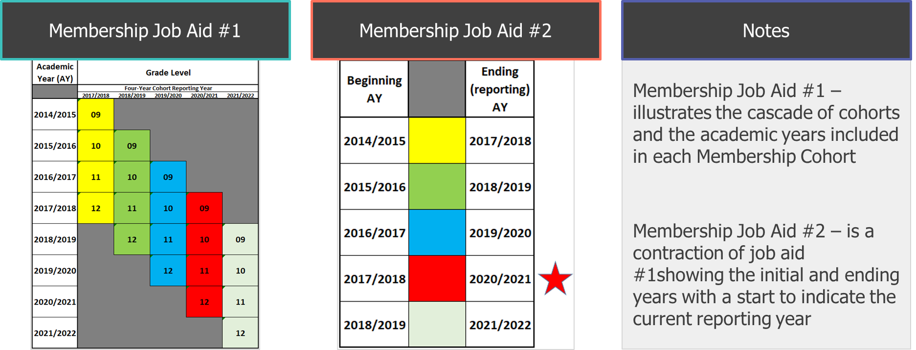
Membership - Overview (cont’d)
Membership Job Aids
Notes:
Page 5 of the Advanced Workbook
Here are the Cohort Membership job aids.
They have ben modified from previous years to be more complete.

Slide 8
Outcome - Overview
Establish Cohort Membership using the Membership job aid and CALPADS enrollment data​
Locate the last exit coding dated on, or before, 8/15/2021​
Using the Cohort Outcome job aid, match the exit coding and identify the associated Outcome​
All data entry needs to be COMPLETE by the last day the Cohort process will run (8/27/2021) for the entry to be captured and displayed in the Cohort reports (15.1 / 15.2); data entered after this point will not be included in the Cohort reports – EVER.
Notes:
Page 6 of the Advanced Workbook
The next step in the Cohort process is to establish the students’ Cohort Outcomes.
This first requires users to know the Cohort Membership.
Then, because we know the reporting year for the Cohort Membership the student belongs to, we can look for the last exit coding posted to CALPADS using a date prior to 8/15/2021 and use the Cohort Outcome job aid to match the exit coding to the Outcome ‘bucket’ in which it will be counted.
As a very important side note, ALL data entry related to the 4-year cohort MUST be complete by 8/27/2021 or it will NEVER (NOT EVER) to included in the 4year cohort data in CALPADS and reported outward.
And, with that, let’s shift gears to the process that the data follows in the 4-year cohort reporting in CALPADS. To explain this, here’s Alex.

Slide 9
Outcome - Overview (cont’d)
Outcome Job Aid
Outcome Job Aid – illustrates the ‘bucket’ each exit code is assigned to for ACGR (Cohort) reporting.
NOTE: Only the E230/100 (Completer / HS Diploma) exit coding is counted as a Graduate Completer for the Four-Year Cohort Reporting.
Notes:
Page 7 of the Advanced Workbook
Outcome job aid modified to include new E230/485

Slide 10
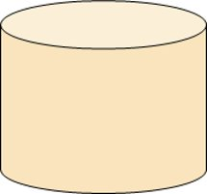
Process - Overview
Generate Cohort reports
Review results
CALPADS ODS​
20/21 Nightly Processing Window​
April 12, 2021 – August 27, 2021
Update if needed
Reports update nightly during window
Notes:
Process starts with data LEA posts to CALPADS. Data posted gets stored in ODS Database.
CALPADS pulls data from ODS database to generate Cohort reports.
Expectation is that LEA reviews these reports to determine accuracy.
If any changes are needed, LEA would make those updates in CALPADS.
Nightly refresh is required for reports to update.
Note: This processing window is only for 20-21 cohort year. Future cohort years are available year-round, current year has processing End Date = 8/27/21. More information on other cohort processing years in future slides.

Slide 11
Timelines​ 2020-21 Cohort
Cohort Date Range ​
July 1, 2017 – August 15, 2021​
Enrollment date range used to determine membership and outcome​​
Cohort Report and Outcome Processing Period ​
April 12, 2021 – August 27, 2021
This is the period in which the nightly process will run. Reports will generate based on the data in the ODS. This is also the time the LEA can make corrections if needed to the ODS data to update the cohort results​
Last Date to Enter Data to be Included in the 2020/21 Cohort
August 27, 2021
Data committed to CALPADS​ after this date will NOT be included in the 2020/21 Cohort reporting
Date Cohort is considered Final ​
August 28, 2021
One day following the close of processing. Once final, the reports will no longer refresh, and students are flagged belonging to that specific cohort permanently​
Notes:
This is the anticipated timeline and dates for the 2020/21 Cohort processes in CALPADS.
Please note, if the EOY submissions end date is changed, expect the Cohort processing window to match the EOY processing window. (e.g., if the EOY deadline changes from 8/27/2021 to 9/5/2021, the end of the Cohort processing window will also change to 9/5/2021, and the final date to add/delete/edit data in CALPADS to be included on the Cohort reports to 9/5/2021)

Slide 12
Pop Quiz!
Notes:
Poll #2

Slide 13
Changes

Slide 14
New Filters & Columns
Adult Age Students with Disabilities in Transition Status
CTE Completer
State of Federal Job Completion
Simulated Work Based Learning
Work Based Learning Internship
Transition Work Based Learning
Work Based Learning through Student Enterprise
Cohort Expected Graduation Year up to four years
Notes:
New filter on both the 15.1 and 15.2
*Postsecondary Transition is now called Adult Age Students with disabilities in Transition
*CTE Completers help for determination of the college and career \CCI on the CA dashboard. They’re now a filter and column on the cohort reports.
Along these lines filters and category columns for Work Based Learning have been added. This data is collected in EOY 1 in the new WBLR file as specific codes.
*LEAs can now run up to four years of cohort reports. This year and three future years.
*All terms are defined in the glossary at the back of your workbooks.

Slide 15
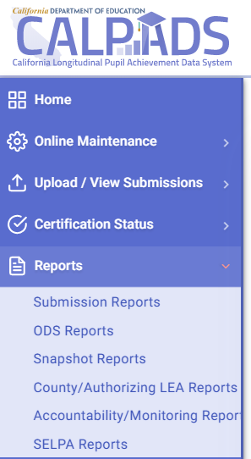
Reports and Calculations
Three Cohort reports
15.1 Cohort Outcome- Counts and Rates
15.2 Cohort Outcome - Student Details
15.1 C/A Cohort Outcome – Counts and Rates
Access Reports with the SENR Role
Notes:
The three Cohort reports.
The 15.1 Cohort Outcome – Counts and Rates,
The 15.2 Cohort Outcome - Student Detail, and
The C/A 15.1 County Authorizing report.
To view these reports go to the Reports dropdown and select Accountability Reports.
Only the SENR View role is needed to view 15.1 and 15.2 is the 'SENR View’.
Note: Once the processing window ends the current year cohort will freeze but future years will still update nightly throughout the year.

Slide 16
Progression Reports starting in 2021
2020-2021 Cohort – Frozen Aug. 2021
Grade 9 | Grade 10 | Grade 11 | Grade 12
2017-18 | 2018-19 | 2019-20 | 2020-2021
2021-2022 Cohort- Processing window Ends August 2022
Grade 9 | Grade 10 | Grade 11 | Grade 12
2018-19 | 2019-20 | 2020-2021 | 2021-2022
2022-2023 Cohort- Processing window Ends August 2023
Grade 9 | Grade 10 | Grade 11 | Grade 12
2019-20 | 2020-2021 | 2021-2022 | 2022-2023
2023-2024 Cohort- Processing window Ends August 2024
Grade 9 | Grade 10 | Grade 11 | Grade 12
2020-2021 | 2021-2022 | 2022-2023 | 2023-2024
Notes:
*Users now have the ability to select this year and up to three future years cohort reports.
This allows LEA’s to track first time 9th graders and future 10 and 11th graders. So current and future.
These reports run consistently and are updated nightly.
The current 2020-2021 cohort will stop and be frozen after August 27th.
Future reports will continue to run. Each subsequent year will end in late August of that year with the next new year added each year.

Slide 17
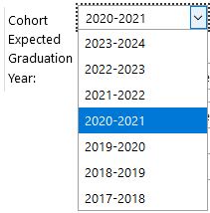
Using the 15.x Reports Proactively
The Four-Year ACGR (Cohort) reports in CALPADS (15.1 & 15.2) can now look at four separate Cohort Memberships to assist in monitoring these groups during their enrollment period rather than attempting to reconcile the data after the fact up to four years later.
This is done by using the ‘Cohort Expected Graduation Year’ filter to select the Cohort Membership to generate the reports for
Notes:
Users will be able to review past , current and future Cohort reports. To select use the Cohort Expected Graduation Year filter.
You’ll be able to monitor students during their enrollment rather then waiting for the end of the student’s cohort period to reconcile data after four years.

Slide 18
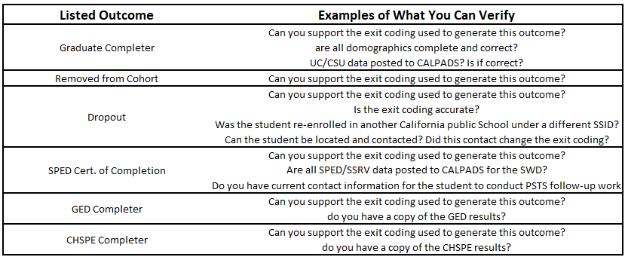
Using the 15.x Reports Proactively (cont’d)
Notes:
By looking at future years as shown in the slide you can see a table identifying some outcomes and examples of what can be verified for each.
THIS IS NOT A COMPLETE LIST of outcomes that can be reviewed proactively.

Slide 19
Reports and Calculations
15.1 Report
Report Filter Options
Notes:
15.1 highlights show the new areas. Selection of years. CTE completers and Adult age students
The 15.1 shows the outcomes and percentages.
If you want to see just a specific group such as the CTE Completers this is where you can filter for them.

Slide 20
Reports and Calculations
15.2 Cohort Outcome – Student Details
Notes:
The filters are, again, available to limit the scope of the report to specific subgroups like Socio-Economically Disadvantaged, English Learners, or Foster Youth.
Here’s the filters for the 15.2 Student list. Highlighting the new Work based learning and other additions. As you’ll see you can filter for specific categories here but because this is a detailed report many of these categories will show under column headings on the report.

Slide 21
Outcome Changes – New Completion Status
E230 / 485 (Completer/Matriculated Non-CASchl)
Definition: The student completed the highest grade level offered at a school (excluding high school completion), left the school, and was expected to attend another school outside of the California public school system (i.e., private school, school outside of California). Note. If the student has matriculated but is expected to return to another California public school, use the exit code most representative of the student's final status (i.e., 480).
REMINDER: All exit/completion codes that remove students from the Cohort require written documentation
The Cohort Outcome ‘bucket’ for the 485 (Matriculated Non-CASchl) completion code is ‘Removed From Cohort”.
Students in this bucket are removed from the denominator of the ACGR calculation.
Notes:
As with all the exits that are Removed From Cohort, ensure that you have the appropriate documentation that supports the exit code. See more guidance in Data Guide page 216.
A new Outcome completion status has also been added for this year.
E230/ 485. This is a completer that has Matriculated to a Non CA public school. Such as private or out of state.
The result of using this code will put the student in the removed from cohort column. These students are not in the denominator for the adjusted cohort graduation rate (ACGR) calculation.
NOTE Documentation for all removed from cohort.

Slide 22
Review of Reports and Calculations

Slide 23
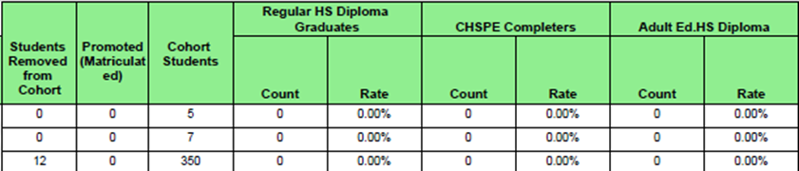
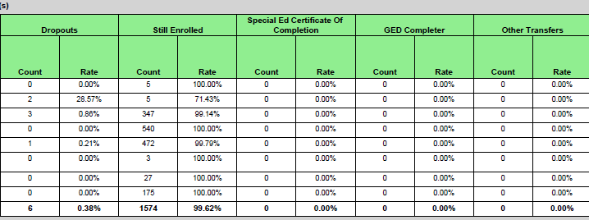
15.1 Details
A
B
C
C
C
C
C
Removed from Cohort and Promoted/Matriculated, are provided to give you the count of each, but, because they are not included in any rate, there is no percentage available for them.
A
C
C
C
C
C
Cohort Students, is the total number of students in your Cohort according to the enrollment data in CALPADS. This is the denominator for all of the rates that follow
B
C
B
C
Reported Outcomes
Notes:
*Removed from Cohort and Promoted/Matriculated, are provided to give you the count of each, but, because they are not included in any rate, there is no percentage available for them.
15.1 is a very wide. The slide has broken it in two, so we can see all the columns better.
The first thing you can see is each of the outcomes we’ve been discussing has their own sections on the report.
A. The first two Outcome columns, Removed from Cohort and Promoted/Matriculated, are provided to give you the count of each, but, because they are not included in any rate, there is no percentage available for them.
B. The next column, Cohort Students, is the total number of students in your Cohort according to the enrollment data in CALPADS. This is the denominator for all of the rates that follow, so, you should take some time to verify the number agrees with your local data or you may be surprised when the rates you are expecting are different from the ones being generated in CALPADS, which are the ones used for all Cohort Rate reporting to CDE, US Dept. of Ed, DataQuest and EdData.
C. Each of the remaining Outcomes has two columns, a count and a rate.
The counts are generated by counting the instances of each Outcome as it appears in CALPADS.
The rate is calculated using this (very basic) formula.
So, again, the rate is calculated by using the number in the ‘Cohort Students’ column as the denominator of the equation, because it represents all of the students in each school that,
began their Cohort Membership at the LEA/School and remained there for the entire Cohort,
transferred into the LEA/School during the Cohort and remained through the end of the Cohort.
The ‘Cohort Students’ are all the students who will be incorporated into one of the Outcomes.
Each Outcome’s count is the numerator for its rate.
When the numerator is divided by the denominator (that is, the Outcome Count divided by the Cohort Population) a decimal is returned, which is the multiplied by 100 to convert it into the displayed percentage.

Slide 24
Reports and Calculations
Calculating the Final Outcomes
Graduate Completer:
High School Diploma
#
295
Cohort Population
#
312
295 / 312 = .9455
.9455 x 100
94.55%
Notes:
For example, remembering the calculation is “outcome divided by population,”
if your HS Diploma recipient outcome count is 295,
and your cohort population is 312
the calculation to determine the percentage of students in this groups looks like this.
Which also looks like this
295 / 312 = .9455
Multiply .9455 by 100
Which, when rounded equals 94.6%

Slide 25
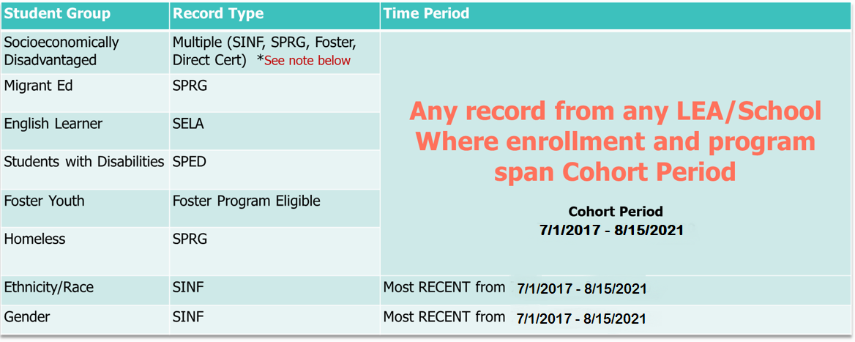
Reports and Calculations
Note: Socioeconomically Disadvantaged is determined if ANY one of the following meet the criteria during the time period: Parent Highest Education Level = 14(Not a HS Graduate), Program 181 or 182 (FRPM), Program 135 (Title I Part C Migrant), Program 191 (Homeless), Foster Youth and/or Directly Certified
Notes:
As we begin to look at the 15.2, it’s important to understand how some of the columns are populated.
The ‘general’ student information (e.g., Ethnicity/Race & Gender) are pulled from the current Student Demographic record.
The subgroups
SED,
Migrant Ed,
EL,
Students with Disabilities,
Foster Youth, and
Homeless
Are populated from their respective fields in CALPADS BUT the record does not have to have originated with your LEA or School provided the effective dates of the record spans into the student’s high school enrollment dates.
If a record for any of these elements (SED, Migrant Ed, EL, Students with Disabilities, Foster Youth, and Homeless) has a date crossing into the student’s grade 09, 10, 11, or 12 years, the indicator on the report will trigger to ‘Y’, even if the record was not created by your LEA/School. That’s important, because it’s different from most other reporting logic.

Slide 26
Reports and Calculations
15.2 Cohort Outcome – Student Details continued
General Student Information
Subgroup Attributes
Cohort-specific Attributes
Completer-specific Attributes
Notes:
Cohort Report 15.2 has 32 columns. The data used in this report is comprised of various data elements from the ODS Database. That’s a lot of data! At first glance, this report can be intimidating, and you may not know where to even begin.
We’ve broken down the report into 4 sections so that we can briefly go over each one and help you know: 1. What you’re looking at and 2. How you can use this report locally.
You don’t have to remember everything we’re about to cover but, hopefully, give you a general understanding of the report and inspire ideas of how you can best utilize this very powerful tool.

Slide 27
15.2 - General Student Information
Column Header | ODS Data derived from
School Code
School Name
SSID
Student Name
Local ID
Gender
Ethnicity/Race
Birth Date
SENR File
SENR File
SENR File
SINF File
SENR File
SINF File
SINF File
SINF File
Notes:
Starting off with basic data elements derived from SENR and SINF data. Important to note, as explained in slide 25, the SINF data elements are pulled from the student’s most recent SINF, based on Effective Start Date that overlaps the cohort period; even if that SINF record was not submitted by your LEA.

Slide 28
15.2 - Subgroup Attributes
Column Header | ODS Data derived from
Migrant Ed
Students with Disabilities
Socio-economically Disadvantaged
English Learner
Foster Youth
Homeless
SPRG File
SPED File / SPRG File
Calculated field
SELA File
Calculated field
SPRG File
Notes:
More colorful slide; these data elements are derived from various file types. Since SPED file collection didn’t start until 19-20 AY, Students with Disabilities can still be identified by SPRG code 144 if within the cohort period.

Slide 29
15.2 - Cohort-specific Attributes
Column Header | ODS Data derived from
Entry Grade in Cohort
Entry Year in Cohort
Cohort Category
Enrollment Status
Student Enrollment Start Date
Student Enrollment Exit Date
Student Exit Reason
Student Completion Status
Calculated field
Calculated field
Calculated field
SENR File
SENR File
SENR File
SENR File
SENR File
Notes:
Not as colorful. All of the data here, even the calculated fields, are all based off SENR data. Emphasizes the importance of SENR data.
Note: These set of data can be extremely powerful when validating. Consider how the Future Year functionality and the availability of the reports throughout the whole year can be beneficial.

Slide 30
15.2 - Completer-specific Attributes
Column Header | ODS Data derived from
Seal of Biliteracy
UC/CSU Requirements Met
Adult Age Student with Disabilities Transition Status
Pre-Apprenticeship Certification Program Completions
Pre-Apprenticeship Program (non-registered) Completion
State or Federal Job Program Completion
Work-based Learning Internship
Work-based Learning through Student Enterprise
Simulated Work-based Learning
Transition Work-based Learning
SENR File
SENR File
SENR File
*
WBLR File
*These data elements were previously collected in SENR. Report will also include if any SENR within cohort period = Y
*
WBLR File
*
WBLR File
WBLR File
WBLR File
WBLR File
WBLR File
Notes:
First three are same as previous years, derived from SENR. However, last 7 columns are now derived from the new WBLR file. The only exception are the first three work-based learning columns; students will also have a Y in these columns if they had one of these indicators = Y in the SENR records.
Note: CTE Completer is not a column on the report, yet it is also a factor in the CCI indicator. There is now a filter available for CTE Completer that should be used for validating. Also, consider how the Future Years functionality can help keep track of CCI metrics for your LEA.

Slide 31
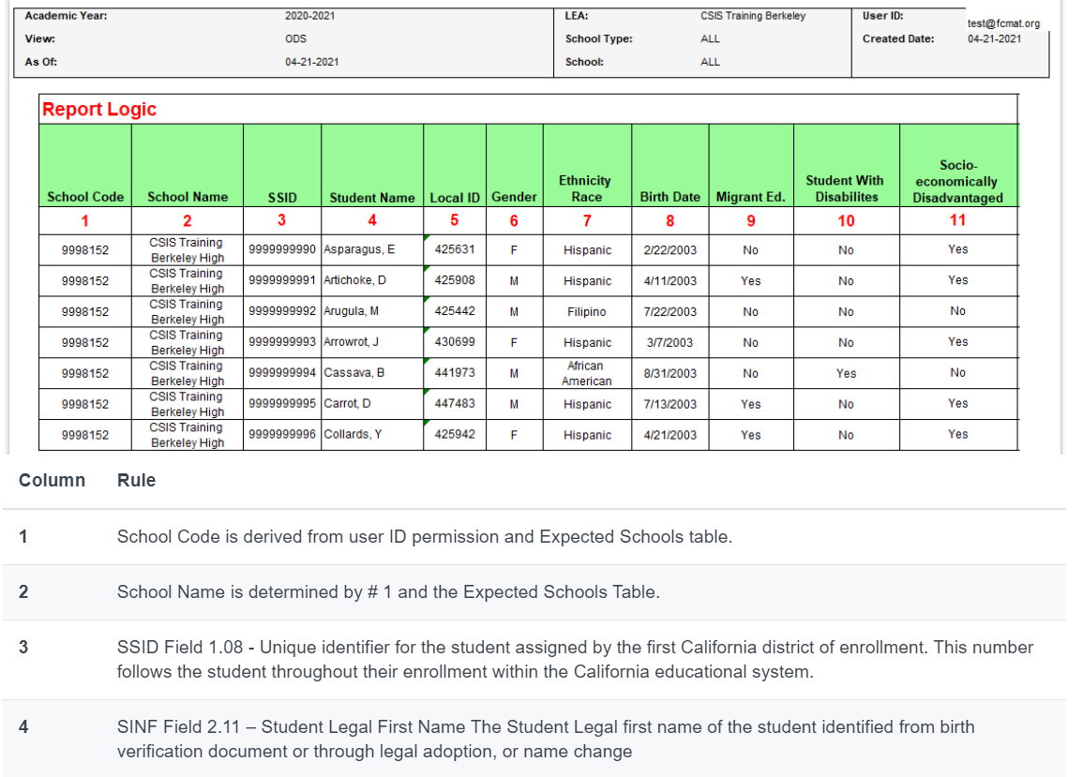
Reports and Calculations
Report Mapping Guides
31
Notes:
Don’t worry about memorizing these rules or frantically scribbling them in your notes.
When working with the 15.1, 15.2 the CALPADS User Manual provides the report mapping guide that describes the report logic and the origin of each data element. It is truly a great tool.
To access the report mapping guides, open the User Manual from the Help menu in CALPADS. Type ‘15.2’ into the search bar and the report mapping will be presented to select. Link: https://documentation.calpads.org/Reports/Accountability/Accountability/

Slide 32
Accountability
CA Dashboard Technical Guide​
https://www.cde.ca.gov/ta/ac/cm/
Dashboard Alternative School Status (DASS) - for schools that serve high-risk students.​
https://www.cde.ca.gov/TA/ac/dass.asp
Notes:
Note that CALPADS doesn’t have a 1-1 report with the CA Dashboard. The Dashboard does its own calculations based on the data posted in CALPADS as of August 27th, 2021. To get more information on CA Dashboard business rules you can look at their technical guide and to get specific information on DASS Grad Rate you can you look visit CDE’s link. Additional information on Graduation Rates is also available in Flash #205.

Slide 33
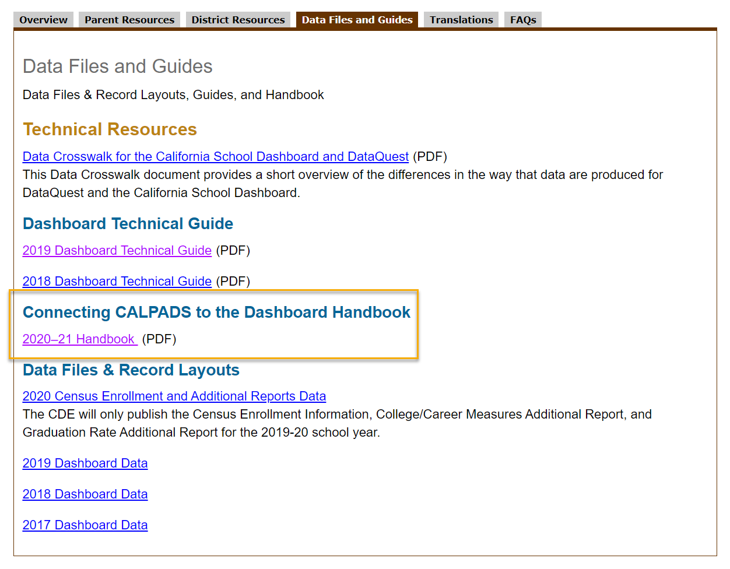
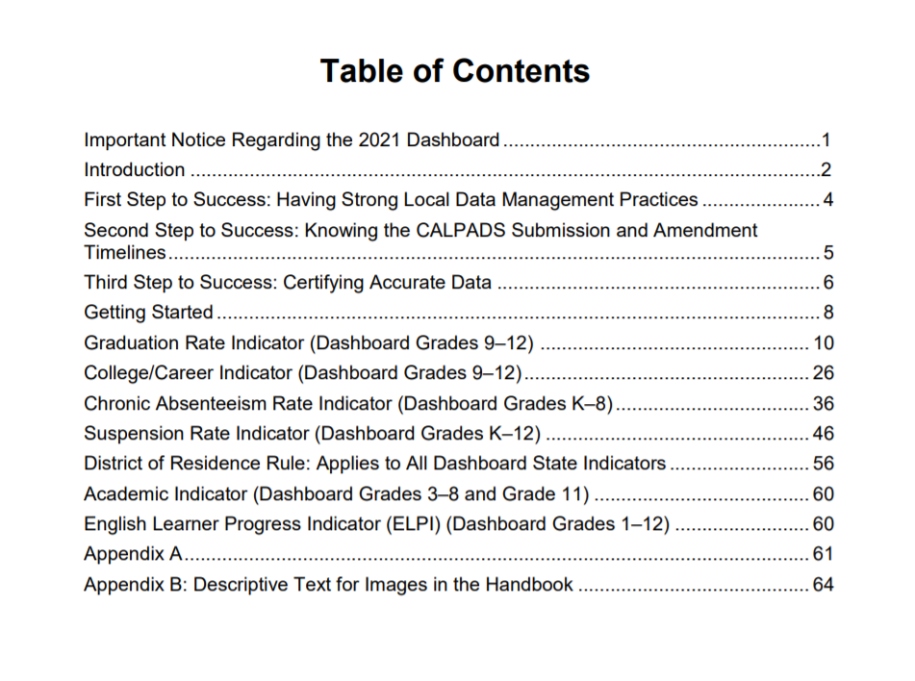
Handbook Connecting CALPADS to the Dashboard
NEW
Notes:
Accountability Office at CDE has created the 2020-21 Handbook Connecting CALPADS to the Dashboard. The 2020–21 Handbook is available on the CDE California School Dashboard and System of Support web page at https://www.cde.ca.gov/ta/ac/cm/ (select Data Files and Guides tab).
Direct link to the Handbook: https://www.cde.ca.gov/ta/ac/cm/documents/caldashhandbook21.pdf
Powerful tool that can help LEAs be proactive and understand how to validate/analyze the reports in CALPADS that will impact the CA Dashboard.

Slide 34
Scenarios

Slide 35
Case Studies & the Rules
To work through the Cohort case studies, you will be placed into a breakout room with other attendees,
We will have two (2) breakout sessions, each with two (2) case studies,
The breakout rooms will be randomly assigned,
You may ‘see’ one of us loitering in your rooms; we are flies on the wall monitoring that each group is working through the case studies
Notes:
Paul

Slide 36
Pam Case Study ​
Pam Beesly
Pam is good at anything she puts effort into.
Pam put minimal effort into high school, preferring to dedicate her time to things that interested her, personally.
Taking care to pass all her courses; she maintained a 2.85 GPA throughout her HS career, coincidentally, the same minimum GPA to be accepted to any Pennsylvania public university.
Pam’s HS career had one issue with her Calculus teacher requiring Pam to attend Summer school to complete the second semester of her Senior year.
Notes:
Paul

Slide 37
Case Study - Pam (cont’d) - Instructions
Each case study will require you – as a group – to answer the questions for each student case study presented.
The questions will be based on the narrative, the SENR history, and any other element presented in the scenario.
The answers can be arrived at by applying the skills and knowledge obtained in the previous Cohort training and using the job aides provided.
The questions to be answered are included in the workbook.
The answers will be discussed when all groups are brought back into the training.
Notes:
Provide link to workbook in chat again and point out to the page # in the workbook

Slide 38
Case Study - Pam (cont’d) - Questions​
What is Pam’s Cohort Membership?
Identify the Cohort Membership using the Ending (reporting) Year described on the Cohort membership job aide
What is Pam’s Cohort Outcome?

Slide 39
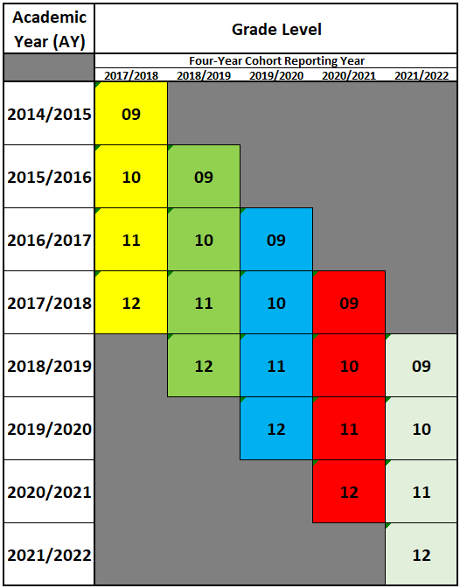
Case Study – Pam (cont’d) - Process
What is Pam’s Cohort Membership?
Process to identify a student’s Cohort Membership:
Identify the first high school grade level reported in CALPADS (primary enrollment or short-term exceeding 30 days)
Use the Cohort Membership job Aid to place the student in their Cohort Membership

Slide 40
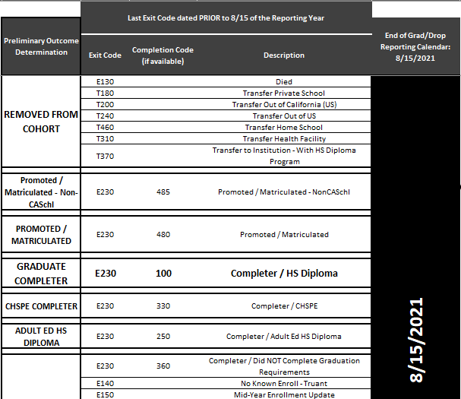
Case Study - Pam (cont’d) - Process
What is Pam’s Cohort Outcome?
Process to identify a student’s Cohort Outcome:
Identify the student’s membership,
Use the Cohort Membership job Aid to see the reporting year,
Identify the last exit coding prior to 8/15 of the reporting year,
Use the Cohort Outcome job aid to match the exit coding to the Cohort ‘bucket’ it is aggregated in.

Slide 41
Case Studies 1 and 2 – Dwight & Creed​
Pages 9 – 11 on Workbook
8 minutes on the clock
Write down your answers

Slide 42
Case Studies 3 & 4 – Andy and Kelly
Pages 12 – 15 in Workbook
8 minutes on the clock
Write down your answers

Slide 43
Wrap Up
Key Points, Resources and Support

Slide 44
Key Points & Best Practices
Identify your Cohort Team
Document a plan including a Calendar or Timeline
Share what you learned today in this training with your team – remember to communicate
Debrief when it is complete – learn from experience
Notes:
Work-Based Learning is new this year, make sure that you’re communicating now with your WBLR SME’s to determine how this data is being collected/entered in your SIS.
Internal deadlines are so important to establish. There are so many moving parts during this submission – EOY submissions are also happening at this time.

Slide 45
Summary
The 20-21 Cohort Processing window April 12 thru August 27
Last day to make edits in CALPADS August 27
Analyze and validate reports for accuracy
New CTE and WBLR filters
Take advantage of new Future Year functionality and accessibility throughout the year
Best practices and building your local Dream Team
Some key points to remember
Notes:
Let’s recap the objectives we hope you’ve learned throughout this presentation.

Slide 46
Resources
Here are some important resources.
https://learn.fcmat.org/
https://www.youtube.com/channel/UCA9oRTiyVECCCzOxpmJheZw
https://documentation.calpads.org/Support/References
https://www.cde.ca.gov/ta/ac/cm/documents/dashboardguide19.pdf
Notes:
Also available on your workbook, page 22

Slide 47
Support
http://www2.cde.ca.gov/calpadshelp/default.aspx
Web
calpads-support@cde.ca.gov
Email
916-325-9210
Phone
https://csis.fcmat.org/ListServ
You can get help through these channels.
Listserv
Notes:
As always, we are here to support you.

Slide 48
Feedback
I have a question…
“
”
Please complete survey…
https://forms.office.com/r/3brkkj8UDk
“
”

Slide 49
Thank You
CSIS Training
(916) 325- 9210
calpads-support@cde.ca.gov
https://csis.fcmat.org/

