Slide 1
CALPADS Regional Updates
September 2026

Slide 2
Housekeeping
All participants are muted
Type your questions in the Q&A
  Please wait to ask questions in the Q&A until after each section
  Please focus questions to the topic currently being presented
  You can give a “thumbs up” vote to any question so that it’s given a higher priority in the queue
  We will attempt to answer all questions, any unanswered questions will be followed up in a frequently asked questions document forwarded to all participants
If you are having audio issues:
  Click the microphone icon in the bottom left-hand corner of the Zoom window and select “Switch to phone audio” and call in using the information provided
This meeting will be recorded and posted to the CSIS Training Channel; the posting will be communicated in the CALPADS Digest

Slide 3
Accessing PowerPoint and Resources
All materials for the Regional Update Meetings will be available at the following locations –
Zoom Resources Tab
CSIS Resources Page:
https://csis.fcmat.org/document/CALPADSResources/CALPADS-Regional-Updates-September-2026.pptx

Slide 4
Presenter Information (1)
California School Information Services (CSIS)
Rima Mendez, Requirements Management
Heather Cota, Requirements Management
Angela Ratty, Client Services
Matt Clark, Client Services

Slide 5
Presenter Information (2)
Educational Data Management Division (EDMD)
Diana Casanova, Education Administrator, CALPADS Office
Paula Mishima, Education Administrator
Shaun Walker, Information Technology Specialist I
Special Education Division (SPED)
Dominic Johnson, Information Technology Specialist I
Multilingual Support Division (MSD)
Lorrie Kelling, Education Program Consultant

Slide 6
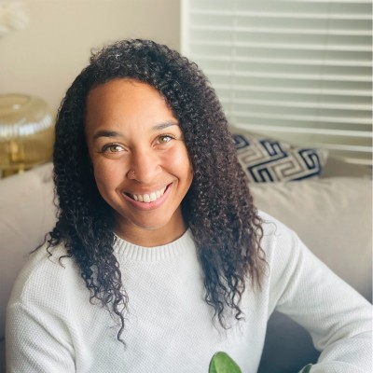
CALPADS Administrative Unit (CAU)
Welcome Brittney Bridges!
Supervisor I, CAU

Slide 7
Agenda
2026-27 CALPADS Submission Calendar
Multi-Factor Authentication
Special Education Updates
Fall 1 & Fall 2 Submission Changes and Reminders
Upcoming Changes
Continuous Learning
CALPADS Support Updates
Wrap Up

Slide 8
2026-27 CALPADS Calendar

Slide 9
2026-27 CALPADS Calendar
Submission | Official Submission Window | Certification Deadline | Close of Amendment Window
Fall 1 | October 7, 2026 (Census Day) to January 22, 2027 | December 11, 2026 SELPA strongly encouraged, but not required | January 22, 2027 SELPA approval required
Fall 2 | October 7, 2026 (Census Day) to February 26, 2027 | February 26, 2027 | No Amendment Window
End-of-Year (EOY) 1 | May 4, 2027 to July 30, 2027 | July 16, 2027* SELPA strongly encouraged, but not required | July 30, 2027 SELPA approval required
EOY 2 | May 4, 2027 to Monday, August 16, 2027 | August 16, 2027 | No Amendment Window:
 |  | Pull Date
4-Year Adjusted Cohort Graduation Rate (ACGR)* |  | August 16, 2027 | No Amendment Window
*The Graduate Cut-Off Date is always August 15th (for any year). The pull of data for the cohort is the same as the certification deadline, Monday, August 16, 2027

Slide 10
Multi-Factor Authentication

Slide 11
Multifactor Authentication
(Flash 330)
Multifactor Authentication (MFA) Begins September 15
MFA will be required for all CALPADS users beginning September 15, 2026
Early opt-in window: between August 25 and September 14
  Users may select “Activate MFA” on the CALPADS home page to begin using MFA early
A verification code will be sent to the email address associated with the user’s CALPADS account
Users should confirm their account has a person-specific, non-generic email address
Key takeaway: Verify your email address and consider activating MFA before September 15

Slide 12
Special Education Updates

Slide 13
New/Updated Validations
Validation | Severity | Description
SWDS0755F1 | DD/CDD | Special Education Initial Entry Start Date less than Student Birthdate
PLAN0748F1 | DD/CDD | Enforces Plan type 200 and program setting 403
PLAN0387 | IVR | Missing preschool program setting service location code
PLAN0388 | IVR | Missing Ten or more weekly hours in setting indicator
SENR0745F1 | DD/CDD | Missing District of Geographic Residence for COE
PLAN0732F1 | DD/CDD | Modify Severity, Error Description, and Trigger - Invalid County Office of Education Code populated in DSEA field
PLAN0364F1 | DD/CDD | Modify Error Description and Trigger to account for PS and age 6 as of Sept 1
PLAN0675F1 | DD/CDD | Modify Error Description and Trigger to account for PS and age 6 as of Sept 1
PLAN0387F1 | DD/CDD | Modify Error Description and Trigger to remove age references
PLAN0388F1 | DD/CDD | Modify Error Description and Trigger to remove age references

Slide 14
Private School Enrollments
Previous guidance for enrolling Parentally Placed Private School Students (PPPSS) for the purposes of proportionate share calculations is now mandatory.
District of Location (DOL) must create and maintain enrollments for PPPSS:
Enrollment Status Code: 50 - Non-ADA Enrollment
School of attendance: 0000002 - Private School Group
Enrollments for all eligible PPPSS attending non-profit private schools should be maintained for the duration of the school year and exited with E170 – Non-Primary Enrollment Exit.
Enrollments for students attending FOR PROFIT private schools within the LEA’s boundaries should be exited with N470 – No Show.

Slide 15
Private School Enrollments (2)
LEAs must also include and report students who:
Were determined eligible in the prior three years
Remain enrolled at the private school
The parents/guardians continue to decline services
These students have an eligibility period of three years and must be reevaluated after three years.
CALPADS Data for SWD in Private Schools and Proportionate Share webinar:
https://cde.box.com/s/w8w24uho7xfk05chceozinrx0n2ud1pp

Slide 16
Personnel Data Report
The Personnel Data Report collection timeline is adjusting to align with the Fall 2 data collection. Details forthcoming via:
CALPADS Special Education Data Support Listserv
To subscribe, send an email to: subscribe-calpads-sped-support@mlist.cde.ca.gov
CALPADS Fall 2026 Statewide Virtual Special Education Data Roadshow
Wednesday September 16th, 9:00AM-12:00PM
Register here: https://us02web.zoom.us/webinar/register/WN_5TXgIncrSE2vf5rNaEv5tQ

Slide 17
In-Person Roadshows
Date | Host | Registration link | Notes
9/14 | Merced COE | http://merced.k12oms.org/210-285228
9/15 | Tulare COE | http://tulare.k12oms.org/146-284577
9/17 | Madera County SOS - Madera-Mariposa SELPA | https://madera.k12oms.org/eventdetail.php?id=282540
9/18 | Fresno County SELPA | http://fresno.k12oms.org/131-285220 | OMS PW: 091826
9/28 | Sonoma County SELPA | https://forms.gle/9n3D69HuG3razRtn8
9/29 | Shasta SELPA | https://www.shastacoe.org/forms/~form-uuid/b142f112-dec6-4766-8944-66d7e328519e
9/30 | Sacramento COE | https://proflearn.scoe.net/Home/Event/1225
10/1 | San Joaquin COE | https://forms.gle/ra8zhbfLMM9uYfS99
10/5 | East County SELPA | https://sdcoe.k12oms.org/1035-285133
10/6 | Santa Clarita Valley SELPA | https://forms.gle/5N5jsrtMXnJJQUhD8
10/7 | Kern County Consortium SELPA | https://www.events.kern.org/event/b94b5cc2-77d4-4287-812f-eae052044158/summary
10/8 | East Valley Selpa | https://sbcss.k12oms.org/46-277042
10/9 | Riverside COE | https://events.rcoe.us/CALPADS_SPED_FALL26
10/12 | Contra Costa SELPA | https://forms.gle/GnhHQDazeDv5Rc9N9
10/13 | Santa Clara North West SELPA | https://forms.gle/7eog45fQuhUYJ5oU7

Slide 18
Fall 1 and Fall 2
Submission Changes and Reminders

Slide 19
School Rollover: Flash 329
Flash 329 summarizes 2026-27 Fall 1 and Fall 2 changes for 2026-27:
  Points to other Flashes that discuss major changes:
    Flash 325 – Closing homeless records
    Flash 326 – Changes to Job Classification Codes and Course Section File
    Flash 328 – Changes to Student Exit Category Codes (transfers due to discipline)
  Summarizes:
    New and Changed Codes (effective July 1, 2026, but in production on August 25, 2026)
    File Format Changes for Fall 2
    New Validations
  Provides a Heads-Up for 2026-27 End-of-Year Major Changes

Slide 20
Students Transferring for Disciplinary Reasons (T165, T166, T169)
Refer to Flash 328
The California Department of Education is required to collect and publicly report on student transfers due to disciplinary reasons, including whether pupils transferred to an alternative school based on a referral by the school. The following three Student Exit Category codes are intended to capture all disciplinary transfers:
T165 – TransSpecDiscRsnsOrJudg: LEAs should use T165 when student is being mandatorily transferred because they committed a statutory offense that requires expulsion per Education Code section 48915(a)(b)(c), or they were referred by a judge or other judicial official.
T166 – TransRefAltSchlDisc: LEAs should use T166 when the LEA referred the student to an Alternative School due to a disciplinary reason. An Alternative School includes the following Educational Options school types: Juvenile Court, County Community, Community Day, Continuation, Opportunity.
T169 – TransOtherDiscRsns: LEAs should use T169 for all other transfers to any school type due to disciplinary reasons.
REMINDER: LEAs should now be using these exit codes

Slide 21
Increasing Data Quality for Immigrant Student Counts
Title III, Part A, Sections 3201(5) define immigrant children and youth as individuals who:
  are aged 3 through 21,
  were not born in any state, and
  have not been attending one or more schools in any one or more states for more than three full (cumulative) academic years. Section 3201(13) of the ESSA defines a "State" as each of the 50 States, the District of Columbia, and the Commonwealth of Puerto Rico.
Analysis of CALPADS data finds that many students identified as immigrant have been enrolled for significantly more days than the number of school days that would be expected
In anticipation of new Immigrant Report in EOY 2026-27 of cumulative counts of immigrant students (in addition to the current Census Day count) to meet federal reporting requirements, CDE seeks to increase data quality:
  Implemented SENR0756F1 – Invalid Enrolled in US School < 3 Cumulative Years given Total Enrollment Days for Student
  This validation triggers if the number of days enrolled is greater than 818 days
  Warning Data Discrepancy in 2026-27; fatal in the future

Slide 22
Fall 2 Certification Reports Available Earlier in 2026
Fall 2 Submission Window for 2026-27 is October 7, 2026 (Census Day) – February 26, 2027
This year, Certification Reports will begin rendering earlier, November 23, 2026
Some Fall 2 training will be available in early December
Plan for 2027-28 is for Fall 2 reports to begin rendering on Census Day, just like Fall 1

Slide 23
Upcoming Changes

Slide 24
Career Technical Education (CTE) Concentrator Designation Returning in 2026-27
CALPADS will reintroduce the CTE Concentrator designation beginning in 2026-27, requiring LEAs to report both Concentrators and Completers
The change aligns statewide reporting with current federal CTE and Perkins V requirements
Concentrator and Completer designations will represent different stages of a student's CTE pathway progression and, at a high level, will be based on reported Concentrator and Capstone courses, respectively
A future CALPADS Flash will provide additional information, including reporting guidance and examples

Slide 25
Retiring the Adult (AD) Grade Level
The Adult (AD) Grade Level Code will be retired beginning in 2027–28.
Multi-year analysis showed low and generally declining use
  Outreach confirmed that LEAs primarily use AD for local tracking of adult students pursuing a high school diploma or GED.
AD is not used for state accountability or federal student-level reporting.
Minimal system and validation impacts are expected, and AD will remain available for historical reporting.

Slide 26
AB 2555 – Change to Reclassification
Assembly Bill 2555 is enrolled and waiting to be signed
This bill requires EL students to be reclassified to RFEP based solely on Summative ELPAC or Summative Alternate ELPAC scores
This will be operationalized like the current EL and IFEP determinations; RFEP statuses will be loaded into CALPADS from the assessment vendor once Summative ELPAC assessments are scored
  This process will be implemented for the 2027−28 Summative ELPAC administration
New requirement, however, begins immediately, meaning students attaining reclassification scores on the 2025−26 Summative ELPAC or Summative Alternate ELPAC must be reclassified
Guidance for 2025-26 and 2026-27 is forthcoming

Slide 27
Break

Slide 28
Continuous Learning

Slide 29
Language Instructional Programs (LIP) (1)
Required: All English learner students must be assigned a LIP.
Voluntary: Local educational agencies may choose to input a LIP education program record for non-English learner students (Initial Fluent English Proficient (IFEP), English Only (EO), Reclassified Fluent English Proficient (RFEP)) when the program has a goal of bilingualism and biliteracy (listed below):
    Developmental Bilingual (could include IFEP or RFEP students)
    Heritage or Indigenous Language
    Dual Language Immersion
    One Way Immersion
Data Accuracy is Critical: All data should be input and checked for accuracy before Census Day.

Slide 30
Language Instructional Programs (LIP) (2)
(300) Developmental Bilingual Program: A language instructional program (LIP) designed for English learners which provides content instruction delivered in the students’ native language and English. The goals of this program are language proficiency and academic achievement in students’ first and second languages. The portion of the instructional day delivered in each language varies by the type of program. English learners receive instruction in designated and integrated English language development (ELD) based on the California (CA) ELD standards, and all students are provided grade-level content instruction based on the state-adopted academic standards.
(301) Dual Language Immersion Program: A LIP designed for English learners and native English speakers, which provides content instruction delivered in the English learners’ native language and English. Goals include language proficiency and academic achievement in students’ first and second languages, and cross-cultural understanding. English learners receive instruction in designated and integrated ELD based on the state-adopted CA ELD standards. All students are provided grade-level content instruction based on the state-adopted academic standards. Dual-Language Immersion program models may include Two-Way Immersion, 50/50 Dual Immersion, 90/10 Dual Immersion, and other similar program models.

Slide 31
Language Instructional Programs (LIP) (3)
(302) Heritage or Indigenous Language: A LIP in English and another language for non-English speakers or students with limited literacy skills in their first language. Indigenous language programs support endangered minority languages in which students may have limited receptive and no productive skills. Both programs often serve American Indian students. English learners receive instruction in designated and integrated English language development (ELD) based on the state-adopted CA ELD standards, and all students are provided grade-level content instruction based on the state-adopted academic standards.
(303) Newcomer Program (Various Models): A language instructional program (LIP) designed for English learners who are new to the country with less than 12 months of schooling in the United States. This program provides instruction in designated and integrated English language development (ELD) based on the state-adopted CA ELD standards and grade-level content instruction based on the state-adopted academic sta1ndards. Instruction and/or support may be provided in the students’ native language. Program models vary. This program has clear entry and exit criteria, with goals and timelines defined.

Slide 32
Language Instructional Programs (LIP) (4)
(304) One-Way Immersion Program: A LIP in English and another language for non-speakers of the other language, with the goals of language proficiency and academic achievement in English and the other language, and cross-cultural understanding. The portion of the instructional day delivered in each language varies by the type of program.
(305) Structured English Immersion Program or other predominantly English Language Instructional Models: A LIP designed for English learners in which nearly all classroom instruction is provided in English with curriculum and a presentation designed for students who are learning English. The goals of this program are language proficiency and academic achievement in English. Students receive instruction in designated and integrated English language development (ELD) based on the state-adopted CA ELD standards and grade-level content instruction based on the state-adopted academic standards. Some instruction and/or support may be provided in the students' native language. Program models in addition to Structured English Immersion may include English Language Mainstream, or other program models in which all or nearly all instruction is delivered in English.

Slide 33
Language Instructional Programs (LIP) (5)
(306) Transitional Bilingual Program: A LIP designed for English learners utilizing English and students’ native language for literacy and academic instruction, with the goals of language proficiency and academic achievement in English. Students typically transition to “English only” instruction by third grade. English learners receive instruction in designated and integrated English language development (ELD) based on the state-adopted CA ELD standards, and all students are provided grade-level content instruction based on the state-adopted academic standards.
(307) Parent Opted Out of EL Program: The local educational agency (LEA) is not providing any instructional services designed for English learners because the parent of this English learner has opted this student out of EL services. The LEA maintains a record of the action to demonstrate the parents have chosen to opt out of such services.

Slide 34
Language Instructional Programs (LIP) (6)
Multilingual Support Division
Language Policy and Leadership Office
916-319-0845
LPLO@cde.ca.gov

Slide 35
Direct Certification (DC) Best Practices
Review CALPADS Important Messages and Active Known Issues regularly.
Monitor monthly DC results and scheduled processing dates.
Download and save DC extracts monthly. Historical data is not retained in CALPADS and changes as students transfer.
Verify extracts cover the full school year (July 1 onward) to capture all eligible students, including transfers.
Update student enrollment records before the 1st of each month to ensure accurate DC matching.
Establish clear roles, responsibilities, and timelines for DC processes.
Promote collaboration between Nutrition Services staff and the CALPADS Administrator.
Assign DC extract access to authorized staff to support eligibility verification and reimbursement claims.

Slide 36
CALPADS, CARS, and Title I Terminology
California Longitudinal Pupil Achievement Data System – CALPADS
Consolidated Application and Reporting System – CARS
Schoolwide Program – SWP
Targeted Assistance School program – TAS
Local Control and Accountability Plan – LCAP

Slide 37
CALPADS, CARS, and Title I Functionality
CALPADS: student enrollment, demographics, programs, outcomes​
CARS: ​application and reporting system for Title I state and federal funds​
LCAP metrics and federal reporting rely on accurate CALPADS data​
Title I: funds are allocated to LEAs based upon eligibility of low-income students ages 5 to 17 that are actively enrolled in CALPADS

Slide 38
CALPADS, CARS, and Title I Connectivity Matters
Data sourced from CARS identifies whether each Title I school operates as a SWP or TAS
SWP or TAS designation is synchronized to CALPADS
CALPADS reporting expectations change based on the CARS SWP or TAS designation
Uncertified and inaccurate CARS data will prevent successful CALPADS certification

Slide 39
Reporting Differences: SWP vs. TAS
Schoolwide Program (SWP): No individual Title I student records are submitted in CALPADS
Targeted Assistance School (TAS): Individual eligible students must be reported with Education Program Code 122 in CALPADS
  Submissions that only include one student will be reviewed for technical assistance in accordance with data quality standards
CALPADS validates submissions based on the CARS SWP or TAS designation

Slide 40
Data Flow and Strategic LEA Best Practices
Establish collaboration between Federal Programs, CARS coordinators, and CALPADS administrators
Verify school Title I, Part A School Allocations designations before certifying CARS data
  This information cannot be corrected after the CARS final close date
  LEA certifies accurate Title I School Allocations in CARS
Verify school Title I, Part A Notification of Authorization of Schoolwide Program designations before opening of EOY reporting
  LEA certifies SWP or TAS Program Authorizations for each school in CARS (if applicable)
CALPADS determines whether TAS Program Code 122 records are expected
  If expected LEA uploads all locally identified student program records
Review CALPADS Certification Reports 5.1–5.3
Resolve certification errors by the recommended date for zero fatal errors
LEA certifies EOY 1 by the deadline
Document annual local validation procedures

Slide 41
Common Data Quality Risks
Lack of coordination between Title I and CALPADS staff
Failure to certify CARS forms before CALPADS reporting
School incorrectly identified as SWP or TAS and has received funding
Missing or Submitting only one Program Code 122 records for TAS schools
Submitting Program Code 122 records for SWP schools

Slide 42
CALPADS, CARS, and Title I Key Takeaways
Accurate CARS data drives accurate CALPADS expectations.
Title I funding designations determine student-level reporting requirements.
Cross-program collaboration improves data quality and avoids certification delays.
Data accuracy supports equitable distribution of federal resources and program accountability.

Slide 43
CALPADS Support Updates

Slide 44

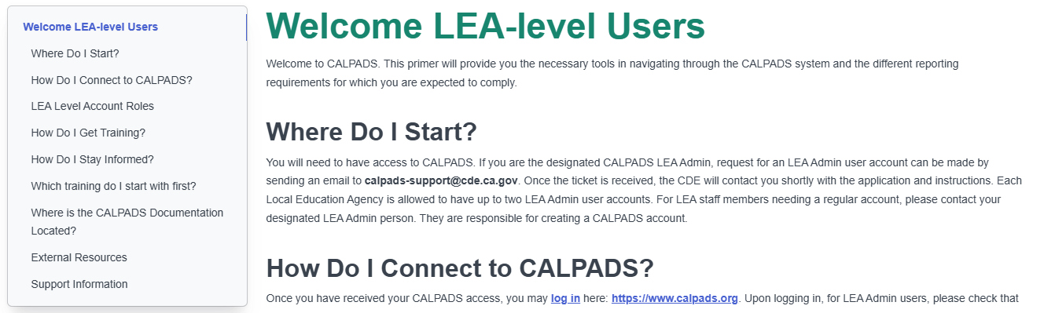
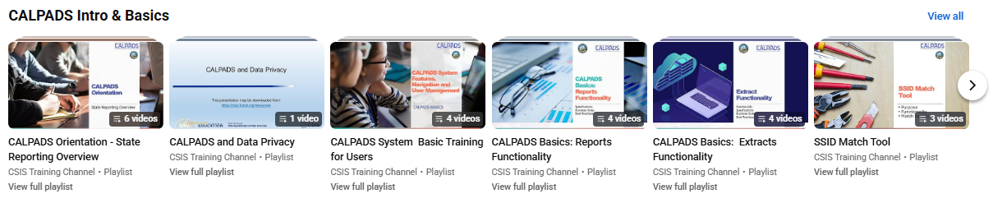

CALPADS Training for New Users

Slide 45
CALPADS Technical Assistance (TA)
“...[A]ny school district that fails to meet the requirements of Section 60900, the county superintendent of schools shall provide technical assistance for a minimum of one year that shall be focused on the school district’s data management processes and building the school district’s capacity to develop and implement actions and services responsive to data quality and integrity in support of state and federal accountability…” –AB126
“This shall include working collaboratively with the school district to review California Longitudinal Pupil Achievement Data System data reporting practices, including, but not limited to, the roles and responsibilities, data management policies and data collection submission processes, monitoring and oversight of the student information system, and accountability and audit mechanisms that address any areas of weakness to ensure the submission of accurate data according to the processes and timelines established by the department pursuant to Section 60900.” –AB126

Slide 46

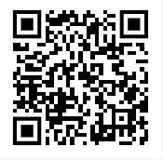

CALPADS Audits for Administrators
Fall 1: LCFF Funding Audits
October 2026
Fall 2: Staff and Course Audits
January/February 2027
EOY: Accountability Audits
April 2026
In-Person and Watch Party Registration Available
https://csis.fcmat.org/data-management/CALPADS-administrator-audits

Slide 47

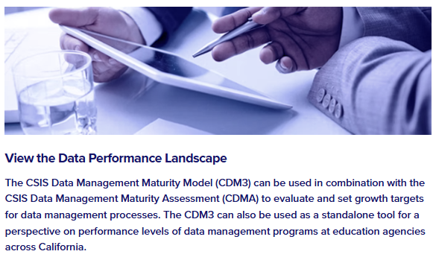
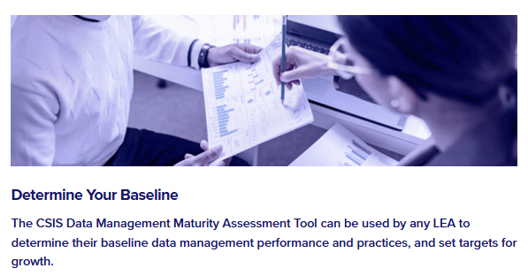

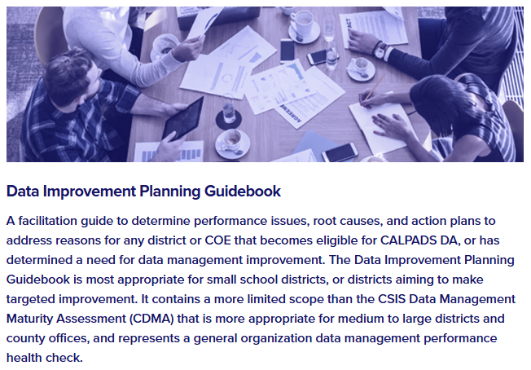
Universal
Supports
Toolkit
Data Management
Maturity Model
Data Management Assessment
Data Improvement Planning Guidebook*

Slide 48

Support Tips and Resources

Slide 49

Live Demo
MFA
Fall 1 and Fall 2 Roadmaps
Notes:
Ask your IT department to whitelist this email domain: CALPADS (via Microsoft)<account-security-noreply@accountprotection.microsoft.com>
Fall 1 Roadmap: https://documentation.calpads.org/Training/Fall1ReportingRoadmap/
Fall 2 Roadmap: https://documentation.calpads.org/Training/Fall2ReportingRoadmap/
Report Mapping Guides - https://documentation.calpads.org/Reports/ReportMain/#report-mapping-guides

Slide 50



Resources and Training
https://csis.fcmat.org/csis-training
https://www.youtube.com/channel/UCA9oRTiyVECCCzOxpmJheZw
https://documentation.calpads.org/Support/References
https://www.cde.ca.gov/ds/sp/cl/systemdocs.asp
https://csis.fcmat.org/resources
CALPADS Regional Update September 2026

Slide 51

Support
http://www2.cde.ca.gov/calpadshelp/default.aspx
Web
calpads-support@cde.ca.gov
Email
916-325-9210
Phone
https://csis.fcmat.org/ListServ
https://www.cde.ca.gov/ds/sp/cl/listservs.asp
You can get help through these channels
Listserv
CALPADS Regional Update September 2026

Slide 52
Wrap Up

Slide 53

Next Meeting
March 9-10, 2027
(Tuesday and Wednesday)
Focus: 26-27 EOY Submissions
This information will be communicated and posted once the registration is available.

Slide 54

Additional Questions

Slide 55

Thank you for your work!

