Slide 1
CALPADS Regional Updates
September 2025

Slide 2
Housekeeping
All participants are muted
Type your questions in the Q&A
  Please wait to ask questions in the Q&A until after each section
  Please focus questions to the topic currently being presented
  You can give a “thumbs up” vote to any question so that it’s given a higher priority in the queue
  We will attempt to answer all questions, any unanswered questions will be followed up in a frequently asked questions document forwarded to all participants
If you are having audio issues:
  Click the microphone icon in the bottom left-hand corner of the Zoom window and select “Switch to phone audio” and call in using the information provided
This meeting will be recorded and posted to the Box Site; The posting will be communicated in the CALPADS Digest

Slide 3
Community Agreements
Keep students at the center; we work together to achieve our goals
Take space; make space
We include and respect all
Listen to understand
We participate, listen, and learn actively
Tough on the problems and easy on the people: our meetings are respectful and judgement-free. All positions, voices, and ideas are valued
Honor the agenda

Slide 4
Accessing PowerPoint and Resources
All materials for the Regional Update Meetings will be available at the following locations -
CDE Box Site Link:
  https://cde.box.com/s/h73s0fcoy7il9imsh392vp6n3kj1m6gr
CSIS Resources Page:
  https://csis.fcmat.org/document/CALPADSResources/CALPADS-Regional-Updates-September-2025.pptx

Slide 5
Presenter Information (1)
California School Information Services (CSIS)
Rima Mendez, Requirements Management
Heather Cota, Requirements Management
Angela Ratty, Client Services
Matt Clark, Client Services

Slide 6
Presenter Information (2)
Educational Data Management Division (EDMD)
Diana Casanova, Education Administrator, CALPADS Office
Paula Mishima, Education Administrator
Shaun Walker, Information Technology Specialist I
Special Education Division (SPED)
Dominic Johnson, Information Technology Specialist I

Slide 7
ASL Translation Services
Leah Brown
Tiffany Jones
Wednesday, September 10, 2025: 9:30–11:30 AM – Southern A Region
(recording shared via the CALPADS Digest and Wednesday’s Q&A once available)

Slide 8
Agenda
2025-26 CALPADS Submission Calendar
New CALPADS Authentication
Special Education Updates
2025-26
Fall 1 & Fall 2 Submission Changes and Reminders
EOY Submission Changes and New Collections
CALPADS Support Update

Slide 9
2025-26 CALPADS Calendar

Slide 10
2025-26 CALPADS Deadlines (1)
Submission | Primary Data Submitted | Official Submission Window | Recommended Date for Zero Errors | Certification Deadline | Close of Amendment Window
Fall 1 | 2025–26 (Census Day – October 1, 2025): Enrollment counts English language acquisition status Immigrant Counts Free/reduced-price meal-eligibility Special Education 2024–25: Dropouts | October 1, 2025 to January 23, 2026 | November 21, 2025 | December 12, 2025* | January 23, 2026 (no changes can be made after this date)
LEA Approval is required and SELPAs are strongly encouraged to approve the Fall 1 submissions by the December 12 Certification Deadline.

Slide 11
2025-26 CALPADS Deadlines (2)
Submission | Primary Data Submitted | Official Submission Window | Recommended Date for Zero Errors | Certification Deadline | Close of Amendment Window
Fall 2 | Student Course Enrollments Staff Assignments and full-time equivalent (FTE) English Learner Education Services Postsecondary Outcomes for prior year graduates who were Career Technical Education (CTE) Completers | October 1, 2025 to February 27, 2026 | February 6, 2026 | February 27, 2026 | No Amendment Window; Final Deadline is February 27, 2026

Slide 12
2025-26 CALPADS Deadlines (3)
Submission | Primary Data Submitted | Official Submission Window | Recommended Date for Zero Errors | Certification Deadline | Close of Amendment Window
End-of-Year (EOY) 1 | Program Eligibility/Participation Student Incidents Cumulative Enrollment Student Absence Summary Count of English Learner (EL) Reclassified during School Year Homeless Students Special Education Postsecondary Outcomes for Students with Disabilities (SWD) Prior Year Completers | May 5, 2026 to July 31, 2026 | June 26, 2026 | July 17, 2026 | July 31, 2026 SELPA Approval Required
EOY 2 | Course Completion for Grades 7–12 Career Technical Education (CTE) Participants, Completers Work-Based Learning Indicators One-Year Graduate and Completer Counts | May 5, 2026 to August 17, 2026 | August 3, 2026 | Augusts 17, 2026* | No Amendment Window: Final Deadline is August 17, 2026
The Cohort data pull will occur on August 17, 2026.

Slide 13
New Authentication

Slide 14
Upgrading Authentication in CALPADS (1)
CALPADS will be transitioning to an upgraded authentication system that can support multifactor authentication (MFA)
This is needed to keep CALPADS in line with best practices for keeping our student and staff data secure

Slide 15
What does this mean for users?
Upgrading Authentication in CALPADS (2)
Each user will need to obtain a new username and password for logging into CALPADS
When will this happen?
Users must obtain their new username and password during the transition window, which is:
March 2, 2026 – May 1, 2026

Slide 16
How will this happen?
Upgrading Authentication in CALPADS (3)
During the Transition Window, the CALPADS login screen will display two options:
  Log into CALPADS using existing username/password
  Log into CALPADS using new username/password
Users will be prompted to convert their accounts once they log in using existing username/password

Slide 17
Upgrading Authentication in CALPADS (4)
What if I don’t get my new account within the Transition Window?
If you do not get your new username/password within the Transition Window, you will not be able to log into CALPADS
To get into CALPADS you will need to establish a new username/password by working with your LEA CALPADS Administrator

Slide 18
Upgrading Authentication in CALPADS (5)
What is multifactor authentication?
Multifactor Authentication (MFA) is when you must prove that you are who you say you are in more than one way before getting access to a system, in this case CALPADS
Once you get your new username/password, you must establish a second way to prove that you are who you are
In accessing CALPADS, you will authenticate who you are through your
(1) new username and password, and
(2) an access code which will be sent to your email
Users will only be able to authenticate through email
  Other options, such as using text, are being explored in the future

Slide 19
Upgrading Authentication in CALPADS (6)
Will there be more information?
More detailed information will be provided in a Flash
Training videos are currently being prepared for publication on the CSIS YouTube Training Channel.
Communications will be ongoing with the county Technology Steering Committee (TSC)
High-level communications will be provided to superintendents, charter school administrators, and Special Education Local Plan Areas (SELPAs)
Ongoing communications will be provided to LEA users through additional Flashes, and once the Transition Window opens, through the bi-weekly Digest and Listserv messages

Slide 20
Special Education Updates

Slide 21
New Part C PLAN Data Elements​
Part C to B Transition Conference Date​
The date of the meeting held to discuss the transition of a child with a disability from early intervention services under Part C of the Individuals with Disabilities Education Act (IDEA) who may be eligible for special education and related services under Part B of IDEA where key interest-holders like parents/guardians, Part C providers, and Part B representatives plan the necessary steps for a smooth transition. A Part C to Part B transition conference must be held between 2 years 3 months and 2 years 9 months before a child's third birthday.​
Part C to B Transition Plan in IFSP Indicator​
An indication of whether the transition plan of a child with a disability from early intervention services under Part C of the Individuals with Disabilities Education Act (IDEA) who may be eligible for special education and related services under Part B of IDEA has been included in the Individualized Family Services Plan (IFSP). The Part C to Part B transition plan should be in place between the ages of 2 years 3 months and 2 years 9 months. A "Y" would indicate that the transition plan was in place on the Plan Effective Start Date, an "N" would indicate that the transition plan was NOT in place on the Plan Effective Start Date.​

Slide 22
Degree of Support​
Field 23.16 - Degree of Support is now a required data element that will be certified as a part of the Fall 1 Submission. LEAs should populate the Degree of Support for students with specific primary or secondary disabilities during any triggering events (amendments, annual plan reviews, eligibility reevaluations, initial evaluations) for any Plan that will be in effect on Census Day. ​
Guidance for determining the student’s Degree of Support can be found at the following link: https://documentation.calpads.org/Training/Fall1ReportingRoadmap/#student-degree-of-support-identification-guidance​

Slide 23
Disproportionality Data and Annual
Determinations​
As in prior years, LEAs are required to approve their Fall 1 Submission by the initial certification deadline. While Special Education Local Plan Area (SELPA) approval is strongly encouraged by this deadline, SELPAs are required to do so by the close of the amendment window.​
Once again, for the 2025−26 academic year, data used to calculate the one-year Disproportionality risk ratio by setting, primary disability, and federal ethnicity categories will be pulled from CALPADS following the Certification Deadline, December 12, 2025, rather than after the close of the amendment window. These data will therefore include data approved by the LEA only, or data which have been approved by both the LEA and SELPA. ​
The data are being harvested earlier so that Annual Determination Letters can be issued to LEAs in early February 2026 so that LEAs have more time to complete Compliance Improvement Monitoring (CIM) activities.​

Slide 24
Submitting Discipline Data Year Round
Best Practice: Submit Incident Data Monthly
Improved Data Quality
Avoid End of Year (EOY) log-jam
Incident data available for review before key staff leave for summer break
Encourages local site administrators to submit incident data regularly
Allows for periodic review of incident data
  This improves data quality, validity, and reliability
Helps ensure accuracy of incident data used in monitoring determinations and the Compliance Improvement Monitoring (CIM) process
To assist LEAs in monitoring discipline incidents year-round, a new incident-related operational data store (ODS, or Real-Time) report will be made available this winter (currently slated for December or January). LEAs will be notified when this new report becomes available.

Slide 25
CALPADS Special Education Data Roadshows Fall 2025
Date of Roadshow Hosting Agency
9/15/2025 Merced County Office of Education
9/16/2025 Madera-Mariposa SELPA
9/18/2025 Tulare County Office of Education
9/19/2025 Fresno County Superintendent of Schools
9/22/2025 Ventura COE/ Ventura County SELPA
9/23/2025 Los Angeles County Office of Education
9/24/2025 East County SELPA
9/25/2025 Riverside County Office of Education
9/26/2025 East Valley SELPA
10/6/2025 San Joaquin County Office of Education
10/8/2025 Sonoma County SELPA
10/10/2025 Shasta SELPA
10/13/2025 Contra Costa SELPA
10/20/2025 Sacramento County SELPA
10/14/2025 Santa Clara North West SELPA
More information, including registration links, can be found at the CDE CALPADS Roadshow Website here: CALPADS Special Education Data Spring Roadshows - Announcements & Current Issues (CA Dept of Education)

Slide 26
2025-26 General Changes

Slide 27
Updated Code Sets (1)
Code Set Name | Code Value | Name | Notes
Language | qad | Mixteco | New code
Language | hbs | Serbo-Croatian | New code
Language | qac | Toishanese (Taishanese) | New code
Language | khm | Khmer, Central Khem | Updated code name and definition
Language | kur | Kurdish | Updated code name and definition
Language | cmn | Mandarin Chinese (Putonghua, Guoyu) | Updated code name and definition
Language | syr | Syriac | Updated code name and definition
Language | yue | Yue Chinese (Cantonese) | Updated code name and definition

Slide 28
Updated Code Sets (2)
Code Set Name | Code Value | Name | Notes
Course Group State | 9701 | Visual Impairment Instruction | Added new code
Course Group State | 9702 | Orthopedic Impairment Instruction | Added new code
Course Group State | 9703 | Hearing Impairment Instruction | Added new code
Student Transfer Category | 5 | Disciplinary COE School Transfer | Updated code definition
Education Program | 135 | Title I Part C Migrant | Retired Code
LEA Level Education Program | 194 | ELP – Expanded Learning Programs | New Code (for new LEAP file)

Slide 29
Updated Code Sets - SPED (1)
Code Set Name | Code Value | Name | Notes
Meeting Delay | 15 | Exceptional Family Circumstances (Part C Initial) | Added new code
Meeting Delay | 25 | Late Referral to Part C | Added new code
Meeting Delay | 40 | School Break | Updated definition
Special Education Service | 350 | Individual and Small Group Instruction | Retired code
Special Education Service | 535 | Behavior Intervention Services | Updated definition
Special Education Service | 610 | Specialized Services for Low Incidence Disabilities | Updated definition
Special Education Service | 865 | Agency Linkages (referral and placement) | Updated definition

Slide 30
Updated Code Sets - SPED (2)
Code Set Name | Code Value | Name | Notes
Special Education Service Location | 205 | Home/ community-based (infants/preschool age) on IEP/IFSP team determination | Added new code
Special Education Service Location | 310 | Head Start program | Retired code
Special Education Service Location | 320 | Child development or child care facility | Retired code
Special Education Service Location | 570 | Charter schools | Retired code
Special Education Service Location | 340 | Private preschool | Updated definition
Special Education Service Location | 640 | County Community School | Updated code name and definition

Slide 31
Updated Code Sets - SPED (3)
Referring Party | Code Value | Name | Notes
Referring Party | 10 | Parent | Updated definition
Referring Party | 15 | California Department of Education (CDE) Website | Added new code
Referring Party | 20 | Teacher | Updated definition
Referring Party | 30 | Student Study Team/Intervention Team | Updated definition
Referring Party | 40 | Other school/district personnel | Updated definition
Referring Party | 42 | California State Preschool Program (CSPP) Staff | Added new code
Referring Party | 45 | Private Preschool/Childcare Program Staff | Added new code

Slide 32
Updated Code Sets - SPED (4)
Code Set Name | Code Value | Name | Notes
Referring Party | 47 | Early Head Start/Head Start Staff | Added new code
Referring Party | 50 | Early Intervention Provider | Added new code
Referring Party | 60 | California Regional Center | Added new code
Referring Party | 65 | Community-based/Non-Profit Organization | Added new code
Referring Party | 70 | Hospital/Medical Provider | Added new code
Referring Party | 75 | Social Worker | Added new code
Referring Party | 80 | Family/Neighbor/Friend | Added new code
Referring Party | 90 | Other | Updated definition

Slide 33
Migrant Student Reminders (1)
Refer to Flash 308
CALPADS now provides LEAs with extracts of their migrant students from the authoritative source, Migrant Student Information Network (MSIN)
  LEAs no longer populate the Migrant Student ID field (leave blank) on the Student Program file, and Education Program Code 135 – Migrant was retired as of 6/30/2025
  There is a new Migrant Eligible Program Status container at the bottom of the student details screen.
The Migrant Eligible Program Students (MEPS) extract is updated weekly
  LEAs should download the extract and then upload it into the student information system
  LEAs should not upload migrant statuses from other sources

Slide 34
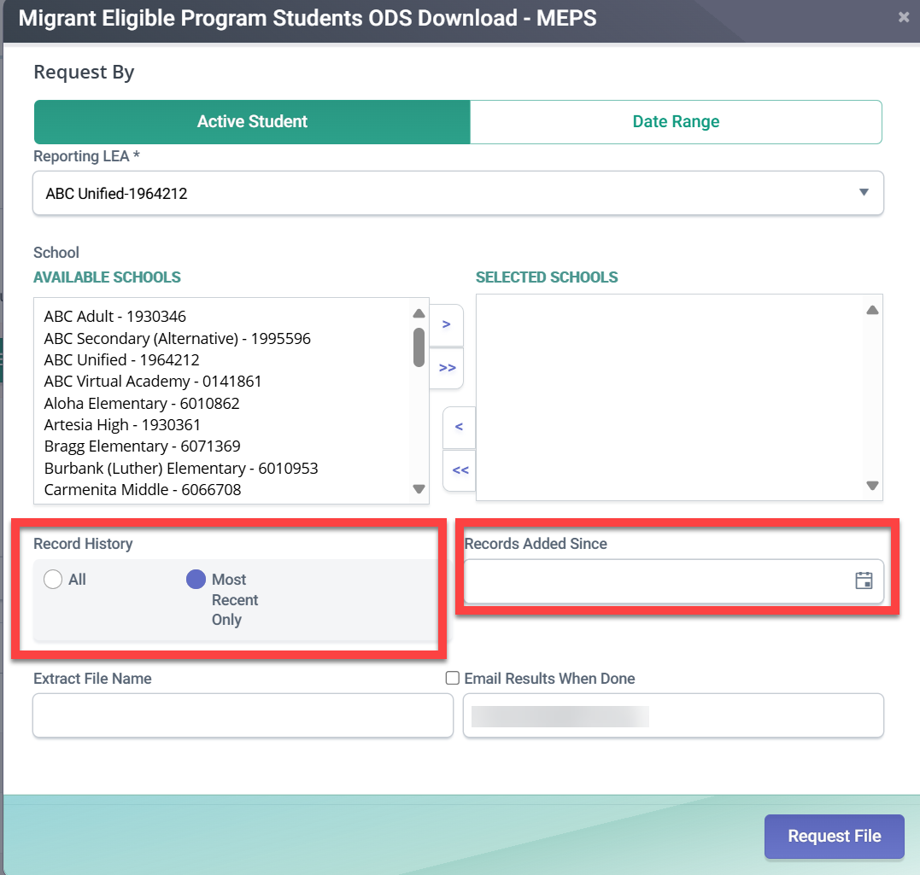
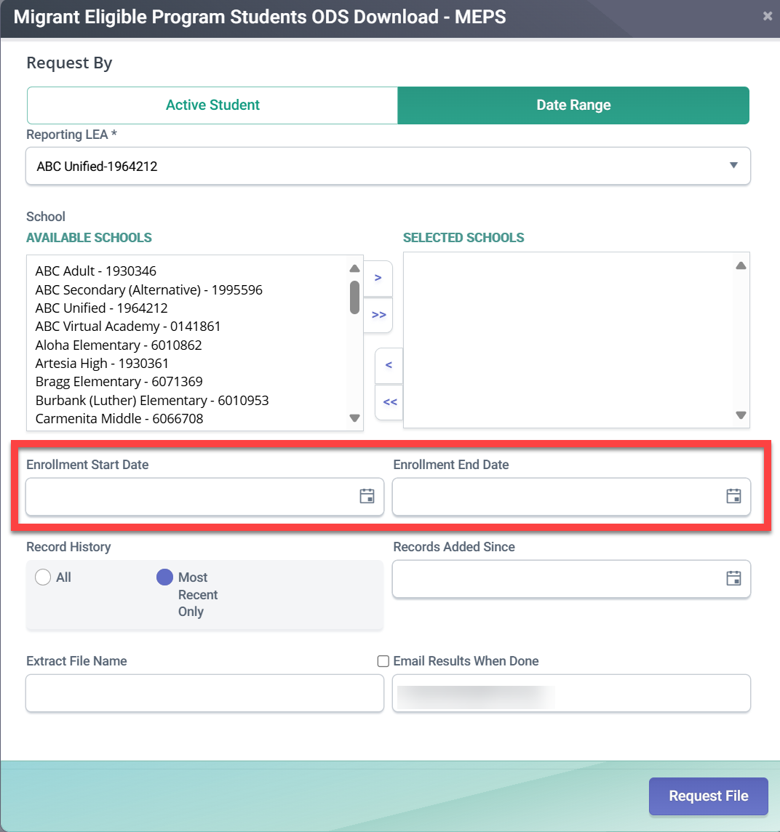
MEPS Extract Request (2)

Slide 35
Migrant Student Extract Filters (3)
Refer to Flash 308
Record History: Choice of only 1 record per student or all MEPS records per student
  “Active Students” and “Most Recent Only”: LEAs will only get the most recent MEPS record per each currently enrolled students
  “Active Students” and “All”: LEAs will get all MEPS records per each students currently enrolled (i.e., a student may have multiple MEPS records)
  “Date Range”, LEAs can get All or Most Recent MEPS record, for students enrolled within the selected date range
Records Added Since
  If left blank, LEAs will get all MEPS records added to CALPADS as of 7/1/2025 when CALPADS started receiving MEPS data
  If a date is entered, LEAs will only get MEPS records added (or updated) since that date

Slide 36
MEPS Extract Layout (4)
# | CALPADS File Element | Field Type | Max Length | Business Rule
1 | SSID | CS | 10 | The SSID for the student from the associated SENR record. If the SSID associated with the enrollment is retired, the system will populate the SSID field with the active SSID associated with the retired SSID. May not be blank.
2 | MSDNumber | CS | 11 | Number issued by MSIN to uniquely identify MEP eligible students. May not be blank.
3 | EligibilityStartDate | DT | 8 | Eligibility start date for the Certificate of Eligibility (COE), also known as the Qualifying Arrival Date (QAD) as provided by MSIN.
4 | EndofEligibilityDate | DT | 8 | End of eligibility (EoE) provided by MSIN. Can be a future date. During the eligibility period, it will be a projected future date. May not be blank.
5 | RetiredMSDNumber | CS | 11 | The MSD number that is no longer in use due to a merge. May be blank.
6 | RetirementDate | DT | 8 | The date the MSD Number is retired. On retirement, a system process will update the MSD File with the new MSD number. May be blank.
7 | Latest Update Date | DT | 8 | The date the MEPS record was last updated in the weekly MSIN import.

Slide 37
MEPS Future Enhancements (5)
System Updates:
  CALPADS homepage messages will auto-update when MEPS data is refreshed
Tentative RealTime Reports:
  Report 5.10 – Title I Part C Migrant - Count
  Report 5.11 – Title I Part C Migrant - Student List

Slide 38
CCGI Update and Reminders
Refer to CCGI Flashes https://www.cde.ca.gov/ds/sp/cl/communications.asp
Upcoming Deadlines (Education Code Section 60900(f)(3))
  January 1, 2026 – LEAs serving 9th-12th grade students are required to have partnered with the California College Guidance Initiative (CCGI)
  June 30, 2026 – LEAS have provided at least an initial data file to CCGI
  LEAs are to complete the onboarding process to bring transcript-informed accounts on CaliforniaColleges.edu to their students
CSIS is required (Education Code Section 49083.5), in collaboration with CDE, to create and maintain a list of SIS vendors and product capabilities
  On August 25, 2025, the CCGI Vendor Compatibility matrix was published on the CSIS website: https://csis.fcmat.org/sis-vendors/ccgi-vendor-compatibility

Slide 39
2025 Sun Bucks Reminders (1)
Refer to Flash 297, 307
The 2025 SUN Bucks eligibility period ended on September 2, 2025, which means LEAs should focus on:
  Processing any Universal Benefits Applications (UBAs) or National School Lunch Program (NSLP) applications submitted to the LEA by September 2, 2025
  Uploading records for students with these applications to the Education Data Collection System (EDCS) as soon as possible, but no later than December 31, 2025
  Verify any UBAs held back for verification, and upload records for students with verified UBAs to EDCS as soon as possible, but no later than December 31, 2025

Slide 40
2025 Sun Bucks Reminders (2)
Refer to Flash 297, 307
The remaining dates that data will be pulled from EDCS for 2025 SUN Bucks are…
*
Data pulled from EDCS and CALPADS at the close (5 pm) of the last business day of the month on ... (Specific dates provided below) | Will be included in the extract sent to CDSS on the first day of these months… (NOTE: Families should not expect cards right away. After receiving the extract CDSS must process the data and send then the data to card vendors for card issuance)
September 30, 2025 | October 1, 2025
October 31, 2025 | November 1, 2025
November 26, 2025 | December 1, 2025
December 31, 2025 | January 1, 2026

Slide 41
UBAs for 2026 SUN Bucks
Refer to Flash 297, 307
The 2026 SUN Bucks Eligibility period is July 1, 2025 – August 31, 2026
  Therefore, the UBAs LEAs collect after September 2, 2025 make students eligible for 2026 SUN Bucks
Additionally, students with UBAs received by October 31, 2025, may be included in the 2025-26 UPC
LEAs, however, will not submit these UBAs in the Supplemental SUN Bucks Collection (SSBC) in EDCS until the system opens after April 1,2026
More information on 2026 SUN Bucks will be provided in an upcoming Flash.

Slide 42
AIF/UBAs/NSLP applications for
2025-26 UPC
Refer to Flash 297, 307
For 2025-26 Local Control Funding Formula (LCFF), Unduplicated Pupil Count (UPC) purposes, LEAs are reminded that students enrolled on Census Day (October 1, 2025):
  Who have submitted Alternative Income Forms (AIF), UBAs, or NSLP applications by October 31, 2025 for the 2025-26 school year must submit Program Record 181 – Free Meal Program or 182 – Reduced-Price Meal Program with a Start Date between July 1, 2025 – October 31, 2025 in order to be reflected in Certification Report 1.17 – LCFF - Count and included in the LEAs’ Unduplicated Pupil Count
  As has been past practice, for LCFF purposes only, AIFs or UBAs collected during spring registration of the preceding school year which are evaluated based on 2025-26 Income Eligibility Guidelines (IEG) may be included in the 2025-26 UPC, though the LEA must submit a 181/182 program records with a start date on or after July 1, 2025
  Note: UBAs submitted by families prior to July 1 (e.g. May or June 2025) make students eligible for 2025 SUN Bucks, but not 2026 SUN Bucks. To be eligible for 2026 SUN Bucks, the family must submit a UBA during the 2026 SUN Bucks eligibility period of July 1, 2025 – August 31, 2026

Slide 43
Student Online Accountability Record Status (SOARS) system
Reminder: ALL LEA CALPADS Data Administrators were notified of the SOARS system release on July 3, 2025 from the CDE Analysis, Measurement, and Accountability Reporting (AMARD) Division
The student-level data file identifies students determined to be long-term English learners (LTELs) or students “at-risk” of becoming long-term English learners (AR-LTELs) as defined under California Education Code (EC) Section 313.2
  The California Education Code (EC) identifies two distinct definitions of LTEL students, both of which are used for reporting LTEL data for different purposes.
  To clarify these differences, the following web page outlines the definitions https://www.cde.ca.gov/ds/ad/lteldef.asp
The 2024–25 LTEL and AR-LTEL student-level data will be available for download through the close of business on September 30, 2025, after which the data will be removed from the SOARS system

Slide 44
Break

Slide 45
2025-26 Fall 1 & Fall 2 Submission Changes and Reminders

Slide 46
Reminder of Difference between
Certification Reports 1.17 and 1.1
These two Certification Reports are different and should not be compared:
    1.17 – LCFF – Unduplicated Pupil Count (UPC) and
    1.1 – Enrollment – Primary and Short-term Enrollment Count by Subgroup
A key difference is:
    Report 1.17 reflects students who meet the requirements for the UPC, which includes students who have 181 or 182 records with Start Dates on or before October 31, and students directly certified in November, where as…
    Report 1.1 only includes those students who have 181 or 182 records that overlap Census Day (October 1, 2025), which is consistent with state and federal reporting requirements

Slide 47
Changes to Reports
Reports 1.17*, 1.18*, 1.19, 1.20, CA 1.17 | LCFF Age Eligibility logic includes 4-year old TK students born on or before 9/1
Report 1.17 | Renaming Total Enrollment column to LCFF Eligible Total Enrollment
Report 1.17, CA1.17 | To support LEA review of their UPC count, two new columns will be added that provide the LEA’s prior year UPC Count and the difference between current and prior year UPC counts The new columns are for informational purposes only, and are intended to help LEAs identify if their UPC counts appear correct
Report 1.1 | To support LEA review of their count, two new columns will be added that provide the LEA’s prior year Count and the difference between current and prior year counts The new columns are for informational purposes only, and are intended to help LEAs identify if their counts appear correct
*Realtime Reports

Slide 48
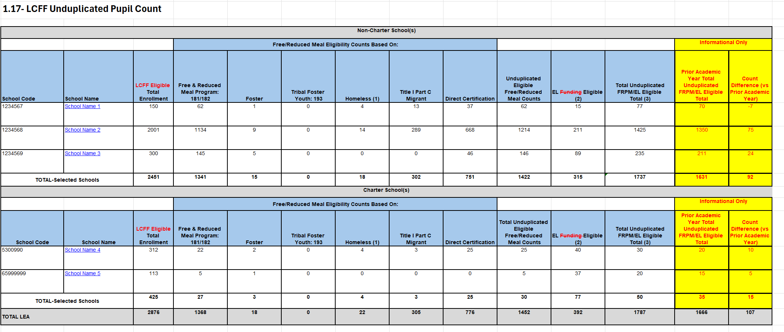
Update to 1.17 Report Layout

Slide 49
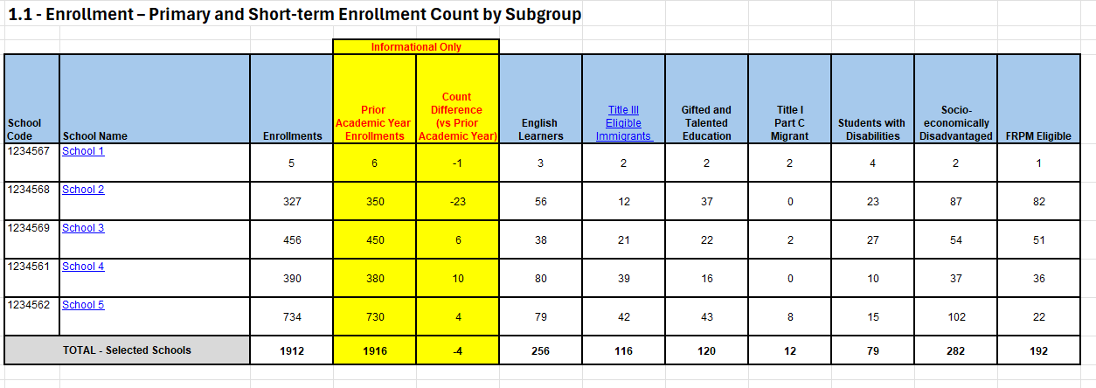
Update to Report 1.1 Report Layout

Slide 50
Course Updates
Code Set v17.0 includes three new Course Group State codes to better identify instruction services provided to students:
    9701 – Visual Impairment Instruction
  9702 – Orthopedic Impairment Instruction
  9703 – Hearing Impairment Instruction
When using these codes on the Course Section Enrollment (CRSE) and Staff Assignment (SASS) file, be sure to:
  Populate Field 9.22 – Instructional Strategy Code on the CRSE file, with Instructional Strategy Code 700 – Special Education, as all students in these course should be students with disabilities
  Populate Field 8.13 – Staff Job Classification Code, on the SASS file, with Educational Service Job Classification Code of “Teacher” (Code 12)
NOTE: Student course enrollment records are REQUIRED for Teacher assignments.

Slide 51
2025-26 EOY Submission Changes and New Collections

Slide 52
2025−26 EOY Submission Changes
Refer to Flash 312
BRAIN RESET
EOY 1 – FINAL Deadline: July 31, 2026
  Previous EOY 2, 3, 4 minus One-Year Graduates & Completers
  For Students with Disabilities, a new count of graduates and dropouts between July 1 – June 30
  New Expanded Learning Program submitted on LEA Program (LEAP) file
EOY 2 – FINAL Deadline: August 17, 2026
  Previous EOY 1 plus One-Year Graduates & Completers for all students (August 16 – August 15)
  Final Deadline is same date that data will be pulled for the 4-year Cohort

Slide 53
2025-26 EOY Submission Changes (2)
CALPADS EOY | Certification Deadline | Close of Amendment Window
EOY 1 (Formerly EOY 2,3,4) | July 17, 2026 | July 31, 2026
EOY 2 (Formerly EOY 1) | August 17, 2026* | N/A
Cohort Pull | August 17, 2026*
SELPAs are strongly encouraged to approve the EOY 1 by the July 17 Certification Deadline
*Cohort Date Remains August 15, 2026

Slide 54
Attendance Recovery
Refer to Flash 305
Refer to the Attendance Recovery Web page https://www.cde.ca.gov/fg/it/aarecovery.asp
  In particular review FAQs under the ADA Reporting Tab
Changes to the Student Absence Summary (STAS) file and related validations and report changes will be implemented in the coming months
A new “RealTime” report of certification report 14.1 Student Absenteeism – Count will also be implemented that will include a new column displaying Attendance Recovery Days

Slide 55
Attendance Recovery
Refer to Attendance Recovery FAQs
FAQ: ADA Reporting Tab
3. Does a student have to meet the applicable minimum daily minute requirement in a single day in order for it to count for average daily attendance (ADA)?
No. A student may generate a day of attendance for apportionment by participating in Attendance Recovery (AR) over multiple days, accruing time in hourly increments (EC Section 46211(e)(1)). The teacher of each AR classroom must document these increments. Once this time meets the applicable minimum daily minutes, the local educational agency (LEA) may claim a day of ADA for the attendance month when the absence occurred.
4. Is there a minimum amount of time in a day that an Attendance Recovery (AR) program must be scheduled in order to count for funding purposes?
Yes, a student’s participation time in AR may accumulate in increments of one hour, as documented by the supervising teacher. (EC Section 46211(e)(1)). When participation time on a day is less than one hour, that time does not accrue towards meeting the applicable minimum daily minute requirement. Fractions of an hour do not carry forward. For example, a student who was in an AR program 1.5 hours on Monday and 1.5 hours on Tuesday has accrued two hours of participation time, not three.

Slide 56
Attendance Recovery
Refer to Attendance Recovers FAQs
FAQs: ADA Reporting Tab
5. Do local educational agencies (LEAs) need to maintain hourly records of Attendance Recovery (AR) attendance?
It depends. LEAs must maintain AR attendance in daily or hourly increments, as appropriate to the duration of the sessions offered.
Hourly accounting of attendance is appropriate if students meet their minimum daily minute requirement over multiple days. In this case, the AR teacher must document each hour of student attendance, and the LEA must make this supporting documentation available for the purpose of the annual audit process.
Daily accounting may be used when an AR session meets the minimum daily minute requirement in a calendar day, and in this case the hourly recordkeeping requirement does not apply.

Slide 57
Expanded Learning Programs
Refer to Flash 305
Refer to Flash 305 for information about the new Expanded Learning Program (ELP) collection
The new ELP data will be submitted on a new LEA Program (LEAP) file
  The LEAP file will be available prior to the opening of 2026 End-of-Year (EOY) and will be part of the new EOY 1
  The LEAP file will require a new LEAP View or LEAP Edit role assigned to LEA level users (no school level user)
  UAT with vendors and select LEAs will be conducted in January/February 2026 that will include the new file, related validations and reports

Slide 58
CALPADS Support Updates

Slide 59

SB 114 established new DA eligibility criteria for Districts and COEs:
2023-24
Certified
Data
2024-25
Submission Deadlines
2025-26
Accurate Data
  SB 114 establishes new CALPADS pathway to DA for School Districts and COEs centered around
  Any district that fails to submit data according to the processes and timelines as specified in EC 60900(f) and established by the CDE.
  *This includes submitting and certifying accurate, correct, and complete data by each certification deadline.

Slide 60
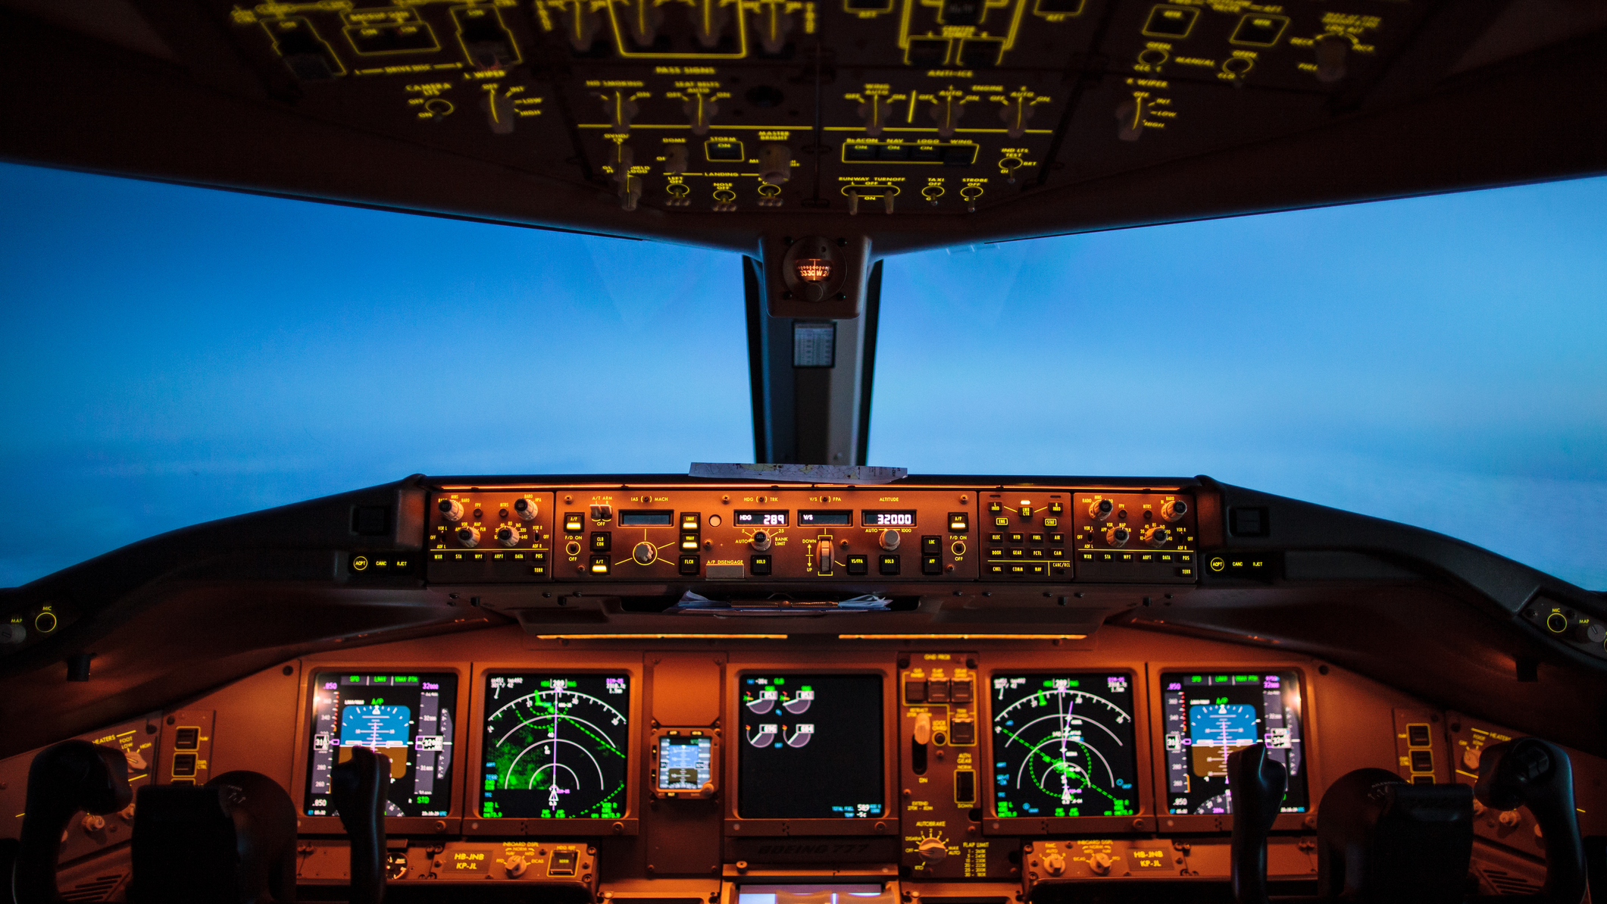
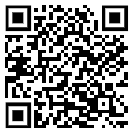

Half-day sessions
Data Governance Academy
Session 1: Data Governance for LEA Executives
October 2025
Virtual Check-In: Case Study and Project Progress
February 2026
Session 2:Operationalizing Data Governance at Scale
April 2026
In-Person and Watch Party Registration Available
https://csis.fcmat.org/data-management/csis-data-governance-academy

Slide 61

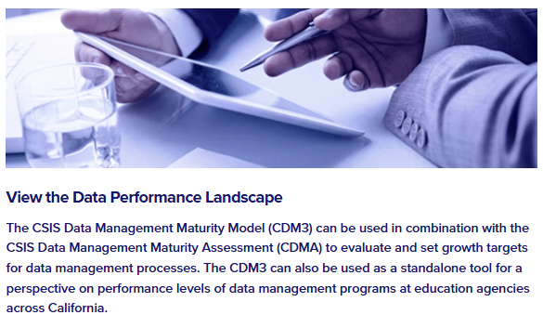
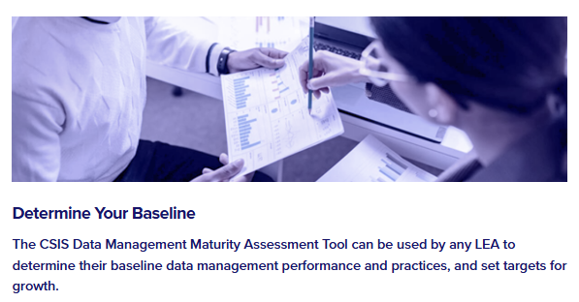

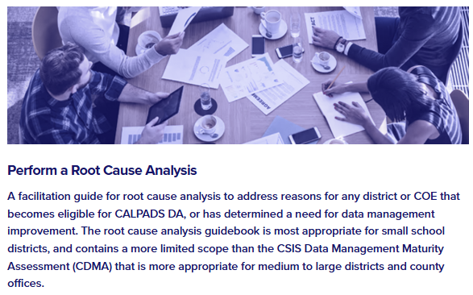
Universal
Supports
Toolkit
Data Management
Maturity Model
Data Management Assessment
Root Cause Analysis Guidebook

Slide 62

Support Tips and Resources

Slide 63

Live Demo
Updated MID functionality
Fall 1 Roadmap and Checklist
Fall 2 Roadmap and Checklist
Report Mapping Guides
Service Request Best Practices
Notes:
Training on new MID functionality: https://www.youtube.com/watch?v=5k6wE4ExNpQ
Fall 1 Roadmap: https://documentation.calpads.org/Training/Fall1ReportingRoadmap/
Fall 1 Checklist: https://documentation.calpads.org/Training/doc/2025-26Fall1ChecklistwithCertificationReportSummary.xlsx
Fall 1 Report Mapping Guides - https://documentation.calpads.org/Reports/Certification_Real_TimeReports/#fall-1-report-mapping-guides
Fall 2 Roadmap: https://documentation.calpads.org/Training/Fall2ReportingRoadmap/
Fall 2 Checklist: https://documentation.calpads.org/Training/doc/2025-26Fall2ChecklistwithCertificationReportSummary.xlsx
Fall 2 Report Mapping Guides - https://documentation.calpads.org/Reports/Certification_Real_TimeReports/#fall-2-report-mapping-guides

Slide 64




Resources and Training
https://csis.fcmat.org/csis-training
https://www.youtube.com/channel/UCA9oRTiyVECCCzOxpmJheZw
https://documentation.calpads.org/Support/References
https://www.cde.ca.gov/ds/sp/cl/systemdocs.asp
https://csis.fcmat.org/resources
CALPADS Regional Update September 2025
Notes:
CSIS Training Registration: https://csis.fcmat.org/csis-training
CSIS YouTube: https://www.youtube.com/channel/UCA9oRTiyVECCCzOxpmJheZw
CALPADS documentation (CFS, Valid Codes, etc.): https://documentation.calpads.org/Support/References
CSIS Resources (training PPT presentations, Key Roles template, How CALPADS Data are Used, etc.):
https://csis.fcmat.org/resources

Slide 65





Support
http://www2.cde.ca.gov/calpadshelp/default.aspx
Web
calpads-support@cde.ca.gov
Email
916-325-9210
Phone
https://csis.fcmat.org/ListServ
https://www.cde.ca.gov/ds/sp/cl/listservs.asp
You can get help through these channels
Listserv
CALPADS Regional Update September 2025
Notes:
Service Desk Request - http://www2.cde.ca.gov/calpadshelp/default.aspx
CSIS two-way listserv registration - https://csis.fcmat.org/ListServ
CALPADS one-way listserv - https://www.cde.ca.gov/ds/sp/cl/listservs.asp

Slide 66
Wrap Up

Slide 67
2025−26 Regional Update Meetings
New Registration Coming Soon:
https://csis.fcmat.org/csis-training
Meeting Dates | Meeting Focus
September 9–10, 2025 | Fall 1 and Fall 2
March 3–4, 2026 | End of Year (EOY)
May 5–6, 2026 | Changes for the Upcoming School Year

Slide 68

Next Meeting
March 3-4, 2026
(Tuesday and Wednesday)
Focus: End of Year (EOY)
This information will be well communicated and posted once the registration links are available.

Slide 69

Thank you for your work!

Slide 70

Additional Questions

