Slide 1
CALPADS Regional Updates
May 2026

Slide 2
Housekeeping
All participants are muted
Type your questions in the Q&A
Please wait to ask questions in the Q&A until after each section
Please focus questions to the topic currently being presented
You can give a “thumbs up” vote to any question so that it’s given a higher priority in the queue
We will attempt to answer all questions, any unanswered questions will be followed up in a frequently asked questions document forwarded to all participants
If you are having audio issues:
Click the microphone icon in the bottom left-hand corner of the Zoom window and select “Switch to phone audio” and call in using the information provided
This meeting will be recorded and posted to the CSIS Training Channel; the posting will be communicated in the CALPADS Digest

Slide 3
Accessing PowerPoint and Resources
All materials for the Regional Update Meetings will be available at the following locations –
Zoom Resources Tab
CSIS Resources Page:
https://csis.fcmat.org/document/CALPADSResources/CALPADS-Regional-Updates-May-2026.pptx

Slide 4
Presenter Information (1)
California School Information Services (CSIS)
Rima Mendez, Requirements Management
Heather Cota, Requirements Management
Angela Ratty, Client Services
Matt Clark, Client Services

Slide 5
Presenter Information (2)
Educational Data Management Division (EDMD)
Diana Casanova, Education Administrator, CALPADS Office
Paula Mishima, Education Administrator
Shaun Walker, Information Technology Specialist I
Special Education Division (SPED)
Dominic Johnson, Information Technology Specialist I

Slide 6
Agenda
2026-27 CALPADS Calendar
Special Education Updates
General Changes
Final 2025-26 EOY Updates
2026-27 Looking Ahead
CALPADS Support Updates
Wrap Up

Slide 7
2026-27 EOY CALPADS Calendar

Slide 8
2026-27 CALPADS Calendar (Pending Approval)
Submission | Official Submission Window | Certification Deadline | Close of Amendment Window
Fall 1 | October 7, 2026 (Census Day) to January 22, 2027 | December 11, 2026 SELPA strongly encouraged, but not required | January 22, 2027 SELPA approval required
Fall 2 | October 7, 2026 (Census Day) to February 26, 2027 | February 26, 2027 | No Amendment Window
End-of-Year (EOY) 1 | May 4, 2027 to July 30, 2027 | July 16, 2027* SELPA strongly encouraged, but not required | July 30, 2027 SELPA approval required
EOY 2 | May 4, 2026 to Monday, August 16, 2026 | August 16, 2027 | No Amendment Window:
 |  | Pull Date
4-Year Adjusted Cohort Graduation Rate (ACGR)* |  | August 16, 2027 | No Amendment Window
*The Graduate Cut-Off Date is always August 15th (for any year). The pull of data for the cohort is the same as the certification deadline, Monday August 16, 2027

Slide 9
Special Education Updates

Slide 10
Special Education Validation Updates
New for EOY 1 2026
PLAN0748E1 – Invalid School Program Setting for Student on ISP
Enforces a Program Setting of 403 – Parentally Placed in Private School
Updated
SWDS0749E1 - An Eligible and Participating student must not change statuses on the same day they exit School
Currently disabled - Trigger is being updated to ONLY trigger for specific Completion Status and Exit Codes related to Indicators 1 (graduates) and 2 (dropouts)

Slide 11
New EOY 1 Students with Disabilities Completers and Dropouts Reports
SELPA & LEA Reports
16.27 Students with Disabilities – Completers and Dropouts Count
16.28 Students with Disabilities – Completers and Dropouts Student List
Reports will show:
Students with disabilities (SWDS) most recent exit is between 7/1 – 6/30 of selected Academic Year

Slide 12
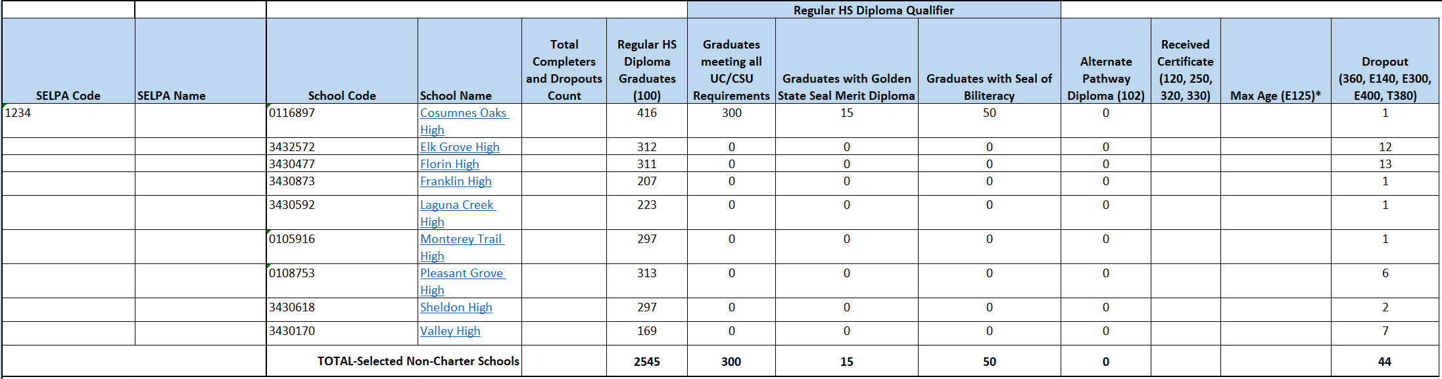

EOY 1 Report– 16.27 SWD Completer and Dropout Counts
NOTE: SWDs will ONLY appear on these reports if their SWDS Status is 1 – Eligible and Participating on the Enrollment Exit Date

Slide 13
Enrollments for SWD in Private Schools
Private school enrollments (Enrollment Status 50, School 0000002) should only be created if:
A student is parentally placed in a private school located within your LEA’s boundaries and is referred for initial evaluation for special education and is
A student with disabilities on an active ISP or IEP transfers into a private school located within your LEA’s boundaries
Nonprofit Private School Enrollments
These enrollments should remain OPEN for the duration of the academic year and be exited at the end of the year with an Exit Code of E170 – Nonprimary Enrollment Exit – even if the student will NOT be served on an ISP.
For-profit Private School Enrollments
These enrollments should be exited with an N470 – No Show with an exit date equal to the Enrollment start date because the student is not eligible to be served on an ISP because the private school is FOR-PROFIT

Slide 14
Using CALPADS Data to Calculate Proportionate Share
If a LEA elects to use CALPADS data to calculate Proportionate Share for the provision of Equitable Services then it is imperative that private school enrollments for the last prior three years follow the guidance from the prior slide
LEAs choosing to utilize CALPADS are encouraged to clean up these enrollments over the last three academic years to ensure that:
Students who were actively served on ISPs appear in Report 16.12 and in the SWDS Real-time Extract for each academic year;
Students who were evaluated but whose parents declined will appear on Report 16.24 – Students with Disabilities Status and Non-Participation Reasons SWDS Real-time Extract for each academic year

Slide 15
Private School and Proportionate Share Workgroup
The Special Education Division is currently heading a workgroup to discuss these and other issues. The objectives of this workgroup are:
Develop and release new Private School File Submission Scenarios
Release Frequently Asked Questions and guidance on Private School Data for Students with Disabilities and Proportionate Share Calculations

Slide 16
EOY Data Used for Federal Indicators
Indicator | Uses Data Certified in… | Reports Used to Verify
Indicator 1: Graduates | End-of-Year 1 | NEW 16.27 – SWD Completer and Dropout Counts NEW 16.28 – SWD Completer and Dropout Student List
Indicator 2: Dropouts | End-of-Year 1 | NEW 16.27 – SWD Completer and Dropout Counts NEW 16.28 – SWD Completer and Dropout Student List
Indicator 4a: Suspension and Expulsion (overall) | End-of-Year 1 | 7.12 Incident Results Student list 7.16 Incident Removals for SWD 7.18 Incident Removals for SWD – Student List
Indicator 4b: Suspension and Expulsion (by race/ethnicity) | End-of-Year 1 | 7.12 Incident Results Student list 7.16 Incident Removals for SWD 7.18 Incident Removals for SWD – Student List
Indicator 13: Transition in IEP | End-of-Year 1 | 16.14 – SWDs Student Profile – Student List
Indicator 14: Post-School Outcomes: | End-of-Year 1 | 17.3 – Postsecondary Survey Outcome for SWDs 17.4 – Postsecondary Survey Outcome for SWDs – Student List

Slide 17
ODS Data Used for Federal Indicators
Indicator | Uses Data Certified in… | Reports Used to Verify
Indicator 8: Parental Involvement | N/A – Uses ODS data as of EOY amendment window close date | 16.24 – Students with Disabilities – Meetings Student List
Indicator 11: Timeframe Between Evaluation and Identification (Child Find) | N/A – Uses ODS data as of EOY amendment window close date | 16.25 – Students with Disabilities – Initial Part B Evaluation 60-Day Timeline Student List
Indicator 12: Transition Between Part C and Part B | N/A – Uses ODS data as of EOY amendment window close date | 16.26 – Students with Disabilities – Initial Part C to B Transition Student List

Slide 18
Remaining Spring Roadshows!
Date | Hosting Agency | Start Time | In-Person Registration link | Virtual Registration link (if providing a virtual option)
5/11/2026 | Sacramento County Office of Education | 9:00AM | https://proflearn.scoe.net/Home/Register/923 | https://proflearn.scoe.net/Home/Register/923
5/13/2026 | Sonoma County/Charter SELPAs | 9:00AM | https://forms.gle/TYwZMYc5pm2Dex6F6 | https://forms.gle/RYygaQqY8hHfWvQf6
5/14/2026 | San Joaquin County Office of Education | 9:00AM | https://forms.gle/n8yZNLLYaJPrWwgr9 | N/A
5/15/2026 | Shasta SELPA | 9:00AM | https://www.shastacoe.org/forms/~form-uuid/b87424f8-71c5-4b4c-9489-f79c19fcbf10 | N/A
5/18/2026 | Contra Costa SELPA | 9:00AM | https://forms.gle/DWGF5PWGSqcXJ36Y8 | N/A
5/19/2026 | Santa Clara North West SELPA | 9:00AM | https://na.eventscloud.com/876375 | N/A
5/21/2026 | California Department of Education – Statewide Virtual | 9:00AM | N/A | https://us02web.zoom.us/webinar/register/WN_ZGaFf3hXRN2hZcWf1tOBtg

Slide 19
General Changes

Slide 20
New User Authentication (1) (Flash 319)
Congratulations to all users who have successfully acquired new usernames and passwords in the new CALPADS User Authentication system
For users that missed the transition window…
If you are not a CALPADS LEA Administrator, your Administrator must assign you a new account
If you are a CALPADS LEA Administrator, you must submit a CALPADS Service ticket with “CALPADS Administrator Account Request” in the subject to initiate the process of getting a new account
Updated guidance for all CALPADS Users: https://www.youtube.com/watch?v=_Wkc0SXUYKI

Slide 21
New User Authentication (2) (Flash 319)
As described in Flash 319, this project has 2 phases:
Phase 1: Required all users to get a new username and password for logging into CALPADS by May 1, 2026
Phase 2: Includes turning on Multi-factor Authentication for your CALPADS account
Phase 2 is anticipated to occur later in the year, sometime following the close of End-of-Year 2
More information will be forthcoming

Slide 22
Final 2025-26 EOY Updates

Slide 23
2025−26 EOY Submission Changes Refer to Flash 312
EOY 1 – FINAL Deadline: July 31, 2026
Previous EOY 2, 3, 4 minus One-Year Graduates & Completers
For Students with Disabilities, a new count of graduates and dropouts between July 1 – June 30
New Expanded Learning Program submitted on LEA Program (LEAP) file
EOY 2 – FINAL Deadline: August 17, 2026
Previous EOY 1 plus One-Year Graduates & Completers for all students (August 16 – August 15)
Final Certification Deadline is same date that data will be pulled for the 4-year Cohort

Slide 24
EOY 2 Certification Date and ACGR Pull Date is August 17, 2026
The Graduate Cut-Off Date for the 4-year Adjust Cohort Graduation Rate (ACGR) remains August 15. Students must have a graduate exit date by August 15 to be included as a graduate in 2025-26
The EOY 2 Certification Deadline and the ACGR pull date are the same: Monday, August 17, 2026
Students who graduate after August 15, 2026, will not be included as graduates in the 4-year ACGR for 2025-26, but will be counted as 5th year graduates in 2026-27

Slide 25
Expanded Learning Collection Reminders
The new LEA Program (LEAP) file is available in production
LEAs are reminded that:
Users uploading LEAP files require a LEAP role
As part of the EOY 1 submission, LEAs are required to certify:
Report 19.1 – Expanded Learning Program Participants – Count
LEAs should report the total number of days students participated in any Expanded Learning Program (ELP) during the 2025-26 academic year, which is July 1, 2025 through June 30, 2026
FAQ updated to clarify that a student may participate in ELP and AR on the same day, but they are two different programs and student participation in each program must be clearly differentiated –meaning a student is participating in either AR or ELO-P at any time, not both simultaneously.

Slide 26
Attendance Recovery Reminders
The updated Student Absence Summary (STAS) file is in production and now includes Field 13.24 – Attendance Recovery Days
FAQ updated to clarify students participating in “short-term” independent study may be eligible
Students enrolled in nonclassroom-based programs or a nonclassroom-based charter school cannot participate in Attendance Recovery (AR) and do not generate attendance for apportionment through AR
For the purposes of determining eligibility for AR, a student is considered enrolled in a nonclassroom-based program when they are participating continually in traditional independent study for a span of 16 school days or more (EC Section 46211(g)(2))
Therefore, students participating 15 days or less are eligible to participate in AR and any incomplete independent study day absences may be used for AR

Slide 27
AR and ELP FAQs Updates
FAQ Requirements Tab, Eligibility:
10. If a student has participated in independent study for more than 15 days earlier in the year, but has returned to in-person instruction, can they still participate in Attendance Recovery (AR)?
FAQ Attendance Recovery Tab and ELO-P tab, Eligibility:
2. Can an Expanded Learning Opportunity (ELO) student participate in Attendance Recovery (AR)?

Slide 28
2026-27 Looking Ahead

Slide 29
Language Course Content Subcategory Codes
2023-24
Adopted the ISO Language Code Set
World language subcategories (CRSE/C DE 9.28 - Course Content Area Subcategory Code) not updated due to significant impact on Valid Code Combos (VCCs)
2026-27 (Planned Updates)
Align world language subcategories to the ISO codes based on review of last 3 years of data
Update world language subcategories and Course Group State-Course Content Area Subcategory Valid Code Combos to:
Map ~43 high-use world language subcategories to ISO codes
Retire ~114 outdated world language subcategories
Use “mis” for uncoded/non-listed world language subcategories

Slide 30
Updating Student Exit Category Codes (1)
33317.3.
(a) Commencing with the 2026–27 school year, the department shall collect and publish on its internet website, and local educational agencies shall provide to the department, data on pupil transfers due to disciplinary reasons, including whether the pupil transferred to an alternative school based on a referral by the school.
(b) The department, when providing guidance on its internet website about reducing disproportionate discipline of pupil subgroups in schools, shall advise local educational agencies against the use of transfers to avoid reporting suspensions and expulsions.
(c) For purposes of this section, “local educational agency” means a school district, county office of education, or charter school.
(Added by Stats. 2024, Ch. 368, Sec. 1. (AB 1984, Weber. Pupil discipline: transfer reporting.) Effective January 1, 2025.)

Slide 31
Updating Student Exit Category Codes (2)
Retiring T167 TransAltSchlPrgm and T168 AltIndStdySchlDschrg
Adding NEW T166 TransAltEdPrgmDisc
Modifying T160 TransCASchlRegular and T165 TransSpecDiscRsnsOrJudg

Slide 32
Updating Student Exit Category Codes (3)
Adding T166 TransAltEdPrgmDisc
Coded Value | Name | Definition | Start Date
T166 | TransAltSchlPrgmDisc | The student was referred by a school and/or school district and the district has acceptable documentation that the student enrolled in an alternative education school in another California public school in the same district or in a different district for one of the following reasons: (1) a student was referred by school and/or school district to withdraw from/leave school and transfer to an alternative education school for any disciplinary reason except those specified in T165. Do NOT use this code for: (1) - interdistrict transfers (i.e., formal agreement pursuant to Education Code Section 46600, NCLB public school choice-program improvement, NCLB public school choice-persistently dangerous, district of choice transfers pursuant to Education Code Section 48313); or (2) - students who are referred to an alternative education school for disciplinary reasons by a juvenile court judge or other correctional or judicial officer or who are expelled pursuant to Education Code Section 48915 (a), (b), or (c). (Use T165) | 7/1/2026

Slide 33
Updating Student Exit Category Codes (4)
Modifying T160 TransCASchlRegular
All Independent Study transfers will use T160. All Alternative School or Independent Study School Discharge (retired T168) will use T160.
Coded Value | Name | Definition
T160 | TransCASchlRegular | The student withdrew from/left school and the district has acceptable documentation that the student has transferred (not referred by a school or district) to another California public school (within or outside the district), including transfers to a non-sectarian, non-public certified (NPS) school. This may include court school students who either transfer to another California public school with acceptable documentation or who complete their sentence and are released without documented evidence of a subsequent transfer, provided the exit was not the result of a school or district referral. Transfers that are a result of referrals made by a school or district are to be coded as T165, T167, or T168 or T166 as appropriate.

Slide 34
Updating Student Exit Category Codes (5)
Modifying T165 TransSpecDiscRsnsOrJudg
Coded Value | Name | Definition
T165 | TransSpecDiscRsnsOrJudg | Mandatory Transfer Due to Discipline Reason: The student was mandatorily exited from the school for a specified disciplinary reasons to transfer to another California public school (within or outside the district). The specified disciplinary reasons include: (1) referral by a juvenile court judge or other correctional or judicial official; or (2) expulsions pursuant to Education Code Section 48915 (a), (b), or (c). Do NOT use this code if: a student is expelled and referred to an alternative education program for disciplinary reasons other than those specified in Education Code Section 48915 (a), (b), or (c). ( T166 [TransAltSchlPgmDisc]). If it is unknown whether the student enrolls in another institution use E300 (ExpelledNoKnownEnroll).

Slide 35
New Reclassified Fluent English Proficient (RFEP) Validation (1)
New EOY 1 CDD validation (effective for 2025–26) will be implemented sometime in May 2026 to ensure that a student’s Reclassified Fluent English Proficient (RFEP) status start date does not match their enrollment start date:
The validation supports the calculation of the percentage of English Leaner (EL) students that reclassify:
Reclassification Rate = Total Number of EL students that Reclassified/Total Number EL students
When a student’s RFEP status start date is the same date as the start of their enrollment, the student and their enrollment lack an EL status for calculating the rate
Rule # | Error Level | Error Message | Error Description
SELA0751E1 | Fatal | RFEP Status Start Date Cannot Equal Enrollment Start Date | Student must not be Reclassified Fluent English Proficient (RFEP) on the first day of enrollment.

Slide 36
New Reclassified Fluent English Proficient (RFEP) Validation (2)
For data submitted in during 2025-26, most of the instances where the Enrollment Start Date = RFEP Start Date were submitted for students who were reclassified during the summer.
The CDE will be notifying LEAs with RFEP records that will trigger the new fatal SELA0751E1 error to ensure earlier awareness of the issue and to provide more time to update records
To address the error, LEAs will need to:
Identify the students with RFEP Start Dates that equal the Enrollment Start Date
Submit a record that deletes the RFEP Start Date
Submit a new record with a RFEP Start Date that is at least one day after the Enrollment Start date

Slide 37
Job Classification & Course Attribute Updates (1)
Retire Job Classification Code:
12: Teacher
25: Non-certificated Administrator
26: Charter School Non-Certificated Teacher
27: Itinerant or Pull-Out/Push-in Teacher
Add Job Classificaton Codes:
13: Teacher: Instructional Assignments
14: Teacher: Non-Instructional Assignments
Add CRSE/C Indicators:
Itinerant Teacher
Pull-Out/Push-in Teacher
Objectives:
Improve FTE transparency in CALPADS reporting
Enable accurate assignment monitoring by subject area
Support CTC evaluations of teacher authorizations
These changes will occur for Fall 2, AY 2026-27

Slide 38
Job Classification & Course Attribute Updates (2)
13: Teacher - Instructional Assignments
A staff member (employee) who holds a position at a school or district with an instructional teaching assignment that requires certification or other state alternative and whose duties require providing direct instruction to the pupils in the school(s). The teaching staff included in these data have a Statewide Educator Identifier (SEID) assigned by the California Commission on Teacher Credentialing (CTC) and their staff assignment and demographic data are reported through the California Longitudinal Achievement Data System (CALPADS).
Teaching staff have instructional assignments that include, but are not limited to, the following: teacher, instructional teacher librarian, itinerant or pull-out/push-in teachers, independent study teacher, and teachers facilitating or leading online courses, and in some cases long-term substitute teacher.

Slide 39
Job Classification & Course Attribute Updates (3)
14: Teacher - Non-Instructional Assignments
A staff member (employee) who holds a position at a school or district with a non-instructional support assignment that requires certification or other state alternatives and whose duties do not involve providing direct instruction to the pupils in the school(s). The non-instructional support staff included in these data have a Statewide Educator Identifier (SEID) assigned by the California Commission on Teacher Credentialing (CTC) and their staff assignment and demographic data are reported through the California Longitudinal Achievement Data System (CALPADS).
Non-instructional support staff have assignments that include, but are not limited to, the following: mentor teacher, peer Assistance and review, other certificated non-instructional assignments, non-instructional teacher librarian, teacher on special assignment, special education case manager (non-instructional), program coordinator - school site level, and department chair.

Slide 40
Job Classification & Course Attribute Updates (4)
Create two indicators in the course section enrollment/completion files (CRSE/C) identifying the instruction services being provided.
9.37: Itinerant Teacher
9.38: Pull-Out/Push-In Teacher
These will be included in the definition of the new Job Class 13 (Teacher – Instructional Assignments) and more specifically, will be identified on the CRSE/C record as Y/N optional indicators.

Slide 41
Job Classification & Course Attribute Updates (5)
9.37: Itinerant Teacher
A staff member (employee) who holds a position at a school or district with an instructional teaching assignment that requires certification or other state alternative and whose duties require providing direct instruction to the pupils in multiple schools and is not assigned to a single classroom or school building. Instead, itinerant teachers travel between multiple sites, such as different schools within a district or multiple districts, to provide specialized instruction. The itinerant teacher included in these data have a Statewide Educator Identifier (SEID) assigned by the California Commission on Teacher Credentialing (CTC) and their staff assignment and demographic data are reported through the California Longitudinal Achievement Data System (CALPADS).

Slide 42
Job Classification & Course Attribute Updates (6)
9.38: Pull-Out/Push-In Teacher
A staff member (employee) who holds a position at a school or district with a teaching specialist assignment that requires certification or other state alternative and whose duties require instructing students using two methods: "pushing in" to the general education classroom to provide co-teaching or aide, or "pulling out" students for focused, small-group instruction in a separate setting. The pull-out/push-in teachers in these data have a Statewide Educator Identifier (SEID) assigned by the California Commission on Teacher Credentialing (CTC) and their staff assignment and demographic data are reported through the California Longitudinal Achievement Data System (CALPADS). Examples of duties performed by pull-out/push-in teachers include, but are not limited to, the following: (1) providing instruction to students with disabilities to address Individualized Education Program (IEP) goals; (2) providing language instructional services to english learners; or (3) providing subject-based intervention or academic support services (e.g., reading or math) for students.
Pull-out/push-in staff are reported in CALPADS as teachers and have instructional assignments that include, but are not limited to, the following: resource specialist program (RSP) teacher, special education teacher, english language development (ELD) specialist, intervention specialist, or reading specialist.

Slide 43
New Course Codes for 2026-27 (1)
Coded Value | Name | Definition | Start Date
9704 | Personal Finance | Personal Finance courses typically cover topics that develop students to make informed financial decisions to satisfy California’s Education Code Section 51225.3 graduation requirement. Personal Finance courses present students with an opportunity to learn and develop management skills about banking, budgeting, employment income, credit and debt management, loans and student loan policies, insurance, taxes, investing and wealth-building, consumer protection, education financing, financial psychology, and charitable giving. | 7/1/2026

Slide 44
New Course Codes for 2026-27 (2)
Coded Value | Name | Definition | Start Date
9705 | AP Networking | AP Networking trains students in the field and aligns closely with standard first-year collegiate networking courses. Students develop problem-solving and communication skills by configuring, securing, and troubleshooting networks of increasing scale. Through hands-on activities and real-world scenarios, students are encouraged to understand, design, and manage networks that enable functionalities such as streaming and communication, workplace collaboration, and resilient public infrastructure. Developed in partnership with college faculty and industry leaders, this yearlong course aligns with the NICE Workforce Framework. | 7/1/2026

Slide 45
New Course Codes for 2026-27 (3)
Coded Value | Name | Definition | Start Date
9706 | AP Cyber Security | AP Cybersecurity is a broad introduction to the field of cybersecurity that aligns closely with a standard first-year college introductory cybersecurity course. Students learn about common threats and vulnerabilities and how those combine to create risk. Students study the ways that individuals and organizations manage risk and how risk can be mitigated through a defense-in depth strategy. Students explore specific vulnerabilities, attacks, mitigations, and detection measures across a variety of domains, including physical spaces, computer networks, devices, and data and applications. Throughout the course, students consider the impact of cybersecurity on individuals, organizations, societies, and governments. | 7/1/2026

Slide 46
New Course Codes for 2026-27 (4)
Coded Value | Name | Definition | Start Date
9707 | AP Business Principles with Personal Finance | AP Business with Personal Finance is an introductory, college-level business and personal finance course. Students explore the business disciplines of entrepreneurship, marketing, finance, accounting, and management through real-world business application, case studies, and project-based learning. In addition, students learn and apply all the National Standards for Personal Financial Education created by the Council for Economic Education and the Jump$tart Coalition for Personal Financial Literacy. | 7/1/2026

Slide 47
Break

Slide 48
Immigrant Data Update
As part of California’s federal reporting requirements, the CDE must submit immigrant data to the U.S. Department of Education
Collection of data includes the count of immigrants, ages 3-21, in the TK-12 grade levels and the reporting period is the entire school year (i.e., July 1 to June 30, cumulative enrollment)
CALPADS has a Fall 1 Certified Report, 2.1-Title III Eligible Immigrants – Count (Fall1), however, it does not currently have a similar report for the cumulative count of immigrant students
Starting in the 2026-27 school year, a new EOY Immigrant Student certification report will be added
This allows the CDE to fulfill the cumulative enrollment federal reporting requirements, strengthen compliance, improve accuracy, and increase transparency so there is visibility into what the CDE reports to the U.S. Department of Education

Slide 49
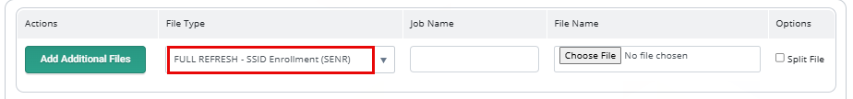
SENR Full Replacement (1)
Add a new option via File Upload, to allow users to submit a SENR batch file as a Full Replacement, as opposed to current Transactional updates
Operational Key for Full Replacement*:
Academic Year
Reporting LEA
School of Attendance
*NOTE: Online Maintenance will continue to be transactional processing

Slide 50
SENR Full Replacement (2)
To support SENR full refresh, we recognized that we needed to implement a few new validations:
Next Steps: User Acceptance Testing (UAT) with Vendors and some LEAs in 2026-27 (after EOY submission is complete)
Rule # | Error Level | Error Message | Error Description | Implementation Date
SENR0742 | Fatal | Invalid AY based on Enrollment Start Date | Academic Year ID must be the academic school Year associated with the Enrollment Start Date | October 2025
IVR0750 | Warning | Low Record Count Detected | The number of records submitted is lower than expected, given prior submissions and existing data. This may indicate incomplete or missing records | Pending

Slide 51
CALPADS Support Updates

Slide 52

Differentiated Assistance (DA)
25-26
Final CALPADS Deadlines
26-27
Data Quality Criteria
“Any district that fails to submit data according to the processes and timelines as specified in EC 60900(f) and established by the CDE.” –SB114
“This includes submitting and certifying accurate, correct, and complete data by each certification deadline.” –SB114

Slide 53


Data Governance Academy
Session 1: Data Governance for LEA Executives
October 2025
Virtual Check-In: Case Study and Project Progress
February 2026
Session 2: Operationalizing Data Governance at Scale
April 2026
Thank you to our hosting and watch party sites!
https://csis.fcmat.org/data-management/csis-data-governance-academy

Slide 54

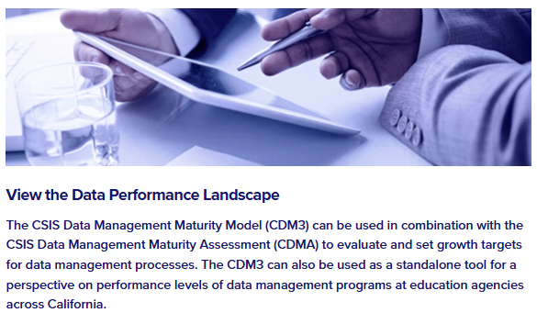
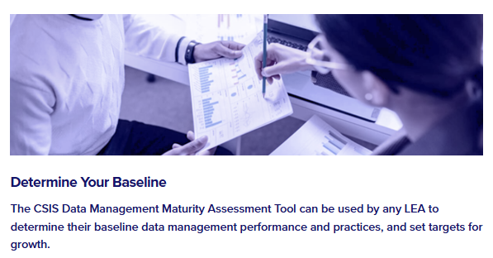

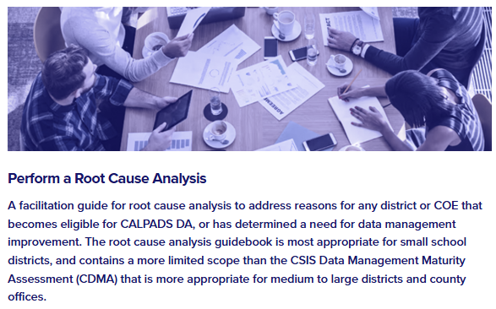
Universal Supports Toolkit
Data Management
Maturity Model
Data Management Assessment
Root Cause Analysis Guidebook

Slide 55

Support Tips and Resources

Slide 56

Live Demo
New Service Desk software
New User Manual

Slide 57



Resources and Training
https://csis.fcmat.org/csis-training
https://www.youtube.com/channel/UCA9oRTiyVECCCzOxpmJheZw
https://documentation.calpads.org/Support/References
https://www.cde.ca.gov/ds/sp/cl/systemdocs.asp
https://csis.fcmat.org/resources
CALPADS Regional Update May 2026

Slide 58

Support
http://www2.cde.ca.gov/calpadshelp/default.aspx
Web
calpads-support@cde.ca.gov
Email
916-325-9210
Phone
https://csis.fcmat.org/ListServ
https://www.cde.ca.gov/ds/sp/cl/listservs.asp
You can get help through these channels
Listserv
CALPADS Regional Update May 2026

Slide 59
Wrap Up

Slide 60

Next Meeting
September 8-9, 2026
(Tuesday and Wednesday)
Focus: 2026-27 Fall 1 & 2 Submissions
This information will be well communicated and posted once the registration is available.

Slide 61

Additional Questions

Slide 62

Thank you for your work!

