Slide 1
CALPADS Regional Updates
March 2026

Slide 2
Housekeeping
All participants are muted
Type your questions in the Q&A
Please wait to ask questions in the Q&A until after each section
Please focus questions to the topic currently being presented
You can give a “thumbs up” vote to any question so that it’s given a higher priority in the queue
We will attempt to answer all questions, any unanswered questions will be followed up in a frequently asked questions document forwarded to all participants
If you are having audio issues:
Click the microphone icon in the bottom left-hand corner of the Zoom window and select “Switch to phone audio” and call in using the information provided
This meeting will be recorded and posted to the CSIS Training Channel; the posting will be communicated in the CALPADS Digest

Slide 3
Community Agreements
Keep students at the center; we work together to achieve our goals
Take space; make space
We include and respect all
Listen to understand
We participate, listen, and learn actively
Tough on the problems and easy on the people: our meetings are respectful and judgement-free. All positions, voices, and ideas are valued
Honor the agenda

Slide 4
Accessing PowerPoint and Resources
All materials for the Regional Update Meetings will be available at the following locations -
Zoom Resources Tab/Pane
CSIS Resources Page:
https://csis.fcmat.org/document/CALPADSResources/CALPADS-Regional-Updates-March-2026.pptx

Slide 5
Presenter Information (1)
California School Information Services (CSIS)
Rima Mendez, Requirements Management
Heather Cota, Requirements Management
Angela Ratty, Client Services
Matt Clark, Client Services

Slide 6
Presenter Information (2)
Educational Data Management Division (EDMD)
Diana Casanova, Education Administrator, CALPADS Office
Paula Mishima, Education Administrator
Special Education Division (SPED)
Dominic Johnson, Information Technology Specialist I

Slide 7
ASL Translation Services
Zachary Smith
Lacey Easton
Wednesday, March 4, 2026: 9:30–11:30 AM – Southern A Region
(recording shared via the CALPADS Digest and Wednesday’s Q&A once available)

Slide 8
Agenda
2025-26 CALPADS Calendar
Special Education Updates
2025-26 EOY General Updates
EOY Submission Changes, New Collections, and Reminders
CALPADS Support Updates
Wrap Up

Slide 9
2025-26 EOY CALPADS Calendar

Slide 10
2025-26 CALPADS Deadlines - EOY
Submission | Primary Data Submitted | Official Submission Window | Recommended Date for Zero Errors | Certification Deadline | Close of Amendment Window
End-of-Year (EOY) 1 | Program Eligibility/Participation Student Incidents Cumulative Enrollment Student Absence Summary Count of English Learner (EL) Reclassified during School Year Homeless Students Special Education Postsecondary Outcomes for Students with Disabilities (SWD) Prior Year Completers | May 5, 2026 to July 31, 2026 | June 26, 2026 | July 17, 2026* | July 31, 2026 SELPA Approval Required
EOY 2 | Course Completion for Grades 7–12 Career Technical Education (CTE) Participants, Completers Work-Based Learning Indicators One-Year Graduate and Completer Counts | May 5, 2026 to August 17, 2026 | August 3, 2026 | August 17, 2026** | No Amendment Window: Final Deadline is August 17, 2026
*SELPAs are strongly encouraged but not required to approve the EOY 1 submission for LEAs by the July 17, 2026 Certification Deadline; SELPAs must approve EOY 1 submissions by the close of the Amendment Window, July 31, 2026.
**The Graduate Cut-Off Date is always August 15th (for any year). The pull of data for the cohort is the same as the certification deadline, Monday August 17, 2026

Slide 11
Special Education Updates

Slide 12
CALPADS SPED Data Roadshows
4/13/2026 Merced
4/14/2026 Madera
4/15/2026 Tulare
4/17/2026 Fresno
4/20/2026 San Diego
4/21/2026 Los Angeles COE
4/22/2026 Ventura
4/23/2026 Riverside
4/24/2026 San Bernardino
5/11/2026 Sacramento
5/13/2026 Sonoma
5/14/2026 San Joaquin
5/15/2026 Shasta
5/18/2026 Contra Costa
5/19/2026 Santa Clara
Registration information coming soon!

Slide 13
Monitoring Report 16.14 by DSEA
LEAs can use Monitoring Report 16.14 by District of Special Education Accountability (DSEA) to find students for whom they are responsible but are not enrolled at their LEA and thus not available on most CALPADS reports.
For EOY, LEAs should monitor these students’ EOY data as it informs the Federal Indicators
Discipline
Suspension, expulsion, restraint & seclusion
Disproportionality overall and by disability
Statutory Plan Review and Reevaluation timelines (monitor all year)

Slide 14
EOY Data → Federal Indicators (1)
Indicator | Uses Data Certified in… | Reports Used to Verify | Results Assigned To | Year data will appear in the ADL and APR
Indicator 1: Graduates | End-of-Year | 16.27 Students with Disabilities – Completers and Dropouts Count 16.28 Students with Disabilities – Completers and Dropouts Student List | District of Special Education Accountability | February 2027
Indicator 2: Dropouts | End-of-Year | 16.27 Students with Disabilities – Completers and Dropouts Count 16.28 Students with Disabilities – Completers and Dropouts Student List | District of Special Education Accountability | February 2027
Indicator 4a: Suspension and Expulsion (overall) | End-of-Year | 7.12 Incident Results Student list 7.16 Incident Removals for SWD 7.18 Incident Removals for SWD – Student List | District of Special Education Accountability | February 2027
Indicator 4b: Suspension and Expulsion (by race/ethnicity) | End-of-Year | 7.12 Incident Results Student list 7.16 Incident Removals for SWD 7.18 Incident Removals for SWD – Student List | District of Special Education Accountability | February 2027
Indicator 8: Parental Involvement | N/A – Uses ODS data as of EOY amendment window close date | 16.24 – Students with Disabilities – Meetings Student List | District of Special Education Accountability | February 2027

Slide 15
EOY Data → Federal Indicators (2)
Indicator | Uses Data Certified in… | Reports Used to Verify | Results Assigned To | Year data will appear in the ADL and APR
Indicator 11: Timeframe Between Evaluation and Identification (Child Find) | N/A – Uses ODS data as of EOY amendment window close date | 16.24 – Students with Disabilities – Meetings Student List | Reporting LEA | February 2027
Indicator 12: Transition Between Part C and Part B | N/A – Uses ODS data as of EOY amendment window close date | 16.24 – Students with Disabilities – Meetings Student List | District of Special Education Accountability | February 2027
Indicator 13: Transition in the IEP | End-of-Year | 16.14 – SWDs Student Profile – Student List | District of Special Education Accountability | February 2027
Indicator 14: Post-School Outcomes: | End-of-Year | 17.3 – Postsecondary Survey Outcome for SWDs 17.4 – Postsecondary Survey Outcome for SWDs – Student List | District of Special Education Accountability | February 2027

Slide 16
New EOY 1 Students with Disabilities Completers and Dropouts Reports
SELPA & LEA Reports
16.27 Students with Disabilities – Completers and Dropouts Count
16.28 Students with Disabilities – Completers and Dropouts Student List
Reports will show:
Students with disabilities (SWDS) most recent exit is between 7/1 – 6/30 of selected Academic Year

Slide 17
Private School Enrollments for Proportionate Share (1)
Private School Data and Proportionate Share Webinar
Recording: https://youtu.be/IVDMECaP6U0?si=0lTtn1uVTol_dU64
Materials: https://cde.box.com/s/l61ettcu05l9zisk02xqeepj5zm96q0l
EOY Data used in Proportionate Share Calculations
Cumulative counts of students enrolled in non-profit private schools who were evaluated and found eligible, regardless of whether or not they are eligible and participating
Currently, there is no specific report in CALPADS that LEAs certify; however, LEAs can use CALPADS Reports and Operational Store Data (ODS) Extracts to pull these data

Slide 18
Private School Enrollments for Proportionate Share (2)
Key Takeaways
ONLY Districts of location should submit private school enrollments for all students attending private schools within the LEA who are referred for evaluation or transferring from outside the district on active IEPs/ISPs
Districts of residence should NEVER submit private school enrollments unless they are also the District of Location
Private school enrollments for students attending NON-PROFIT private schools should NOT be exited with N470 – No Show, they should be exited at the end of the year with E170 – Non-primary Enrollment Exit
Private school enrollments for students attending FOR PROFIT private schools should ALWAYS be exited with N470- No Show
Additionally, we have put together a Private Schools workgroup and are discussing guidance for reporting proportionate share counts.

Slide 19
General Updates

Slide 20
New User Authentication (1) (Review Flash 319)
CALPADS is transitioning to a new User Authentication system which will require all users to acquire a new username and password
User Acceptance Testing completed on February 27, 2026
All users must acquire their new username/password during the transition window: March 10, 2026 – May 1, 2026
Users are encouraged to get their new username/password early in the transition window
Users that fail to do so will not be able to log into CALPADS after the transition window closes on May 1, 2026. These users must work with their LEA CALPADS Administrator to establish a new username/password

Slide 21
New User Authentication (2)
Acquiring a new username/password should take about 5-10 minutes
A demonstration will be given towards the end of the presentation
LEA CALPADS Administrators will have access under User Management during the transition to manage account creation and track which users have obtained their new username and password.
A training video will be provided to guide users through the process, along with additional communication prior to the official rollout

Slide 22
2025-26 EOY Data Discrepancies Now Visible (1)
LEAs may now view their 2025-26 EOY Data Discrepancies (DDs) in the DD screen
Identifies potential data discrepancies earlier rather than discovering them during certification
The goal is to reduce last-minute EOY surprises by spreading data validation across the academic year
This approach supports proactive data quality, not just EOY cleanup

Slide 23
2025-26 EOY Data Discrepancies Now Visible (2)
DD/CDDs fall into two broad categories:
Earlier-Year Checks
Reasonability and consistency checks
Age, grade, and data logic
Required records existing when data is submitted
Closer to End-of-Year
Checks that rely on finalized data
Enrollment exits, absences, incident outcomes, course completion

Slide 24
New Split File Functionality (1)
The new Split File functionality automatically splits large files and creates smaller files that are submitted to CALPADS
Useful for large districts who currently manually split large files to submit data to CALPADS via File Upload
User Acceptance Testing conducted with large-medium sized districts with the following feedback:
The functionality is best used for large student course files

Slide 25
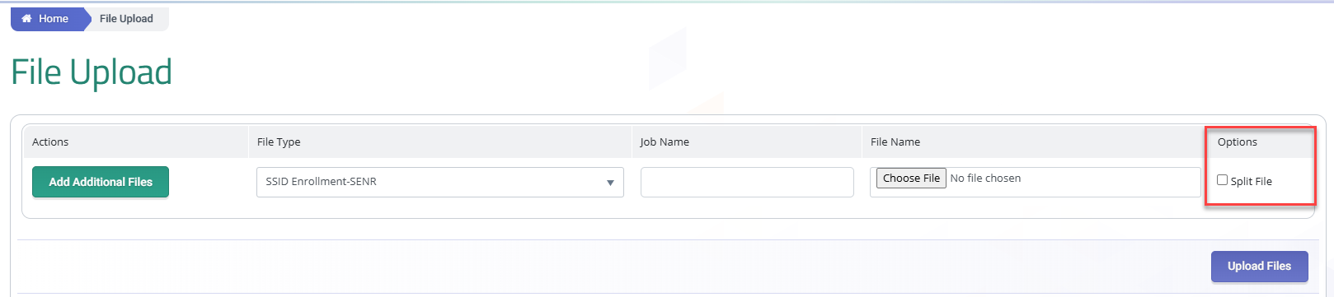
New Split File Functionality (2)
Split File functionality will be provided as an option in the production environment beginning March 10, 2026
The CDE will continue to review all feedback and continue to enhance the functionality so that it is usable for all files
Notes:
Split File Currently Unsupported Record Types:
MEET, PSTS, SSRV, PLAN, SELA, SSVR, SINF, SWDS, LEAP

Slide 26
Reminders Regarding Assessment and Reclassifying English Learners (1)
#1 Review 2024-25 Summative Scores for Reclassification in 2025-26
After May 31, 2026, 2024-25 Summative English Language Proficiency Assessments for California (ELPAC) and Summative Alternate ELPAC scores can no longer be used for reclassification purposes in 2025-26
LEAs should review students with 2024-25 scores that may enable reclassification

Slide 27
Reminders Regarding Assessment and Reclassifying English Learners (2)
#2 Reclassify Students and Upload to CALPADS By May 15, 2026
English Learners (EL) who meet reclassification criteria should be reclassified and their new Reclassified Fluent English Proficient (RFEP) statuses uploaded to CALPADS by May 15, 2026, to ensure it is in Test Operations Management System (TOMS) by May 31
This is important because LEAs’ “participation rate” (rate of ELs taking summative ELPAC) impacts their English Learner Progress Indicator (ELPI) on the California School Dashboard, and the participation rate is based on statuses (e.g., RFEP) in TOMS which are sent nightly to TOMS from CALPADS
RFEP Students do not have to be assessed and therefore are not included in the participation rate
EL students must be assessed and if they are not tested, the LEAs’ participation rate is negatively impacted

Slide 28
Reminders Regarding Assessing and Reclassifying English Learners (3)
Therefore:
Update RFEP statuses in CALPADS by May 15, 2026 (to make sure those statuses are in TOMS)
All EL students who have not been reclassified by May 15, 2026, should be assessed with the Summative ELPAC or Summative Alternate ELPAC by May 31, 2026. This is to ensure that all eligible EL students are annually tested as required by law

Slide 29
Reminders Regarding Assessing and Reclassifying English Learners (4)
#3 Routinely Review SENR0657E1 for TBD Students Who have Not Been Tested in 30 Days
As discussed earlier, use Data Discrepancy (DD) functionality to identify “TBD” students who have not been assessed within the thirty-day window

Slide 30
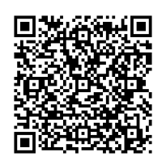
2026 SUN Bucks (1) (Review Flash 321)
CDE’s Nutrition Services Division (NSD) will be providing a webinar on 2026 SUN Bucks program implementation on March 10, 2:00
https://us02web.zoom.us/webinar/register/WN_ZVsY-CT7Q0aLI-dCgBMITw#/registration
Also refer to Flash 321
https://www.cde.ca.gov/ds/sp/cl/calpadsupdflash321.asp
NSD Sun Bucks
Webinar Registration

Slide 31
2025 SUN Bucks Statistics
2026 SUN Bucks (2)
CDE (CALPADS/EDCS): 718,367
CDSS (CALSAWS): 3,504,429
Total Card Issuances: 4,222,747

Slide 32
2026 SUN Bucks (3)
Who are the 83% from CalSAWS?
Students, ages 6-18, enrolled in CALPADS who ARE directly certified by CALPADS ARE NOT in the 17%; rather they are in the 83% pulled from CalSAWs, the authoritative source for that data

Slide 33
2026 SUN Bucks (4)
Who are the 17% from CALPADS/EDCS?
Students enrolled in CALPADS who are homeless, migrant, or foster during the eligibility period (July 1, 2025 – August 31, 2026).
These data are already in CALPADS; Of these students, LEAs only submit program records to CALPADS for homeless students
Students enrolled in CALPADS who are NOT directly certified, or homeless, migrant, or foster, BUT are income eligible based on an approved National School Lunch Program (NSLP) application or a Universal Benefits Application
These students must be submitted to EDCS

Slide 34
2026 SUN Bucks (5)
Who are the 17% from CALPADS/EDCS?
Students ages 0-5, 19-22, who are enrolled in a school participating in a federal meal program, who are directly certified by a local process and NOT by CALPADS, ARE in the 17%
These students must be submitted to EDCS because they are not pulled from CalSAWS and were not identified in the CALPADS statewide match process
Students, ages 0-22, with extended benefits ARE in the 17%
These students must be submitted to EDCS because they are not pulled from CalSAWS

Slide 35
2026 SUN Bucks (6)
How do LEAs submit the students in the 17%?
By keeping CALPADS up-to-date with enrollments, homeless program records (191), and student addresses
By submitting one of the following records to EDCS:
The date approved NSLP applications or UBAs were submitted by the family
The date a student was directly certified through a local process and had not been directly certified by CALPADS (do not send students directly certified by CALPADS)
The date benefits were extended to the student by the LEA
Notes:
\

Slide 36
2026 SUN Bucks (7)
Are data submitted the same way to EDCS?
The file is the same, however, LEAs submitted “full replacement” files to EDCS last year; this year each file the LEA submits will be “appended” or added to what has already been submitted for 2026 SUN Bucks
Should an LEA submit wrong data (e.g. students who are NOT eligible), it is critical that the LEA notify the CDE immediately at EducationDataCollection@cde.ca.gov

Slide 37
2026 SUN Bucks (8)
When does EDCS open for 2026 SUN Bucks?
EDCS OPENS: April 2, 2026
In April, LEAs submit all records July 1, 2025 – April 1, 2026, and new or verified records monthly thereafter
Note: LEAs resubmit records July 1, 2025 – September 2, 2025, previously sent for 2025 SUN Bucks
LEAs must hold for verification, 3% of all approved UBAs submitted between September 3, 2025 – April 1, 2026

Slide 38
2026 SUN Bucks (9)
When does EDCS close for 2026 SUN Bucks?
EDCS CLOSES: September 30, 2026
Note the earlier close date!
It is important to process applications submitted in August, as soon as possible, because they must be uploaded to EDCS by September 30, 2026 at 5 p.m.

Slide 39
2026 SUN Bucks (10)
When are data pulled from CALPADS and EDCS?
The last business day of the month at 5 p.m.
For CALPADS: February – September
For EDCS: April – September
Refer to Flash 321 for specific dates

Slide 40
Break

Slide 41
2025-26 EOY Submission Changes, New Collections and Reminders

Slide 42
2025−26 EOY Submission Changes Refer to Flash 312
EOY 1 – FINAL Deadline: July 31, 2026
Previous EOY 2, 3, 4 minus One-Year Graduates & Completers
For Students with Disabilities, a new count of graduates and dropouts between July 1 – June 30
New Expanded Learning Program submitted on LEA Program (LEAP) file
EOY 2 – FINAL Deadline: August 17, 2026
Previous EOY 1 plus One-Year Graduates & Completers for all students (August 16 – August 15)
Final Certification Deadline is same date that data will be pulled for the 4-year Cohort

Slide 43
EOY 2 Certification Date and ACGR Pull Date is August 17, 2026
The Graduate Cut-Off Date for the 4-year Adjust Cohort Graduation Rate (ACGR) remains August 15. Students must have a graduate exit date by August 15 to be included as a graduate in 2025-26
The EOY 2 Certification Deadline and the ACGR pull date are the same: Monday, August 17, 2026
Students who graduate after August 15, 2026, will not be included as graduates in the 4-year ACGR for 2025-26, but will be counted as 5th year graduates in 2026-27

Slide 44
Attendance Recovery Refer to Flash 305
Refer to the Attendance Recovery Web page https://www.cde.ca.gov/fg/it/aarecovery.asp
In particular review FAQs under the ADA Reporting Tab
Changes to the Student Absence Summary (STAS) file and related validations are included in CALPADS File Specifications v17.0
Certification Report 14.1 – Student Absenteeism Count has been updated to include a new column displaying Attendance Recovery Days
“RealTime” report of certification report 14.1 Student Absenteeism – Count is forthcoming and will include a new column displaying Attendance Recovery Days

Slide 45
Expanded Learning Programs Refer to Flash 305
Refer to Flash 305 for information about the new Expanded Learning Program (ELP) collection
The new ELP data will be submitted on a new LEA Program (LEAP) file
UAT with vendors is currently being conducted
The LEAP file will be available to submit the new LEAP file when 2026 End-of-Year (EOY) 1 opens
The LEAP file will require a new LEAP View or LEAP Edit role assigned to LEA level users (no school level user)

Slide 46
Long-Term English Learners (1)
The 2024 Dashboard included Long-Term English Learners (LTEL) as a new student group
LTELs are being identified in CALPADS in two phases:
Phase 1 (May 2025) – Students were identified as LTEL in CALPADS, and included in the Cohort report
Phase 2 (May 2026) – LTEL student group will be included in EOY 1 Certification reports

Slide 47
Long-Term English Learners (2)
Phase 2 (May 2026) will focus on certification data. The following report modifications will be implemented:
1.21 – Cumulative Enrollment – Counts: Add LTEL Indicator filter (Y/N)
C/A 1.21 Cumulative Enrollment – Counts: Add LTEL Indicator filter (Y/N)
8.1 – Student Profile List (EOY):
Add LTEL Indicator filter (Y/N)
Add EL Enrollment Indicator, EL Status Start Date, Long-Term English Learner Indicator , LTEL Start Date, Initial US School Enrollment Date K-12, Earliest SENR Enrollment Start Date, Earliest EL Status Start Date columns (similar to data on CENR extract)
A critical piece of data used for LTEL determination is populated in Field 2.36 – Student Initial US School Enrollment Date K-12 on the Student Information (SINF)
Refer to Flash #272 for best practices

Slide 48
New EOY 1 Fatal Validations: Homeless Program Annual Close-Out
New Fatal Validations:
Supports annual redetermination and improves the accuracy of homeless data
Once 25/26 EOY closes, CALPADS will auto close all remaining open homeless records
Rule | Type | Error Message | Error Description
SPRG0746E1 | EOY1 DD/CDD | Homeless Education Membership End Date is Missing | Homeless records (Education Program Code 191) must be closed within same Academic Year (July 1–June 30) starting AY 2025-26.
SPRG0747E1 | EOY1 DD/CDD | Homeless Education Membership End Date is Missing | Homeless records (Education Program Code 191) opened prior to 2025-26 must be closed out with end date of 6/30/2025 or prior.
SPRG0748 | INPUT | Homeless Education Membership End Date is Missing | Homeless records (Education Program Code 191) opened prior to 2025-26 must be closed out with end date of 6/30/2025 or prior.

Slide 49
County Certification Reports (1)
CALPADS County Certification Reports (CCR)
Public, county-level reports used to monitor LEA certification by submission
Used by County of Offices of Education during certification windows
Oversight-focused, not student-level detail
Answers key questions:
Which LEAs are certified
Which are blocked by errors or approvals?
Where county follow-up is needed before deadlines

Slide 50
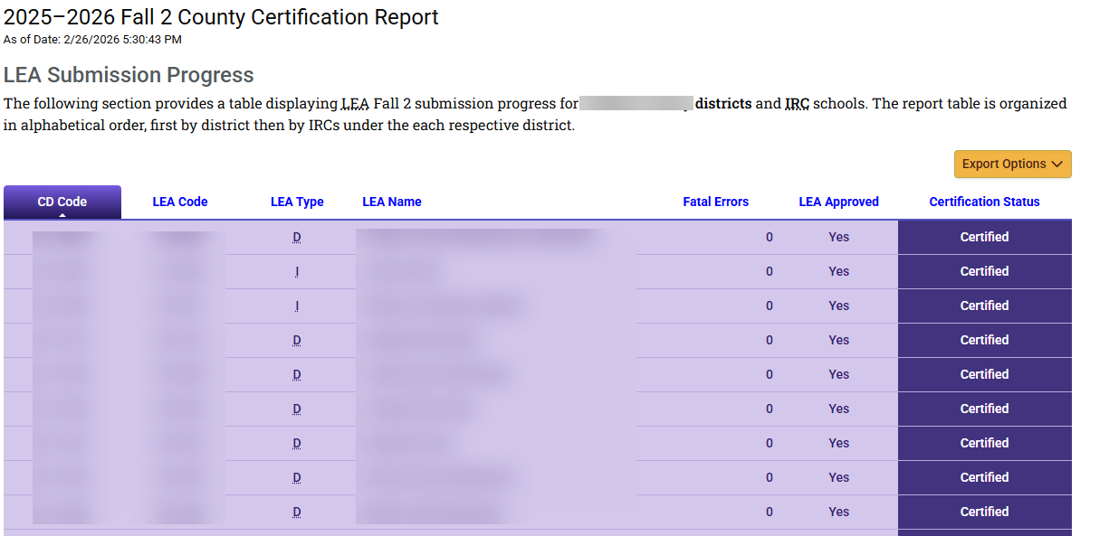
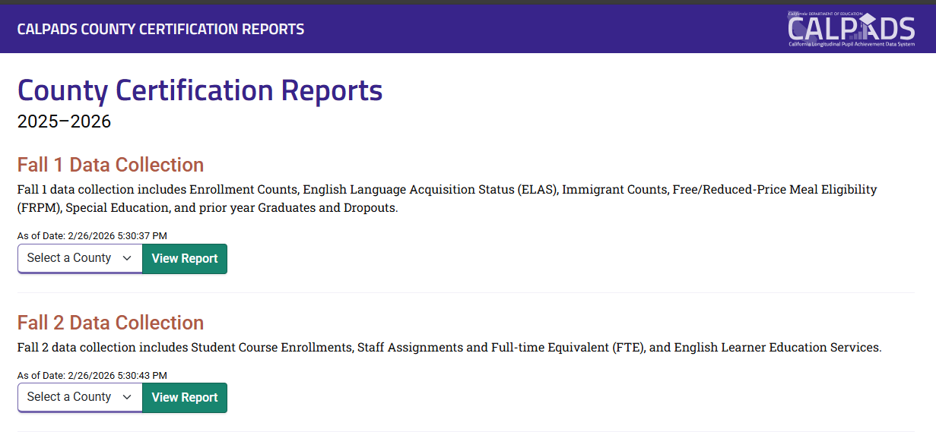
County Certification Reports (2)
Public access:
https://ccr.calpads.org

Slide 51
County Certification Reports (3)
End-of-Year (EOY) certification moving from EOY 1-4 to EOY 1-2
EOY County Certification Report layout will be updated to include new columns for LEA and SELPA Approved:

Slide 52
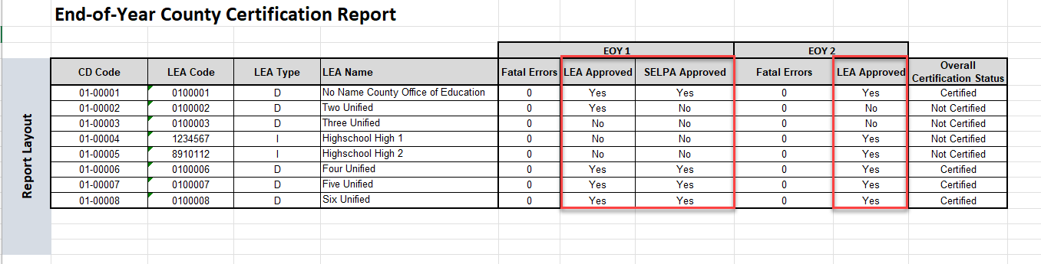
County Certification Reports (3)
End-of-Year (EOY) certification moving from EOY 1-4 to EOY 1-2
EOY County Certification Report layout will be updated to include new columns for LEA and SELPA Approved:
Notes:
Rima
Since End-of-Year (EOY) certification is moving from EOY 1-4 to EOY 1-2, the County Certification Report (CCR) layout for EOY will need to be updated, which will include new LEA and SELPA Approved columns for each submission. Prior AYs only included Fatal Errors and Overall Certification Status.

Slide 53
Looking Ahead

Slide 54
New Course Codes for 2026-27
Additional information is forthcoming and will be provided in the May Regionals
New AP Courses (3)
Note: these are not CTE Courses
Ensure to review the Code Set for CTE Courses and CFS for AP/IB Course Attributes
New Personal Finance Course Code
Graduation requirement for the 2030-31 AY

Slide 55
CALPADS Support Updates

Slide 56

Differentiated Assistance (DA)
25-26
Final CALPADS Deadlines
26-27
Data Quality Criteria
“Any district that fails to submit data according to the processes and timelines as specified in EC 60900(f) and established by the CDE.” –SB114
“This includes submitting and certifying accurate, correct, and complete data by each certification deadline.” –SB114

Slide 57


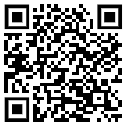
Data Governance Academy
Session 1: Data Governance for LEA Executives
October 2025
Virtual Check-In: Case Study and Project Progress
February 2026
Session 2:Operationalizing Data Governance at Scale
April 2026
In-Person and Watch Party Registration Available
https://csis.fcmat.org/data-management/csis-data-governance-academy

Slide 58

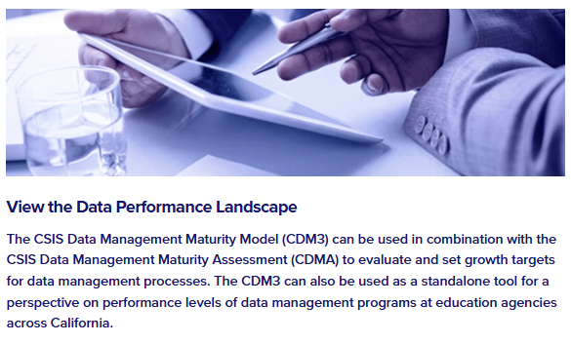
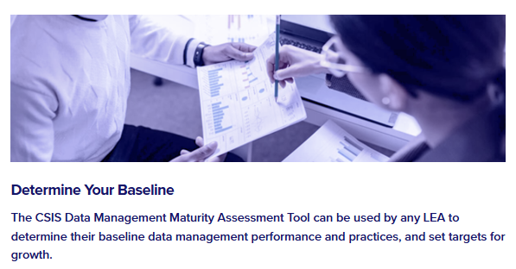

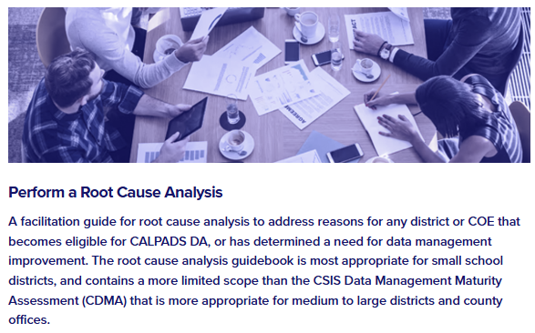
Universal Supports Toolkit
Data Management
Maturity Model
Data Management Assessment
Root Cause Analysis Guidebook

Slide 59

Support Tips and Resources

Slide 60

Live Demo
New Username
Report Mapping Guides

Slide 61




Resources and Training
https://csis.fcmat.org/csis-training
https://www.youtube.com/channel/UCA9oRTiyVECCCzOxpmJheZw
https://documentation.calpads.org/Support/References
https://www.cde.ca.gov/ds/sp/cl/systemdocs.asp
https://csis.fcmat.org/resources
CALPADS Regional Update March 2026

Slide 62





Support
http://www2.cde.ca.gov/calpadshelp/default.aspx
Web
calpads-support@cde.ca.gov
Email
916-325-9210
Phone
https://csis.fcmat.org/ListServ
https://www.cde.ca.gov/ds/sp/cl/listservs.asp
You can get help through these channels
Listserv
CALPADS Regional Update March 2026

Slide 63
Wrap Up

Slide 64

Next Meeting
May 5-6, 2026
(Tuesday and Wednesday)
Focus: Changes for the 2026-27 school year
This information will be well communicated and posted once the registration links are available.

Slide 65

Additional Questions

Slide 66

Thank you for your work!

