Slide 1



FILE
SUBMISSION
Redesign Training
Overview of System Upgrade/Workflow Changes

Slide 2

Target Audience
All CALPADS Users that submit data in CALPADS
Notes:
We expect any user that uploads files to CALPADS attend this session.

Slide 3
Training Sequence
CALPADS Intro
Data Coordinator Orientation
CALPADS
CALPADS Basics
Fall-1 Data Population (Student Profile)
Fall-2 Data Population
EOY 1-4 Data Population
Data Privacy
LEA Admin Data Privacy
SELPA Data Privacy
Data Collections
Fall 1
Reporting and Certification
Advanced
Fall 2
Reporting and Certification
Advanced
EOY
EOY Advanced
Advanced
Guide to CALPADS Documentation
Guide to Troubleshooting CALPADS Errors
EOY 1-4 Reporting and Certification
File Submission Workflow Change
Notes:
This slide shows the CALPADS course catalog.

Slide 4




Objective
Identify
Prepare
Coordinate
Be Successful
the changes for File Submissions
for system changes and local readiness
with other staff to ensure everyone is aware of changes
Uploading files and resolving data discrepancies
Notes:
At the end of this session, with the information provided, LEAs should be able to:
Identify the the changes in the File Submission workflow
Prepare for the system changes and share the information with your data team
Coordinate with other staff to ensure everyone is aware of changes
Change local practices to adapt to system change

Slide 5





Agenda
Workflow Changes
File Submission Features
Summary of Changes - Other System Functionality
Wrap-Up
Notes:
Here is the agenda for this training.

Slide 6


CALPADS Background
Academic Year: 2021-2022
Academic Year: 2009-2010
1392 LEAs
1 data collection
3 File types
1 external connection
2 Methods of input
1980 LEAs
6 data collections
21 File types
4 external connections
3 Methods of input
Notes:
The file processing system in CALPADS was designed in 2008 to support four periodic data submissions, totaling eight files. Since then, the number of LEAs and IRCs has increased from 1,392 to 1,980, the number of files being submitted has grown from eight to twenty, and the frequency of submissions has shifted from a periodic collection to ongoing data maintenance. The CALPADS demand for internal support and external connection has increased to support English Language Proficiency (ELPAC), California Assessment of Student Progress (CAASPP), and focused monitoring of special education programs required by Individuals with Disabilities Education Improvement Act of 2004 (IDEA).*
https://www.cde.ca.gov/sp/se/ds/leadatarpts.asp
The initial processing system was designed to queue files one at a time, locking database tables in order to validate the data. This method restricts system resources and has cascading effects on the overall system. The increased number of files coup[led with increased frequency of submissions has made this method inefficient leading to poor performance, inconsistencies, increased wait times, failed system functions.

Slide 7

Motivations for redesigning the system…
System is slow with unacceptable wait times for:
  File validation warnings and errors
  File posting
  File Uploads dependent on a sequence
Sequential Input Validations slows LEA response
Certification validations dependent on snapshots running
Workarounds causing LEAs unnecessary burden
  Working on weekends/nights
  Using Online Maintenance to resolve errors/warnings one record at a time

Slide 8

CALPADS Enhancements
The system has been modified for the:
  File Submission process to:
    Execute minimal validations
    Post automatically (no Partial post)
  SSID Request to automatically issue New SSID if SSID field is blank
    Utilize MID detection to obtain correct SSID
    Anomaly Detection to have a new schedule & process
  Get data in faster and check quality once in ODS
    System to display data discrepancy results upon each Post (remaining file validations and certification validations)

Slide 9

File Submission Redesign Features
File Submission
SSID Request
MID Anomaly Resolution
Online Maintenance
Data Discrepancies
Notes:
Let's start with the overview of redesign workflow and look at what is changing and what is remaining the same.

Slide 10












Legacy Workflow
File Submission
File Submission
Errors and Warnings
ODS Reports
Submission Snapshot Revisions
Validations (Passed/Rejected)
Partial/Post to ODS
Certification Validations
Staging
Certification
SSID Matching
Nightly Anomaly Detection
SSID Extract
MIDs, CCEs, ERDs

Slide 11











Redesign Workflow
File Submission
(Batch File or
Online Maintenance)
CALPADS Portal
File Rejected
(Review Submission Errors, then resubmit file)
SSID Extract
File Input Validations (File Passes)
Reports & Extracts
Submission Revisions
Data Discrepancies
Certification
Auto Generated
New SSIDs
from records in file
Auto Post to Data Store
Certification Validations
Realtime Anomaly Detection
MIDs, CCEs, ERDs
Anomaly Reports
Anomaly Resolution
(OM or Batch File)
Notes:
Let's start with the redesigned workflow that begins with a batch submission or edit within online maintenance. The icons in red are key areas where enhancements have been made to the system.
Online maintenance now runs the same process a file would. Your records now follow the same data flow whether they are submitted in batch or through OM.

Slide 12

What does this mean for LEAs
Local file submission for Special Education Data System (SEDS) will continue to use API process
File submissions to CALPADS will either Post all records or Fail entire file
  LEAs will need to review Data Discrepancy reports for additional errors
SIS Vendors could implement local file validations to reduce file failures
Collaboration/Integration between SIS and LEAs will be CRITICAL
SSID Process requires changes in local practices to ensure SSID integrity

Slide 13


Multiple files can be uploaded regardless of file order/sort
Entire file rejected with one or more initial errors
Retired and existing SSIDs in file are replaced at file upload.
Files with all passed records will automatically post
Archive file functionality removed
No more Partial Post (all or nothing)
Additional errors are produced after data has been posted and must be checked and addressed if necessary, after post is complete
File Submission
Notes:
Hello, In this training video, we will do a demo of the file submission functionality and what has changed as a result of the file submission redesign release. At this time please pause the video for a few minutes and read through the summary of changes on this screen. We will cover these in more detail in the midst of the live demo.

Slide 14
New CALPADS Submission Process
CALPADS
Data extracted from local SIS
Local Student Information System
Upload files (Pass or Fail)
Uploaded files processed using Input Validation Rules and compared to CALPADS data
File with Fatal Errors = ENTIRE file is rejected.
Error messages available for LEA user in View Submissions.
File without fatal errors - AUTOMATICALLY Posted
Operational Data Store (ODS)
Resolve ALL Fatal Certification Errors
Data Discrepancies are run after data are posted
Certification Reports
State Reporting Snapshots
Report Review and
2-Level Approvals

Slide 15
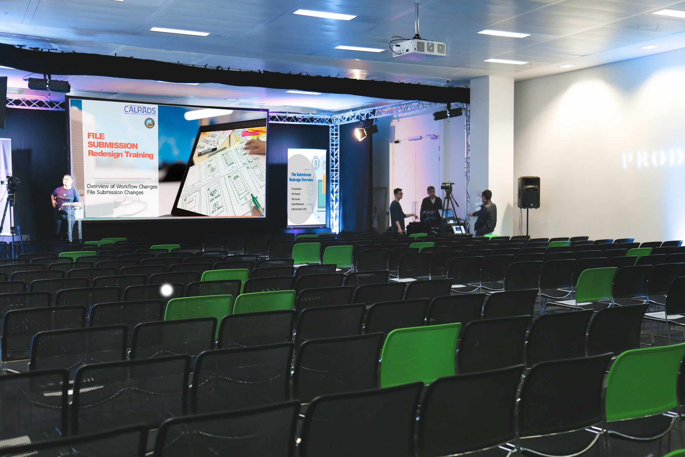

LIVE DEMO - File Submission
Demonstrate how to submit a batch file

Slide 16
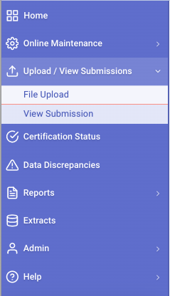

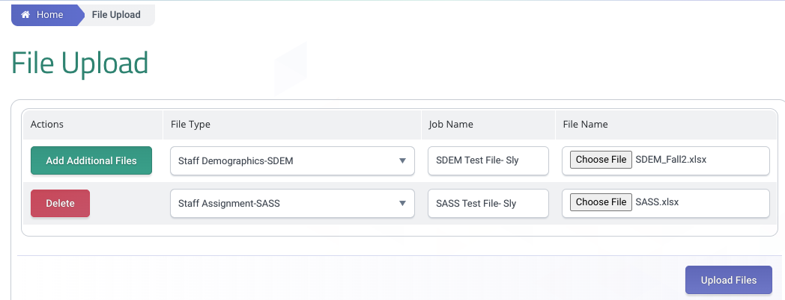
Batch File upload
To Submit a batch file, go to Upload / View Submissions, File Upload.
1
4
Click Choose file to locate file to upload.
2
3
Select the File type from the list that you wish to upload.
Enter Job Name (optional)
5
Click Upload Files to complete upload.
Notes:
To upload a batch file:
Click on the Upload/View Submission link from the Left Navigation menu to expand the menu and click on File Upload.
Choose the appropriate file type that matches your extract. For enrollment choose SSID Enrollment- SENR.
We give this file a Job Name so we can browse for it later.
4. Click the Choose file button and select a file from a location saved on your computer.

Slide 17
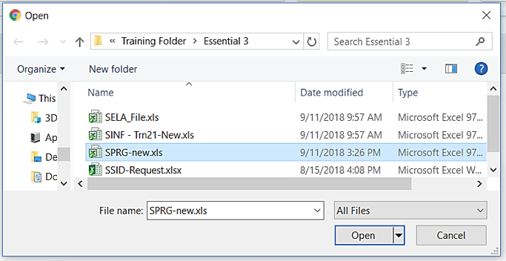
Batch Student Enrollment
Click on Browse
Select the Batch file from the list of files on the computer
Click Open
Click Upload Files
Notes:
Click the Choose file button and select a file from a location saved on your computer. Once selected, click open in the dialog box and then submit in CALPADS to initiate the upload process.
Click on Browse
Select the Batch file from the list of files on the computer
Click Open
Click Upload Files

Slide 18
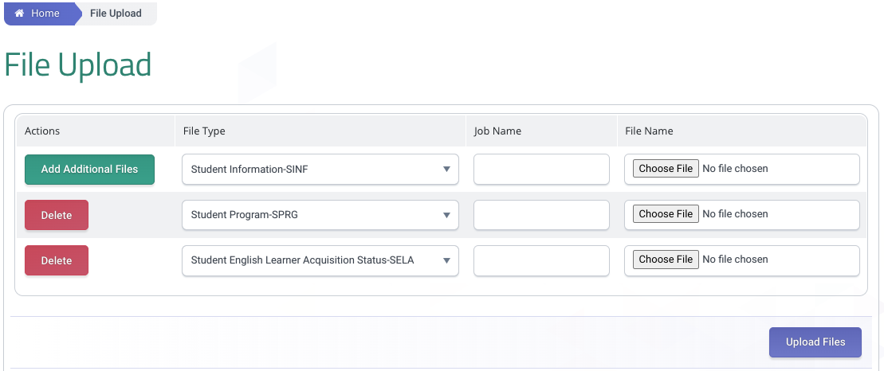
Additional Files
NOTE: Once the SENR file upload is complete and LEAs gain ownership of the student, users can upload multiple files (SINF, SPRG, SELA) all at once.
Notes:
Generating and uploading the Student Information(SINF), Student Program(SPRG), and SELA files from your Local SIS for upload into CALPADS is similar in process to uploading the SENR file. However, LEAs need to wait until the SENR file shows a status of Posted to submit the next files.
To submit:
Go to Upload/ View Submissions and click on File Upload.
Select the file type/s to upload. LEAs now have the ability to select multiple files of different types and upload it all at the same time.
Once the files are selected, enter a job name and locate the file from your local system
Click on the Upload Files button to submit the files.
It important to select the correct file type otherwise CALPADS will not accept the file upload. To upload a Student Information file select the file type for upload. Enter the Job name and select the file. Then submit the file to CALPADS. Once passing the first set of validations the file will go to the In Queue status.

Slide 19
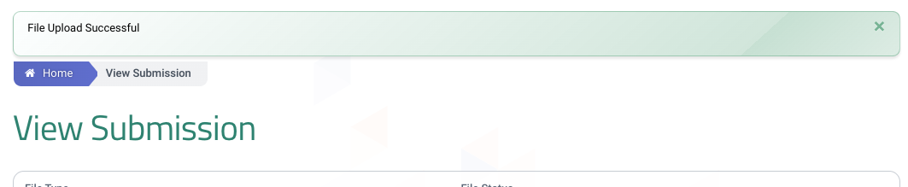
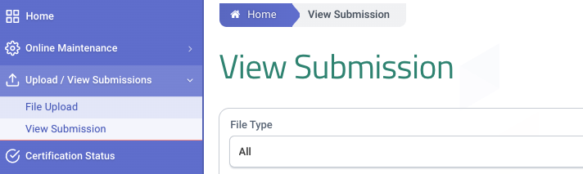
View Submission
After an upload, the system takes the user to the View Submission status page and displays a successful file upload message.
The View Submission page can also be accessed from Upload/View Submission – View Submission menu.
Notes:
After an upload, the system displays a successful file upload message and takes the user to the View Submission status page.

Slide 20
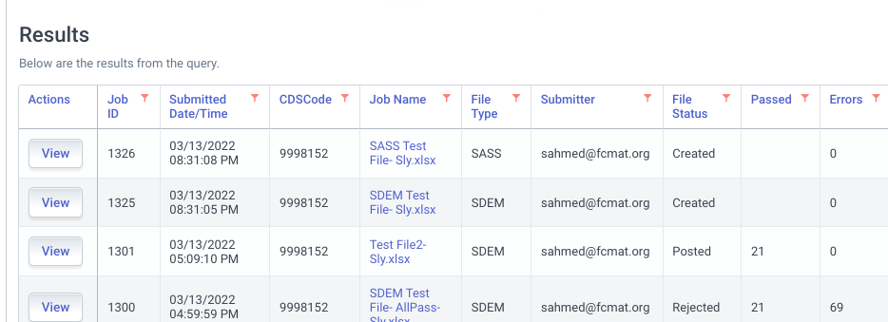
Batch Results
As the file goes through different stages during the submission process the status updates to indicate what user interaction is required.
The View or the Job name link button will allow users to see the details of the file. Note – Only rejected files need to have the details reviewed.

Slide 21
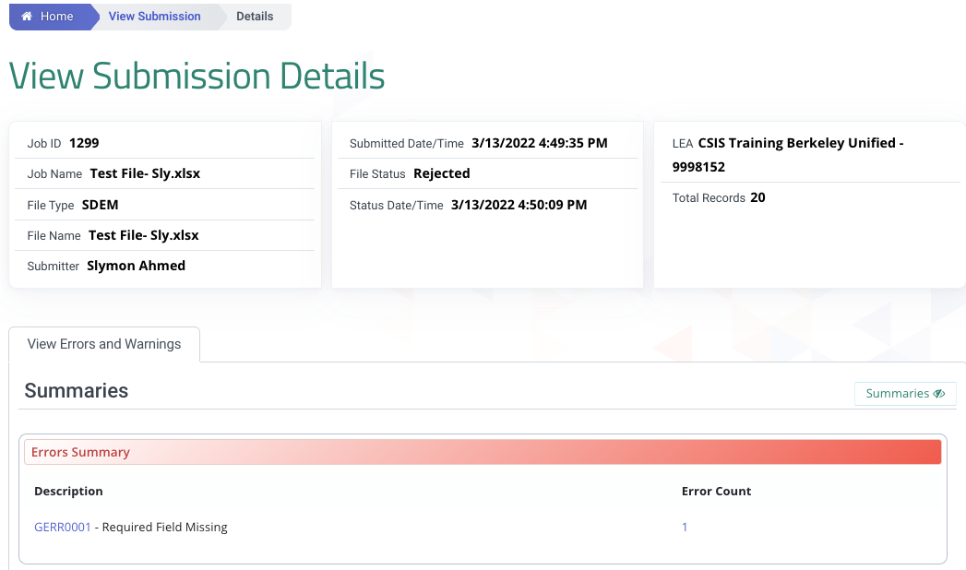
Submission Details
Only rejected records with errors can be examined in greater detail in the “View Errors and Warnings” tab.
Note - The passed records tab no longer exists.
Rejected record(s) will fail the entire file. User needs to review the error(s), fix, then resubmit the file.

Slide 22
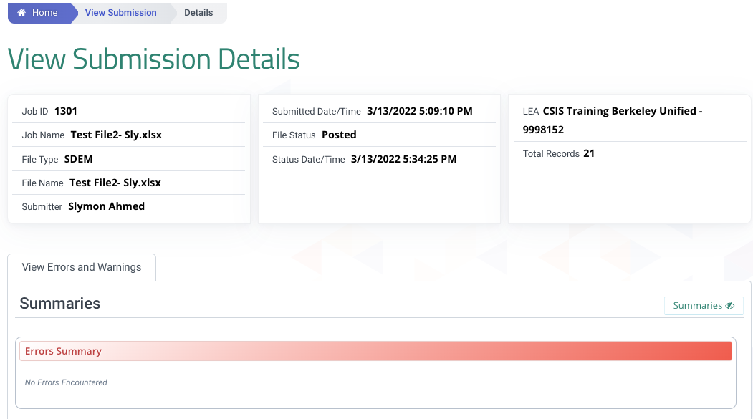
Submission Details
The passed records are automatically posted to CALPADS. There isn’t any additional information to review or action to take.
Notes:
On the View Submission Details screen, users will expect to see a summary information of the file and the View Errors and Warnings page below it. Total records, Passed records and Rejected records are displayed as well.

Slide 23
File submission statuses
Status | Definition
File Upload
Created | File upload was successful, validations have not run on the data yet.
Failed | File upload was not successful, the system did not receive the file. The user needs to reformat the file or reach out to customer service for assistance.
File Input Validations
Staging | File is in staging database and is processing.
Staged | File has been processed in staging database.
Validating | Data is being validated through IVR processes.
Validated | File has been processed; user can review errors.
Posting | Records are posting to database.
Posted | Records are posted - data have passed all input validations and the records are committed to the database.
Standardizing | Converting to batch file.
Standardized | File converted.
Rejected | File uploaded successfully but triggered full rejection when file input validations were executed. The file input validation errors should be resolved before data is resubmitted.
Notes:
These are the various states of submission a file can be in.
READ SLIDE table, dispositions and Descriptions.

Slide 24

Validate Button removed
Post button validates first, then posts
Data is not instantly posted – a batch file is created and is put in the post queue
Go to View Submission Status screen to monitor job
Must delete a record if primary key is changing (delete then add a new record)
Online Maintenance

Slide 25
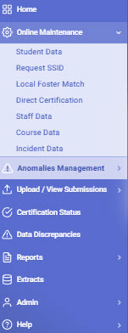
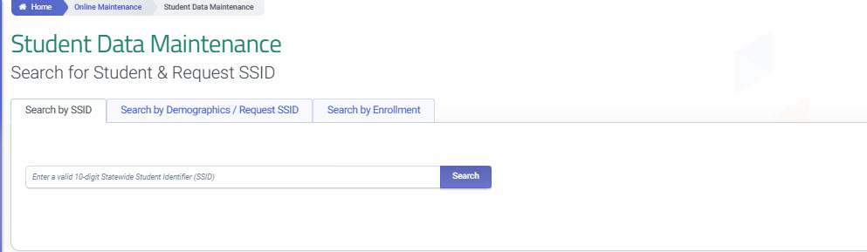
Online Maintenance
1
Select Student Data to access the Student Data Maintenace section.
The Search by SSID, Demographic/Request SSID and Enrollment taps are available
2
Notes:
To access student data online:
Click on the Online Maintenance link from the Left Navigation menu to expand the menu and click on Student Data.
The Search by SSID, Search by Demographics / Request SSID and Search by Enrollment tabs are available

Slide 26
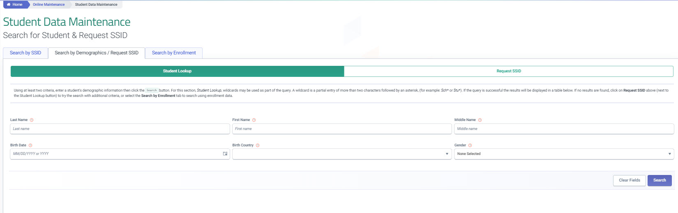
Online Maintenance
Select Search by Demographic / Request SSID
1
2
Select the Student Lookup section
Student search criteria Section
3
4
Click Search
Notes:
To access student data online:
The Search by SSID section has not changed
Choose the Search by Demographics/Request SSID tab
Select the Student Lookup section
Student search criteria section
The Search Button location

Slide 27
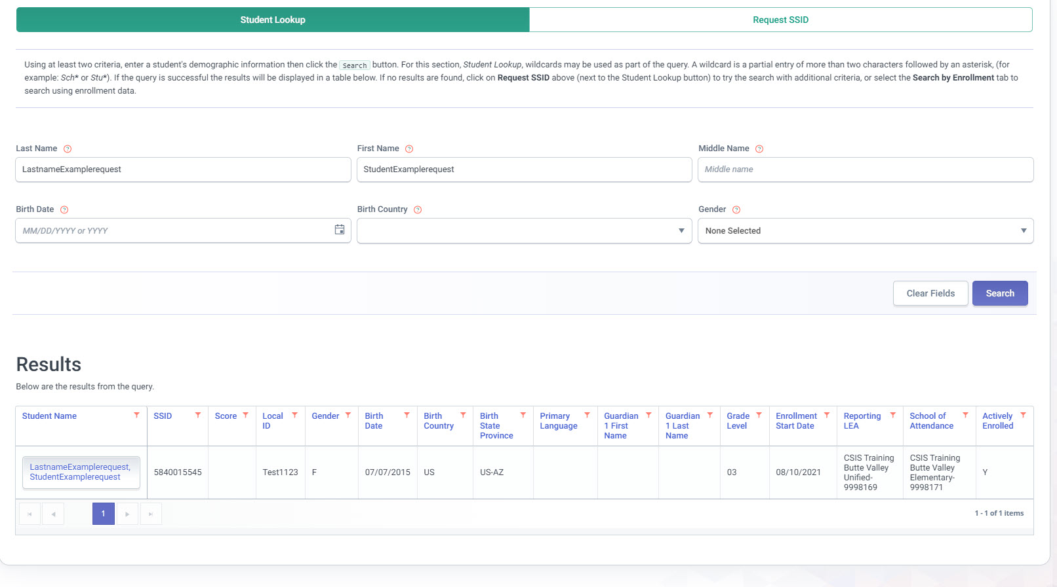
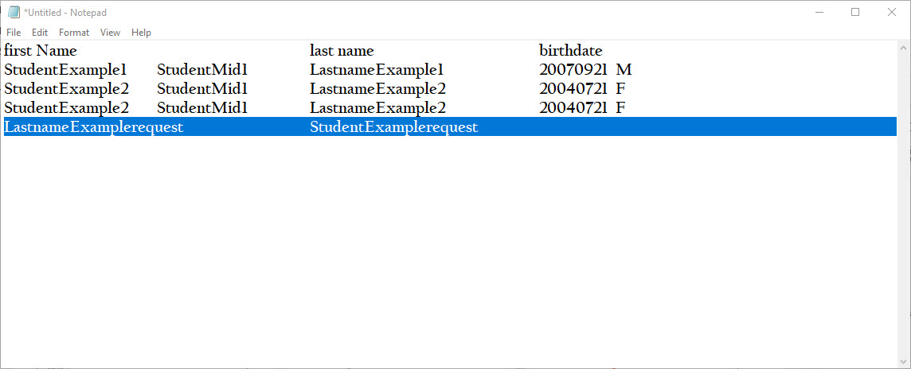
Search by Demographic
Enter available student search criteria
5
Matched results are displayed below in the Results container
6
Click Search
CALPADS does an ODS search for matches to the criteria entered.
Notes:
Click the Choose file button and select a file from a location saved on your computer. Once selected, click open in the dialog box and then submit in CALPADS to initiate the upload process.
Enter available student search criteria
Student last name, first name and birthdate are primary search keys
Wild card * search can be use in combination of first and last name criteria
Click the Search Button
CALPADS Searches the ODS for matching criteria and displays it in the re Results container.

Slide 28
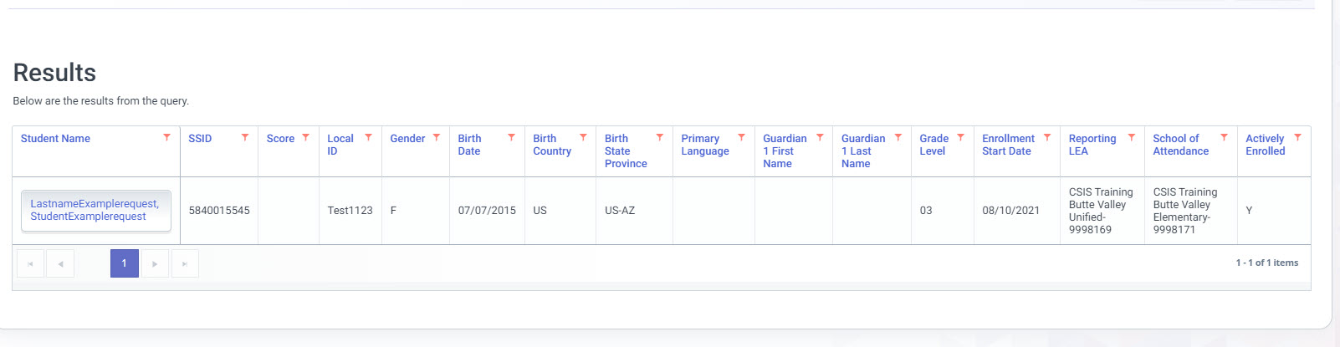
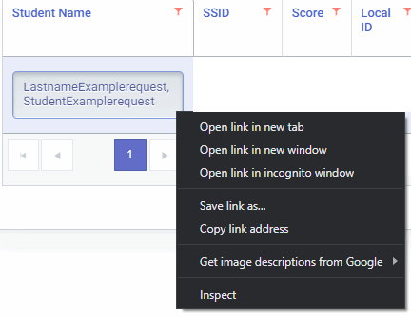
Student Details
7
8
NOTE: Inspect results from the ODS query to determine the match is the student’s record needing an updated.
Notes:
Inspect results from the ODS query to determine the match is the student’s record needing an updated.
To access the student’s detail record:
Right click the Students name
Select open link in new tab

Slide 29
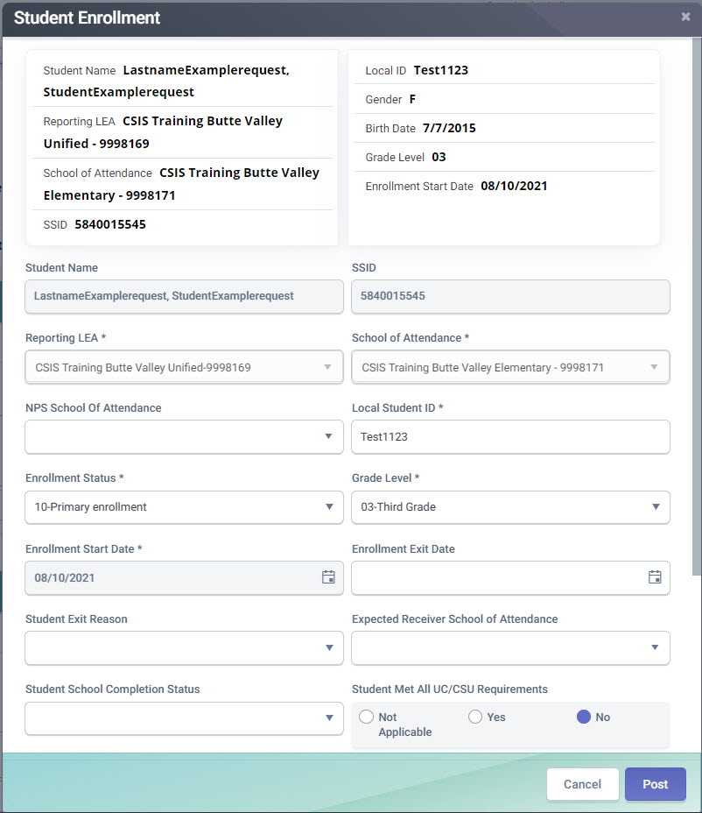
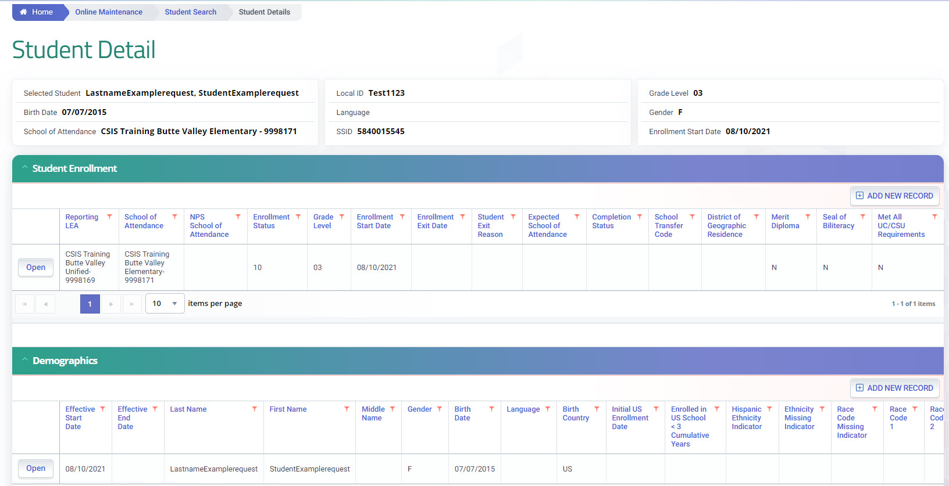

Student Detail Modal Changes
Grayed fields can not be edited.
Data is not instantly posted
9
Must delete the record if primary keys is change (Delete the record then add a new record reflecting the change primary key)
10
Validate Button has been removed
The Post Button validates then submits information to the ODS
11
Data is not instantly posted – a batch file is created and placed in the post queue
Notes:
After accessing the Student Details page things to remember:
Grayed fields can not be edited. Data is not instantly posted.
Must delete the record if primary keys is change (Delete the record then add a new record reflecting the change primary key).
Validate Button has been removed and then Post Button validates then summits information to the ODS
Select the Student Enrollment container.
Select the Open button to activate the modal
Grayed fields can not be edited. Data is not instantly posted
Most delete the record if primary keys is change (Delete the record then add a new record reflecting the change primary key)
Click the Post button
Validate Button has been removed.
The Post Button validates then summits information to the ODS

Slide 30
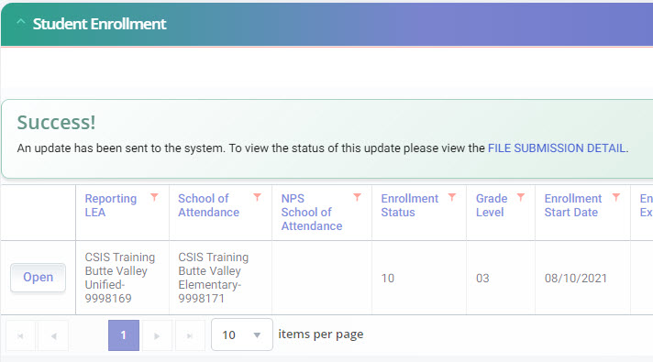

Data Posting Change
Success! Is defined as sent to the posting queue.
12
Clicking the Post button is submitting the record change for validation and placing those changes in the posting queue for status
Notes:
Clicking the Post button is submitting the record change for validation and placing those changes in the posting queue for status and displays a link to the view file submissions detail section.
The record is NOT instantly updated during the posting process.
Select the File Submission Detail link
Refer to slide 23 for the various states of submission a file can be in.

Slide 31
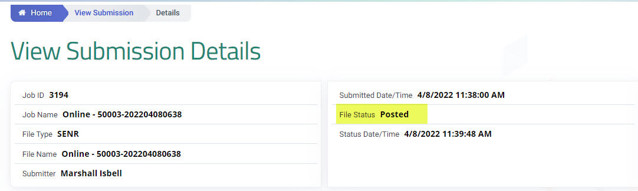
Submission Details
The passed records are automatically posted to CALPADS. There isn’t any additional information to review or action to take.
Notes:
On the View Submission Details screen, users will expect to see a summary information of the file and the View Errors and Warnings page below it. Total records, Passed records and Rejected records are displayed as well.

Slide 32
Submission Details
Only rejected records with errors can be examined in greater detail in the “View Errors and Warnings” tab.
Note - The passed records tab no longer exists.
Rejected record(s) will not post in the Student Detail contain. User needs to review the error(s), fix, then resubmit the file
Notes:
Only rejected records with errors can be examined in greater detail in the “View Errors and Warnings” tab.
Note - The passed records tab no longer exists.
Rejected record(s) will not post in the Student Detail contain. User needs to review the error(s), fix, then resubmit the file.

Slide 33
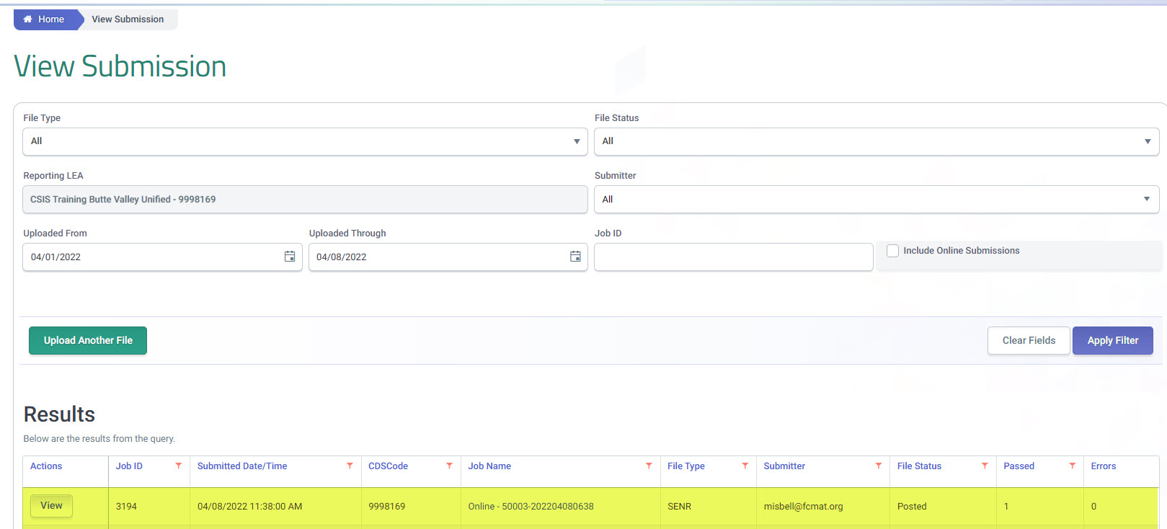
Submission Details
The passed records are automatically posted to CALPADS. There isn’t any additional information to review or action to take.
Notes:
On the View Submission Details screen, users will expect to see a summary information of the file and the View Errors and Warnings page below it. Total records, Passed records and Rejected records are displayed as well.

Slide 34
Enrollment Start Date change
For Start Date delete the record then add a new record reflecting the change
Notes:
The record must be deleted ,if primary keys needs to change:
(Delete the record then add a new record reflecting the changed primary key)
Batch File Templates
The following are the available Batch File Templates. You may click on the specific file type to download the desired template. https://documentation.calpads.org/Support/FileTemplates/
Import data into the record type template
Enter the transaction type D to delete that record from the CALPADS ODS
Step for uploading files to CALPADS
Reference Batch upload starting on slide 16

Slide 35
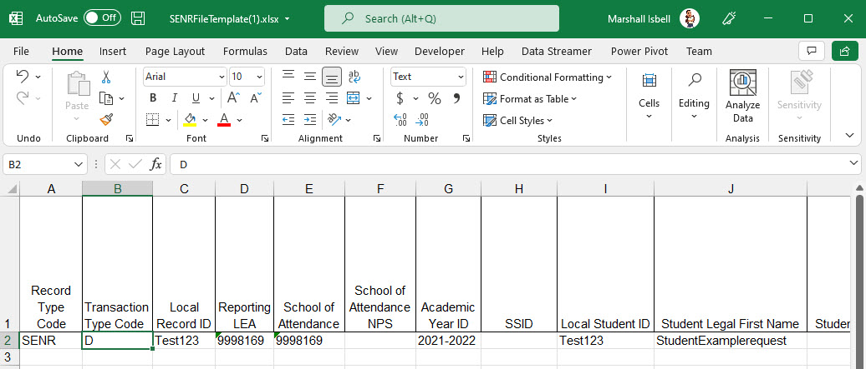
Enrollment Start Date change
Import data into the record type template
Enter the transaction type D to delete that record from the CALPADS ODS
For Start Date delete the record then add a new record reflecting the change
Step for uploading files to CALPADS
Reference the Batch upload section
Notes:
The record must be deleted ,if primary keys needs to change:
(Delete the record then add a new record reflecting the changed primary key)
Batch File Templates
The following are the available Batch File Templates. You may click on the specific file type to download the desired template. https://documentation.calpads.org/Support/FileTemplates/
Import data into the record type template
Enter the transaction type D to delete that record from the CALPADS ODS
Step for uploading files to CALPADS
Reference Batch upload starting on slide 16

Slide 36

SSIDs are auto assigned in batch if the SSID field is blank in the SENR batch file.
SENR file auto-posts if error-free
Manual selection of potential matches removed
Suggestion for ease of review:
  Resolve MIDs before requesting (TBD) results file
  Use small batch files so MIDs can be resolved the same day
SSID Assignment
Notes:
It is important to resolve MIDs the same day , before nightly processing sends the data to TOMS, Direct Certification, or Foster matching.

Slide 37

SSID
Assignment
Post Process Redevelopment
Walkthrough Demonstration
Notes:
CALPADS SSID Assignment Post Process Redevelopment Walk Through. We will show you the steps recommended in described in flash message # 221 and demonstrate the functionality changes.

Slide 38
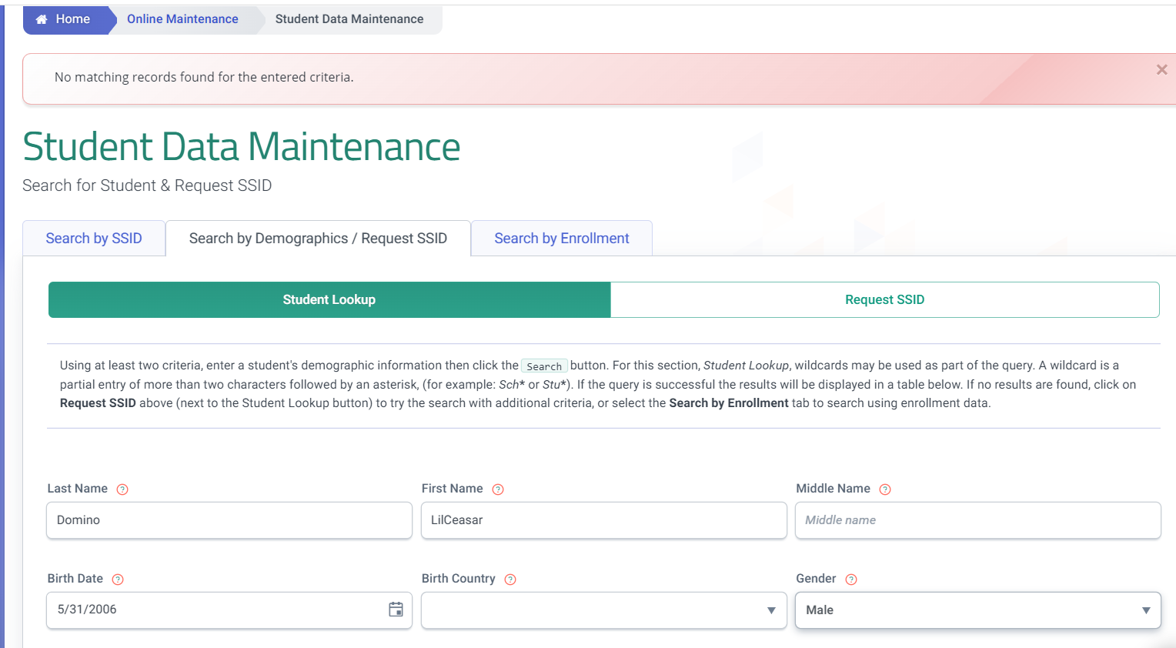
Search for Student
Notes:
The Post Process Redesign changed the Statewide Student Identifier (SSID) assignment process to exclude the comparison of demographic data. It is expected that the elimination of this functionality may result in an increase of MID anomalies, It may be necessary for LEAs to change local business processes that can mitigate the creation of MIDs. Depending on the volume of transfers it is advisable for LEAs to perform a student search in CALPADS Online Maintenance based on demographic criteria.
For larger districts, LEAs can train school site staff or those who enter student SIS data upon enrollment to do a demographic search CALPADS upon each enrollment. This can be a step added to your local enrollment process like copying required documents, verifying residency and signatures.

Slide 39
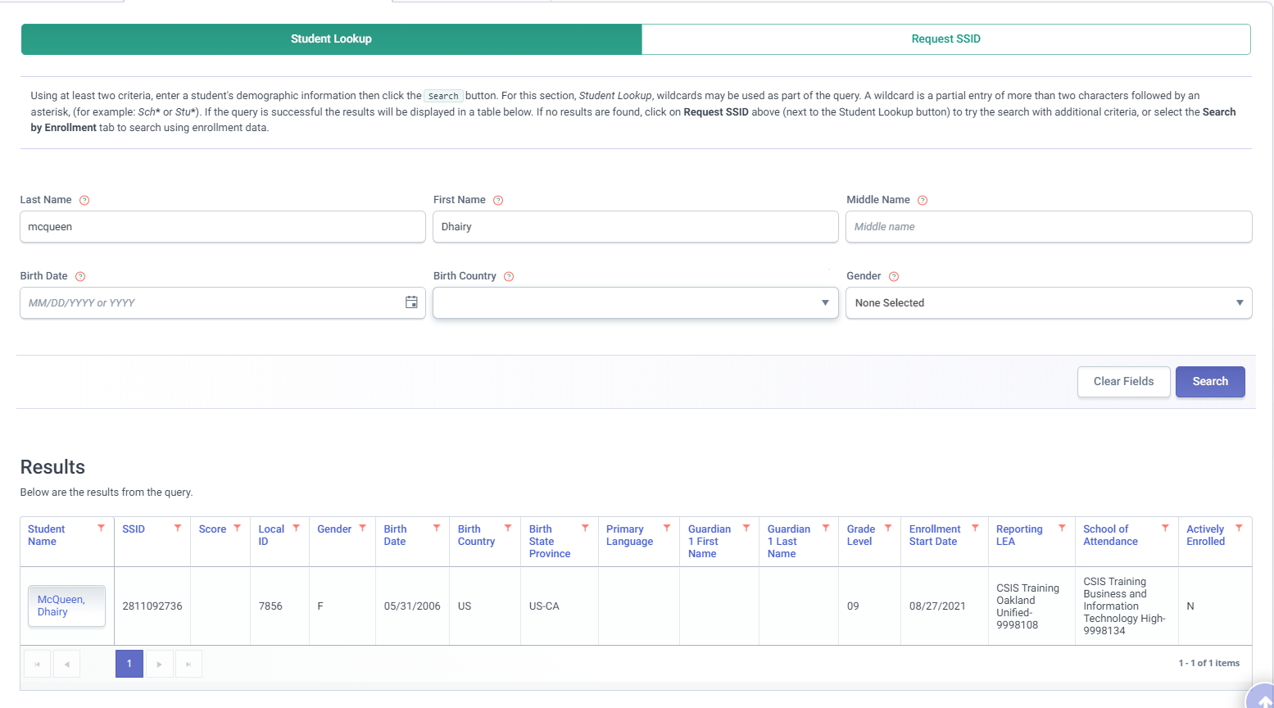
Review Student Search Matches
Post Process Redevelopment
Post Process Redevelopment
Notes:
If an existing SSID is found, manually update the SSID in the Student Information System (SIS). Leas can continue to enroll the student using online maintenance or submit a SENR file with the updated SSID to enroll the student.

Slide 40
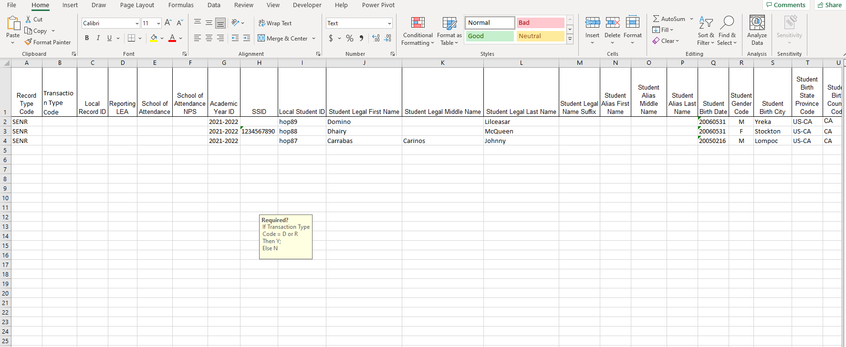
Update SIS with Student Matches
Notes:
Once updated in your SIS, your SENR extract will include the transfer student’s SSID and will be matched to the known student profile in CALPADS eliminating the chance of a MID creation.

Slide 41
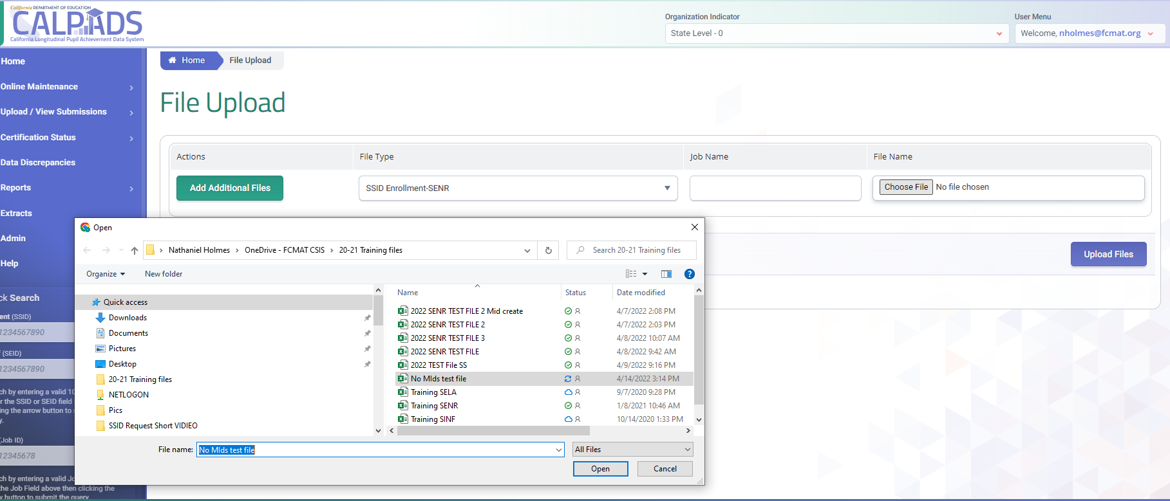
File Upload Remains the Same
Notes:
The upload file functionality remains the same.

Slide 42
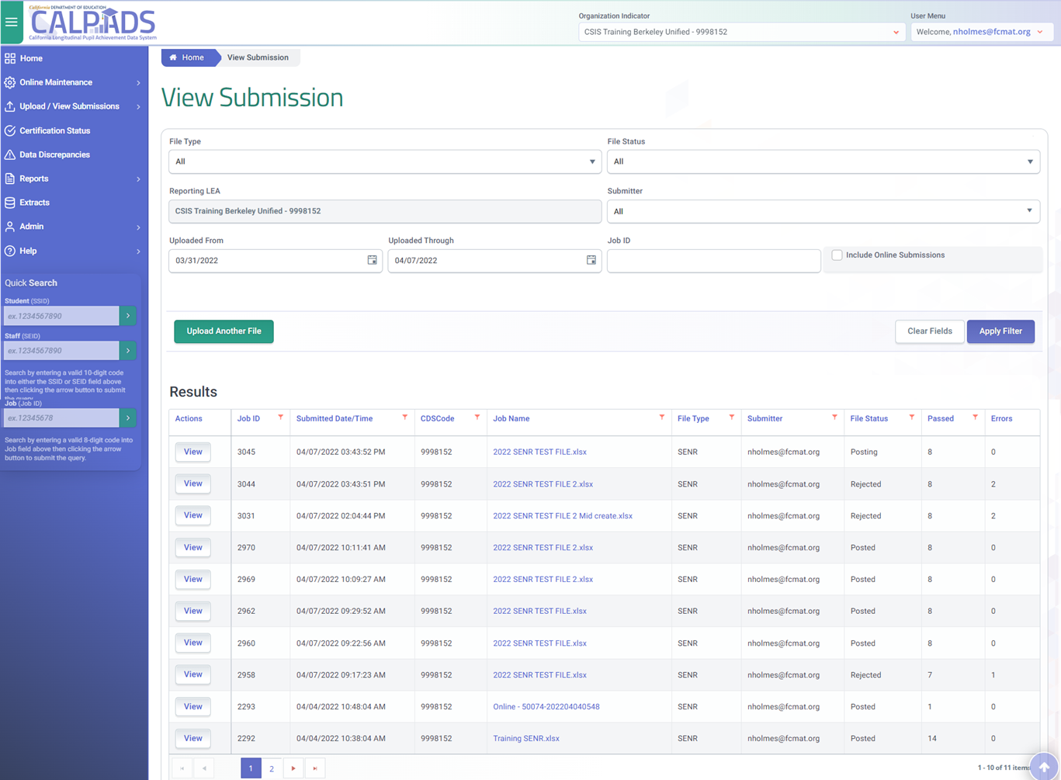
Look for Total Records
Passe
Passed Records are no longer displayed. Look for Total Records and Errors
Notes:
On the View Submission screen, files will automatically post if the total records pass validations. In the future the far left two columns will display the number of total records and the number of errors in the file. Remember if the file generates in a single error upon upload the file fails as a result of the post process redesign.

Slide 43
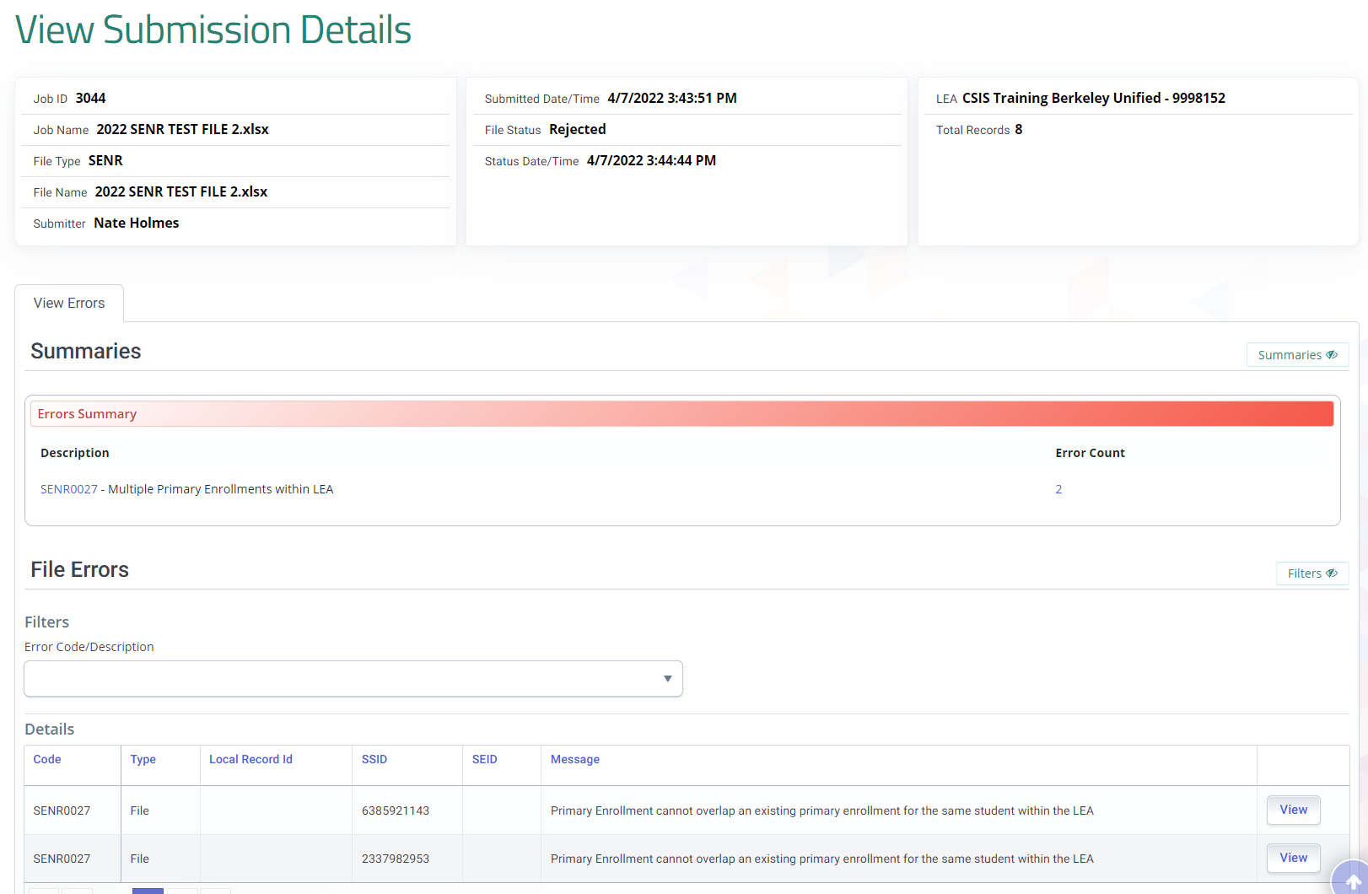
Submission Details
Only errors are visible from the View Submission Details screen
Notes:
The view submission details screen no longer displays passed records. Errors are shown to assist in troubleshooting. However, some functionality has been removed in order to increase performance of the file upload process.

Slide 44
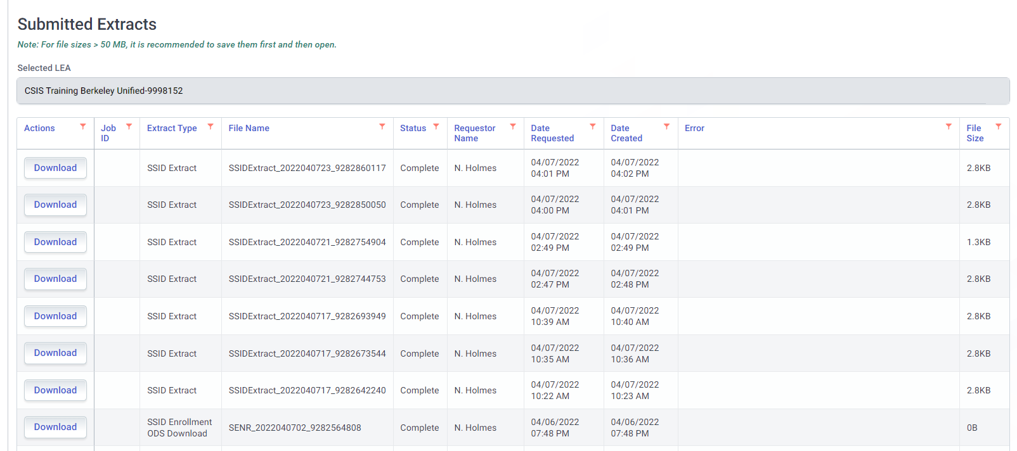
SSID Extracts should be Used to Update the SIS
Notes:
SSID extracts can still be requested and retrieved to update your SIS with the newly acquired SSIDs.

Slide 45
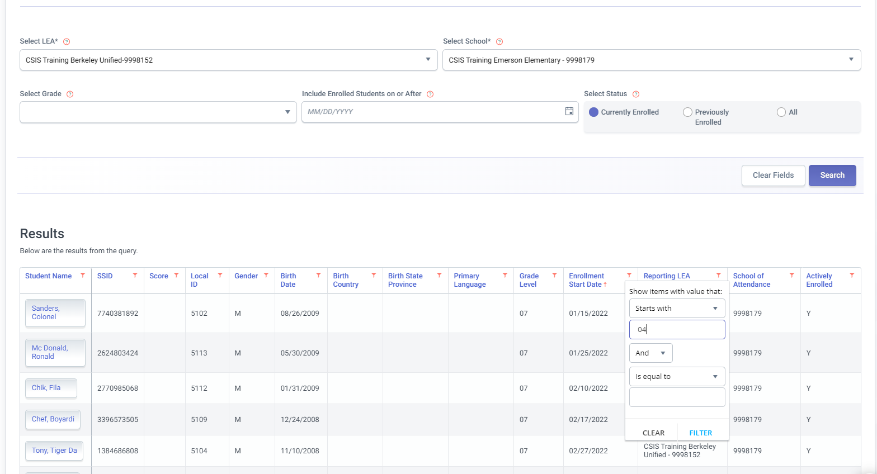
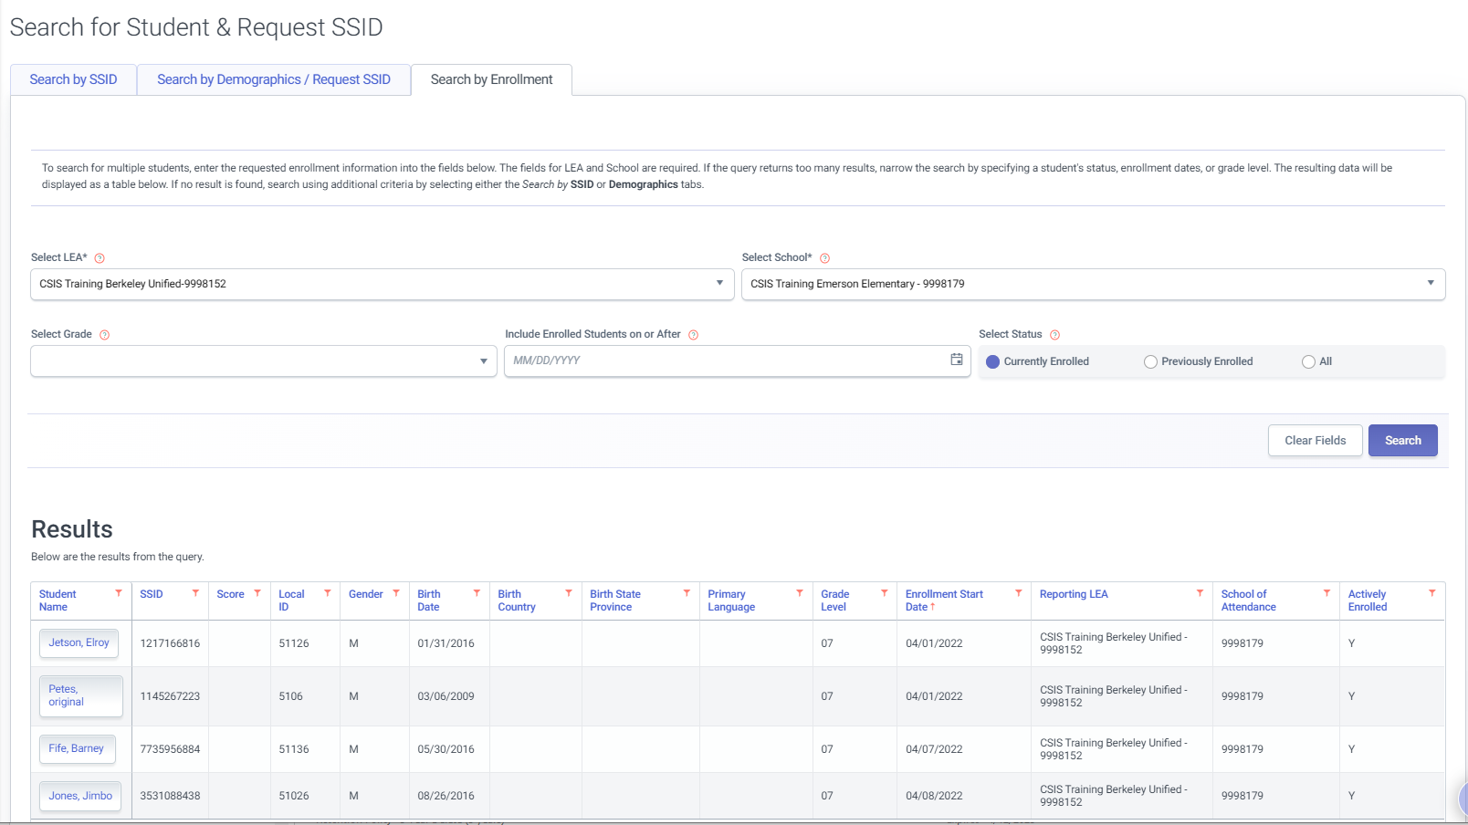
Search by Enrollment for SSID Confirmation
Notes:
An option for viewing recently assigned SSIDS is the search by enrollment functionality in online maintenance. You will have to filter by school, then search. When the search results return click the title of the column Enrollment school start date. This will sort the rows of students by most recent enrollment. These students will be your newly assigned SSIDs.

Slide 46
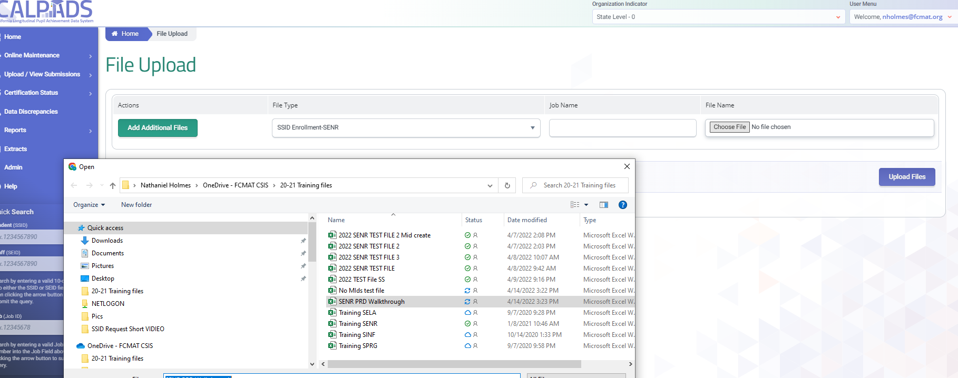
File Upload
Notes:
Regardless of local business practices since there is no manual or probabilistic matching of candidates at this time a review of MIDs should be performed every day. MIDs should be resolved on the same day the SENR is posted in order to avoid MIDs from being sent to TOMs in the nightly feed, and prior to downloading the SSID Extract to import into the SIS. To accommodate the need to resolve MIDs on the same day the SENR is posted, MID processing will occur on an ongoing basis throughout the day, and not just overnight

Slide 47
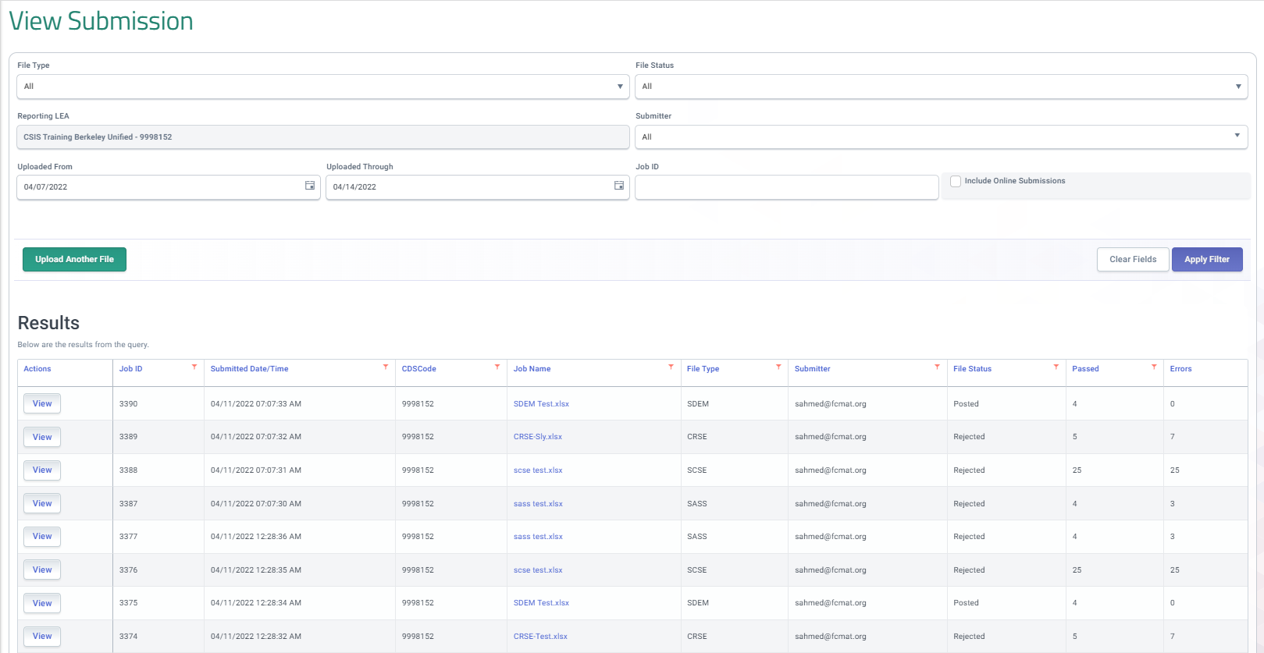
View Submission
Notes:
Once the file has posted, Your next step in the process will be to Resolve MIDs on the same day that the SENR records are posted through MID Resolution. We will look at the files details just to reiterate why this is the next step.

Slide 48
No Candidate Matching
Notes:
Again, we see that there are no passed records nor, did we select potential candidate matches for our students. The records were posted automatically. If you take a moment to think about it, the MID resolution process is the candidate selection process of old. If this step is adopted as part of your Student enrollment business practices in CALPADS you will have the opportunity to select candidates and assign the historical SSID as appropriate.

Slide 49
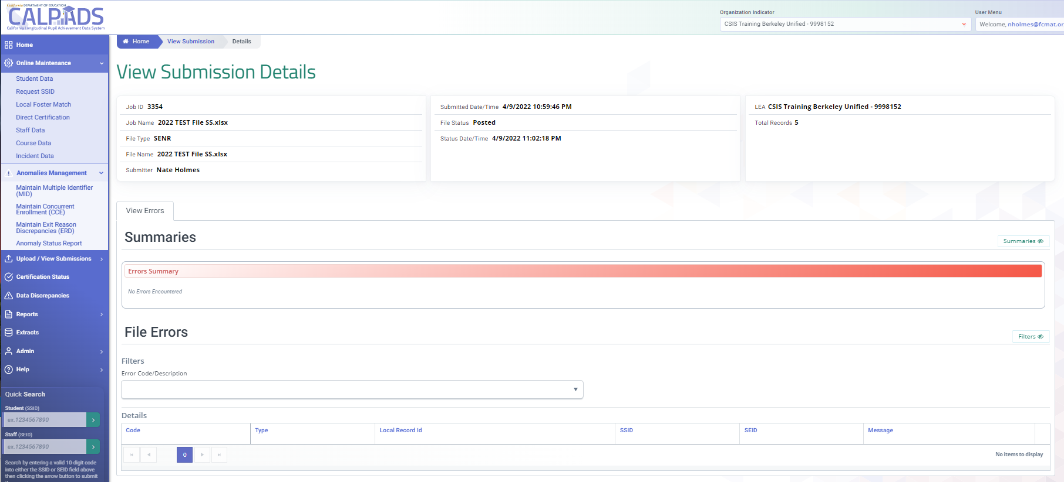
Notes:
Using the left navigation menu go to online maintenance> Anomalies management, then select Maintain Multiple identifier.

Slide 50
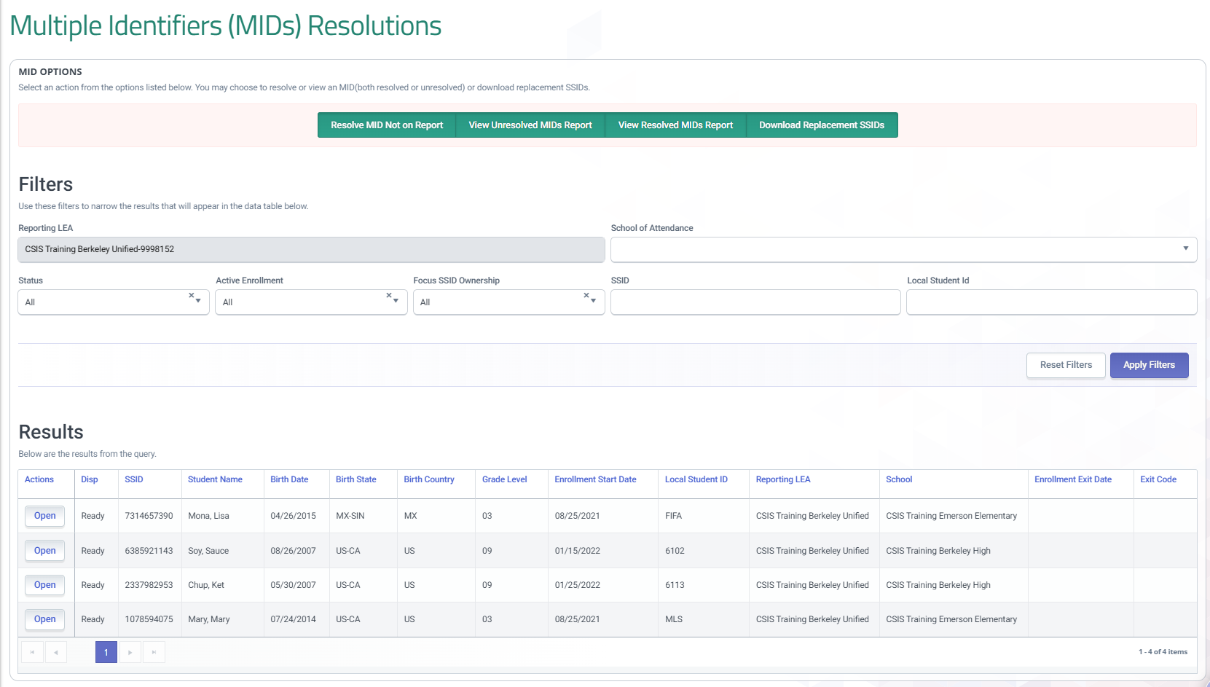
Multiple Identifiers
Notes:
On the MID resolution screen you will find that are now only matched on exact first and last name and date of birth, However in the near future CALPADS will be to include probabilistic matching.

Slide 51

MID anomaly business rules modified
  Matching detection based on exact first and last name (not middle) and date of birth
1st and 2nd Parent/Guardian added to MID UI to assist in MID resolution
MID detection is run every time student data is posted to the ODS
MID resolution is available in the same feature section as the legacy system
MID Anomaly

Slide 52
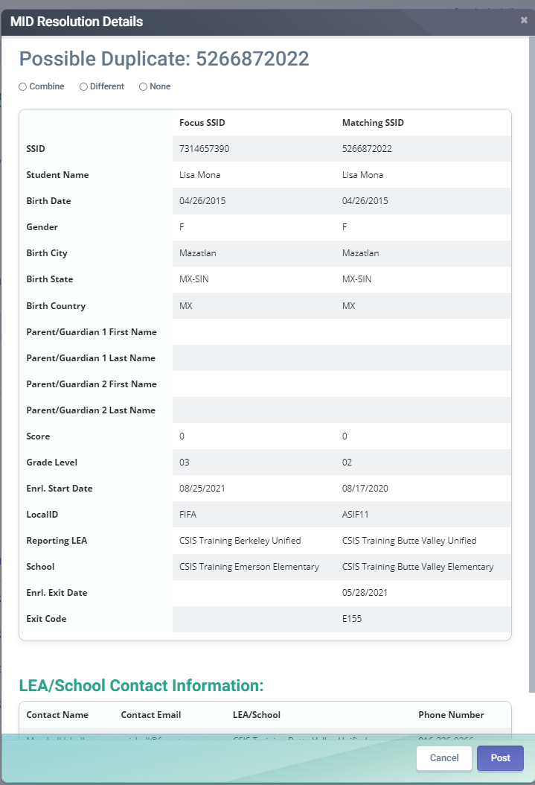
MID Resolution
Notes:
Use confirming demographic information to determine if your MIDs are matches. In particular Parent/Guardian information may help identify the correct student.

Slide 53
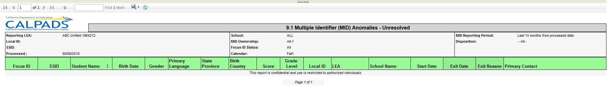
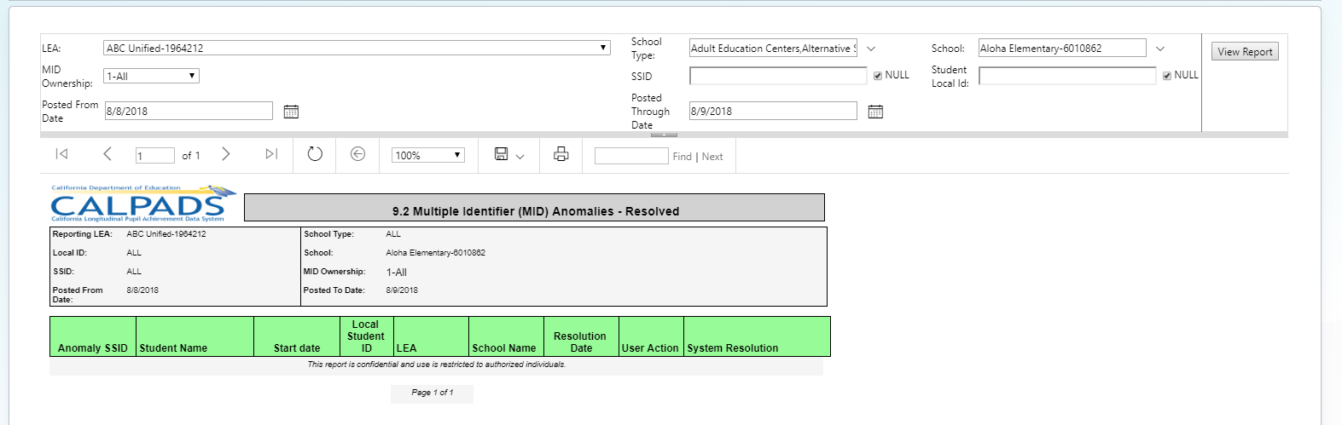
Unresolved MID Report
Notes:
CALPADS Administrators should share MID reports with Testing Coordinators to ensure that students with possible MIDs are not tested until the MIDs are resolved.

Slide 54
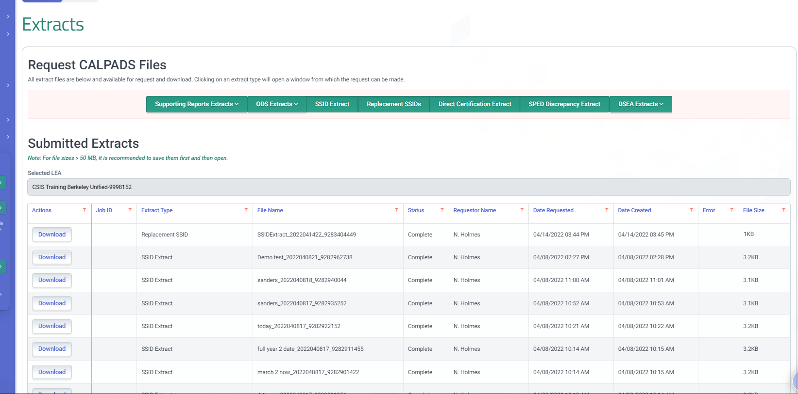
SSID Extract
Notes:
Only once MIDs are resolved, download the SSID Extract to populate the SIS with new or replacement SSIDs that result from resolving MIDs. The SSID Extract is now downloaded by a date range that is based on the active enrollment within the range and not based on job ID. Therefore, the SSID Extract may include SSIDs that already exist in the SIS, You can minimize this by selecting the date prior to your SENR submission and then the end date can be the same day as the submission. CALPADS does not allow the same start and end date for a date range. Again, only update your SIS with a SSID extract only after resolving your MIDs.

Slide 55

Key Points
Any file with even a single error will be rejected completely
Files are auto posted with no view of passed record
The MID resolution process is the SSID candidate selection is how accomplished
MIDs must be resolved prior to requesting an SSID extract
In the near future functionality will be expanded to include:
    Broader matching including probabilistic matching
    Candidate list report

Slide 56

New functionality
Repackaged version of input validation rules (same error numbers, no new validations – think of this as former 'warnings')
Validations are run every time data is posted to the ODS
Intended to inform about data conflicts within LEA and between LEAs
Similar design to View Submissions Status detail screen
New menu selection on the navigation panel
Data Discrepancy

Slide 57

Review Local Practices for Impacts
Avoid sending up blank SSIDs for students who were previously enrolled in another CA public school – perform student search in OM first
Submit SSID request files in smaller batches to resolve MIDS same day
Transitioning to automatic posting of records requires cleaner data
Work with SIS vendors to add more data validations
Reducing Data Discrepancy results necessary to achieve accurate reports
Continue developing local data governance practices for team collaboration
Retrieving SSIDs from CALPADS may require changes
MID anomalies may increase
Data Discrepancies indicate inconsistent data that could impact snapshot aggregates

Slide 58


Wrap Up
Key Points, Resources and Support

Slide 59

Summary
Critical for LEAs and SIS vendors to collaborate to ensure file extracts are validated properly before upload to CALPADS
Entire file rejected with one or more errors
Multiple files can be uploaded regardless of file order/sort
Files with all passed records will auto post
Additional validations/errors are produced downstream and must be checked after post is complete
SSIDs are auto assigned in batch if the SSID field is blank in the SENR batch file.
MID anomaly business rules modified
  Matching detection based on exact first and last name (not middle) and date of birth
Data Discrepancy - new functionality
Some key points to remember

Slide 60





Support
http://www2.cde.ca.gov/calpadshelp/default.aspx
Web
calpads-support@cde.ca.gov
Email
916-325-9210
Phone
http://www.cde.ca.gov/ds/sp/cl/listservs.asp#listservs
You can get help through these channels.
Listserv

Slide 61
Feedback
I have a question…
“
”
Please complete survey…
https://bit.ly/2MXsECg
“
”
Notes:
Please take the time to complete our training survey. Your responses assist in improving our trainings.
We review these surveys on a regular basis—in fact due to LEAs’ suggestions we have changed our survey, have included more visual aids, and demonstrations in our trainings.
If you experience any technical difficulty with accessing the survey, please try the alternative long URL:
Long URL: https://forms.office.com/Pages/ResponsePage.aspx?id=k1b3XxqV6E2E3dWxsESwNX2FYi3dRZNNt8LpvkF_wmhUNVRLOVBDVkoySE01UTJSRk42VTlaUUFIQi4u
Short URL: https://bit.ly/2MXsECg
Thank you for providing us the opportunity to evaluate our trainings.

Slide 62






Thank You
CSIS Training Team
916-325-9200
csistraining@fcmat.org
https://csis.fcmat.org/
https://www.youtube.com/CSISCALPADSTrainingChannel

