Slide 1



Anomaly Detection and Resolution
Concurrent Enrollments
Exit Reason Discrepancies
Multiple Student Identifier

Slide 2
CALPADS Training Sequence
Orientation
Data Coordinator Orientation
Basics
Fall-1 Data Population (Student Profile)
Fall-2 Data Population
EOY 1-4 Data Population
Data Collections
Fall 1
Reporting and Certification
Advanced
Fall 2
Reporting and Certification
Advanced
EOY
EOY 2 & 3 Reporting and Certification
EOY 1 Reporting and Certification
EOY Advanced
Skill Building
Guide to CALPADS Documentation
Guide to Troubleshooting CALPADS Errors
LEA Admin Data Privacy
SELPA Data Privacy
Data Population
User Management
File Submission
Extracts
Reports
Certifications
Anomalies Management
Features & Navigation
Notes:
The CSIS training model is designed to be segmented to provide organization of specific topics and concise delivery. We aim to provide focused trainings with relevant information and instruction. On the left we have the CALPADS Orientation and Basics as well as the Data Population sessions. These sessions are the prerequisite for the rest of the Reporting and certification courses, one of which you are attending today for Fall-1. We also have a couple of Skill Building courses which we are working on making them available to you in the near future.

Slide 3





Objective
Identify
Determine
Demonstrate
Contact
Review
the SSIDs triggering anomalies
what type of anomaly the SSID triggers and how to resolve it
with ease, the steps in resolving the different anomalies
designated LEA contact person when anomaly correction involve other LEA records
and ensure all critical anomalies have been resolved

Slide 4







Agenda
Overview
Anomaly Roles
Concurrent Enrollment
Multiple
Identifier
Exit Reason Discrepancy
Wrap-Up
Brief list of learning topics. This is a 2 hour training.

Slide 5


Overview
Discuss background of SSID Anomalies

Slide 6
Background
What is a SSID Anomaly?
It is a problem involving SSID’s enrollment, exits as well as a student being assigned more than one SSID
Posting of SENR or SINF record trigger the immediate detection of anomalies.
These discrepancies impact an LEA’s certification in the process as well as completion and dropout counts.

Slide 7
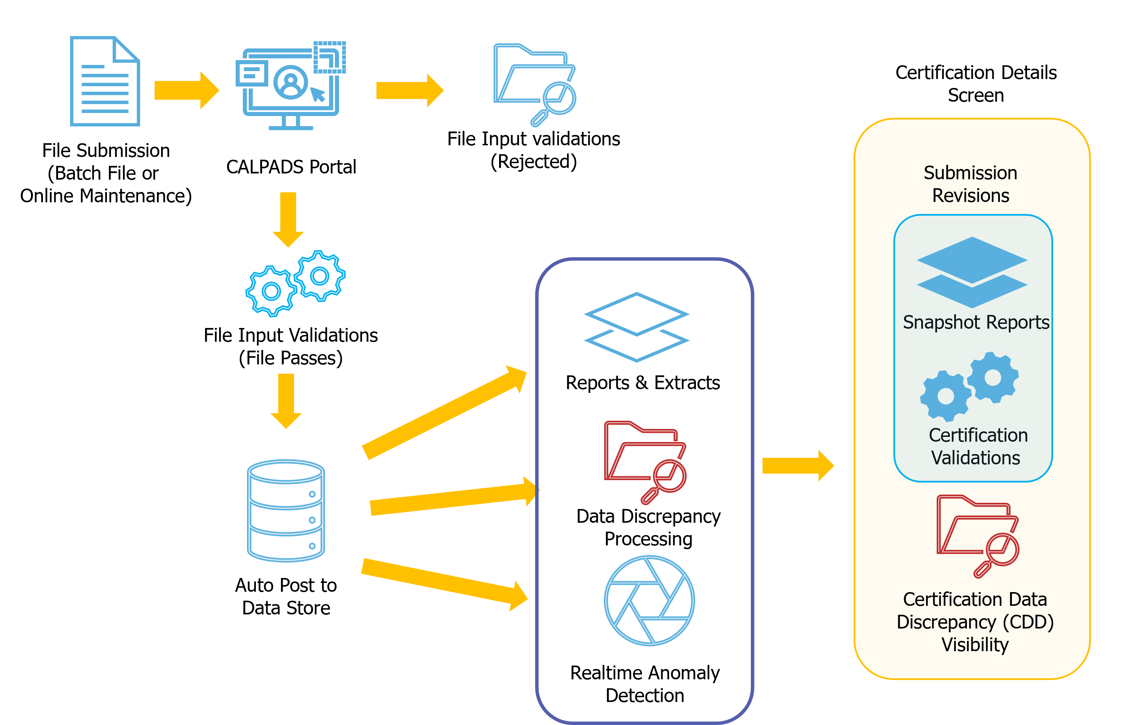




Post- File Submission Work and Certification
SELPA
Review LEA Approved
Or Revised Uncertified Reports
Correct CDDs and any report discrepancies
Review updated reports
and
LEA Approve
SELPA Approval and
Final Certification
Notes:
Real time Anomalies detection occurs after a SENR record is posted in CALPADS. It runs along the same timeline of the Data discrepancy detection.

Slide 8

Why resolve anomalies?
What’s the rush?
Maintain just one SSID for a student for their entire CA enrollment period.
Gain sole ownership of a SSID
- LCFF, TOMS, ELPAC, CAASPP
Properly report completers and dropouts
Maintain zero or below 2% anomaly to certify.

Slide 9



Anomalies Management Survival Kit
User Roles Needed
Documentation
LEA Contact List
Data Resolution*
  Student Search
  SENR (Edit and View)
  Anomaly Contact
  SINF (View)
*Above roles are the bare minimum required to manage anomalies. However, it is advisable to assign all file type Edit and View roles to a user to better facilitate MID clean-up.
Code Sets
SSID Enrollment Procedures
User Manual
Data Guide (Appendix B)
Reporting Data for Students w/ Disabilities
Anomaly Module School Contact
CSIS LEA Contact Lookup Tool
Notes:
Documentation: https://documentation.calpads.org/Support/References/
User Roles: https://documentation.calpads.org/Admin/UserManagement/UserRoles/

Slide 10





The Big Picture
Expected anomalies management workflow of LEAs
Other LEA Involved
Other LEA Involved
Other LEA Involved
Only MID and CCE anomalies are counted towards the Anomaly threshold
Anomaly percentage above 2% will prevent you from certifying Fall 1
2% - 0%
Assign User Roles
Review Anomaly Report
Monitor/ Resolve MIDS
Monitor/ Resolve CCE
Monitor/ Resolve ERD
Check Anomaly Percentage is below 2% and CERT040 cleared
Anomaly Percentage should be below 2%
Notes:
Correct sequence is behind this current image group.

Slide 11
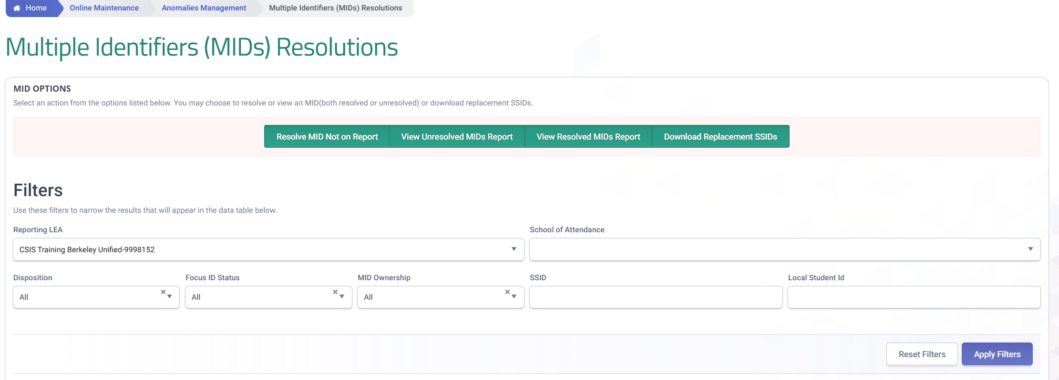
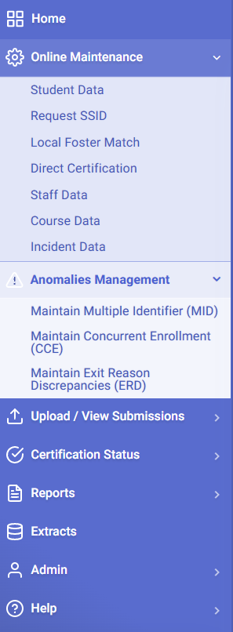
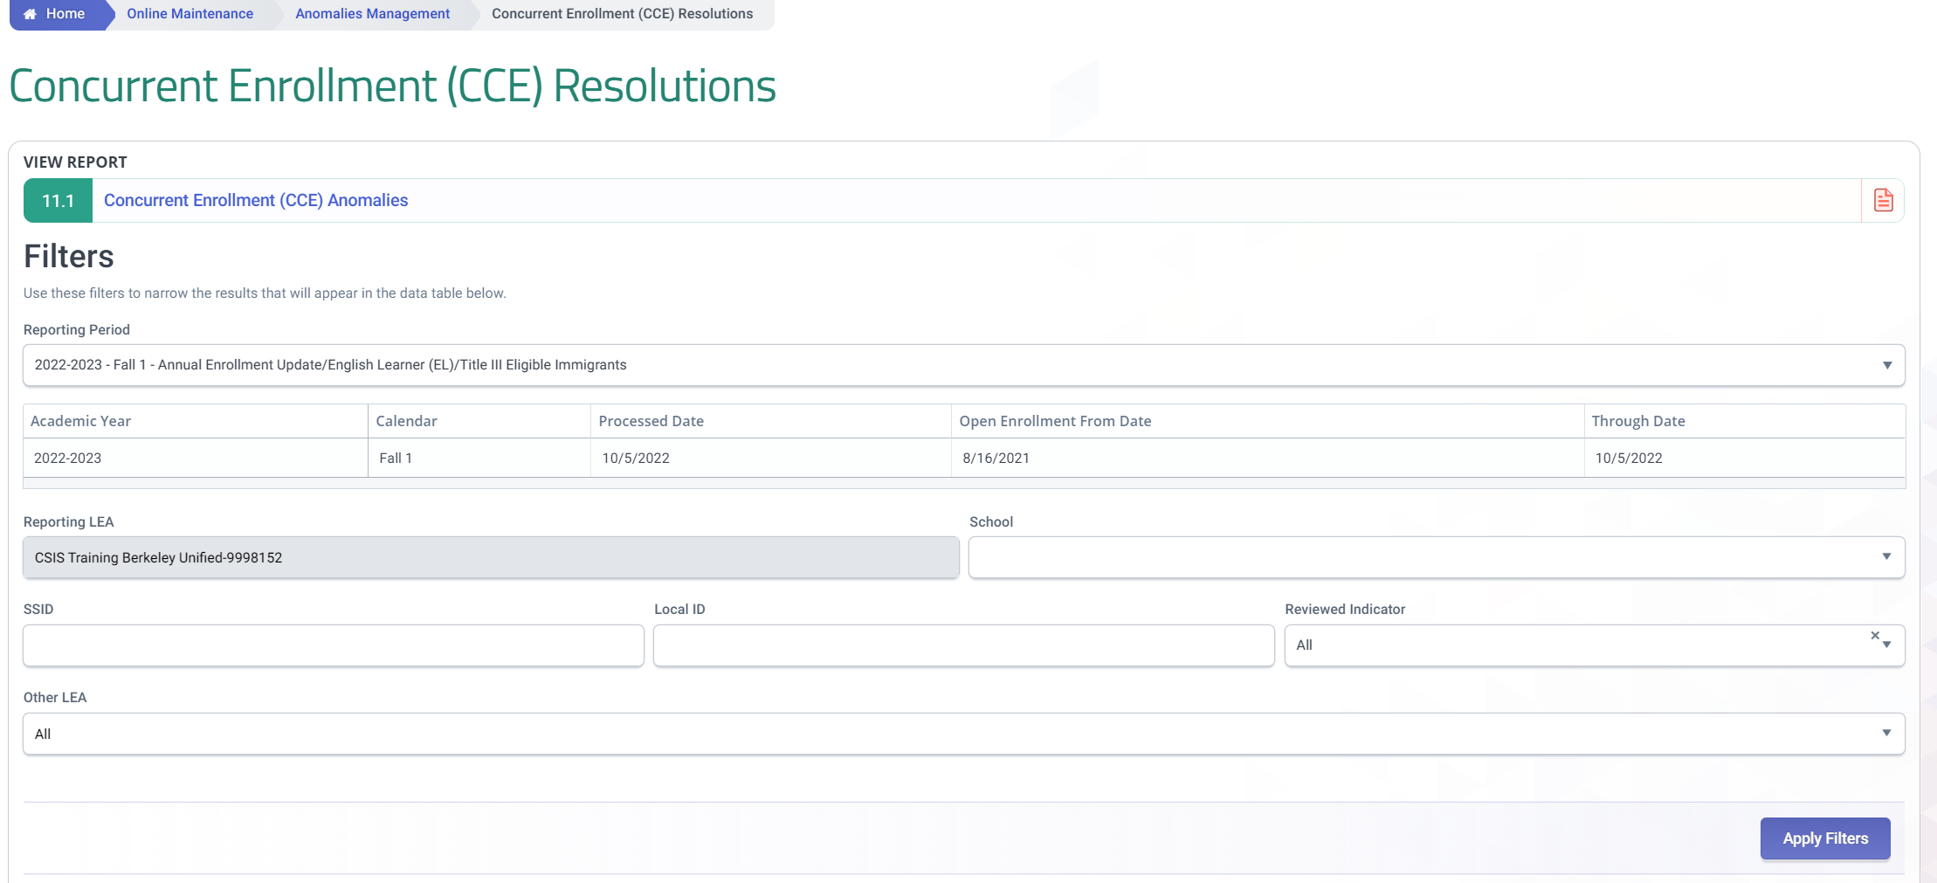
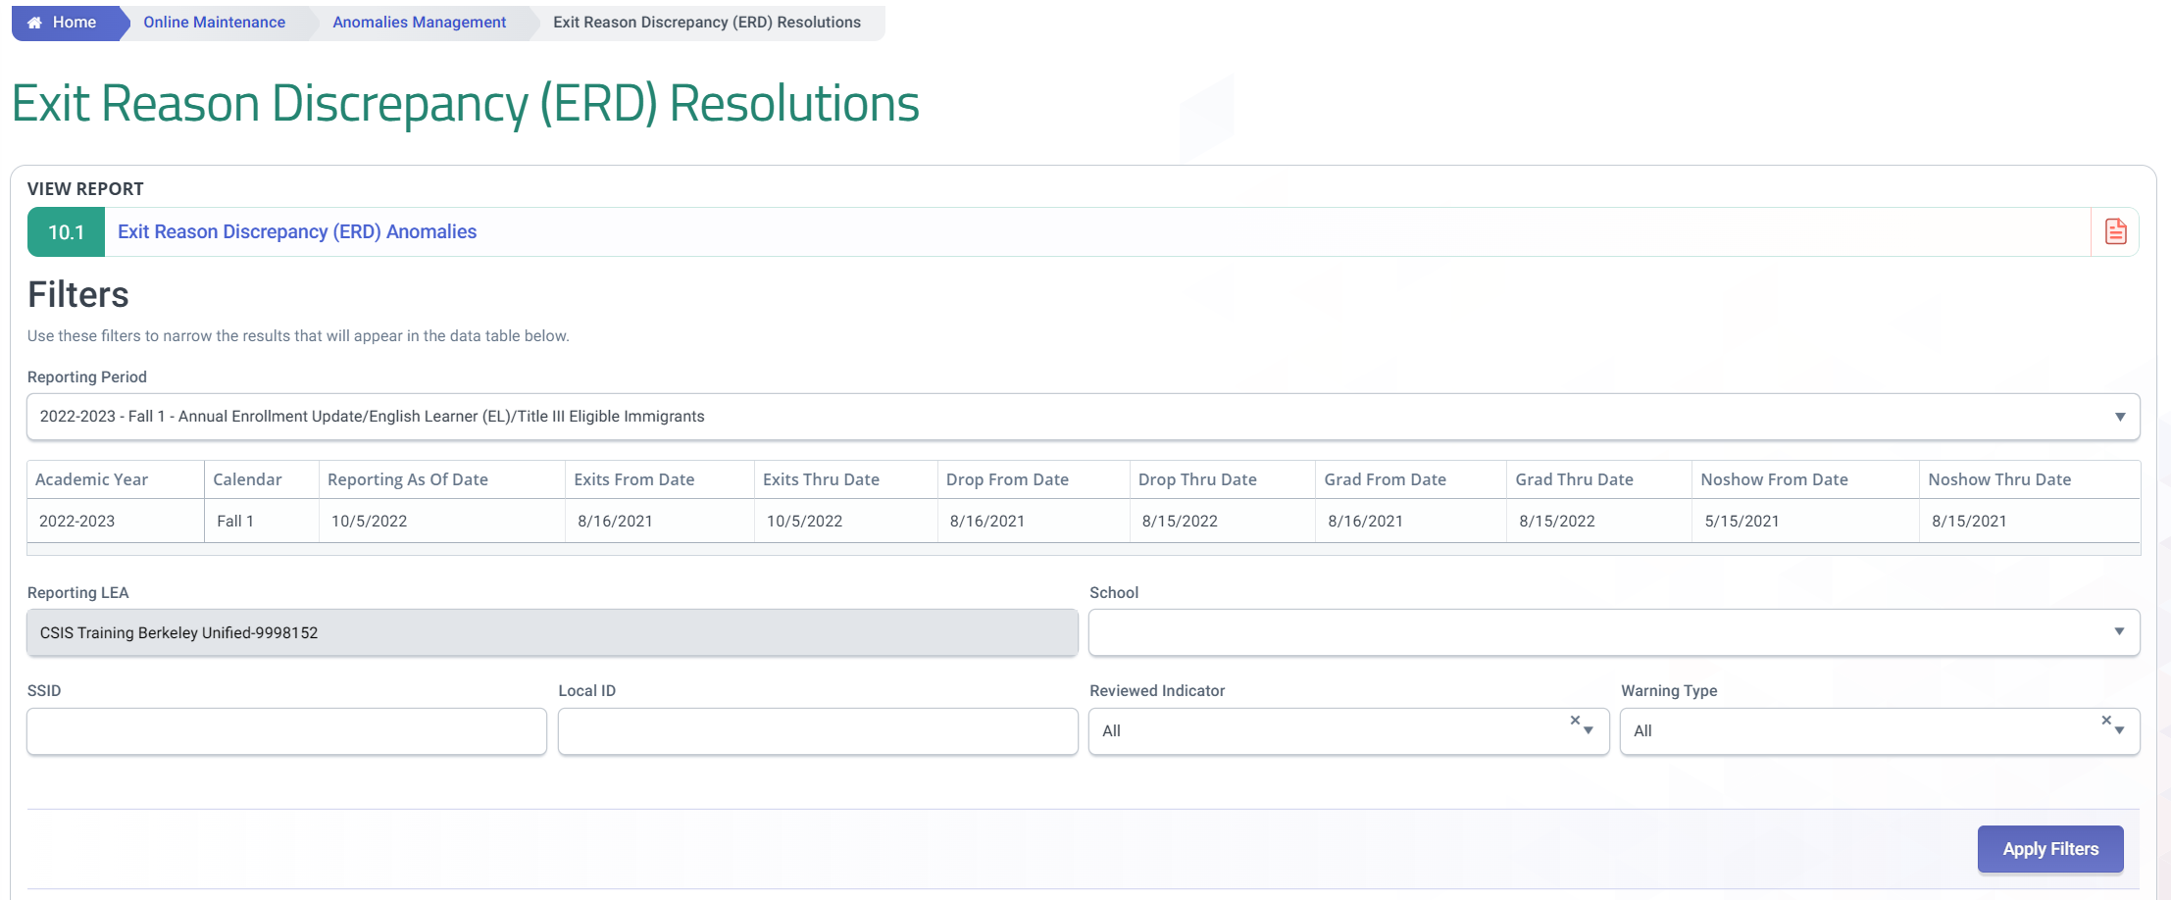
Checking for Anomalies
Directly thru the Anomalies UI

Slide 12
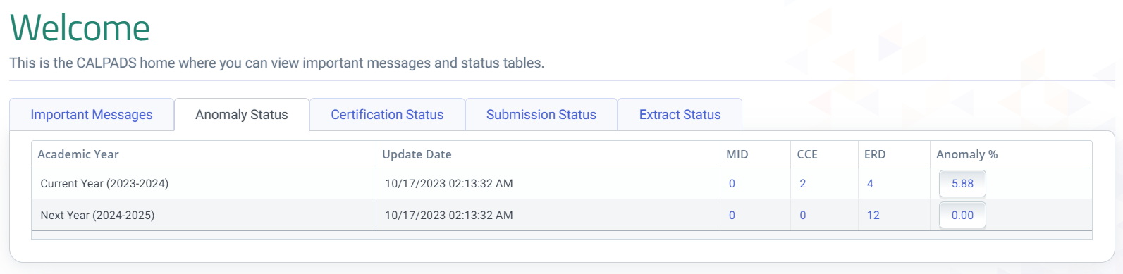
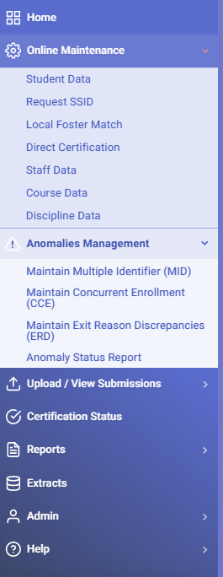
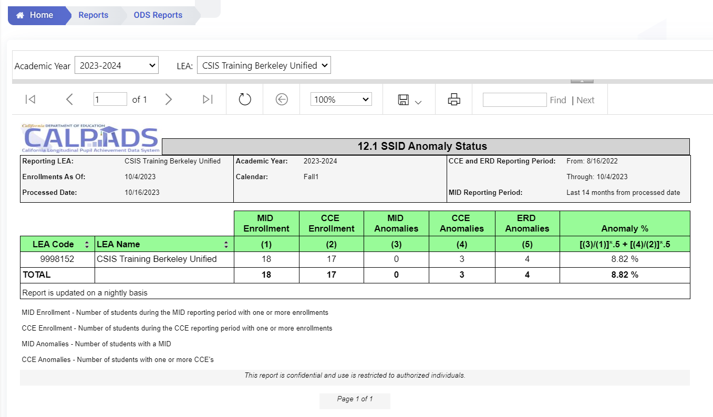
Checking for Anomalies
Through ODS Reports
To certify Fall 1 an LEA must have 2% or fewer anomalies, of MIDs and CCEs

Slide 13
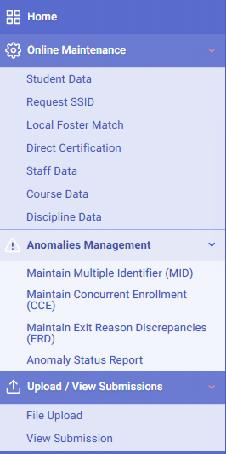
How to Resolve Anomalies
1. Online Maintenance (Enrollment Correction)
2. Anomaly Module Functionality
3. Batch SENR File Upload & Post

Slide 14


Anomaly Roles
Discuss assigning and removing essential roles

Slide 15
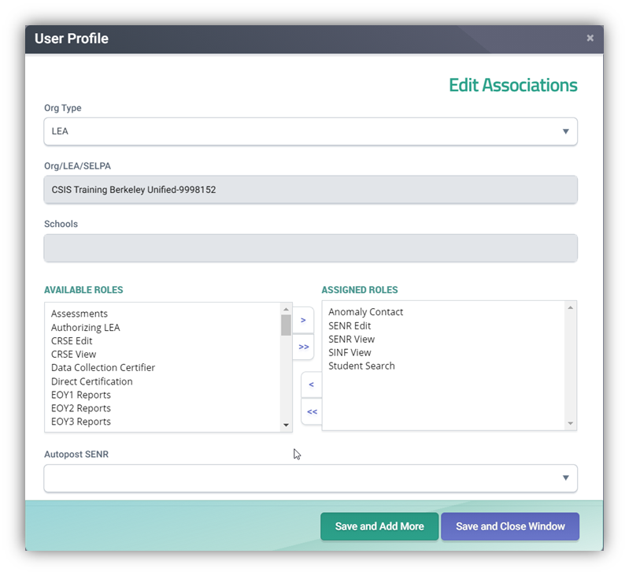
Anomaly Roles
Anomaly Contact
Designates the user as the anomaly contact person for an LEA
SENR Edit
Provides functionality to create and manage SSID Enrollment records using the online and batch interface
Review and resolve MIDs, ERDs, and CCEs in anomaly module
SENR View
Provides functionality to only view SSID Enrollment records via Online Maintenance.
SINF View
Provides functionality to check additional student demographic attributes to verify correct SSID
Student Search
Provides functionality to perform search for a student and access the Student Details page.

Slide 16
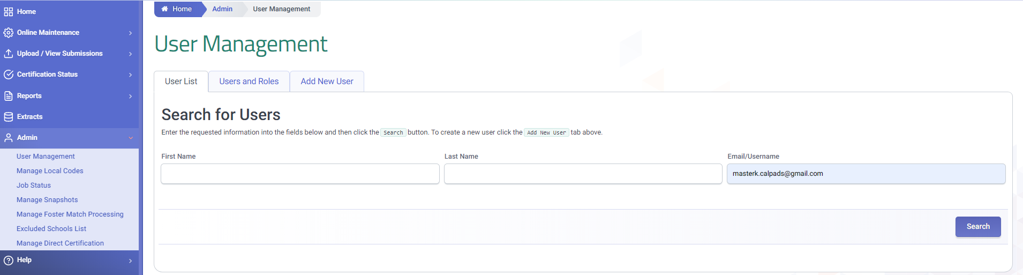
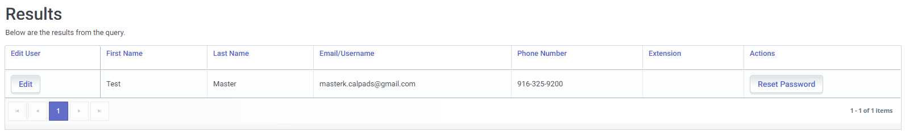
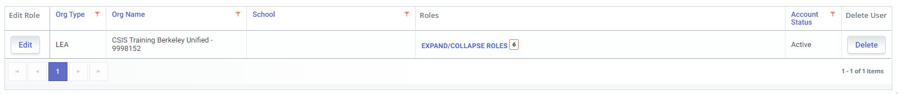
Assigning Anomaly Roles
2
1
3
4
5
6

Slide 17
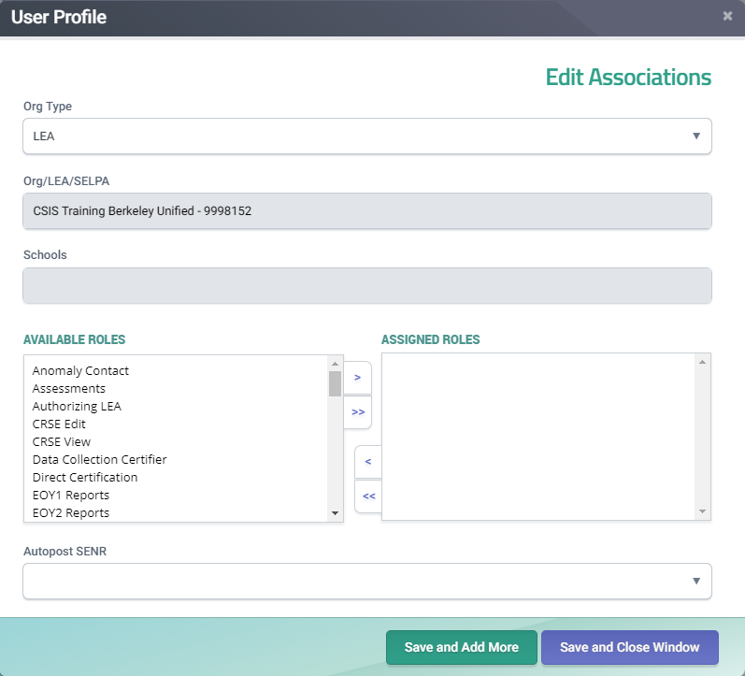
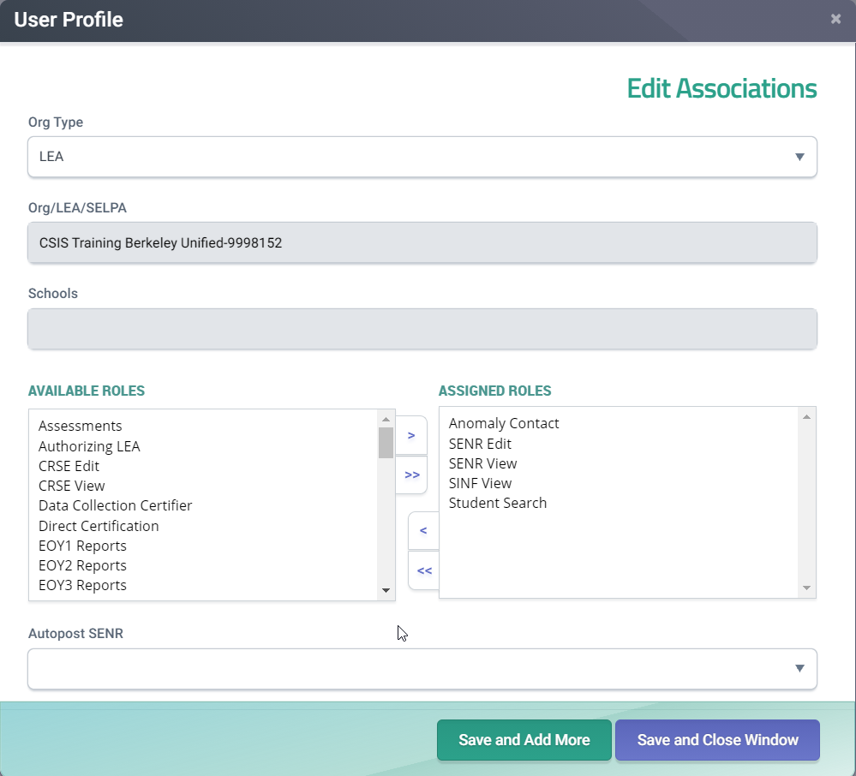

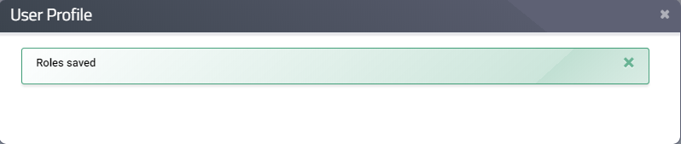
Assigning Anomaly Role
7
8
9
10

Slide 18
Removing Anomaly Role
2
1
3
4
5
6

Slide 19
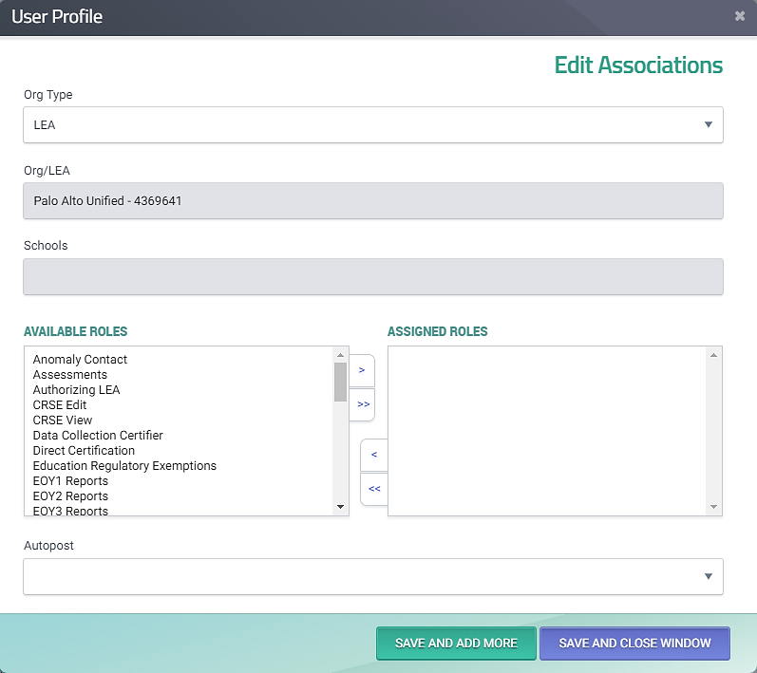
Removing Anomaly Role
7
8
9
10

Slide 20

Best Practices
You may assign multiple users as anomaly contacts, so the work of is spread out.
Inversely, you can also just assign one anomaly contact (maybe a helpdesk user account).
Reach out to CSIS support to establish who should be listed in the CSIS LEA Lookup tool.
Make sure a phone number and extension is included.
Nailed It!

Slide 21


Concurrent Enrollment
Demonstrate identifying and correcting CCEs

Slide 22

CCE Definition
An SSID has a primary enrollment at more than one LEA at the same time
Sun | Mon | Tue | Wed | Thu | Fri | Sat
 |  |  |  |  |  | 1
2 | 3 | 4 | 5 | 6 | 7 | 8
9 | 10 | 11 | 12 | 13 | 14 | 15
16 | 17 | 18 | 19 | 20 | 21 | 22
23 | 24 | 25 | 26 | 27 | 28 | 29
30 | 31
 | Enrollment at School 1 (3rd – 13th)
 | Enrollment at School 2 (12th – 25th)
ABC
LEA
XYZ
LEA

Slide 23


Enrollment Status Combinations
Here are the possible enrollment scenarios that may/ may not trigger a CCE.
Do not
cause CCEs
Cause CCEs
Short-Term (30)* (less than 30 days)
LEA 1
LEA 2
Primary
Primary
Primary (10)
Secondary (20)*
LEA 1
LEA 2
Primary
Short-Term (more than 30 days)
Non-ADA (50)
* A student can have secondary and/or short-term enrollments in addition to the primary one

Slide 24


CCE Ownership
All LEAs involved are responsible in resolving the CCE regardless of ownership rules
New
Enrollment
Created
Open
Enrollment
LEA #2
CCE Anomaly on New LEA
8/16
* of year prior
14-Day Period after Initial Detection
Fall 1
Census Day
LEA #1
Open
Enrollment
Open
Enrollment
CCE Anomaly on Prior LEA
CCE Anomaly remains with Prior LEA

Slide 25
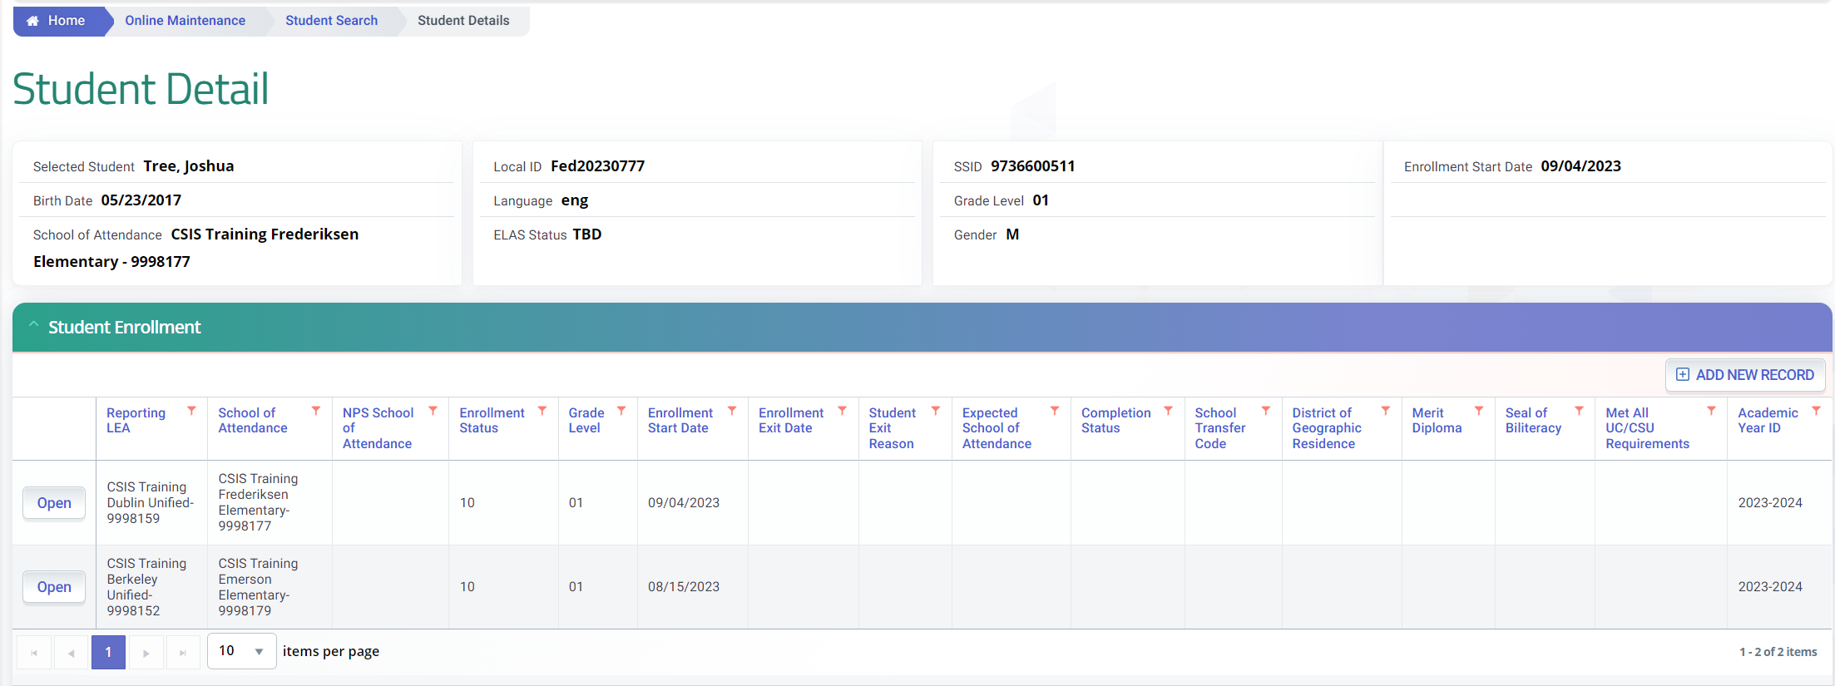
Common Causes of CCEs
Previous enrollment either is missing exit information or overlaps most current enrollment.
Exit date and reason are missing even though student has left the previous school
Solution
Contact the previous LEA to confirm the student’s enrollment and request that they update their CALPADS enrollment record to reflect the student’s actual enrollment.

Slide 26
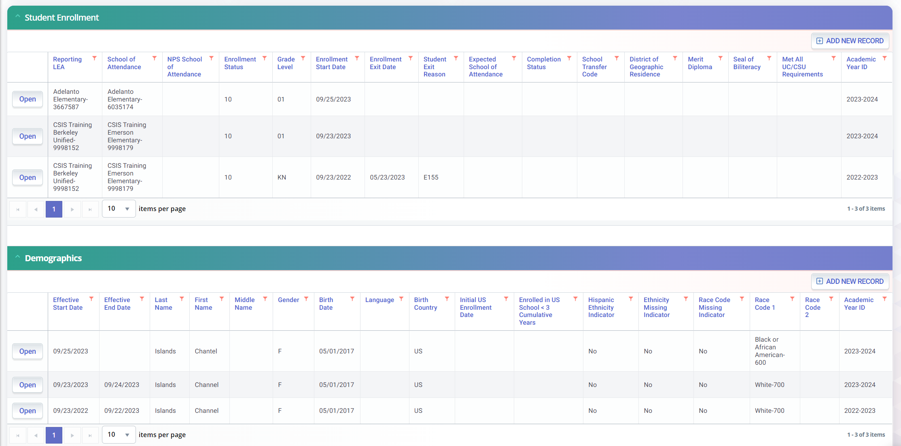
Common Causes of CCEs
Two or more students are using the same SSID.
Exit date and reason are missing even though student has left the previous school.
Check if Demographic information are different.
Solution
Contact the previous LEA to confirm the student’s enrollment and verify student demographic details. If both agree these are 2 different students, most recent LEA should delete records and request a new SSID or find a different match.

Slide 27
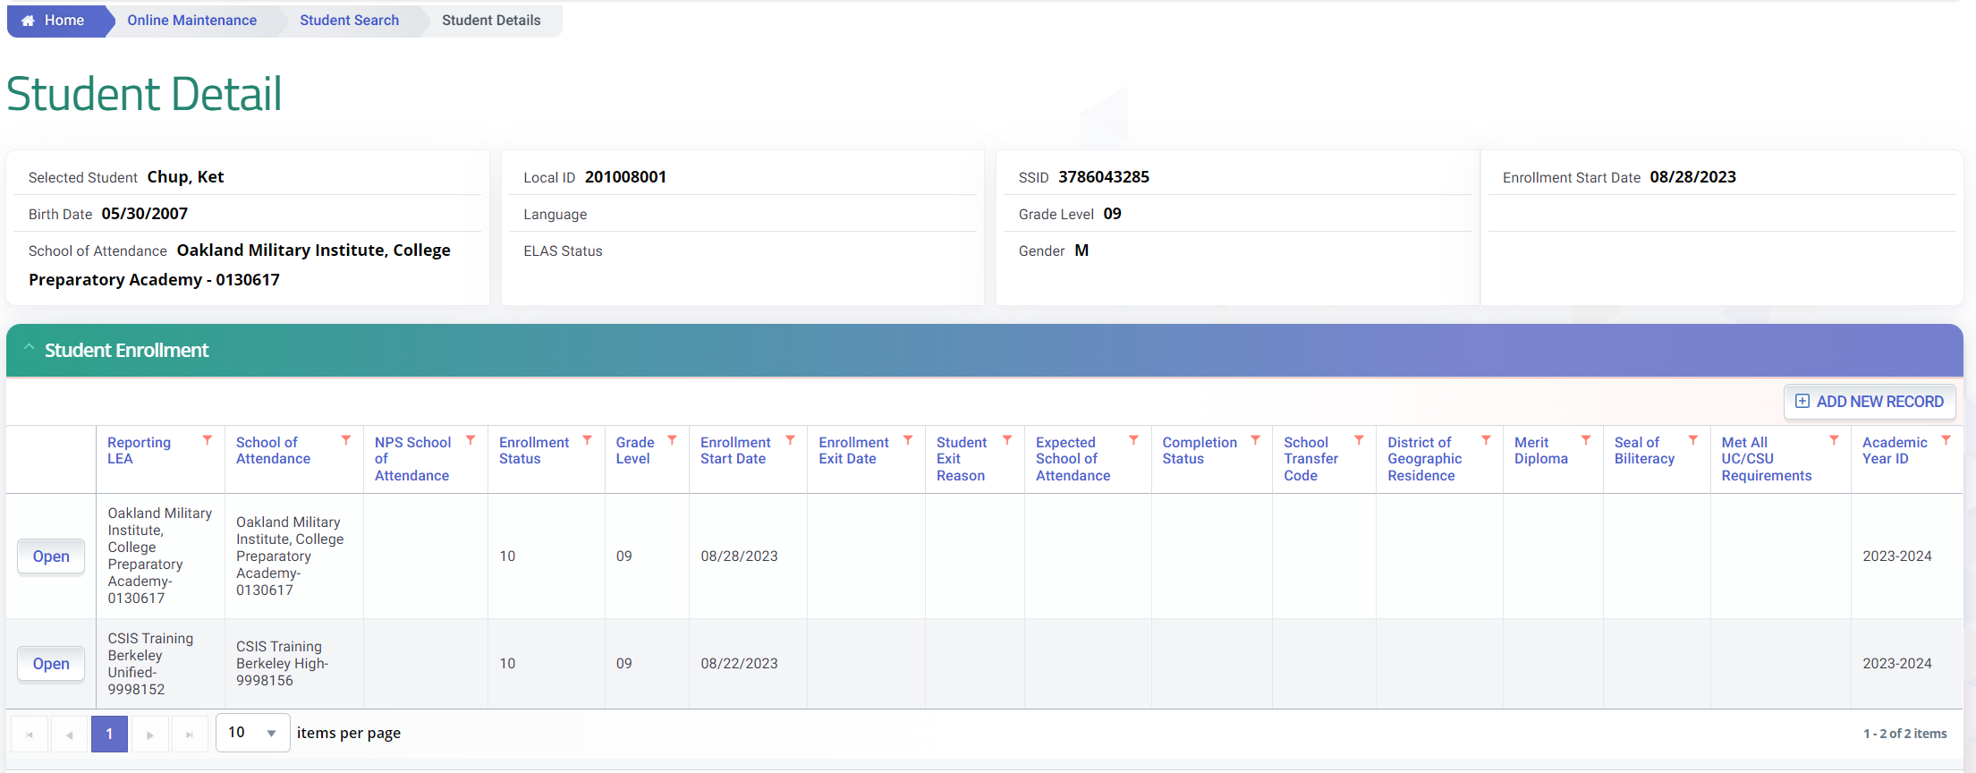
Common Causes of CCEs
The student is attending 2 Leas but has two primary enrollments.
The student’s enrollment status is a 10 even though the student is concurrently enrolled
Solution
A student can have multiple enrollments if all but one of them are non-primary. Update the non-primary enrollments to the proper enrollment status code. A list of the valid codes & descriptions can be found in the CFS Code Sets document.

Slide 28

Ask the right questions when troubleshooting
Have we established continued ownership of the right student?
Enrollment type reported is correct?
Last day of actual student participation was when?
Parent’s name in SINF demographic section matches?

Slide 29

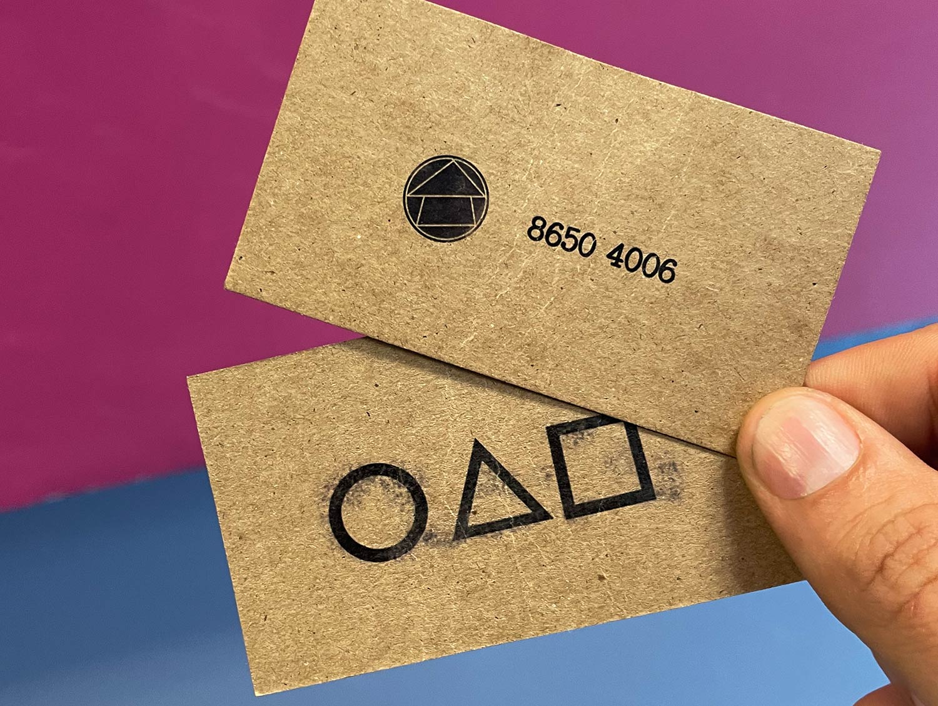


Resolving CCEs
Correct enrollment start or exit dates
We will help facilitate the resolution of CCE’s if there is an impasse.
Correct enrollment status or exit code
Delete enrollment record and get new SSID

Slide 30
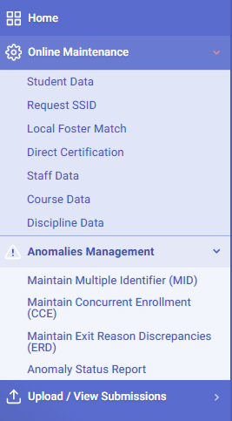
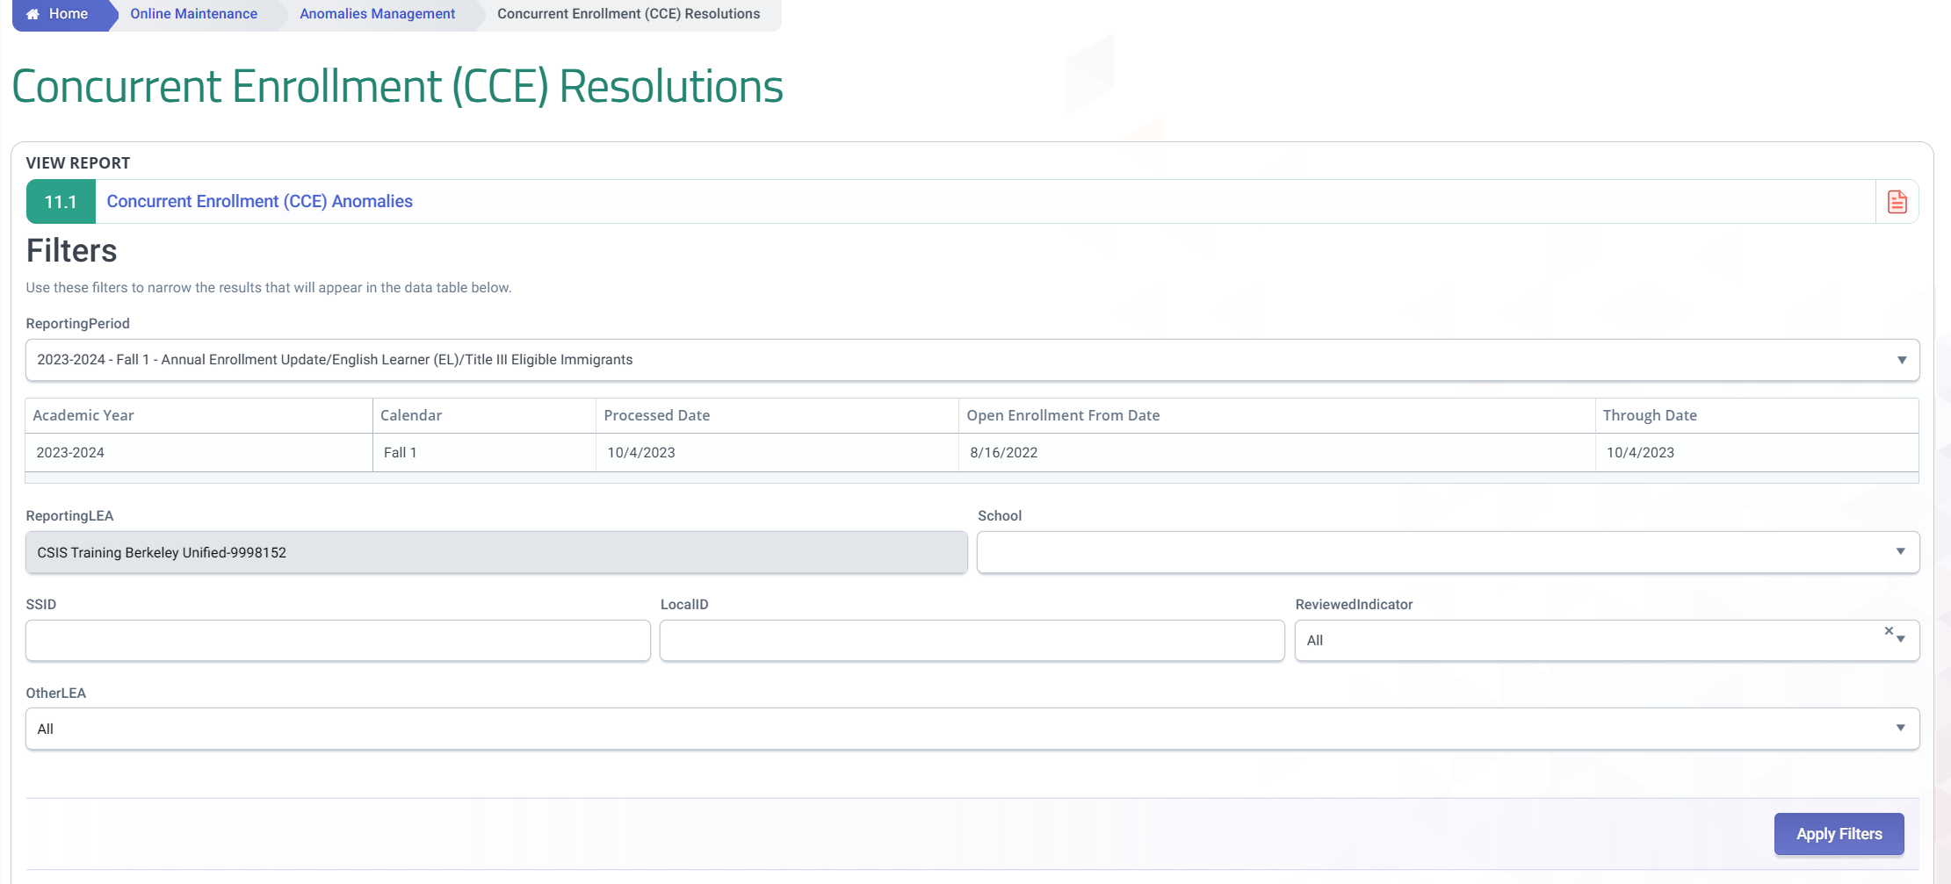
CCE – Module Interface
This section list all students triggering CCEs based on the selected reporting period.
Only CCEs with open enrollments between these dates are detected.
User filters to limit which records are shown below. Remember to click Apply Filters after changing the options.

Slide 31
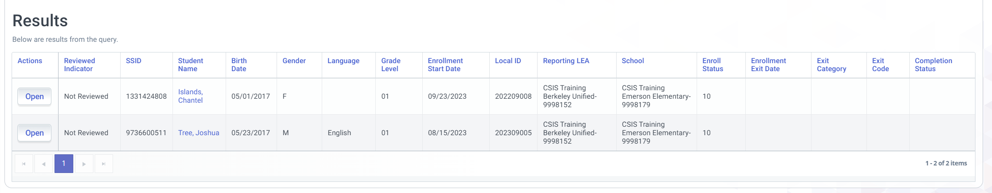
CCE – Results List
Sort results by clicking on the column header.
Click on Open to bring up the CCE anomaly details page.
Right-click on the name and open in new window to bring up the student detail enrollment.

Slide 32
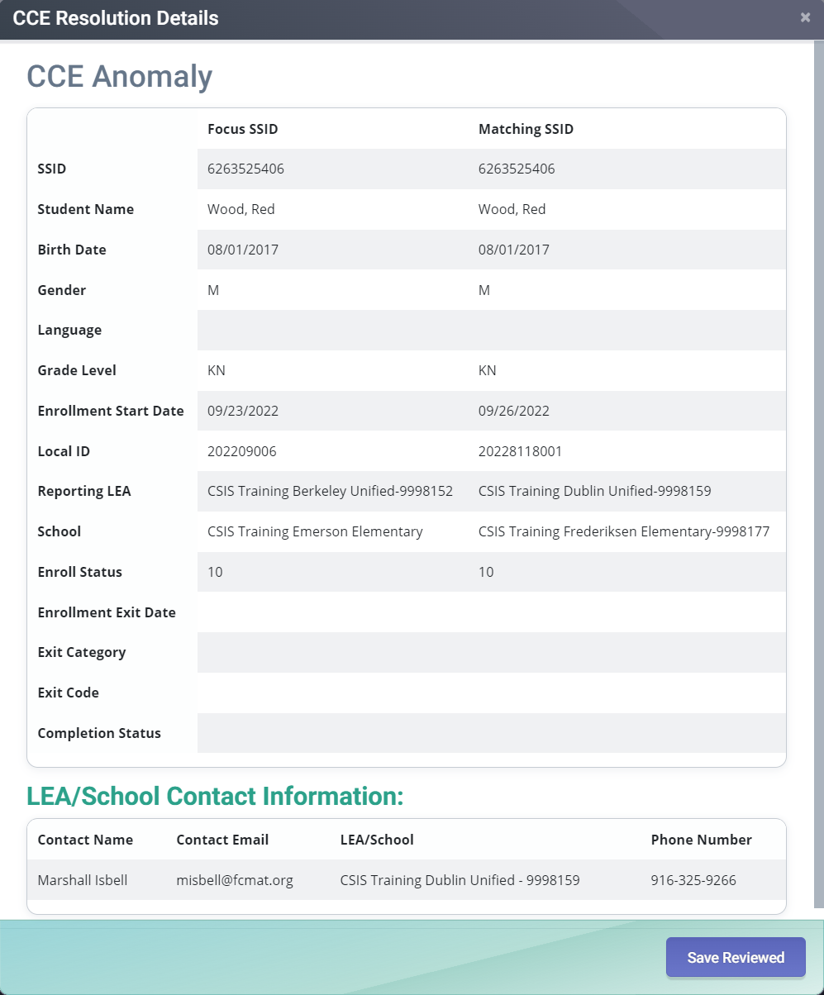
CCE - Analysis
Exit code and date could be missing. Student may be a no-show that has not been reported.
Enrollment start date could be wrong. Student may have started at a later date.
Enrollment status could be wrong. Actual enrollment may be secondary
Check cumulative folder to see if the student attended the other school. If they did not, it’s likely the student is sharing the SSID with another student.

Slide 33
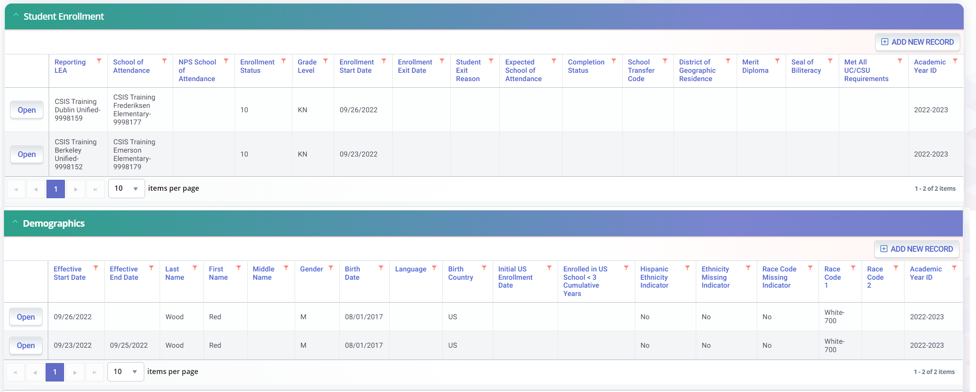
CCE - Analysis
Start date could be wrong. Student may have started at a later date.
Exit code and date could be missing. Student may be a no-show that has not been reported.
Enrollment status could be wrong. Actual enrollment may be secondary.
Check cumulative folder to see if the student attended the other school. If they didn’t, it’s likely the student is sharing the SSID with another student.
Compare demographic information. For possibility that 2 students may be sharing the same SSID.

Slide 34
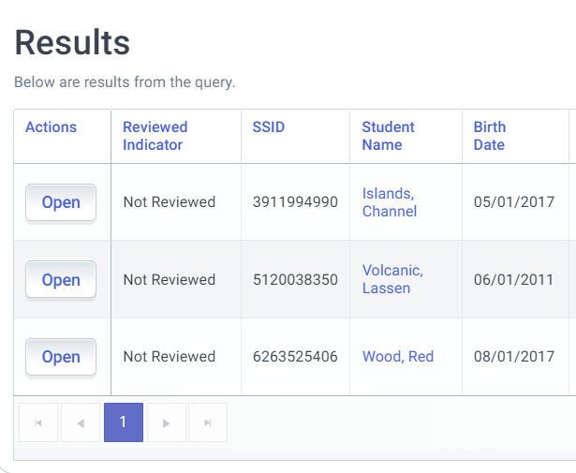
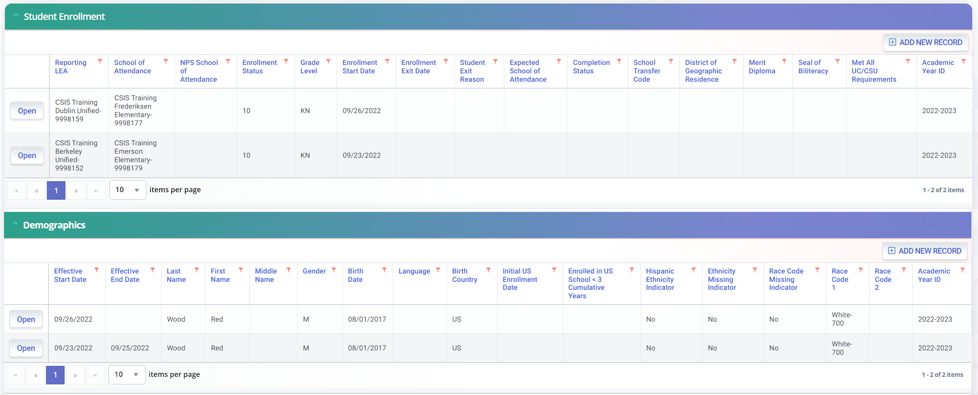
CCE – Resolving an Anomaly
Click Open to display anomaly modal
Click name to open student enrollment detail
Anomaly contacts are listed at the bottom of the CCE Resolution Details screen

Slide 35
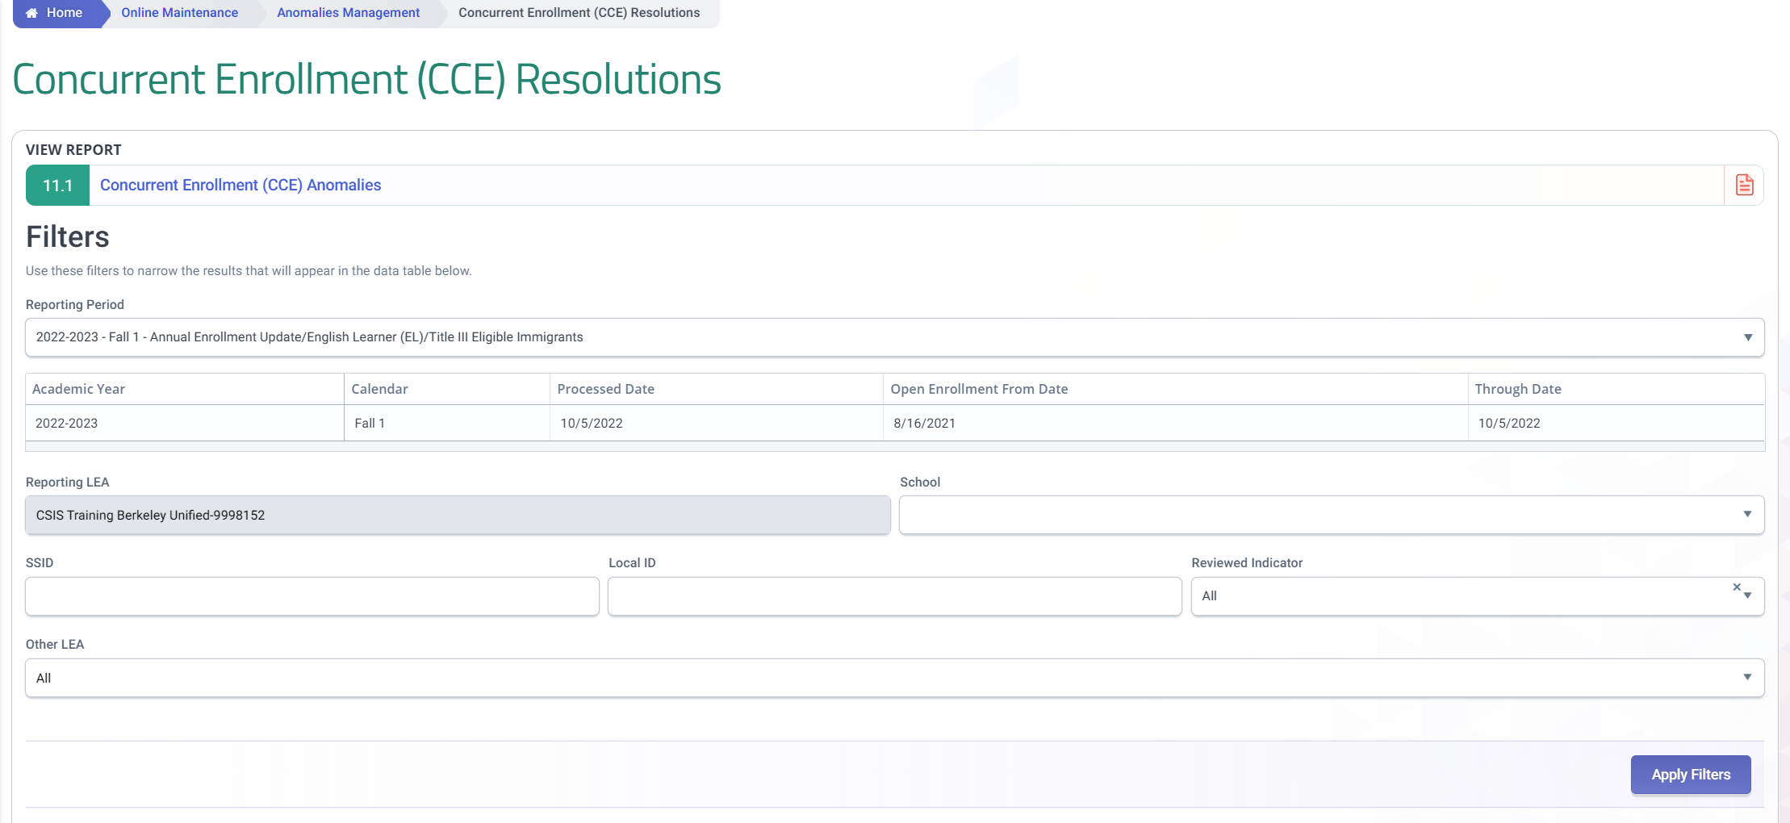
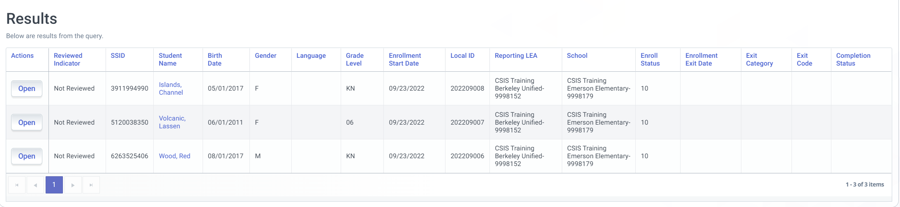
CCE – Hiding a Resolved Anomaly from View
Set filter to show “Not Reviewed” to filter out reviewed records.

Slide 36


Multiple Identifier
Demonstrate identifying and combining MIDs

Slide 37

MID Definition & Ownership
Two or more SSIDs have very similar or identical demographics, indicating that a student may have multiple SSIDs
LEA with most recent enrollment of all SSIDs involved
Enrollments up to 14 months prior to Census Day are included.
Notes:
A MID anomaly represents a situation where two SSIDs have very similar or identical demographics. Therefore it appears that a student may have been assigned more than one SSID.
MID ownership differs from CCEs and ERDs because unlike those anomaly types, MIDs are only owned by a single LEA, the LEA with the most recent enrollment out of all the SSIDs involved in the anomaly.
The date range also differs. MID anomalies are detected for enrollments within 14 months of Census day.
Now we will show you a demonstration of how to view and resolve MID anomalies. For those of you also following along on a printed presentation, this demonstration will cover slides 55 – 65.

Slide 38
MID Example
 | Student 1 | Student 2
SSID | 4265874932 | 359875167
Name* | Ann Smith | Annie Smith
Alias Name*
Gender | F | F
Birth Date | 7/6/2000 | 7/6/2000
Birth State** | US-CA | US-CA
Birth Country** | US | US
* Soundex is used to match similar names and match can be made against either alias or regular name
** Only used for MID matching if provided for both students involved in MID match
Notes:
Here is are some example demographics that you might see for SSIDs involved in a MID anomaly. Note that the name differs slightly. This situation is possible because MID anomaly detection uses a process for matching which allows similar names to match.

Slide 39
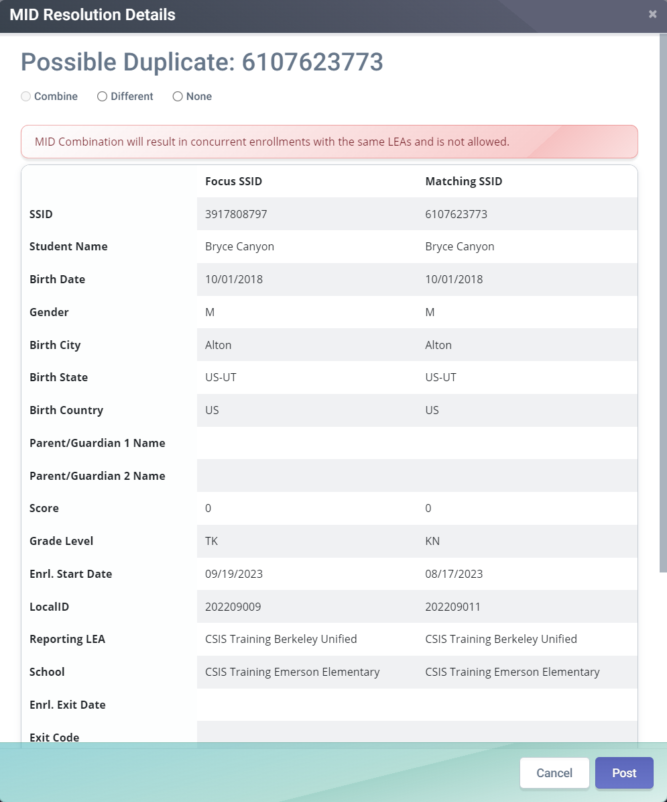
Common Causes of MIDs
A student has been assigned two or more SSIDs
Look up each SSID and review their enrollment history. Make sure that among the two SSIDs there is only one open enrollment record (a record without an exit date and reason). Select the comb (combine) option and post the selection. Look up each of the SSIDs that was combined. For the one that is still active (i.e., not retired), update the enrollment records to match the student’s actual enrollment history.
Two similar but different students have been detected
Select the diff (different) option and post the selection
Notes:
Explains common reasons causing MIDs.

Slide 40


MID Resolution Options
Combine SSIDs
Mark SSIDs as different
Notes:
There are two ways to resolve MIDs:
{Read options}
We explain more about when and how to use these options once we get to the examples.
[Present demo of MID resolution and then return to presentation afterward]

Slide 41
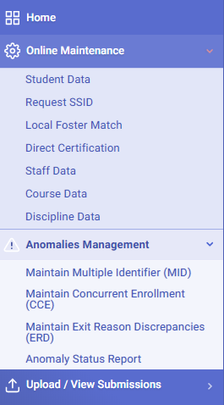
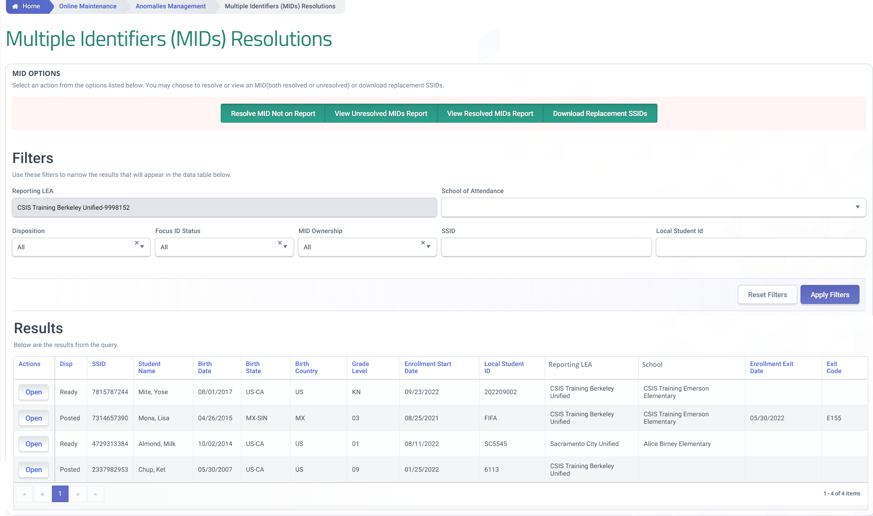
MID – Anomaly Report
Notes:
To reach the MID anomaly list we again go to the Left Navigation menu, click on Online Maintenance. Under Anomalies management ,click on “Manage Multiple Identifiers (MID)”

Slide 42
MID - Interface
Notes:
As with the CCEs and ERDs, there are filters at the top left which can be used to limit the records you see below. However MIDs, unlike CCEs and ERDs, are only owned by the LEA with the most recent enrollment so it is recommended that you set the MID Ownership filter to Reporting LEA-2 and click Apply Filters before reviewing the MID list. This step will make sure that you only see the MID anomalies owned by your LEA.
There is no listed date range for MID detection, but MIDs are detected for the 14 months prior to Census day for the 2% calculation in fall 1.
In the bottom part of the page, there will be a list of MID anomalies. Similar to CCEs and ERDs, you can click the reveal button on the left to reveal the other record involved in the anomaly, however unlike CCEs and ERDs, the conflicting record represents a completely different SSID.

Slide 43
MID – Analysis
If your LEA’s student did not attend this school, then this enrollment record belongs to a different student and the Diff option should be selected.
Review the enrollment history records in the student profile. Conflicts between the records make it more likely that they represent two different students.
Fields such as Birth City and parent names can be used to distinguish similar students.
The None option can be selected if you have already selected Comb or Diff, but still need more time to decide if that is the right decision.
Clicking on Post will execute the selection made.
Notes:
The concept behind resolving MID anomalies is simple: You need to determine if the SSIDs shown represent the same student.
However, due to the number of possibilities and records involved, making that determination may take a significant amount of research and possibly discussion, with other LEAs that are involved.
Most MID anomalies only involve two SSIDs, but in some rarer cases there may be three or more. Although each SSID can be resolved separately.
The school listed for the SSID which your LEA does not own can sometimes solve the problem quickly because if your student never attended the other school, it is pretty likely that the SSIDs are owned by different students.
Birth city and parent names can also be good ways to distinguish whether two SSIDs are owned by the same student.
In the event that those fields still do not resolve the problem, it may be necessary to compare the SSID’s enrollment history, demographic history, or other parts of the student profile.
If one or more of the SSIDs belongs to another LEA, you may need to contact the other LEA to discuss the anomaly.
Applying the resolution is simple: you select either “Comb” to combine the two SSIDs or “Diff” to mark them as different. The none option is only meant to be used if you select “Comb” or “Diff”, but then decide to do more research before posting your selection.
It is very important to diligently research the anomaly, because MID resolutions, once posted, can not be undone.
Also be aware that two SSIDs can only be combined if their enrollment histories do not overlap. Trying to combine two SSIDs with overlapping history will trigger an error. To get around the error, you will need to modify or delete enrollment records which overlap. Once the combine has been completed the enrollment history can be updated further if necessary.

Slide 44
Common Problems
March
April
May
Overlapping enrollment not allowed when combining MID anomalies
SENR #1
SENR #2
Today
Aug
Sep
Oct
Focus ID’s current enrollment record is closed
SENR #1
SENR #2
Notes:
When resolving MID anomalies there are a couple common problems that you may encounter. The first is caused by having overlapping enrollment records between the two SSIDs. The MID anomaly resolution process will not allow you to create a CCE anomaly as a result of resolving a MID anomaly so any overlaps need to be cleaned up prior to combining two SSIDs.
The second problem occurs when your LEA owns a MID anomaly but the most recent enrollment in the history has an exit date and reason. Because of how MID anomalies are processed, the most recent enrollment record must be open. Even if the enrollment record is accurate and the student has left, you may need to temporarily remove the exit date and reason so that that you can complete the MID combine.

Slide 45
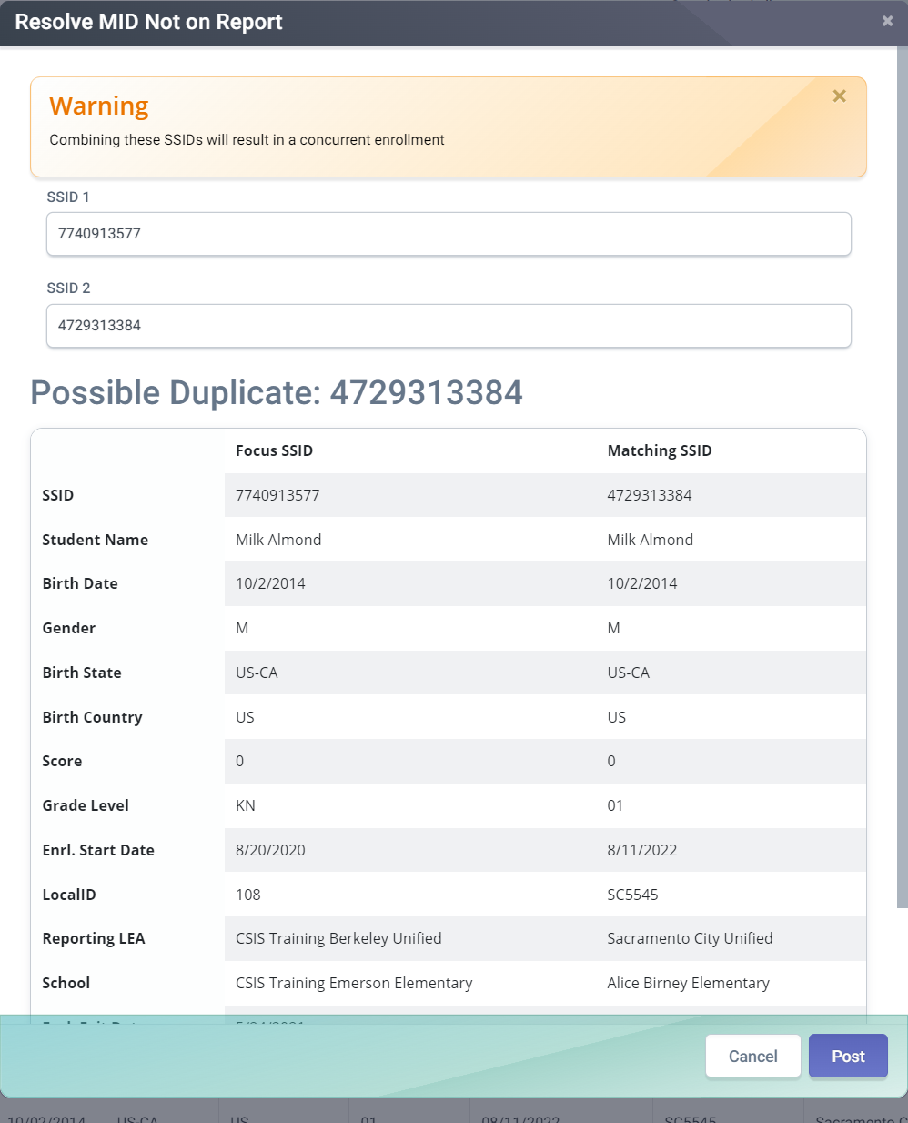
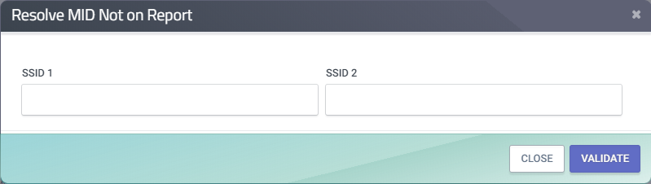
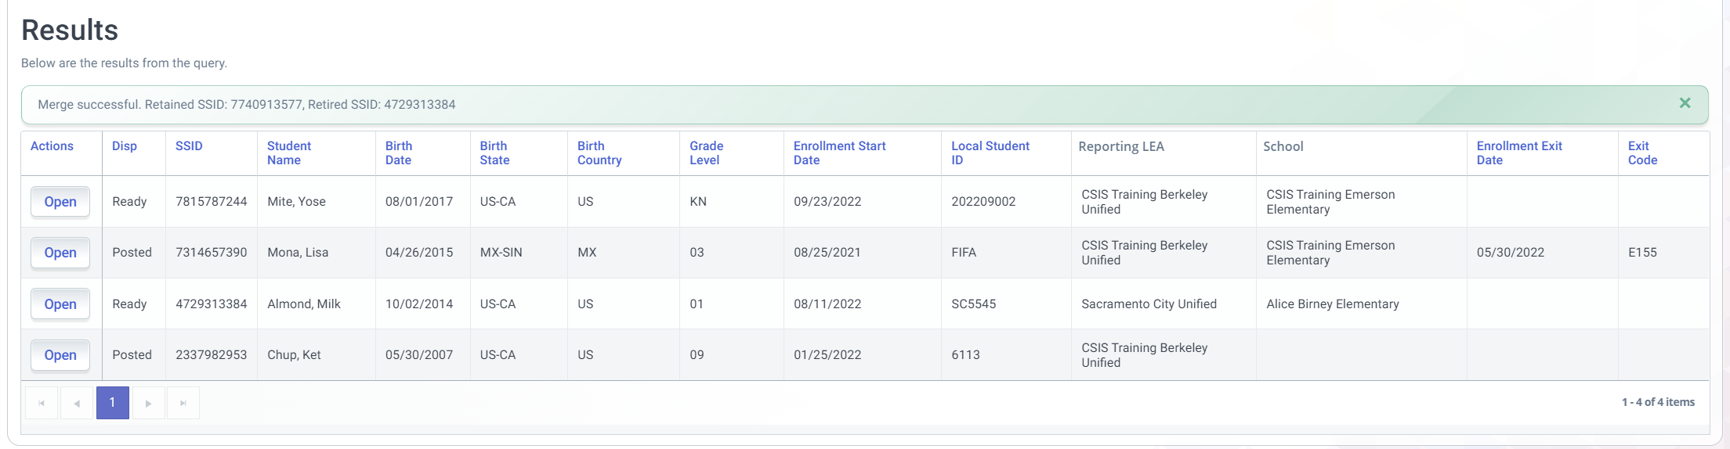
MID - Resolving Undetected MIDs
1
3
CALPADS will reveal the possible duplicate.
Click on this from the MID Anomaly page.
2
Click Post to combine the ssid
Notification of what SSID was retained will appear.
4
Populate the SSID fields and then click on Validate.
Notes:
Because MID anomaly detection uses specific fields for comparison, there may be some cases where a student actually has been assigned two SSIDs, but CALPADS has not detected it.
In this situation you can use the Resolve MID Not on Report function to resolve the anomaly.
To initiate the process, make sure that you have the SSIDs ready and then click the Resolve MID Not on Report button. You will be prompted for the two SSIDs that you believe belong to the same student. Enter both SSIDs. The order does not matter.
Then click Validate.
You will be presented with the basic information for both SSIDs and then informed which SSID will be kept if you choose to finalize the combine.
To finalize the combine, click “Combine SSIDs”. Otherwise, you can click cancel to abandon the process.

Slide 46
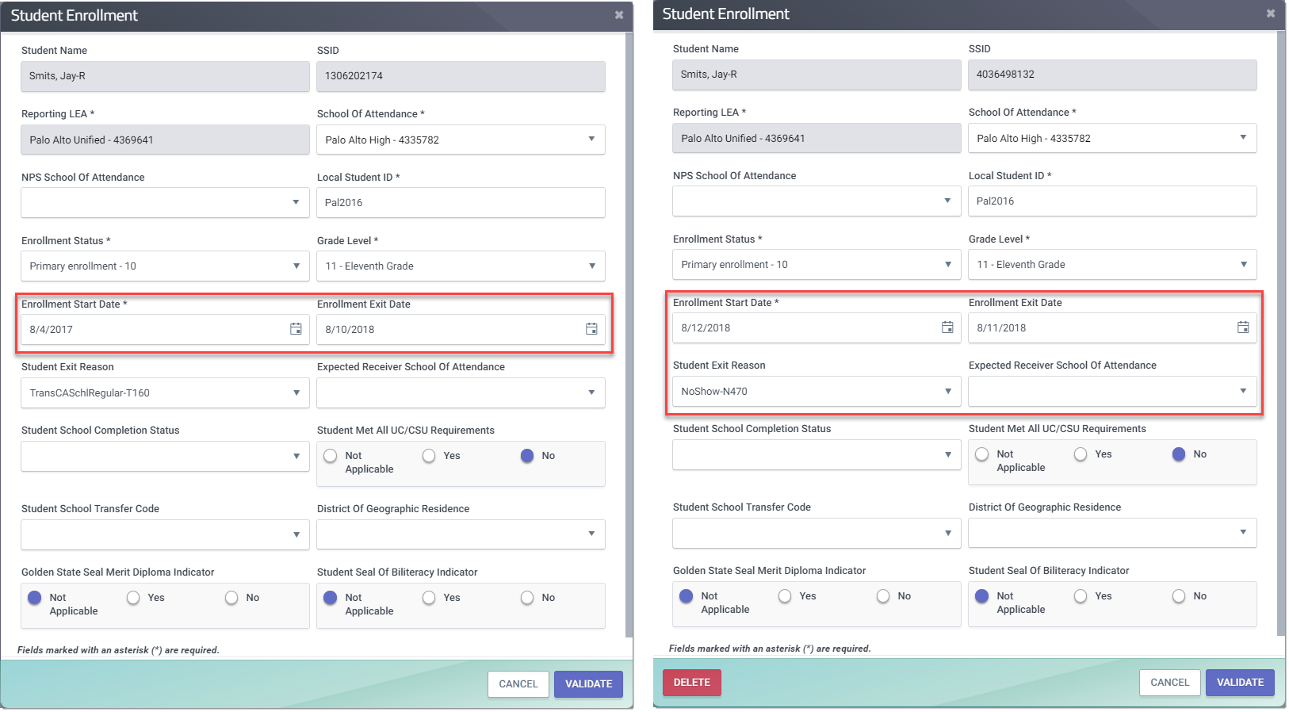
Resolving Undetected MIDs
If combine fails due to overlapping enrollment, make sure the enrollment records between the 2 SSIDs won’t overlap.
LEAs should coordinate to correct the overlap.
Once the overlap is corrected, the SSIDs can be combined.
Notes:
User Manual Reference: https://documentation.calpads.org/OnlineMaintenance/AnomaliesManagement/MID/#resolve-mid-not-on-report

Slide 47
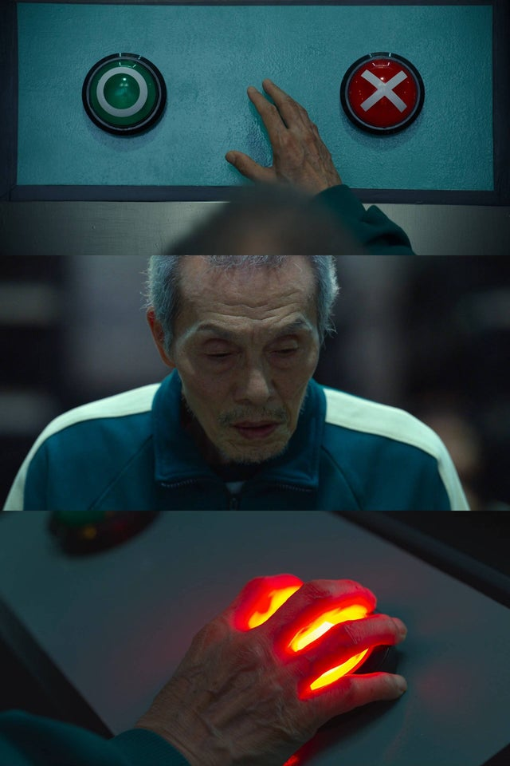
MID Resolution Effects
COMBINE
MARKED DIFFERENT
The SSID with the earliest enrollment record is kept and the other SSID is retired. Enrollment, demographic, and other supporting records of the two SSIDs are combined. Retirement of SSIDs are permanent and irreversible.
The SSIDs are permanently marked different and will not be detected as MIDs ever again.
Notes:
If the SSID to retire does not have an open enrollment associated with another LEA, the system shall perform processing for combining the data from the SSID to be retired with the Focus ID as well as all Enrollment, Discipline, English Language Acquisition Status, Course Section (Enrollment and Completion), Student Course Section (Enrollment and Completion), Program, Foster, Direct Certification and Grade Level records (which is now associated with the SENR record). This information will be merged and viewable to the LEA. The system will display the follow update successful message: “Update(s) successful. For MID pairs marked as Combine, one or more of the Focus IDs have been retired. For MID pairs marked as Diff, the SSIDs were flagged as different students and will not be detected as a MID again.”

Slide 48

Retained student data
The following records from both Retained and Retired SSIDs will be retained.
Enrollment,
English Language Acquisition Status,
Course Section (Enrollment and Completion),
Student Course Section (Enrollment and Completion),
Program,
Incident, Incident Result, and Offense
Special Education (SWDS, PLAN, MEET, SERV)
Postsecondary
Work-Based Learning (TBD)
Foster
Direct Certification and
Grade Level records

Slide 49
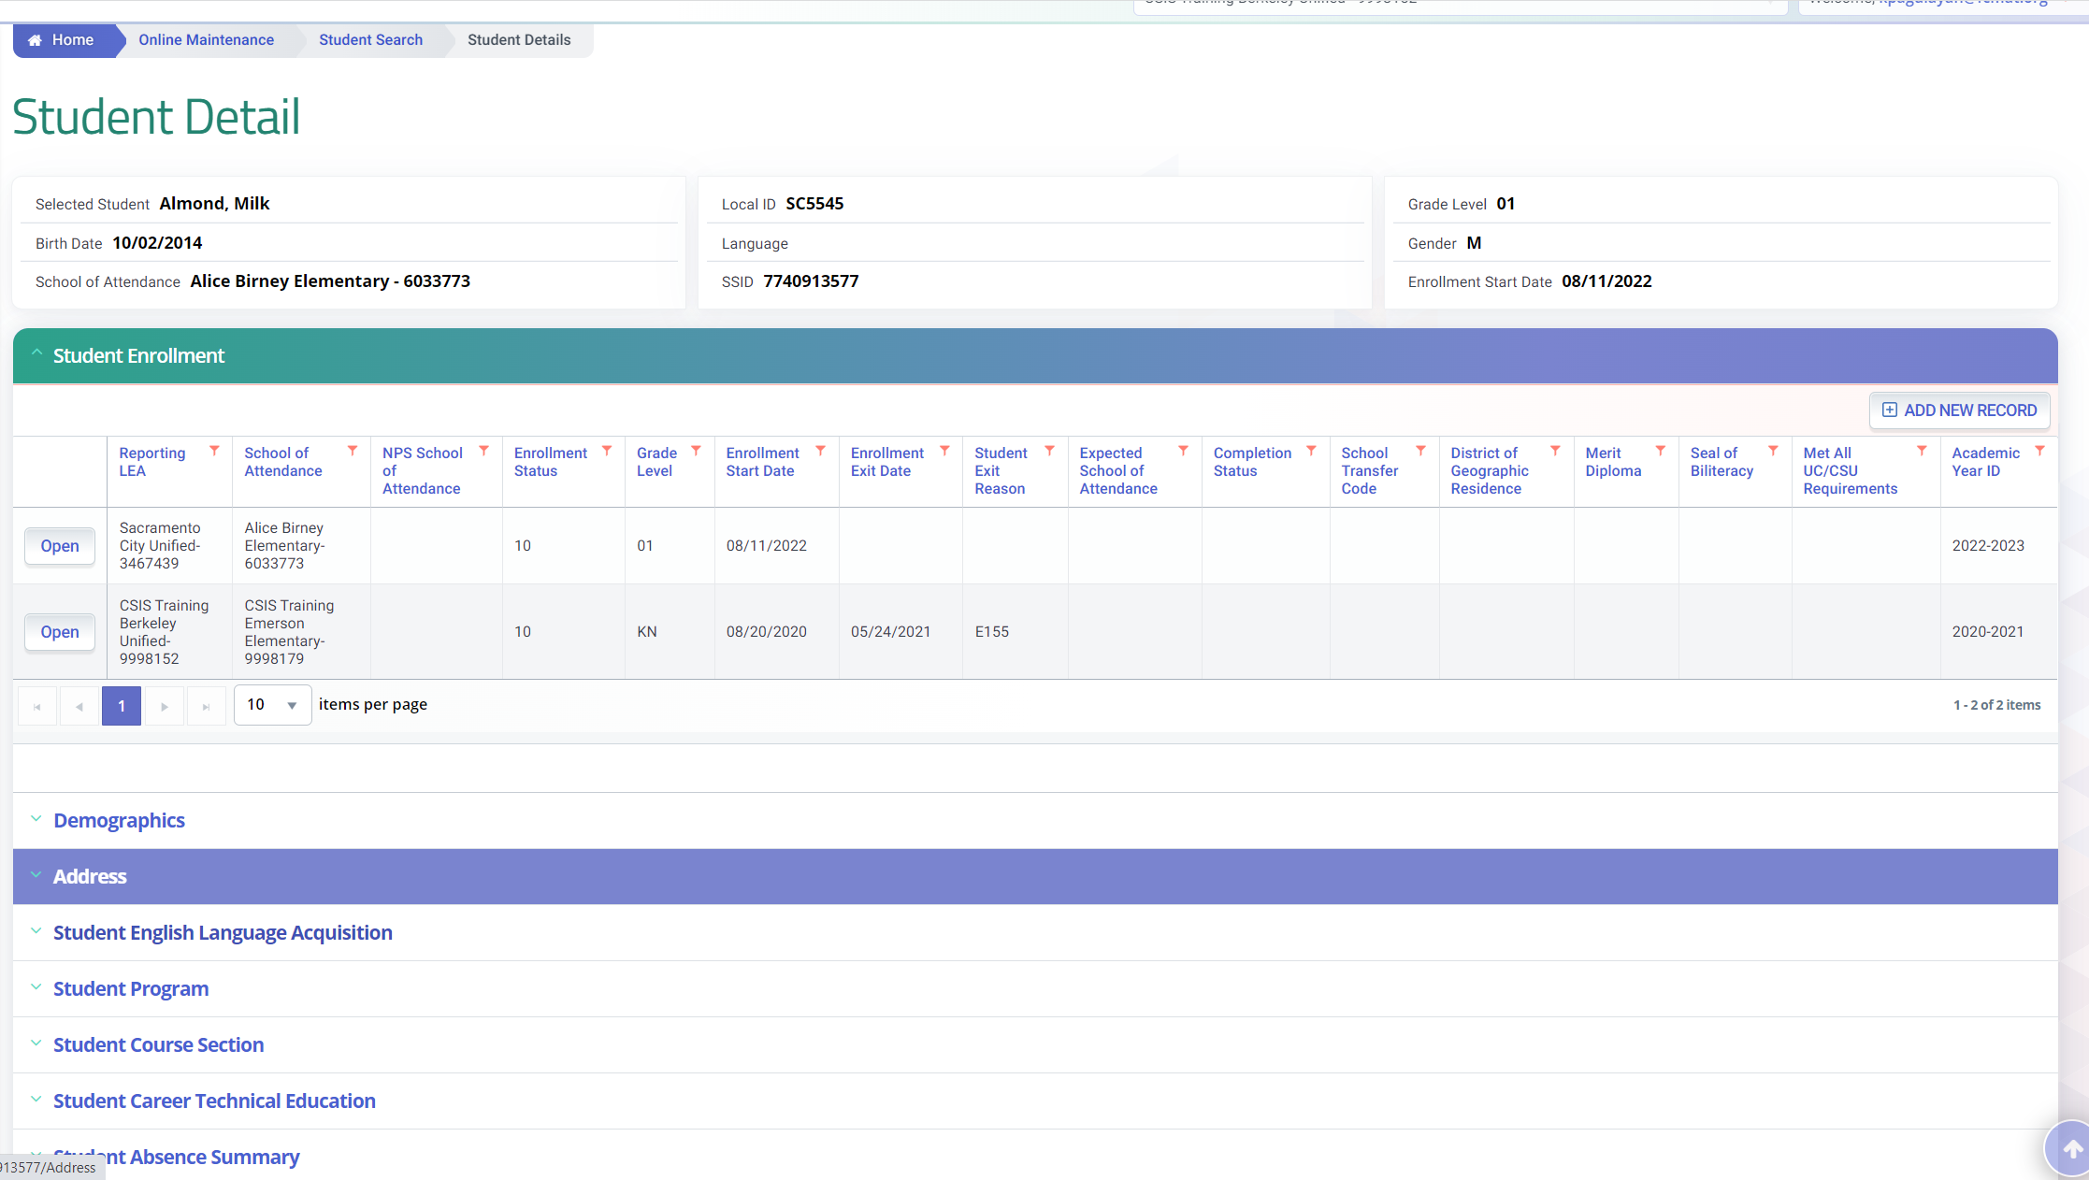

MID Resolution Cleanup
All sections of the student profile should be reviewed after a MID combine to ensure that the student’s combined records are accurate.
Note: No validations are applied when Student English Language Status records are combined resulting to out of order status. So delete potential SELA duplicates before combining the SSIDs.

Slide 50
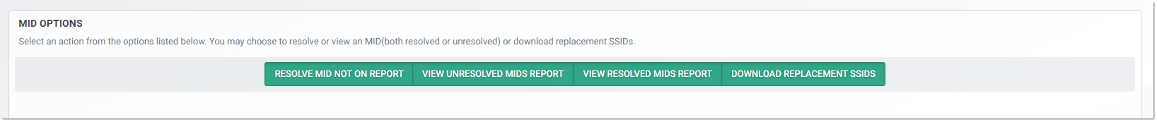
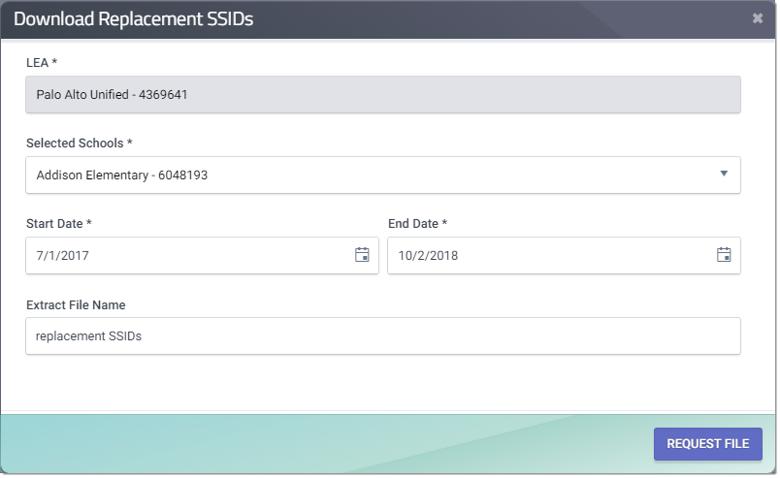
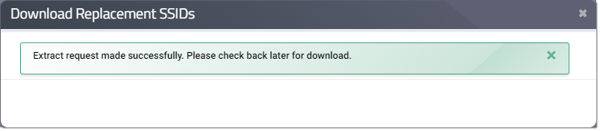
Replacement SSID Request
1
2
3
Notes:
After SSIDs which involve your students have been combined by you or another LEA it is very important that you retrieve the list of SSIDs that were kept so you can update your local systems.
User Manual Reference: https://documentation.calpads.org/OnlineMaintenance/AnomaliesManagement/MID/#download-replacement-ssids

Slide 51
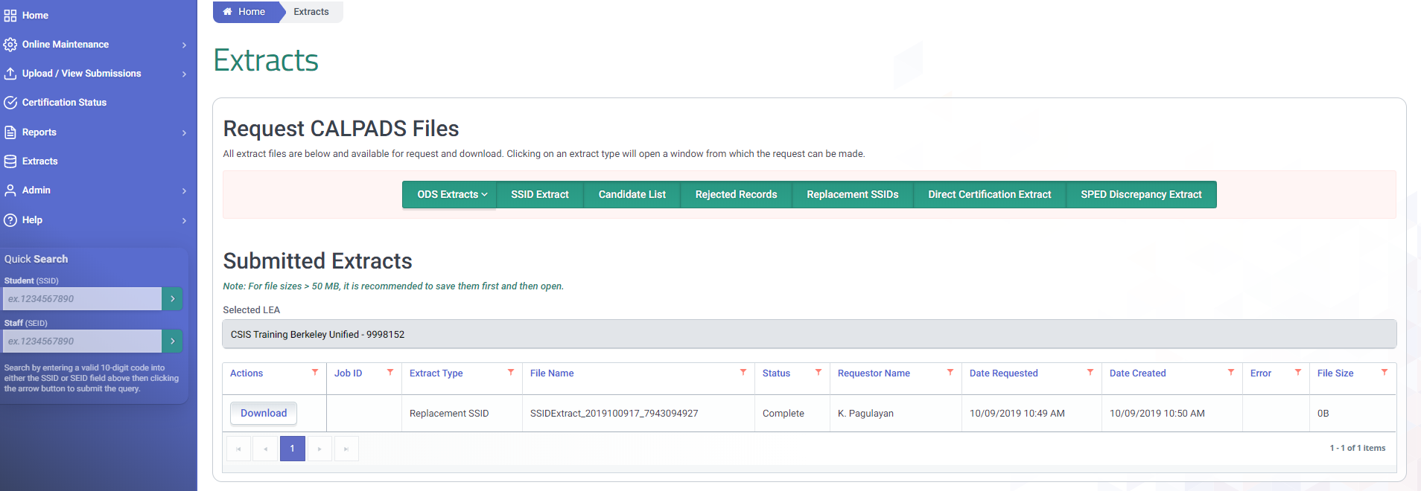
Replacement SSID Retrieval
1
2
Notes:
After SSIDs which involve your students have been combined by you or another LEA it is important that you retrieve the list of SSIDs that were kept so you can update your local systems.
This file can be obtained just like other extracts, by going to the Extracts menu from the Left Side Navigation. However, you will need to wait overnight before requesting the extract.

Slide 52


Exit Reason Discrepancy
Demonstrate identifying and correcting ERDs

Slide 53

ERD Definition
An inconsistency exists between a student’s exit reason and subsequent enrollment status in a school
Enrollment Not Expected
A | Completer Re-enrolled | Student is coded as completing CA K-12 education but has been re-enrolled in a CA K-12 school. This indicates a potential SSID assignment error.
B | Dropout Re-enrolled | Student is coded as a dropout but has been enrolled in another CA K-12 school. This indicates either an SSID assignment error or a re-enrolled dropout.
E | Re-enroll, Different School | Student exited with an E150 and re-enrolled in another CA K-12 public school. Possible improper use of exit code.
?
?
?
?
?
All LEAs involved in an ERD own the responsibility
Expected Enrollment
C | Potential Dropout | Student has not enrolled in another CA K-12 public school by the report's "As of" Date. This indicates a possible dropout.
D | No Re-enroll, Same School | The student is expected to stay enrolled at the same school, but is missing a continuing enrollment record.

Slide 54
ERD Detection
For the 2023-24 reporting year:
the prior year is 2022
the current year is 2023
Prior Year
Current Year
Jan | Feb | Mar | Apr | May | Jun | Jul | Aug | Sep | Oct | Nov | Dec
Jan | Feb | Mar | Apr | May | Jun | Jul | Aug | Sep | Oct | Nov | Dec
8/16
8/15
Completers (Type A)
Dropouts (Type B)
Lost Transfers (Type C)
Mid Year Update (Type D & E)
5/15
8/15
No Show dropouts (Type B)

Slide 55
Exits That Cause ERDs
Exit Reason Code | Exit Reason Code | Exit Reason Code Description | Completion Status Code | Completion Status Code Description | ERD Exit Type
A | E125 | PriorComplSpecEd | n/a | n/a | Completer
 | E130 | Died | n/a | n/a | Completer
 | T280 | TransCollege | n/a | n/a | Completer
 | E230 | CompleterExit | 100 | Graduated, standard HS diploma | Graduate
 | E230 | CompleterExit | 106 | Grad, CAHSEE mods & waiver | Graduate
 | E230 | CompleterExit | 108 | Grad, CAHSEE exempt | Graduate
 | E230 | CompleterExit | 250 | Adult Ed High School Diploma | Graduate
 | E230 | CompleterExit | 330 | Passed CHSPE (and no standard HS diploma) | Graduate
B | E140 | NoKnownEnroll | n/a | n/a | Dropout
 | E230 | CompleterExit | 360 | Completed grade 12 without completing graduation requirements, not grad | Dropout
 | E300 | ExpellNoKnownEnroll | n/a | n/a | Dropout
 | E400 | Other | n/a | n/a | Dropout
 | T270** | TransDropAdult | n/a | n/a | Dropout
 | T380 | TransInstNoHSDip | n/a | n/a | Dropout
C | E155 | YearEndGradeLevelExit | n/a | n/a | Transient
 | E156 | Gd12ContinuedEd | n/a | n/s | Transient
 | E490* | Summer or Intersession Exit | n/a | n/a | Transient
 | T160 | TransCASchl | n/a | n/a | Transient
 | T165 | TransEnrollDiscip | n/a | n/a | Transient
 | T167 | TransSchlDistReferral | n/a | n/a | Transient
 | T168 | AltIndStdySchlDischrg | n/a | n/a | Transient
D | E150 | MidYearEnrollmentUpdate | n/a | n/a | Mid-Year Update
E | E150 | MidYearEnrollmentUpdate | n/a | n/a | Mid-Year Update

Slide 56
Exits That Do Not Cause ERDs
Exit Reason Code | Exit Reason Code Description | Completion Status Code | Completion Status Code Description | ERD Exit Type
E230 | CompleterExit | 480 | Promoted (matriculated) | None
E170 | SecEnrlExit | n/a | n/a | None
E230 | CompleterExit | 104 | Completed all local and state graduation requirements, failed CAHSEE | None
E230 | CompleterExit | 120 | Special Education certificate of completion | None
E230 | CompleterExit | 320 | Completed GED (and no standard HS diploma). | None
E410 | MedicalRsns | n/a | n/a | None
E450 | PreK-6Exit | n/a | n/a | None
N470 | NoShowOther | n/a | n/a | None
T180 | TransPrivate | n/a | n/a | None
T200 | TransUS | n/a | n/a | None
T240 | TransOutUS | n/a | n/a | None
T260 | TransInAdult | n/a | n/a | None
T310** | TransHealthFacil | n/a | n/a | None
T370 | TransInstHSDipl | n/a | n/a | None
T460** | TransHomeSchl | n/a | n/a | None

Slide 57
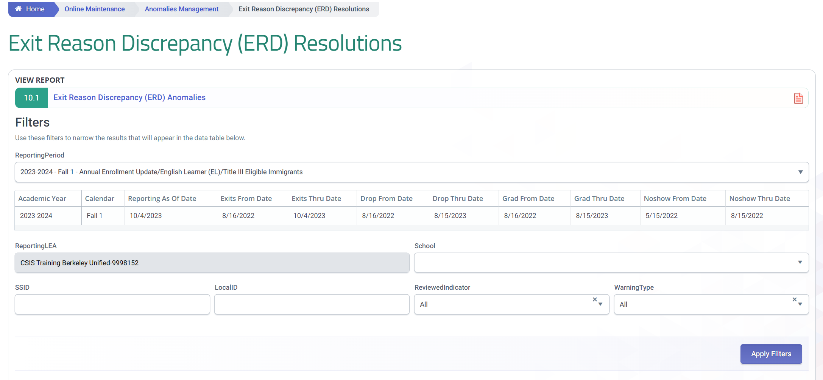
ERD Reporting Cut-offs
Dates determine records to evaluate for Fall. Note that the range differs based on exit type. The range for Drops, Grads, No Shows are the same.

Slide 58

ERD Resolution Options
Correct start or exit dates
Correct exit reason or completion status
Delete enrollment record and get new SSID
Submit the missing enrollment record

Slide 59
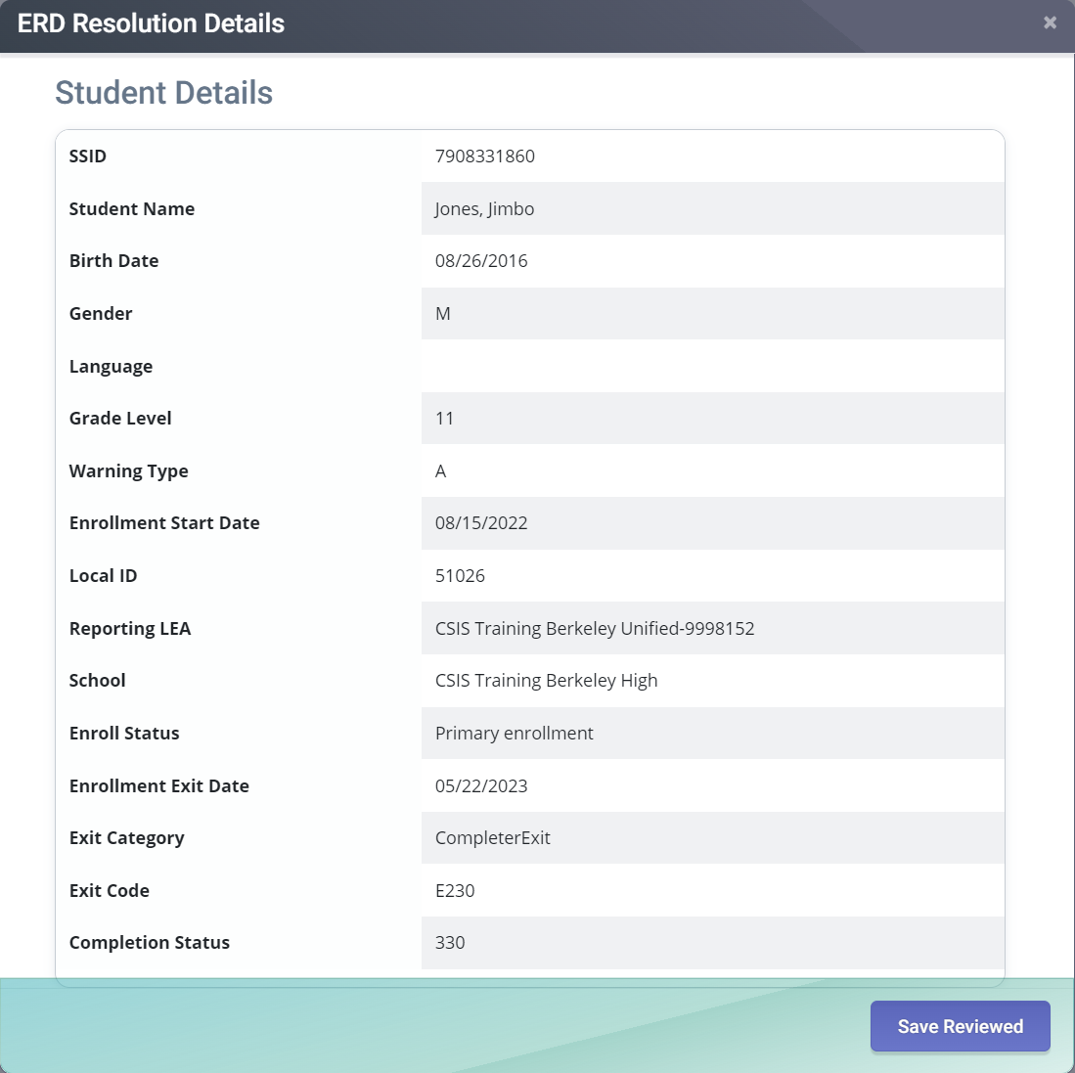
Common Causes Of Type A ERDs
The student did not really complete high school
Update the student’s exit reason to a T160 or other exit code that accurately reflects why the student left
Two or more students are sharing this SSID. The student who exited is not the same student who enrolled at the other school.
Look at the first enrollment record in the SSID’s entire enrollment history. Each LEA that has a different student must get a new SSID for their student and then remove their enrollment record from the SSID with the anomaly.
The student is a valid completer re-enrolled. In some situations a student is allowed to continue attending high school after they complete.
Do not submit a SENR for students who completed high school with diploma. You can track enrollment internally but same enrollment should not be reported to CALPADS.

Slide 60
ERD – Analysis of Warning Type A
Completer Re-enrolled
If earliest record in the history does not match your student’s actual enrollment, your student may have the wrong SSID.
Student left on 05/22/2023 as a high school completer (E230/330), but then re-enrolled on 8/15/2023.
If the other LEA’s record appears to be inaccurate, contact that LEA to discuss the anomaly. Click the School Contact link to get contact information for that LEA.
Determine whether the Exit Code & Completion Status (if supplied) are accurate. If the student did not complete, the Exit Code should be changed to a code that accurately reflects why the student left. The Completion Status also needs to be removed.

Slide 61

Common Causes Of Type B ERDs
The student did not really drop out. The school may not have previously had record of where the student went after they left and therefore marked the student a dropout. The school has since identified where the student went.
Leave exit as is since it accurately represents the exit at the time of posting. Ignore ERD.
Two or more students are sharing this SSID. The student who exited is not the same student who enrolled at the other school.
Look at the first enrollment record in the SSID’s entire enrollment history. Each LEA that has a different student must get a new SSID for their student and then remove their enrollment record from the SSID with the anomaly.

Slide 62
ERD – Analysis of Warning Type B
Dropout Re-enrolled
If earliest record in the history does not match your student’s actual enrollment, your student may have the wrong SSID.
Student was exited on 5/15/2023 as a dropout (E23/360), but then re-enrolled on 07/06/2023.
Leave exit as is since it accurately represents the exit at the time of posting. Ignore ERD.

Slide 63
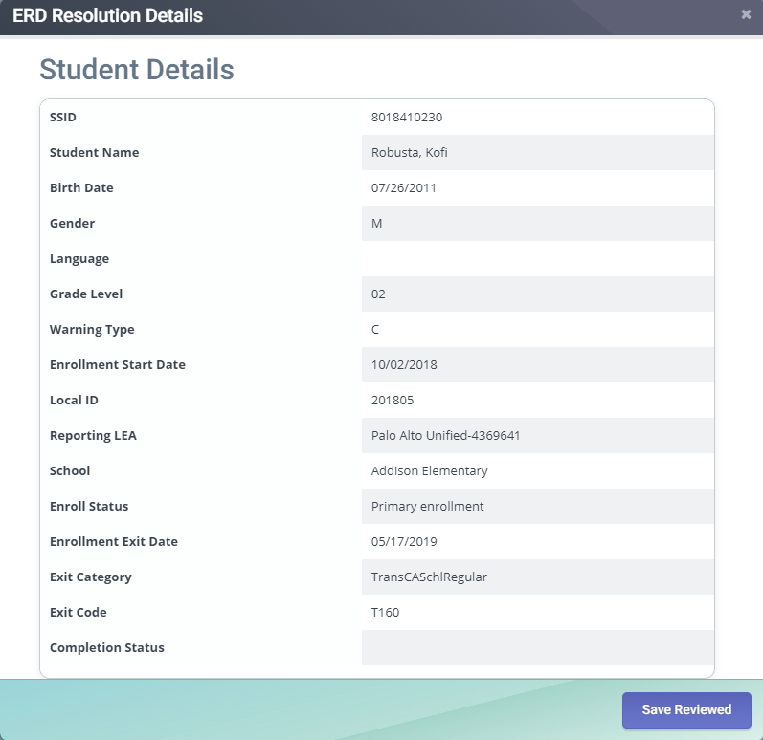
Common Causes Of Type C ERDs
The student is a dropout
Update the student’s exit reason to a E140 or other dropout code that accurately reflects how the student left
The student has multiple SSIDs
Look up both of the SSIDs in CALPADS and compare their demographic records. The name, birthdate, gender, primary language, and birthplace fields should be updated so that they match exactly. Either change your record or request that the other LEA change theirs. A MID anomaly should be detected the next day. Resolving the MID anomaly should also clear the ERD.
LEA has not reported subsequent enrollment record
if it is early in the Fall 1 submission window you may just need to wait for the other school to complete their reporting. If it is later in the submission window you may want to contact the LEA where the student enrolled to confirm they are going to report the student with the same SSID. Cumulative folder requests are a common way to identify where a student went.

Slide 64
ERD – Analysis of Warning Type C
Potential Dropout
If earliest record in the history does not match your student’s actual enrollment, your student may have the wrong SSID.
Student was exited on 5/17/2021 (Exit Reason = T160), and has no subsequent enrollment records in CALPADS.
Determine whether the Exit Reason is accurate. If the student did not transfer to another CA public school, the Exit Reason needs to be updated to a code that accurately reflects why the student left.
If your student did transfer to another CA public school, that school needs to enroll the student in CALPADS using the same SSID.
Notes:
NOTE: This is part of the demo presented during the live classes.
ERD warning type C is known as a lost transfer. For an ERD type C, an SSID has an exit record at a school that indicates that the student was expected to enroll at another California school, but no subsequent enrollment record in CALPADS.
First, review your local records and make sure that the record or records your LEA reported to CALPADS are accurate. The key fields to check are: Enrollment Start Date, Enroll Status, Exit Category, and Exit Code
For a warning type C, a very common cause is that the LEA where the student is currently attending has simply not reported their enrollment yet. Reporting the enrollment should take care of the problem.
It is also possible that the student is actually a dropout. In this case, you can update the student’s exit code to a dropout code if you want. However doing so is optional because the student will be counted as a dropout regardless. The main advantage of updating the student’s exit code in this situation is to keep you CALPADS records more accurate.
Another possibility is that the student reported in the anomaly has been assigned a second SSID by accident and that is why there is no subsequent enrollment record. In this situation the LEA that owns the MID anomaly should resolve it and then work with the other LEA to clean up the enrollment records.

Slide 65
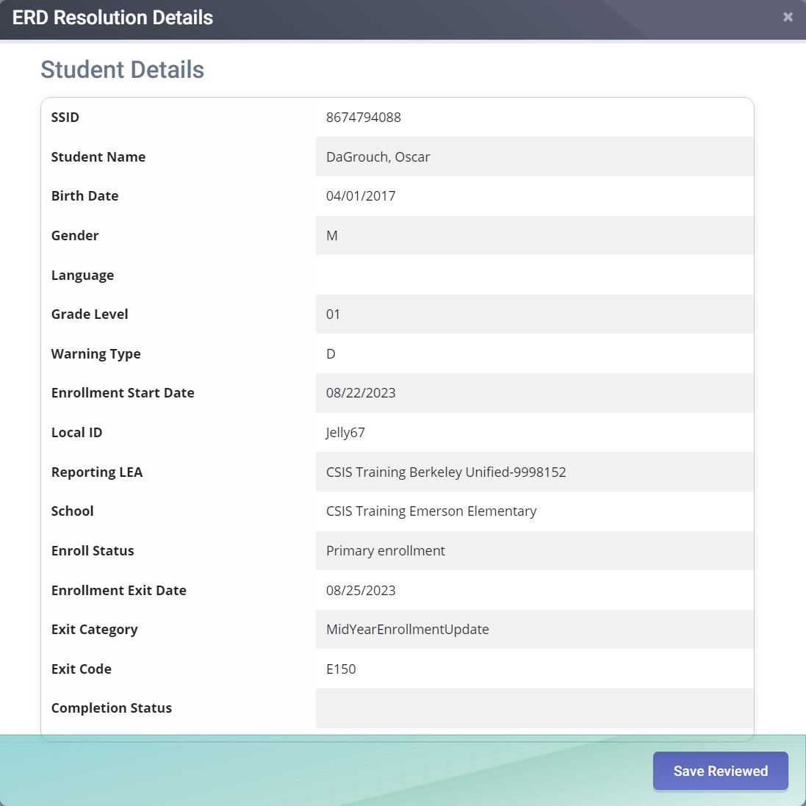
Common Causes Of Type D ERDs
LEA has not reported subsequent enrollment record
Submit the subsequent enrollment record with a start date of one day after the exit date on the E150 record
Student left the school
Update the Student Exit Reason Code to a code which accurately reflects how the student left

Slide 66
ERD – Analysis of Warning Type D
Missing Enrollment
SSID has an exit record (E150) at a school that indicates that the student requires a mid year enrollment update and thus a subsequent next day enrollment is expected.
Student was reported as a mid-year update on 08/25/2023 (Exit Reason = E150), but has no subsequent enrollment in CALPADS. Following an E150 exit, there must be a new enrollment the following calendar day.*
Determine whether the Exit Reason is accurate. If the student did transfer to another CA public school, the Exit Reason needs to be updated to a transfer code such as T160 that accurately reflects why the student left.
* Even if the next calendar day is a weekend or holiday.
Notes:
NOTE: This is part of the demo presented during the live classes.
For an ERD type D, an SSID has an exit record at a school that indicates that the student was expected to return to the same school the following school year, but no subsequent enrollment record was found in CALPADS.
First, review your local records and make sure that the record or records your LEA reported to CALPADS are accurate. The key fields to check are: Exit Category and Exit Code
For a warning type D, a very common cause is that your LEA has simply not reported a current year enrollment record for the student yet. Reporting the enrollment should take care of the problem.
Another possibility is that the student reported in the anomaly has left the school without informing the school. In this case, updating the exit code to the accurate exit reason and entering an exit date should fix the problem.

Slide 67

Common Causes Of Type E ERDs
Two or more students are sharing this SSID. The student who exited is not the same student who enrolled at the other school.
Look at the first enrollment record in the SSID’s entire enrollment history. Each LEA that has a different student must get a new SSID for their student and then remove their enrollment record from the SSID with the anomaly.
Student left the school
Update the Student Exit Reason Code to a code which accurately reflects how the student left

Slide 68
ERD – Analysis of Warning Type E
Unexpected Transfer
Student was reported as a mid-year update on 09/19/2023 (Exit Reason = E150), but has a subsequent enrollment in a different school as the next record. Following an E150 exit, there must be a new enrollment the following calendar day in the same school.
If your LEA still has the student enrolled and has no record of the student transferring to another CA public school, contact the other school to determine the cause. There may be two students sharing the same SSID.
Determine whether the Exit Reason is accurate. If the student did transfer to another CA public school, the Exit Reason needs to be updated to a transfer code such as T160 that accurately reflects why the student left.
Notes:
NOTE: This is part of the demo presented during the live classes.
For an ERD type E, an SSID has an exit record at a school that indicates that the student was expected to return to the same school the following school year, but the student has a subsequent enrollment record at a different LEA in CALPADS.
First, review your local records and make sure that the record or records your LEA reported to CALPADS are accurate. The key fields to check are: Exit Category and Exit Code
For a warning type E, one possibility is that the student reported in the anomaly has left the school without informing the school. In this case, updating the exit code to the accurate exit reason and entering an exit date should fix the problem.
Another possibility is that the two students involved in a warning type E may be sharing an SSID. If they are, the LEA whose student has the earliest enrollment record in the SSID gets to keep it and the other LEA needs to delete their enrollment record from the history and get a new SSID for their student.

Slide 69
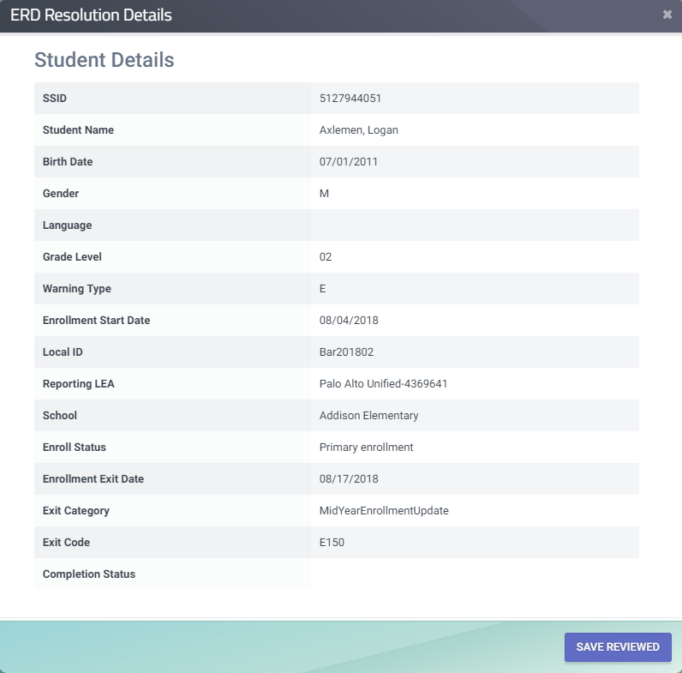
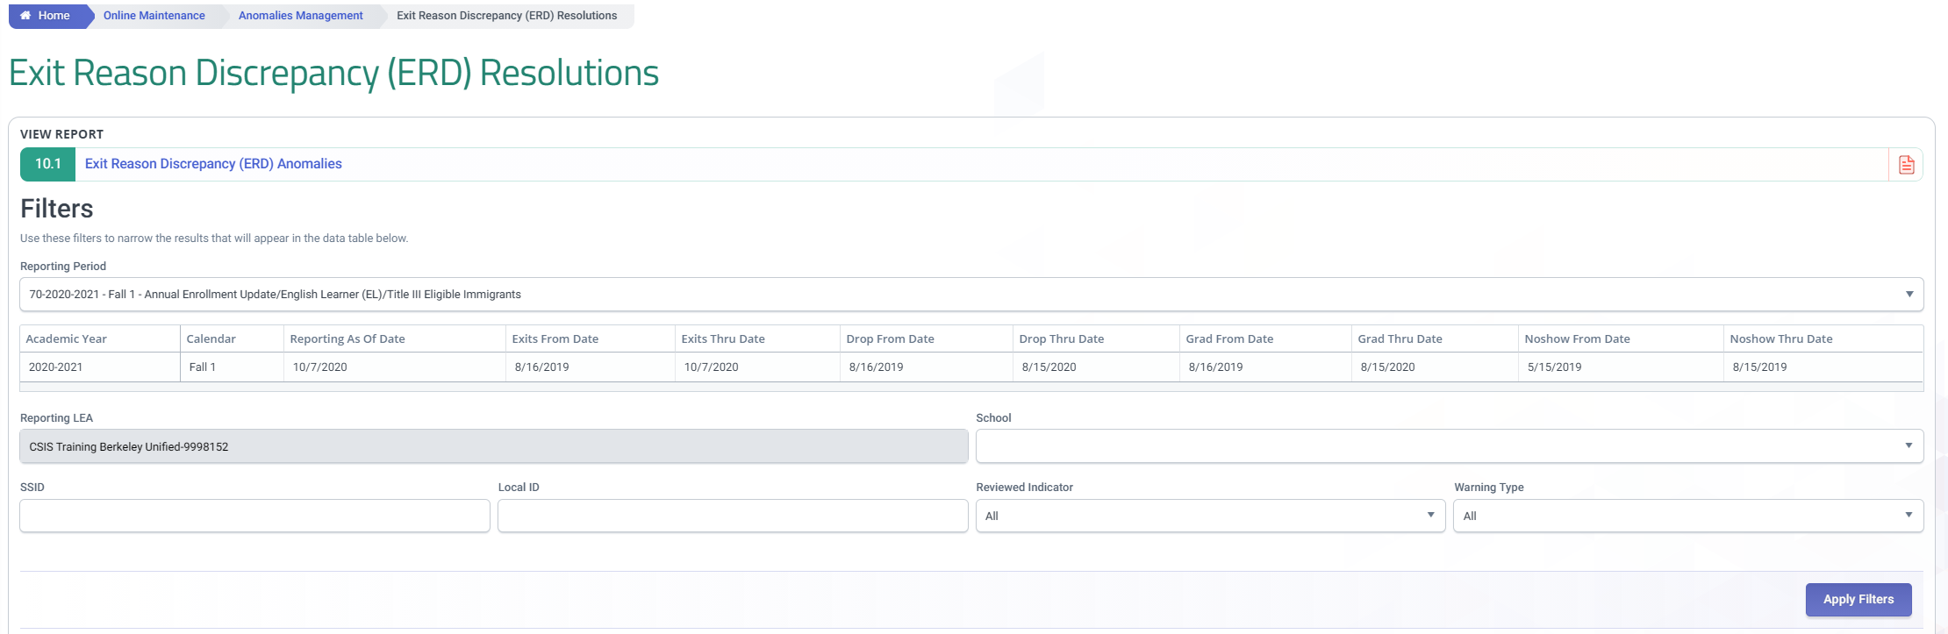
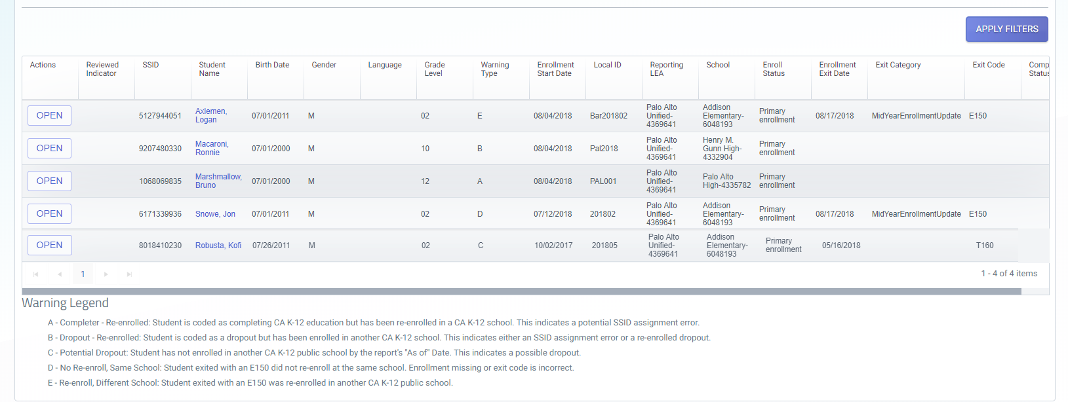
ERD - Mark Anomaly As Resolved
Click Save Reviewed for an anomaly that you resolve and do not want to show in your list. Then filter Reviewed Indicator
If the anomaly was resolved correctly it will not appear in your list after the Anomaly detection process runs again.
Notes:
NOTE: This is part of the demo presented during the live classes.
Remember, anomalies will continue to show on the anomaly list, even if they are resolved, until the next nightly processing. However if you are working through your anomalies you may only want to see the anomalies that have not been reviewed or resolved. To facilitate this process, records can be checked and marked as reviewed using the “Save Reviewed” button. After the records have been marked, you can set the resolution filter to “Not Reviewed” and click Apply Filters to hide all of the anomalies which have been marked.

Slide 70

Reminders
Anomalies are immediately detected by the system upon posting of SENR or SINF and must be resolved ASAP.
Assign an anomaly contact person to handle enrollment correction request from other LEAs.
MIDs found outside MID anomaly report can be resolved using “Resolve MID Not On Report” button
Scan duplicate SELA statuses between 2 SSIDs before combining them.
Replacement SSIDs should be downloaded regularly.
Only MIDs and CCEs account for the anomaly percentage

Slide 71



Resources
Here are some important resources related CALPADS reporting.
  https://learn.fcmat.org/
https://www.youtube.com/channel/UCA9oRTiyVECCCzOxpmJheZw
https://documentation.calpads.org/Support/References
https://www.cde.ca.gov/ds/sp/cl/

Slide 72





Support
http://www2.cde.ca.gov/calpadshelp/default.aspx
Web
calpads-support@cde.ca.gov
Email
916-325-9210
Phone
https://csis.fcmat.org/ListServ
You can get help through these channels.
Listserv

Slide 73
Feedback
I have a question…
“
”
Please complete survey…
https://bit.ly/2MXsECg
“
”

Slide 74






Thank You
CSIS Training
+1 916 325 9201
csistraining@fcmat.org
https://csis.fcmat.org/

